Slide 1
Azure Times #114
April 17, 2024

Slide 2
Networking

Slide 3
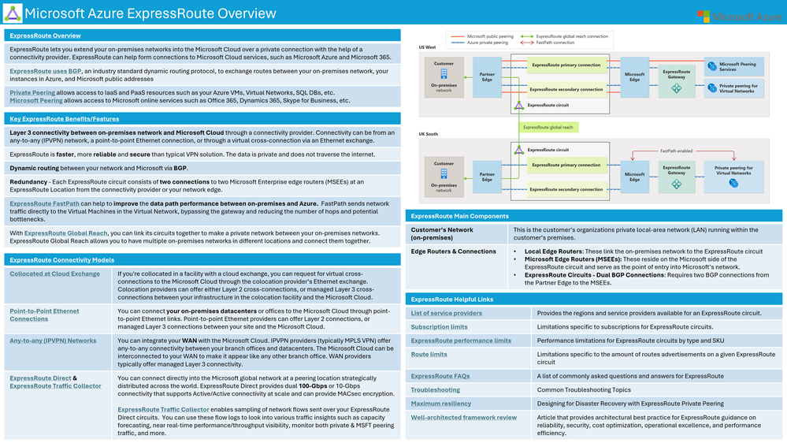
Networking Updates
Microsoft Azure ExpressRoute Overview Cheat Sheet

Slide 4
Security & Identity

Slide 5
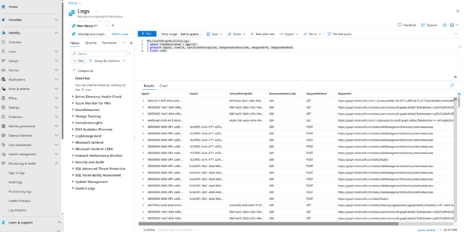
Security & Identity Updates
Generally available: Defender for Cloud supports Azure Database for MySQL - Flexible Server
Microsoft Defender for Cloud secures your Azure Database for MySQL – Flexible Server from threats without affecting the performance or availability. It lowers the risk of data breaches, attacks, and unauthorized access with security monitoring of anomalous or suspicious activities in database. It can be easily enabled from the Azure Portal to start getting security alerts and insights for Azure Database for MySQL - Flexible Server and receive recommendations to mitigate potentially harmful threats.
Please note: It is part of the Defender for open-source relational databases
Microsoft Graph activity logs is now generally available
MS announced general availability of Microsoft Graph activity logs! Microsoft Graph activity logs give visibility into HTTP requests made to the Microsoft Graph service in tenant. With rapidly growing security threats and an increasing number of attacks, this log data source allows to perform security analysis, threat hunting, and monitor application activity in your tenant.
Some common use cases include:
Identifying the activities that a compromised user account conducted in tenant.
Building detections and behavioral analysis to identify suspicious or anomalous use of Microsoft Graph APIs, such as an application enumerating all users, or making probing requests with many 403 errors.
Investigating unexpected or unnecessarily privileged assignments of application permissions.
Identifying problematic or unexpected behaviors for client applications, such as extreme call volumes that cause throttling for the tenant.

Slide 6
Security & Identity Updates
General Availability - TLS 1.3 support for Microsoft Entra
MS announced that Microsoft Entra support for Transport Layer Security (TLS) 1.3 for its endpoints to align with security best practices (NIST - SP 800-52 Rev. 2). With this change, the Microsoft Entra ID related endpoints will support both TLS 1.2 and TLS 1.3 protocols.
General Availability - Just-in-time application access with PIM for Groups
Provide just-in-time access to non-Microsoft applications such as AWS & GCP. This capability integrates PIM for groups, and application provisioning to reduce the activation time from 40+ minutes to roughly 2 minutes when requesting just-in-time access to a role in a non-Microsoft app.
The group membership is provisioned in the application during the next synchronization cycle. The synchronization cycle runs every 40 minutes.
The group membership is provisioned in 2 – 10 minutes. When there is a high rate of requests at one time, requests are throttled at a rate of five requests per 10 seconds.
For the first five users within a 10-second period activating their group membership for a specific application, group membership is provisioned in the application within 2-10 minutes.
For the sixth user and above within a 10-second period activating their group membership for a specific application, group membership is provisioned to the application in the next synchronization cycle. The synchronization cycle runs every 40 minutes. The throttling limits are per enterprise application.
General Availability - Changing Passwords in My Security Info
My Sign Ins (My Sign-Ins (microsoft.com)) supports end users changing their passwords inline. When a user authenticates with a password and an MFA credential, they're able to are able to change their password without entering their existing password. Starting April 1st, through a phased rollout, traffic from the Change password (windowsazure.com) portal will redirect to the new My Sign Ins change experience. The Change password (windowsazure.com) will no longer be available after June 2024, but will continue to redirect to the new experience.
General Availability - API driven inbound provisioning
With API-driven inbound provisioning, Microsoft Entra ID provisioning service now supports integration with any system of record. Customers, and partners, can use any automation tool of their choice to retrieve workforce data from any system of record for provisioning into Microsoft Entra ID and connected on-premises Active Directory domains.

Slide 7
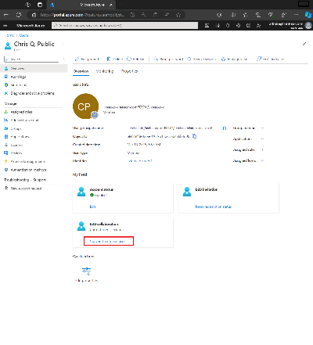
Security & Identity Updates
Public Preview - Convert external users to internal
External user conversion enables customers to convert external users to internal members without needing to delete and create new user objects. Maintaining the same underlying object ensures the user’s account, and access to resources, isn’t disrupted and that their history of activities remains intact as their relationship with the host organization changes.
The external to internal user conversion feature includes the ability to convert on-premises synchronized users as well.
Converting external users requires an account with at least the user administrator role assigned.
Only users configured with an authentication method external to the host organization are eligible for conversion.
Public Preview - Azure Lockbox Approver Role for Subscription Scoped Requests
Customer Lockbox for Microsoft Azure is launching a new built-in Azure Role-based access control role that enables customers to use a lesser privileged role for users responsible for approving/rejecting Customer Lockbox requests. This feature is targeted to the customer admin workflow where a lockbox approver acts on the request from Microsoft Support engineer to access Azure resources in a customer subscription.
In this first phase, MS is launching a new built-in Azure RBAC role that helps scope down the access possible for an individual with Azure Customer Lockbox approver rights on a subscription and its resources. A similar role for tenant-scoped requests is available in subsequent releases.
Public Preview - Alternate Email Notifications for Lockbox Requests
Customer Lockbox for Microsoft Azure is launching a new feature that enables customers to use alternate email IDs for getting lockbox notifications. This enables Lockbox customers to receive notifications in scenarios where their Azure account isn't email enabled, or if they have a service principal defined as the tenant admin or subscription owner.

Slide 8
Management & Governance

Slide 9
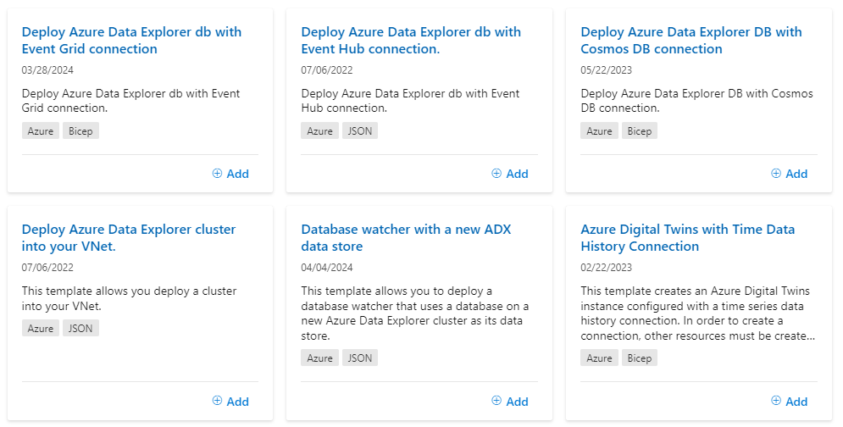
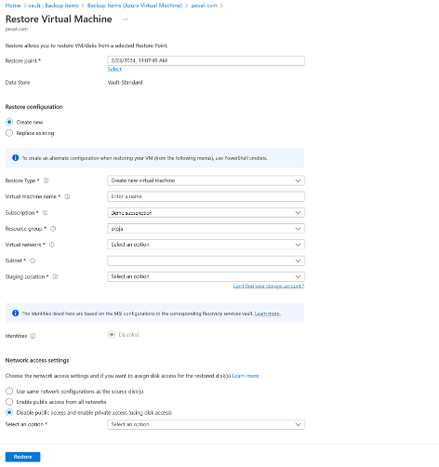
Management & Governance Updates
Public preview: Backup and restore of virtual machines with private endpoint enabled disks
Azure Backup now allows to back up Azure virtual machines that use disks with private endpoints enabled. This support is available for virtual machines using standard backup policies as well as enhanced backup policies, and can be configured using standard Azure Backup experiences. Additionally, while initiating restores, it is possible to specify the network access settings for restored disks- you can choose if you want the restored disks to use the same network configuration as the source disks, allow access from specific networks only, or allow public access from all networks.
ARM Templates for Kusto
For many years now, Azure Quickstart templates have been a repository of ARM templates aimed at being a starting point for different Azure Workload. Now Microsoft Released 6 ARM templates:

Slide 10
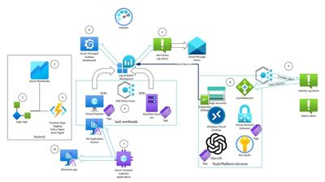
Management & Governance Updates
Azure billing meters: What you need to know about the upcoming changes
MS will be updating a number of Azure billing meters to reflect the true meter ID metadata. A billing meter is used to determine the cost of using a specific service or resource in Azure. It helps calculate the amount will be charged based on the quantity of the resource consumed. The billing meter varies depending on the type of service or resource. his process will be implemented in batches over the next several months.
Azure Monitoring Packs - V2 is out!
Azure Services monitoring – powered by the splendid work done by the AMBA (Azure Monitor Baseline Alerts) team, the packs now include Azure services, like Key Vault, Load Balancers and others, divided into two categories, PaaS and Platform.
AVD Accelerator Alerts integration - as part of the packs experience, the AVD alerts can be enabled using the Admin workbook, the same way other packs are enabled.
Augmented Monitoring (preview) - by using Azure Compute Galleries and VM Applications, packs can now have scripting or code added to the monitored servers to enrich data collection.
Workload discovery (preview) - also using VM Applications, Roles and applications installed on the servers, allow workloads to be discovered and for easier targeting when enabling specific packs.
Service Name | Product Name | Meter ID (new) | Meter ID (previous)
Virtual Machines | Virtual Machines DSv3 Series Windows | 59f7c6d9-3658-5693-8925-4aae24068de8 | 0ce7683b-0630-4103-a9a7-75a68fbf6140

Slide 11
Compute

Slide 12
Compute Updates
Azure Red Hat OpenShift April 2024 updates
ARO support in Azure Terraform Provider: The AzureRM Terraform provider now supports managing Azure Red Hat OpenShift resources.
Bring your own Network Security Groups: It is now possible to attach own NSGs that include both organization’s security rules and ARO service rules. This will be applied to both master and worker subnets before installing ARO clusters with a flag indicating the presence of the NSGs.
Azure Monitor Signals: ARO cluster now is supported by Resource Health and integration with Azure Monitor Signals. Azure Monitor signals can be configured to generate alerts based on signals from Azure Red Hat OpenShift clusters.
New GPU instance types for Day 2 operations: Azure Red Hat OpenShift now supports new GPU instance types that are aimed at Day 2 operations. The following GPU instance types are now supported: ND96asr_v4, NC24ads_A100_v4,NC48ads_A100_v4, NC96ads_A100_v4,and ND96amsr_A100_v4.
ARO is now supported in the Taiwan Region: Azure Red Hat OpenShift is now supported in the Taiwan region providing more availability and fault tolerance to customers in this area.
General Available: Azure Synapse Runtime for Apache Spark 3.4 is now GA
Azure Synapse Runtime for Apache Spark 3.4 is now Generally Available! This runtime has been in Public Preview since November 2023 and is now ready for production workloads. The key changes in the new runtime include features resulting from the upgrade of Apache Spark to version 3.4 and Delta Lake to 2.4. Additionally, the operating system has been upgraded to Mariner (an internal Linux distribution tailored for Microsoft’s cloud infrastructure), and Java has been upgraded from version 8 to 11. We encourage all Azure Synapse customers with Apache Spark workloads to migrate to the newest GA version.

Slide 13
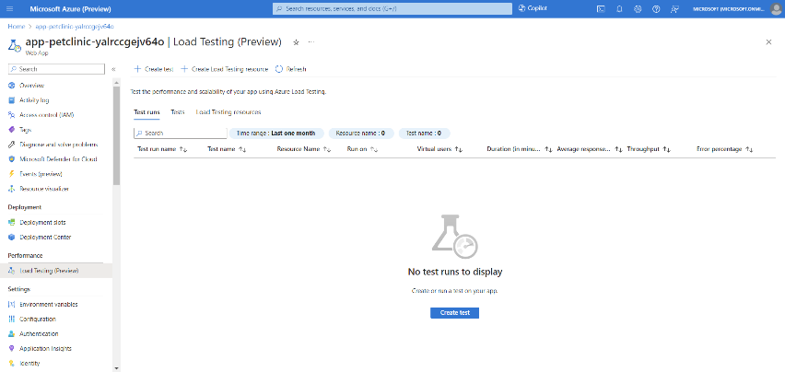
Compute Updates
Run Azure Load Testing on Azure App Service web apps
It is now possible to create and run load tests directly from App Service in Azure portal. Load test of web apps by simply selecting the deployment slot followed by specifying request parameters and load configuration. The integration supports:
Create a URL-based load test for the app service endpoint or a deployment slot
View the test runs associated with the app service
Create a load testing resource
App Service virtual network integration multi plan subnet join
MS announced that the multi plan subnet join for virtual network integration is now available in preview in all regions!
Minimum requirement for subnet size will be /26.
There is currently no validation if the subnet has available IPs, so you might be able to join N+1 plan, but the instances will not get an IP.
During public preview, the web app create experience in the portal will not let you join a subnet that already has an App Service plan joined with it. Instead, you can use the Azure CLI or ARM to join during create. The Azure portal can be used to view your connections and make additional connections once the app is created. Alternatively, if you only want to use the portal, create the app without the connection and join it once it's created.
Azure Load Testing availability in Fairfax (USGov Virginia)
Azure Load Testing is now generally available in Fairfax cloud - USGov Virginia. US Government customers on the Fairfax cloud can now use Azure Load Testing, a fully managed load-testing service to generate high scale load and run simulations, easily identify performance bottlenecks through a rich dashboard of client-side and server-side metrics and integrate load tests into their CI/CD workflows. Customers can get started without any knowledge of load-testing tools, or use their existing Apache JMeter scripts.

Slide 14
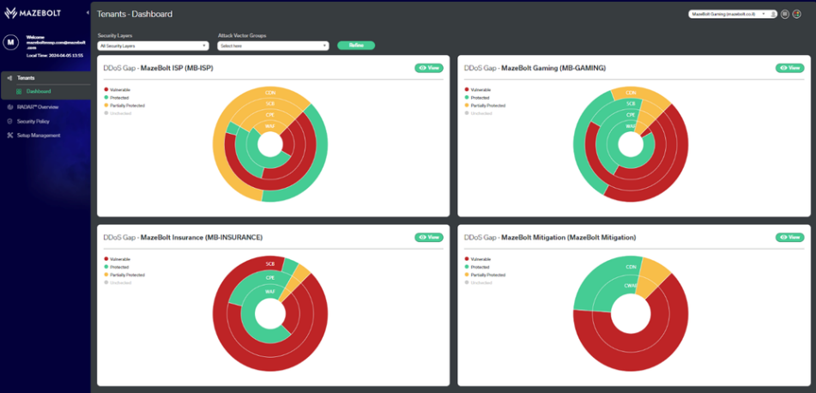
Compute Updates
Azure Spring Apps feature updates in Q1 2024
Save up to 47%: Azure Spring Apps Enterprise is now eligible for Azure Savings plan - All Azure Spring Apps regions under the Enterprise plan are eligible for substantial cost savings – 20% for one year and 47% for three years – when you commit to Azure savings Plan
Azure CLI supports to stream log of Spring Cloud Gateway - This feature allows to fetch the log of Spring Cloud Gateway in real-time for diagnosis purposes
Azure CLI supports to stream log of Application Configuration Service - the feature allows to retrieve the log of the Application Configuration Service using Azure CLI, making it possible to detect any configuration updates
Showing version of buildpacks - The latest feature added to buildpacks assists in comprehending the version utilized and diagnosing issues associated with the build process.
Enhanced troubleshooting of Application Configuration Service – now it is possible to view the linked configMap to apps directly to further assist in troubleshooting issues of unrefreshed configurations and also you can export configuration files pulled by the Application Configuration Service from upstream Git repositories to local environment through Azure CLI which helps examine the content and use configuration files for local development
MazeBolt RADAR™ DDoS testing
Microsoft introduced a new collaboration with MazeBolt, giving a new option for DDoS simulation testing. With the unique MazeBolt RADAR™ platform, it is possible to non-disruptively and continuously validate entire external attack surface for DDoS vulnerabilities without any interruption to your production environment.
The MazeBolt RADAR platform uses patented non-disruptive DDoS attack simulations that can cover an organization's entire attack surface. Due to the underlying technology RADAR is built upon, the platform takes DDoS attack simulation to a new level by automatically and continuously using thousands of attack simulations (of all known attack vectors) to identify and enable the elimination of DDoS vulnerabilities before a damaging attack interrupts business continuity.

Slide 15
Compute Updates
Azure Virtual Desktop for Azure Stack HCI now has autoscale
MS announced that autoscale support on Azure Virtual Desktop for Azure Stack HCI is now in public preview. With the Azure Virtual Desktop autoscale feature, organizations running virtualized desktops and apps on-premises, at the edge or in their datacenter, can optimize costs by turning off idle Azure Virtual Desktop session hosts running on Azure Stack HCI.
Autoscale is Azure Virtual Desktop’s native scaling solution that automatically starts session hosts according to schedule or using Start VM on Connect and then turning off session hosts based on capacity threshold or user session state (log off/disconnect) defined in the scaling plan.
The following capabilities are new in public preview with Azure Virtual Desktop autoscale:
It is now possible to assign a scaling plan to an Azure Virtual Desktop host pool with Azure Stack HCI VMs to scale session host Azure Stack HCI VMs in a host pool up or down, according to schedule to optimize costs.
This feature supports both pooled and personal host pools with Azure Stack HCI VMs.

Slide 16
Databases

Slide 17
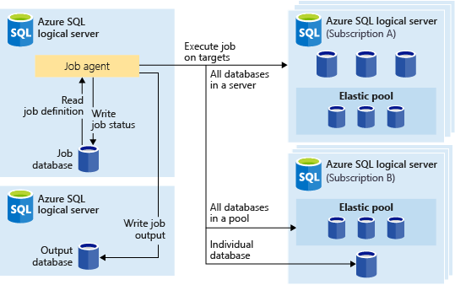
Databases Updates
General availability: Elastic Jobs in Azure SQL Database
Elastic Jobs is a fully integrated Azure SQL database service that allows you to automate and manage administrative tasks across multiple SQL databases in a secure, scalable way. It can run one or more T-SQL job scripts in parallel using Azure portal, PowerShell, REST, or T-SQL APIs. Jobs can be run on a schedule or on-demand, targeting any tier of Azure SQL Database. Job target can include all databases in a server, in an elastic pool, across multiple servers and even databases across different subscriptions and geo regions on Azure. Servers and pools are dynamically enumerated at runtime, so jobs run against all databases that exist in the target group at the time of execution.
General availability: Extensible key management using Azure Key Vault for SQL Server on Linux
Leveraging Azure Key Vault as part of Extensible key management (EKM) in SQL Server provides enhanced security, simplified key management, compliance support, and seamless integration with Azure services.
With the release of EKM using Azure Key Vault for SQL Server on Linux , it is possible to use a centralized key storage and streamlined operations while maintaining data security and compliance. This feature allows to manage encryption keys outside of SQL Server using Azure Key Vaults and is available for SQL Server 2022 CU12 onwards.
Public Preview: Mirroring Azure Cosmos DB in Microsoft Fabric
Now it is possible to sync Azure Cosmos DB data into Microsoft OneLake. Mirroring allows to get near real-time analytics on Cosmos DB data without impacting the performance of transactional workloads.
Data from Cosmos DB is incrementally replicated in OneLake, in Delta Parquet format, without the need for complex ETL pipelines.

Slide 18
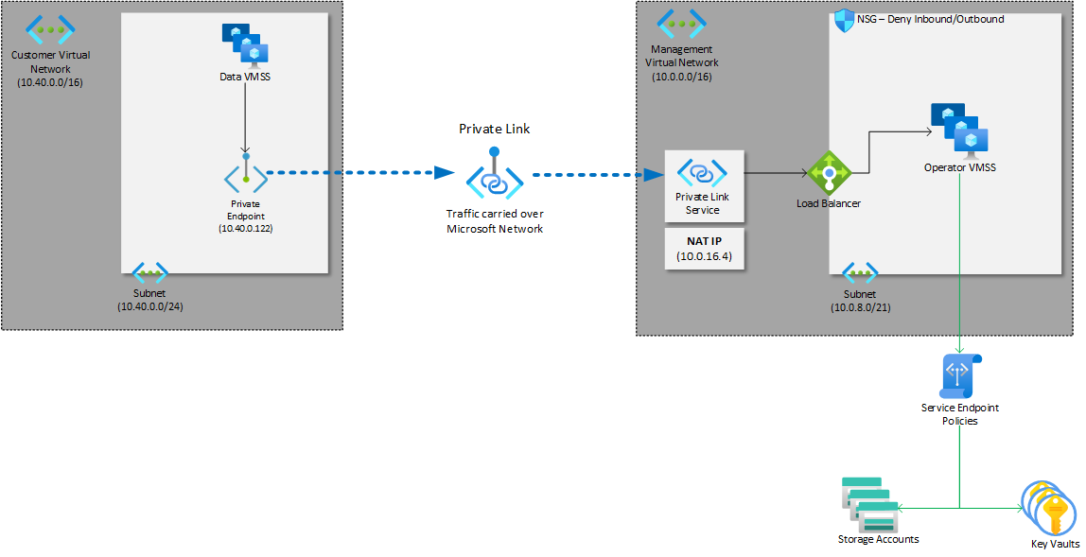
Databases Updates
General Availability: Virtual private network (VPN) with Azure Managed Instance for Apache Cassandra
Azure Managed Instance for Apache Cassandra nodes requires access to many other Azure services when they're injected into virtual network. Normally, access is enabled by ensuring that virtual network has outbound access to the internet. If security policy prohibits outbound access, you can configure firewall rules or user-defined routes for the appropriate access.
However, if you have internal security concerns about data exfiltration, your security policy might prohibit direct access to these services from your virtual network. By using a virtual private network (VPN) with Azure Managed Instance for Apache Cassandra, you can ensure that data nodes in the virtual network communicate with only a single VPN endpoint, with no direct access to any other services.
Public Preview: Long-term retention for Azure Database for MySQL – Flexible Server
Azure Backup and Azure Database for MySQL - Flexible Server services have built an enterprise-class long-term backup solution for Azure Database for MySQL - Flexible Server instances that retains backups for up to 10 years. It is possible to use long-term retention to extend the current limitation of 35 days backup retention to 10 years, meeting compliance and regulatory requirements. In addition to long-term retention (LTR), this feature enhances the backup resiliency by protecting the source data from different levels of data loss, such as accidental deletions and ransomware protection.
General Availability: Azure Database for PostgreSQL - Flexible Server networking with Azure Private Link
Azure Private Link is now GA and allows to create a private endpoints for Azure Database for PostgreSQL - Flexible Server bringing it inside virtual network. With Private Link, traffic between virtual network and the service travels the Microsoft backbone network. Exposing service to the public internet is no longer necessary. It is possible to use own private link service in virtual network. This feature is available in all public Azure regions where service is currently available and adds to existing networking capabilities provided by VNET injection.

Slide 19
Databases Updates
Optimize Your Azure Cosmos DB Costs with New Reserved Capacity Tiers
Commit to a reservation for Azure Cosmos DB resources using Azure Cosmos DB reserved capacity to save money. Starting with new 100 RU/s option, any customer can now reduce costs using Azure Cosmos DB request units (RU/s). It is now possible to buy any quantity of the 100 RU/s reservation, at any time. There is no limit to the number of reservations, and the purchase process is simplified in the Azure Portal.
Azure Cosmos DB reserved capacity offers a minimum 20% discount on the provisioned throughput for resources such as databases or containers (tables, collections, and graphs).
Reservation Size | Discount Type | One-Year Discount | Three-Years Discount
Between 100 – 1,000,000 RU/sec | Fixed | 20% | 30%
Over 1,000,000 RU/sec | Progressive | Up to 60% | Up to 63%

Slide 20
Integration

Slide 21
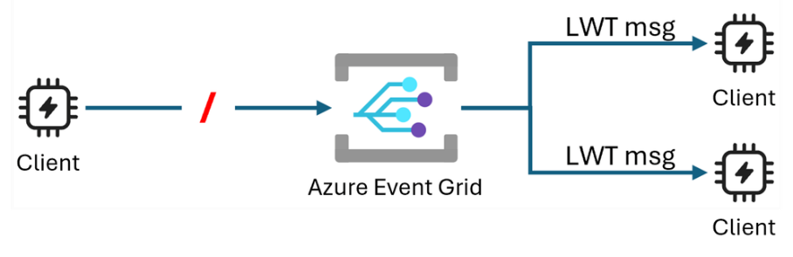
Integration Updates
Announcing MQTT Last Will and Testament Public Preview in Azure Event Grid
MS announced the public preview release of the Last Will and Testament (LWT) support in Azure Event Grid's MQTT broker capability, in compliance with the MQTTv3.1.1 and MQTTv5 specifications. LWT enables your MQTT clients to get notified with the abrupt disconnections of other MQTT clients. This powerful feature ensures predictable and reliable flow of communication among MQTT clients during unexpected disconnections, which is valuable for scenarios where real-time communication and coordinated actions are critical.
When a client connects to the MQTT broker, it can specify a will message, will topic, and the rest of the will properties in the CONNECT packet. If the client disconnects gracefully through the MQTT DISCONNECT packet with reason code 0x00, the will message is discarded.
Native Delta Lake Output Now Generally Available in Azure Stream Analytics
MS announced the native support for Delta Lake output in Azure Stream Analytics is now generally available.
Delta Lake is a popular format utilized by enterprises to construct their lakehouses, as it enhances reliability, quality, and performance within data lakes. With the native Delta Lake output connector in Stream Analytics, you can effortlessly write streaming data directly to your Delta Lake tables without the need to write a single line of code. This connector is optimized for high-speed ingestion into Delta tables in append mode and also ensures exactly-once semantics, guaranteeing that no data is lost or duplicated.
Announcing MQTT Last Will and Testament Public Preview in Azure Event Grid
MS announced the public preview release of the Last Will and Testament (LWT) support in Azure Event Grid's MQTT broker capability, in compliance with the MQTTv3.1.1 and MQTTv5 specifications. LWT enables your MQTT clients to get notified with the abrupt disconnections of other MQTT clients. This powerful feature ensures predictable and reliable flow of communication among MQTT clients during unexpected disconnections, which is valuable for scenarios where real-time communication and coordinated actions are critical.
When a client connects to the MQTT broker, it can specify a will message, will topic, and the rest of the will properties in the CONNECT packet. If the client disconnects gracefully through the MQTT DISCONNECT packet with reason code 0x00, the will message is discarded.

Slide 22
Miscellaneous

Slide 23

Miscellaneous Updates
Notes:
May 21-23, 2024 | Seattle and Online - Microsoft Build

Slide 24
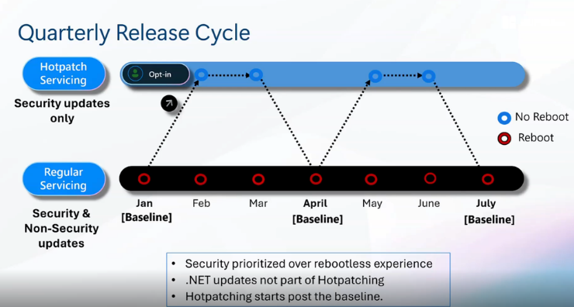
Miscellaneous Updates
Windows Server Summit Wrap Up
Windows Server 2025 – Hotpatching:
Storage
Optimized NVME -improves performance and lower CPU utilization.
Demo of Win 2022 vs Win 2025 on the same hardware a 70 percent performance improvement is seen
Storage replica updates
Networking
Network ATC -one click deployment and drift remediation of host network configuration across the cluster.
Network HUD – always on alerting and remediation of operational network issues and inefficiencies.
SDN multisite – Stretched Site Native L2 & L3 connectivity for workloads in multiple locations.
SDN Gateway Performance Improvements- 20-50% performance improvements with lower CPU utilization.
Empowering Modern AKS applications – Secure, scalable and adaptive SDN Infrastructure for Hybrid AKS.
Active Directory/AD
LADP support for TLS1.3
LDAP prefers encryption by default.
Kerberos support for AES SHA 256/384
32 K DB Page sizes
Boosted replication links get replication queue priority
New Functional levels for forest and domain

Slide 25
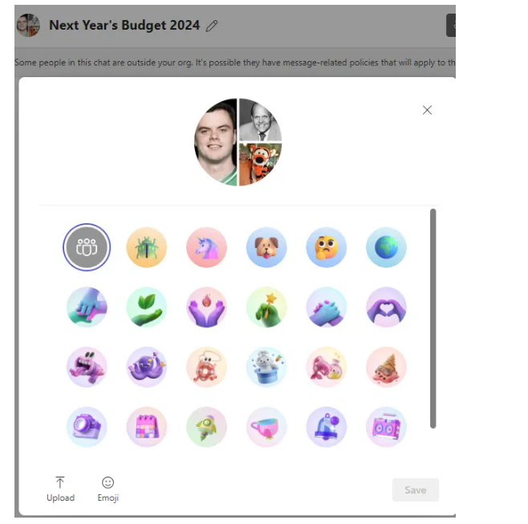
Miscellaneous Updates
Teams Adds Support for Customizable Group Chat Pictures
Until now, group chats get a default picture generated from the profile pictures of the participants. Note that this group chat has already been renamed to clearly communicate the intention of the chat. Using appropriate names also makes group chats easier to find in the chat list because you don’t end up with a bunch of chats named after the chat participants.

Slide 26
Information

Slide 27
Information
Azure Times GitHub Repo

Slide 28
Questions

