Slide 1
Azure Times #116
May 1, 2024

Slide 2
Networking

Slide 3
Networking Updates
General availability: Virtual network flow logs
Azure Network Watcher provides network monitoring and troubleshooting capabilities to increase observability and actionable insights with out of box health metrics and topology visualization, connectivity monitoring, traffic monitoring and diagnostics suite.
Virtual network flow logs are a new capability of Network Watcher service that enable to capture information about IP traffic flowing through virtual networks for usage monitoring and optimization, troubleshooting connectivity, compliance, and security analysis. These flow logs provide a lightweight, scalable approach to address network observability needs.
Benefits:
Record network traffic at the scope of virtual network, subnet, or NIC to meet audit and compliance needs.
Identify top talkers in network for usage monitoring and optimization to evaluate traffic levels and bandwidth consumption.
Troubleshoot connectivity issues and identify blocked traffic due to Network Security Group (NSG) or Azure Virtual Network Manager rules.
Observe encrypted traffic and evaluate encryption status of the traffic.
Perform security analysis on network data to detect malicious activity.
Currently flow logs are supported on network security groups, this new functionality allows to log traffic at the scope of virtual networks. Flow data is sent to Azure Storage accounts.
Virtual network flow logs will be billed effective June 1, 2024
Virtual network flow logs are charged per gigabyte of Network flow logs collected and come with a free tier of 5 GB/month per subscription
Storage of logs is charged separately
Key properties of virtual network flow logs include:
Flow logs operate at Layer 4 of the Open Systems Interconnection (OSI) model and record all IP flows going through a virtual network.
Logs are collected at one-minute intervals through the Azure platform. They don't affect Azure resources or network traffic.
Logs are written in the JavaScript Object Notation (JSON) format.
Each log record contains the network interface that the flow applies to, 5-tuple information, traffic direction, flow state, encryption state, and throughput information.
All traffic flows in network are evaluated through the applicable network security group rules or Azure Virtual Network Manager security admin rules.

Slide 4
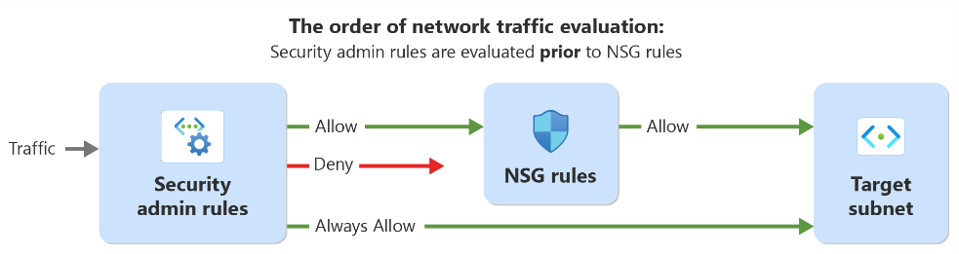
Networking Updates
Azure Virtual Network Manager security admin rule generally available in all public regions
Azure Virtual Network Manager security admin rule lets enforce security policies for virtual networks at scale across subscriptions and regions globally. These rules will be evaluated before network security groups (NSGs), ensuring standardized security enforcement. They help prevent potential misconfigurations and oversights, making sure that critical services run without interruption and that network owners adhere to company policies.
Security admin rules allow users to manage security efficiently, reducing operational complexities. They also offer a default setting to avoid errors or oversights in setting up NSGs. As such, users can simplify and enhance their network security for their growing network environments.
General availability: Application Gateway Web Application Firewall (WAF) inspection limit & size enforcement
Azure’s regional Web Application Firewall (WAF) integrated with Application Gateway v2 now supports greater control over inspection limits and size enforcement for WAF policies running Core Rule Set (CRS) 3.2 or later. This feature allows to control request body inspection, maximum request body limit, and maximum file upload limit independently of each other. Additionally, it is possible now disable maximum request body limit enforcement and/or maximum file upload limit enforcement without disabling request body inspection. With this update, now there are more flexibility on how WAF inspects requests while allowing larger requests to pass without being blocked.

Slide 5
Security & Identity

Slide 6
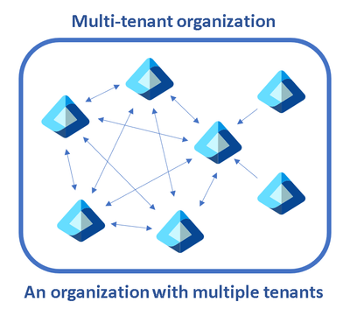
Security & Identity Updates
Collaborate across M365 tenants with Entra ID multi-tenant organization
Multitenant organization is a feature in Microsoft Entra ID and Microsoft 365 that enables to form a tenant group within organization. Each pair of tenants in the group is governed by cross-tenant access settings that can use to configure B2B or cross-tenant synchronization. The primary goals are:
Define a group of tenants belonging to organization
Collaborate across tenants in new Microsoft Teams
Enable search and discovery of user profiles across tenants through Microsoft 365 people search
The following is the process to establish multi-tenant organization:
Define a multitenant organization
Join a multitenant organization
The multitenant organization capability has been designed with the following constraints:
Any given tenant can only create or join a single multitenant organization.
Any multitenant organization must have at least one active owner tenant.
Each active tenant must have cross-tenant access settings for all active tenants.
Any active tenant may leave a multitenant organization by removing themselves from it.
A multitenant organization is deleted when the only remaining active (owner) tenant leaves.
Limitations:
Maximum number of active tenants, including the owner tenant is 100

Slide 7

Security & Identity Updates
Introducing of CNAPP mastery
MS Released new CNAPP mastery e-book! MS released an e-book all about CNAPP (Cloud Native Application Protection Platform) that has been written by some of the leading experts out there.
CNAPP is a framework for securing cloud-native applications and infrastructure. The book is packed with valuable information on how to create a unified, proactive, and holistic strategy that covers all aspects of cloud security. From threat detection and scaling to governance and compliance, this book has got you covered.
Comprehensive and integrated cloud security approach
Scalability and customization of Microsoft Defender for Cloud
Streamlining compliance in a complex regulatory environment
Embracing the shift-left paradigm in cloud security
Empowering SOC with advanced insights:

Slide 8
Management & Governance

Slide 9
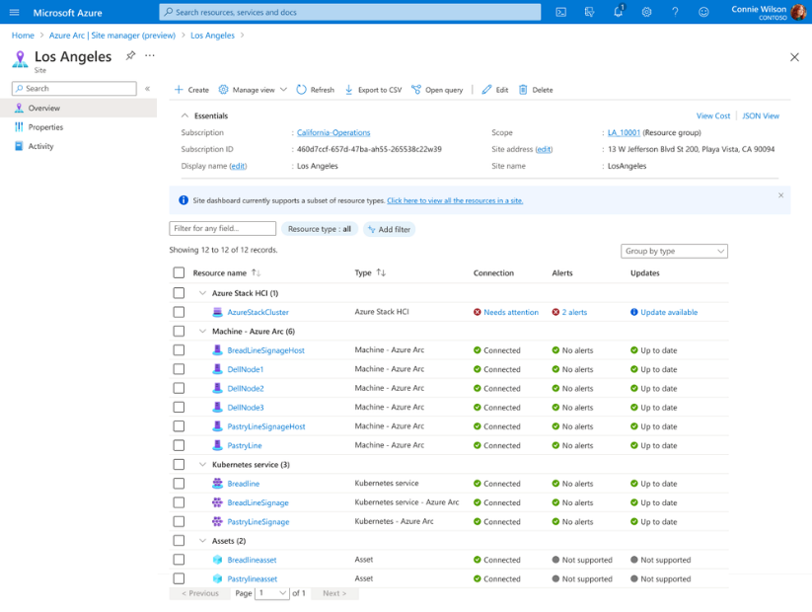
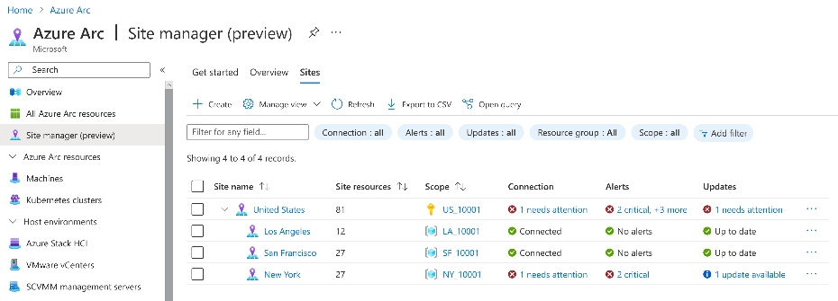
Management & Governance Updates
Public Preview of Azure Arc Site Manager
MS announced the Public Preview of Azure Arc site manager. Azure Arc site manager allows to manage and monitor on-premises environments as Azure Arc sites. Arc sites are scoped to an Azure resource group or subscription and enable to track connectivity, alerts, and updates across environment. The experience is tailored for on-premises scenarios where infrastructure is often managed within a common physical boundary, such as a store, restaurant, or factory.
Arc sites currently have a 1:1 relationship with resource groups and subscriptions.
Free of charge
Sites Can be aggregated into hierarchy
Supported Resources:
Azure Stack HCI
Arc-enabled Servers
Arc-enabled VMs
Arc-enabled Kubernetes
Azure Kubernetes Service (AKS) hybrid

Slide 10

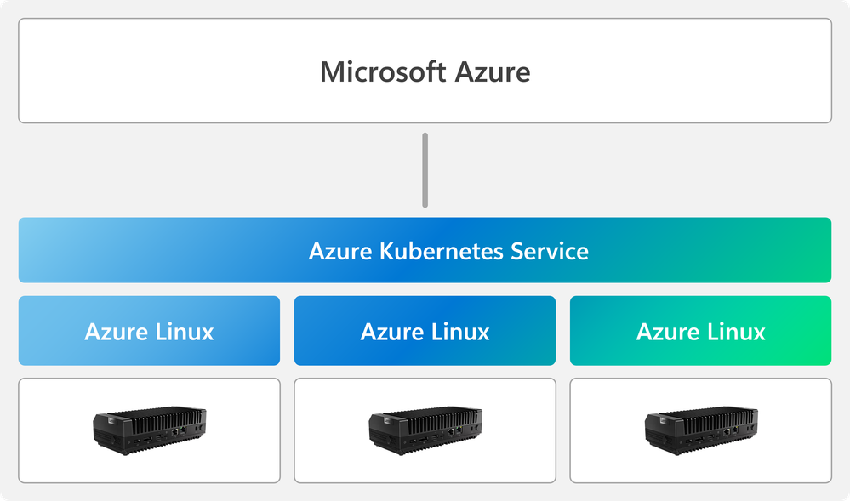
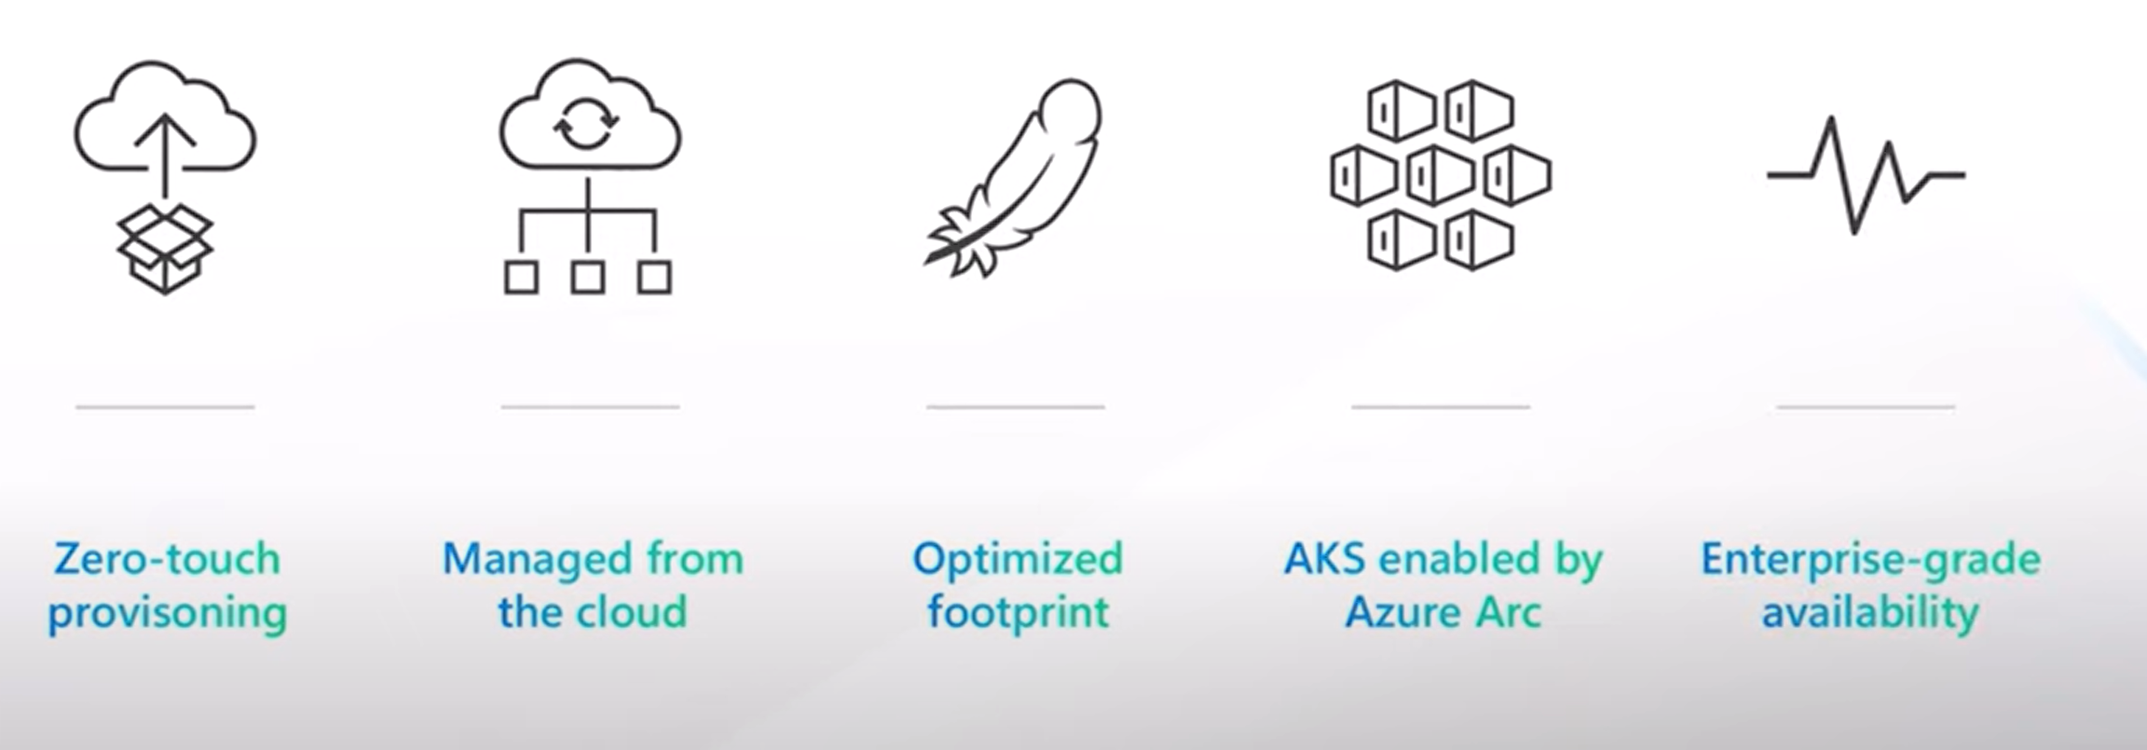
Management & Governance Updates
Azure edge infrastructure
As organizations adopt new OT technologies like Azure IoT Operations, which runs on Kubernetes, a core challenge for IT is to provide an appropriate computing infrastructure at the edge to support it.
MS introduced a new Edge solution and devices to run Azure Arc-Enabled K8S at edge with:
Zero-Touch Prisoning
Fully Managed from the Cloud
Optimized
Integrated with ARC
Enterprise Scale

Slide 11
Management & Governance Updates
GitHub Copilot for Infrastructure as Code
Infra Copilot is leveraging GitHub Copilot to generate infra code specifically for infrastructure professionals—Infra Copilot. Infra Copilot is helping to revolutionize the way infrastructure is written, addressing the pain points experienced by professionals in the field.
Code Generation with Precision
Streamlining the IaC Development Process
Consistency Across Environments and Projects
Accelerating Onboarding and Learning
Efficiency and Time Savings
Prerequisites
Install visual studio code
GitHub Copilot license
PowerShell extension for VS Code
Public Preview: Azure Monitor Agent Upload to Storage and Event Hubs
The Azure Monitor Agent is the new, consolidated telemetry agent for collecting data from IaaS resources like virtual machines. By using the upload capability in this preview, it is possible to upload the logs send to Log Analytics workspaces to Event Hubs and Storage. Both data destinations use data collection rules to configure collection setup for the agents.

Slide 12
Compute

Slide 13
Compute Updates
The billing meter for Azure Databricks materialized views and streaming tables will change 1 May 2024
MS announced that the billing meters for Azure Databricks Materialized Views and streaming tables will be changed on 1 May 2024.
Pricing before 1 May 2024
Usage charged to Serverless SQL Compute billing meter
Pricing after 1 May 2024
Usage charged to Automated Serverless Compute billing meter

Slide 14
Storage & Data

Slide 15
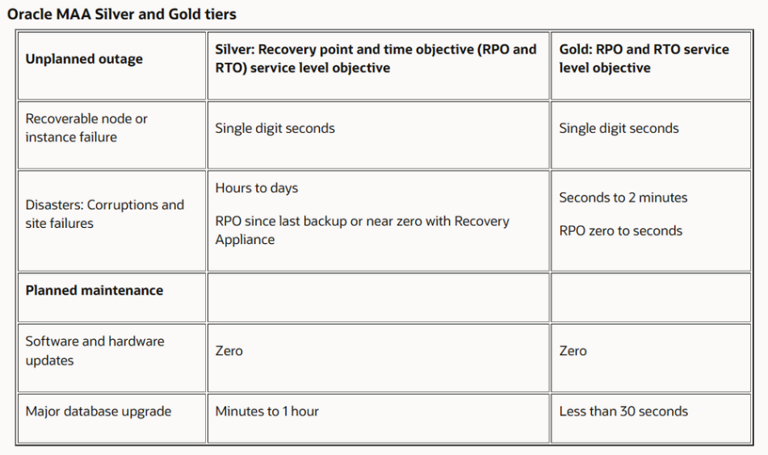
Storage & Data Updates
Announcing Oracle Database@Azure in United Kingdom South
MS announced the general availability of Oracle@Azure for the Azure United Kingdom South region in London.

Slide 16
Databases

Slide 17
Databases Updates
Generally Available: Index Advisor in Azure Cosmos DB helps optimize index policy for NoSQL queries
The new Index Advisor feature is a game-changer for Azure Cosmos DB users! It’s like having a personal consultant that guides on optimizing NoSQL queries, ensuring you’re using the right indexes to slash costs and boost query speeds.
With Index Advisor, it is possible to receive tailored advice on which indexes to add to policy and which ones are already working hard, making queries not just faster, but also more cost-efficient. It’s the smart way to get the most out of Azure Cosmos DB!
General availability: Semantic caching with vCore-based Azure Cosmos DB for MongoDB
Get ready to revolutionize the way we handle data with Semantic Caching and vCore-based Azure Cosmos DB for MongoDB!
By harnessing the power of historical user inquiries and LLM responses stored in Cosmos DB, we’re catapulting our applications into a new realm of efficiency. Imagine the speed - a vector search can deliver past LLM responses in a flash, saving you both time (lower latency) and money (fewer calls to LLM APIs), especially with top-tier models like GPT-4!
Public preview: Filtered vector search in vCore-based Azure Cosmos DB for MongoDB
Azure Cosmos DB for MongoDB has improved its vector search capabilities through the introduction of pre-filter vector search. The filter expression in the search spec can compare an indexed single path field, effectively acting as a prefilter to significantly narrow the scope of the vector search.
General availability: Azure Cosmos DB for PostgreSQL geo-redundant backup and restore
While increasingly rare, a region-wide outage might happen, impacting availability of Azure Cosmos DB for PostgreSQL clusters hosted in that region. Geo-redundant backup for Azure Cosmos DB for PostgreSQL allows you to protect against outages impacting the primary region by storing cluster backup in another Azure region.
Geo-redundant backup is an optional capability that can be enabled during cluster provisioning. With geo-redundant backup enabled on your cluster, you can do point-in-time restore (PITR) for your cluster to another region at any time regardless of availability of the primary region.

Slide 18
Databases Updates
General availability: HNSW vector index in vCore-based Azure Cosmos DB for MongoDB
The HNSW vector index is now generally available in vCore-based Azure Cosmos DB for MongoDB in M40 and above cluster tiers! This enables applications to scale to millions of vector embeddings at high accuracy and fast speeds.
General availability: Azure Database for PostgreSQL - Flexible Server enhanced disaster recovery features
MS excited to announce the general availability of new disaster recovery features for Azure Database for PostgreSQL - Flexible Server. These updates make keeping data safe and accessible easier than ever.
With virtual endpoints, database connection stays stable, no matter the current role of servers. This means if it is needed to promote read replica to primary server, apps will keep working without any changes.
Also, the new "Promote to primary server" feature lets switch roles between primary database and its replica quickly. This is crucial for disaster recovery and running recovery drills, ensuring minimal disruption and smooth operations even during unexpected issues.

Slide 19
Databases Updates
Azure SQL Migration extension for Azure Data Studio v1.5.4
Single-click SHIR - Now with this feature, all the steps required for Self-hosted IR configuration will be done with a Single-click. This allows the users to choose if they want to configure the current node (running Azure Data Studio) or a remote node to be configured as a Self-hosted IR node by using PowerShell script. The PowerShell script will take care of downloading the script, then installing it and then registering it against the Azure Database Migration Service.
SKU recommendation fix for different cultural region - Every region has its own standard and convention for representing numbers. Similarly decimal point representation varies from region to region, example: frequently used decimal separator are the comma (, U+002C) and the dot (. U+002E). This fix allows to correctly present and parse the decimal point separation based upon the region. Hence presenting the SKU recommendation data in the correct format.
Cancellation feedback - Now user can provide feedback (optional) while cancelling the Azure data studio’s extension – Azure SQL migration session or migration. Users can now provide the reason for the cancellation of the current migration.

Slide 20
ML & AI & IOT

Slide 21
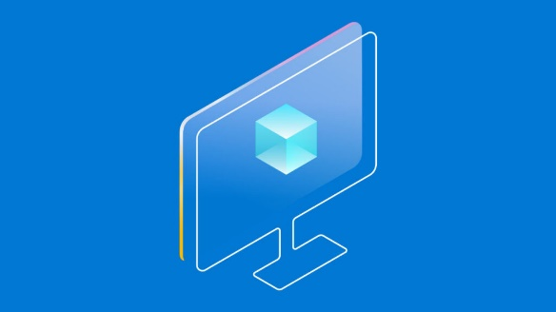
ML & AI & IOT Updates
Introducing Phi-3: Redefining what’s possible with SLMs
MS announced Phi-3, a family of open AI models developed by Microsoft. Phi-3 models are the most capable and cost-effective small language models (SLMs) available, outperforming models of the same size and next size up across a variety of language, reasoning, coding, and math benchmarks. This release expands the selection of high-quality models for customers, offering more practical choices as they compose and build generative AI applications.
Phi-3-mini, a 3.8B language model is available on Microsoft Azure AI Studio, Hugging Face, and Ollama.
Phi-3-mini is available in two context-length variants—4K and 128K tokens.
It has been optimized for ONNX Runtime with support for Windows DirectML along with cross-platform support across graphics processing unit (GPU), CPU, and even mobile hardware.

Slide 22
DevOps & IaC & Automation

Slide 23

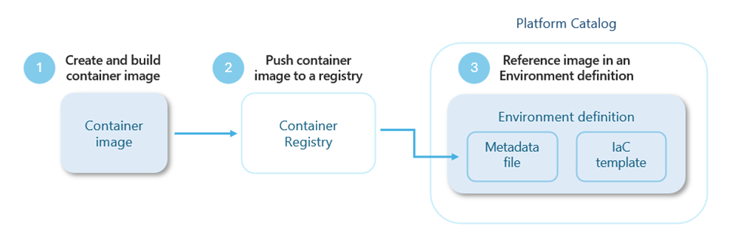
DevOps & IaC & Automation
HashiCorp joins IBM to accelerate multi-cloud automation
IBM and HashiCorp a leading multi-cloud infrastructure automation company, announced that they have entered into a definitive agreement under which IBM will acquire HashiCorp for $35 per share in cash, representing an enterprise value of $6.4 billion. HashiCorp's suite of products provides enterprises with extensive Infrastructure Lifecycle Management and Security Lifecycle Management capabilities to enable organizations to automate their hybrid and multi-cloud environments.
Public preview: Extensibility model in Azure Deployment Environments
Azure Deployment Environments is adding a new extensibility model, now available in public preview, that empowers customers to customize their deployment workflows using Bicep, Terraform, Pulumi, or any other infrastructure-as-code (IaC) framework of their choice. The model further streamlines app infrastructure provisioning and gives platform engineers the flexibility to meet the unique needs of their organization.
Extensibility model: Harness any preferred IaC framework of choice and customize deployment workflows to meet specific needs.
Terraform support: Directly use Terraform templates in Azure Deployment Environments by configuring a container image.
Bicep support: Directly use Bicep templates in Deployment Environments with a sample Bicep container image or by building a container image for Bicep deployments.

Slide 24
Miscellaneous

Slide 25
Miscellaneous Updates
.Net Standard user-defined functions for Azure Stream Analytics will be retired on 30 September 2024.
.Net Standard user-defined functions for Azure Stream Analytics will be retired on 30 September 2024. After that date, it won’t be possible to use the feature.
MS released support for .Net Standard user-defined functions in public preview for Azure Stream Analytics to let customers invoke their own functions written in any .NET Standard language (C#, F#, etc.) to extend the Stream Analytics query language.
Required action
MS recommend replace .net standard user-defined functions with JavaScript user-defined functions in Azure Stream Analytics. JavaScript user-defined functions support stateless, compute-only scalar functions that don't require external connectivity.
Azure Advisor will no longer display aggregated potential yearly savings beginning 30 September 2024
In the Azure portal, Azure Advisor currently shows potential aggregated cost savings under the label "Potential yearly savings based on retail pricing" on pages where cost recommendations are displayed. This aggregated savings estimate will be removed from the Azure portal on 30 September 2024.
Recommended action
If you want to continue calculating aggregated potential yearly savings, follow these steps. Note that individual recommendations may show savings that overlap with the savings shown in other recommendations, although you may not be able to benefit from them concurrently.

Slide 26
Miscellaneous Updates
Five Azure classic networking services will be retired on 31 August 2024
MS announced that Azure Cloud Services (classic) will be retired on 31 August 2024. Because classic Azure Virtual Network, reserved IP addresses, Azure ExpressRoute gateway, Azure Application Gateway, and Azure VPN Gateway are dependent on Azure Cloud Services (classic), they’ll be retired on the same date.
Before that date, it is mandatory to migrate any resources that use these classic networking services to the Azure Resource Manager deployment model, which provides the same capabilities as classic plus.
To avoid service disruptions, follow the guidance to migrate your resources that use these classic networking services to Azure Resource Manager by 31 August 2024:
Classic Application Gateway
Classic Virtual Network
Classic reserved IP addresses
Classic ExpressRoute Gateway
Classic VPN gateway
Cloud Services (classic) deployment model is retiring on 31 August 2024
On 31 August 2024, we’ll retire the Cloud Services (classic) deployment model. Before that date, you’ll need to migrate your services that were deployed using this model to Cloud Services (extended support) in Azure Resource Manager, which provides new capabilities, including:
Support for deployment templates.
Role-based access control.
Regional resiliency.
Required action
In order to avoid service disruption and continue to use your cloud services that were deployed using Cloud Services (classic), you must migrate them to Cloud Services (extended support) in Resource Manager before 31 August 2024. Beginning 1st September 2024, your Cloud Service deployments would be stopped and deallocated, and data will be permanently lost.

Slide 27
Miscellaneous Updates
App Service Environment version 1 and version 2 will be retired on 31 August 2024
In August 2021, Azure announced that the retirement of Cloud Services (classic) is happening on 31 August 2024. As App Service Environment v1 and v2 run on Cloud Services (classic), MS will retire App Service Environment v1 and v2 on the same date. Before that date, please complete migration to App Service Environment v3.
As of 29 January 2024, App Service Environment v1 and v2 no longer supports the creation of new workloads using any of the available methods including APM/Bicep templates, Azure portal, Azure CLI, or REST API.
After 31 August 2024, App Service Environment v1 and v2 and the applications running on them will be deleted and any application data associated with them will be lost.
Support of Azure Notification Hubs’ Firebase Cloud Messaging (FCM) legacy API will be deprecated by July 2024.
Firebase Cloud Messaging (FCM) is a service that, among other things, facilitates developers sending push notifications to Google Play supported Android devices. ANH previously communicated with FCM using the Legacy HTTP protocol. FCM v1 is an updated API that offers more features and capabilities. Google will stop supporting FCM legacy HTTP on June 20, 2024. All customers must migrate your applications and notification payloads to the new format (FCM v1) before then. The Firebase Cloud Messaging (FCM) legacy API will be deprecated by July 2024.
Required action
To minimize impact, follow the steps to migrate to FCM v1 before 1 June 2024.

Slide 28
Miscellaneous Updates
Skill up on Modern Work
Copilot is everyday AI companion, bringing the power of generative AI to everyone across work and life - Copilot Lab
Enhance your Microsoft Copilot for Microsoft 365 skills: MS-4004 - Empower your workforce with Copilot for Microsoft 365 Use Cases
Discover ways to craft effective and contextual prompts for Microsoft Copilot for Microsoft 365: MS-4005 - Craft effective prompts for Microsoft Copilot for Microsoft 365
Learn about Copilot for Microsoft 365 design for administrators with a focus on security: Course MS-4006 - Copilot for Microsoft 365 for Administrators
Updated Retirement Notice: Azure Data Catalog will now be retired on 15 May 2024
To enhance data security and comprehensive data management, MS has moved up the retirement date of Azure Data Catalog to May 15, 2024. MS strongly recommend migrating to Microsoft Purview before this date.
Like Azure Data Catalog, Microsoft Purview is more than just a data catalog; it’s a complete governance platform for data security. We’re committed to ensuring your migration to a secure solution is successful, especially given that your current data catalog offers insights into a large subset of organizational data assets. Swift migration to Purview is crucial for maintaining data security and governance standards.
Microsoft Purview is a fully managed cloud service that facilitates comprehensive data discovery and understanding of your data landscape. With Purview, you can effectively manage and govern your data across on-premises, multi-cloud, and SaaS environments, all while ensuring robust data security measures are in place, presenting a superior alternative to Azure Data Catalog. Additionally, with Microsoft Purview, you can:
Create a holistic, up-to-date map of your data landscape.
Drive automated data discovery, sensitive data classification, and end-to-end data lineage.
Find valuable, trustworthy data through its data catalog.

Slide 29
Information

Slide 30
Information
Azure Times GitHub Repo

Slide 31
Questions

