Slide 1
Azure Times #104
February 7, 2024

Slide 2
Networking

Slide 3
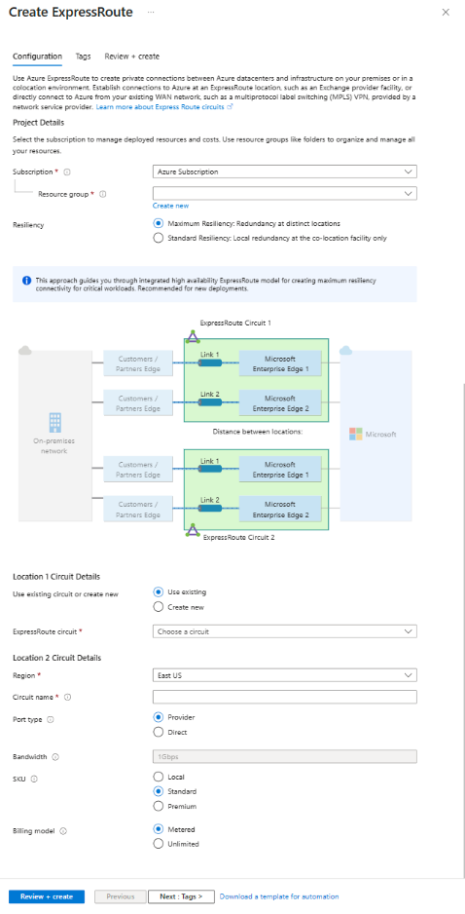
Networking Updates
Public preview: ExpressRoute guided portal experience for multi-site resiliency
MS Announced the public preview of ExpressRoute guided portal experience, which makes it easier to configure multi-site resilient ExpressRoute circuits and connect them to a virtual network gateway. The new experience provides information including distance between the peering-locations (sites) and traffic engineering recommendations to help customers make informed configuration decisions
The public preview includes guided experience for:
configuring multi-site resiliency ExpressRoute circuits.
configuring standard single-site resiliency ExpressRoute circuit and augmenting for multi-site resiliency.
connecting multi-site resilient ExpressRoute circuits to a VNet gateway.
connecting standard ExpressRoute circuit to a VNet gateway and augmenting for multi-site resiliency.

Slide 4
Networking Updates
Azure Virtual Network Manager topology view now generally available
Azure Virtual Network Manager (AVNM) topology view is now generally available.
AVNM is a highly scalable and available network management solution that allows to simplify network management across subscriptions globally. Azure Resource Topology (ART) allows to visualize the resources in network – collaborating with AVNM results in a topology view contextualized by AVNM connectivity configurations.
With topology view, it is possible to visualize the connectivity you’re establishing during and after creation of AVNM connectivity configuration, providing confidence in the topology want to deploy. Topology view displays the connectivity among AVNM network groups and virtual networks (VNets), and lets dive into the more granular connectivity established among network groups’ member VNets from a global perspective.
Azure Virtual Network Manager security admin rule generally available in 30 regions
Azure Virtual Network Manager's security admin rule configuration feature is now generally available (GA) in 30 regions.
This feature lets enforce security policies for virtual networks (VNets) at scale across subscriptions and regions globally. These rules will be evaluated before network security groups (NSGs), ensuring standardized security enforcement. They help prevent potential misconfigurations and oversights, making sure that critical services run without interruption and that network owners adhere to company policies.
Security admin rules allow users to manage security efficiently, reducing operational complexities. They also offer a default setting to avoid errors or oversights in setting up NSGs. As such, users can simplify and enhance their network security for their growing network environments.

Slide 5
Security & Identity

Slide 6
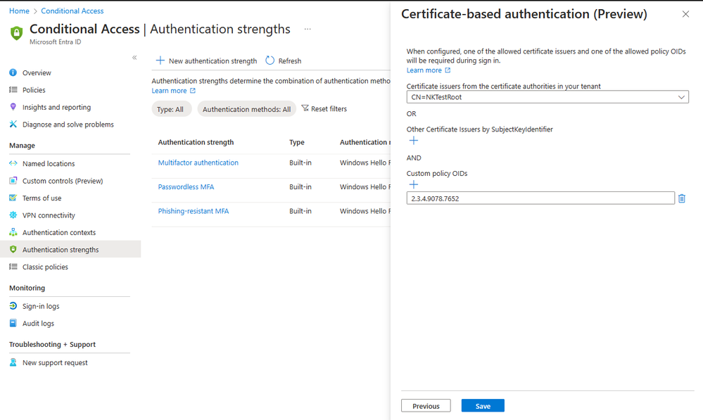
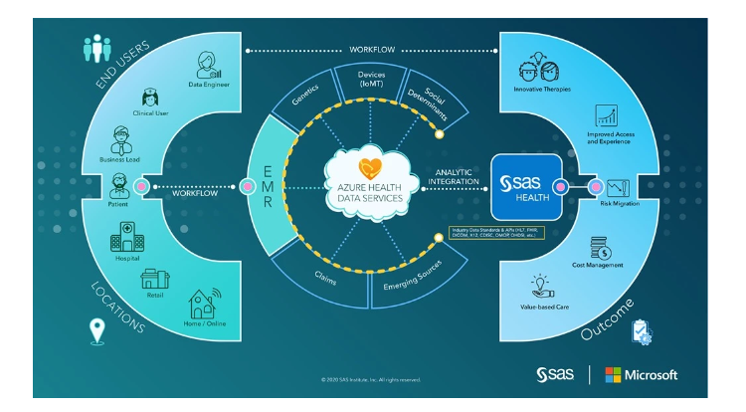
Security & Identity Updates
Advanced Certificate-Based Authentication Configuration in Conditional Access
Now it is possible to allow access to specific resources based on the certificate Issuer or Policy Object Identifiers (OIDs) properties.
Authentication strength capability in Conditional Access, allows to create a custom authentication strength policy, with advanced CBA options to allow access based on certificate issuer or policy OIDs.
Preview: Selectable search parameter capability for the FHIR service in Azure Health Data Services
MS announced that the selectable search parameter capability for the FHIR service in Azure Health Data Services is available for preview. This capability allows to tailor and enhance searches on FHIR resources. It is possible to choose which inbuilt search parameters to enable or disable for the FHIR service according to unique requirements. By enabling only, the search parameters it is possible to store more FHIR resources and potentially improve performance of FHIR search queries.

Slide 7
Security & Identity Updates
SMB alternative ports now supported in Windows Insider
Starting with Windows 11 Insider preview Build 25992 (Canary) and Windows Server Preview Build 25997, the SMB client now supports connecting to an SMB server over TCP, QUIC, or RDMA using alternative network ports.
MB server in Windows has required inbound connections using the IANA-registered port TCP/445 for decades, and the SMB TCP client has only supported connecting outbound to that TCP port. The newer SMB over QUIC protocol requires the QUIC-mandated UDP/443, both for server and client. Until now these were hard-coded and unalterable.
It is now possible to connect to alternative TCP, QUIC, and RDMA ports with the SMB client as long as the SMB server supports listening on that port and has been configured to do so.

Slide 8
Management & Governance

Slide 9
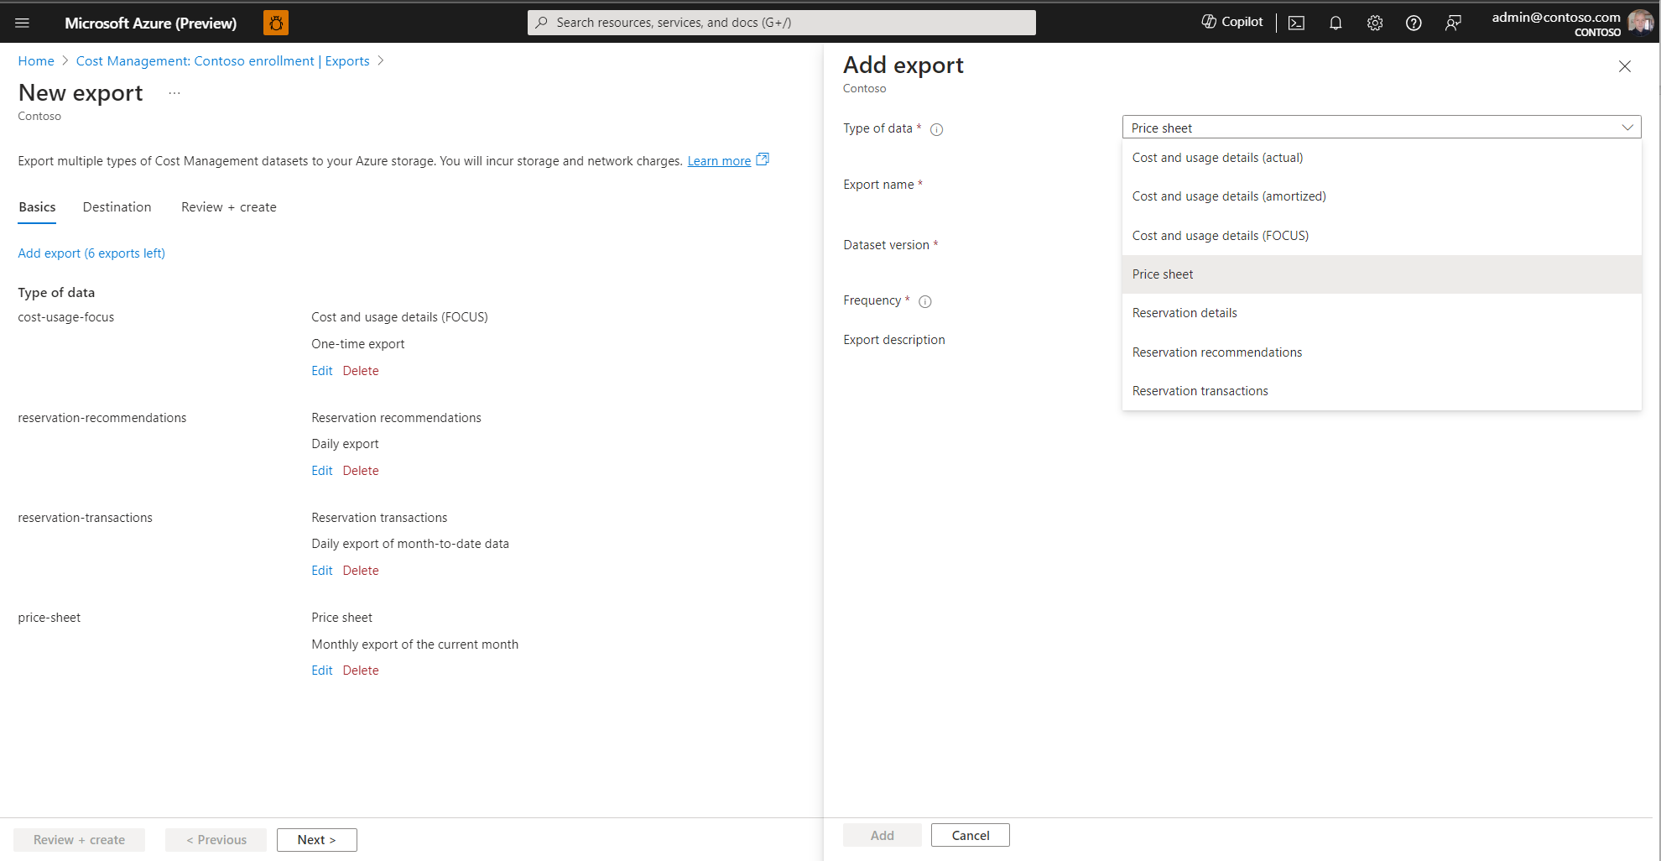
Management & Governance Updates
Improved exports experience
MS improved exports experience design with automatic exports of additional cost-impacting datasets.
It is now possible to export additional datasets, including price sheets, reservation recommendations, reservation details, and reservation transactions. Furthermore, it is possible to download cost and usage details using the open-source FinOps Open Cost and Usage Specification (FOCUS) format, which combines actual and amortized costs and reduces data processing times and storage and compute costs.

Slide 10
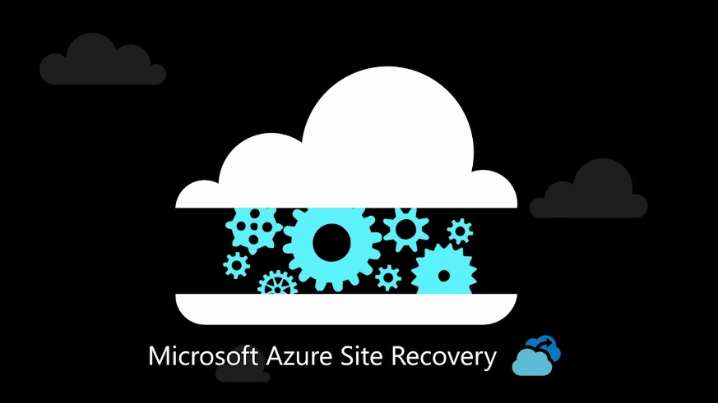
Management & Governance Updates
Public Preview: Azure Business Continuity Center is now available in all regions
Azure Business Continuity (ABC) Center a groundbreaking initiative designed to enhance business's resilience across all regions.
With the Azure Business Continuity Center, enterprises can seamlessly govern, monitor, operate, and analyze protection at scale:
Insights into Protection Estate
Identify and Protect Resources
Centralized Resource Protection
Optimize Security Configuration
Unified Monitoring
Ensuring Compliance
Private Preview: Azure Site Recovery support for Azure Trusted Launch VMs (Windows OS)
MS announced the private preview of Azure Site Recovery support for Azure Trusted Launch VMs. Azure Trusted Launch VMs provide foundational compute security to Azure Generation 2 VMs by enabling Secure Boot and vTPM capabilities.

Slide 11
Management & Governance Updates
Announcing General Availability of Azure Monitor Metrics Data Plane API
MS announced that the Azure Monitor Metrics Data Plane API has reached General Availability! Now, it is possible to seamlessly manage and monitor Azure resources with enhanced query efficiency. Azure Metrics Data plane API in Azure monitoring makes resource insight gathering more efficient with a higher capacity querying experience. It provides the capability to retrieve the metric data for up to 50 resource IDs in the same subscription and region in a single batch API call thus improving query throughput and reducing the risk of throttling.
Public Preview: Azure Monitor introduces Prometheus community recommended alerts
With just a single click within the Azure Portal, customers can now effortlessly enable Prometheus recommended alerts. These alerts are an enhanced version of the Prometheus community alerts and cover alerts at the cluster, node, and pod level. Previously, the process required customers to download a template and deploy it via command-line interface (CLI). By enabling recommended alerts, customers will:
Monitor key signals to be promptly notified on potential critical issues within their clusters.
Streamline the triage and troubleshooting process, reducing the time and effort required to identify and resolve issues.
Ensure their clusters are running efficiently and reliably, with minimal downtime and performance issues.

Slide 12
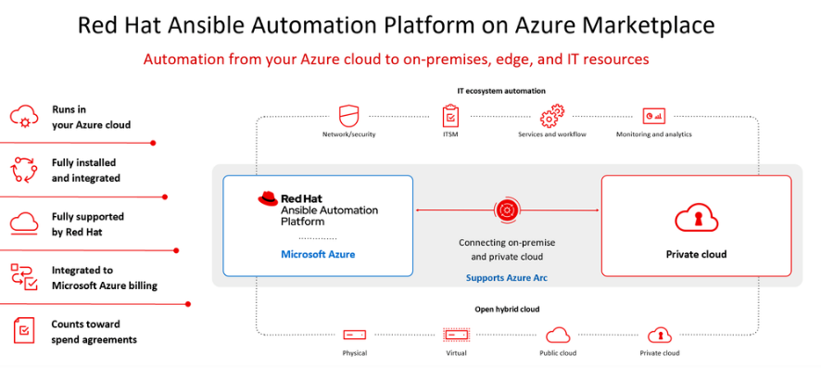
Management & Governance Updates
Public Preview: Azure Functions Support for Java 21 on Linux
Azure Functions support for Java 21 on Linux is now in preview.
It is now possible to develop apps using Java 21 locally and deploy them to all Azure Functions plans on Linux. Azure Functions support for Java 21 on Windows will be added soon. Learn more about updating your app to Java 21.
Public Preview: Distributed tracing v2 for durable Functions
Distributed tracing allows to correlate operations and track requests between services from end to end.
It is possible to distributed tracing v2 with any of the supported durable Functions language SDKs and storage backends.
Distributed tracing v2 is also compatible with applications using Durable Task Framework, the underlying C# OSS framework that powers durable Functions.
Ansible for Enhanced Automation on Azure
MS announced partnership with Red Hat to bring their new Ansible Automation Platform self-managed offering to Microsoft Azure.
Starting December 20, 2023, it is possible to deploy the self-managed Red Hat Ansible Automation Platform on Azure offering directly through the Azure Marketplace in North America, EMEA, Singapore, India, Korea, New Zealand, Australia with additional availability coming soon.
Red Hat’s Ansible Automation Platform is a powerful tool that enables organizations to automate their infrastructure, networks, and cloud resources. With the new self-managed offering on Azure, customers can now take full control of their automation environment and tailor it to their specific needs.

Slide 13
Compute

Slide 14
Compute Updates
Azure Red Hat OpenShift January 2024 updates
Azure Red Hat OpenShift now offers Resource Health for clusters with integration with Azure Monitor via Signals and Alerts
General availability: Israel Central region added to Azure HDInsight
HDInsight is now generally available in Israel Central. Azure HDInsight is a managed, full-spectrum, open-source analytics service in the cloud for enterprises. It is now possible to use open-source frameworks such as Hadoop, Apache Spark, Apache Hive, LLAP, Apache Kafka, and more. For more information about HDInsight
General availability: Italy North region added to Azure HDInsight
HDInsight is now generally available in Italy North. Azure HDInsight is a managed, full-spectrum, open-source analytics service in the cloud for enterprises. It is now possible to use open-source frameworks such as Hadoop, Apache Spark, Apache Hive, LLAP, Apache Kafka, and more.

Slide 15
Compute Updates
Generally Available: Outbound type migration in AKS
AKS uses outbound types to customize egress for a cluster to fit specific scenarios.
It is now possible to use Azure CLI to migrate outbound types on existing clusters without having to recreate a cluster.
Migrating the outbound type to user managed types (userAssignedNATGateway and userDefinedRouting) will change the outbound public IP addresses of the cluster.
Changing the outbound type on a cluster is disruptive to network connectivity and will result in a change of the cluster's egress IP address.
Visual Studio Code extension update for Azure Kubernetes Service (AKS)
Visual Studio Code extension for Azure Kubernetes Service (AKS) has recently been updated to bring new capabilities, features, and improvements. Highlights include:
A brand-new cluster create experience
Reconcile/abort cluster
Enhanced networking capabilities such as granular packet capture/tcp dump
Public preview: Disable Secure Shell (SSH) support in AKS
Secure Shell (SSH) is currently on by default for AKS provisioned nodes, and it is a recommended to disable SSH manually.
This public preview feature allows to disable or enable SSH. This also gives the ability to secure cluster and reduce the attack surface.
After update the SSH key, AKS doesn't automatically update node pool. At anytime, please perform a nodepool update operation. Only after a node image update is complete does the update SSH key operation take effect.
Managed VNet | loadBalancer | managedNATGateway | userAssignedNATGateway | userDefinedRouting
loadBalancer | N/A | Supported | Not Supported | Supported
managedNATGateway | Supported | N/A | Not Supported | Supported
userAssignedNATGateway | Not Supported | Not Supported | N/A | Not Supported
userDefinedRouting | Supported | Supported | Not Supported | N/A

Slide 16
Compute Updates
Public preview: Node OS API options feature for AKS
Node OS API options feature for AKS is now in public preview. This feature allows those without Kubernetes API access to get private IP & name information of a node in a nodepool using the ARM API. This is useful in situations such as when it is required to perform Node API for troubleshooting.
Public preview: Upgrade support in Istio add-on for AKS
Istio add-on for AKS now allows upgrading the minor version of Istio using canary upgrade process.
When an Istio upgrade is initiated, the control plane of the new (canary) revision is deployed alongside the old (stable) revision's control plane. Workload pods can then be restarted while using monitoring tools to track the health of workloads during this process.
If no issues are observed with the health of workloads, upgrade can be completed so that only the new Istio revision remains on the cluster. Otherwise, it is possible to roll back to the previous revision of Istio.
Public preview: Istio add-on for AKS now supports plug-in certificate authority (CA)
In the Istio-based service mesh add-on (currently in public preview) for Azure Kubernetes Service, by default the Istio certificate authority (CA) generates a self-signed root certificate and key and uses them to sign the workload certificates.
To protect the root CA key, it is recommended to use a root CA, which runs on a secure machine offline. It is possible to use the root CA to issue intermediate certificates to the Istio CAs that run in each cluster.
The Istio add-on now allows to bring your own certificates and keys for Istio CA. An Istio CA can sign workload certificates using the administrator-specified certificate and key and distribute an administrator-specified root certificate to the workloads as the root of trust.

Slide 17
Compute Updates
Public Preview: New major version of durable Functions extension
Durable Functions extension v3.0.0 is now in public preview. This new major version introduced two key changes: upgrade to the latest Azure Storage SDK and a new partition manager.
This SDK upgrade provides the latest performance, correctness, and security updates. However, it may be a breaking change for some .NET in-process users.
The new partition manager helps to reduce idle-state costs significantly for those using Azure Storage backend, especially v2 Storage accounts. In a benchmark, daily cost reduction is 93%. The new partition manager uses Azure Tables to manage partition assignments instead of Azure Blob leases, and in addition to being more cost efficient, it is also easier to debug.
Generally Available: Kube-reserved resource optimization in Azure Kubernetes Service (AKS)
Reserved space contains resources set aside on a node, such as system daemons that back Kubernetes and the operating system itself. If these resources are not allocated sufficient reserved space, pods and system daemons will compete. This competition leads to starvation on the node.
Azure Kubernetes Service (AKS) addresses this issue by enforcing a rate at which it reserves space, as detailed by the Kube-reserved flag. This flag shows the resource reservation for Kubernetes system daemons including kubelet, container runtime, and more.
Beginning with AKS support of Kubernetes 1.29 in preview, optimized reservation logic reduces Kube-reserved memory by up to 20% depending on the node configuration and will apply to everyone.

Slide 18
Compute Updates
Improvements to configuring networking in Azure portal
MS has gradually been making improvements to the Azure portal experience for managing network configuration in App Service.
New Network Hub Overview
Networking Integration
Domain Names
Public network access/Access restrictions
DNS Configuration
Preview of Distributed Tracing V2 for Durable Functions
MS released Distributed Tracing V2 for Durable Functions to help improve observability!
Durable Functions enables to write long-running, reliable, event-driven, and stateful logic on the Azure Functions platform using everyday imperative code.
Distributed Tracing allows to correlate operations together and track requests between services. This is especially useful for Durable Functions apps as they coordinate work across multiple services and VMs.
Harnessing the Power of Network Trace Analysis in Azure App Service
MS announced the public preview of a powerful new feature in Azure App Service: the Network Trace Analyzer. Designed to simplify the often-complex task of network trace analysis, this tool is set to revolutionize your troubleshooting process.
Key Features
Basic Network Connectivity
Transmission Control Protocol (TCP) Reset Errors: Identify and address TCP reset errors that may be disrupting your web application’s connectivity.
TCP SYN Retransmissions: Detect and troubleshoot TCP SYN retransmission errors that can degrade your web application’s performance.
TCP Reset Errors: Checks for TCP reset errors which occur when a TCP connection is abruptly closed by the receiving end of the connection.
Transport Layer Security (TLS) Handshake: This tool checks the TLS “handshake” process, which is the initial step in establishing a TLS connection
TLS Alerts: Monitor for TLS alerts, which are warning or error messages that can be sent at any time during the TLS connection process. These alerts can indicate issues like an unknown certificate authority, a decryption error, or a protocol version mismatch.
Future updates will introduce scenarios like TCP Packet Loss, TCP Zero Window Dead, and more.

Slide 19
Management & Governance Updates
Generally Available: Azure Stack HCI latest feature release
This new Azure Stack HCI release is the version of the product required to run Azure Virtual Desktop on-prem which is also now in GA and called Azure Virtual Desktop for Azure Stack HCI. This is an exciting development as the public preview of this product is in high demand specifically in Healthcare and Financial Services.
In addition, customers will benefit from the following new features and enhancements:
Cloud based life-cycle management to deploy, create, expand, and update, HCI and AKS infrastructure to host Arc VMs and AVD session host VMs with the consistency of Azure portal, Azure CLI, and ARM templates
Azure Arc (Resource Bridge) set up automatically for provisioning VMs and provisioning Kubernetes clusters
Templatize clusters in ARM and deploy onto minimally-configured servers
Manage updates for Azure Stack HCI clusters from the Azure portal, including at-scale (~100s)
Expanded VM Extensions support including Microsoft Defender for Cloud, Azure Monitor, and Azure Update Management
New Site manager to help you organize resources in Azure Arc by location
Annual update for core stack (hypervisor, storage, etc.) with new deduplication and compression, Trusted Launch VMs, improved GPU support
Azure Virtual Desktop for Azure Stack HCI
For organizations with data residency requirements, latency-sensitive workloads, or those with data proximity requirements. Azure Virtual Desktop for Azure Stack HCI extends the capabilities of the Microsoft Cloud to local datacenters.
With Azure Virtual Desktop for Azure Stack HCI, it is possible
Improve performance for Azure Virtual Desktop users in areas with poor connectivity to the Azure public cloud by giving them session hosts closer to their location.
Meet data locality requirements by keeping app and user data on-premises.
Improve access to legacy on-premises apps and data sources by keeping desktops and apps in the same location.
Deliver the full Windows experience while retaining cost efficiency with Windows 11 and Windows 10 Enterprise multi-session.
Unify VDI deployment and management compared to traditional on-premises VDI solutions by using the Azure portal.
Achieve the best performance by using RDP Shortpath for low-latency user access.
Deploy the latest fully patched images quickly and easily using Azure Marketplace images.

Slide 20
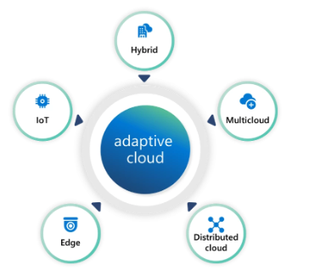
Management & Governance Updates
Announcing HCIBox support for Azure Stack HCI 23H2
HCIBox now supports Azure Stack HCI 23H2 and is ready to offer the latest capabilities of Azure edge environments with native Azure Arc and AKS integration in a self-contained sandbox. This sandbox deploys easily into an Azure subscription, and uses nested virtualization to emulate an HCI cluster inside an Azure VM. This allows users to experience many Azure Stack HCI 23H2 features like the new cloud deployment feature with minimal manual effort. HCIBox automatically generates a ready-to-go ARM template that can be used to deploy a new HCI cluster. The cloud deployment also automatically provisions Arc resource bridge and AKS components, and HCIBox comes with additional modules to showcase cloud VM management and AKS on HCI.
AKS enabled by Azure Arc is now available on Azure Stack HCI 23H2
MS announced the general availability of Azure Kubernetes Service (AKS) for the newest Azure Stack HCI version, a key enabler of advancing hybrid cloud to adaptive cloud with Azure.
The adaptive cloud approach unifies siloed teams, distributed sites, and sprawling systems into a single operations, security, application, and data model, enabling organizations to leverage cloud-native and AI technologies to work simultaneously across hybrid, multicloud, edge, and IoT.
An adaptive cloud approach shifts organizations from a reactive posture to one of proactive evolution, enabling people to anticipate and act upon changes in market trends, customer needs, and technological advancements ahead of time.
Common Deployment Challenges and Workarounds for HCI 23H2
Azure Stack HCI 23H2 introduces a new method for deploying the cluster from the Azure portal. Azure portal should be used to join on-premises servers to the domain, build a cluster, and set up an AKS on top of that to act as the resource bridge created by an AKS Cluster. These involve numerous steps and tasks that need completion, spanning from the cloud to your on-premises servers.

Slide 21
Management & Governance Updates
Generally Available: Azure Container Apps supports additional TCP ports
Azure Container Apps now supports additional TCP ports, enabling applications to accept TCP connections on multiple ports. This feature is generally available.
The following apply to additional TCP ports:
Additional TCP ports can only be external if the app itself is set as external and the container app is using a custom VNet.
Any externally exposed additional TCP ports must be unique across the entire Container Apps environment. This includes all external additional TCP ports, external main TCP ports, and 80/443 ports used by built-in HTTP ingress. If the additional ports are internal, the same port can be shared by multiple apps.
If an exposed port isn't provided, the exposed port will default to match the target port.
Each target port must be unique, and the same target port can't be exposed on different exposed ports.
There's a maximum of 5 additional ports per app. If additional ports are required, please open a support request.
Only the main ingress port supports built-in HTTP features such as CORS and session affinity. When running HTTP on top of the additional TCP ports, these built-in features aren't supported.
Announcing Public Preview of Migration plugin for WordPress on App Service
MS announced the public preview of the App Service migration plugin for WordPress.
The plugin copies all content from existing site to a new WordPress site in App Service without impacting the existing site, so that it is possible to verify and test new site before making it available to visitors.
Generally Available: VMware Cloud Director Availability for Azure VMware solution with Run commands
MS announced the general availability for VMware Cloud Director Availability, a Disaster Recovery as a Service (DRaaS) solution on Azure VMware Solution.
An added benefit is the simplicity it brings to the deployment. Customers can effortlessly deploy and configure VMware Cloud Director Availability in the Azure VMware Solution cloud site using Run commands, streamlining the process with full automation, and eliminating the need for manual intervention.
VMware Cloud Director Availability can be used to migrate and protect virtual machines, vApps and templates to and from Azure VMware Solution Cloud Director Service site. Azure VMware solution integrates with the classic Data Engine of VMware Cloud Director Availability. This Host-based replication engine not only supports migration but also caters to Disaster Recovery scenarios, making it a comprehensive solution for various use cases.

Slide 22
Storage & Data

Slide 23
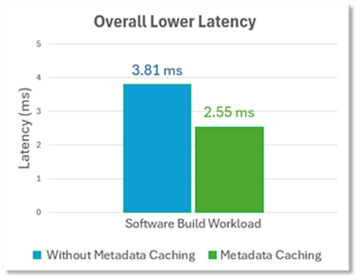
Storage & Data Updates
Announcing the Public Preview of Metadata Caching for Azure Premium SMB File Shares
Azure Files is excited to announce the public preview of Metadata Caching for the premium SMB file share tier. Metadata Caching is an enhancement aimed at reducing metadata latency for file workloads running on Windows/Linux clients. In addition to lowering metadata latency, workloads will observe a consistent latency experience which will allow metadata intensive workloads to be more predictable and deterministic. Reduced metadata latency also translates to more data IOPS (reads/writes) and throughput.
Once Metadata Caching is enabled, there is no additional cost or operational management overhead when using this feature.
The following Metadata APIs will benefit from Metadata Caching.
Create: Creating a new file; Up to 30% Faster
Open: Opening a file; Up to 55% Faster
Close: Closing a file; Up to 45% Faster
Delete: Deleting a file; Up to 25% Faster
Expected Performance Improvement with Metadata Cache.
2-3x Improved Metadata Latency Consistency
Improved Metadata Latency beyond 30%
Increased IOPS and Bandwidth up to 60%

Slide 24
Storage & Data Updates
Announcing the general availability of NFS Azure file share snapshots
File share backups are critical to every organization's data protection strategy. Even though snapshots aren’t considered backups in the traditional sense, they’re generally seen as a complementary approach in mitigating data protection challenges. Customers rely on technologies like snapshots and replication to deliver on lower recovery point objective (RPO) and recovery time objective (RTO) SLAs compared to traditional backup technologies.
AzCopy support for Entra ID authentication
Using AzCopy version 10.22.0 or newer it is possible to use existing Entra ID authentication tokens from Azure PowerShell and Azure CLI for authentication for blob transfers to and from storage accounts. This will reduce the number of times needed to enter credentials when using Azure PowerShell and Azure CLI in the same session as login to either Azure PowerShell or Azure CLI once and you do not need to enter a separate set of credentials in AzCopy.

Slide 25
Databases

Slide 26
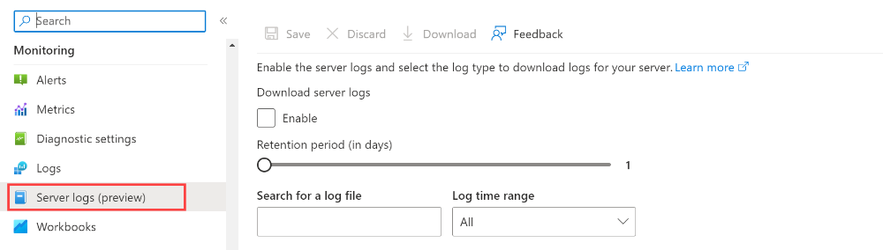
Databases Updates
General availability: Azure Cosmos DB for PostgreSQL Customer-managed keys (CMK)
Data stored in Azure Cosmos DB for PostgreSQL cluster is automatically and seamlessly encrypted with keys managed by Microsoft (service-managed keys). Optionally, it is possible to add an additional layer of security by enabling encryption with customer-managed keys.
Many organizations require full control of access to the data using a customer-managed key. Data encryption with customer-managed keys for Azure Cosmos DB for PostgreSQL allows to bring your own key to protect data at rest. It also allows organizations to implement separation of duties in the management of keys and data.
With customer-managed encryption, you're responsible for, and in full control of, a key's lifecycle, key usage permissions, and auditing of operations on keys. Data encryption with customer-managed keys for Azure Cosmos DB for PostgreSQL is set at the node level. Data, including backups, is encrypted on disk, including the temporary files created while running queries.
General Availability: Server logs for Azure Database for PostgreSQL - Flexible Server
Server logs for Azure Database for PostgreSQL - Flexible Server are now generally available.
It is possible to use server logs for Azure Database for PostgreSQL - Flexible Server to enable logging for database instance and save the results to a file.

Slide 27
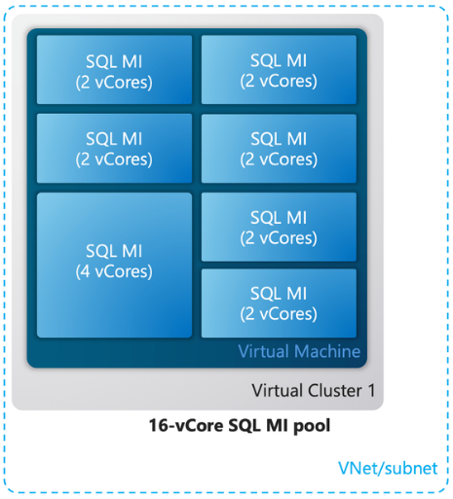
Databases Updates
Public preview: Azure SQL updates for late-January 2024
Azure SQL Managed Instance pools now have new functionalities. Save costs by migrating to 2-vCore instances within instance pools, while enjoying great flexibility including instance move into/out of the pool, pool resizing and hardware tier change.
Instance pools provide the unique capability to provision small, cost-effective 2-vCores instances within a pre-provisioned instance pool. This way, small instances can cost 50% less compared to non-pooled instances. As an additional advantage, pooled instances provision very fast (under 5 minutes) which recommends them for many scenarios that involve rapid capacity scaling.
General availability: Azure SQL updates for late-January 2024
The Azure SQL trigger is now available and uses SQL change tracking functionality to monitor a SQL table for changes. This provides developers a no code/low code change data stream capturing when data is created, updated, or deleted allowing for participation in modern application architectures.

Slide 28
Databases Updates
General availability: PgAudit in Azure Cosmos DB for PostgreSQL
Audit logging for Azure Cosmos DB for PostgreSQL clusters via pgAudit is now generally available. Produce audit logs of events on all or some nodes in Azure Cosmos DB for PostgreSQL cluster including writes, reads, role changes, and Data Definition Language (DDL) with the PostgreSQL audit extension. Detailed session and object audit logging is provided using the standard PostgreSQL logging facility. PostgreSQL logs can be saved to a storage account, sent to Event Hub, or queried in Azure Monitor logs.
General Availability: Read replica in special regions with Azure Database for PostgreSQL - Flexible Server
MS announced the general availability of the read replica feature in Azure Government regions and Microsoft Azure operated by 21Vianet regions, including US Gov Arizona, Texas, Virginia, China North 3, and China East 3 for Azure Database for PostgreSQL - Flexible Server.
The read replica feature allows to isolate read workloads to the replicas, ensuring optimized performance, while directing write workloads to the primary server. This separation not only improves efficiency but also enhances the overall system reliability. Additionally, read replicas can be deployed in different regions, providing a robust solution for disaster recovery scenarios. In such events, these replicas can be converted to read-write servers, ensuring your operations continue seamlessly.
Employing PostgreSQL engine native physical replication technology, replicas are updated asynchronously, maintaining data integrity and consistency. You have the flexibility to replicate from the primary server to up to five replicas, allowing for extensive scalability and redundancy.
Please note, preview features such as promoting to primary server and virtual endpoints are not supported in these regions.

Slide 29
Databases Updates
Generally Available: Support for Cross Region Restore for PostgreSQL backups
Cross Region Restore of PostgreSQL backups using Azure Backup is now generally available. Azure Backup uses Read-Access Geo Redundant Storage (RA-GRS) that stores three replicas of backup data across each of the two paired regions. While Geo-Redundant Storage (GRS) allows to access secondary region backups when Azure declares a disaster, enabling Cross Region Restore allows to access and do restore operation from the backups residing in the paired region at all the times, which includes non-outage scenarios.
Enable the Cross Region Restore option when:
You need to do recovery drills on your secondary region backups to assess disaster readiness.
You need high resiliency of backup data.
This capability helps in the following scenarios:
When the primary region is available to test data backed up in the secondary region for audit/compliance purposes.
When the primary region is unavailable, you can trigger restore of backed-up data in the secondary region without any wait time even if the Azure primary region is partially or completely unavailable.

Slide 30
Integration

Slide 31
Integration Updates
Use Streaming Ingestion to Azure Data Explorer with Azure Stream Analytics
Azure Streaming Analytics provides a streaming ingestion mode when writing to Azure Data Explorer, delivering latencies as low as less than ten seconds.
Data Ingestion:
Azure Data Explorer supports streaming ingestion and queued ingestion:
Streaming ingestion: This method ensures near-real-time latency for small sets of data per table. Data is ingested in micro batches from a streaming source, initially placed in the row store, and then transferred to column store extents. For more information, see Configure streaming ingestion.
Queued ingestion: This method is optimized for high ingestion throughput. Data is batched based on ingestion properties, with small batches then merged and optimized for fast query results. By default, the maximum queued values are 5 minutes, 1000 items, or a total size of 1 GB. The data size limit for a queued ingestion command is 6 GB. For more information, see Ingestion batching policy.
Considering a streaming injection for:
Latency of less than a few seconds is required.
Optimize operational processing of many tables where the stream of data into each table is relatively small

Slide 32
ML & AI & IOT

Slide 33
ML & AI & IOT Updates
Generally Available: Continuous model monitoring in Azure Machine Learning
Model monitoring is a critical step in the machine learning lifecycle. Azure Machine Learning customers can use model monitoring, now generally available, to track model performance in production, better-understand model behavior from both data science and operational perspectives and inform ongoing optimization for improved business value and compliance.

Slide 34
DevOps & IaC & Automation

Slide 35
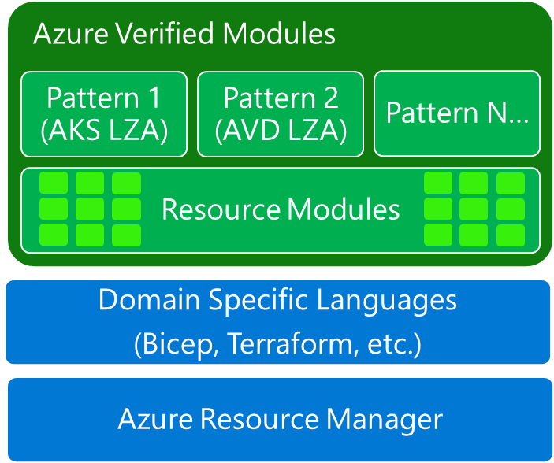
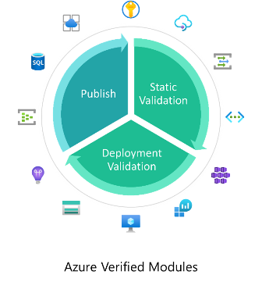
DevOps & IaC & Automation
Azure Verified Modules
Azure Verified Modules (AVM) is an initiative to consolidate and set the standards for what a good Infrastructure-as-Code module looks like.
Modules will then align to these standards, across languages (Bicep, Terraform etc.) and will then be classified as AVMs and available from their respective language specific registries.
AVM is a common code base, a toolkit for our Customers, our Partners, and Microsoft. It’s a community driven aspiration, inside and outside of Microsoft.
Azure Verified Modules enable and accelerate consistent solution development and delivery of cloud-native or migrated applications and their supporting infrastructure by codifying Microsoft guidance (WAF), with best practice configurations.
Azure Verified Modules provides two types of modules: Resource and Pattern modules.
AVM modules are used to deploy Azure resources and their extensions, as well as reusable architectural patterns consistently.
Modules are composable building blocks that encapsulate groups of resources dedicated to one task.
Flexible, generalized, multi-purpose
Integrates child resources
Integrates extension resources
AVM improves code quality and provides a unified customer experience.

Slide 36
DevOps & IaC & Automation
Generally available: Up to 50 test fail criteria in Azure Load Testing
Azure Load Testing now supports specifying up to 50 test fail criteria in load tests. This allows to easily set up multiple failure thresholds across several requests and metrics.

Slide 37
Miscellaneous

Slide 38
Miscellaneous Updates
Support for log alert rules that use cross-workspace queries with resource names or qualified name identifiers will be retired on 31 May 2024
As of May 31, 2024, log alert rules will no longer support cross-workspace queries that use resource names or qualified name identifiers.
Alert rules created in the Azure portal or using the Scheduled Query Rules API version 2023-03-15-preview, using resource names (e.g. workspaces('AIFabrikamDemo')) or qualified names (<subscriptionName>/<resourceGroup>/<workspaceName>) patterns in cross-resource queries will not be supported.
Public Preview: Azure API Center – January Updates
Azure API Center is one-stop solution for inventorying and managing organization’s APIs. In this update, MS intoruced new features and improvements to help discover, reuse, and consume APIs more easily and efficiently.
API Center portal: This is an automatically generated website that showcases APIs and provides a web-based experience for discovering and consuming APIs
CLI extension for Azure API Center: With the new Azure CLI extension for API Center, it is possible to manage APIs from the command line.
Import APIs from Azure API Management via CLI: The latest CLI extension release lets import APIs from multiple Azure API Management instances.
Visual Studio Code extension: It is now possible to discover and test APIs from within Visual Studio Code, the popular code editor and development environment. You can see a list of all your APIs, quickly explore API documentation, and generate SDKs for various languages and platforms.

Slide 39
Information

Slide 40
Information
Azure Times GitHub Repo

Slide 41
Questions

