Slide 1
Azure Times #99
December 13, 2023

Slide 2
Networking

Slide 3
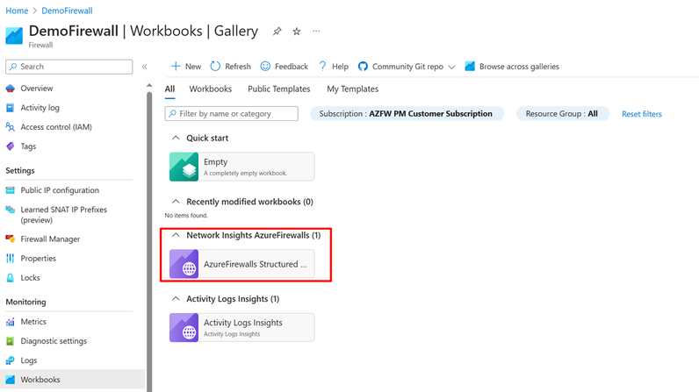
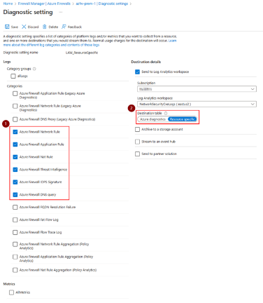
Networking Updates
Azure Firewall: New Embedded Workbooks
Azure Firewall Portal has now incorporated embedded workbooks functionality, offering customers a seamless means to analyze Azure Firewall traffic. This feature facilitates the creation of sophisticated visual reports within the Azure portal, allowing users to leverage data from multiple Firewalls deployed across Azure and unify them into interactive, cohesive experiences.
The Embedded Workbook presents users with consolidated information through charts and logs. It is structured into distinct sections, covering Application rules, Network rules, DNS proxy, Intrusion Detection and Prevention System (IDPS), Threat intelligence, and Investigation. Designed to function across multiple tenants and subscriptions, it offers filtering capabilities for various firewalls.

Slide 4
Security & Identity

Slide 5
Security & Identity Updates
General availability: Encryption with customer-managed keys in Azure Health Data Services
Data stored in Azure Health Data Services is automatically and seamlessly encrypted with service-managed keys managed by Microsoft. It is now possible to enable data encryption with customer-managed keys (CMK) for new and existing FHIR® and DICOM® services, providing organization with improved flexibility to manage access controls.
Data encryption with customer-managed keys for Azure Health Data Services enables you to bring your own key to protect and control access to the key that encrypts your organization’s data at rest. It also allows organizations to implement separation of duties in the management of keys and data. Additionally, you can centrally manage and organize keys using Azure Key Vault. With customer-managed encryption, you're responsible for and in full control of a key's lifecycle, key usage permissions, and auditing operations.
Public Preview: Azure Managed HSM Backup/Restore when Storage Account is Behind a Private Endpoint
MS announced the Public Preview of support for Azure Key Vault Managed HSM backup/restore when the storage account is behind a private endpoint.
General Availability: Managed HSM Networking Settings in Azure Portal
MS announced the General Availability of networking settings for Azure Key Vault Managed HSM on the Azure portal. Customers can now configure public internet, private endpoints, and Microsoft trusted service bypass settings using the Azure portal.

Slide 6
Management & Governance

Slide 7

Management & Governance Updates
New Defender for Resource Manager pricing plan
MS announced a new Pricing Plan Tier for the Defender for ARM.
The legacy pricing plan (per-API call) is priced at $4 per 1M API Calls, which can become a bit expensive if there is a lot going on in your subscriptions.
The new pricing plan (per-subscription) is priced at $5 per subscription per month.
However, make sure that you have at least 1.25M API calls per month in the subscription you are looking to switch for the new pricing plan. Otherwise, you will end up paying more for the same service.
Generally available: Azure Site Recovery update rollup 69 - November 2023
Mobility Service:
Added support for Linux OS for:
Azure to Azure – Rocky Linux 8.7, Rocky Linux 9.0, Rocky Linux 9.1, and SUSE Linux Enterprise Server 15 SP5
Modernized VMware/Physical to Azure - Rocky Linux 8.7, Rocky Linux 9.0, Rocky Linux 9.1, and SUSE Linux Enterprise Server 15 SP5
Added support for Windows OS for:
Azure to Azure – Windows 11

Slide 8
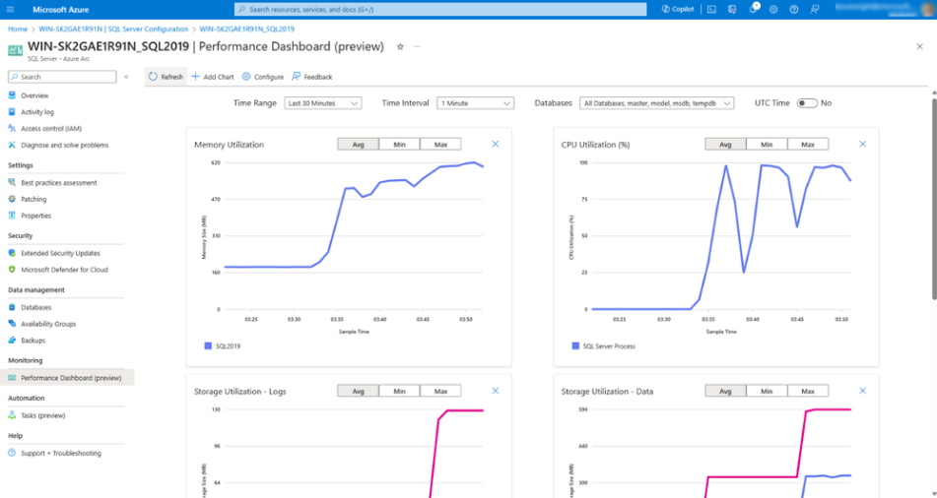
Management & Governance Updates
Performance dashboards for SQL Server enabled by Azure Arc – now in Public Preview
MS announced the public preview of performance dashboards for SQL Server enabled by Azure Arc.
Azure Arc will automatically collect the following types of data from the Dynamic Management Views (DMV) datasets oof the SQL Server:
Active Sessions
CPU Utilization
Database Properties
Database Storage Utilization
Memory Utilization
Performance Counters
Storage I/O
Wait Stats
Once your SQL Server is configured, here’s what the performance dashboard will look like in Azure.
The Azure Extension for SQL Server (WindowsAgent.SqlServer) is running v1.1.2504.99 or later.
SQL Server is running on the Windows operating system.
SQL Server is a Standard or Enterprise Edition.
The license type on the Azure Extension for SQL Server is set to "License with Software Assurance" or "Pay-as-you-go".
Azure Extension for SQL Server is able to connect to the endpoint telemetry.<region>.arcdataservices.com (review all network requirements)

Slide 9
Management & Governance Updates
Automated Backups with custom schedule - Automated backups, as a feature, has been available for Arc SQL Servers since April release. However, we only provided a “default” option. Enabling the automated backups would create a schedule that would initiate a weekly full backup, daily differential and 5-min transaction log backups. It is still applied at the instance level, meaning the schedule will apply to ALL the user databases on the SQL Server.
Point-in-time restore - Once the backups are enabled via Azure Arc, you can perform a point-in-time restore from these backups, either using Azure portal or az CLI. The experience is very similar to what we have for Azure SQL products.
Always On Availability Groups Inventory and real time status - If you have any Always On Availability Groups configured on your SQL Server, Arc enabling those SQL Servers lets you view all the AGs in Azure portal and a real-time status of each of those AGs. The status view is very similar to the AG dashboard in SSMS for consistency
Support for Arc enabling SQL Server Failover Cluster Instances - Now each of these nodes has an Arc SQL extension service running that needs to have the intelligence to (1) detect that the SQL instance its connecting to is an FCI, and then (2) determine whether the FCI is active on this node or a different one and (3) connect (using the network name connection) and do its thing.

Slide 10
Compute

Slide 11
Compute Updates
CMK on ADX Leader/Follower Cluster
MS announced the support of utilizing Customer Managed Keys (CMK) in an ADX Leader/Follower configuration. No additional steps or configuration needed; MS have just unlocked this capability through the normal process!
New Microsoft Teams app generally available on Azure Virtual Desktop
MS announced the general availability of the new Microsoft Teams app on Azure Virtual Desktop.
Microsoft Teams on Azure Virtual Desktop supports chat and collaboration. With media optimizations, it also supports calling and meeting functionality by redirecting it to the local device when using a supported Remote Desktop client. Users and admins can now experience and enjoy all the benefits of the new Teams app on their virtual desktop. The new Teams App has not only matched features of the classic Teams app, but has also improved performance, reliability, and security.
Moving forward, new features and capabilities as well as enhancements to existing features will be available exclusively in the new Teams.
The classic Teams will reach the end of support on June 30th, 2024, after which users will not be able to use the classic Teams and will be asked to switch to the new Teams app. Therefore, we recommend you update to the new Teams today.

Slide 12
Compute Updates
Migration of Azure Virtual Network injected Azure Data Explorer cluster to Private Endpoints
VNet injection has some limitations and drawbacks, such as increased complexity, reduced scalability, and dependency on public IP addresses. Therefore, it is recommended to migrate VNet injected ADX cluster to a new network security model based on Azure Private Endpoints. Private endpoints enable to connect to ADX cluster using a private IP address within VNet, without the need for public IP addresses.
MS released a preview feature that allows to migrate VNet injected ADX cluster to Private Endpoints with minimal downtime and disruption. The migration process is simple and can be done using the Azure portal, the ARM template, or any code which uses the ADX SDK.
GA: Azure Kubernetes Service (AKS) support for 5K Node limit by default for Standard tier clusters
AKS now supports cluster scale beyond the 1000 node limit in the Standard tier. It is now possible to scale clusters beyond 1000 node limit up-to a maximum of 5000 out of the box without requesting any limit increases or special enablement.
Both existing and new AKS clusters using the Standard tier now get greater scalability and performance for Kubernetes control plane, up-to a maximum of 5000 nodes and 100,000 pods per cluster. This will help to run larger workloads and get greater scaling performance of the Kubernetes deployments and allow to consolidate AKS clusters and get better control plane reliability at scale.
 | Free tier | Standard tier
When to use | • You want to experiment with AKS at no extra cost • You're new to AKS and Kubernetes | • You're running production or mission-critical workloads and need high availability and reliability • You need a financially backed SLA
Supported cluster types | • Development clusters or small scale testing environments • Clusters with fewer than 10 nodes | • Enterprise-grade or production workloads • Clusters with up to 5,000 nodes
Pricing | • Free cluster management • Pay-as-you-go for resources you consume | • Pay-as-you-go for resources you consume
Feature comparison | • Recommended for clusters with fewer than 10 nodes, but can support up to 1,000 nodes • Includes all current AKS features | • Uptime SLA is enabled by default • Greater cluster reliability and resources • Can support up to 5,000 nodes in a cluster • Includes all current AKS features

Slide 13
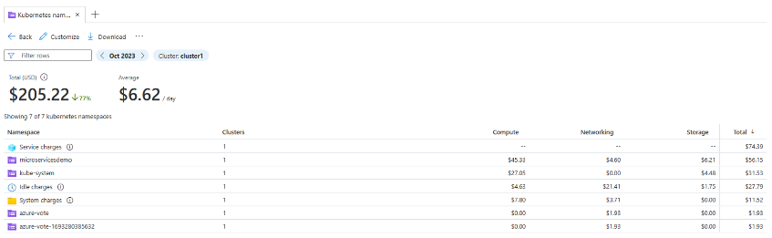
Compute Updates
Generally Available: AKS support for API breaking change detection
Azure Kubernetes Service (AKS) now supports fail fast on minor version change of Kubernetes cluster upgrades. This feature alerts with an error message if it detects usage of deprecated Kubernetes standard APIs in the intended goal version provided you are using the latest API version. Detecting the change at this stage saves time to spend time on post upgrade workload troubleshooting.
Public Preview: New AKS cost views for standard and premium tier clusters
It provides a granular visibility into Kubernetes costs in Cost analysis within Azure portal. It is now possible to view the aggregated costs for all clusters in a subscription and costs of all the namespaces for clusters.
All you need to do is to enable the AKS cost analysis add-on for your clusters. The AKS cost analysis add-on is built on top of OpenCost, an open-source Cloud Native Computing Foundation Sandbox project for usage data collection, which gets reconciled with your Azure billing data. Please refer to the articles below for installation of the add-on and accessing the views.
Public preview: Node autoprovision support in AKS
Azure Kubernetes Service (AKS) now supports Node autoprovision (NAP) in public preview. This feature will provision the right VMs for workloads based on the resources needed to efficiently allocate infrastructure. This greatly reduces the burden to design node pool configuration ahead of workloads being deployed. NAP also comes with consolidation, which efficiently reschedules your workloads on the right size of virtual machines greatly reducing running costs for your applications.

Slide 14
Compute Updates
Generally Available: Azure Functions support on Apple Silicon Macs
Azure Functions support for local development on Apple Silicon Macs is now generally available for Node.js, .NET, PowerShell, Python 3.8+, and Java 11 & 17.
GA: Azure SQL Trigger for Azure Functions
Azure SQL trigger for Azure Functions is now generally available.
Users can now build application logic in azure function apps which can be driven by the data from Azure SQL database. Azure SQL trigger for Azure Functions allows customers with nearly any SQL database enabled with change tracking to develop and scale event-driven applications using Azure Functions.
Invoking an Azure Function from changes to an Azure SQL table is now possible through the Azure SQL trigger for Azure Functions in Elastic Premium and Dedicated plans for Azure Functions supported languages.
Azure SQL trigger for Azure Functions will allow nearly any SQL database enabled with change tracking, to develop and scale event-driven applications using Azure Functions.
With input and output bindings for SQL already generally available, it is possible to quickly write Azure Functions that read and write from their databases, data can be input from a database to the function with an input binding and data can be output from the function to the database with an output binding.
Azure previews ND MI300X v5 optimized for demanding AI and HPC workloads
MS announced the Preview of ND MI300X v5 VMs.
ND MI300X v5 VMs are designed to tackle the most challenging AI and HPC workloads. They are powered by the AMD Instinct MI300X accelerator, which provides each VM with a staggering 1.5 TB of high bandwidth memory (HBM) and 5.2 TB/s of memory bandwidth. Moreover, these VMs are connected by NVIDIA Quantum-2 CX7 InfiniBand, which delivers 3.2Tb/s of scale out bandwidth per VM. This enables you to scale up to thousands of VMs and tens of thousands of GPUs. With ND MI300X v5 VMs, you can train and run the latest large language models (LLMs) faster and with fewer GPUs, saving you power, cost, and time.
ND MI300X v5 VMs are now available for preview and will soon become a standard offering in the Azure portfolio.

Slide 15
Compute Updates
New app attach features for Azure Virtual Desktop in public preview
New app attach functionality for Azure Virtual Desktop is now available in public preview and should roll out over the next few days. App attach has had a major re-work with new and exciting features. Here's a summary of the new capabilities in public preview:
Applications can now be assigned to any host pool or session host.
Applications can now be assigned per user, both within a desktop session and remote app sessions. This means that in any host pool in any session, users can be assigned different application combinations. This should reduce the number of host pools and images you require.
Applications are now assigned using the application itself. Application groups are no longer required to assign users to app attach apps, significantly simplifying assignment and reducing the number of application groups needed.
Application assignment, removal, and upgrades can be performed without needing a maintenance window and without interrupting a user's workflow.
Microsoft Entra ID support for app attach has been introduced, removing the pre-requisite for line of sight to a domain controller. Microsoft Entra Hybrid Join will still work as it did before.
Dependency support has improved, including modification packages for remote apps.
A migration script is available to move existing MSIX app attach application packages to the new architecture.

Slide 16
Compute Updates
Preview of Durable Functions Extension v3.0.0
There are two major changes introduced in this release: upgrading to the latest version of the Azure Storage SDK (a breaking change for .NET in-process apps) and the introduction of a new partition manager.
Partition Manager:
In the Azure Storage backend, an internal component known as the Partition Manager is responsible for distributing partitions/control queues among workers. Internally, this partition manager uses Azure Blob leases to determine which app instances own which control queue partitions. In the new v3 extension release, we’ve introduced a new partition manager (called Partition Manager V3) that uses Azure Tables to manage partition assignment instead of Azure Blob leases. This new design reduces storage costs, especially when using an Azure Storage v2 account, and is easier to debug compared to previous implementations.
When utilizing Partition Manager V3, a new Table named "Partitions" is introduced into your Durable Function App’s TaskHub. This Table stores and displays the current partition information, providing a clear view of your app’s activity for improved debuggability.

Slide 17
Databases

Slide 18
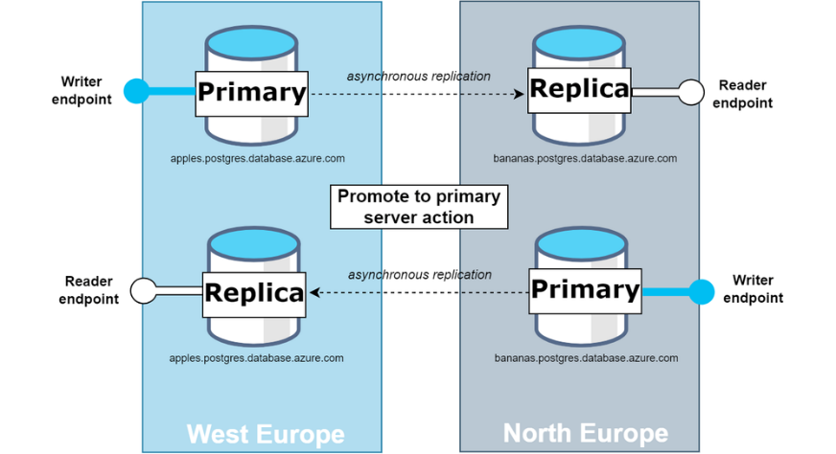
Databases Updates
Public Preview: Azure Database for PostgreSQL - Flexible Server, enhanced disaster recovery features
Promote replicas:
"Promote" refers to the process where a replica is commanded to end its replica mode and transition into full read-write operations.
Promotion of replicas can be done in two distinct manners:
Promote to primary server (preview): This action elevates a replica to the role of the primary server. In the process, the current primary server is demoted to a replica role, swapping their roles. For a successful promotion, it's necessary to have a virtual endpoint configured for both the current primary as the writer endpoint, and the replica intended for promotion as the reader endpoint. The promotion will only be successful if the targeted replica is included in the reader endpoint configuration, or if a reader virtual endpoint has yet to be established.
Promote to independent server and remove from replication: By opting for this, the replica becomes an independent server and is removed from the replication process. As a result, both the primary and the promoted server will function as two independent read-write servers. It should be noted that while virtual endpoints can be configured, they aren't a necessity for this operation.
Virtual Endpoints (preview) :
Virtual Endpoints are read-write and read-only listener endpoints, that remain consistent irrespective of the current role of the PostgreSQL instance. This means you don't have to update your application's connection string after performing the promote to primary server action, as the endpoints will automatically point to the correct instance following a role change.
Virtual Endpoints offer two distinct types of connection points:
Writer Endpoint (Read/Write): This endpoint always points to the current primary server.
Read-Only Endpoint: This endpoint can be configured by users to point either to a read replica or the primary server.

Slide 19
Databases Updates
Public Preview: Accelerated logs in Azure Database for MySQL - Flexible Server
The accelerated logs feature in Azure Database for My SQL – Flexible Server allows to boost the performance of servers in the Business-Critical service tier. Enable this feature to store server transactional logs on faster storage thereby enhancing throughput without incurring any extra cost.
Enhanced throughput: Experience up to 2x increased query throughput in high concurrency scenarios, resulting in faster query execution. This improvement also comes with reduced latency, reducing latency by up to 50%, for enhanced performance.
Cost efficiency: Accelerated logs provide enhanced performance at no extra expense, offering a cost-effective solution for mission-critical workloads.
Enhanced scalability: Accelerated logs can accommodate growing workloads, making it an ideal choice for applications that need to scale easily while maintaining high performance. Applications and services on the Business Critical service tier benefit from more responsive interactions and reduced query wait times.
Limitations
New primary servers created under the Business Critical service tier created after November 14 are eligible to use the accelerated logs feature.
During the preview phase, the accelerated logs are not supported feature on servers that have the following features enabled.
High Availability (HA) servers.
Servers enabled with Customer Managed Keys (CMK).
Servers enabled with Microsoft Entra ID authentication.
Performing a major version upgrade on Azure Database for MySQL flexible server with the accelerated logs feature enabled is not supported.
Accelerated logs feature in preview is currently available only in specific regions.
After the accelerated logs feature is activated, any previously configured value for the "binlog_expire_seconds" server parameter will be disregarded and not considered.

Slide 20
Databases Updates
Generally available: PostgreSQL 16 support in Azure Database for PostgreSQL – Flexible Server
MS Introduced the PostgreSQL 16 on Azure Database for PostgreSQL – Flexible Server. With this release, you will get a new experience enhanced logical replication capabilities, allowing for more efficient and reliable data synchronization across systems. Improve the performance and efficiency of your query execution, thanks to advanced optimizations in FULL and RIGHT joins, and refined plans for complex queries.
Furthermore, bulk data loading is now faster, with some operations showing up to a 300% speed increase, streamlining your data handling tasks. The enhancements in vacuum strategy also mean less need for full-table vacuums, making database maintenance smoother and more efficient.
Embrace this opportunity to elevate your database performance and reliability. Start exploring PostgreSQL 16 on Azure Database for PostgreSQL – Flexible Server today, and see how these advancements can transform your data management and analysis
General Availability: Connection audit logs for Enterprise tier caches for Azure Cache for Redis
Enterprise and Enterprise Flash tier caches for Azure Cache for Redis are able to log all connection, disconnection, and authentication events occurring on cache. This is a powerful tool for to monitor for any unauthorized usage of a cache resource, for instance by looking for unknown IP addresses connected to cache or for unsuccessful authentication attempts. Logging occurs on a separate thread to optimize performance, and logs can be sent to Azure Log Analytics, a storage account, an event hub, or even a partner solution.

Slide 21
Integration

Slide 22
Integration Updates
Azure Event Grid system topics support for resource management and health resources now in Public Preview
Azure Event Grid has created a new system topic for Azure health resources and resource management events.
This new system topic utilizes Azure Resource Notifications (ARN), which means you can now receive near real-time alerts in Event Grid regarding disruptions from a wide range of publishers, allowing to immediately begin mitigation activities.
Azure Resource Notifications (ARN) represent the cutting-edge unified pub/sub service catering to all Azure resources. ARN taps into a diverse range of publishers, and this wealth of data is now accessible through ARN's dedicated system topics in Azure Event Grid.

Slide 23
Miscellaneous

Slide 24
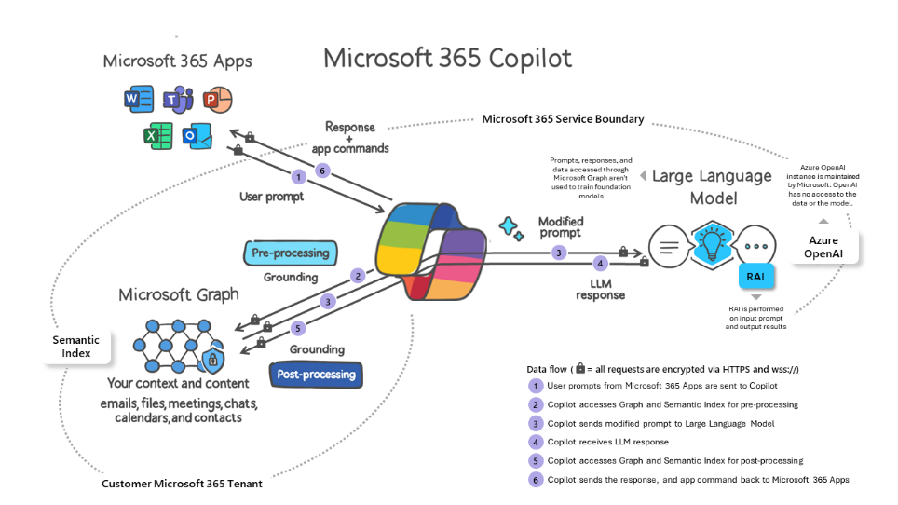
Miscellaneous Updates
Microsoft 365 App | Feature
Word | Draft with Copilot
 | Chat
PowerPoint | Draft with Copilot
 | Chat
 | Light commanding
Loop | Collaborative content creation
Outlook | Coaching tips
 | Summarize
 | Leverage content
Teams | Chat
 | Meetings
 | Business Chat
 | Whiteboard
OneNote | Draft with Copilot
Microsoft 365 Copilot is generally available
Microsoft 365 Copilot combines the power of large language models (LLMs) with your data in the Microsoft Graph, the Microsoft 365 apps, and the web to turn words into the most powerful productivity tool on the planet.
Copilot is covered by the Microsoft 365 product terms applicable to core online services, data protection addendum, and our commitments under the EU Data Boundary.
Copilot is currently supported in the following languages: English (US, GB, AU, CA, IN)​​, Spanish (ES, MX)​​, Japanese​​, French (FR, CA)​​, German​​, Portuguese (BR)​​, Italian​​, and Chinese Simplified​​.

Slide 25
Miscellaneous Updates
Azure support plan offer extended to June 30, 2024
The existing Azure Support offer is being extended. Beginning January 1, 2024, all new and renewing Azure customers who purchase an Enterprise Agreement (EA or EES) or are part of the field-led Microsoft Customer Agreement (MCA) will receive free Azure Standard support. Qualifications for the promotion will end on June 30, 2024.
This offer is designed for customers who buy Microsoft Azure services on an Enterprise Agreement. It provides an additional level of access to expert technical support from Microsoft to help customers with their cloud journey and comes at no additional charge.
GitHub Enterprise Server 3.11 is now generally available
Highlights of this version include:
Scale application security testing with code scanning’s default setup
The new Activity view makes viewing repository history much easier by showing activities like pushes, merges, force pushes, tag changes, and branch changes.
Prevent secret leaks with data-driven insights and new metrics on secret leak prevention in security overview
A GitHub CLI extension for the Manage GitHub Enterprise Server API to interact with your GitHub Enterprise Server instance via the gh command-line interface.

Slide 26
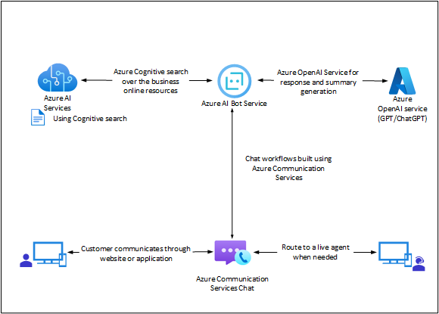
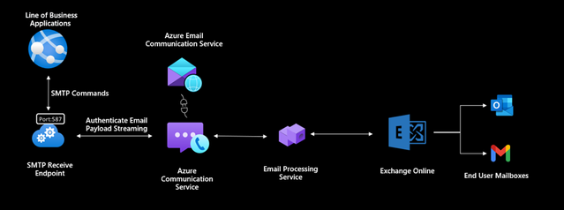
Miscellaneous Updates
Azure Communication Services December 2023 Feature Updates
Azure AI Bot Support in Chat Channel
Azure Communication Services chat integration with the Azure AI Bot Service is now generally available. This new capability enables developers to connect their conversational bots built on the Azure AI Bot Service to Azure Communication Services Chat. This new functionality will be especially helpful in customer service scenarios where bots can provide the first line of support.
Email SMTP as a Service
Azure Communication Services Email’s SMTP as a Service feature is now available in public preview. With SMTP support in Azure Communication Services, it is possible to easily send emails, enhance security features, and centralize control over outbound communications. As a bridge between email clients and mail servers, the SMTP Relay Service improves the effectiveness of email delivery. It creates a specialized relay infrastructure that not only meets the higher throughput requirements and successful email delivery but also enhances authentication to secure communication. Additionally, this service provides business with a centralized platform that gives them the power to manage outgoing emails for all B2C communications and gain insights into email traffic.

Slide 27
Information

Slide 28
Information
Azure Times GitHub Repo

Slide 29
Questions

