Slide 1
Azure Times #118
May 15, 2024

Slide 2
Networking

Slide 3
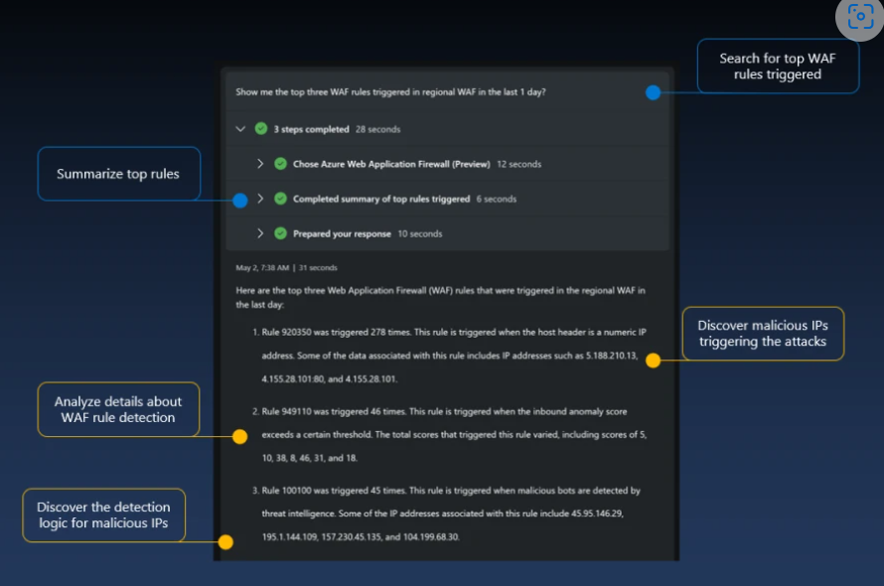
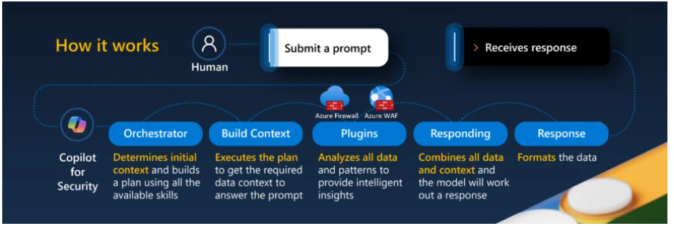
Networking Updates
Azure WAF and Azure Firewall Integration with Security Copilot
MS announced the Azure Web Application Firewall (WAF) and Azure Firewall integrations in the Microsoft Copilot for Security standalone experience. This is the first step to taking toward bringing interactive, generative AI-powered capabilities to Azure network security.

Slide 4
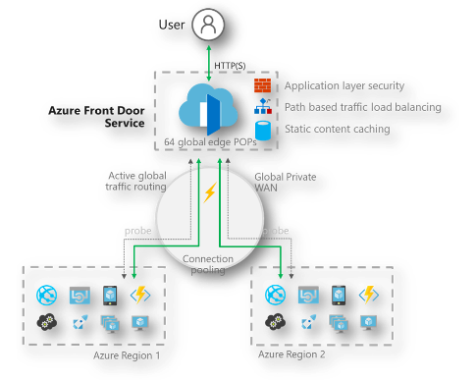
Networking Updates
Azure Front Door log scrubbing of sensitive data is general available
Azure Front Door log scrubbing tool helps to remove sensitive data (e.g. personal identifiable information) from Azure Front Door access logs. It works by enabling log scrubbing at Azure Front Door profile level and selecting the log fields to be scrubbed. Once enabled, the tool scrubs that information from logs generated under this profile and replaces it with “****”.
Normally, when a request is served by Azure Front Door, Azure Front Door logs the details of the request in clear text. Sensitive data might be included in the request URL (such as customer passwords), and client IP and socket IP are logged. These data are viewable by anyone with access to the Azure Front Door access logs. To protect customer data, you can set up log scrubbing rules targeting this sensitive data for protection.

Slide 5
Security & Identity

Slide 6
Security & Identity Updates
Platform SSO for macOS now in public preview
MS announced that Platform SSO for macOS is available in public preview with Microsoft Entra ID. Platform SSO is an enhancement to the Microsoft Enterprise SSO plug-in for Apple devices that makes usage and management of Mac devices more seamless and secure.
At the start of public preview, Platform SSO will work with Microsoft Intune. Additional mobile device management (MDM) providers will be added during the public preview.
MS introduced Microsoft Entra Join for macOS. This feature uses the Enterprise SSO plug-in to create a hardware-bound device record in Entra ID. Entra Join requires the use of an Entra ID organizational account:
Passwordless authentication with Secure Enclave
Passwordless authentication with smart cards
Password synchronization with the local account
Defender Vulnerability Management
Starting May 1st, MS introduced unified vulnerability assessment, and as a part of this Defender for Cloud will now exclusively offer Microsoft Defender Vulnerability Management as its primary scanner across servers and containers.
It provides:
Consistency
Efficiency
Cost-Effective
Seamless Integration
Coverage
Rich Metadata
Compliance

Slide 7
Management & Governance

Slide 8

Management & Governance Updates
General Availability: Microsoft Azure now available from new cloud region in Mexico
The first cloud region in Mexico is now available with Azure Availability Zones and provides organizations across the globe with access to scalable, highly available, and resilient Microsoft Cloud services while confirming its commitment to promoting digital transformation and sustainable innovation in the country. The Mexico Central region connects Mexico to the largest and trusted global cloud infrastructure, delivering the highest standards of security, privacy and regulatory-compliant data storage in the country.
Generally available: Automation Update Management to Azure Update Manager migration tool
Azure Automation Update Management will be deprecated on 31st August 2024 as the Log Analytics agent it uses, also known as the Microsoft Monitoring Agent (MMA), will be retired. Therefore, it is recommended to move to Azure Update Manager before 31st August 2024.
Methods to move from Automation Update Management to Azure Update Manager:
First Method: Using automated migration tool (GA)
Second Method: Using automated migration scripts
Third method: Using manual migration guidance:

Slide 9
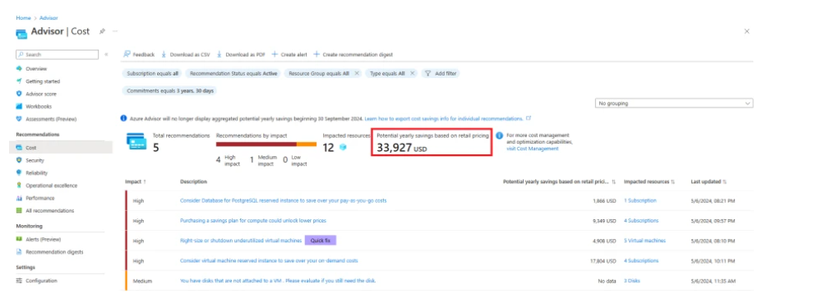
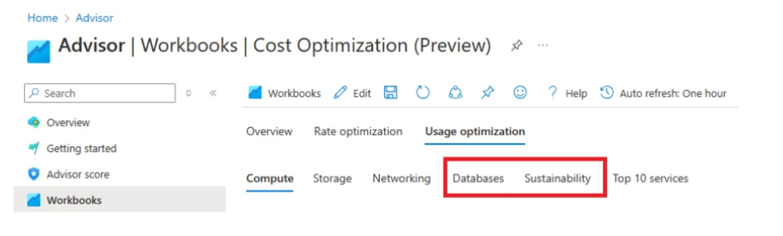
Management & Governance Updates
Azure Advisor Label Removal
In the Azure portal, Azure Advisor currently shows potential aggregated cost savings under the label “Potential yearly savings based on retail pricing” on pages where cost recommendations are displayed (as shown in the image below.
Cost Management Updates
Savings plan role-based access control roles
Azure savings plan for compute allows organizations to lower eligible compute usage costs by up to 65% (off listed pay-as-you-go rates) by committing to an hourly spend for 1 or 3 years. It provides now four new role-based access control roles:
Savings plan administrator
Savings plan purchaser
Savings plan contributor
Savings plan reader
Cost optimization workbook update
Two additional insights: databases and sustainability

Slide 10
Compute

Slide 11
Compute Updates
Generally Available: Azure Red Hat OpenShift v4.14 at install time
Azure Red Hat OpenShift version 4.14 is now available at install time.
Azure Red Hat OpenShift provides highly available, fully managed OpenShift clusters on demand, and is monitored and operated jointly by Microsoft and Red Hat.
GA: Support for disabling Windows outboundNAT in AKS
Windows OutboundNAT can cause certain connection and communication issues with AKS pods. An example issue is node port reuse. In this example, Windows OutboundNAT uses ports to translate pod IP to Windows node host IP, which can cause an unstable connection to the external service due to a port exhaustion issue.
Windows enables OutboundNAT by default. It is now possible to manually disable OutboundNAT when creating new Windows agent pools.

Slide 12
Compute Updates
New version of AKS extension in Visual Studio Code now available
The AKS extension in Visual Studio Code has been updated to version 1.4.3. This new release includes general enhancements as well as a new command “Retina capture”. Retina capture uses Retina, a cloud-agnostic, open-source eBPF network observability tool to help capture logs such as iptables-rules.
Public preview: Initialization taints in AKS
Taints are a Kubernetes node property that allows nodes to accept or reject pods for scheduling based on specific criteria. There are two types of taints that can be applied to AKS nodes.
Node taints: These are meant to remain permanently on the node for scheduling pods with node affinity. Node taints can only be removed completely using the AKS API.
Node initialization taints: Now available in preview, initialization taints are meant to be used temporarily, for example in scenarios where it might be needed to have extra time to setup nodes. Ideally, they should be removed shortly after applying them. Node initialization taints can be removed using the Kubernetes API, but they will reappear after scaling or upgrades.
Once the initialization taints are removed from cluster spec using AKS API, newly created nodes after reimage operation will no longer have initialization taints
The Impact of RedHat Linux 7 Extended Life Cycle Support on Azure Guest Patching Customers
RedHat announced that Linux 7 will enter the Extended Life Cycle Support (ELS) phase beginning from July 1, 2024. Initially slated for deprecation, RedHat is allowing customers to remain on RedHat Enterprise Linux 7.9 minor version with the ability to purchase an ELS Add-on for their subscriptions to receive security updates and technical support.

Slide 13
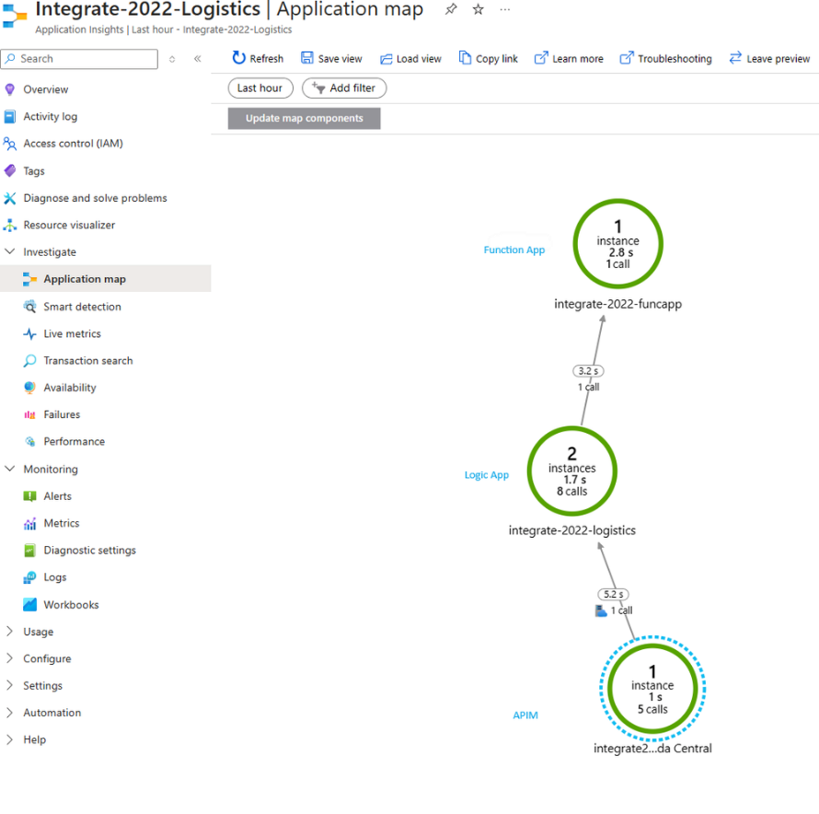
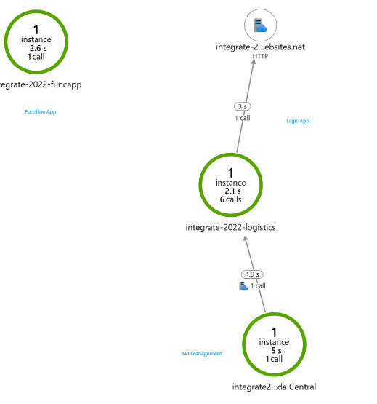
Compute Updates
Application Insights for Azure Logic Apps (Standard) - Correlation Tracking Update
MS introduce a new feature flag that will modify the default behavior of passing correlation between Azure services and Logic Apps when tracking data using Application Insights v2. The feature allows to control the Operation Id that gets emitted to Application Insights V2. The default behavior is to store the workflow's Run Id in the operation_id field. The impact of this default behavior is that it can lead to additional complexity when trying to correlate events across other services like API Management and Azure Functions.

Slide 14
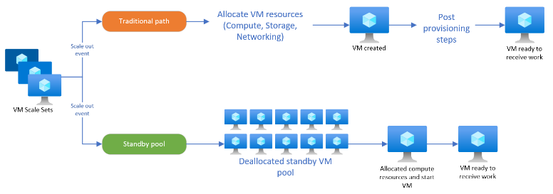
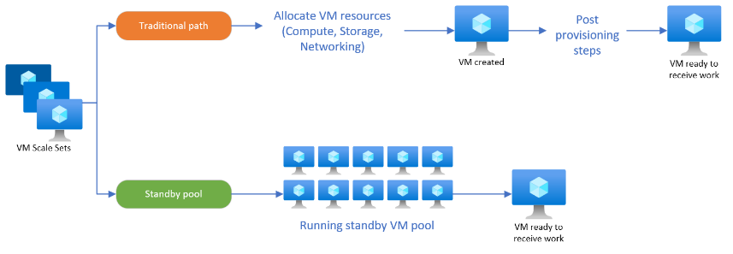
Compute Updates
Public preview: Standby pools for Virtual Machine Scale Sets with flexible orchestration
Standby pools for Virtual Machine Scale Sets with flexible orchestration enables you to increase scaling performance by creating a pool of pre-provisioned virtual machines from which the scale set can draw from when scaling out.
Standby pools reduce the time to scale out by performing various initialization steps such as installing applications/ software or loading large amounts of data. These initialization steps are performed on the virtual machines in the standby pool before to being put into the scale set.
The number of virtual machines in a standby pool is calculated by the max ready capacity of the pool minus the virtual machines currently deployed in the scale set. When your scale set scales back down, the instances are deleted from your scale set based on the scale-in policy you have configured and your standby pool will refill to meet the max ready capacity configured.
Virtual machine instances in the standby pool can be kept in a running or a deallocated state. Using virtual machines in a running state is recommended when latency and reliability requirements are strict. Deallocated virtual machines are shut down and keep any associated data disks, NICs, and static IPs. Using a standby pool with virtual machines in the deallocated state is a great way to reduce the cost while keeping your scale-out times fast.
The virtual machines in the standby pool can be kept in a running or deallocated state.
Deallocated: Deallocated virtual machines are shut down and keep any associated disks, network interfaces, and any static IPs. Ephemeral OS disks don't support the deallocated state.
Running: Using virtual machines in a running state is recommended when latency and reliability requirements are strict. Virtual machines in a running state remain fully provisioned.

Slide 15
Storage & Data

Slide 16
Storage & Data Updates
Public Preview: Azure Storage Actions is now available in 14 more regions
Azure Storage Actions is a fully managed platform that helps to automate data management operations for Azure Blob Storage and Azure Data Lake Storage. Combining serverless infrastructure with a no-code experience, Azure Storage Actions offers a high-performance, cost-effective, and reliable solution that automatically scales to your data management needs.
Azure Storage Actions is now open for preview in the following public Azure regions:
Australia East
Australia Southeast
Brazil South
Canada Central
Central India
Central US
France Central
Germany West Central
North Central US
North Europe
South Central US
Southeast Asia
Switzerland North
West Europe
West US
West US 2
Azure Ultra Disk Storage is now available in Italy North
Azure Ultra Disk Storage is now available in Italy North. Azure Ultra Disk Storage offers high throughput, high IOPS, and consistent low latency disk storage for Azure virtual machines (VMs). Ultra Disk Storage is suited for data-intensive workloads such as SAP HANA, top-tier databases, and transaction-heavy workloads.

Slide 17
Storage & Data Updates
Public Preview: NFS Azure Files volume mount support in Azure Container Apps
Azure Container Apps now supports mounting Network File System (NFS) Azure Files volumes to containerized applications. This feature is in public preview. NFS Azure Files volumes provide a scalable and high-performance file system for apps and jobs. It is now possible to use NFS Azure Files volumes to share data between multiple containers in application, or to persist data across container restarts.

Slide 18
Databases

Slide 19
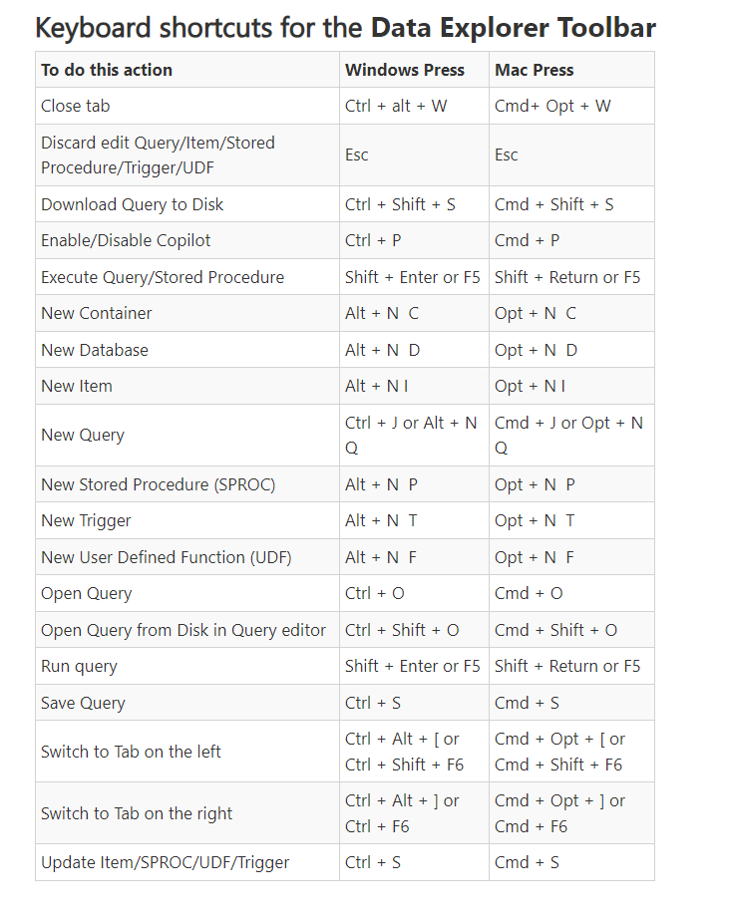
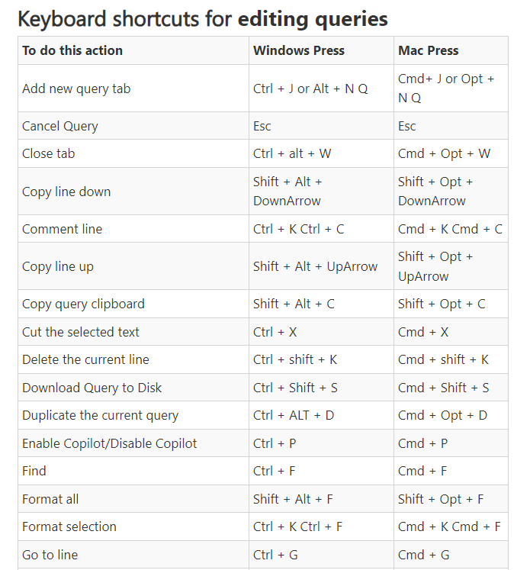
Databases Updates
General availability: Azure Cosmos DB API for MongoDB RU supports version 5.0 and 6.0
Azure Cosmos DB for MongoDB RU now supports MongoDB versions 5.0 and 6.0, offering expanded coverage for MongoDB. Developers can now integrate higher MongoDB versions into their applications. Stay updated with the latest enhancements and ensure compatibility with projects. Upgrade to MongoDB 5.0 and 6.0 for a smoother development journey. Enhance your applications and keep pace with the evolving technology.
General Availability: Azure Cosmos DB Data Explorer keyboard shortcuts
Maximize efficiency in Azure Cosmos DB Data Explorer with our new keyboard shortcuts. Navigate and manage databases with increased speed, without the need for a mouse. This update brings a streamlined workflow, allowing to execute tasks with simple key combinations. Whether executing a query or creating a new container, our intuitive shortcuts will save time and enhance productivity. The worry of losing progress by accidentally hitting F5 is now a thing of the past.

Slide 20
Databases Updates
General availability: Latest PostgreSQL minor versions supported by Azure Database for PostgreSQL - Flexible Server
PostgreSQL minor versions 16.2, 15.6, 14.11, 13.14, and 12.18 are now supported by Azure Database for PostgreSQL – Flexible Server.
These minor version upgrades are automatically performed as part of the monthly planned maintenance in Azure Database for PostgreSQL – Flexible Server. This upgrade automation ensures that your databases are always running on the most secure and optimized versions without requiring manual intervention. This release fixes two security vulnerabilities and over 40 bugs.
General availability: Latest version of the TimeScaleDB extension on Azure Database for PostgreSQL - Flexible Server
The latest version of TimeScaleDB is now fully available on Azure Database for PostgreSQL - Flexible Server, bringing enhanced features and improved performance for handling time-series data. This update offers advanced capabilities such as more efficient data partitioning, faster query responses, and improved support for complex analytical queries. Additionally, the new version includes better compatibility with PostgreSQL, ensuring a seamless integration and a robust environment for managing large-scale time-series workloads. Upgrade today to leverage the enhanced functionality and performance optimizations of the latest TimeScaleDB extension.

Slide 21

Databases Updates
General availability: Customer-managed keys on existing accounts
MS announced that possibility to enable Customer Managed Keys (CMK) on existing Azure Cosmos DB accounts. This eliminates the need to migrate data to a new account to enable CMK.
This release follows the existing ability to enable a second layer of encryption for data at rest using CMK while creating a new Azure Cosmos DB account.
Consideration / Limitations
Enabling CMK will kick off a background, asynchronous process to encrypt all the data.
Data encryption using CMK cannot be reversed. Data encryption happens in batches.
Enabling CMK is available only at a Cosmos DB account level and not at collections.
MS does not support enabling CMK on existing Azure Cosmos DB for Apache Cassandra accounts.
Existing accounts that are enabled for Materialized Views and Full Fidelity Change Feed (FFCF) are presently not supported for CMK.

Slide 22
Databases Updates
Public Preview: SQL Server on Azure VM storage configuration deployment experience with support for Premium SSD v2
Premium SSD v2 enhances SQL Server workloads on Azure Virtual Machines by delivering higher IOPS and throughput, with capabilities of up to 80,000 IOPS and 1,200 MB/s for a single disk, ensuring consistent sub-millisecond latency. This next-generation storage solution is tailored for performance-sensitive workloads. It provides increased flexibility and cost efficiency with precise provisioning of disk sizes, IOPS, and throughput to align with specific workload demands.
In the SQL Server on Azure Virtual Machine portal experience, you can easily provision storage to your specifications. The complexities of constructing an optimized storage pool are seamlessly managed behind the scenes simplifying your experience when provisioning storage for SQL Server on Azure Virtual Machines.

Slide 23
Integration

Slide 24
Integration Updates
General Availability - Azure API Center
Azure API Center is now generally available, providing a centralized solution to manage the challenges of API sprawl, which is exacerbated by the rapid proliferation of APIs and AI solutions. Azure API Center offers a unified inventory for seamless discovery, consumption, and governance of APIs, regardless of their type, lifecycle stage, or deployment location.
Key features of Azure API Center
API Inventory Management
API Cataloging for Azure API Management
API Design Governance
API Reusability
API Development Enhancement

Slide 25
ML & AI & IOT

Slide 26
ML & AI & IOT Updates
Announcing the General Availability of GPT-4 Turbo with Vision on Azure OpenAI Service
MS announced the general availability of GPT-4 Turbo with Vision on the Azure OpenAI Service, which processes both text and image inputs and replaces several preview models. This multimodal model has already been used by customers in various industries to enhance efficiencies and innovate, with case studies to be featured at the upcoming Build conference. For deployment details and future enhancements, including JSON mode and function calling for image inputs, please refer to our Azure OpenAI Service resources and updates.

Slide 27
DevOps & IaC & Automation

Slide 28
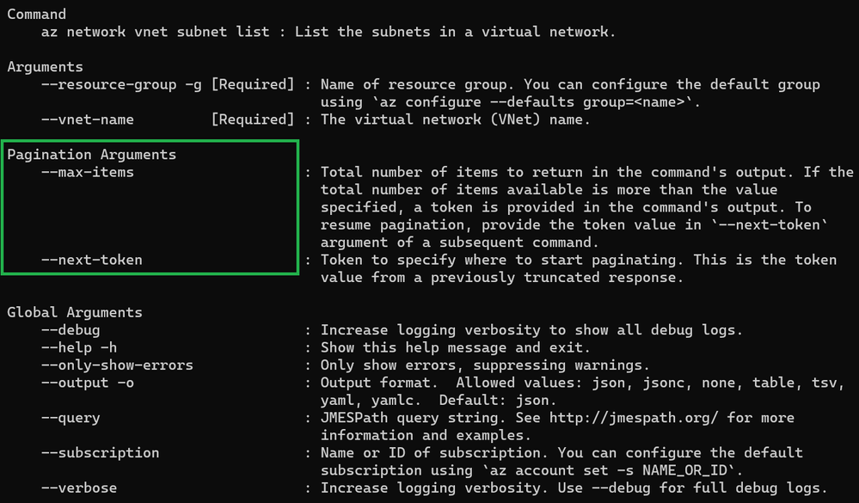
DevOps & IaC & Automation
Azure DevOps Server 2022 Update 2 RC now available
MS announced the release candidate (RC) of Azure DevOps Server 2022.2!
This release includes new features that have been previously released in hosted version of the product. Here are a few of the highlights:
Limits for area and iteration paths
Bypass approvals and checks in pipelines
Improved YAML validation
Azure Artifacts support for Cargo Crates
New Dashboard directory experience
Quick Copy and import for Test Plan or Suite ID
Demystifying Azure CLI pagnination
Pagination in the context of the command line refers to the process of displaying long lists of information or text in a way that makes it more manageable for the user. When a command is run it can generate a large amount of output, such as a directory listing or the contents of a file, it may not all fit on the screen at once. Pagination allows to view the information one screenful (or page) at a time.

Slide 29
DevOps & IaC & Automation
Terraform on Azure May 2024 Update
AzureRM provider
Support for Key Vault reference secrets in Container Apps (v3.98)
Support for Configuring Tables in Log Analytics (v3.86)
Fixing a bug with Linux function apps breaking when losing external WEBSITE_RUN_FROM_PACKAGE setting...
Fixed a bug with App Service Certificates being unable to determine Key Vault Resource ID (v3.95)
Support for .NET 8.0 and Node 20 for Linux and Windows Function Apps (v3.96)
Fixed a bug with PIM Active and Eligible Role Assignments
Support for Customer Managed Keys with Managed HSM for Key Vault (v3.102.0)
Support for CMKs with MHSM for Storage Accounts (v3.102.0)
AzAPI provider
TF announced the release of AzAPI v1.13.1, which removes JSON through the implementation of dynamic schemas. Previously, AzAPI required JSON encoding and decoding to define properties within the body. The JSON has been replaced with dynamic schemas, which are defined the exact same way as before:
Azure Verified Modules - The following Terraform modules have been released in February through April:
Kusto Clusters
Service Bus Namespace
Azure Databricks Workspace
Private DNS Zone
App Managed Environment
AVS Private Cloud
Cognitive Service
Virtual Machine Scale Set
Azure Container Registry
Bastion Host
Network Security Group
Public IP Address
Storage Account
Web/Function App
Static Web App

Slide 30
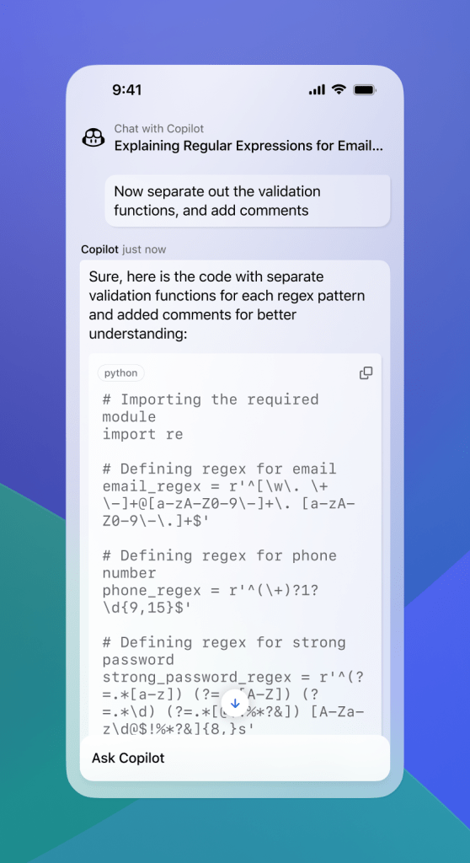
DevOps & IaC & Automation
GitHub Copilot Chat in GitHub Mobile is now generally available
Developers are constantly coming up with new ideas, exploring new skills, and collaborating with other developers on work and personal projects. Developers increasingly use their mobile devices to learn, understand, and perform important tasks in the software development process.
GitHub Team making that easier than ever, empowering developers to build in natural language with the general availability of GitHub Copilot Chat for GitHub Mobile.
With GitHub Copilot Chat natively integrated with GitHub Mobile, developers can access their AI coding assistant to get answers for all their coding questions, or even repositories and knowledge bases, from anywhere they use mobile devices.

Slide 31
Miscellaneous

Slide 32
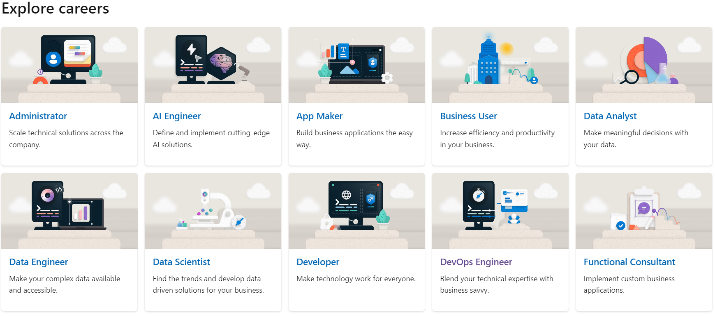
Miscellaneous Updates
Plans on Microsoft Learn
MS Introduced Plans on Microsoft Learn, which help learners, teams, and organizations accelerate the achievement of their learning goals using curated sets of content combined with milestones and automated nudges to keep learners focused and motivated. With Plans, it is possible to progress through carefully structured curricula to build new skills, making the most of the high-quality content on Microsoft Learn. Experts who are familiar with Microsoft technology can create new Plans
Key features of Plans include:
Learning outcomes. Clear learning outcomes specify the skills that a Plan is designed to help build.
Milestones of content. Thoughtfully created milestones of Microsoft Learn content across a wide variety of training and resources, along with the recommended number of days to complete them.
Optional email prompts. These reminders help keep learners on track with their skill-building goals (for learners who opt in to receive emails from Microsoft Learn).
Tracking and reporting. Plan creators and team leads can invite individuals or groups of learners to work through a Plan that includes progress tracking and reporting.

Slide 33
Miscellaneous Updates
Five Azure classic networking services will be retired on 31 August 2024
To avoid service disruptions, follow the guidance to migrate your resources that use these classic networking services to Azure Resource Manager by 31 August 2024:
Classic Application Gateway
Classic Virtual Network
Classic reserved IP addresses
Classic ExpressRoute Gateway
Classic VPN gateway
Cloud Services (classic) deployment model is retiring on 31 August 2024
On 31 August 2024, we’ll retire the Cloud Services (classic) deployment model. Before that date, it is required to migrate services that were deployed using this model to Cloud Services (extended support) in Azure Resource Manager

Slide 34
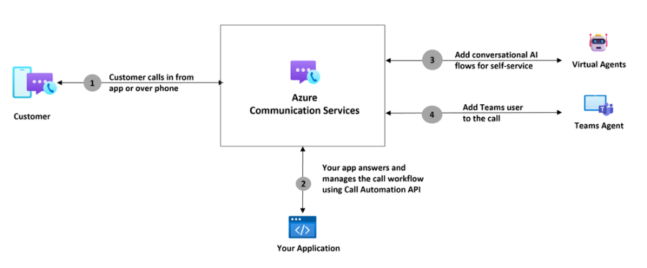
Miscellaneous Updates
Azure Communication Services May 2024 Feature Updates
This month’s updates:
Business-to-consumer extensibility with Microsoft Teams for Calling
Image Sharing in Teams meetings
Deep Noise Suppression Desktop
Updated Calling native SDKs for Android, iOS, and Windows
Updated Calling native UI Library for Android and iOS

Slide 35
Information

Slide 36
Information
Azure Times GitHub Repo
Azure Times Telegram

Slide 37
Questions

