Slide 1
Azure Times #131
August 23, 2024

Slide 2
Networking

Slide 3
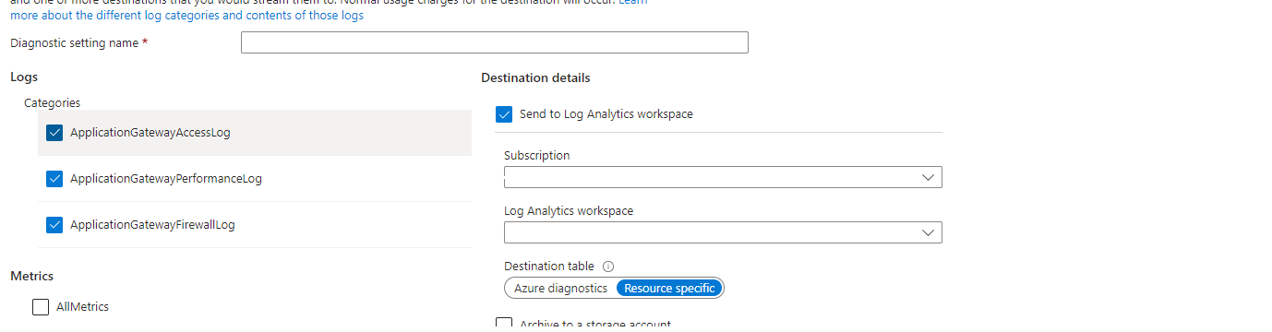
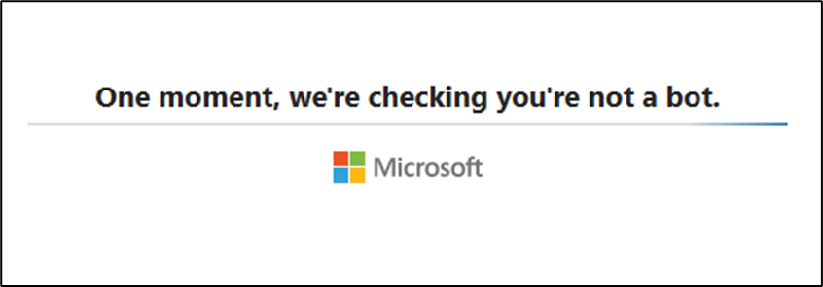
Networking Updates
Generally Available: Dedicated log analytics tables in Application Gateway
Application Gateway now offers general availability for storing logs in a dedicated log analytics table.
In resource specific mode, individual tables in the selected workspace are created for each category selected in the diagnostic setting. This new mode helps with better log querying capabilities along with a reduction in ingestion latencies and query times.
Public Preview: JavaScript (JS) Challenge on Azure WAF integrated with Azure Front Door
Azure Web Application Firewall (WAF) integrated with Azure Front Door now supports JavaScript (JS) challenge. Azure WAF JS challenge is available as a new mitigation action as part of the Bot Manager rule set and custom rules. The JavaScript challenge is an invisible web challenge used to distinguish between legitimate users and bots. Malicious bots fail the challenge, which protects web applications. In addition, the JavaScript challenge is beneficial as it reduces friction for legitimate users. This is because it doesn't require any human intervention.

Slide 4
Security & Identity

Slide 5
Security & Identity Updates
Generally Available: Enable multifactor authentication for your tenant by 15 October 2024
Starting 15 October 2024, MS will require users to use multifactor authentication (MFA) to sign into the Azure portal, Microsoft Entra admin center, and Intune admin center.
All users who sign into the applications listed previously to perform any Create, Read, Update, or Delete (CRUD) operation will require MFA when the enforcement begins.
Workload identities, such as managed identities and service principals, aren't impacted by MFA enforcement.
Break glass or emergency access accounts are also required to sign in with MFA once enforcement begins. MS recommend updating these accounts to use passkey (FIDO2) or configure certificate-based authentication for MFA. Both methods satisfy the MFA requirement.
Application Name | App ID | Enforcement phase
Azure portal | c44b4083-3bb0-49c1-b47d-974e53cbdf3c | Second half of 2024
Microsoft Entra admin center | c44b4083-3bb0-49c1-b47d-974e53cbdf3c | Second half of 2024
Microsoft Intune admin center | c44b4083-3bb0-49c1-b47d-974e53cbdf3c | Second half of 2024
Azure command-line interface (Azure CLI) | 04b07795-8ddb-461a-bbee-02f9e1bf7b46 | Early 2025
Azure PowerShell | 1950a258-227b-4e31-a9cf-717495945fc2 | Early 2025
Azure mobile app | 0c1307d4-29d6-4389-a11c-5cbe7f65d7fa | Early 2025
Infrastructure as Code (IaC) tools | Use Azure CLI or Azure PowerShell IDs | Early 2025

Slide 6
Management & Governance

Slide 7
Management & Governance Updates
Generally Available: Cross Region Restore of SQL and HANA database backups from a vault with Private Endpoints enabled
Azure Backup users can now perform Cross-Region Restore (CRR) of SQL and HANA backups if the vault has private endpoints enabled. It is possible to create Secondary Private Endpoints in the vault and initiate CRR to the secondary region.
Maximum of 12 Azure Backup Secondary Private Endpoints to a vault is supported.
Generally Available: Azure Policy support for Azure Database for PostgreSQL - Flexible Server
MS announced Azure Policy support for Azure PostgreSQL - Flexible Server. This new feature helps enforce rules and check compliance easily across Azure resources. With Azure Policy, it is possible to set, assign, and manage rules that apply to Azure Database for PostgreSQL - Flexible Server instances. This support makes it easier to maintain governance, improve security, and have better control over your databases. You can use built-in policies from Microsoft or create your own custom policies to fit your needs.
A Microsoft Entra administrator should be provisioned for PostgreSQL flexible servers
Auditing with PgAudit should be enabled for PostgreSQL flexible servers
Connection throttling should be enabled for PostgreSQL flexible servers
Deploy Diagnostic Settings for PostgreSQL flexible servers to Log Analytics workspace
Disconnections should be logged for PostgreSQL flexible servers
Enforce SSL connection should be enabled for PostgreSQL flexible servers
Geo-redundant backup should be enabled for Azure Database for PostgreSQL flexible servers
Log checkpoints should be enabled for PostgreSQL flexible servers
Log connections should be enabled for PostgreSQL flexible servers
PostgreSQL FlexIble servers should use customer-managed keys to encrypt data at rest
PostgreSQL flexible servers should be running TLS version 1.2 or newer
Private endpoint should be enabled for PostgreSQL flexible servers

Slide 8
Management & Governance Updates
ArcBox 3.0 General Availability
Cost reduction on all three flavors of ArcBox
Automatic Logon to the Client VM - no need for the user to interactively log in to ArcBox Client VM anymore for the Jumpstart automation to complete.
Enchanted security posture by removing the Service Principal Names (SPN) user requirement in favor of Managed Identity at deployment time.
Switching from Chocolatey to WinGet as the solution package manager.
PowerShell 7 is now the default scripting language for running our automation scripts, allowing us to host modern features and improvements that significantly enhance the efficiency, performance, and reliability of our automation processes compared to the traditional Windows PowerShell.
PowerShell 7 also introduces several performance enhancements, including the Foreach-Object -Parallel command, which enables parallel execution of script blocks.
Introducing Declarative Configurations based on PowerShell Desired State Configuration (DSC) for more reliable and consistent automation.
Introducing a new set of comprehensive Integration tests for infrastructure validation using Pester.
Added modularization functionalities for the Logon-Script with PowerShell modules, allowing for an easier contribution and troubleshooting experiance.
ArcBox now includes sample Bicep parameter files, replacing former JSON parameter files, for a more streamlined and readable infrastructure-as-code experience. Bicep parameters simplify the creation and management of Azure Resource Manager templates, making infrastructure-as-code more intuitive and less error-prone.
Updates Windows and Ubuntu VHD images.
Azure Update Manager experience.
Modernized Azure Monitor Workbooks for enhanced monitoring and visualization capabilities for IT professionals
PowerShell remoting over SSH is available for Windows and Linux machines.
SSH for Arc-enabled servers - SSH-based PowerShell remoting connections to Arc-enabled servers without requiring a public IP address or additional open ports.
SSH Posture Control (auto configure via Azure Policy) - audit and configure SSH Server security posture on supported Linux distros including Ubuntu, Red Hat, Azure Linux, and more.

Slide 9
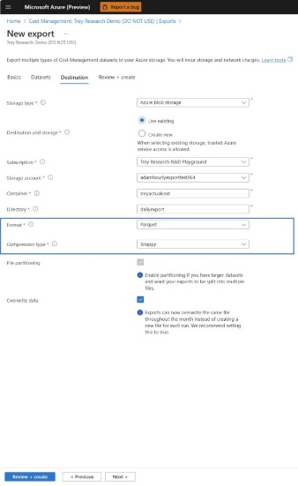
Cost Management updates
Exports enhancements
Parquet format support - Parquet is an open-source, columnar storage file format designed for efficient data processing and analytics. It offers several benefits over traditional formats like Comma-Separated Values (CSV)
File compression – it now possible to compress CSV files using GNU ZIP (GZIP) and parquet files using Snappy.
Fabric ingestion – MS added new documentation to make it easy to ingest exported costs datasets into new or existing Fabric workspaces

Slide 10
Compute

Slide 11
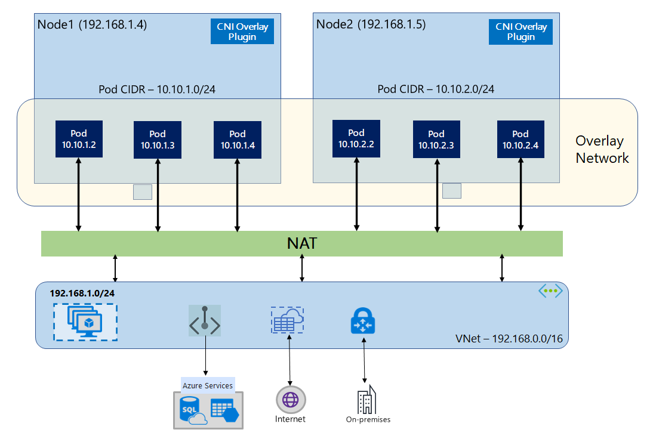
Compute Updates
Public Preview: Azure CNI overlay Windows support in AKS
Azure CNI Overlay dual-stack support for Windows nodepools in AKS is now in public preview. This new capability allows AKS clusters to support dual-stack IPv4 and IPv6 network configurations on Windows nodes, enhancing flexibility and control over network traffic within your Kubernetes environments.
You can't use Application Gateway as an Ingress Controller (AGIC).
Virtual Machine Availability Sets (VMAS) aren't supported.
You can't use DCsv2-series virtual machines in node pools. To meet Confidential Computing requirements, consider using DCasv5 or DCadsv5-series confidential VMs instead.
If you're using your own subnet to deploy the cluster, the names of the subnet, VNet, and resource group containing the VNet, must be 63 characters or less. These names will be used as labels in AKS worker nodes and are subject to Kubernetes label syntax rules.
Generally Available: New features in AKS extension for Visual Studio Code
The Azure Kubernetes Service (AKS) Visual Studio Code extension has been updated to support the ability to attach an ACR to cluster, generate Kubernetes deployment files, generate dockerfiles and generate GitHub Actions.

Slide 12
Compute Updates
Public Preview: Azure CNI Powered by Cilium & Azure CNI Overlay support in AKS
Public preview of Azure CNI Overlay dual-stack with Azure CNI powered by Cilium for Linux clusters in AKS is now available.
This enhancement enables AKS clusters to support IPv4 and IPv6 network policies, providing greater flexibility and control over network traffic within Kubernetes environments.
Additionally, Azure CNI powered by Cilium offers improved performance with its efficient dataplane, enhancing the overall networking performance of your workloads.
Available only for Linux and not for Windows.
Cilium L7 policy enforcement is disabled.
Hubble is disabled.
Network policies cannot use ipBlock to allow access to node or pod IPs. See frequently asked questions for details and recommended workaround.
Incompatible with Microsoft Entra pod-managed identities (aad-pod-identity). Use Microsoft Entra Workload ID instead.
Public Preview: FIPS mutability support in AKS
Azure Kubernetes Service (AKS) allows to create Linux and Windows node pools with FIPS 140-2 enabled. Deployments running on FIPS-enabled node pools can use those cryptographic modules to provide increased security and help meet security controls as part of FedRAMP compliance.
With FIPS mutability, it is possible to enable or disable FIPS on an existing node pool. When you update an existing node pool, the node image will change from the current image to the recommended FIPS image of the same OS SKU. This will immediately trigger a reimage. When migrating your application to FIPS, first validate that your application is working properly in a test environment before migrating it to a production environment.
FIPS-enabled node pools have the following limitations:
FIPS-enabled node pools require Kubernetes version 1.19 and greater.
To update the underlying packages or modules used for FIPS, you must use Node Image Upgrade.
Container images on the FIPS nodes haven't been assessed for FIPS compliance.
Mounting of a CIFS share fails because FIPS disables some authentication modules.

Slide 13
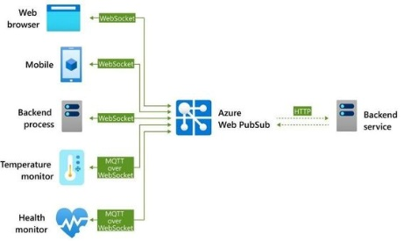
Compute Updates
.NET 9 Preview 6 now available on App Service
MS announced that App Service now supports apps targeting .NET 9 Preview 6 across all public regions on Linux App Service Plans. Deployment is underway, and it will be available for Windows App Service plans soon
Azure Red Hat OpenShift Now Supports 250 Nodes
Azure Red Hat OpenShift (ARO) is a fully managed Red Hat OpenShift service on Azure. MS announced two significant enhancements to ARO's capabilities:
The ability to configure multiple IP addresses per cluster load balancer is now generally available.
ARO clusters can now scale up to 250 worker nodes.
Previously, ARO clusters were limited to 62 worker nodes due to having only one IP (Internet Protocol) address associated with the cluster's load balancer. By enabling multiple IP addresses for the load balancer, MS has removed this bottleneck, offering organizations greater flexibility in expanding their deployments.
These enhancements significantly improve the scalability and adaptability of ARO public clusters, empowering organizations to scale their infrastructure more effectively. Our goal is to support even larger clusters, providing robust solutions for enterprises with extensive computational requirements. In this blog post, we will delve into the specifics of deploying large ARO clusters, explore a real-world use case, and provide essential information to help you get started with this powerful new capability
Announcing MQTT Support in Azure Web PubSub Service (public preview)
MQTT (Message Queuing Telemetry Transport) is a lightweight, pub/sub messaging protocol designed specifically for low-bandwidth, high-latency, or unreliable networks. It's an ideal choice for IoT (Internet of Things) devices and other scenarios where resources are limited. Development teams even build chat apps using MQTT protocol.
Now, with Azure Web PubSub’s support for MQTT, you can connect clients running on WebSocket protocol or MQTT (over WebSocket) without worrying about scalability. Better yet, these clients can cross-communicate with each other despite the different protocols used, making it an ideal architectural solution if an application has mixed clients.

Slide 14
Compute Updates
Public Preview: Instance Mix on Virtual Machine Scale Sets
MS announced the public preview of Instance Mix, a new feature designed to optimize Virtual Machine Scale Set (VMSS) deployments. Instance Mix allows to specify multiple VM sizes within a single Virtual Machine Scale Set (VMSS), providing greater flexibility and cost efficiency. To further optimize deployments, Instance Mix allows you to specify an allocation strategy to optimize price or capacity.
Key Features
Flexible VM Combinations: Mix and match various VM sizes within a single VMSS to better align with your workload requirements.
Cost Optimization: Achieve cost savings by utilizing smaller VMs for less demanding tasks while reserving larger VMs for more intensive processes. Further, utilize the lowestPrice allocation strategy to let
Simplified Management: Manage a diverse set of VMs under one VMSS, reducing the complexity of handling multiple scale sets.
Enhanced Performance: Optimize performance by allocating the right VM size to the right task, ensuring efficient resource utilization.
Announcing General Availability of Attach & Detach of Virtual Machines on Virtual Machine Scale Sets
Now you have the ability to attach or detach Virtual Machines (VMs) to and from a Virtual Machine Scale Set (VMSS) with no downtime is Generally Available
Note: This functionality is available for scale sets with Flexible Orchestration Mode with a Fault Domain Count of 1.
It Provides:
Easily scale
No downtime
Isolated troubleshooting
Easily move VMs

Slide 15
Storage & Data

Slide 16
Storage & Data Updates
Unplanned Failover | Planned Failover
After an unplanned failover the storage account is converted to Locally Redundant Storage (LRS) and the secondary region becomes the new primary region. | After a planned failover the storage account remains Geo Redundant Storage (GRS) while the secondary region becomes the new primary region, and the primary region becomes the new secondary region.
Once an unplanned failover is initiated the operation begins immediately. Writes that were pending replication to the secondary region (made after the Last Sync Time) will potentially be lost. Users can utilize their Last Sync Time to determine the recovery point of their storage account. | Once a planned failover is initiated the first step is replicating pending writes (writes made after the Last Sync Time) to the secondary region. As a result, the Last Sync Time is caught up and there should be no data loss.
Primary use case: a storage related outage in the primary region. | Primary use case: to test the Failover workflow or a non-storage related outage in the primary region.
Can be used when the primary storage endpoint becomes unavailable (there is a storage related outage on the primary region). | Works while the primary and secondary storage endpoints are available.
Public Preview: Customer Managed Planned Failover for Azure Storage
Planned Failover provides the ability to swap your geo primary and secondary regions while the storage service endpoints are still healthy. As a result, a user can now failover their storage account while keeping geo-redundancy and with no data loss or additional cost. Users will no longer need to reconfigure geo-redundant storage (GRS) after their planned failover operation which will save them both time and cost. Once the planned failover operation is completed all new writes will be made to your original secondary region, which will now be your primary region.
There are multiple scenarios where Planned Failover can be utilized including:
Planned disaster recovery testing drills to validate business continuity and disaster recovery.
Recovering from a partial outage that occurs in the primary region where storage is not impacted.
A proactive solution in preparation of large-scale disasters that may impact a region.

Slide 17
Storage & Data Updates
Generally Available: Azure NetApp Files storage with cool access for all service levels
With the general availability of cool access feature, standard service level capacity pools in addition to volumes created in premium and ultra service level capacity pools can transparently store data more cost-effectively on Azure storage accounts based on their access pattern.
The cool access feature provides the ability to configure a capacity pool with cool access, that moves cold (infrequently accessed) data transparently to Azure storage account to help reduce the total cost of storage. There will be a difference in data access latency as data blocks might be tiered to Azure storage account. The cool access feature provides options for the “coolness period” to optimize the days in which infrequently accessed data moves to cool tier and network transfer cost, based on your workload and read/write patterns. The ‘coolness period” feature is provided at the volume level.
In a cross-region or cross-zone replication setting, cool access can now be configured for destination only volumes as well to ensure data protection. This provides you with cost savings without any latency impact on source volumes.

Slide 18
Databases

Slide 19
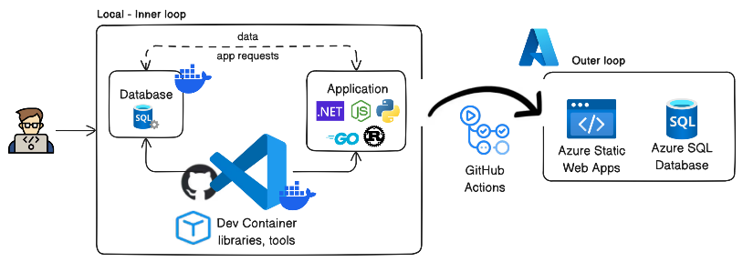
Databases Updates
Generally Available: Dev Containers templates for Azure SQL Database
These templates provide a streamlined and efficient way to set up development environments with all necessary tools and dependencies pre-configured.
Available for .NET Aspire, .NET 8, Node.js, and Python, allow seamlessly integrate Azure SQL Database into development workflow, ensuring a consistent and productive experience.
Adopting dev containers offers several advantages: efficient local development, cost-efficiency, faster time-to-market, and alignment with cloud-native trends.
Preconfigured environments: These come with all necessary tools and dependencies.
Consistency: Maintain uniformity across different development setups.
Simplified setup: Reduce time spent on configuration.
Enhanced collaboration: Improve teamwork within development teams.
Seamless transition to Azure: Leverage the scalability and reliability of Azure SQL Database for production deployments.
Accelerated time-to-market: Streamline development workflows and integrate seamlessly with existing toolsets, giving businesses a competitive edge.
Cost-efficient development: Reduce dependencies on cloud resources during the development and testing phases.

Slide 20
Databases Updates
Generally Available: Enforce passwordless authentication with Azure Cache for Redis
For Azure Cache for Redis caches in the Basic, Standard and Premium tiers, it is now possible to disable access key-based authentication and use only Microsoft Entra ID managed identities and service principals. Using Microsoft Entra ID and disabling access keys helps provide a higher level of security in authentication and authorization scenarios. This capability helps prevent unsafe sharing and storage of access keys and other potential security incidents that can lead to unauthorized access of your caches.

Slide 21
ML & AI & IOT

Slide 22
ML & AI & IOT Updates
Generally Available: Azure Sphere (Integrated) announces Locate Device feature
Azure Sphere (Integrated) users can now search for a specific device ID using the locate device feature in the Azure portal. If the device is claimed to an Azure Sphere catalog that the user has privileges for, the search displays links to the catalog and the device, as well as to the product and device group to which the device is assigned. For security purposes, if the device has not yet been claimed, or if it is claimed to an Azure Sphere catalog for which the user does not have access privileges, the search returns a no device found.

Slide 23
DevOps & IaC & Automation

Slide 24
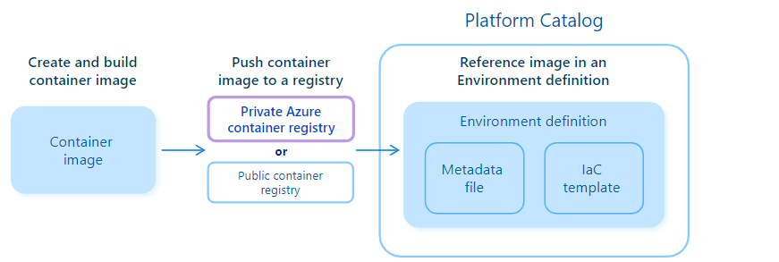
DevOps & IaC & Automation
Generally Available: Azure Chaos Studio supports a new Network Isolation fault for virtual machines
Azure Chaos Studio now supports a new agent-based fault action for Windows and Linux virtual machines and virtual machine scale sets.
Network Isolation: this new agent-based fault allows to isolate an Azure virtual machine from network connections by dropping all packets (subject to certain environment limitations) for the specified duration as part of a Chaos Experiment. This can help test applications inside virtual machines and their resilience to losing network traffic.
This new fault can be used in Azure Chaos Studio by deploying templates, using the REST API, or designing experiments in the Azure portal.
The agent-based network faults currently only support IPv4 addresses.
When running on Windows, the network packet loss fault currently only works with TCP or UDP packets.
When running on Linux, this fault can only affect outbound traffic, not inbound traffic. The fault can affect both inbound and outbound traffic on Windows environments (via the inboundDestinationFilters and destinationFilters parameters).
This fault currently only affects new connections. Existing active connections are unaffected. You can restart the service or process to force connections to break.
Generally Available: Terraform support for geo-restore in Azure Database for PostgreSQL - Flexible Server
It is now possible to use Terraform to perform geo-restore for Azure Database for PostgreSQL - Flexible Server data. This capability enables to integrate geo-restore activities into continuous integration (CI) and continuous delivery (CD) pipelines, automating the deployment and management of database instances.
Public Preview: Private registry support in Azure Deployment Environments
Private registry support for the extensibility model in Azure Deployment Environments allows platform engineers and development teams to use private Azure Container Registry (ACR) to host and reference container images that define their deployment patterns.
Private ACR support in Azure Deployment Environments enables to further secure customized project-specific templates.

Slide 25
Miscellaneous

Slide 26
Miscellaneous Updates
Retirement: Azure App Service Environment v1/v2 will be retired on 31 August 2024
After the official retirement on 31 August 2024, Service Level Agreement (SLA) and Service Credits will no longer apply for App Service Environment v1 and v2 workloads that continue to be in production.
MS will attempt to auto-migrate any remaining App Service Environment v1 and v2 on a best-effort basis, but Microsoft makes no claim or guarantees about application availability after auto-migration. If auto-migration is not feasible, your resources and associated app data will be deleted. We strongly urge you to act now to avoid either of these extreme scenarios.
Retirement: Azure API Management STV1 compute platform is retired as of August 31, 2024
In August 2021, Azure announced that the retirement of Cloud Services (classic) would happen on August 31, 2024. As Azure API Management stv1 compute platform runs on Cloud Services (classic), MS announced that they would retire on the same date. Decommissioning of the stv1 hardware has begun, and this may affect the availability and performance of instances hosted on the stv1.
Starting September 1, 2024, the Service Level Agreement (SLA) and Service Credits will no longer apply to any stv1 compute instances that remain in production.
Retirement: Azure Logic Apps Integration Service Environment is retired as of August 31, 2024
In August 2021, Azure announced that the retirement of Cloud Services (classic) would happen on August 31, 2024. As Azure Logic Apps Integration Service Environments (ISE) run on Cloud Services (classic), MS announced that they would retire on the same date. Decommissioning of the ISE workflows hardware has begun, and this may affect the availability and performance of apps and data.
Starting September 1, 2024, Service Level Agreement (SLA) and Service Credits will no longer apply for Logic Apps workflows deployed in ISE environments that continue to be in production.
Retirement: Upcoming TLS changes for Azure Event Grid
Starting October 31, 2024, all Azure services will require using TLS 1.2 or higher. Support for TLS 1.0 and TLS 1.1 will end on Oct 31,2024.

Slide 27
Miscellaneous Updates
Retirement: Planned Service Retirement - Azure Automation State Configuration on September 16, 2027
Azure Automation State Configuration will be retired on September 16, 2027, please transition to Azure Machine Configuration by that date.
From now to September 16, 2027 you can continue to use Azure Automation State Configuration without disruption. On 16 September 2027—all configurations and node registrations in Azure Automation State Configuration will be deleted and associated historical data will be lost.
This announcement only impacts the State Configuration features of Azure Automation and does not affect related products or services such as:
Other Azure Automation services such as runbooks or hybrid runbook workers.
Windows DSC Extension.
PowerShell Desired State Configuration.
Retirement: Azure Synapse Runtime for Apache Spark 3.2 disablement
Disablement for Azure Synapse Runtime for Apache Spark 3.2 announced September 12th, 2024.

Slide 28
Information

Slide 29
Information
Azure Times GitHub Repo

Slide 30
Questions

