Slide 1
Azure Times #103
January 31, 2023

Slide 2
Networking

Slide 3
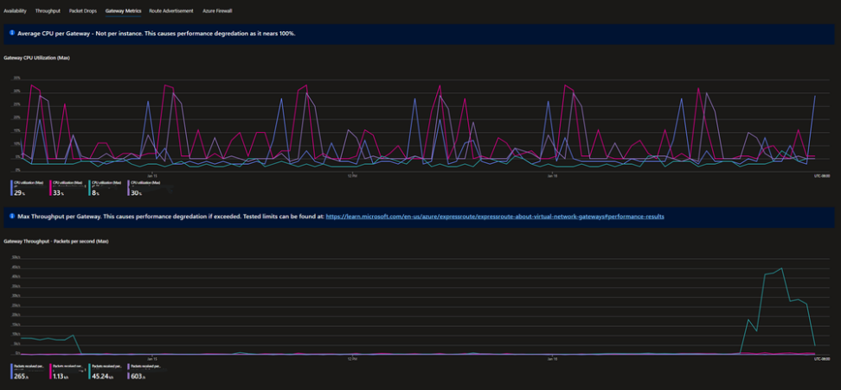
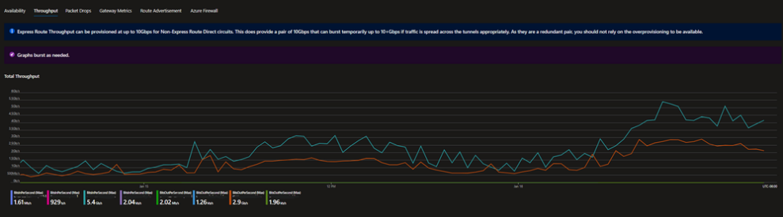
Networking Updates
Monitoring ExpressRoute: A Workbook Solution
MS released a new Azure Monitor Workbooks. The workbook that we developed is specifically designed for ExpressRoute monitoring and troubleshooting. It allows to dynamically choose ExpressRoute circuit and gateway from a drop-down list and see relevant metrics and logs in an interactive dashboard. The dashboard includes sections for
ExpressRoute Circuit Status
BGP Availability
Total Throughput
Primary and Secondary Connection Traffic
Packet Drops
Gateway Utilization and Throughput
Route Advertisements
Azure Firewall SNAT and Throughput

Slide 4
Security & Identity

Slide 5
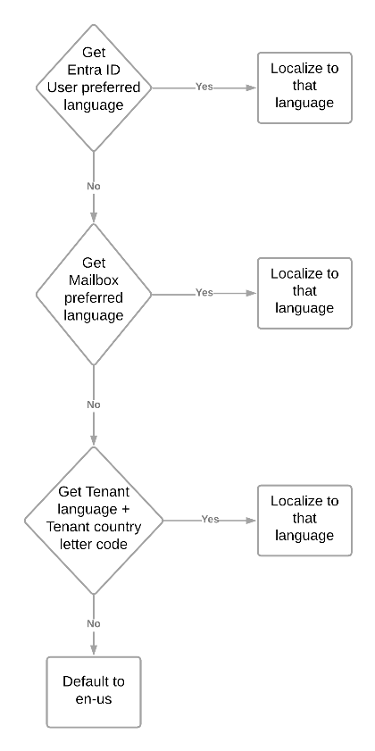
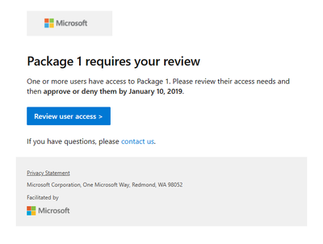
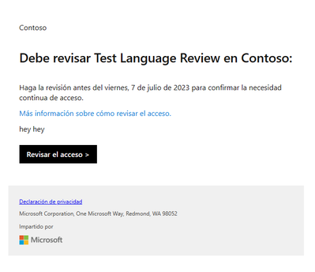
Security & Identity Updates
Generally available: FHIR service integration with Azure Active Directory B2C
MS announced that healthcare organizations can now use the FHIR service in Azure Health Data Services with Azure Active Directory B2C (Azure AD B2C). This capability gives organizations a secure and convenient way to grant access to the FHIR service in Azure Health Data Services with fine-grained access control for different users or groups, without creating or comingling user accounts in their organization’s Microsoft Entra ID tenant.
With this integration, organizations can:
Use additional identity providers to authenticate and access FHIR resources with SMART on FHIR scopes.
Manage and customize user access rights or permissions with SMART on FHIR scopes that support fine-grained access control, FHIR resource types and interactions, and a user’s underlying privileges.
To set up the integration, it is needed:
Create an Azure AD B2C tenant for the FHIR service.
Configure the identity provider settings for the FHIR service.
Register applications and users with Azure AD B2C.
Use access tokens issued by Azure AD B2C to access FHIR service resources.
Entra ID now enables to receive emails in preferred language.
MS added logic to check multiple places for language information to make the best possible choice for what language should be sent an email in, and these changes are now generally available for Privileged Identity Management, Access Reviews and Entitlement Management.

Slide 6
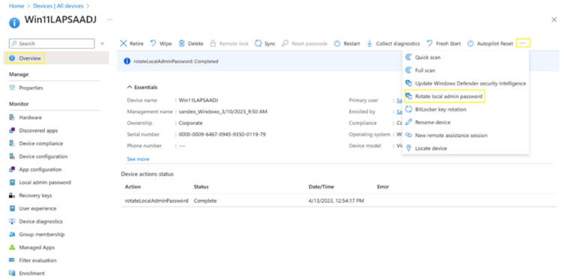
Security & Identity Updates
Administrator Password Solution with Microsoft Entra ID now Generally Available!
This capability is available for both Microsoft Entra joined and Microsoft Entra hybrid joined devices. It helps every organization to protect and secure their local administrator account on Windows and mitigate any Pass-the-Hash (PtH) and lateral traversal type of attacks.
This feature is available on the following Windows OS platforms with the April 11, 2023, or later Windows Updates installed:
Windows 11 22H2
Windows 11 21H2
Windows 10 20H2, 21H2 and 22H2
Windows Server 2022
Windows Server 2019
The following features are available now:
Configure client-side policies via Microsoft
Recover stored passwords via Microsoft Entra/Microsoft Intune portal or Microsoft Graph API/PSH.
Enumerate all LAPS-enabled devices via Microsoft Entra portal or Microsoft Graph API/PSH.
Create Microsoft Entra ID role-based access control (RBAC) policies with custom roles and administrative units for authorization of password recovery.
View audit logs via Microsoft Entra portal or Microsoft Graph API/PSH to monitor password update and retrieval events.
Configure Conditional Access policies on directory roles that have the authorization of password recovery.

Slide 7
Security & Identity Updates
Microsoft Entra ID Governance licensing for business guests
A new ID Governance license for business guests was introduced. This license will operate on a monthly active usage (MAU) model. Customers will be able to acquire licenses matching their anticipated business guest MAU.
ID Governance for business guest licenses will be priced at $0.75 per MAU, and MS anticipate making them available in spring 2024. In the interim, organizations that govern the identities of their employees with ID Governance can govern the identities of their business guests for no additional cost. Existing Azure AD External ID customers are grandfathered to continue using the subset of identity governance features that are included in Entra ID P1 and P2.
Deprecation of security alerts and update of security alerts to informational severity level
Plenty of alerts were updated by changing the criticality level or deprecated at all. Alert for the following services are impacted:
Azure Resource Manager
Azure network layer
Azure App Service
Windows machines
DNS
Containers

Slide 8
Management & Governance

Slide 9
Management & Governance Updates
Private Preview: Support for Azure VMs using Premium SSD v2 in Azure Site Recovery
MS announced the private preview of enabling Azure Site Recovery on Azure VMs using Premium SSD v2, in selected Azure regions. Premium SSD v2 offering provides the most advanced block storage solution designed for a broad range of IO-intensive enterprise production workloads that require sub-millisecond disk latencies as well as high IOPS and throughput — at a low cost.
Enabling disaster recovery on Premium SSD v2 is currently available in select regions and we plan to keep adding support in more regions over the coming weeks.
Generally Available: Azure Monitor VM Insights Dependency Agent support for RHEL 8.6 Linux VMs
Dependency Agent from Azure Monitor VM Insights is now supported for Red Hat Enterprise Linux (RHEL) 8.6 Linux VMs. This means it is possible to use the Dependency Agent to monitor the network connections and processes of RHEL 8.6 Linux VMs, and visualize the dependencies between them in the Map feature of VM Insights.
For the full list of supported Linux OS and kernel versions refer to dependency agent support article.

Slide 10
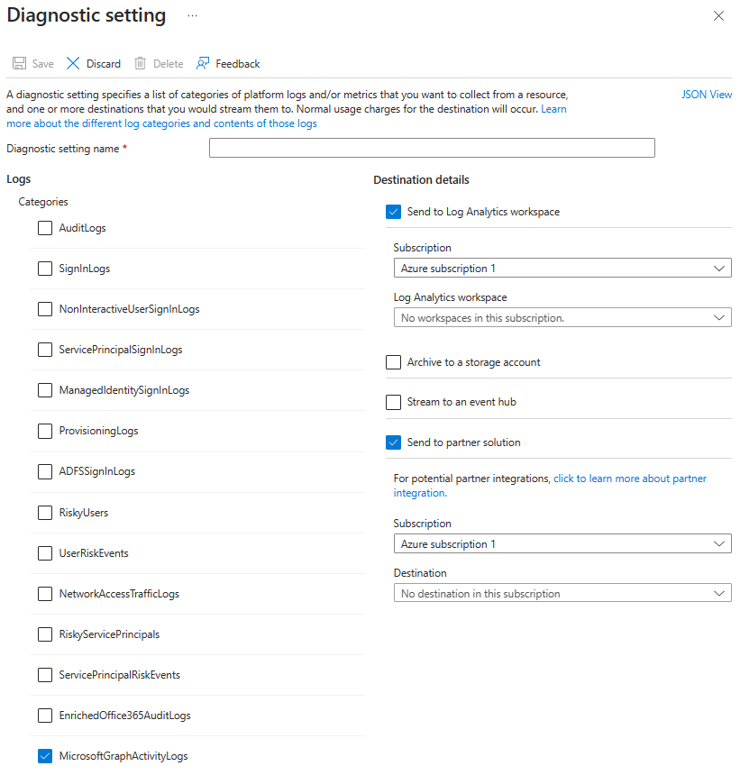
Management & Governance Updates
Microsoft Graph Activity Log is Now Available in Public Preview
MS announced the public preview of Microsoft Graph Activity Logs. It provides a full visibility into all HTTP requests accessing tenant’s resources through the Microsoft Graph API.
The Microsoft Graph Activity Logs include information about the request and client application. Some common use cases include:
Identifying the activities that a compromised user account conducted in tenant.
Building detections and behavioral analysis to identify suspicious or anomalous use of Microsoft Graph APIs – such as an application enumerating all users; or making probing requests with many 403 errors.
Investigating unexpected or unnecessarily privileged assignments of application permissions.
Identifying problematic or unexpected behaviors for client applications – such as extreme call volumes that exhaust rate-limits for the tenant.

Slide 11
Management & Governance Updates
Dedicated clusters in Azure Monitor logs now support any commitment tier
Now it is possible to create dedicated clusters in public and sovereign clouds at any commitment tiers, starting at a minimum of 100GB per day. The minimum capacity was reduced from 500 to 100. Configuration is first available via REST.
The minimum commitment tier in a dedicated cluster is essential to guarantee the provisioning of a managed Azure Data Explorer (ADX) cluster in the backend. This provisioned cluster is responsible for supporting data ingestion and queries related to the workspaces linked to the cluster. The billing of the cluster initiates upon provisioning, irrespective of the actual data ingestion and usage. Therefore, the implementation of a commitment tier becomes necessary to align with this billing structure.
Automatic Image Creation using Azure VM Image Builder is now generally available!
Automatic image creation using Azure Image Builder is now generally available. This feature improves speed and efficiency by allowing the ability to start image builds for new base images automatically.
Automatic image creation is critical for keeping images up-to-date and secure. It also minimizes the manual steps required for managing individual security and image update requirements.
It is not needed to manually update images that have been patched. Instead, it is possible to create ‘triggers’ for the images that needs update automatically and allow the Azure Image Builder service to perform the build.

Slide 12
Management & Governance Updates
New Features for graph-match KQL Operator: Enhanced Pattern Matching and Cycle Control
These features will enhance ability to express complex and flexible patterns and find more relevant matches:
The cycles parameter: It is now possible to control how cycles, or closed paths, are matched in the pattern. There are three options: all, none, or unique_edges. The default option is unique_edges, which means that cycles are matched only if they do not include the same edge more than once. This can help to avoid redundant or overlapping matches.
The nonlinear patterns: It is now possible to express nonlinear patterns, or patterns that have more than one sequence of edges, by using multiple comma delimited sequences. This can help to capture more complex structures and relationships in the graph.
Azure Arc-Enabled Kubernetes now available on Azure Marketplace!
With Kubernetes Apps, teams can extend the capabilities of deployments with a vibrant ecosystem of tested and transactable third-party solutions from industry-leading partners and popular open-source offerings. MS announced that they are expanding the range of offers to include Arc-Enabled Kubernetes. Azure Arc-Enabled Kubernetes allows to connect, manage, and operate Kubernetes clusters and applications running anywhere using Azure Arc. With this offer expansion, Kubernetes apps on Marketplace can be deployed to Azure Arc-enabled Kubernetes connected clusters.
An Azure Arc-enabled Kubernetes connected cluster is a Kubernetes cluster that is hosted on an on-premises, hybrid, or multi-cloud environment and connected to Azure Arc. This type of cluster allows customers to manage their on-premises and cloud-based resources from a single unified platform. It also provides a secure, reliable, and cost-effective way to manage and deploy applications across multiple environments. The Azure Arc-enabled connected cluster is designed to simplify the deployment and management of hybrid cloud architecture. With the GA release of Azure Arc-Enabled Kubernetes connected cluster-based apps on Azure Marketplace, we have pre-defined billing meters available. Pre-defined meters allow customers to easily monitor and track their usage of Azure Arc-enabled connected clusters and applications. With usage based pre-and take action to optimize their cost savings. Get started today with Azure Arc-Enabled Kubernetes on Azure Marketplace!

Slide 13
Management & Governance Updates
General availability: Azure Data Explorer adds new geospatial capabilities
MS announced the addition of three new geospatial functions in Kusto: geo_polygon_to_h3cells(), geo_angle() and geo_azimuth().
geo_polygon_to_h3cells() allows to convert a polygon into a set of H3 cells. This is useful for spatial indexing and querying, as it allows to efficiently represent and query spatial data
geo_angle() calculates the angle between two lines on the earth's surface. This can be useful for determining the direction of movement or the orientation of a geographical feature.
geo_azimuth() calculates the azimuth angle between two points on the earth's surface. The azimuth angle is the angle between the line from the first point to the second point and the line from the first point to the north pole. This can be useful for navigation and direction finding.
These new functions enhance Kusto's geospatial capabilities, allowing to perform more complex analyses and gain deeper insights into geospatial data.
Azure Advisor integration with Azure Monitor Log Analytics Workspace
MS introduced several cost optimization related recommendations and added Azure Advisor to the Log Analytics Workspace admin experience.
Consider configuring the cost-effective Basic logs plan on selected tables
Consider Changing Pricing Tier
Consider removing unused restored tables

Slide 14
Compute

Slide 15
Compute Updates
Public Preview: Azure Automation Runtime environment & support for Azure CLI commands in runbooks
Azure Automation introduces Runtime environment (preview) that provides a simple and hassle-free experience for updating scripts to the latest language versions. It also provides complete control to configure the script execution environment, without worrying about conflicting module versions in a single Automation account. All existing runbooks are automatically available in the new Runtime environment experience with zero manual effort.
Additionally, this feature enables support for Azure CLI commands (preview) in PowerShell 7.2 runbooks. It provides:
Granular control
Runbook update
Module management
Rollback capability
Streamlined cod
Runtime environment is currently supported in all Public regions
Currently only cloud jobs are supported for newly created runbooks linked to user-created Runtime environments.
Existing runbooks that are automatically moved from old experience to Runtime environment experience would be able to execute as both cloud and hybrid job.
When the runbook is updated and linked to a different Runtime environment, it can be executed as cloud job only.
PowerShell Workflow, Graphical PowerShell, and Graphical PowerShell Workflow runbooks only work with System-generated PowerShell-5.1 Runtime environment.
RBAC permissions cannot be assigned to Runtime environment.
Runtime environment can't be configured through Azure Automation extension for Visual Studio Code.
Deleted Runtime environments cannot be recovered.
The feature is only supported through Azure portal and REST API.

Slide 16
Compute Updates
Azure Spring Apps Feature Update Q4 2024: Spring Cloud Gateway supports a response cache and more
The following updates are now available in the Enterprise plan:
Spring Cloud Gateway supports a response cache: The response cache enables services and clients to efficiently store and reuse responses to HTTP requests. It is possible to configure the memory size and the time-to-live of the cache and apply settings at the route-level or globally. For more information, see the Configure the response cache section of Configure VMware Spring Cloud Gateway.
API Portal supports enable/disable of the try-out option: The try-out feature enables to try out APIs through the centric view of API Portal. It is now possible easily turn this feature off if there's any security concern. For more information, see the Try out APIs in API portal section of Use API portal for VMware Tanzu.
Service connector supports application-level settings: This update enables to efficiently configure common settings across deployments within one application.
Richer information in the build history: To help better troubleshoot build-related issues for apps, the build history now presents richer information for all builds. For more information, see the Build history section of Use Tanzu Build Service.
The following update is now available in the Enterprise and Basic/Standard plans:
Planned maintenance (public preview): Azure Spring Apps regularly patches server-side components that applications depend on to make sure they are secure and up to date. These components include the JDK, Spring Cloud middleware, APM, base OS image, and runtime infrastructure. For such patches to take effect, It is needed to restart applications. With planned maintenance, you can schedule a time on a specific day for such mandatory restarts. For more information, see How to configure planned maintenance (preview).
Auto sync of certificates: Some Azure Spring Apps features secure applications with certificates of choice. With auto sync of certificates, you can now rotate your certificates in Azure Key Vault and they automatically sync to Azure Spring Apps. This enhancement makes it easier for you to manage features such as custom domain and TLS/SSL settings. For more information, see the Auto sync certificate section of Map an existing custom domain to Azure Spring Apps.

Slide 17
Integration

Slide 18
Integration Updates
Public Preview: Circuit Breaker in Azure API Management
Customers now have the capability to configure the circuit breaker property in the backend resource, providing protection for a backend service against being overwhelmed by excessive requests.
The circuit breaker property defines rules to trip the circuit breaker, such as the number or percentage of failure conditions during a defined time interval and a range of status codes that indicate failures.
When the circuit breaker trips, API Management stops sending requests to the backend service for a defined time, and returns a 503 Service Unavailable response to the client.
After the configured trip duration, the circuit resets and traffic resumes to the backend.
The backend circuit breaker is an implementation of the circuit breaker pattern to allow the backend to recover from overload situations.
Currently, the backend circuit breaker isn't supported in the Consumption tier of API Management.
Public Preview: Load Balancer in Azure API Management
Starting in API version 2023-05-01 preview, API Management supports backend pools, when there is a need to implement multiple backends for an API and load-balance requests across those backends. Currently, the backend pool supports round-robin load balancing.
Use a backend pool for scenarios such as the following:
Spread the load to multiple backends, which may have individual backend circuit breakers.
Shift the load from one set of backends to another for upgrade (blue-green deployment).
To create a backend pool, set the type property of the backend to pool and specify a list of backends that make up the pool

Slide 19
Miscellaneous

Slide 20
Miscellaneous Updates
Cloud Services (classic) deployment model is retiring on 31 August 2024
On 31 August 2024, MS will retire the Cloud Services (classic) deployment model. Before that date, It is needed to migrate services that were deployed using this model to Cloud Services (extended support) in Azure Resource Manager, which provides new capabilities, including:
Support for deployment templates.
Role-based access control.
Regional resiliency.
Required action
In order to avoid service disruption and continue to use cloud services that were deployed using Cloud Services (classic), you must migrate them to Cloud Services (extended support) in Resource Manager before 31 August 2024. Beginning 1st September 2024, your Cloud Service deployments would be stopped and deallocated, and data will be permanently lost.

Slide 21
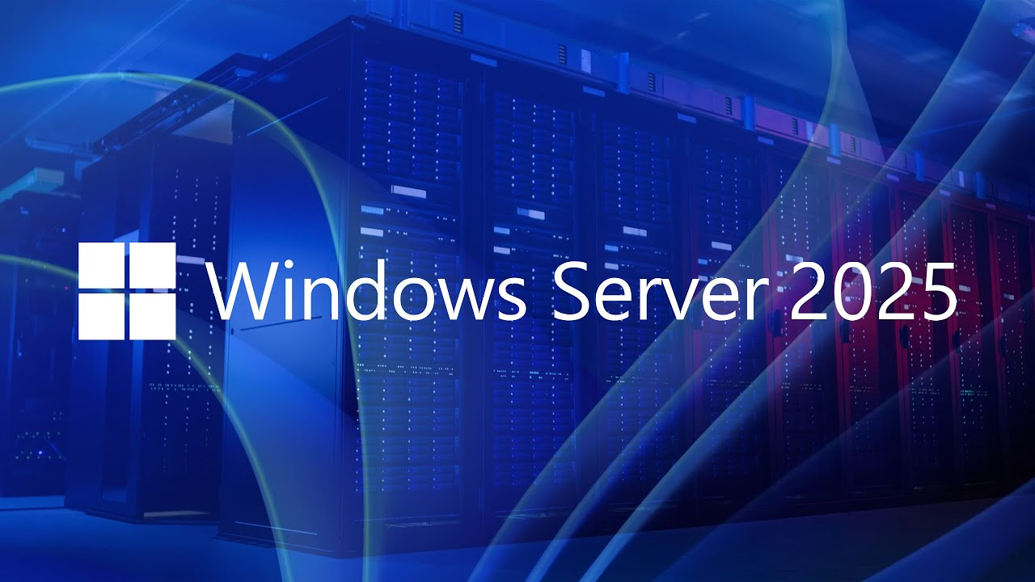

Slide 22
Windows Server 2025
Introducing Windows Server 2025!
MS released the official name of the next release of the Windows Server vNEXT that is Windows Server 2025. What it brings:
Windows Server Flighting: Windows Server Insider now support flighting and downloadable in-place upgrades, exactly like Windows 11; no need to grab ISOs and run manual setup.
SMB over QUIC alternative ports: Change from using the default UDP/443 port for SMB over QUIC to any port defined.
Hotpatching for everyone and Everywhere
Next Generation Active Directory
Active Directory 32k DB Page Sizes: New/Upgrades
AD DS now takes advantage of NUMA capable hardware by utilizing CPUs in all processor groups
LDAP support for TLS 1.3
Kerberos support for AES SHA256/384
Improved security for confidential attributes
Changes to default behavior of legacy SAM RPC password change methods
Kerberos & PKINT support cryptographic agility
Active Directory Replication Priority Boost
Remote mailslots now deprecated and no longer used for DC location
New Forest and Domain Functional Levels
New AD forests or AD LDS configuration sets are required to have a functional level of Windows Server 2016 or greater.
Windows Server Storage
Delivers 70% more IOPs on NVMe SSDs
NVMe-oF TCP Initiator
Improved Storage Replica (SR) performance
ReFS Native Deduplication and Compression
Storage Space Stretch Cluster Support
SMB over QUIC in Windows Server
Windows Server GPU-P Support
Container Flexibility
And many more……

Slide 23
Information

Slide 24
Information
Azure Times GitHub Repo

Slide 25
Questions

