Slide 1
Azure Times #91
October 15, 2023

Slide 2
Networking

Slide 3
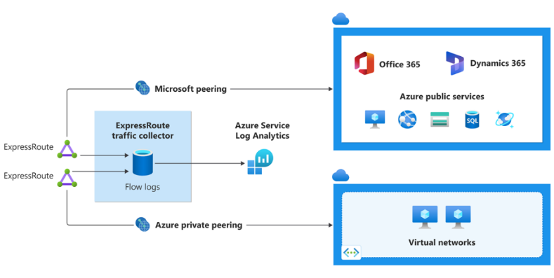
Networking Updates
ExpressRoute Traffic Collector is now generally available
ExpressRoute Traffic Collector enables to capture information about IP flows sent over ExpressRoute direct circuits. It is possibleet to enable flow logs capture for both Private and Microsoft peering with ExpressRoute Traffic Collector. Captured flow logs data get sent to a Log Analytics workspace.
Flow logs are collected at an interval of every 1 minute. All packets collected for a given flow get aggregated and imported into a Log Analytics workspace for further analysis. During flow collection, not every packet is captured into its own flow record. ExpressRoute Traffic Collector uses a sampling rate of 1:4096, meaning 1 out of every 4096 packets gets captured. Therefore, sampling rate short flows (in total bytes) might not get collected. This sampling size doesn't affect network traffic analysis when sampled data is aggregated over a longer period of time. Flow collection time and sampling rate are fixed and can't be changed
Use cases
Network monitoring
Monitor Azure private peering and Microsoft peering traffic
Near real-time visibility into network throughput and performance
Perform network diagnosis
Capacity forecasting
Monitor network usage and cost optimization
Analyze traffic trends by filtering sampled flows by IP, port or by applications
Top talkers for a source IP, destination IP or applications
Optimize network traffic expenses by analyzing traffic trends
Network forensics analysis
Identify compromised IPs by analyzing all the associated network flows
Export flow logs to a SIEM (Security Information and Event Management) tool to monitor, correlate events, generate security alerts

Slide 4
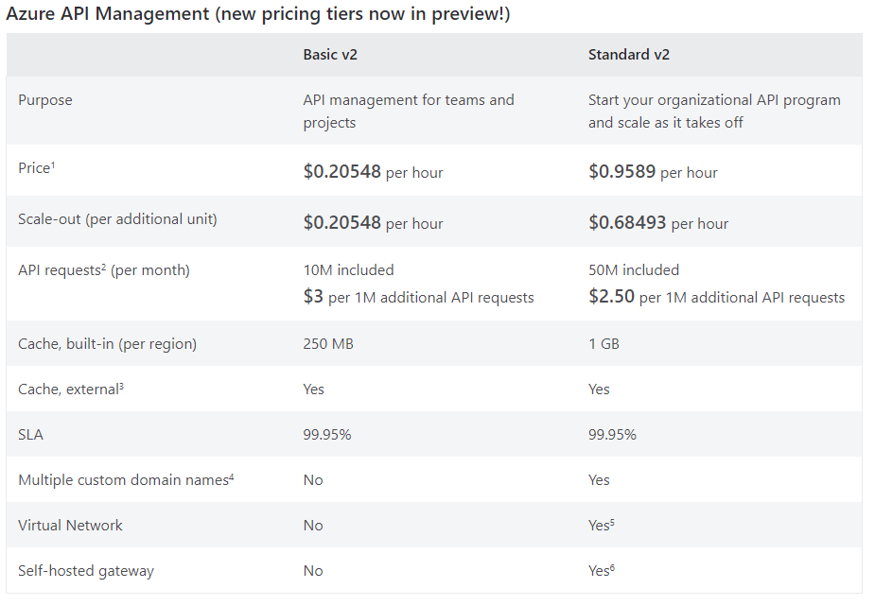
Networking Updates
Announcing Public Preview of Azure API Management Basic v2 and Standard v2 Tiers
MS announced the launch of the public preview of newest Azure API Management tiers – Basic v2 and Standard v2. The new tiers answer popular customer requests, offer quality-of-service improvements, and allow customers of any size to get started with API Management, adding capabilities and scale as their API programs grow.
Key capabilities and quality of service improvements
Faster deployment and scaling
Private networking: Standard v2 tier now supports VNet Integration, allowing outbound traffic can be restricted to a single connected VNet
Higher scale: Basic v2 and Standard v2 tiers support up to 10 scale units, a 5X and 2.5X improvement over Basic and Standard tiers respectively.
Preview limitations
The Basic v2 and Standard v2 tiers public preview is available only in selected public regions for newly created service instances.
Upgrades from the current tiers aren’t supported. During the preview some features found in the current tiers will not be present the new tiers.

Slide 5
Security & Identity

Slide 6
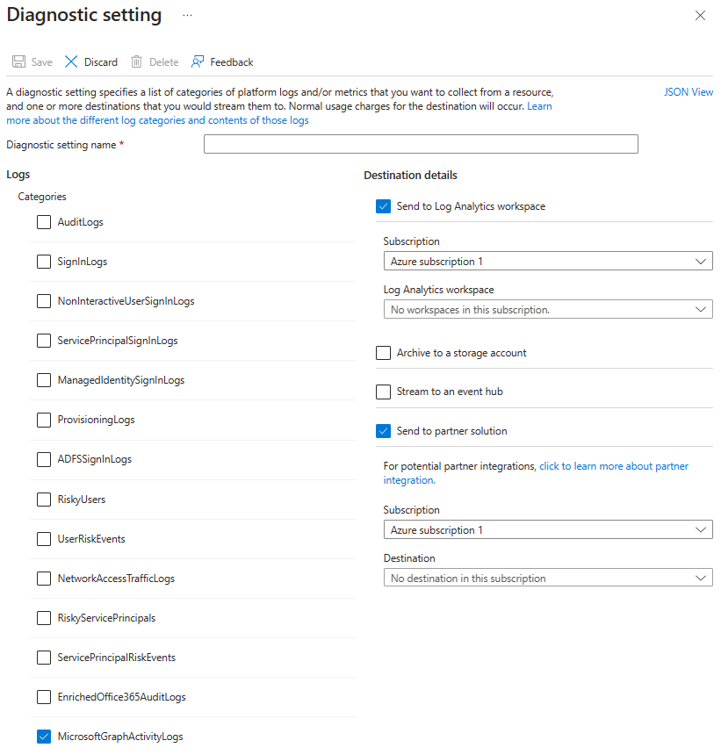
Security & Identity Updates
Microsoft Graph Activity Log is Now Available in Public Preview
MS announced the public preview of Microsoft Graph Activity Logs.
With Microsoft Graph Activity Logs, it is possible to investigate the complete picture of activity in tenant – from token request in SignIn logs, to API request activity (reads, writes, and deletes) in Microsoft Graph Activity Logs, to ultimate resource changes in Audit logs
The Microsoft Graph Activity Logs include information about the request and client application. Some common use cases include:
Identifying the activities that a compromised user account conducted in your tenant.
Building detections and behavioral analysis to identify suspicious or anomalous use of Microsoft Graph APIs – such as an application enumerating all users; or making probing requests with many 403 errors.
Investigating unexpected or unnecessarily privileged assignments of application permissions.
Identifying problematic or unexpected behaviors for client applications – such as extreme call volumes that exhaust rate-limits for the tenant.

Slide 7
Management & Governance

Slide 8
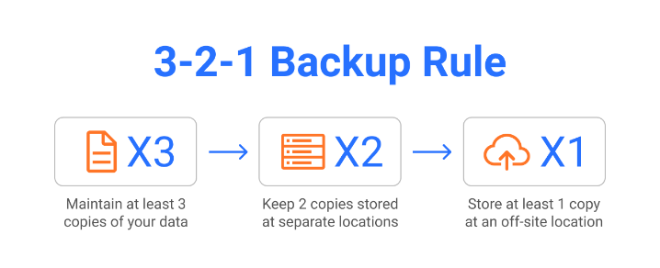
Management & Governance Updates
LSA payload update for fixes on 15-Jan
Log alerts are one of the alert types that are supported in Azure Monitor. Log alerts allow users to use a log analytics query to evaluate resources logs every set frequency, and fire an alert based on the results. Rules can trigger one or more actions using action groups.
As a part of Log alerts payload, MS is sending the fields ResultCount (Log Alerts V1), metricValue (Log Alerts V2).
ResultCount: That should contain the value of the number of records returned by the query. For metric measurement rules, the number or records that match the specific dimension combination. Unfortunately, today the resultCount of the last evaluation which met the threshold and not of the evaluation which fired the alert as in “Metric Alerts”.
metricValue: that should contain the metric value at the time that it violated the threshold. Unfortunately, today the result is always null.
On the 15-Jan we are going to fix those 2 values to contain the correct values according to our other alerts services.
Private Preview: Regional Disaster Recovery by Azure Backup for AKS
Azure Backup for AKS enables customers to protect containerized workloads along with application data deployed on AKS clusters. The solution allows to configure scheduled backups of AKS clusters and restore them in same or alternate cluster in the scenarios like Operational Recovery, Accidental Deletion and Application Migration. Customers are also looking to utilize their AKS backups to recover application during a regional disaster recovery and also follow industry-wide best practice of 3-2-1 backup strategy.
With this intent, Azure Backup service is announcing private preview of AKS Backup - Regional Disaster Recovery Capability. Using this feature it is possible:
Recover AKS cluster from backups in a secondary region as an Azure Paired Region in case of a regional disaster.
Store Backup Copy offsite i.e. a Vault Store as per 3-2-1 backup strategy and have ability to restore in case tenant gets compromised.
Retain data for a long duration for compliance purposes in regulated industries.

Slide 9
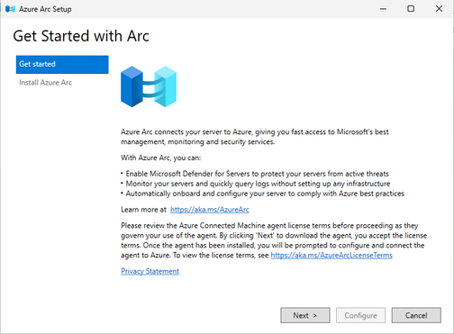
Management & Governance Updates
Easily enable Azure Arc on Windows Server 2022
MS released a set of new in-box experiences for WS2022! They are making it easier than ever before to connect server to Azure Arc, Microsoft's management platform for on-premises and multi-cloud servers.
The first change is a new system tray icon that helps get started with Azure Arc . The entire process -- downloading, installing, and configuring the Azure Connected Machine agent -- can now be completed using graphical wizards on the server.

Slide 10
Compute

Slide 11
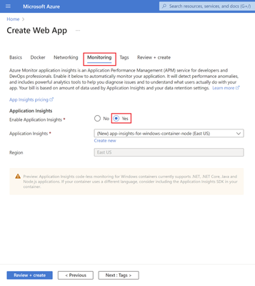
Compute Updates
Public Preview: Application Insights Auto-Instrumentation for Node.js on Windows Containers Web Apps
It is possible to monitor applications with Application Insights Auto-Instrumentation without changing code. When enabled, the App Service platform will configure and attach the agent to the application in container. It is possible to start seeing data such as requests, logs, and traces in Application Insights resource.
Generally Available: Azure Dedicated Host – Resize
With Azure Dedicated Host’s ‘resize’ feature, it is now possible easily move existing dedicated host to a new Azure Dedicated Host SKU (e.g., from Dsv3-Type1 to Dsv3-Type4). This feature minimizes the impact and effort involved in configuring VMs when want to upgrade underlying dedicated host system.
It is now possible to automatically create the new host, migrate all existing VMs, and delete old host, thus avoiding any manual operations when upgrading dedicated host.
Resize limitations:
Host can only be resized to an ADH within the same VM family. A Dsv3-Type3 host can be resized to Dsv3-Type4 but not to an Esv3-Type4.
It is possible to resize to newer generation of hardware. A Dsv3-Type3 host can be resized to Dsv3-Type4 but not Dsv3-Type2.
Resizing changes the 'Host Asset ID'. The 'Host ID' remains the same.
The host and all associated VMs become unavailable during the resize operation.

Slide 12
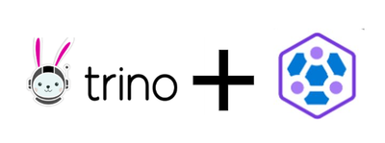
Compute Updates
HDInsight on AKS cluster
HDInsight on AKS is a modern, reliable, secure, and fully managed Platform as a Service (PaaS) that runs on Azure Kubernetes Service (AKS).
Now it is possible to deploy HDInsight on the AKS Cluster that allows to deploy popular Open-Source Analytics workloads like Apache Spark, Apache Flink, and Trino.
Apache Flink on Azure HDInsight on AKS
Apache Flink is a framework and distributed processing engine for stateful computations over unbounded and bounded data streams. It is one of the top projects of the Apache Software Foundation, it has emerged as the gold standard for stream processing. With high performance, rich feature set, and robust developer community; Flink makes it one of the most popular choices for low-latency, high throughput stateful stream processing.
Flink enables enterprises to harness the value of data immediately, making it a valuable tool for time-sensitive applications and scenarios requiring up-to-the-minute insights. Stream processing systems excel at handling high-velocity, unbounded data streams, such as click streams, log streams, live sensor data, social media feeds, event streams, transactional data, and IoT device data.
Trino with Azure HDInsight on AKS
Trino is a tool to query humongous volume of data using distributed query. Note that Trino is not an OLTP (Online transaction processing) database like My SQL, Postgre SQL, HBase. It is neither an open-source data lake, lakehouse alternate like Hadoop file system or Delta format. Trino is a tool to execute ad hoc query in petabyte scale data management system like Hive and Delta Lake. However, Trino is not restricted to connecting only Datalake or Lakehouse. Trino extends its query capability to multiple sources. As per Trino community definition it is,
A query engine that runs at ludicrous speed, fast distributed SQL query engine for big data analytics that helps you explore your data universe.
Trino is known primarily for,
Interactive analytics speed
Federated Query across multiple systems
Ad hoc Querying
Supports Ansi SQL

Slide 13
Compute Updates
Public Preview Announcement: Azure VMSS Zonal Expansion
MS introduced the public preview of VMSS Zonal Expansion. This feature enables to take regionally (non-zonal) configured VMs and distribute across Azure availability zones in a zonal configuration, enhancing business continuity and resilience with minimal disruption and potentially increasing your availability SLA from 99.95% to 99.99%.
This feature allows to modify a virtual machine scale set (VMSS) to expand the set of zones over which to spread VM instances. This preview is supported for VMSS stateless infrastructure workloads that do not need to preserve disks or network resources. It is not supported for scale sets with stateful workloads or used with Service Fabric or Azure Kubernetes Services.
Benefits
This feature enables you to increase the availability and resiliency of your scale set by taking advantage of higher zonal availability SLA (99.99%) vs regional availability SLA (99.95%)
Update the selection of zones over which the scale set will spread instances without deleting and recreating the scale set
Expand your scale set to take advantage of new availability zones that were not available when the scale set was created.

Slide 14
Storage & Data

Slide 15
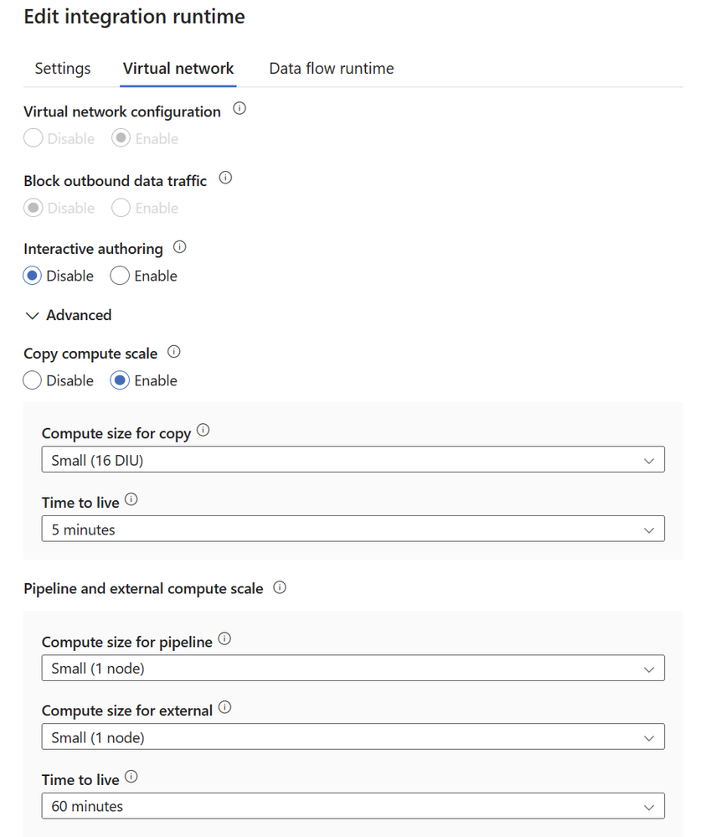
Storage & Data Updates
General Availability of Time to Live (TTL) for Managed Virtual Network in Azure Data Factory
Time to Live (TTL) is a crucial enhancement for Azure integration runtimes within a Managed Virtual Network. It allows to specify a TTL value and Data Integration Unit (DIU) numbers required for various data integration activities. The TTL feature helps to manage compute resources more effectively, reduce startup times, and optimize overall performance.
Now, let's explore the key benefits of Managed Virtual Network TTL and why it's a game-changer for your data integration workflows:
Improved Performance: One of the challenges in Managed Virtual Network is managing the startup time of compute resources, especially when dealing with multiple copy activities or complex pipelines. Managed Virtual Network TTL addresses this by keeping computes alive for a certain period after their execution completes. If a new copy activity starts during the TTL time, it will reuse existing computes, significantly reducing startup time and enhancing overall performance.
Compute Size Flexibility: With Managed Virtual Network TTL, you have the flexibility to select from pre-defined compute sizes or customize the compute size based on your specific requirements and real-time needs. This customization ensures that your compute resources are optimally sized for the tasks at hand.

Slide 16
Storage & Data Updates
Azure Files has been improved to support all valid Unicode characters
Azure Files now supports an expanded character set, enabling file and directory names that were restricted until now.
This support includes:
Control characters supported by NTFS, and other special case valid Unicode character ranges.
Trailing dot (.) characters at the end of directory and file names.
Characters that would work individually, but were previously blocked when used in combination with each other (predominant in non-English languages).
This will allow users to create SMB File shares with file and directory names on par with NTFS file system, for valid Unicode characters. It also enables tools like AzCopy and Storage mover to migrate all the files into Azure Files using the REST protocol.
Expanded character support is now available in all Azure regions

Slide 17
Databases

Slide 18
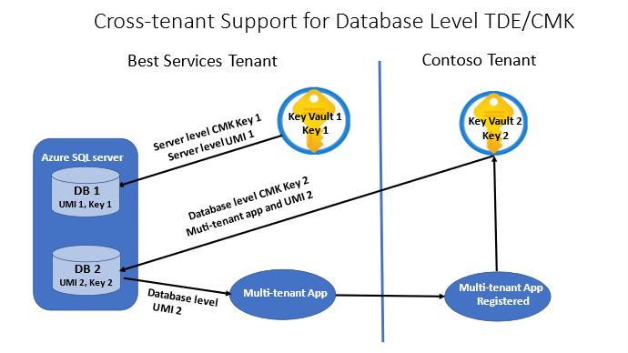
Databases Updates
Apache Cassandra version 3.11 support beyond EOL
The Apache Cassandra Project Team recently announced that, after more than half a decade, versions 3.0.x and 3.11.x will reach End of Life at the end of 2023.
Azure Managed Instance for Apache Cassandra we will be fully supported Cassandra version 3.11 until the end of 2024. Support will include any required CVE patches, as well as any bug fixes that cause production issues.
General availability: Azure SQL updates for early-October 2023
Enable transparent data encryption (TDE) with customer-managed keys (CMK) at the database level for Azure SQL DB.

Slide 19
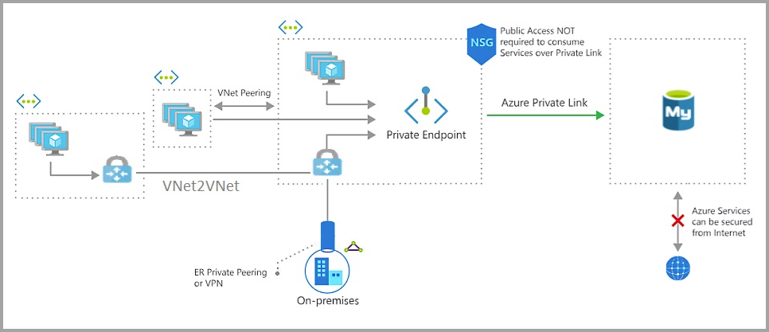
Databases Updates
General Availability: Azure Private Link for MySQL – Flexible Server
Azure Private Link allows to connect to various PaaS services, such as Azure Database for MySQL - Flexible Server, in Azure, via a private endpoint. Private Link brings Azure services inside private virtual network (VNet). Using the private IP address, the Azure Database for MySQL - Flexible Server is accessible just like any other resource within the VNet.
General Availability: Universal cross-region read replica on Azure Database for MySQL - Flexible Server
The new read-replica in universal regions feature allows to replicate data from an instance of Azure Database for MySQL - Flexible Server to a read-only server in a universal region, which could be any region from the list of Azure supported regions where flexible server is supported. It is possible to use universal cross-region read replicas for read-only traffic and to provide protection from regional disasters

Slide 20
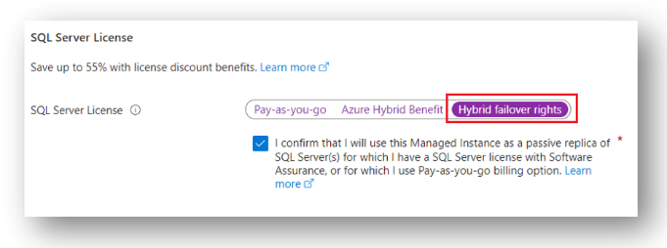
Databases Updates
License-free DR on Azure SQL Managed Instance for SQL Server 2022
Hybrid failover rights is a new benefit that allows to run a license-free Azure SQL Managed Instance when used as a passive DR replica for SQL Server 2022 licensed under Software Assurance (SA), or using Pay-as-you-go billing option.
The new Hybrid failover rights licensing benefit is technology agnostic. It is possible to use any technology, such is MI link as the most advanced replication technology using Always On, or perhaps LRS, ADF, transactional replication, backup and restore, or similar to setup replication between SQL Server and Managed Instance. As long as Azure SQL Managed Instance used only as a passive replica for SQL Server 2022, you are eligible to apply the new licensing benefit.
Always On technology is known to be the most advanced method of setting up disaster recovery between SQL Servers on-premises. The link feature for Managed Instance is the same – Always On is used for near real-time replication between SQL Server and Azure SQL Managed Instance. The MI link disaster recovery (DR) feature was released in a limited public preview at the time of SQL Server 2022 release.

Slide 21
ML & AI & IOT

Slide 22
ML & AI & IOT Updates
Public Preview: Azure Open AI “Use your data” integration with Azure Cosmos DB for MongoDB vCore
The "Use your data" feature in Azure OpenAI Studio now integrates with Azure Cosmos DB for MongoDB vCore. Harness the power of Retrieval Augmented Generation and vector search effortlessly, bringing data directly into OpenAI models.
Azure OpenAI on your data enables you to run supported chat models such as GPT-35-Turbo and GPT-4 on your data without needing to train or fine-tune models. Running models on your data enables you to chat on top of, and analyze your data with greater accuracy and speed.

Slide 23
Miscellaneous

Slide 24
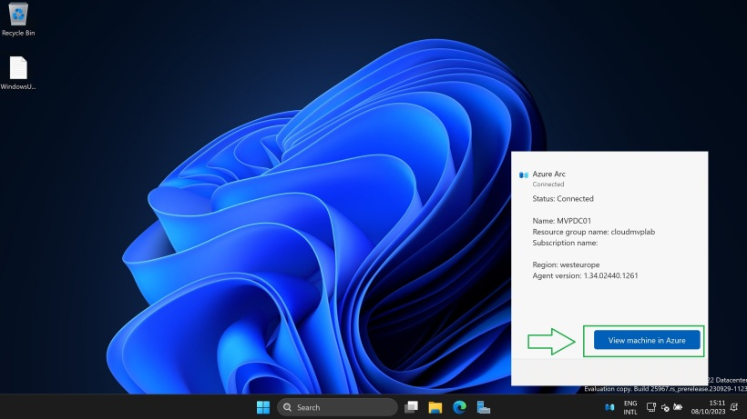
Miscellaneous Updates
Public Preview: Azure Chaos Studio has Query-Based Dynamic Targets
The Query-Based Dynamic Targets feature allows Chaos Studio to select fault targets by inputting a KQL query to be executed at experiment execution time. All resources onboarded to Chaos Studio at experiment execution time that match the query result set will be targeted by the selected fault.
Windows Server Insider Preview Build 25967
New in Windows Server Insider Preview Build 25967 is Microsoft Azure Arc in taskbar system tray Icon.

Slide 25
Miscellaneous Updates
October patches for Azure DevOps Server
The following versions of the products have been patched. Check out the links for each version for more details.
Azure DevOps Server 2022.0.1
Azure DevOps Server 2020.1.2
Azure DevOps Server 2020.0.2
Windows Server 2012/R2 reaches end of support
On October 10th, 2023, Windows Server 2012/R2 reaches end of support. After the end of support date, Windows Server 2012/R2 workloads will be vulnerable as they will no longer receive regular security updates. Organizations can remain protected by:
Modernizing to a PaaS platform
Migrating to Azure for free Extended Security Updates.
Purchasing Extended Security Updates enabled by Azure Arc to remain protected on premises and in multi cloud environments.

Slide 26
Miscellaneous Updates
Azure Functions support for Python 3.8 is ending on 14 October 2024
Azure Functions support for Python 3.8 is ending on 14 October 2024, alongside end of Python 3.8 community support.
Breaking Change Notice: Virtual Machine Scale Set Default Orchestration Mode changing from Uniform to Flexible on PowerShell, Azure CLI
MS announced an upcoming breaking change to the default orchestration mode for Virtual Machine Scale Sets created on PowerShell and Azure CLI starting November 2023. Once this change is complete, any new VM scale sets created using these clients will automatically default to Flexible orchestration mode instead of Uniform. To learn more about VM Scale Set orchestration modes, please see Orchestration modes for Virtual Machine Scale Sets in Azure - Azure Virtual Machine Scale Sets | Microsoft Learn.
Impacted Commands
PowerShell: Starting November 2023, the -OrchestrationMode parameter for New-AzVmss will have a new default value of “Flexible”, replacing the current default of “Uniform”. VM Scale Sets created using New-AzVmss after this change will default to “Flexible” orchestration mode if no –OrchestrationMode is specified.
Azure CLI: Starting November 2023, the –orchestration-mode parameter for az vmss create will have a new default value of “flexible”, replacing the current default of “uniform”. VM Scale Sets created using az vmss create after this change will default to “flexible” orchestration mode if no --orchestration-mode is specified.
Flexible scale sets will be configured with a Standard Load Balancer and Standard Public IP.

Slide 27

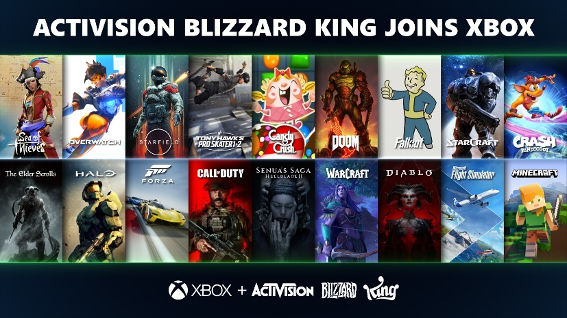
Miscellaneous Updates
Welcoming the legendary teams at Activision Blizzard King to Team Xbox
Microsoft officially completed the acquisition of Activision Blizzard, publishers of some of the most played and most beloved franchises in gaming history across console, PC and mobile. From Pitfall to Call of Duty, World of Warcraft to Overwatch, Candy Crush Saga to Farm Heroes Super Saga, their studios have pushed the boundaries of gaming for players around the world.
For the millions of fans who love Activision, Blizzard and King games, we want you to know that today is a good day to play. Together, we’ll learn, innovate and continue to deliver on our promise to bring the joy and community of gaming to more people.
Introducing Windows Terminal Canary
Windows Terminal is distributed in a variety of formats. MS announced Windows Terminal Canary to the Windows Terminal family. Windows Terminal Canary is a new canary channel of Windows Terminal that ships nightly and includes “hot off the presses” features. This Canary channel gives users the opportunity to try new and experimental features before those features go into Windows Terminal Preview.
Windows Terminal Canary can be installed side-by-side with Windows Terminal stable and Windows Terminal Preview.

Slide 28
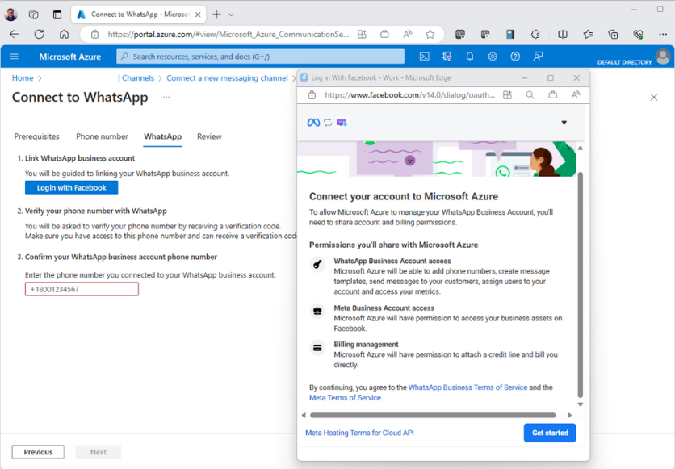
Miscellaneous Updates
Advanced Messaging enables WhatsApp
Available in public preview, developers can integrate WhatsApp Business Platform into applications with Azure Communication Services Advanced Messaging.
The Advanced Messaging SDK from Azure Communication Services enables businesses to reach more customers at scale and deliver reliable communications to users worldwide.
Azure Communication Services October 2023 Feature Updates
The Azure Communication Services team is excited to share several new product and feature updates released in September 2023.
Alphanumeric Sender ID
Enhanced Troubleshooting Features
Calling Native UI Library: Picture in Picture
Calling Web UI Library updates
3x3 Video Grid
Number Lookup
Microsoft Teams Interoperability Updates

Slide 29
Information

Slide 30
Information
Azure Times GitHub Repo

Slide 31
Questions

