Slide 1
Azure Times #123
June 15, 2024

Slide 2
Networking

Slide 3
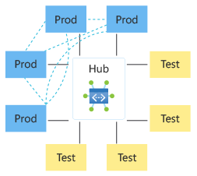
Networking Updates
Azure Virtual Network Manager (AVNM) mesh and direct connectivity are generally available
This feature enables a group of virtual networks to directly communicate to each other without an additional hop, thus improving the latency and management overhead of establish each virtual network's desired connectivity. For example, it will be possible to use this feature to let a subset of the spoke virtual networks in a hub and spoke topology that require low latency to directly communicate to each other. The traffic between these virtual networks can be filtered using network security groups (NSGs) and Azure Virtual Network Manager's security admin rules while still maintaining this direct connectivity.
Enabling Direct connectivity creates an overlay of a connected group on top of your hub and spoke topology, which contains spoke virtual networks of a given group. Direct connectivity allows a spoke VNet to talk directly to other VNets in its spoke group, but not to VNets in other spokes.

Slide 4
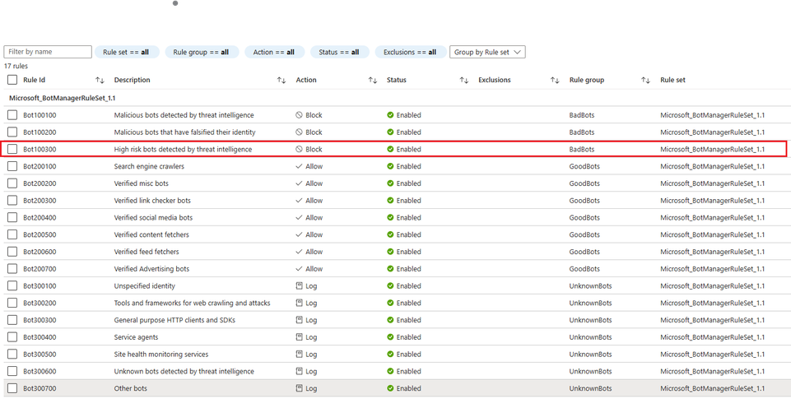
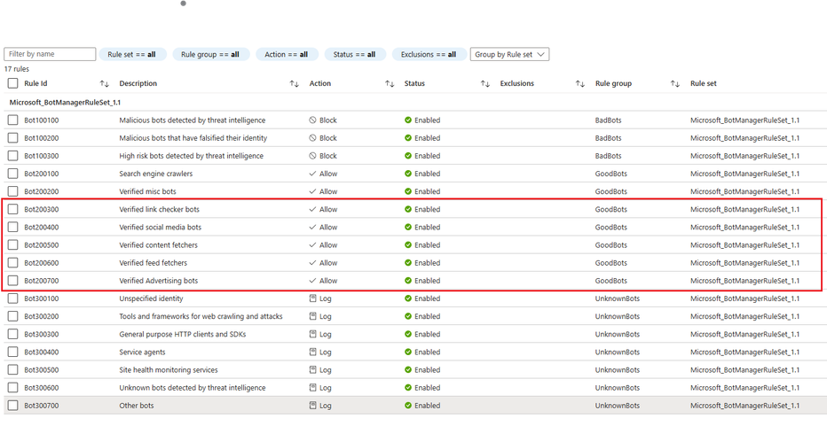
Networking Updates
General availability of Azure WAF Bot Manager1.1 Ruleset
MS announced the general availability of Bot Manager1.1 ruleset in Azure WAF integrated with Azure Front Door.
Bot Manager1.1 extends all the rules in the existing Bot Manager1.0 ruleset and adds multiple new rules to provide comprehensive bot management capabilities to web applications. The new capabilities introduced in this ruleset include new Goodbots rules and a new Badbots rule.
The main value prop of the new ruleset is to reduce false positives in good bot detections and increase true positives in malicious bot detections.
Benefits of the new rule in the Badbots rule group:
Scraping websites and spreading dis-information, executing targeted phishing attacks and social engineering attacks.
Spamming customer websites with form submission pages.
Manipulating rankings of content tooling websites’ analytics pages.
Launching denial-of-inventory attacks.
and many others.

Slide 5
Management & Governance

Slide 6

Management & Governance Updates
Microsoft at FinOpsX 2024 in San Diego
Microsoft speakers in the following sessions:
Unveiling Chevron's transformation
Navigating new intersections and trends
Bring your data into the AI era - democratize FinOps with Microsoft
General Availability of SQL FCI and AG Features SQL Server Enabled by Azure Arc
Two business continuity features for SQL Server enabled by Azure Arc are now generally available:
View Failover Cluster Instance
Manage Availability Group
With Azure Arc, these features help manage high availability and disaster recovery for SQL Server workloads across on-premises, hybrid and multi- cloud environment. It is now possible to manage them all from the comfort and convenience of the Azure portal.

Slide 7
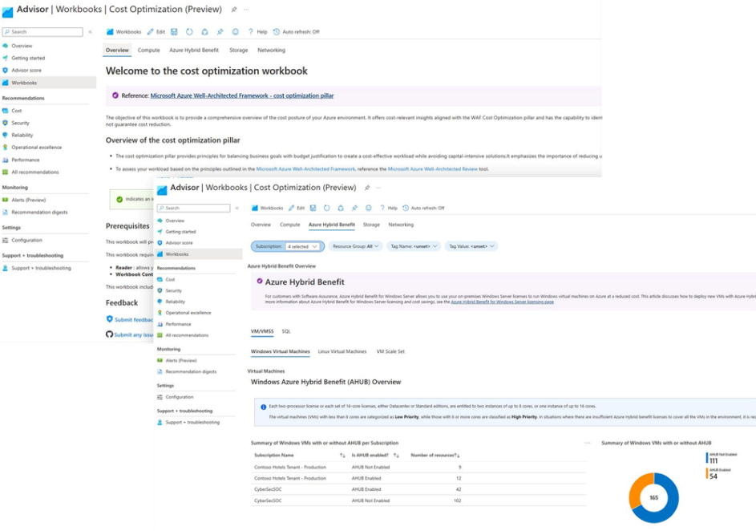
Management & Governance Updates
Azure Advisor Cost Optimization workbook – April release
The following updates has been released:
New query to identify idle ExpressRoute circuits: Express Route Gateways without a completed circuit (ISP has not completed the connection) still incurs charges, so it's better to review if they are used or not.
New query to show the Routing Preference for the public Ip addresses: Azure routing preference enables you to choose how your traffic routes between Azure and the Internet.
New query to show the public Ip addresses with DDoS enabled: If you need to protect fewer than 15 public IP resources, the IP Protection tier is the more cost-effective option. However, if you have more than 15 public IP resources to protect, then the Network Protection tier becomes more cost-effective.
New pie chart to summarize commitment discount savings
New queries to show Azure Hybrid Benefit for Azure SQL Database elastic pools

Slide 8
Compute

Slide 9
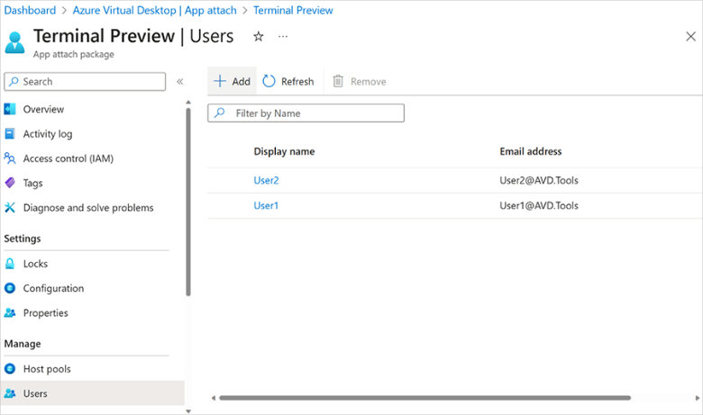
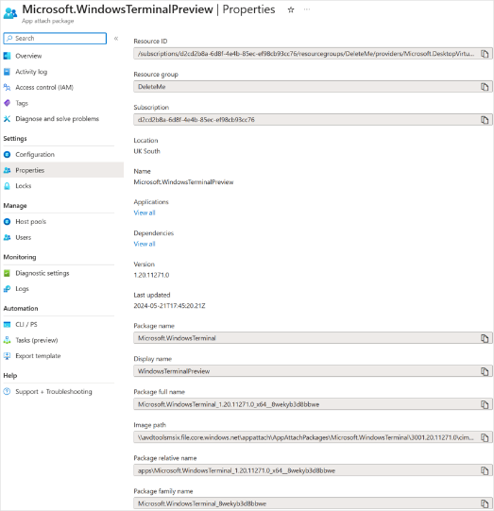
Compute Updates
App attach for Azure Virtual Desktop now generally available
App attach for Azure Virtual Desktop allows IT admins to dynamically attach applications from an application package to a user session in Azure Virtual Desktop.App attach is now generally available and here is a summary of the new capabilities:
Applications can now be assigned to any host pool or session host.
Applications can now be assigned per user, both within a desktop session and remote app sessions. This means that in any host pool in any session, users can be assigned different application combinations. This should reduce the number of host pools and images you require.
Application groups are no longer required to assign users to app attach apps, significantly simplifying assignment and reducing the number of application groups needed.
Application assignment, removal, and upgrades can be performed without needing a maintenance window and without interrupting a user’s workflow.
Microsoft Entra ID support for app attach has been introduced. Microsoft Entra hybrid join will work as it did before.
Dependency support has improved, including modification packages for remote apps.
A migration script is available to move existing MSIX app attach application packages to the new architecture.

Slide 10
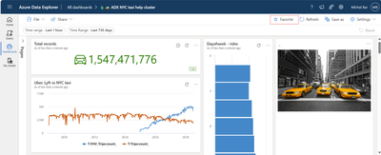
Compute Updates
ADX Web updates – May 2024
MS released a new look and feel to Connections explorer, designed to help manage list of data sources more efficiently. While maintaining the familiar functionality of the old experience, this updated interface features a modern design, improved performance and an enhanced way to manage and view your Favorites.
Easily Favorite and Find Important Dashboards: MS announced that now is possible to add dashboards to favorites list from two convenient locations: both from the catalog and, as a newly introduced feature, directly from the dashboard itself!

Slide 11
Storage & Data

Slide 12
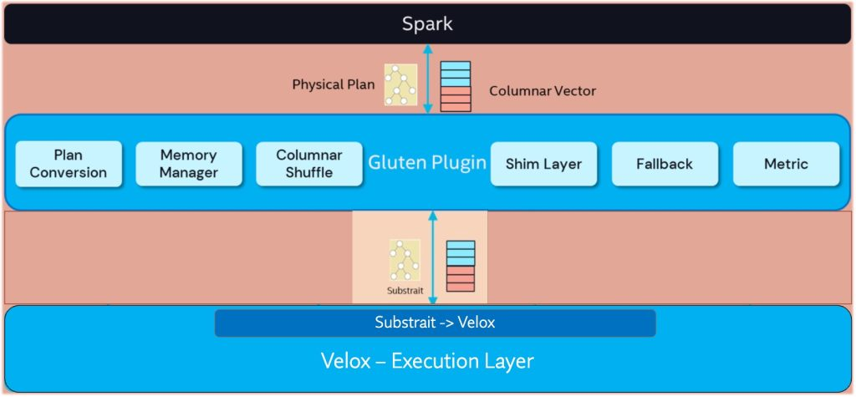
Storage & Data Updates
Public Preview of Native Execution Engine for Apache Spark on Fabric Data Engineering and Data Science
The Native Execution Engine leverages technologies such as a columnar format and vectorized processing to boost query execution performance.

Slide 13
Databases

Slide 14
Databases Updates
Efficient Time-Based Audit Log Filtering for Azure SQL Database
MS announced an enhanced version of fn_get_audit_file. Now, it is easy to specify desired time range to retrieve audit logs more efficiently.
The sys.fn_get_audit_file_v2 function in Azure SQL Database is designed to retrieve audit log data with enhanced efficiency compared to its predecessor, sys.fn_get_audit_file. The new function introduces time-based filtering at both the file and record levels, providing significant performance improvements, particularly for queries targeting specific time ranges.
sys.fn_get_audit_file_v2 ( file_pattern, initial_file_name, audit_record_offset, start_time, end_time )

Slide 15
ML & AI & IOT

Slide 16
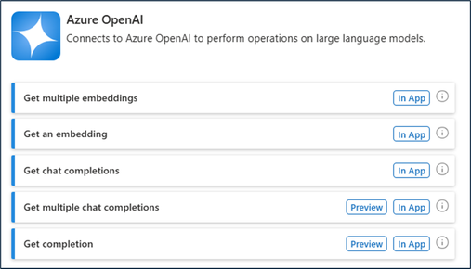
ML & AI & IOT Updates
Pricing Update: Token Based Billing for Fine Tuning Training
MS has been updating billing for fine tuning with the Azure OpenAI Service to bill based on the number of tokens in training file – instead of the total elapsed training time.
Simple to estimate count the number of tokens in file, multiply that by the per token price, and the number of epochs
Announcing General Availability: Azure OpenAI and AI Search Connectors for Logic Apps
MS announced the General Availability of the Azure OpenAI and AI Search connectors for Logic Apps. These new connectors integrate the power of Azure Open AI's natural language processing with Azure AI Search's intelligent search capabilities, enabling developers to build intelligent, AI-driven applications seamlessly.
Model | Previous Price | New Price
Babbage-002 | $34 / hour | $0.0004/1K tokens
Davinci-002 | $40 / hour | $0.006/1K tokens
GPT-35-Turbo (4k) | $45 / hour | $0.008/1K tokens
GPT-35-Turbo (16K) | $68 / hour | $0.008/1K tokens
GPT-4 | $102 / hour | $0.080/1K tokens

Slide 17
DevOps & IaC & Automation

Slide 18
DevOps & IaC & Automation
June patches for Azure DevOps Server
Azure DevOps Server 2022.1 Patch 4: Release notes
Fixed an issue in wiki and work items where search results were not available for Projects that had Turkish “I” in their name for Turkish locale.
Visual Studio | Version | Basic Authentication enabled for the specific App Service web app ### | Remote Debugging Supported | Applicable Timeline | Local Ports Required
2017 | All | N/A | No | Starting June 2024 | N/A
2019 | All | N/A | No | Starting June 2024 | N/A
2022 | 17.9 or earlier | Yes | Yes | Until January 31, 2025 | Yes. On local machine
2022 | 17.9 or earlier | N/A | No | After January 31, 2025 | N/A
2022*** | 17.10 or later | N/A | Yes | N/A | No local machine ports required. Remote debugging no longer uses basic authentication on App Service.
Upcoming Changes to Supported Versions of Visual Studio for Remote Debugging with Azure App Service
The current features requires opening of ports on local machines to use remote debugging with App Service. This often requires multilevel approvals and leads to configurational & operational complexity.
Now MS announced changes related to supportability of Visual Studio versions for remote debugging of Windows web applications deployed to App Service. These changes will remove the requirements for local ports when using remote debugging with App Service.
Versions of Visual Studio prior to Visual Studio 2022 will no longer work with the updated remote debugging feature on App Service. Visual Studio 2022 will work with the updated remote debugging feature, but customers will need to upgrade to a newer version of Visual Studio 2022 no later than January 31, 2025. The changes to remote debugging on App Service outlined in the table below will be applicable starting June 2024.

Slide 19
Miscellaneous

Slide 20
Miscellaneous Updates
SAP on Azure upskilling
MS and SAP released plenty of learning path for preparing for the exam as well as for upskilling:
Explore Azure for SAP workloads - Training | Microsoft Learn
Deploy SAP on Azure - Training | Microsoft Learn
Explore the foundations of IaaS for SAP on Azure - Training | Microsoft Learn
Explore SAP HANA on Azure (Large Instances) - Training | Microsoft Learn
Plan to deploy the Microsoft Sentinel solution for SAP - Training | Microsoft Learn
Improve SAP seller productivity with Microsoft Teams and Power Platform - Training | Microsoft Learn

Slide 21
Information

Slide 22
Information
Azure Times GitHub Repo

Slide 23
Questions

