Slide 1
Azure Times #102
January 24, 2024

Slide 2
Networking

Slide 3
Networking Updates
General Availability: Azure Virtual Network Encryption
Virtual Network encryption allows to enable encryption of traffic between Virtual Machines and Virtual Machines Scale Sets within the same virtual network and between regionally and globally peered virtual networks. This new feature enhances the existing encryption in transit capabilities in Azure.
Azure Virtual Network encryption is available in the following regions: UK South, Swiss North, and West Central US.
Azure Virtual Network encryption has the following limitations:
In scenarios where a PaaS is involved, the virtual machine where the PaaS is hosted dictates if virtual network encryption is supported. The virtual machine must meet the listed requirements.
For the Internal load balancer, all virtual machines behind the load balancer must be a supported virtual machine SKU.
There's a minimal performance effect on throughput/bandwidth. The crypto operations are offloaded to a crypto-specialized FPGA. There's a minimal effect to an initial connection between two virtual machines because a tunnel needs to be established.
Virtual Network encryption is supported on general-purpose and memory optimized VM instance sizes including:
Accelerated Networking must be enabled on the network interface of the virtual machine.
Encryption is only applied to traffic between virtual machines in a virtual network.
The start/stop of existing virtual machines is required after enabling encryption in a virtual network.
VM Series | VM SKU
D-series | Dv4 and Dsv4-series, Ddv4 and Ddsv4-series, Dav4 and Dasv4-series
D-series V5 | Dv5 and Dsv5-series, Ddv5 and Ddsv5-series
E-series | Ev4 and Esv4-series, Edv4 and Edsv4-series, Eav4 and Easv4-series
E-series V5 | Ev4 and Esv4-series, Edv4 and Edsv4-series
LSv3 | LSv3-series
M-series | Mv2-series, Msv3 and Mdsv3 Medium Memory Series

Slide 4
Security & Identity

Slide 5
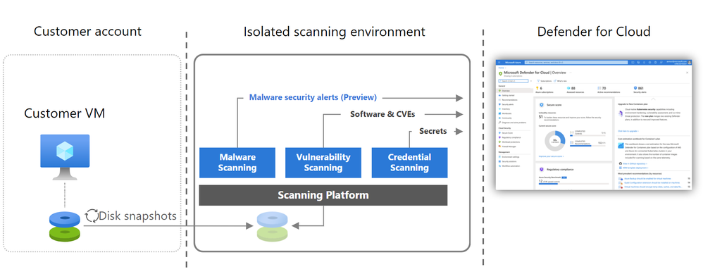
Security & Identity Updates
Agentless malware scanning for servers with Defender for Cloud
Agentless scanning continuously conducted periodic inspections of VM filesystems to surface posture issues, and now extending to threat detection as well, it harnesses the power of MDAV engine to detect malicious files on VMs. Onboarded VMs undergo a daily inspection, with MDAV scans combining signature-based with heuristic methods to assess files. Each scan utilizes our latest signatures and threat intelligence feeds to detect threats early on.
When malicious files are detected, Defender for Cloud generates detailed alerts with context.
Agentless malware scanning is included with Defender for Servers P2 and becomes an integral part for VMs already enabled for agentless scanning.

Slide 6
Compute

Slide 7
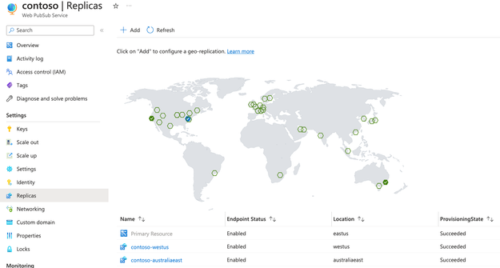
Compute Updates
Private Preview: Upgrade existing Azure Gen1 VMs to Gen2-Trusted launch
MS announced preview support to enable Trusted launch on existing Azure Gen1 VMs by upgrading the Gen1 VM to Gen2-Trusted launch. This will help improve the foundational security of existing Azure VMs.
Trusted Launch VMs provide foundational compute security to Azure Generation 2 VMs by enabling Secure Boot and vTPM capabilities. Trusted Launch capabilities protects OS against rootkits, boot kits and enables attestation by measuring the boot chain of VM.
Web PubSub Geo-Replica is GA
Geo-replication is generally available and setting up replicas is as easy as a few clicks on Azure Portal.
After enabling geo-replications, a DNS router (Azure Traffic Manager) is put in front of Web PubSub resource. Both clients and servers will be routed to the closest Web PubSub replicas. Health checks are done periodically by the traffic manager. An automatic DNS failover will happen within 3 minutes if a replica becomes unavailable. So, the most disruption to the application is limited to a maximum of 3 minutes.
Sending messages to clients in the same region will be extremely fast (usually < 10ms). When sending messages to a group of clients that are connected to different replicas, messages between replicas go through the Azure network backbone which has improved speed and reliability.

Slide 8
Storage & Data

Slide 9
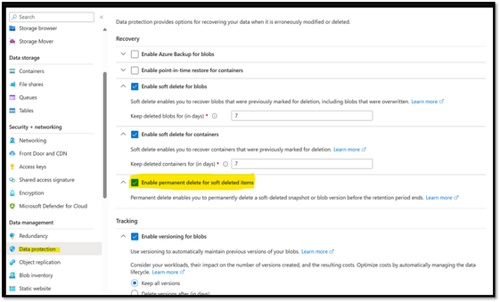
Storage & Data Updates
Azure Data Factory is generally available in two more regions
Azure Data Factory is now available in two new regions:
Israel Central
Italy North
Data Factory can be now provisioned in the new regions in order to co-locate Extract-Transform-Load logic with data lake and compute.
Permanent Delete of Soft Delete Items
The API version 2020-02-10 and later, allows to permanently delete a soft-deleted snapshot or version. Permanent delete enables to permanently delete a soft-deleted snapshot or blob version before the retention period ends.
The storage account must have versioning or snapshots enabled. Soft-delete must also be enabled on the storage account to soft-delete versions or snapshots of blobs in the account.
Please note Permanent delete option can be enabled from Azure Portal at the moment only for GPv2 Storage account without Hierarchical namespace enabled Storage account.

Slide 10
Databases

Slide 11
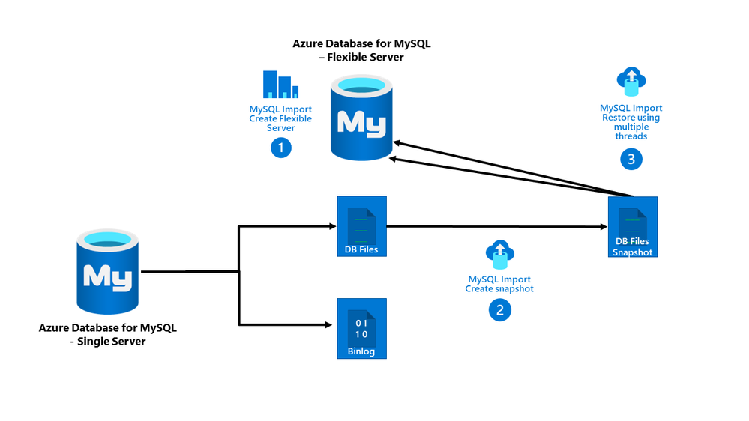
Databases Updates
General Availability: Azure MySQL Import feature for Azure Database for MySQL Single to Flexible Server migrations
Azure SQL Database – Single Server is being retired by September 16,2024. To facilitate seamless migration from Azure Database – Single Server to Flexible Server, MS announced the general availability of Azure MySQL Import.
With Azure MySQL Import, it is possible to migrate an Azure Database for MySQL - Single Server instance to Azure Database for MySQL- Flexible Server by running a single CLI command.
Azure Database for MySQL – Flexible Server is the best platform for running MySQL workloads on Azure. It is a fully managed database service designed to provide granular control and flexibility over database management functions and configuration settings for MySQL workloads.
Azure MySQL Import uses snapshot backup and restores technology to offer a simple and fast migration path to restore the source server's physical data files to the target server. Based on user-inputs, it takes up the responsibility of provisioning target Flexible Server and then taking the backup of the source server and restoring it on the target.
The key features of Azure MySQL Import include the following:
Supports Azure Database for MySQL - Single Server as data source.
Provisions target Flexible Server and consequently triggers import.
Supports schema, data and logins import.
Fast data backup and restore to target, suitable for bigger workloads.
Supports near-zero downtime
Supports migration for all compatible firewall rules from MySQL Single to Flexible Server instance.

Slide 12
Databases Updates
Public preview: Partition merge now supports shared throughput databases
Shared throughput databases can now merge unused partitions.
With partition merge, it is possible to rework the physical partitions for containers with fragmented throughput (less than 3000 request units per partition) or storage (less than 20 GB of storage per partition). If a container's throughput has been scaled up and needs to be scaled back down, merge can help resolve throughput fragmentation issues. For the same amount of provisioned RU/s, having fewer physical partitions means each physical partition gets more of the overall RU/s. Minimizing partitions reduces the chance of rate limiting if a large quantity of data is removed from a container and RU/s per partition is low. Merge can help clear out unused or empty partitions, effectively resolving storage fragmentation problems.
SQL MI Business Critical improved its storage-to-vCore ratio
Customers sometimes had to buy more vCores than their workloads required to be able to unlock the required amount of storage. For that reason, MS increased up to twice as much storage for the same number of vCores!
Business Critical | Before | Now (New in blue)
Max instance storage size (reserved) | Premium-series: - 1 TB for 4, 8 vCores - 2 TB for 16, 24 vCores - 4 TB for 32 vCores - 5.5 TB for 40, 64, 80 vCores Memory optimized premium-series: - 1 TB for 4, 8 vCores - 2 TB for 16, 24 vCores - 4 TB for 32 vCores - 5.5 TB for 40 vCores - 16 TB for 64 vCores | Premium-series: - 1 TB for 4, 6 vCores - 2 TB for 8, 10, 12 vCores - 4 TB for 16, 20 vCores - 5.5 TB for 24, 32, 40, (64, 80, 96, 128 vCores) - 16 TB for 64, 80, 96 and 128 vCores (in certain regions, see blog) Memory optimized premium-series: - 1 TB for 4, 6 vCores - 2 TB for 8, 10, 12 vCores - 4 TB for 16, 20 vCores - 5.5 TB for 24 vCores - 8 TB for 32, 40 vCores - 12 TB for 48 and 56 vCores - 16 TB for 64, 80, 96 and 128 vCores

Slide 13
ML & AI & IOT

Slide 14
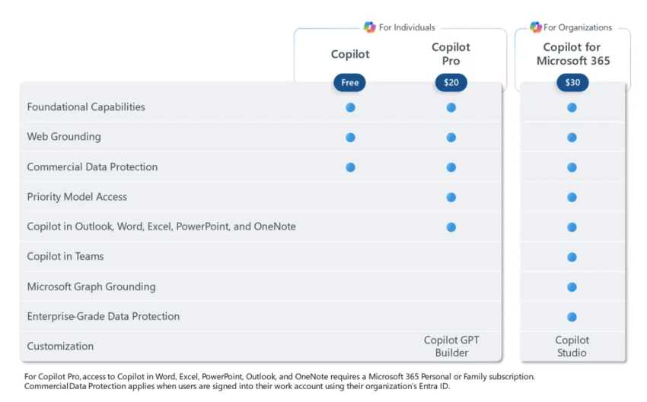
ML & AI & IOT Updates
Copilot Pro was released for Office 365
Copilot Pro offers a premium subscription at $20 per month. This service includes AI-enhanced functionalities within Office applications such as Word, Excel, and PowerPoint. Additionally, subscribers gain priority access to the newest OpenAI models and the capability to create their personalized Copilot GPT. Similar to what ChatGPT has with ChatGPT Plus.
Also MS removed 300 seats limitations

Slide 15
DevOps & IaC & Automation

Slide 16
DevOps & IaC & Automation
Final notice of alternate credentials deprecation
MS announced before that the alternate credentials feature will be formally deprecated in March 2020. Since then, a small number of users were grandfathered in with continued usage of existing alternate credentials, which have remained active until today.
Then it was second attempt in the middle of 2023 and also not successful.
Now MS announced that it will be fully deprecated in end of the January 2024.
The simplest of these alternative authentication methods would be replacing alternate credential with a new personal access token.
GitHub-hosted runners: Double the power for open source
From now on, any Linux or Windows workflow triggered from a public repository, using GitHub’s default labels, will run on our faster, more powerful 4-vCPUs, 16 GiB of memory, and 150GiB storage.
These new machines provide up to a 25% increase in performance for most CI/CD workloads without any configuration change required.
Rotating credentials for GitHub.com and new GHES patches
On December 26, 2023, GitHub received a report through Bug Bounty Program demonstrating a vulnerability which, if exploited, allowed access to credentials within a production container. It was fixed on GitHub.com the same day and rotation all potentially exposed credentials started
This vulnerability is also present on GitHub Enterprise Server (GHES). However, exploitation requires an authenticated user with an organization owner role to be logged into an account on the GHES instance, which is a significant set of mitigating circumstances to potential exploitation. A patch is available from January 16, 2024—for GHES versions 3.8.13, 3.9.8, 3.10.5, and 3.11.3.

Slide 17
Miscellaneous

Slide 18
Miscellaneous Updates
Announcing the availability of the new gMSA on AKS workshop
gMSA is incredibly popular (of course, anyone trying to containerize a Windows app that relies on AD for authentication will use it), but also because it is somewhat complex to configure it. Setting up gMSA means have to configure Kubernetes cluster, the networking between the cluster and Domain Controller(s), the secret store (such as Azure Key Vault), the Domain Controller itself, and so on…
Because so many resources need to be configured, many customers have a hard time to see how gMSA actually works before doing it in production. MS announced that now it is possible to try gMSA on AKS with a guided workshop. This workshop still requires a subscription to use, but all the other configurations can be implemented by following the workshop’s instructions. We plan to upgrade this into a self-contained workshop in the future.
This is an end-to-end workshop has the following objectives:
Provide an overview of gMSA on AKS, necessary components, and how to set up an environment for a Windows app that requires Active Directory authentication.
Understand how the AksGMSA PowerShell module helps in the process of configuring gMSA on AKS.
Understand the flow of configuring gMSA on AKS and how the multiple resources interact with each other.
The workshop is divided into seven exercises:
Exercise 01 - Spinning up Azure environment
Exercise 2 - Configure Active Directory
Exercise 3 - Enable Azure Bastion to RDP into DC01 VM and take note of additional resources
Exercise 4 - Configure the AksGMSA PowerShell module on the DC01 VM
Exercise 5 - Deploy gMSA on AKS and configure AD and Azure resources
Exercise 6 - Validate the deployment of gMSA on AKS
Exercise 7 - Deploy IIS with Windows authentication enabled

Slide 19
Information

Slide 20
Information
Azure Times GitHub Repo

Slide 21
Questions

