Slide 1
Azure Times #146
January 6, 2025

Slide 2
Networking

Slide 3
Networking Updates
Azure CDN from Edgio is shutting down on January 15, 2025
If Azure CDN from Edgio customers don't set the Feature Flag DoNotForceMigrateEdgioCDNProfiles before 7 January 2025, Microsoft will migrate existing Azure CDN from Edgio profiles to Azure Front Door Standard profiles. Migration is happening between January 7th and 14th, 2025. These migrations to Azure Front Door are performed on a "best effort" basis, and doing so might cause issues related to the billing, features, availability, and/or performance you're currently consuming with Azure CDN from Edgio.

Slide 4
Security & Identity

Slide 5
Security & Identity Updates
Sensitivity scanning capabilities now include Azure file shares
Defender for Cloud's Security Posture Management (CSPM) sensitivity scanning capabilities now include Azure file shares in GA in addition to blob containers.
Before this update, enabling the Defender CSPM plan on a subscription would automatically scan blob containers within storage accounts for sensitive data. With this update, Defender for CSPM's sensitivity scanning feature now includes file shares within those storage accounts. This enhancement improves the risk assessment and protection of sensitive storage accounts, providing a more comprehensive analysis of potential risks.
Integrate Defender for Cloud CLI with Popular CI/CD Tools
The CLI can now be incorporated into CI/CD pipelines to scan and identify security vulnerabilities in containerized source code. This feature assists development teams in detecting and addressing code vulnerabilities during pipeline execution. It requires authentication to Microsoft Defender for Cloud and modifications to the pipeline script. Scan results will be uploaded to Microsoft Defender for Cloud, allowing security teams to view and correlate them with containers in the container registry. This solution delivers continuous and automated insights to expedite risk detection and response, ensuring security without disrupting workflows.

Slide 6
Security & Identity Updates
Revised interval options for Defender for Cloud scan of a cloud environment
The scan interval options for cloud connectors associated with AWS, GCP, Jfrog, and DockerHub have been revised. The scan interval feature allows to control the frequency at which the Defender for Cloud initiates a scan of the cloud environment. It is possible to set up scan interval to 4, 6, 12, or 24 hours, when adding or editing a cloud connector. The default scan interval for new connectors continues to be 12 hours.
GA: FIPS 140-2 Level 3 HSMs Premium Key Vault in Mooncake China
The FIPS 140-2 Level 3 HSMs offer the highest level of security for cryptographic keys, ensuring data is protected with the most stringent standards.
Enhanced Security: FIPS 140-2 Level 3 certification ensures that the HSMs meet rigorous security requirements, providing robust protection for your cryptographic keys.
Compliance: This launch helps customers in highly regulated industries meet their compliance requirements.
This general availability is offered in the China North 3, China North 2, China East 3, and China East 2 regions.

Slide 7
Security & Identity Updates
General Availability - Privileged Identity Management integration in Azure Role Based Access Control
Privileged Identity Management (PIM) capabilities are now integrated into the Azure Role Based Access Control (Azure RBAC) UI. Before this integration, RBAC admins could only manage standing access (active permanent role assignments) from the Azure RBAC UI. With this integration, just-in-time access and timebound access, which are functionalities supported by PIM, are now brought into the Azure RBAC UI for customers with either a P2, or Identity Governance, license.
General Availability - Microsoft Entra External ID Custom URL Domains
This feature allows to customize Microsoft default sign in authentication endpoint with own brand names. Custom URL Domains help users to change Ext ID endpoint < tenant-name >.ciamlogin.com to login.contoso.com.

Slide 8
Security & Identity Updates
General Availability - Temporary Access Pass (TAP) support for internal guest users
Microsoft Entra ID now supports issuing Temporary Access Passes (TAP) to internal guest users. TAPs can be issued to internal guests just like normal members, through the Microsoft Entra ID Admin Center, or natively through Microsoft Graph. With this enhancement, internal guests can now seamlessly onboard, and recover, their accounts with time-bound temporary credentials.
General Availability - Update Profile Photo in MyAccount
Users can now update profile photo directly from their MyAccount portal. This change exposes a new edit button on the profile photo section of the user’s account.
In some environments, it’s necessary to prevent users from making this change. Global Administrators can manage this using a tenant-wide policy.

Slide 9
Security & Identity Updates
General Availability - Expansion of SSPR Policy Audit Logging
Starting Mid-January, MS improving the audit logs for changes made to the SSPR Policy.
With this improvement, any change to the SSPR policy configuration, including enablement or disablement, will result in an audit log entry that includes details about the change made. Additionally, both the previous values and current values from the change will be recorded within the audit log. This additional information can be found by selecting an audit log entry and selecting the Modified Properties tab within the entry.
These changes are rolled out in phases:
Phase 1 includes logging for the Authentication Methods, Registration, Notifications, and Customization configuration settings.
Phase 2 includes logging for the On-premises integration configuration settings.
Public Preview - Sign in with Apple
This new feature adds Apple to list of preconfigured social identity providers. As the first social identity provider implemented on the eSTS platform, it introduces a "Sign in with Apple" button to the sign-in options, allowing users to access applications with their Apple accounts.

Slide 10
Security & Identity Updates
Public Preview - Provision custom security attributes from HR sources
With this feature, customers can automatically provision "custom security attributes" in Microsoft Entra ID from authoritative HR sources. Supported authoritative sources include: Workday, SAP SuccessFactors, and any HR system integrated using API-driven provisioning.
Public Preview - Microsoft Entra ID Governance: access package request suggestions
MS introduced a new feature in My Access: a curated list of suggested access packages. This capability allows users to quickly view the most relevant access packages (based off their peers' access packages and previous requests) without scrolling through a long list.

Slide 11
Management & Governance

Slide 12
Management & Governance Updates
GA: New Zealand North Region added to Azure HDInsight
HDInsight is now generally available in New Zealand North. Azure HDInsight is a managed, full-spectrum, open-source analytics service in the cloud for enterprises.

Slide 13
Compute

Slide 14
Compute Updates
SQL Server Containers and SQL Server on Linux Now Available on Windows via WSL
MS announced that developers can now easily get started with SQL Server container images and SQL Server on Linux installations directly on Windows machines using Windows Subsystem for Linux (WSL). This new capability is designed to streamline development process, making it more efficient and versatile.

Slide 15
Storage & Data

Slide 16
Storage & Data Updates
GA: Azure NetApp Files 50 GiB minimum volume sizes
This enhancement allows to create an Azure NetApp Files volume as small as 50 GiB—a reduction from the initial minimum size of 100 GiB. This reduced size can save costs for workloads that require volumes smaller than 100 GiB, allowing to appropriately size storage volumes. All volume workflows which were supported with a 100 GiB minimum volume size are now supported with this new minimum size of 50 GiB.
GA: creating volumes with the same file path, share name, or volume path in different availability zones
Azure NetApp Files allows to create volumes with the same file path (NFS), share name (SMB), or volume path (dual-protocol) as long as they are in different availability zones.

Slide 17
Storage & Data Updates
PP: Cloud Backup for Virtual Machines on Azure NetApp Files datastores for Azure VMware Solution
Cloud Backup for Virtual Machines now integrates with Azure NetApp Files backup, significantly enhancing data protection by offering a fully managed backup solution for long-term recovery, archiving, and compliance. This integration allows to mount a datastore from a snapshot or Azure NetApp Files backup to restore files. It is possible to mount the backup to either the Azure VMware Solution host where it was created or to an alternate host.
Cloud Backup for Virtual Machines now also includes the capability to attach one or more VMDKs from a backup to the parent VM, to an alternate VM on the same Azure VMware Solution host, or to an alternate VM on an alternate host managed by the same vCenter instance.

Slide 18
DevOps & IaC & Automation

Slide 19
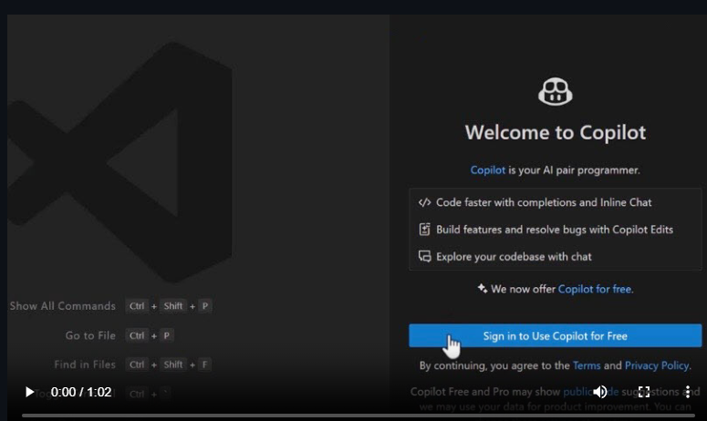
DevOps & IaC & Automation
Announcing a free GitHub Copilot for VS Code
MS announced a new free plan for GitHub Copilot, available for everyone today in VS Code. All is needed is a GitHub account. No trial. No subscription. No credit card required.
GitHub Copilot Free provides 2000 code completions/month. That's about 80 per working day and 50 chat requests/month.
Azure DevOps Switching CDN Providers
The current content delivery network (CDN) provider Edgio, used by Azure DevOps is retiring. MS is urgently transitioning to a solution served by Akamai and Azure Front Door CDNs to maintain the responsiveness of our services.
If network includes firewalls that could affect access to the new CDNs, the following domain URLs should be whitelisted:
https://*.vsassets.io
https://vstsagentpackage.azureedge.net

Slide 20
Information

Slide 21
Information
Azure Times GitHub Repo

Slide 22
Questions

