Slide 1
Azure Times #135
September 23, 2024

Slide 2
Security & Identity

Slide 3
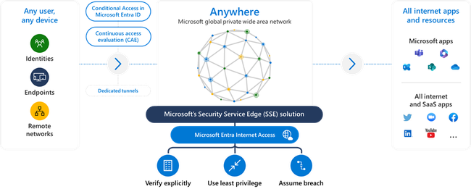
Security & Identity Updates
Microsoft Entra Internet Access now generally available
Internet Access secures access to all internet and SaaS applications and resources with an identity-centric secure web gateway (SWG) solution, unifying identity and network access controls through a single Zero Trust policy engine to close security gaps and minimize the risk of cyberthreats. MS solution integrates seamlessly with Microsoft Entra ID, eliminating the need to manage users, groups, and apps in multiple locations. It protects users, devices, and resources with capabilities such as universal Conditional Access, context aware network security, and web content filtering, so no longer need to manage multiple disconnected network security tools.
It:
Unified identity and network security
Protect your users with context aware network security
Provide defense in depth against token replay attacks with Compliant Network check
Protect against data exfiltration by enabling universal tenant restrictions (TRv2) controls
Avoid obfuscating original user source IP
Deliver fast and consistent access at a global scale

Slide 4
Management & Governance

Slide 5
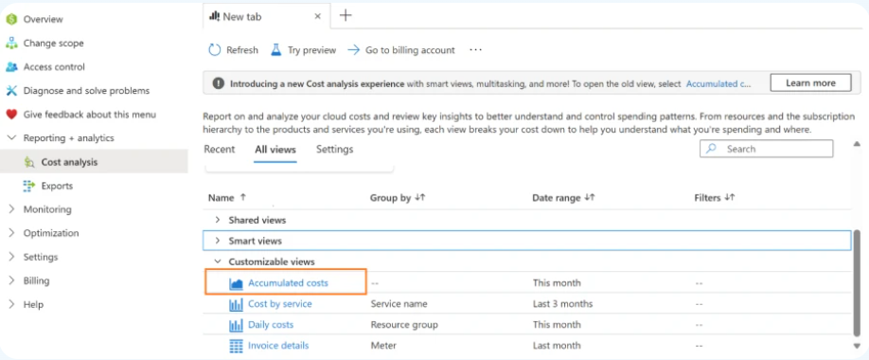
Management & Governance Updates
Generally Available: Azure Site Recovery update rollup 75 – August 2024
Mobility Service:
Added support for Linux OS
Microsoft Cost Management updates—August 2024
Azure OpenAI Service Provisioned Reservations
The default landing page of Accumulated costs will only be available as a view accessible from the customizable views section under All Views as shown in the screenshot below. The rollout of these updates is expected to be completed by the end of October 2024. Please note that the functionality of these views remains the same.

Slide 6
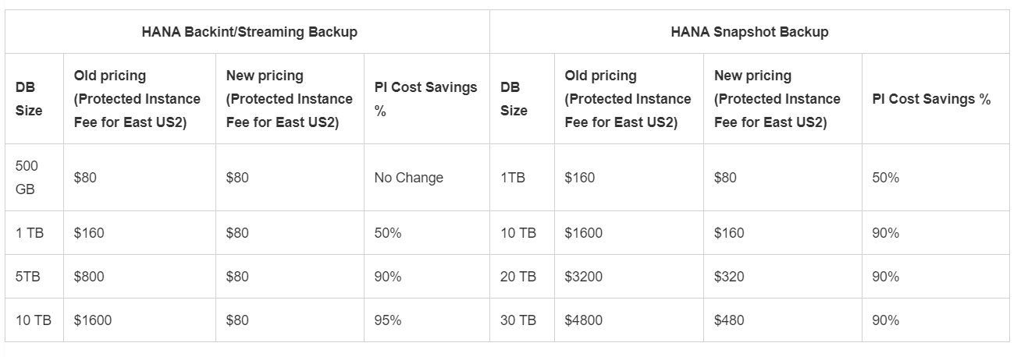
Management & Governance Updates
Azure Backup-SAP HANA DB Backup Delivers More Value at Lower TCO with Reduced Protected Instance Fee
MS announced a significant update that will bring enhanced cost efficiency to our SAP HANA Database Backup service. Starting September 1, 2024, ms is reducing the Protected Instance (PI) fees for "Azure Backup for SAP HANA on Azure VM."
Announcing the Public Preview of Azure Monitor Metrics Export
Currently, export of metrics supported via Diagnostic Settings is limited. Customers cannot export metrics with dimensions, not all metrics are supported, and it incur a few minutes of latency.
MS announced a platform metrics from Azure Monitor. This powerful addition allows customers to export metrics for their Azure resources on a large scale with full fidelity and low latency, along with the new added ability to filter particular metrics while configuring exports.
Azure Monitor Metrics Export is configurable through Data Collection Rules (DCR), which provides the capability to route Azure resource metrics data to Azure Storage Accounts, Azure Event Hubs and Azure Log Analytics Workspace for 18 resource types and 10 Azure public regions.
DCRs for metrics export have the following limitations:
Only one destination type can be specified per DCR.
A maximum of 5 DCRs can be associated with a single Azure Resource.

Slide 7
Management & Governance Updates
Generally Available: Automated Patching retirement and replacement with Azure Update Manager
Effective Sept 15th, 2027, MS will be retiring the Automated Patching feature and replacing it with Azure Update Manager. This decision was made after careful consideration, and MS believe it will lead to a more streamlined and efficient process for managing updates.
Azure Update Manager provides:
Centralize Update Management
Customize Schedule
Patch Compliance Report

Slide 8
Compute

Slide 9
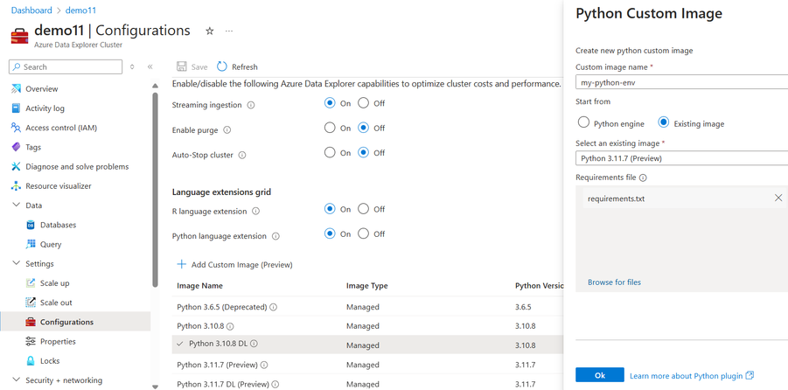
Compute Updates
New Custom and Managed Python images in Azure Data Explorer
Azure Data Explorer (ADX) supports running Python code embedded in KQL query using the python() plugin . The plugin runtime is hosted in a sandbox, an isolated and secured environment hosted on ADX existing compute nodes. This sandbox contains the language engine as well as common mathematical and scientific packages.
MS introduced new managed Python images as well as the option to fully customize the Python image to include required Python packages:
Managed images are Python environment that are built and maintained by the Kusto team, containing specific Python engine and a set of packages. MS added Python 3.11.7 and Python 3.11.7 DL (containing torch & tensorflow), both images contain up to date Python engine 3.11.7 and packages .
Custom images let create specific Python images in case of needs additional packages or different versions of the Python engine and/or packages.

Slide 10
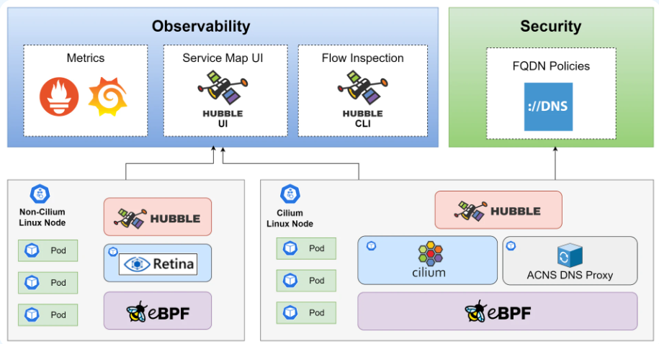
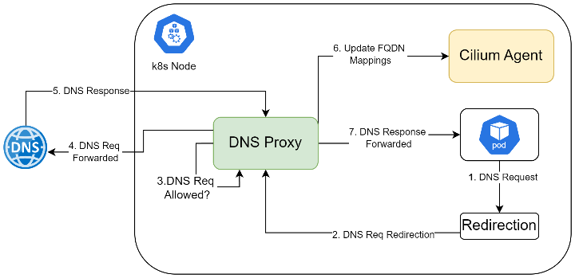
Compute Updates
Public Preview: Advanced Container Networking Services: Enhancing security and observability in AKS
Advanced Container Networking Service offers advanced security feature, FQDN filtering. FQDN filtering allows you to define granular network policies based on domain names rather than IP addresses. This simplifies policy management, reduces administrative overhead, and ensures consistent policy enforcement across the network. By restricting access to specific domains, FQDN filtering helps prevent unauthorized access and mitigate security risks.
To complement FQDN filtering, the HA DNS proxy ensures uninterrupted DNS resolution. This redundancy enhances the overall reliability and availability of your containerized applications, minimizing downtime and disruptions.
FQDN filtering allows you to create pod level policies using domain names rather than IP addresses, which eliminates the need to update policies when an IP address changes.
Cilium Agent: The Cilium Agent is a critical networking component that runs as a DaemonSet within Azure CNI clusters powered by Cilium. It handles networking, load balancing, and network policies for pods in the cluster. For pods with enforced FQDN policies, the Cilium Agent redirects packets to the DNS Proxy for DNS resolution and updates the network policy using the FQDN-IP mappings obtained from the DNS Proxy.
ACNS DNS Proxy: ACNS DNS Proxy runs as DaemonSet in Azure CNI powered by Cilium cluster with Advanced Container Networking services enabled. It handles DNS resolution for pods and on successful DNS resolution, it updates Cilium Agent with FQDN to IP mappings.

Slide 11
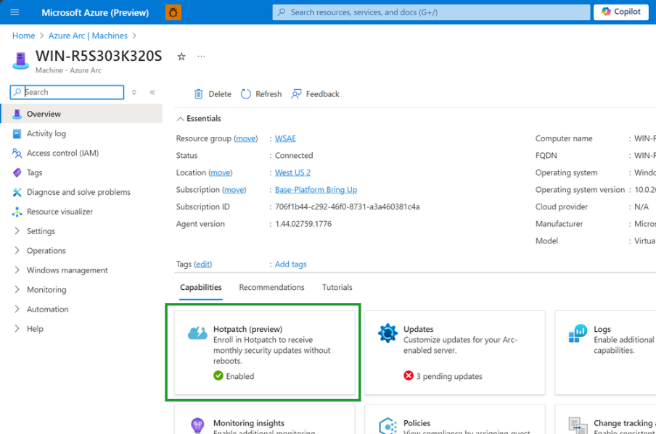
Compute Updates
Now in preview: Hotpatch for Windows Server 2025
Standard and Datacenter edition server hotpatching - security updates without reboots - is ready for your evaluation in Windows Server 2025 Azure Arc-enabled Hotpatch public preview. This feature will be a game changer; simpler change control, shorter patch windows, easier orchestration
How to preview: Azure Arc-connected Hotpatching for Windows Server 2025
With this preview you can connect your Windows Server 2025 Datacenter Evaluation edition machines to Azure Arc and subscribe to Hotpatching.
Connect to Azure Arc Windows Server 2025 Datacenter Evaluation machines
Subscribe/ unsubscribe Hotpatching service via the Azure Arc portal
Manage deployment of Hotpatch updates natively on Azure via Azure Update Manager.
There are some prerequisites:
Windows Server 2025 Datacenter evaluation
Virtualization Based Security should be enabled and running on your machine
July Security update installed
Machines should be Azure Arc connected

Slide 12
Storage & Data

Slide 13
Storage & Data Updates
Generally Available: Azure Data Box 80 TB is now Generally available at Azure China
Azure Data Box 80 TB SKU is now generally available at Azure China. Azure Data Box is Azure’s offline data transfer solution.
Customers in China can order a device to import or export data to/from any of the Azure China regions.
Generally Available: Azure NetApp Files Reserved Capacity
By committing to a one-year or three-year of Azure NetApp Files reserved capacity, allows to safe up to 34% on sustained usage of Azure NetApp Files. Reserved capacity is available in stackable increments of 100TiB and 1PiB on Standard, Premium and Ultra service levels in a given region.
Azure NetApp Files reserved capacity benefits are automatically applied to existing Azure NetApp Files capacity pools in matching region and service level.

Slide 14
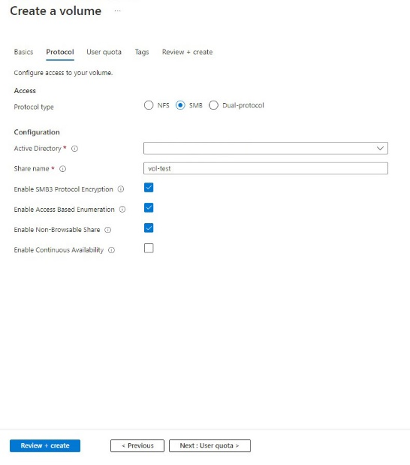
Storage & Data Updates
Generally Available: Access-based enumeration and non-browsable shares for SMB and dual-protocol Azure NetApp Files volumes
In environments with Azure NetApp Files volumes that are shared among multiple departments, projects and users, users can see the existence of other files and folders in directory listings even if they do not have permissions to access those items.
Enabling Access-based enumeration (ABE) on Azure NetApp Files volumes ensures users only see those files and folders in directory listings that they have permission to access
It is now possible to enable ABE on Azure NetApp Files SMB and dual-protocol (with NTFS security style) volumes.
By default, Azure NetApp Files SMB and dual-protocol volumes show up in the list of shares in Windows Files Explorer. In certain scenarios, customers may wish to exclude specific Azure NetApp Files volumes from being listed due to their sensitive content or other reasons.
It is now possible to configure these volumes as non-browsable in Azure NetApp Files. This new feature prevents the Windows client from browsing the share, and the share does not show up in the Windows File Explorer. This new capability provides an additional layer of security by not displaying these shares. This setting does not impact permissions and users who have access to the share will maintain access.

Slide 15
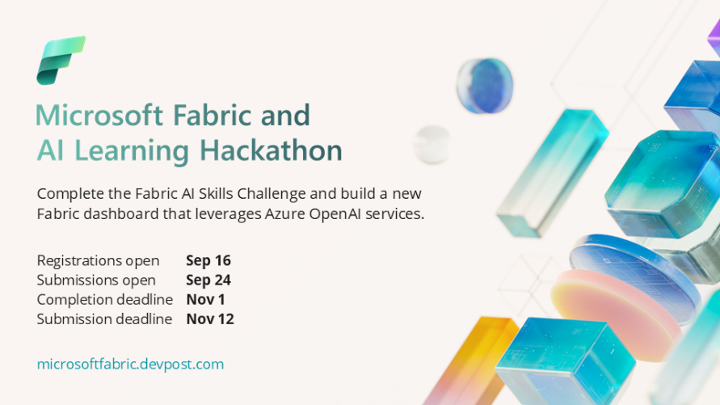
Storage & Data Updates
Announcing: The Microsoft Fabric & AI Learning Hackathon
Generally Available: Force detach zone redundant data disks during zone outage
MS excited to announce the GA support to force detach ZRS data disks from a stand-alone Virtual Machine or Virtual machine scale sets residing on a zone impacted by failure. Now it is possible to detach the ZRS data disks and attach them to another VM, decreasing the RTO.

Slide 16
ML & AI & IOT

Slide 17
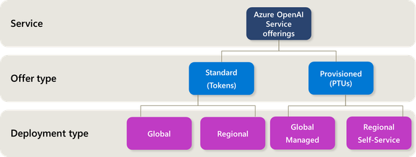
ML & AI & IOT Updates
Announcing Global Provisioned Managed Deployments for Scaling Azure OpenAI Service Workloads
MS announced a major advancement in AI deployments with Azure OpenAI Service: Global Provisioned Managed Deployments, now Generally Available (GA) as of September 18, 2024.
Global Provisioned Managed is a new deployment type within the Azure OpenAI Service that leverages Azure's global infrastructure to serve provisioned traffic more efficiently. It supports the latest GPT-4o (2024-08-06) and GPT-4o-mini (2024-07-18) models, making them accessible to customers without the limitations of region-specific quotas or capacities.
Access to the Latest Models Everywhere: The Global Provisioned Managed deployment model removes regional limitations, allowing customers to access the newest AI models like GPT-4o and GPT-4o-mini across all supported Azure regions, including eastus, westeurope, japaneast, and more.
Simplified Deployment and Management: Unlike traditional deployment approaches, Global Provisioned Managed decouples capacity management from specific regions, granting automatic access to the new global quota for all eligible customers.
Data Residency and Compliance Flexibility: While API traffic may be processed globally, all customer data is securely stored in the Azure OpenAI Service resource’s region, ensuring adherence to regional data residency and compliance requirements.
Transparent and Flexible Pricing: Billing for Global Provisioned Managed follows the same model as existing Provisioned Managed deployments, ensuring predictable costs with options for hourly pricing and reservations to accommodate diverse usage scenarios.
Dual Deployment Options for Greater Flexibility: The availability of the GPT-4o model for both Global Provisioned Managed and Provisioned Regional Deployments gives customers the freedom to choose the most suitable deployment strategy for their organizational needs

Slide 18
ML & AI & IOT Updates
Announcing GA of new Indian voices
MS Announced:
Release of 11 new voices for English (India) and Hindi languages in female and male categories.
Upgrade existing English (Indian) and Hindi voices to be more expressive and natural.
Expand portfolio of languages to include Assamese, Punjabi and Oriya languages for both female and male categories. With this, Azure now supports 13 Indian languages, which serve more than 90% of the Indian market.

Slide 19
Miscellaneous

Slide 20
Miscellaneous Updates
Retirement: Azure Managed Confidential Consortium Framework (CCF) Service Support Ending on November 22nd, 2024
Azure Managed Confidential Consortium Framework (CCF) service support will be ending on November 22nd, 2024. After this date, there will be no further support, and instances will be scheduled for deletion.
To avoid any service disruptions, MS recommend to begin planning migration to Azure Confidential Ledger as soon as possible. From September 21st, 2024, the creation of new Azure Managed CCF instances will no longer be possible. Existing instances will continue to be available until the final support date of November 22nd, 2024.
Retirement: Azure AI Vision APIs to be retired
Azure AI Vision is retiring Image Analysis 4.0 Custom Image Classification, Custom Object Detection, Product Recognition and Segment (Background Removal) Preview APIs, and Spatial Analysis Edge container.
On January 10th, 2025, Image Analysis 4.0 Custom Image Classification, Custom Object Detection, Product Recognition and Segment (Background Removal) Preview APIs will be retired and all requests to the service will fail.
On March 30th, 2025, Spatial Analysis Edge container will be retired and all requests to the service will fail.
To avoid interruption for Custom Image classification and Object detection APIs, transition to Azure AI Custom Vision service by January 10th, 2025.
Retirement: Azure Maps Data Registry APIs V 2023-06-01 will be retired on September 30th, 2025
Azure Maps Data Registry APIs V 06-01-2023 will be retired on September 30th, 2025.
On September 30th, 2025—workloads running Azure Maps Data Registry API V 2023-06-01 will be deleted and associated application data will be lost.
To avoid service disruptions, please stop usage of Azure Maps Data Registry API V 2023-06-01 by September 30th, 2025.
Retirement: Microsoft Genomics Service
MS is retiring the Microsoft Genomics service, as Microsoft has developed more flexible open-source genomics solutions that provide equivalent capabilities and much more. MS encourage to transition to Cromwell on Azure prior to the retirement date to experience these new capabilities.

Slide 21
Miscellaneous Updates
Retirement: Azure Maps Creator Service APIs V2 & 2023-03-01-preview will be retired on September 30, 2025
Azure Maps Creator Service APIs V2 & 2023-03-01-preview will be retired on September 30, 2025.
To avoid service disruptions, please stop usage of Azure Maps Creator Service APIs V2 & 2023-03-01-preview, Creator SDK Indoor Modules, Creator On-Boarding Tool, and QGIS Plug-in by September 30, 2025.
Retirement: Azure SQL Edge will be retired on September 30th, 2025
Beginning September 30th, 2025 Azure SQL edge service will be retired. To ensure a smooth transition, migrate to one of the following services:
SQL Server Express edition: SQL Server Express edition utilizes the same database engine as Azure SQL Edge. This free version can run in containers, just like SQL Edge. SQL Server Express edition is also fully supported for 5 years and there’re 5 years of extended support.
SQL Server Standard edition: SQL Server Standard edition provides a cost-effective solution with essential database management features and capabilities, making it the best choice for SQL edge applications that surpass the limits of Express edition.
SQL Managed Instance enabled by Azure Arc: SQL Managed Instance enabled by Azure Arc offers a robust solution. This service provides near 100% compatibility with the latest SQL Server database engine.
Retirement: Azure Remote Rendering will be retired on September 30th, 2025
Remote Rendering will be retired on September 30th, 2025, please make plans to stop usage by that date. From now until 30 September 2025, subscriptions with existing Remote Rendering accounts can continue to use Remote Rendering without disruption, including making new Remote Rendering accounts. Subscriptions that do not have an existing Remote Rendering account, will no longer be able to create Remote Rendering accounts. On September 30th, 2025, all Remote Rendering accounts will be deleted, and the service will stop functioning.

Slide 22
Miscellaneous Updates
Retirement: Microsoft Purview Data Sharing (in Public Preview) is retiring on September 26th, 2025
On September 26th, 2025, MS will retire the Microsoft Purview Data Sharing capability. Before that date, in order to continue to use data sharing transition your data sharing workloads to Microsoft Fabric, which offers External data sharing capabilities.
MS recommend working with account manager or services partner to define a transition plan from Microsoft Purview Data Share to Microsoft Fabric.
Retirement: Support for PowerShell 7.2 on Azure Functions is ending on November 8, 2024
Support for PowerShell 7.2 on Azure Functions is ending on November 8, 2024. Apps that are hosted on Azure Functions will continue to run, but security updates will no longer be available, and we’ll no longer provide customer service for PowerShell 7.2. To avoid potential security vulnerabilities, minimize risk for Azure Functions apps, and take advantage of latest features, follow the steps to upgrade app to PowerShell 7.4 before November 8, 2024. Note that PowerShell 7.4, the latest version available today, has breaking changes. Please be sure to follow the migration guide linked above when upgrading.
Retirement: SQL Insights (preview)
SQL Insights (preview) will be retired on December 31st, 2024. MS recommend to transition to database watcher for Azure SQL or another database monitoring solution by that date.
After December 31st, 2024, SQL Insights (preview) will not be supported and will not be available in the Azure portal. Any existing monitoring data collected by SQL Insights in Log Analytics workspace will be retain.

Slide 23
Information

Slide 24
Information
Azure Times GitHub Repo

Slide 25
Questions

