Slide 1
Azure Times #92
October 25, 2023

Slide 2
Networking

Slide 3
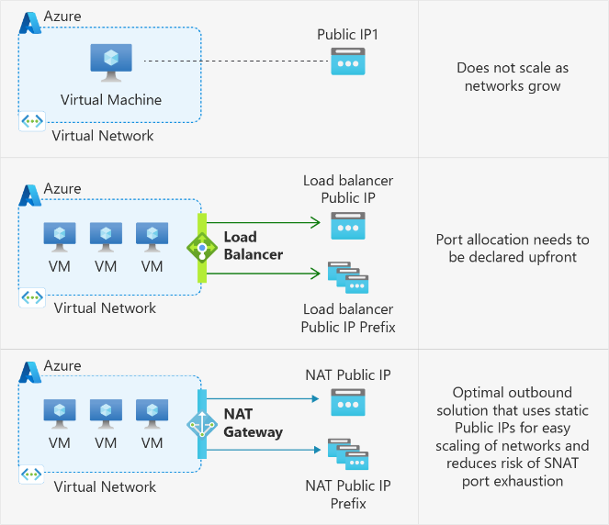
Networking Updates
Default outbound access for VMs in Azure will be retired— updates and more information
MS announced that on 30 September 2025, default outbound access connectivity for all new virtual machines in Azure will be retired. As noted, for enhanced security, Azure is moving towards a secure-by-default model. This means default outbound access to the internet will be turned off. After 30 September 2025, Azure will no longer assign a default implicit IP for VMs to communicate to the internet. Existing VMs will not be impacted by this retirement. If you are already using explicit outbound connectivity methods, you will not be impacted by this retirement.

Slide 4
Security & Identity

Slide 5
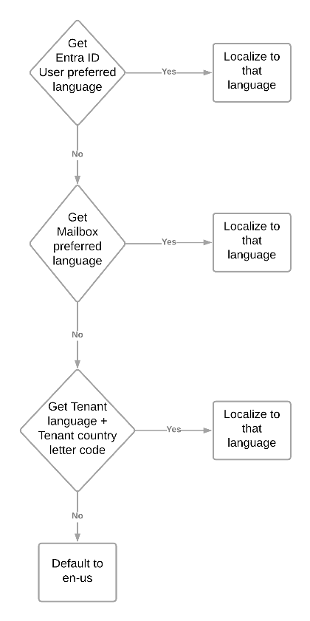
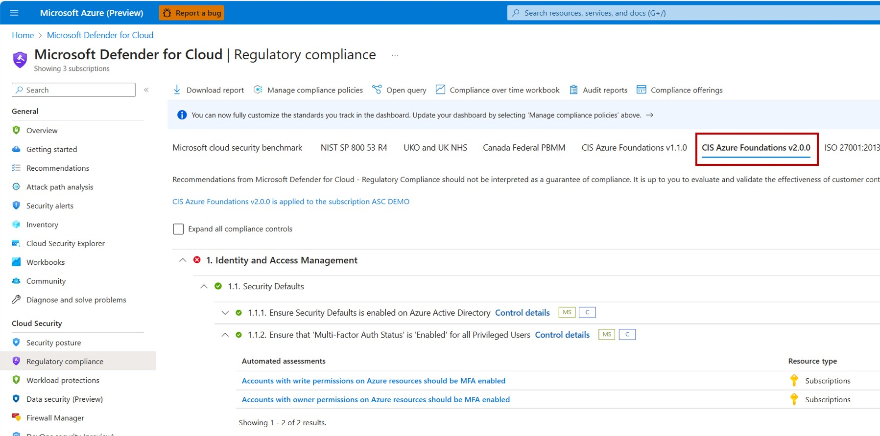
Security & Identity Updates
Microsoft Defender for Cloud Now Supports CIS Azure Security Foundations Benchmark 2.0.0
MS announced that Microsoft Defender for Cloud now supports the latest CIS Azure Security Foundations Benchmark - version 2.0.0. This release also includes the new corresponding built-in policy initiative in the Azure Policy blade.
The release of CIS Azure Security Foundations Benchmark v2.0.0 represents a major version shift of CIS Azure benchmark product support in Azure platform. The v2.0.0 aligns with Microsoft cloud security benchmark and now encompasses over 90 built-in Azure Policies, which is a substantial leap forward compared to the previous versions. The current versions of CIS Azure Security Foundations Benchmark (v1.4.0, v1.3.0, and v1.0) will be gradually phased out from Defender for Cloud.
Entra ID now enables you to receive emails in your preferred language.
MS added logic to check multiple places for language information to make the best possible choice for what language should be used an email in, and these changes are now generally available for Privileged Identity Management, Access Reviews and Entitlement Management.
The system will then check if the Entra ID user object has a preferred language set to determine the locale to be used.
If there are no user settings, MS will check whether the user has a mailbox and has a set preferred language on that mailbox.
After that, the system will fall back to the tenant's preferred language concatenated with the tenant's country letter code (fr-FR or en-US).
If the all above are false, the system will use default en-us.

Slide 6
Security & Identity Updates
Critical zero-day vulnerability CVE-2023-20198 in Cisco devices where thousands of devices have already been compromised
A critical zero-day vulnerability, identified as CVE-2023-20198, has been discovered in Cisco IOS XE devices.
This security flaw resides in the Web UI of Cisco IOS XE devices — a management interface designed to provide user-friendly device administration. Although this feature is intended to be disabled by default, recent data indicates an unsettling reality: approximately 150,000 devices globally have this interface enabled, posing an immense security risk
Microsoft Azure achieves HITRUST CSF v11 certification
Microsoft Azure has achieved HITRUST CSF v11.0.1 certification across 162 Azure services and 115 Azure Government services. All GA Azure regions across Azure and Azure Government clouds are included within this certification.

Slide 7
Management & Governance

Slide 8
Management & Governance Updates
Microsoft Azure available from new cloud region in Israel
MS is launching newest datacenter region in Israel. The new Israel Central datacenter region includes Azure Availability Zones, which offer additional resiliency for applications by designing the region with independent power, network, and cooling for additional tolerance to datacenter failures
Announcing AuthorizationResources in Azure Resource Graph
MS announced support for Azure RBAC resources in Azure Resource Graph (ARG) via the AuthorizationResources table! It is possible now to qury Role Assignments, Role Definitions, and Classic Admins resources. This table allows quickly answer questions such as “how many users are using a role definition?” or “how many role assignments are used?” or “how many role definitions are used?”.
Then, act on the results to clean up unused role definitions, remove redundant role assignments, or optimize existing role assignments using AAD Groups.
AuthorizationResources
| where type =~ 'microsoft.authorization/roleassignments'
| extend principalType = tostring(properties['principalType'])
| extend principalId = tostring(properties['principalId'])
| extend roleDefinitionId = tolower(tostring(properties['roleDefinitionId']))
| join kind=inner (
AuthorizationResources
| where type =~ 'microsoft.authorization/roledefinitions'
| extend id = tolower(id)
) on $left.roleDefinitionId == $right.id
| summarize count() by roleDefinitionId, principalType
| where count_ > 1
| sort by count_ desc

Slide 9
Management & Governance Updates
Application Insights Enhancements for Azure Logic Apps (Standard) reaches General Availability
General
Implemented consistency of names/Ids being used across different events and tables. These include:
Workflow Id
Workflow name
Run Id
Requests table
Reducing redundant data across tables.
Reducing the amount of storage required by your Application Insights instance by moving key information from the trace table to the requests table. This avoids customers having to collect both sets of information to obtain a complete view of your workflow executions.
Moving custom tracking ids and tracked properties from trace table to requests table.
Making retry events easier to track.
For trigger and action events, we now include the Trigger/Action type and the API name that allows you to query for the use of specific connectors.
Traces table
Reduced the amount of verbosity in traces.
Added meaningful categories and log levels to provide more flexibility with filtering.
Workflow start/end records now stored in traces table.
Batch events are now emitted to this table.
Events using a consistent id/name, resource, and correlation details.
Exceptions
Making Exceptions more descriptive.
Exceptions are now captured for action/trigger failures.
Filtering (at source)
Advanced filtering that allows for more control over how events are emitted including: actions and triggers.
More control over filtering non-workflow related events.
Log Stream Support
When using Logic Apps (Standard), developers can use the Log stream feature to view a stream of application log files. This source includes verbose technical information and is equivalent to the output seen when you debug your workflows during local development.
Live Metrics Stream Support
When logic app is connected to Application Insights ,it is possible to view log data and other metrics in near real-time in the Azure portal using Live Metrics Stream. Visualizations are available that allow you to plot incoming requests, outgoing requests and overall health. It also includes a table of trace level diagnostics.

Slide 10
Management & Governance Updates
General Availability of Azure Automation extension for Visual Studio Code
Visual Studio Code is a lightweight source code editor which runs on desktop and is available for Linux, macOS, and Windows. It provides an industry leading creation & editing experience for languages and runtimes like PowerShell, Python etc. The extension offers features for runbook management operations like editing runbook, triggering a job, tracking recent jobs, linking a schedule, asset management, local debugging etc. ensuring the developers and IT admins can author, debug, edit and manage automation runbooks without leaving the IDE (Visual Studio Code).
Supports all the Automation – PowerShell 5, PowerShell 7, Python 2 and Python3 Runbooks
Supports test execution of job, publishing automation Job and triggering job in Azure as well as Hybrid runbook workers. You can execute runbooks locally also.
Supports Python positional parameters and PowerShell parameters for job tiggering.
Supports linking a Schedule to Runbook and creating webhook. Starting a job through Webhook is simplified.
Manage the Automation Assets – certificates, variables, credentials, and connections.
See the recent last 10 jobs by right clicking on the job and select ‘Job Output’ from the menu.
Debug PowerShell scripts locally.
Compare local Runbook to the published or the draft runbook.
With this extension, here is the list of supported Runbook management operations.

Slide 11
Compute

Slide 12
Compute Updates
Version 1.2.4677of the Windows Desktop client for AVD released this week to all users!
Added new parameters for multiple monitor configuration when connecting to a remote resource using the Uniform Resource Identifier (URI) scheme.
Added support for the following languages: Czech (Czechia), Hungarian (Hungary), Indonesian (Indonesia), Korean (Korea), Portuguese (Portugal), Turkish (Türkiye).
Fixed a bug that caused a crash when using Teams Media Optimization.
Improved client logging, diagnostics, and error classification to help admins troubleshoot connection and feed issues.
Public Preview: VMSS Automatic Instance Repairs - Reimage, Restart Repair Actions
Automatic instance repairs help Virtual Machine Scale Set customers achieve high application availability by automatically detecting and recovering unhealthy VM instances at runtime.
MS announced that customers can now choose between Replace, Reimage (Preview), or Restart (Preview) as the default repair action performed in response to an "Unhealthy" application signal. These new options provide a less-impactful repair process, ensuring higher application availability while preserving VM properties and metadata for customers with sensitive workloads.

Slide 13
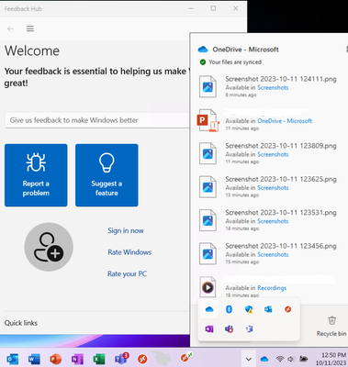
Compute Updates
OneDrive support for Azure Virtual Desktop RemoteApps in public preview
OneDrive is a robust but simple-to-use cloud storage platform for small businesses, enterprises, and everything in between. Unlike other cloud storage providers, most of the advanced enterprise-focused features in OneDrive are available for every subscription type, enabling organizations to use OneDrive in whatever way benefits them the most.
Previously, OneDrive could only be used on Azure Virtual Desktop with non-persistent desktops and was not supported on RemoteApps.
With this new support, It allows to use Microsoft OneDrive alongside a RemoteApp in Azure Virtual Desktop, allowing users to access and synchronize their files while using a RemoteApp. When a user connects to a RemoteApp, OneDrive can automatically launch as a companion to the RemoteApp. The new support has the same features and usability as the OneDrive on your personal device.

Slide 14
Compute Updates
.NET Framework Custom Code for Azure Logic Apps (Standard) Reaches General Availability
MS announced the General Availability (GA) of .NET Framework custom code for Azure Logic Apps (Standard). This capability allows to extend low code solutions with the power of custom code. Once a developer has written and compiled their .NET Framework code, it can be called from a built-in action from within a workflow. In addition, this new capability provides the following benefits:
A no-cliffs extensibility capability to low code offering giving developers the flexibility and control needed to solve the toughest integration problems.
No additional service plans required, deploy custom code alongside workflows.
A local debug experience, in VS Code, which allows to step through workflows and code in the same debugging session.
Supports BizTalk migration scenarios by allowing customers to lift and shift their custom .NET Framework investments from on-premises to the cloud.

Slide 15
Storage & Data

Slide 16

Storage & Data Updates
Microsoft's Project Silica that uses glass as storage is now promoted as a cloud storage solution
Magnetic media has a finite lifetime meaning that after a set number of years, data stored on tape drives will need to be copied over to a new drive to ensure it persists. That gets expensive in the long run, and it is not exactly great for the environment either.
With Project Silica, data is written to glass using a laser system and is encoded using voxels, or 3D pixels. When data needs to be read, a computer-controlled quick-moving microscope gathers the information which is then passed along to AI for decoding.
Glass is far more resilient than magnetic media and can stand up to environmental hazards like water, extreme temperatures, and even surface scratches. Microsoft has even developed a hi-tech robot that can automatically find and retrieve glass panels when data is called upon, although the robot does introduce a whole new set of failure points that need to be weighed.
Kusto NLog connector now supports Azure Data Explorer Free Clusters
NLog, a robust logging framework, captures and stores critical information, providing essential insights for debugging and optimization.
Earlier in the summer Msalready released the open-source NLog connector for Azure Data Explorer. In the latest connector update, a few powerful features has been introduced:
Seamless support for Free Azure Data Explorer Clusters and
Integration with KQL Database in Microsoft Fabric Real-Time Analytics.

Slide 17
Storage & Data Updates
Generally available: Zone Redundant Storage for Azure Disks is now available in more regions
Zone Redundant Storage (ZRS) for Azure Disk Storage is now generally available on Azure Premium SSDs and Standard SSDs in Norway East and UAE North regions.
Disks with ZRS provide synchronous replication of data across three availability zones in a region, enabling disks to tolerate zonal failures without causing disruptions to your application. This feature enables disks to tolerate zonal failures without causing disruptions to your application.

Slide 18
ML & AI & IOT

Slide 19
ML & AI & IOT Updates
Azure Machine Learning - Public Preview for October
Four features now available in Public Preview enable
Environment Support on Compute Instance: Allow to use the same image when running a full job on a cluster or an experiment on a compute instance.
Model Packaging (v2): Allows to build model packages to deploy to Online Endpoints through the Azure Machine Learning inference server or a custom inference server of your choice.
Label pixels in images through Semantic Segmentation: Allows to add tags or labels to individual pixels within images, leverage the vendor workforce in labeling the images, and label categories through hierarchical labeling.
New base inference models with finetuning capabilities: Allows to utilize two new base inference models (Babbage-002 and Davinci-002) and fine-tuning capabilities for three models (Babbage-002, Davinci-002, and GPT-3.5-Turbo).
Azure Machine Learning - General Availability for October
Three features now available in GA enable to streamline network isolation experience, deploy model locally prior to production, and automate the ML lifecycle without accruing extra compute hours or requiring manual intervention.
Managed Network Isolation: It is now possible to execute a faster, streamlined workspace setup, and operate with automated network configurations and simpler architecture.
Inference Server : It is now possible to debug scoring scripts locally to diagnose and resolve issues prior to production deployment.
View statuses of AzureML jobs directly in Azure Pipelines

Slide 20
ML & AI & IOT Updates
General Availability: Azure AI Content Safety
Azure AI Content Safety, now generally available, is a service that enables developers to build safer online environments by detecting and assigning severity scores to unsafe images and text across content categories and languages. These capabilities empower businesses to effectively prioritize and streamline the review of both human and AI-generated content, enabling the responsible development of next-generation AI applications.

Slide 21
Miscellaneous

Slide 22
Miscellaneous Updates
Exchange Online Mail Flow Rules to stop supporting DLP-related rules, conditions, and actions
MS Anonced that starting in the middle of November 2023 we’ll stop supporting the following DLP-related mail flow rules conditions and action:
Conditions
MessageContainsDataClassifications (message contains sensitive information)
ExceptIfMessageContainsDataClassifications
HasSenderOverride (sender has overridden the Policy Tip)
ExceptIfHasSenderOverride
Action
NotifySender
Starting in mid-November, the following will occur:
The ability to create or edit new ETRs that use these conditions or action will be disabled.
ETRs that use these conditions or action will not be evaluated nor run (as if the rule is disabled).
The Mail flow Rules page in the EAC and the Get-TransportRule cmdlet in Exchange Online PowerShell will show these ETRs are no longer supported (Configuration Supported and Unsupported Reason in the EAC, and IsRuleConfigurationSupported and RuleConfigurationUnsupportedReason in Exchange Online PowerShell).
Join Microsoft at Azure Day & KubeCon North America 2023 in Chicago!
KubeCon + CloudNativeCon is just a few weeks away and will take place in Chicago, Nov 7-9, 2023. With a keynote, multiple conference sessions, and 3 full days of informative presentations at the Microsoft booth, there are lots of options to connect and see what Microsoft has been up to with Kubernetes and open-source on Azure.

Slide 23
Information

Slide 24
Information
Azure Times GitHub Repo

Slide 25
Questions

