Slide 1
Azure Times #134
September 16, 2024

Slide 2
Networking

Slide 3
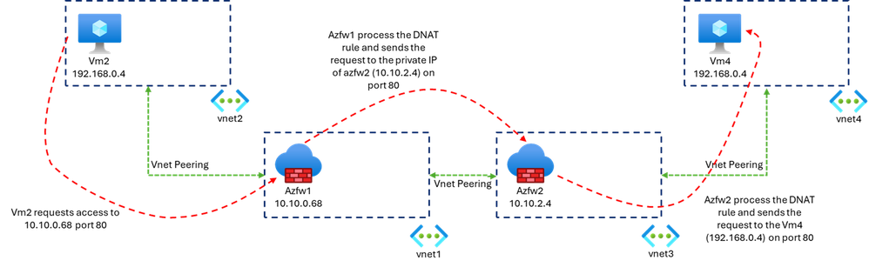
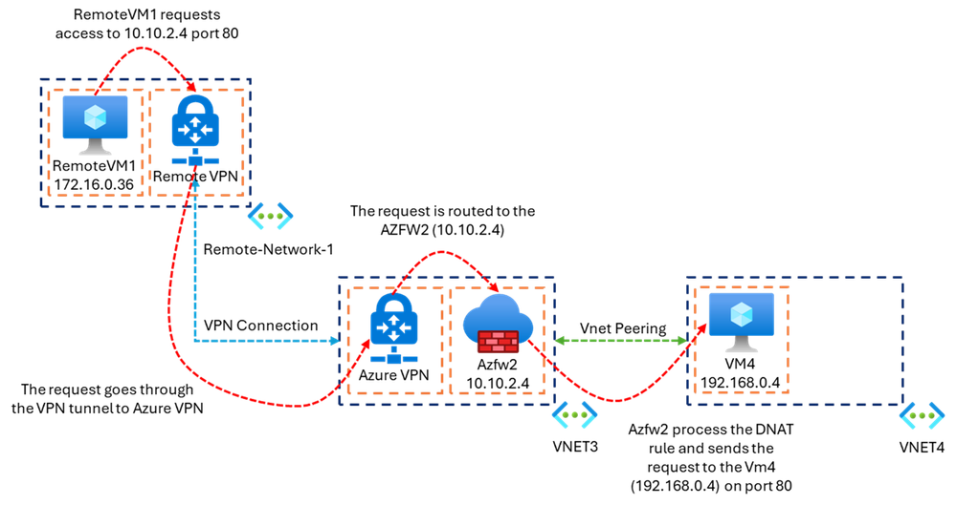
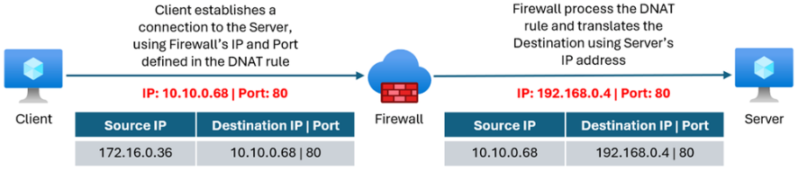
Networking Updates
Private IP DNAT Support and Scenarios with Azure Firewall
MS enhanced DNAT scenario to support port translation on Azure Private IP (VIP). This capability helps with connectivity between overlapped IP networks, which is a common scenario for enterprises when onboarding new partners to their network or merging with new acquisitions. DNAT on Private IP is also relevant for hybrid scenarios (connecting on-premises datacenters to Azure), where DNAT bridges the gap, enabling communication between private resources over non-routable IP addresses.

Slide 4
Security & Identity

Slide 5
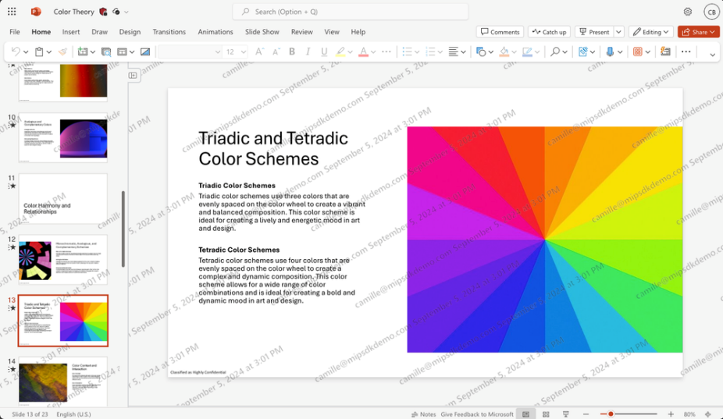
Security & Identity Updates
(Preview) Dynamic watermarking available on Android and iOS with new date-time variable
Android and iOS release can now label files with dynamic watermarking-enabled labels and view, edit, and collaborate on these files regardless of which platform you’re using.
Date-time variable to the dynamic watermark string enables admins to know precisely when leaked information was captured

Slide 6
Management & Governance

Slide 7
Management & Governance Updates
Private Preview: Azure Site Recovery support for Azure Trusted Launch VMs (Linux OS)
MS announced the private preview of Azure Site Recovery support for Azure Trusted Launch VMs. Azure Trusted Launch VMs provide foundational compute security to Azure Generation 2 VMs by enabling Secure Boot and vTPM capabilities. This private preview is available for Azure Trusted launch VMs running Linux OS. Azure Site Recovery support for Trusted launch VM running Windows OS is already generally available.

Slide 8
Compute

Slide 9
Compute Updates
Generally Available: Azure Functions support for PowerShell 7.4
Azure Functions now support PowerShell 7.4
Public Preview: Azure Web PubSub – MQTT support now available
Azure Web PubSub now supports MQTT capabilities (in public preview).
This means that developers using Web PubSub can now connect clients using either WebSocket protocol or MQTT (over WebSocket) while enjoying built-in scalability.
MQTT is specifically designed for environments with low bandwidth, high latency, or unreliable networks. It’s particularly well-suited for IoT (Internet of Things) devices and other scenarios where resources are limited.
Now it is possible to use multiple communications protocols to meet functional and performance requirements – connecting various clients at scale in a fully-managed service.

Slide 10
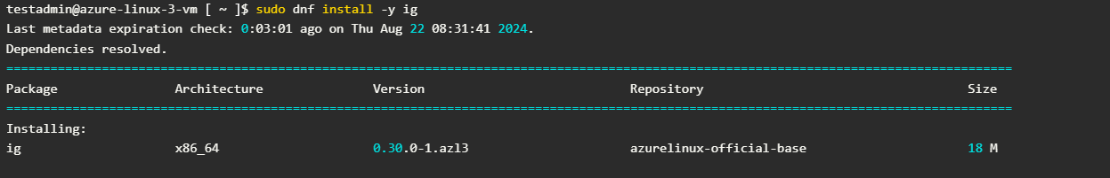
Compute Updates
Generally Available: Java on Azure Container Apps
It is now possible to leverage managed Java components for seamless app-to-app communication. Enhance your monitor and diagnostic experience with managed Spring Boot Admin, dynamic logger, and embedded Java metrics in Azure Monitor.
Inspektor Gadget is available in AzureLinux 3
Inspektor Gadget is a set of tools and a framework enabling observability of Kubernetes clusters and Linux hosts using eBPF.
Inspektor Gadget handles the enrichment of low-level data, like disk I/O to higher level ones, like container names.
Recently, the Azure Linux team officially released its version 3.
Starting with this version, Inspektor Gadget is available in the official repository and can be installed by simply calling `dnf`.

Slide 11
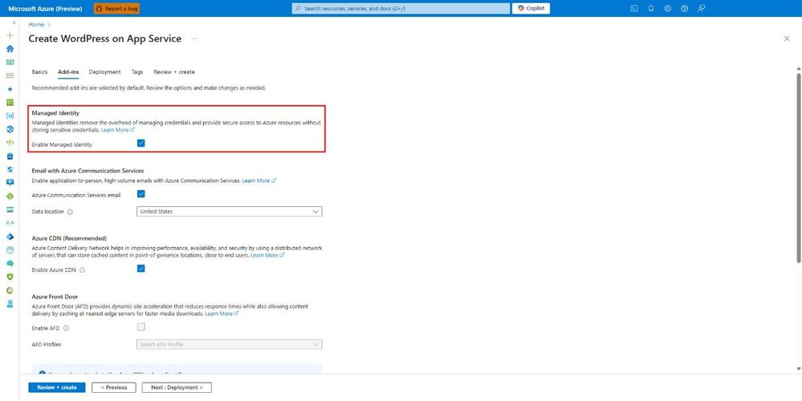
Compute Updates
Managed Identity support for WordPress on App Service
WordPress on App Service now supports Managed Identity. This means WordPress site can securely access other Azure resources, like Azure Database for MySQL Flexible Server and Azure Communication Service Email, without the hassle of managing connection strings and secrets.
WordPress on App Service now uses a user-assigned managed identity configured with App Service. This managed identity allows access to other Azure resources, such as the Azure Database for MySQL flexible server or Azure Communication Services Email, without needing to store credentials in Application settings as we did before.

Slide 12
Storage & Data

Slide 13
Storage & Data Updates
Public Preview: Live Resize for Azure Premium SSD v2 and Ultra Disks
MS announced the Public Preview of Live Resize for Premium SSD v2 and Ultra Disks. Dynamically increase the storage capacity of disks without causing any disruption to applications. To reduce costs, it is possible to begin by creating smaller disks and gradually increase their storage capacity without experiencing any downtime.
Only supported for data disks.
If a Standard HDD, Standard SSD, or Premium SSD disk is 4 TiB or less, deallocate your VM and detach the disk before expanding it beyond 4 TiB. If one of those disk types is already greater than 4 TiB, you can expand it without deallocating the VM and detaching the disk. This doesn't apply to Premium SSD v2 or Ultra Disks.
Not supported for shared disks.
You can't expand a disk while a background copy of data is also occurring on that disk, like when a disk is being hydrated from snapshots.
You can't expand a VM that's using NVMe controllers for Ultra Disks or Premium SSD v2 disks without downtim

Slide 14
Databases

Slide 15
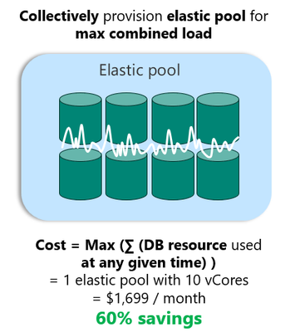
Databases Updates
Generally Available: Azure SQL Database Hyperscale elastic pools
MS announced that Azure SQL Database Hyperscale elastic pools are now generally available. Hyperscale elastic pools enable software as a service (SaaS) developers to optimize the price performance ratio for a group of databases, while delivering predictable performance and elasticity for each database.
Hyperscale elastic pools build on top of the cloud native architecture of Hyperscale and provide the cost effectiveness of elastic pools. During the highly successful public preview, many customers benefited from features enabled by the cloud-native architecture including: auto-scaling storage, predictable scaling of the compute, quicker database copies, newer hardware options, and more.

Slide 16
Databases Updates
Retirement: Azure PostgreSQL migration extension in Azure Data Studio (ADS)
The Azure PostgreSQL migration extension in Azure Data Studio (ADS) will be officially retired on November 15, 2024. As part of MS commitment to providing the most advanced and reliable tools, MS is phasing out this extension in Azure Data Studio. The Azure PostgreSQL migration extension currently offers limited functionality and lacks support for the latest Azure Database for PostgreSQL SKUs, making it less effective for migration needs. By retiring the extension in Azure Data Studio, MS aim to focus on improving and supporting the tools that will offer the most value in migration journey.
IAfter November 15, 2024 it will no longer be enhanced or supported, and will not have the latest security and compliance features.
General Availability of Flexible Maintenance for Azure Database for MySQL - Flexible Server
MS announced that Flexible Maintenance for Azure Database for MySQL - Flexible Server is now Generally Available (GA)! This new feature enables greater control over the timing of the maintenance activities performed on database instances, so that customers can align maintenance schedules with their operational needs.

Slide 17
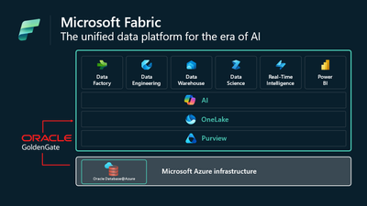
Databases Updates
Announcing availability of Oracle Database@Azure in Australia East
Microsoft and Oracle announced general availability of Oracle Database@Azure for the Azure Australia East region.
OCI Golden Gate integration with Microsoft Fabric
MS introduced MS Fabric integration with OCI Golden Gate.
OCI GoldenGate is a real-time data integration and replication solution that ensures high availability, disaster recovery, and transactional integrity across diverse environments. When integrated with Microsoft Fabric, OCI GoldenGate adds significant value by enabling seamless, real-time data synchronization between Oracle databases and the AI-powered analytics platform of Fabric. This ensures that data professionals can work with the most up-to-date information across their data ecosystem, enhancing the accuracy and timeliness of insights.
OCI GoldenGate’s ability to support complex data transformations and migrations allows organizations to leverage Microsoft Fabric’s advanced analytics and AI capabilities without disruption, driving faster, more informed decision-making and enabling businesses to unlock new levels of innovation.
Public preview is the Oracle Database@Azure integration with Microsoft Sentinel
Customers will be able to extend their threat analytics to their Oracle Exadata Database Service and infrastructure powering Oracle Database@Azure and the Oracle Database services that operate them.

Slide 18
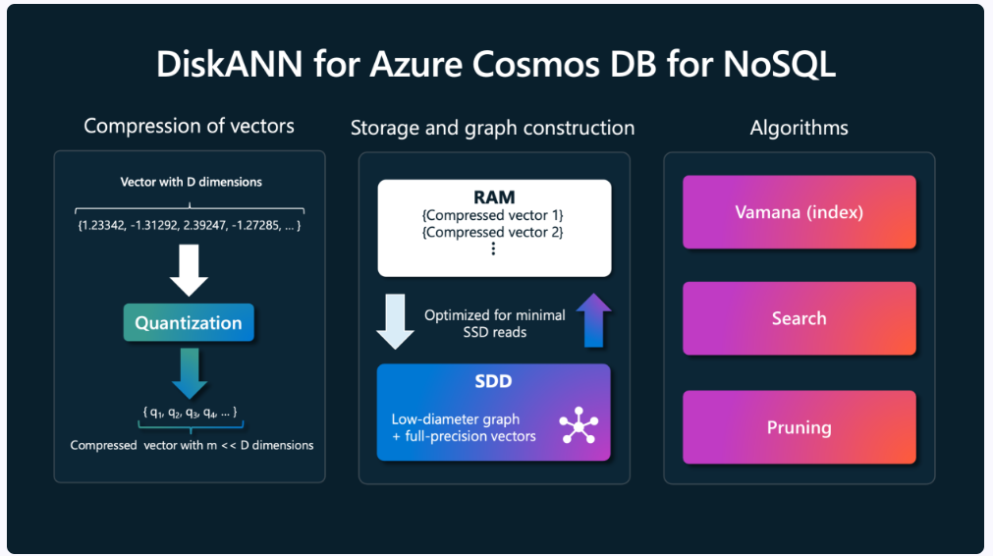
Databases Updates
Native JSON support now in preview in Azure SQL Managed Instance
Processing JSON data in Azure SQL Managed Instance just got more performant thanks to the new way JSON data is stored and handled. Now in preview for Azure SQL Managed Instance with Always-up-to-date update policy configured, JSON data can be stored in a new binary data format with database column declared as a new JSON data type:
DiskANN for Azure Cosmos DB Now in Open Public Preview!
MS announced that the DiskANN vector index is now in open public preview in Azure Cosmos DB for NoSQL! This means that anyone who enrolls an Azure Cosmos DB for NoSQL resource in the Vector Search Public Preview now automatically gets access to the most powerful and scalable vector index on the planet.
DiskANN is a powerful set of algorithms developed at Microsoft Research for low-latency, cost-effective, and highly accurate vector search at scale. It’s an ideal solution for applications requiring fast and efficient search capabilities without compromising on accuracy.
SELECT TOP(5) c.object_id, JSON_ARRAYAGG(c.name ORDER BY c.column_id) AS column_list FROM sys.columns AS c GROUP BY c.object_id;

Slide 19
ML & AI & IOT

Slide 20
ML & AI & IOT Updates
Generally Available: Azure IoT Edge now supports new version releases of Ubuntu Server, Debian, and Yocto
Azure IoT Edge’s supported platforms now include Ubuntu Server 24.04, Debian 12, and Yocto Scarthgap.
Retirement: Azure AI Document Intelligence GA API v2.1 is retiring on 15 September 2027
On 15 September 2027, the Document Intelligence GA API v2.1 will be retired and all requests to the service with that API version will fail. To ensure models continue to operate seamlessly, they have to be migrated to a newer GA API version of Document Intelligence by that date.
If you’re using custom models, MS recommend re-training them with a newer GA API. The newer APIs offer improved model quality, extended capabilities, and additional document type coverage.

Slide 21
ML & AI & IOT Updates
Public Preview: Low-Code RAG ingestion with built-in document parsing and chunking in Logic Apps Standard
MS introduced the Public Preview of built-in actions for document parsing and chunking in Logic Apps Standard, designed to streamline RAG-based ingestion for Generative AI applications. With these out-of-the-box operations, it is now easy ingest documents or files, including both structured and unstructured data, into AI Search without writing or managing any code!
Leverage the new support for templates based on RAG patterns to ingest documents from a variety of sources such as REST endpoints, Blobs, SharePoint, OneDrive, and more.
Simplify workflows and enhance AI-powered applications with this powerful, low-code solution!
New OpenAI o1-preview and o1-mini models
GPT-4o: A versatile, multimodal model that excels in both text and image processing, with superior performance in non-English languages and vision tasks. Suitable for applications needing enhanced accuracy and multilingual capabilities. The model also features JSON Structured Outputs for consistent, well-defined data formats, reducing post-processing needs and improving application efficiency. Designed for real-time applications that require fast, reliable text responses at minimal cost.
o1-preview: Focused on advanced reasoning and solving complex problems, including math and science tasks. Ideal for applications that require deep contextual understanding and agentic workflows.
GPT-4o Mini: A smaller, cost-effective version of GPT-4o, optimized for environments with limited resources or high cost constraints. Retains text and image processing capabilities, making it ideal for lightweight applications.
o1-mini: Smaller and faster, and 80% cheaper than o1-preview, performs well at code generation and small context operations.

Slide 22
DevOps & IaC & Automation

Slide 23
DevOps & IaC & Automation
Roadmaps for Microsoft Dev Box and Azure Deployment Environments are now live!
We released the roadmaps for Microsoft Dev Box and Azure Deployment Environments! These roadmaps showcase plans and upcoming features for both services, reflecting commitment to enhancing users experience developing in the cloud.
Azure Lab Services - Upcoming maintenance update on October 12, 2024
On October 12th, 2024, MS will be updating system between 7:00 AM and 6:00 PM CST. This maintenance will only affect the creation of new Canvas labs or the management of existing Canvas labs through our service. The Canvas labs functionality will be available again after the update.

Slide 24
Miscellaneous

Slide 25
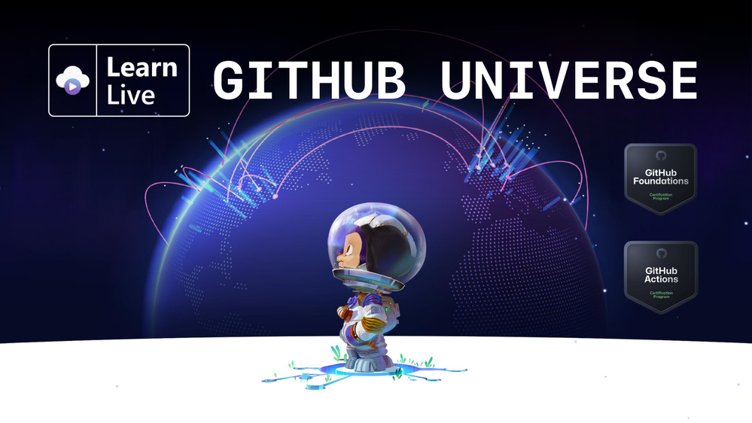
Miscellaneous Updates
New pricing for Microsoft Certification exams effective November 1, 2024
Effective November 1, 2024, Microsoft is updating the retail prices for its Certification exams to reflect the current market conditions and the value of the Certifications.
For most areas, there will be no change in the price. For some areas, the price will decrease to make the exams more affordable. In a few areas, the price will increase to align with global and regional standards. To find the updated price of the exams in your area, check out the full list of new prices for Microsoft Certifications by country or region.
Get certified with Learn Live GitHub Universe series!
GitHub Universe is coming, and Microsoft and GitHub are partnering to offer a new special Learn Live series in English & Spanish: GitHub Universe 2024. From October 8th to 22nd, you'll learn how to make the most of GitHub Copilot, automate with GitHub Actions to create websites and APIs, and more. You will also receive a discount voucher to take one GitHub Certification* for $35 USD (the regular price is $99 USD)

Slide 26
Information

Slide 27
Information
Azure Times GitHub Repo

Slide 28
Questions

