Slide 1
Azure Times #106
February 21, 2023

Slide 2
Networking

Slide 3
Networking Updates
Azure Firewall: Flow Trace Logs is GA
The Firewall Flow logs show traffic through the firewall in the first attempt of a TCP connection, known as the syn packet. However, this doesn't show the full journey of the packet in the TCP handshake. Flow Trace Logs display logs that show additional TCP handshake logs, such as SYN-ACK, FIN, FIN-ACK, RST, and INVALID. This is particularly helpful for identifying packet drops or asymmetric routes.
The following additional properties can be added:
SYN-ACK : Ack flag that indicates acknowledgment of SYN packet.
FIN: Finished flag of the original packet flow. No more data is transmitted in the TCP flow.
FIN-ACK: Ack flag that indicates acknowledgment of FIN packet.
RST: The Reset the flag indicates the original sender doesn't receive more data.
INVALID (flows): Indicates packet can’t be identified or don't have any state.
To avoid excessive disk usage caused by Flow trace logs in Azure Firewall with many short-lived connections, activate the logs only when troubleshooting a specific issue for diagnostic purposes.
Azure Firewall: Autoscaling based on number of connections is now generally available
Azure Firewall can now autoscale based on the number of connections, in addition to throughput and CPU usage. This provides the benefit of having your firewall scale with more granular information about your traffic information.
Azure Firewall gradually scales when average throughput or CPU consumption is at 60%, or the number of connections usage is at 80%. For example, it starts to scale out when it reaches 60% of its maximum throughput. Maximum throughput numbers vary based on Firewall SKU and enabled features.
Scale out takes five to seven minutes.

Slide 4
Networking Updates
Azure Firewall: Parallel IP Group update support is now in public preview
Multiple IP Groups for Azure Firewall can now be updated in parallel. Previously, users were required to update IP Groups sequentially. With this backend update, users can update 20 IP Groups that are referenced in a Firewall Policy at a time.
It is now possible to:
Update 20 IP Groups at a time
Update the firewall and firewall policy during IP Group updates
Use the same IP Group in parent and child policy
Update multiple IP Groups referenced by firewall policy or classic firewall simultaneously
Receive new and improved error messages

Slide 5
Security & Identity

Slide 6
Security & Identity Updates
General availability: Improvements in Azure Key Vault
MS announced the general availability of FIPS 140-2 Level 3 HSMs for Azure Key Vault. Azure Key Vault Premium HSMs are now also PCI DSS and PCI 3DS certified, which means that they meet the security requirements of the Payment Card Industry Data Security Standard (PCI DSS) and Payment Card Industry 3-D Secure (PCI 3DS). This is the same compliance level as the HSM devices used by Managed HSM.
This new capability comes at no extra cost for existing and new customers. All new keys and key versions created in Key Vault Premium are protected by these new HSMs, at no additional cost. We have modernized the HSM fleet that powers Azure Key Vault to ensure the highest industry levels of protection for our customers. SLAs, performance, and other specifications remain the same. Older key versions will continue to work using the original FIPS 140-2 Level 2 HSMs that powered Azure Key Vault. These improvements have rolled out to all geographies except the UK; availability for the UK will be announced later.
Enforcement of Defender CSPM for Premium DevOps Security Capabilities
Microsoft’s Defender for Cloud will begin enforcing the Defender Cloud Security Posture Management (DCSPM). If the Defender CSPM plan is enabled on a cloud environment (Azure, AWS, GCP) within the same tenant, DevOps connectors are created in, you'll continue to receive premium code to cloud DevOps capabilities at no additional cost.
Microsoft Defender CSPM provides advanced security posture capabilities including agentless vulnerability scanning, attack path analysis, integrated data-aware security posture, code to cloud contextualization, and an intelligent cloud security graph. Pricing is dependent on cloud size, with billing based on Server, Storage account, and Database counts.
There is no additional charge for DevOps resources with this enforcement.

Slide 7
Management & Governance

Slide 8
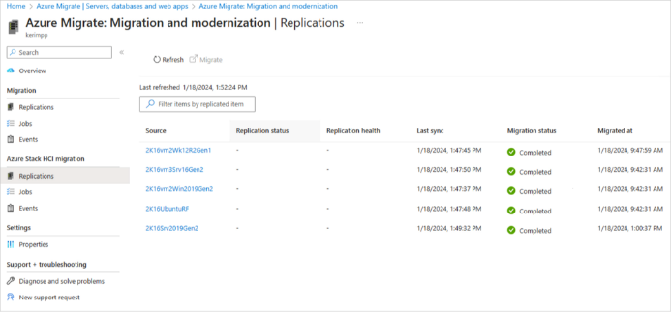
Management & Governance Updates
Hyper-V VM Migration to Azure Stack HCI, version 23H2
This feature allows to migrate Windows and Linux VMs running on Hyper-V to Azure Stack HCI, version 23H2 clusters (GA as of Feb 1st of this year). A wide range of source environments starting from Hyper-V on Windows Server 2012 R2 to Windows Server 2022 are supported.
This feature uses the agentless migration option of Azure Migrate. This means that it is not needed to do any prep such as installing an agent on the source VMs. All is needed that are two appliances, one on the source, and one on the target.
While management plane activities like manage, monitor, and configure via the cloud (Azure Migrate), the data transfer between the source and the target is kept local.
All the migrated VMs are Arc-enabled by default. This means that the full power of Arc VM management is immediately available once the migration is complete.
Public preview: Azure SQL migration assessment enabled by Azure Arc
With SQL Server enabled by Azure Arc, it is possible to get cloud advantages from the very beginning of migration journey. It lets to use the Azure control plane and management services for SQL Server instances on-premises or in multiple clouds. This leads to immediate operational efficiencies and cost savings and the best possible migration and modernization experience.
To make migration even easier, MS released Azure SQL migration assessment, enabled by Azure Arc in public preview. This new feature means, when SQL Server with Azure Arc is onboarded, the Azure SQL migration readiness assessment will be done by default and on a continuous basis that is resilient to changing environment. This assessment provides the Microsoft-recommended Azure SQL deployment option that best fits workload needs at a cost-optimized manner. It also flags any migration risks and provides mitigation recommendations.

Slide 9
Management & Governance Updates
Sending a log search alert to unauthorized target resources will no longer be supported
When a log search alert rule is configured with a target resource for which the alert process does not have access or permissions, the rule has an unauthorized target resource. Currently, log search alert rules might send alerts to unauthorized target resources.
For example, if log search alert rule query is defined with the target resource id column, the log search alert rule might not have the appropriate permissions to fire the alert to this target resource.
As of Mar 15,2024, sending a log search alert to unauthorized target resources is no longer supported. Alerts will not be sent to unauthorized target resources, and log search alert rules with an unauthorized target will be ignored.

Slide 10
Compute

Slide 11
Compute Updates
Public preview: Upgrade policies for Virtual Machine Scale Sets using Flexible Orchestration
Each Virtual Machine Scale Set has an upgrade policy that determines how virtual machines are brought up-to-date with the latest scale set model.
Automatic upgrade policy
With an automatic upgrade policy, the scale set makes no guarantees about the order of virtual machines being brought down. The scale set might take down all virtual machines at the same time to perform upgrades.
Automatic upgrade policy is best suited for DevTest scenarios where you aren't concerned about the uptime of your instances while making changes to configurations and settings.
Manual upgrade policy
With a manual upgrade policy, you choose when to initiate an update to the scale set instances. Nothing happens automatically to the existing virtual machines when changes occur to the scale set model. New instances added to the scale set use the most update-to-date model available.
Manual upgrade policy is best suited for workloads where the instances in the scale set are composed of different configurations and each configuration might require different updates and changes.
Rolling upgrade policy
With a rolling upgrade policy, the scale set performs updates in batches with an optional pause time in between. You also get more control over the upgrades with settings like batch size, max healthy percentage, prioritizing unhealthy instances and enabling upgrades across multiple availability zones at the same time. Additionally, when using a rolling upgrade policy, you can enable max surge which will replace VMs running the old model with new VMs using the latest model.
Rolling upgrade policy is best suited for production workloads that require a set number of instances always be available. Rolling upgrades is safest way to upgrade instances to the latest model without compromising availability and uptime.

Slide 12
Compute Updates
Public preview: AKS cluster control plane metrics in managed Prometheus
AKS cluster control plane metrics in managed Prometheus is a new feature that automatically scrapes the control plane – API server and etcd metrics and send them to an Azure Monitor workspace via managed Prometheus. With this, it is possible to monitor the API server traffic and load along with the etcd size, object count to understand the state of the control plane and tune Kubernetes application client behavior to optimize for performance and reliability. AKS clusters with managed Prometheus get these new metrics automatically once the subscription has been enabled for the preview feature.
Only supports Azure Monitor managed service for Prometheus.
Private link isn't supported.
Only the default ama-metrics-settings-config-map can be customized. All other customizations are not supported.
The cluster must use managed identity authentication.

Slide 13
Storage & Data

Slide 14
Storage & Data Updates
Generally available: Zone Redundant Storage for Azure Disks is now available in Canada Central
Zone Redundant Storage (ZRS) for Azure Disk Storage is now generally available on Azure Premium SSDs and Standard SSDs in the Canada Central region.
Disks with ZRS provide synchronous replication of data across three availability zones in a region, enabling disks to tolerate zonal failures without causing disruptions to your application. This feature enables disks to tolerate zonal failures without causing disruptions to your application.
Generally available: Azure Blob Storage Cold Tier support on Change Feed and Object Replication
Azure Blob Storage Cold Tier was generally available since Aug 10th, 2023. It is a new online access tier that is the most cost-effective Azure Blob offering for storing infrequently accessed data with long-term retention requirements, while providing instant access.
Change feed provides transaction logs of all the changes that occur to the blobs and the blob metadata in the storage account. Now it captures the changes of blobs in cold tier. Object replication asynchronously copies block blobs between a source storage account and a destination account. Now it is possible to asynchronously copy block blobs in cold tier on the source storage account to a destination account.

Slide 15
Storage & Data Updates
Azure Elastic SAN is now generally available
MS announced the general availability (GA) of Azure Elastic SAN, the industry’s first fully-managed and cloud-native storage area network (SAN) offering that simplifies deploying, scaling, managing, and configuring a SAN in the cloud. Azure Elastic SAN responds to the vital need for seamless migration of extensive SAN environments to the cloud, bringing a new level of efficiency and ease. This enterprise-class offering stands out by adopting a SAN-like resource hierarchy, provisioning resources at the appliance level, and dynamically distributing these resources to meet the demands of diverse workloads across databases, virtual desktop infrastructure (VDIs), and business applications. Beyond that, it delivers cloud native benefits with scale on demand, policy-based service management, and cloud native security enforcements across encryption and network access. It's a thoughtful innovation combining the efficiency at scale of on-prem SAN systems and the flexibility of cloud storage.
The following list contains the regions Elastic SAN is currently available in, and which regions support both zone-redundant storage (ZRS) and locally redundant storage (LRS), or only LRS:
South Africa North - LRS
East Asia - LRS
Southeast Asia - LRS
Brazil South - LRS
Canada Central - LRS
France Central - LRS & ZRS
Germany West Central - LRS
Australia East - LRS
North Europe - LRS & ZRS
West Europe - LRS & ZRS
UK South - LRS
Japan East - LRS
Korea Central – LRS
…..

Slide 16
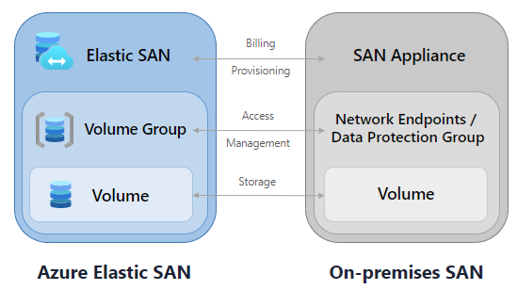
Storage & Data Updates
Compatibility - Azure Elastic SAN volumes can connect to a wide variety of compute resources using the internet Small Computer Systems Interface (iSCSI) protocol. Because of this, rather than having to configure storage for each of your compute options, you can configure an Elastic SAN to serve as the storage solution for multiple compute options, and manage it separately from each option.
Simplified provisioning and management - Elastic SAN simplifies deploying and managing storage at scale through grouping and policy enforcement.
Performance - with an Elastic SAN, it's possible to scale your performance up to millions of IOPS, with double-digit GB/s throughput, and have single-digit millisecond latency.
Support for Azure Storage features
torage feature | Supported for Elastic SAN
Encryption at rest | ✔️
Encryption in transit | ⛔
LRS or ZRS redundancy types | ✔️
Private endpoints | ✔️
Grant network access to specific Azure virtual networks | ✔️
Soft delete | ⛔
Snapshots (preview) | ✔️

Slide 17
Storage & Data Updates
Elastic SAN, is charged by the amount you provision within our two provisioning offerings: Base unit and Capacity only unit. They are designed to offer simple bulk provisioning experience while also providing flexibility to expand your data footprint. The Base unit has a capacity of 5,000 IOPs and a throughput of 200 MBps per TiB and is priced at $0.08/GiB.
Azure Elastic SAN resources will be billed hourly at a monthly unit rate.
The total price of Azure Elastic SAN depends on the base and capacity scale unit. Elastic SAN supports both zone redundant storage (ZRS) and locally redundant storage (LRS) with ZRS redundancy priced at a 50% premium over LRS
Product Name/SKU | Feature | Provisioned resources per unit | Rate per unit/month | Rate per GiB/month | Rate per GiB/hour
Premium Base Unit | LRS | 1 TiB, 5,000 IOPS, 200 MBps | $81.92 | $0.08 | $0.000110¹
Premium Capacity Scale Unit | LRS | 1 TiB, no provisioned IOPS or MBps | $61.44 | $0.06 | $0.000083¹

Slide 18
Databases

Slide 19
Databases Updates
General availability: serverless for Hyperscale in Azure SQL Database
MS announced the general availability of serverless auto-scaling for Hyperscale in Azure SQL Database.
Performance and scaling
Automatic scaling of compute up to 80 vcores and 240 GB memory per replica.
Automatic scaling of local SSD cache up to 720 GB per replica boosting IO performance.
Automatic scaling of database storage up to 100 TB.
Auto-scaling independence of the primary replica, high availability replicas, and named replicas.
Auto-scaling independence of CPU and memory to match workload demand.
Higher IO performance than the General Purpose tier.
Read scale-out up to 30 named replicas.
Business continuity
High availability configuration flexibility.
Fast restore speed in minutes independent of data size.
Price optimization
Price-performance optimized memory management.
Billing for compute based on the amount used per second.
Billing for storage based on the amount used per hour.
Future release: automatic pausing & resuming, and billing only for storage when paused.
General availability: Customer managed key encryption for Enterprise tier caches
Now generally available, Enterprise and Enterprise Flash tier caches can use customer managed keys (CMK) to control encrypted access to the operating system and persistence disk attached to their Enterprise tier cache instances. This ensures that the RDB or AOF files created from Redis persistence or export features are encrypted at rest with a compliant and secure key that you can control. Keys can be stored using Azure Key Vault and user-assigned managed identity is used for authorization.

Slide 20
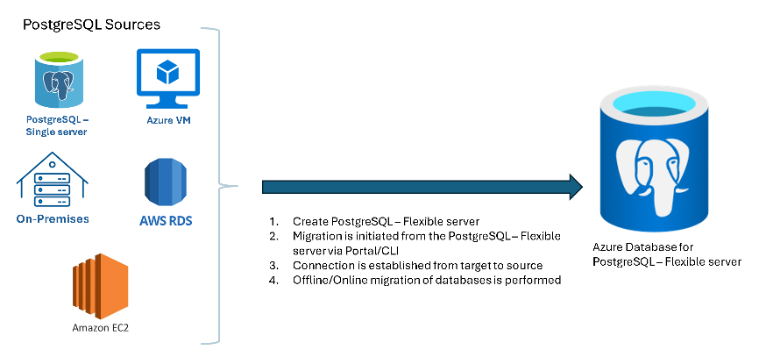
Databases Updates
Public preview: Migration service in Azure Database for PostgreSQL
MS introduced the migration service in Azure Database for PostgreSQL, tailored to simplify moving PostgreSQL workloads to the Azure. This service provides a seamless, fully managed migration experience, adept at handling both schema and data migrations with no size restrictions. Eliminate complex setup procedures and embrace a solution that scales with needs, ensuring a smooth transition.

Slide 21
ML & AI & IOT

Slide 22

ML & AI & IOT Updates
Openai introduced SORA
Sora, our text-to-video model. Sora can generate videos up to a minute long while maintaining visual quality and adherence to the user’s prompt.
Sora is able to generate complex scenes with multiple characters, specific types of motion, and accurate details of the subject and background. The model understands not only what the user has asked for in the prompt, but also how those things exist in the physical world.

Slide 23
DevOps & IaC & Automation

Slide 24
DevOps & IaC & Automation
Announcing NuGet 6.9
NuGet 6.9 is included in Visual Studio 2022 and .NET 8.0 out of the box. It is possible to get NuGet 6.9 for Windows, macOS, and Linux as a standalone executable.
February patches for Azure DevOps Server
Azure DevOps Server 2022.1 Patch 2
CVE-2024-20667: Azure DevOps Server Remote Code Execution Vulnerability.
Fixing details page rendering issue on Search extension.
Fixed a bug where the disk space used by the proxy cache folder was calculated incorrectly and the folder was not cleaned up.
Azure DevOps Server 2020.1.2 Patch 12
CVE-2024-20667: Azure DevOps Server Remote Code Execution Vulnerability.
Fixed a bug where the disk space used by the proxy cache folder was calculated incorrectly and the folder was not cleaned up.
Azure DevOps Server 2019.1.2 Patch 7
CVE-2024-20667: Azure DevOps Server Remote Code Execution Vulnerability.
Fixed a bug where the disk space used by the proxy cache folder was calculated incorrectly and the folder was not cleaned up.

Slide 25
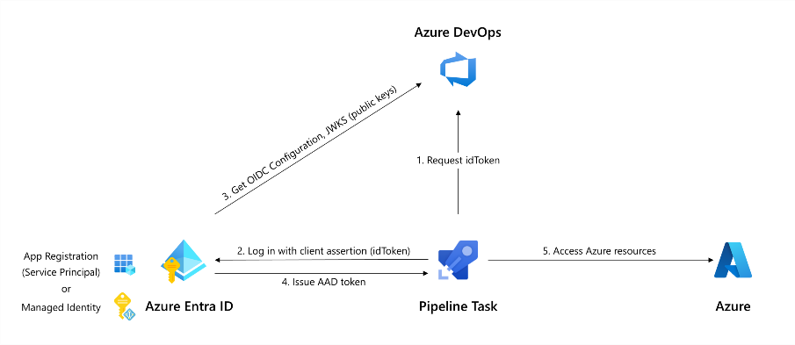
DevOps & IaC & Automation
Workload identity federation for Azure deployments is now generally available
Using workload identity federation allows you to access Microsoft Entra protected resources without needing to manage secrets (for supported scenarios).
End of SSH-RSA support for Azure Repos
Azure Repos provides two methods for users to access a git repository in Azure Repos – HTTPS and SSH. SSH supports:
SSH-RSA
RSA-SHA2-256
RSA-SHA2-512
MS announced deprecation of SSH-RSA as a supported encryption method for connecting to Azure Repos using SSH.
MS strongly encouraged to move from SSH-RSA keys to more secure RSA-SHA2-256 or RSA-SHA2-512 keys:

Slide 26
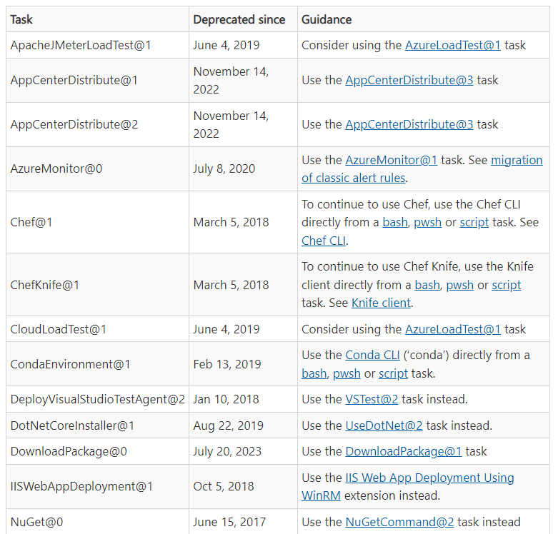
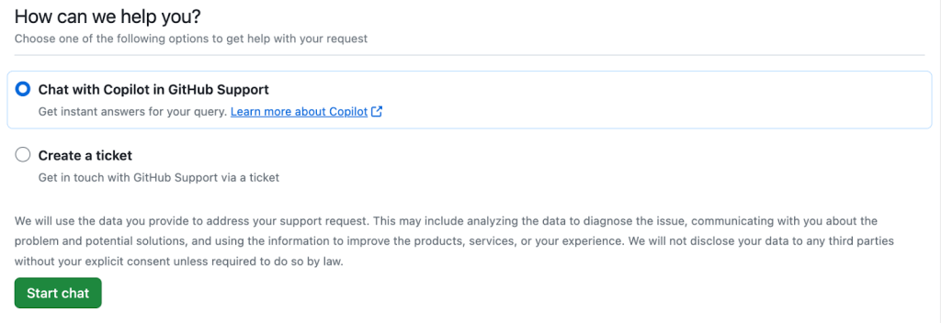
DevOps & IaC & Automation
Copilot in GitHub Support is now available!
GitHub announced the general availability of a powerful new AI tool designed to help find answers to GitHub-specific questions in a fast, self-directed way.
Copilot in GitHub Support is trained on the official GitHub documentation and offers a responsive conversational experience to deliver reliable advice on a wide range of GitHub-related topics.
Following an initial release in August 2023 to a randomly selected cohort of GitHub Enterprise customers, it’s now ready and waiting to converse with a much wider audience!
Azure Pipelines deprecated tasks retirement schedule
Azure Pipelines includes around 150 build & release tasks as well as many more task extensions. Various included tasks have multiple (major) versions bringing the total to over included 200 tasks.

Slide 27
Miscellaneous

Slide 28
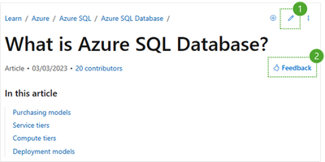
Miscellaneous Updates
MS Announced a new way to give feedback on MS Learn
MS introduced a simplified thumbs up / thumbs down form, where it is possible to provide feedback and comments. Using this form, allows to submit comments in languages other than English, and submissions will remain anonymous. The form is a consistent experience; it’s available on every documentation article and training module on Microsoft Learn.
Second, MS accept Pull Requests for content. This means that even if GitHub Issues is turned off, if you see the pencil icon in the upper right corner of the article, you can send a Pull Request to our team.
Final Reminder: Outlook REST API v2.0 and beta endpoints decommissioning
MS is decommissioning the Outlook REST v2.0 and beta endpoints starting March 31, 2024. After this date, MS will start progressively shutting off the endpoints until they become completely unavailable.
This means that any application that is still using these endpoints will stop working at some point after March 31, 2024 (except for Outlook Add-Ins as also communicated before). MS strongly recommend to migrate applications to the Microsoft Graph API as soon as possible to avoid any disruption.

Slide 29
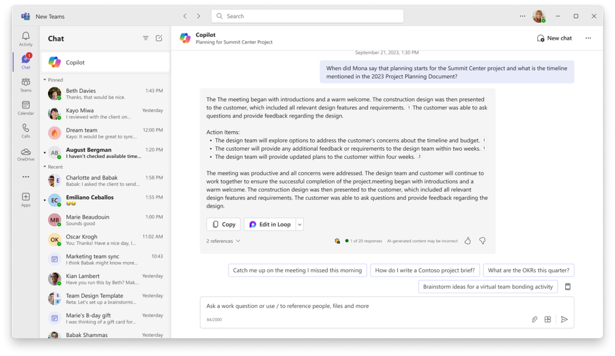
Miscellaneous Updates
Introducing the new Microsoft Copilot experience in Teams
The new Copilot experience is an improved version of the Copilot app in Teams that you may have used before (formerly known as Microsoft 365 Chat). It offers the same functionality and content access as the current app, but with additional benefits, including:
Better prompts, including details specific to you like the people you work with, your meetings, and your files.
Ability to see Copilot chat history
Access to a library of prompts via Copilot Lab

Slide 30
Information

Slide 31
Information
Azure Times GitHub Repo

Slide 32
Questions

