Slide 1
Azure Times #119
May 22, 2024

Slide 2
Networking

Slide 3
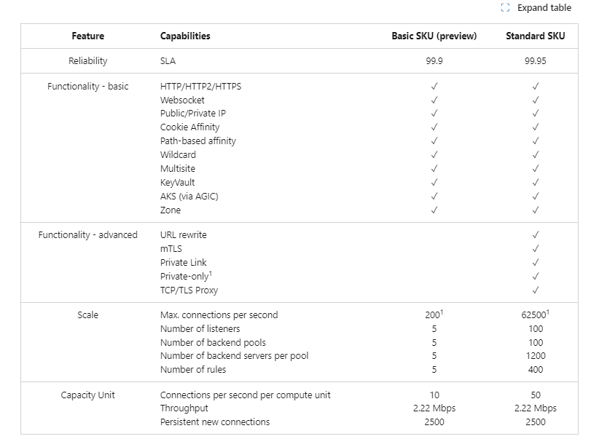
Networking Updates
Public preview: Azure Application Gateway v2 Basic SKU
The Application Gateway Basic SKU is a new SKU within Application Gateway family. It is designed for small and medium-sized customers, making it ideal for applications with lower traffic and SLA requirements that don't require advanced traffic management features. Application Gateway Basic SKU has built-in high availability and supports HTTP2/HTTPS and WebSocket protocols. It offers core application-level load balancing features such as URL-based, host-based and multi-site routing, along with cookie-based affinity. It supports flexible backends, including AKS, VMSS, App Services, and on-premises deployment. Customers can select the Basic SKU either directly from the Azure Portal or through their preferred scripting languages.

Slide 4
Networking Updates
Public preview: Sensitive data protection for Azure Front Door Web Application Firewall
Azure's global Web Application Firewall (WAF) integrated with Azure Front Door now supports sensitive data protection through log scrubbing in preview. When a request matches the criteria of a rule and triggers a WAF action, that event is captured within the WAF logs. WAF logs are stored as plain text for debuggability, and any matching patterns with sensitive customer data like IP address, passwords, and other personally identifiable information could potentially end up in logs as plain text. To help safeguard this sensitive data, you can now create log scrubbing rules that replace the sensitive data with "******".
Sensitive data protection using log scrubbing supports the creation of rules using the following variables:
Request Header Names
Request Cookie Names
Request Body Post Arg Names
Request Body Json Arg Names
Query String Arg Names
Request IP Address
Request URI
General availability: ExpressRoute Seamless Gateway Migration
ExpressRoute customers can now seamlessly migrate a new Gateway SKU that supports Availability Zones and facilitate migration of Public IP configurations from Basic to Standard. Previously, customers were required to delete and recreate their existing virtual network gateway to change from a non-availability zone enabled Gateway SKU to an AZ-enabled SKU.
MS provided a guided gateway migration experience where it is needed to deploy a second virtual network gateway in the same GatewaySubnet and Azure automatically transfers the control plane and data path configuration from the old gateway to the new one. During the migration process, there will be two virtual network gateways in operation within the same GatewaySubnet. This feature is designed to support migrations without downtime. However, users may experience brief connectivity issues or interruptions during the migration process.
Downgrade scenarios, Az-enabled Gateway SKU to non-Az-enabled Gateway SKU.

Slide 5
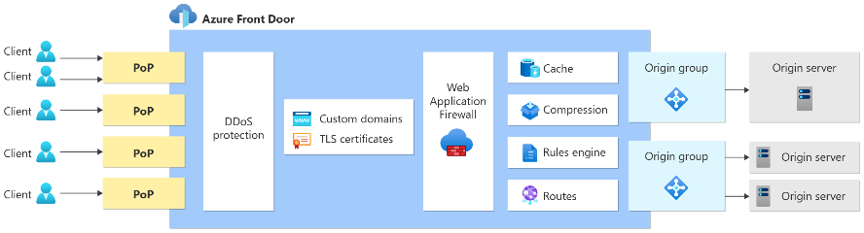
Networking Updates
Azure Front Door server variable enhancement generally available
Azure Front Door rules set, and server variable allows dynamic modification of request and responses at the edge.
For example, it is possible to redirect clients to different pages based on information in the request, or rewrite the URLs, paths and query string; it is possible to insert, modify or delete HTTP headers in the request or response; you can implement security headers to prevent browser-based vulnerabilities; route requests from different country or devices to different origins; apply different caching polices for different content type, and many more, We are also adding more flexibility by adding support for URL path segment capture and rewrite.
Server variables are available with Azure Front Door Standard and Premium tiers.

Slide 6
Security & Identity

Slide 7
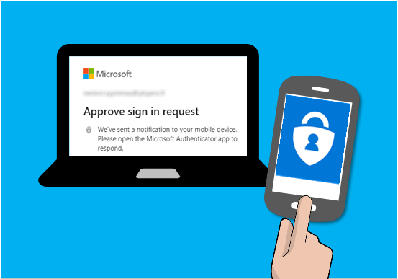
Security & Identity Updates
Microsoft will require MFA for all Azure users
This July, Azure teams will begin rolling out additional tenant-level security measures to require multi-factor authentication (MFA). Establishing this security baseline at the tenant level puts in place additional security to protect your cloud investments and company.

Slide 8
Management & Governance

Slide 9
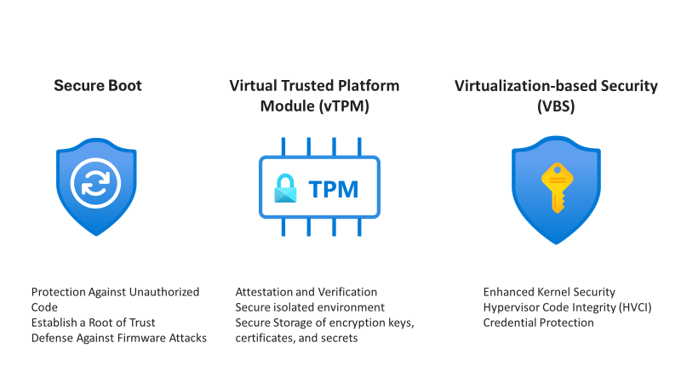
Management & Governance Updates
Public Preview: Azure Site Recovery support for Azure Trusted Launch VMs (Windows OS)
MS announced the Public Preview of Azure Site Recovery support for Azure Trusted Launch VMs. Azure Trusted Launch VMs provide foundational compute security to Azure Generation 2 VMs by enabling Secure Boot and vTPM capabilities.
The availability of Azure compute reservations will continue until further notice
Initially planned to end on January 1, 2024, the availability of Azure compute reservation exchanges for Azure Virtual Machine, Azure Dedicated Host and Azure App Service has been extended until further notice.
It will be possible to continue exchanging compute reservations for different instance series and regions until MS notify again, which will be at least 6 months in advance. In addition, any compute reservations purchased during this extended grace period will retain the right to one more exchange after the grace period ends.
Launched in October 2022, the Azure savings plan for compute aims at providing savings on consistent spend, across different compute services, regardless of region. With savings plan's automatic flexibility, MS updated reservations exchange policy. While instance size flexibility for VMs remains post-grace period, exchanges of instance series or regions for Azure Virtual Machine, Azure Dedicated Host and Azure App Service reservations will no longer be supported.
You may trade-in your Azure Virtual Machine, Azure Dedicated Host and Azure App Service reservations that are used to cover dynamic/evolving workloads for a savings plan or you may continue to use and purchase reservations for stable workloads where the specific configuration needs are known.

Slide 10
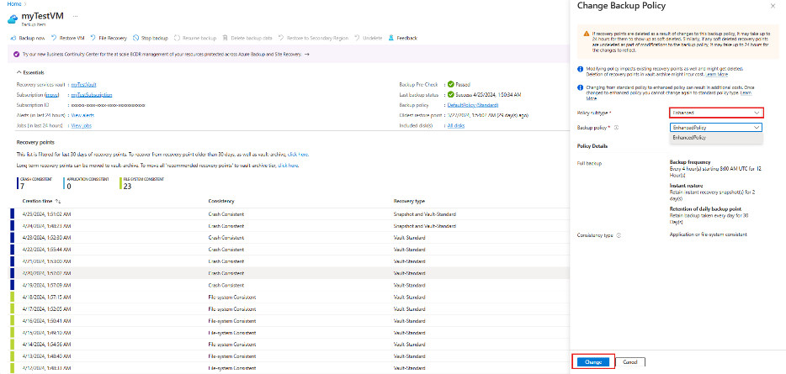
Management & Governance Updates
Announcement: System Center 2025 is here
MS announced System Center 2025, the next release of our Long-Term Servicing Channel (LTSC) will be GA (General Availability) in the fall of 2024, which means all SC products VMM, DPM, SCOM, SM & SCO will be released in its 2025 form by Q4CY2024. This release includes enhancements that provide support for infrastructure modernization, capabilities to manage heterogenous infrastructure while embracing enhanced security.
Public Preview: Migrate virtual machine backups using standard backup policy to enhanced backup policy
Azure Backup now supports migrating virtual backups using standard backup policy to enhanced backup policy. Migration to enhanced policy enables to improve the restore point objective or RPO (up to 4 hours), retain restore points in snapshot tier for up to 30 days and leverage multi-disk crash consistency for currently protected VMs. Snapshot tier restore points created using enhanced policy are zonally resilient. You can also now convert your Azure Backup protected virtual machines to Trusted Launch security and utilize premium SSDv2 or ultra-disks without disrupting existing backups by migrating to enhanced policy.

Slide 11
Compute

Slide 12
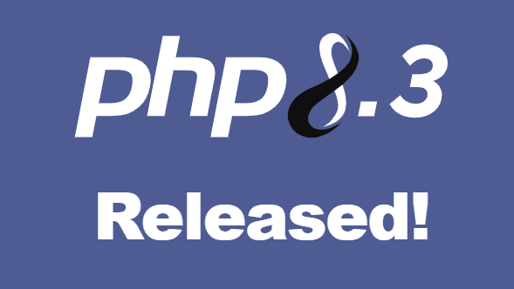
Compute Updates
Generally Available: Ubuntu 24.04 LTS for Azure Virtual Machines
Ubuntu 24.04 LTS, also known as “Noble Numbat”, comes with Linux kernel version 6.8 and systemd version v255.4, and offers new features, enhanced performance, enterprise security, and expanded support for .NET 8. Ubuntu 24.04 LTS images are available in the Azure Marketplace.
PHP 8.3 now available on App Service
MS announced that App Service now supports apps targeting PHP 8.3 across all public regions on Linux App Service Plans.

Slide 13
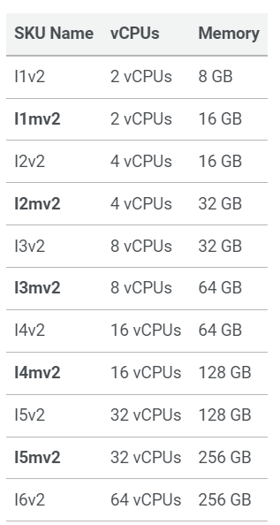
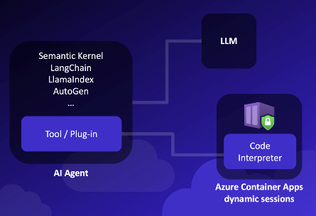
Compute Updates
Announcing Memory intensive SKUs for App Service Environment v3
MS added a memory intensive SKUs added to Premium V3 offering before and now they added these SKU type to App Service Environment v3. The rollout will be in waves of regions and App Service plan types. MS start with Windows in a selected set of regions. Over the coming months they will add support for Linux and Windows Containers as well, and add more regions to the list.
New: Secure Sandboxes at Scale with Azure Container Apps Dynamic Sessions
MS announced the public preview of Azure Container Apps dynamic sessions. Azure Container Apps is a serverless platform that enables to run containerized workloads without managing the underlying infrastructure. Dynamic sessions adds the ability to execute untrusted code in secure, sandboxed environments at scale.
When you build applications that run code or commands from untrusted sources, you must ensure that the code runs in its own isolated environment. Dynamic sessions provide secure, ephemeral sandboxes called "sessions" for running potentially malicious code. Each session runs in its own Hyper-V virtualization boundary — ensuring complete isolation from other sessions and resources.
Dynamic sessions are ideal for running untrusted code in hostile multi-tenant scenarios such as:
Running code generated by a large language model (LLM).
Running code or commands submitted by cloud application users.
Running cloud-based development environments, terminals, and more.

Slide 14
Storage & Data

Slide 15
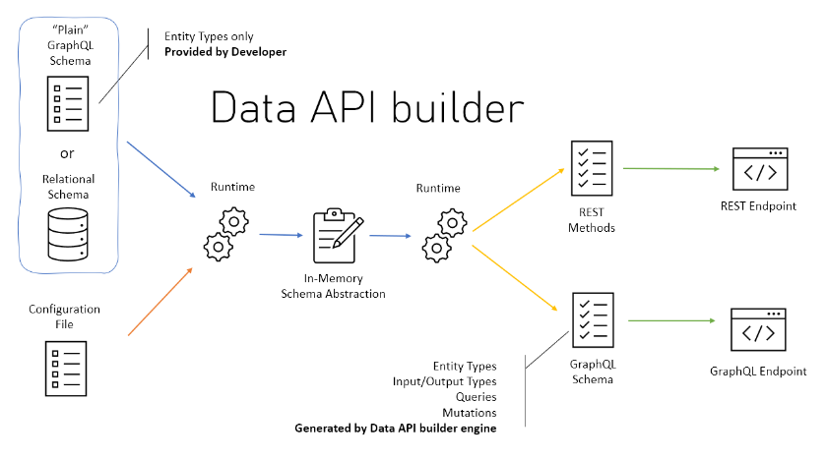
Storage & Data Updates
General Availability: Data API builder
After nearly three years in development, Data API builder (DAB) becomes generally available on May 15. The cross-platform, open-source engine is a no-code solution to add rich and secure GraphQL and REST endpoints for Azure SQL, SQL Server, Azure Cosmos DB, Azure Database for PostgreSQL, Azure Database for MySQL and on-prem PostgreSQL & MySQL databases.
Architecturally, DAB is a dynamic container-based, configuration-driven runtime. It’s an ASP.NET project written in C# and published under the MIT license. MS use ChilliCream’s Hot Chocolate for GraphQL and FusionCache for in-memory cache. And also use Swashbuckle, Polly, and several other libraries that every developer uses in well-designed API projects.
It provides:
Ridiculously flexible
Allow collections, tables, views and stored procedures to be accessed via REST and GraphQL
Support authentication via OAuth2/JWT
Support for EasyAuth when running in Azure
Role-based authorization using received claims
Item-level security via policy expressions
REST
CRUD operations via POST, GET, PUT, PATCH, DELETE
Filtering, sorting and pagination
GraphQL
Queries and mutations
Filtering, sorting and pagination
Relationship navigation
Easy development via dedicated CLI
Full integration with Static Web Apps via Database Connection feature when running in Azure
Open Source

Slide 16
ML & AI & IOT

Slide 17
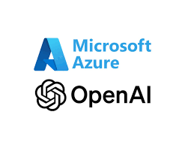
ML & AI & IOT Updates
Introducing GPT-4o: OpenAI’s new flagship multimodal model now in preview on Azure
Microsoft announced the launch of GPT-4o, OpenAI’s new flagship model, now available with Azure AI in preview. This groundbreaking multimodal model integrates text, vision, and audio capabilities, setting a new standard for generative and conversational AI experiences. GPT-4o is available now in Azure OpenAI Service, in preview, with support for text and image. Azure OpenAI Service customers can explore GPT-4o’s extensive capabilities through a preview playground in Azure OpenAI Studio starting today in two regions in the US. This initial release focuses on text and vision inputs to provide a glimpse into the model's potential, paving the way for further capabilities like audio.

Slide 18
Miscellaneous

Slide 19
Miscellaneous Updates
App Service Environment version 1 and version 2 will be retired on 31 August 2024
In August 2021, Azure announced that the retirement of Cloud Services (classic) is happening on 31 August 2024. As App Service Environment v1 and v2 run on Cloud Services (classic), we’ll retire App Service Environment v1 and v2 on the same date. Before that date, please complete your migration to App Service Environment v3.
As of 29 January 2024, App Service Environment v1 and v2 no longer supports the creation of new workloads using any of the available methods including APM/Bicep templates, Azure portal, Azure CLI, or REST API.
After 31 August 2024, App Service Environment v1 and v2 and the applications running on them will be deleted and any application data associated with them will be lost.
Please visit the product documentation for the latest information on the available resources and how to get started. You have access to several migration resources, including Azure FastTrack Architects, to provide more guidance as needed.

Slide 20
Information

Slide 21
Information
Azure Times GitHub Repo

Slide 22
Questions

