Slide 1
Azure Times #130
August 16, 2024

Slide 2
Security & Identity

Slide 3
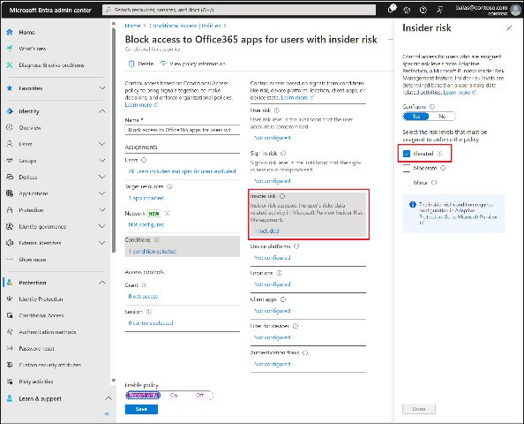
Security & Identity Updates
Azure Entra ID Connect
Functional changes
TLS 1.2 or greater is required for Microsoft Entra Connect.
TLS 1.3 is supported by Microsoft Entra Connect. Support for TLS 1.3 is being rolled out for Entra ID services.
Other Changes
SQL related drivers shipped with Microsoft Entra Connect have been updated. ODBC to 17.10.6, OLE DB to 18.7.2.
Changes to SSPR handling to reduce SQL deadlocks during sync cycles.
Changes to what elements in the Wizard that Narrator will read to improve Accessibility.
Microsoft Entra Connect icon branding
Entra ID Updates
General Availability - Insider Risk condition in Conditional Access is GA
Insider Risk condition, in Conditional Access, is a new feature that leverages signals from Microsoft Purview's Adaptive Protection capability to enhance the detection and automatic mitigation of Insider threats. This integration allows organizations to more effectively manage, and respond, to potential insider risks by using advanced analytics and real-time data.
For example, if Purview detects unusual activity from a user, Conditional Access can enforce extra security measures such as requiring multifactor authentication (MFA) or blocking access. This is a premium feature and requires a P2 license.

Slide 4
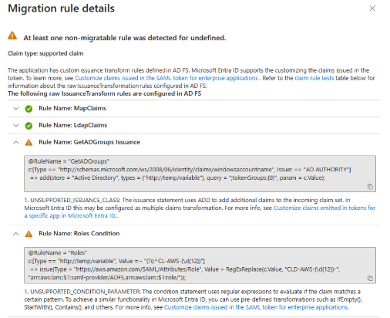
Security & Identity Updates
General Availability - New SAML applications can't receive tokens through OAuth2/OIDC protocols
Starting late September 2024, applications indicated as 'SAML' applications (via the 'preferredSingleSignOnMode' property of the service principal) can't be issued JWT tokens. This means they can't be the resource application in OIDC, OAuth2.0, or other protocols using JWTs. This change will only affect SAML applications attempting to take a new dependency on JWT-based protocols; existing SAML applications already using these flows won't be affected. This will improve the security of apps.
General Availability - Active Directory Federation Services (AD FS) Application Migration Wizard
The Active Directory Federation Services (AD FS) application migration wizard allows the user to quickly identify which AD FS relying party applications are compatible with being migrated to Microsoft Entra ID. The tool shows the migration readiness of each application, highlights issues and the suggested actions to remediate, guides the user through preparing an individual application for migration, and configuring their new Microsoft Entra application.
General Availability - Attacker in the Middle detection alert in Identity Protection
The Attacker in the Middle detection is now Generally Available for users in Identity Protection.
This high precision detection will be triggered on a user account that has been compromised by an adversary that has intercepted the user's credentials, including tokens that were issued to the user. The risk is identified through Microsoft 365 Defender and will raise the user with High risk to trigger the configured Conditional Access policy.

Slide 5
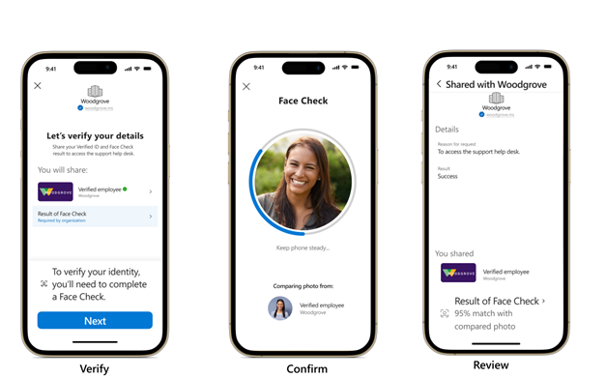
Security & Identity Updates
General Availability - Easy authentication with Azure App Service and Microsoft Entra External ID
An improved experience when using Microsoft Entra External ID as an identity provider for Azure App Service’s built-in authentication, simplifying the process of configuring authentication and authorization for external-facing apps. You can complete initial configuration directly from the App Service authentication setup without switching into the external tenant.
Face Check is now generally available
Face check is a privacy-respecting facial matching feature for high-assurance identity verifications and the first premium capability of Microsoft Entra Verified ID.
Face Check adds a critical layer of trust by matching a user’s real-time selfie and the photo on their Verified ID, which is usually from a trusted source such as a passport or driver’s license.
It can detect and reject various spoofing techniques, including deepfakes, to fully protect your users’ identities.

Slide 6
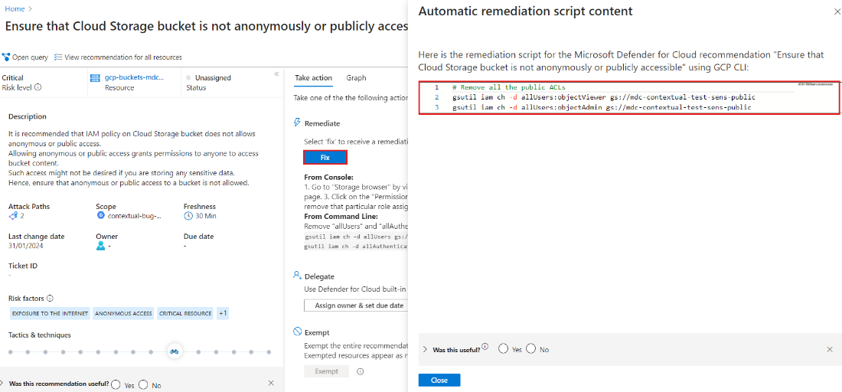
Defender for Cloud Updates
Inventory experience improvement
The inventory experience will be updated to improve performance, including improvements to the blade's 'Open query' query logic in Azure Resource Graph. Updates to the logic behind Azure resource calculation may result in additional resources counted and presented.
Compliance standards are now GA
In March, MS added preview versions of many new compliance standards for customers to validate their AWS and GCP resources against.
Those standards included CIS Google Kubernetes Engine (GKE) Benchmark, ISO/IEC 27001 and ISO/IEC 27002, CRI Profile, CSA Cloud Controls Matrix (CCM), Brazilian General Personal Data Protection Law (LGPD), California Consumer Privacy Act (CCPA), and more.
Automated remediation scripts for AWS and GCP are now GA
Automated remediation scripts for AWS & GCP to Public Preview, that allows to remediate recommendations for AWS & GCP at scale programmatically is now GA
Binary Drift public preview now available in Defender for Containers
MS introduced the public preview of Binary Drift for Defender for Containers. This feature aids in identifying and mitigating potential security risks associated with unauthorized binaries in containers. Binary Drift autonomously identifies and sends alerts about potentially harmful binary processes within containers. Furthermore, it allows the implementation of a new Binary Drift Policy to control alert preferences, offering the ability to tailor notifications to specific security needs.

Slide 7
Defender for Cloud Updates
Updated timelines toward MMA deprecation in Defender for Servers Plan 2
The following capabilities have updated timelines and plans, thus the support for them over MMA will be extended for Defender for Cloud customers to the end of November 2024:
File Integrity Monitoring (FIM): Public preview release for FIM new version over MDE is planned for August 2024. The GA version of FIM powered by Log Analytics agent will continue to be supported for existing customers until the end of November 2024.
Security Baseline: as an alternative to the version based on MMA, the current preview version based on Guest Configuration will be released to general availability in September 2024. OS Security Baselines powered by Log Analytics agent will continue to be supported for existing customers until the end of November 2024.
Adaptive network hardening deprecation
Defender for Server's adaptive network hardening is being deprecated:
Recommendation: Adaptive network hardening recommendations should be applied on internet facing virtual machines [assessment Key: f9f0eed0-f143-47bf-b856-671ea2eeed62]
Alert: Traffic detected from IP addresses recommended for blocking

Slide 8
Management & Governance

Slide 9
Management & Governance Updates
SQL Server enabled by Azure Arc
Extended Security Updates enabled for SQL Server 2014 - Extended Security Updates (ESU) subscription for SQL Server 2014 (12.x) will automatically start billing when SQL Server 2014 ESU program starts. Requires SQL Server 2014 (12.x) be enabled for ESU.
Extended Security Updates using unlimited virtualization - Extended Security Updates (ESU) subscription for SQL Server 2012 (11.x) and SQL Server 2014 (12.x) can be activated using ESU p-core license with unlimited virtualization.
Azure ARC Enabled Servers
Fixed
Fixed a bug where the service would sometimes reject reports from an upgraded extension if the previous extension was in a failed state.
Setting OPENSSL_CNF environment at process level to override build openssl.cnf path on Windows.
Fixed access denied errors in writing configuration files.
Fixed SYMBIOS GUID related bug with Windows Server 2012 and Windows Server 2012 R2 Extended Security Updates enabled by Azure Arc.
New features
Extension service enhancements: Added download/validation error details to extension report. Increased unzipped extension package size limit to 1 GB.
Update of hardwareprofile information to support upcoming Windows Server licensing capabilities.
Update of the error json output to include more detailed recommended actions for troubleshooting scenarios.
Block on installation of unsupported operating systems and distribution versions. See Supported operating systems for details.

Slide 10
Management & Governance Updates
High Scale log collection in Azure Monitor - Container Insights
When High Scale mode is enabled, Container Insights does multiple configuration changes leading to a higher overall throughput. These include using a more powerful agent setup, using a different data pipeline, allocating more memory for agent, and more. All these changes are made in the background by the service and do not require input or configuration from customers.
High Scale mode impacts only the data collection layer (with a new DCR) – the rest of the experience remains the same. Data flows to our existing tables, your queries and alerts work as before too. High Scale mode is available to all customers but requires customers to opt-in to use.

Slide 11
Compute

Slide 12
Compute Updates
Azure Virtual Desktop: New Teams available on Windows Enterprise multi-session images with M365 apps pre-installed
Windows Enterprise multi-session images + Microsoft M365 apps are updated with the new Teams app pre-installed. Users accessing newly provisioned session hosts with the latest images, updated late July, enjoy the new experience.
Announcing General Availability of Attach & Detach of Virtual Machines on Virtual Machine Scale Sets
Now you have the ability to attach or detach Virtual Machines (VMs) to and from a Virtual Machine Scale Set (VMSS) with no downtime is Generally Available
Note: This functionality is available for scale sets with Flexible Orchestration Mode with a Fault Domain Count of 1.
It Provides:
Easily scale
No downtime
Isolated troubleshooting
Easily move VMs

Slide 13
Windows 365 Updates
Uni-directional clipboard support is now generally available
Types of data that can be copied:
Disable clipboard transfers from session host to client, client to session host, or both.
Allow plain text only.
Allow plain text and images only.
Allow plain text, images, and Rich Text Format only.
Allow plain text, images, Rich Text Format, and HTML only.
Windows 365 Government now supports Cloud PC utilization report
Upgrade Windows 365 licenses in Microsoft admin center
Closing port 3389 by default for newly provisioned and reprovisioned Cloud PCs
Windows 365 Government now supports Customer Lockbox
New GPU offerings for Cloud PCs are now generally available
Cloud PC support for FIDO devices and passkeys on macOS and iOS (preview)
Windows 365 Cloud PC gallery images use new Teams VDI

Slide 14
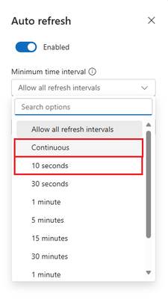
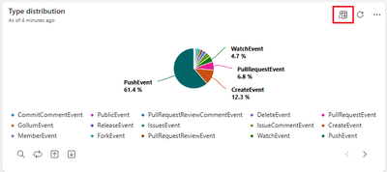
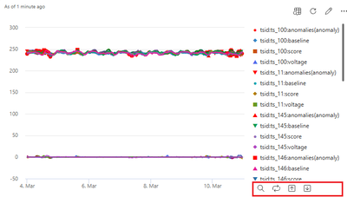
Compute Updates
ADX Web UI updates - July 2023
Copy query with syntax coloring and KQL IntelliSense improvements
Introducing ad-hoc visual Data Exploration feature
Dashboards real time refresh rate
Enhanced Data Interaction for Dashboard Tiles
Resize dashboard tiles using keyboard only

Slide 15
Storage & Data

Slide 16
Azure NetApp Updates
Volume encryption with customer-managed keys with managed Hardware Security Module (HSM)
Customer-managed keys with HSM allows to store encryptions keys in a more secure FIPS 140-2 Level 3 HSM instead of the FIPS 140-2 Level 1 or Level 2 service used by Azure Key Vault (AKV).
Requirements
Customer-managed keys with managed HSM is supported using the 2022.11 or later API version.
Customer-managed keys with managed HSM is only supported for Azure NetApp Files accounts that don't have existing encryption.
Before creating a volume using customer-managed key with managed HSM volume, you must have:
created an Azure Key Vault, containing at least one key.
The key vault must have soft delete and purge protection enabled.
The key must be type RSA.
created a VNet with a subnet delegated to Microsoft.Netapp/volumes.
a user- or system-assigned identity for your Azure NetApp Files account.
provisioned and activated a managed HSM.
Volume enhancement: Azure NetApp Files now supports 50 GiB minimum volume sizes (preview)
It is now possible to create an Azure NetApp Files volume as small as 50 GiB--a reduction from the initial minimum size of 100 GiB. 50 GiB volumes save costs for workloads that require volumes smaller than 100 GiB, allowing to appropriately size storage volumes. 50 GiB volumes are supported for all protocols with Azure NetApp Files: NFS, SMB, and dual-protocol.
Azure NetApp Files double encryption at rest is now generally available (GA)
Azure NetApp Files double encryption at rest provides two levels of encryption protection: both a hardware-based encryption layer (encrypted SSD drives) and a software-encryption layer. The hardware-based encryption layer resides at the physical storage level, using FIPS 140-2 certified drives. The software-based encryption layer is at the volume level completing the second level of encryption protection.

Slide 17
Databases

Slide 18
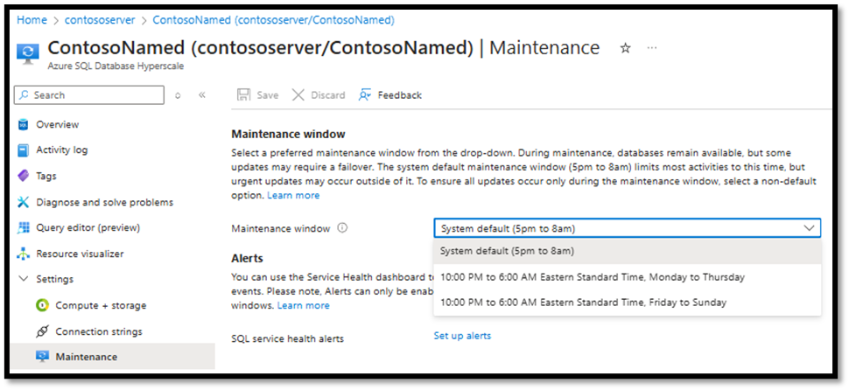
Databases Updates
General Availability: Maintenance window support for Azure SQL Database Hyperscale named replica.
Hyperscale named replicas now support configuring a specific maintenance windows. Now it is possible to choose from predefined time slots for maintenance and setup alerts to be notified of upcoming maintenance events.
By default, impactful updates to Azure SQL Database resources happen during the period 5PM to 8AM local time where Local time is determined by the location of Azure region

Slide 19
Information

Slide 20
Information
Azure Times GitHub Repo

Slide 21
Questions

