Slide 1
Azure Times #93
November 1, 2023

Slide 2
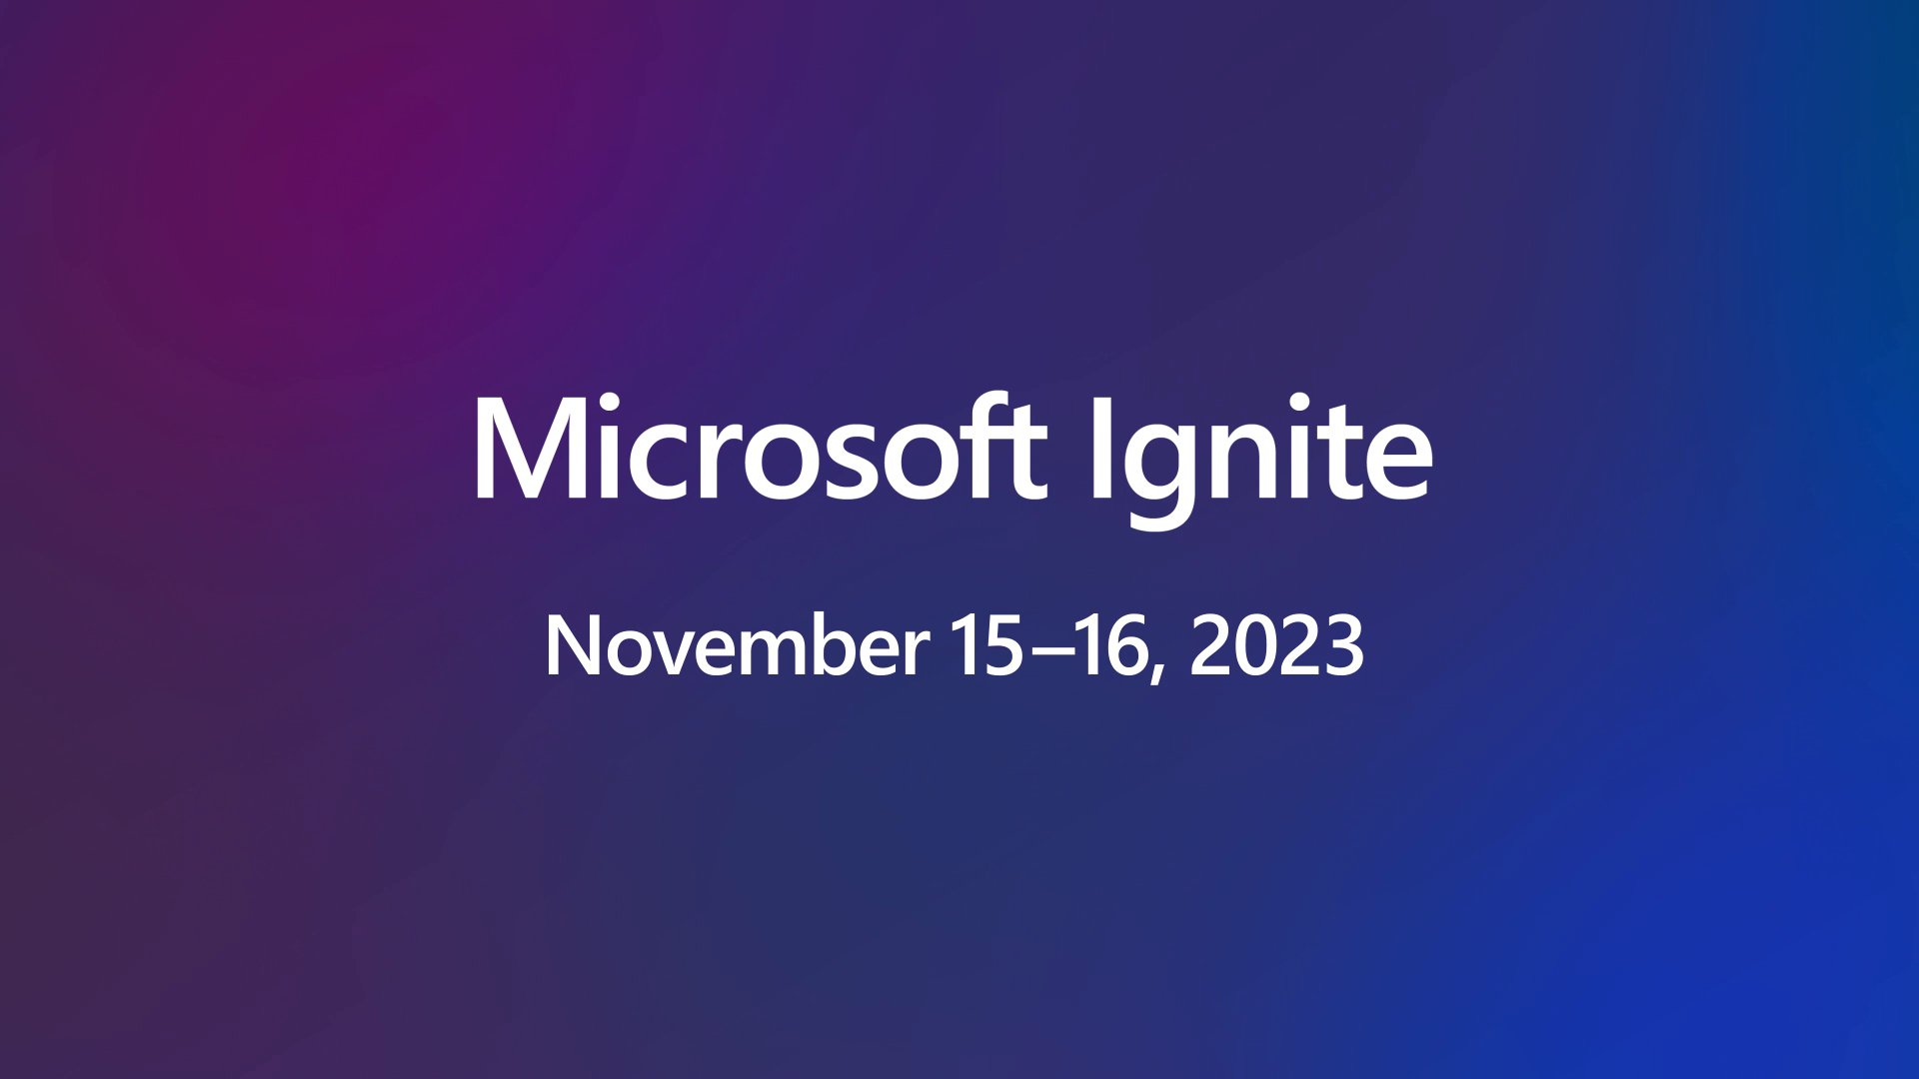

Slide 3
Security & Identity

Slide 4
Security & Identity Updates
Microsoft Security email update and Resources for Azure AD rename to Microsoft Entra ID
Identity emails will now be sent from Microsoft Security (MSSecurity-noreply@microsoft.com). The emails are currently coming from Microsoft Azure (azure-noreply@microsoft.com). It might be needed to update Outlook or Exchange rules/filters.
Reminder:
Microsoft Entra ID is the new name for Azure Active Directory (Azure AD). The rename and new product icon are now being deployed across experiences from Microsoft. Most updates will be complete by mid-November of this year.
Private Preview : Azure Managed HSM Backup/Restore when Storage Account is Behind a Private Endpoint
MS announced the Private Preview of support for Azure Key Vault Managed HSM backup/restore when the storage account is behind a private endpoint. By becoming a Microsoft Trusted Service, MS enhanced backup flow by allowing for private endpoint connection to Azure Storage accounts while backing up and restoring Managed HSM resources. This helps reduce the risk of exposure to the public internet and helps address compliance needs.

Slide 5
Security & Identity Updates
Windows Local Administrator Password Solution with Microsoft Entra ID now Generally Available!
Local Administrator Password Solution (LAPS) is a Microsoft solution that helps organizations manage the local administrator account passwords on Windows devices.
Microsoft Entra ID support for LAPS includes the following capabilities:
Enabling Windows LAPS with Microsoft Entra ID
Local administrator password management
Recovering local administrator password
Enumerating all Windows LAPS-enabled devices
Authorization of local administrator password recovery.
Auditing local administrator password update and recovery
Conditional Access policies for local administrator password recovery
LAPS is supported on Microsoft Entra joined or Microsoft Entra hybrid joined devices only. Microsoft Entra-registered devices aren't supported.
LAPS is available to all customers with Microsoft Entra ID Free or higher licenses.
Key Features of LAPS:
Randomized Passwords: LAPS generates and stores a random and complex password for the local administrator account on each Windows device. These passwords are automatically rotated at scheduled intervals, enhancing security.
Secure Storage: Passwords are securely stored in Microsoft Entra ID or Active Directory, ensuring that only authorized personnel with the necessary permissions can access them.
Access Control: Access to view and manage LAPS passwords can be delegated to specific administrators, reducing the risk of unauthorized access.
Auditing: LAPS logs all password management activities, allowing administrators to track who accessed passwords and when.

Slide 6
Management & Governance

Slide 7
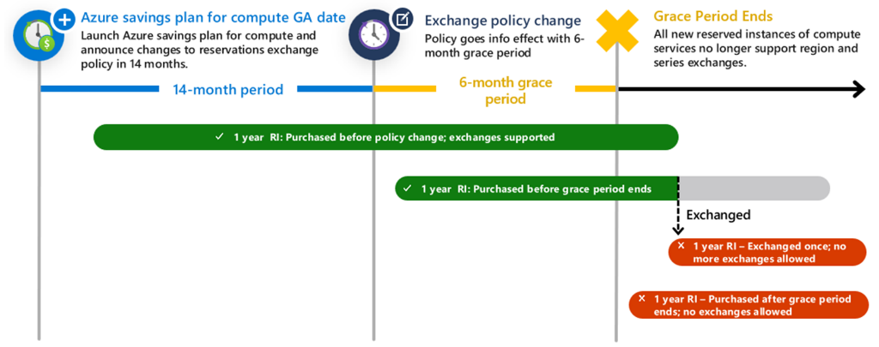
Management & Governance Updates
The availability of Azure compute reservations exchanges extended until at least July 1st, 2024
Through a grace period, it is possible to exchange Azure compute reservations (Azure Reserved Virtual Machine Instances, Azure Dedicated Host reservations, and Azure App Services reservations) until at least July 1, 2024. In October 2022 it was announced that the ability to exchange Azure compute reservations would be deprecated on January 1, 2024. This policy’s start date remains January 1, 2024, but with this grace period, you now have until at least July 1, 2024, to exchange Azure compute reservations. Compute reservations purchased prior to the end of the grace period will reserve the right to exchange one more time after the grace period ends.
Public preview: Built-in Azure Monitor alerts for Azure Site Recovery
Azure Site Recovery (ASR) now surfaces default alerts via Azure Monitor for critical events such as replication health turning unhealthy, failover failures, agent expiry, and so on. It is possible to monitor these alerts via either the Azure Monitor dashboard or via Recovery Services vault, and route them to various notification channels of choice.
Enable disaster recovery failure alerts for Azure VM, Hyper-V, and VMware replication.
Replication health critical alerts for Azure VM, Hyper-V, and VMware replication.
Azure Site Recovery agent version expiry alerts for Azure VM and Hyper-V replication.
Azure Site Recovery agent not reachable alerts for Hyper-V replication.
Failover failure alerts for Azure VM, Hyper-V, and VMware replication.
Auto certification expiry alerts for Azure VM replication.

Slide 8
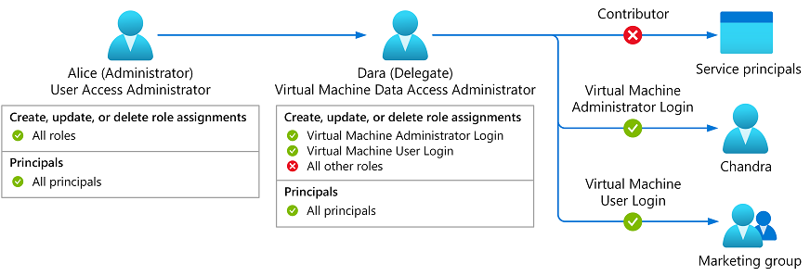
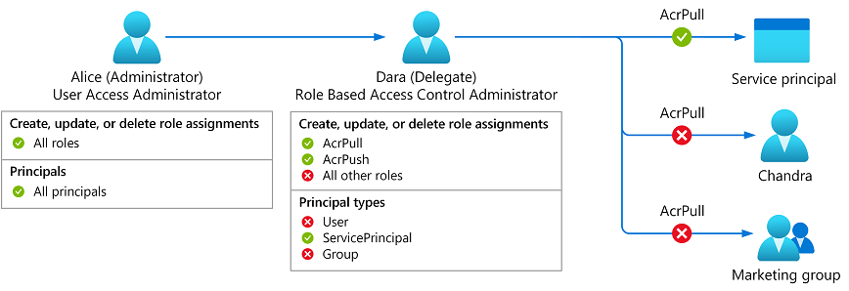
Management & Governance Updates
Delegate Azure role assignment management using conditions
MS announced a public preview of delegating Azure role assignment management using conditions. This preview gives the ability to enable others to assign Azure roles but adds restrictions on the roles they can assign and to whom they can assign roles. There are two approaches:
Make a role assignment that is constrained using conditions.
Use a new built-in role that has built-in conditions.

Slide 9
Compute

Slide 10
Compute Updates
GA: Performance optimizations for the isolated worker model in .NET Azure Functions
Some applications can be particularly sensitive to cold start, which is the amount of time it takes for an application to be initialized and start processing work. The Azure Functions team is constantly making improvements to cold start, and .NET apps using the isolated worker model can now benefit from optimizations available in the latest versions of core dependencies.
To take full advantage of these improvements, projects should be upgraded to the latest versions of core dependencies. Existing function apps may also require changes to a few configuration settings.
Placeholders (preview) - Placeholders are a platform capability that improves cold start.
Optimized executor (preview) - The function executor is a component of the platform that causes invocations to run.
Public preview: Snippets for Azure Static Web Apps
With snippets for Azure Static Web Apps, it is possible to specify code that will be injected into each page of website without having to change source code. When providing a snippet to indicate whether to append or prepend the snippet to the head or the body or your pages.
Common use cases of snippets include:
Analytics scripts
Common scripts
Global UI elements
GA: Service Bus message settlement in isolated worker model for .NET Azure Functions
The Service Bus trigger in Azure Functions allows functions to react to messages in a queue or topic. Azure Service Bus offers features for managing the transfer state of messages through settlement actions such as completion, deferral, and dead-lettering. .NET function apps using the isolated worker model can now perform these actions against messages that triggered the function.

Slide 11
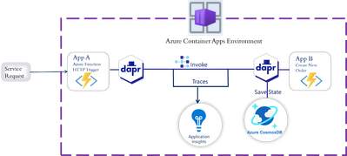
Compute Updates
Public preview: Traffic Splitting for Azure Static Web Apps
With traffic splitting, it is possible to split the traffic of Azure Static Web Apps resources across multiple environments and specify the amount of traffic each environment should receive. This enables gradually roll out new changes to site which can mitigate risks of new changes. Traffic splitting can also be used to implement A/B testing which enables data-driven decision making and facilitates optimizations.
Traffic splitting is available on the Standard hosting plan.
Public preview launch of Dapr extension for Azure Functions
MS announced the public preview launch of the Dapr extension and the seamless integration with Azure Functions for cloud-native services hosted on Azure Container Apps. These capabilities enable functions to seamlessly interact with Dapr, facilitating the development of cloud-native applications. Azure Functions on Azure Container Apps was launched in public preview in May 2023 which enables to quickly build event driven, cloud-native apps, with the flexibility to run Functions along with other microservices, APIs, websites, workflows or any container hosted components. With this seamless integration cloud native microservices can leverage DAPR to simplify the development of distributed applications by abstracting away the challenges in building resilient, scalable, and secure cloud-native systems.
The DAPR extension for Azure Functions is optimized for Azure Functions on Azure container apps plans. In addition, the extension can also be used in other environments that supports Dapr and Azure Functions like AKS, Kubernetes or self-hosted mode.

Slide 12
Compute Updates
GA: Bring our own keys (BYOK) on Ephemeral OS Disk
AKS nodes support for using custom managed keys for encryption of both the OS and data disks of clusters is now generally available.
Azure storage encrypts all data in a storage account at rest. By default, data is encrypted with Microsoft-managed keys.
For more control over encryption keys, it is possible to supply your own managed keys to use for encryption at rest for both the OS and data disks for your AKS clusters.
Public preview: Disable Secure Shell (SSH) support in AKS
Secure Shell (SSH) is currently on by default for AKS provisioned nodes, and must disable SSH manually.
This public preview feature allows to disable or enable SSH. This gives the ability to secure cluster and reduce the attack surface.

Slide 13
Storage & Data

Slide 14
Storage & Data Updates
Public preview: Azure NetApp Files standard storage with cool access
The standard storage with cool access preview program provides the ability to configure a standard capacity pool with cool access. The cool access feature moves cold (infrequently accessed) data transparently to an Azure storage account to help reduce the cost of storage. Throughput to and from the volume remains the same for the standard storage enabled with cool access. However, there can be a difference in data access latency as data blocks might be tiered to Azure storage accounts.
The standard storage with cool access feature provides options for the “coolness period” to optimize the network transfer cost, based on workload and read/write patterns. This feature is provided at the volume level.
NOTE:
Cool access is an additional service only on the Standard service level.
The coolness period, ranging from 7 to 183 days
Tiered data will appear to be online and continue to be available to users and applications by transparent and automated retrieval from the cool tier.
Metadata is never cooled and always remains in the hot tier. As such, the activities of metadata-intensive workloads (for example, high file-count environments like chip design, VCS, and home directories) aren't affected by tiering.
Azure NetApp Files Estimator

Slide 15
Storage & Data Updates
Azure File share NFS Snapshots is now Public Preview!
MS announced the public preview of Snapshot support for NFS share. Customers using NFS shares will now be able to perform share level Snapshot management operations via REST API, PowerShell and CLI. Using Snapshots users will be able to roll back the entire filesystems or pull specific files that were accidentally deleted or corrupted. Therefore, it is always recommended to create a snapshot schedule that best suits RPO (recovery point objective) requirement. Snapshot schedule frequency can be hourly, daily, weekly or monthly.
Continued region expansion: Azure Data Factory is generally available in Poland Central
Azure Data Factory is now available in Poland Central.

Slide 16
Databases

Slide 17
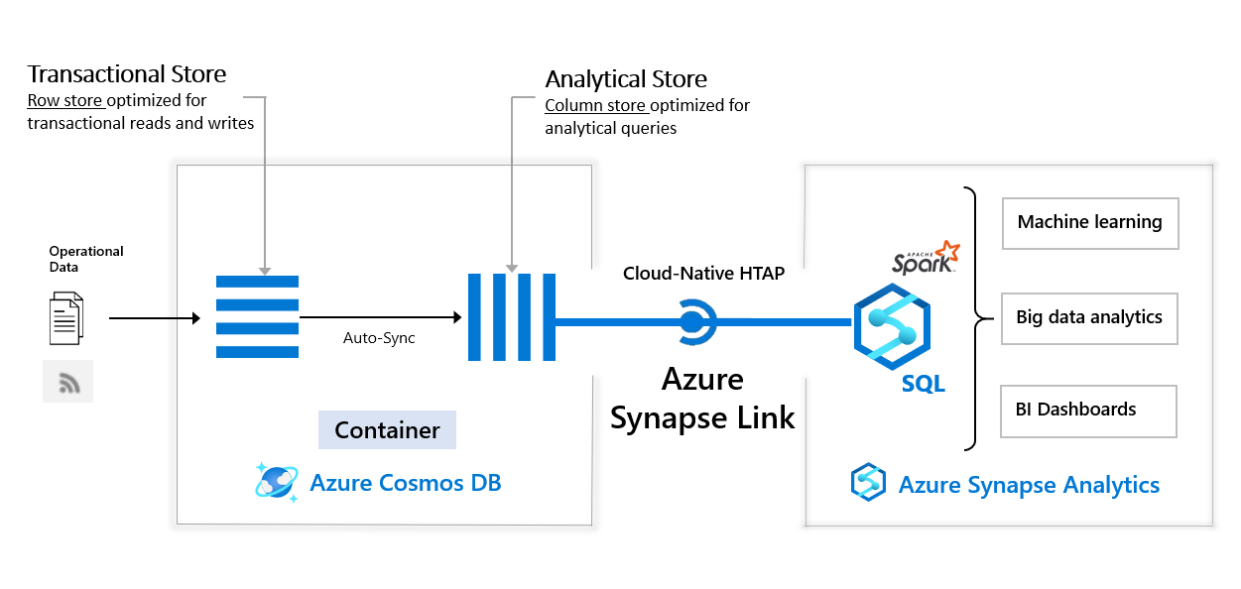
Databases Updates
Public Preview: Azure Synapse Link compatibility with Cosmos DB continuous backup
It is now possible to enable Azure Synapse Link with Azure Cosmos DB accounts protected by continuous backup. It unlocks the power of near-real-time HTAP (hybrid transactional and analytical processing) analytics on database accounts and containers using Azure Cosmos DB continuous backup.
General availability: Azure Synapse Link for existing MongoDB collections
Now it is possible to enable Azure Synapse Link on existing MongoDB collections stored in Azure Cosmos DB for Mongo DB. Unblock near real time analytics at no RU/s cost. This capability is available via Azure CLI or PowerShell.

Slide 18
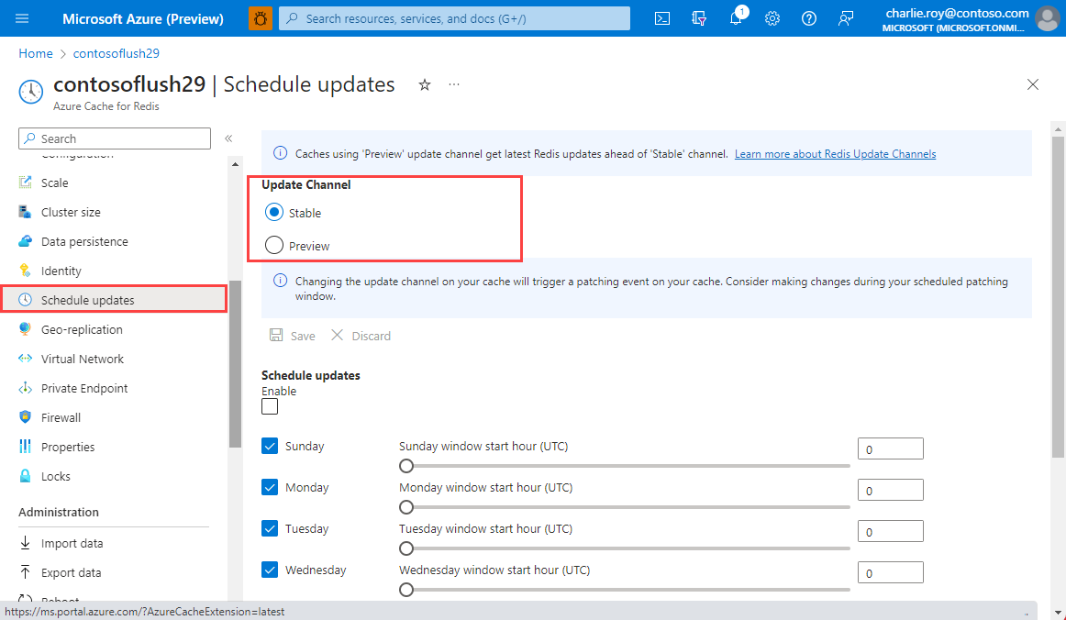
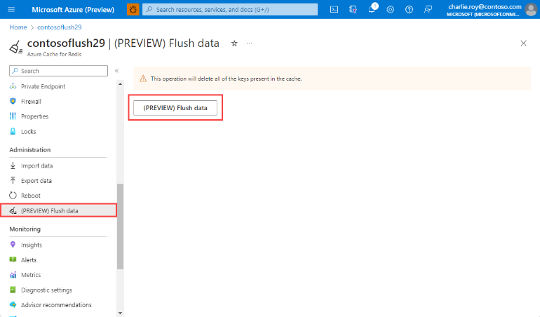
Databases Updates
Public preview: Update channel for Basic, Standard and Premium Caches
Basic, Standard, and Premium tier caches now support the frequency of getting updates and the possibility of receiving early updates by changing the configuration of the update channel. It is recommended to set the "Preview" update channel for non-production and less critical workloads to preview updates; and choose the "Stable" update channel for most critical, production workloads. All caches default to the Stable update channel.
Public preview: Flush data operation for Azure Cache for Redis
The flush data operation for Basic, Standard, and Premium caches allows to deletion or flush all data in cache. This flush operation can be used before scaling operations to potentially reduce the time required to complete the scaling operation on the cache. It ıs also possible to configure the flush operation to run periodically on dev/test caches to keep memory usage in check.
The flush operation, when executed on a clustered cache, clears data from all shards at the same time.
Note:
Previously, the flush operation was only available for geo-replicated enterprise-tier caches. Now, it is available in Basic, Standard and Premium tiers.

Slide 19
Databases Updates
General availability: PostgreSQL 16 production support in Azure Cosmos DB for PostgreSQL
It is now possible to select the latest major PostgreSQL version, PostgreSQL 16, for Azure Cosmos DB for PostgreSQL clusters. Existing clusters can be upgraded to PostgreSQL 16 using the in-place upgrade feature. PostgreSQL 16 provides:
Query performance improvements with more parallelism;
Developer experience enhancements;
Monitoring of I/O stats using pg_stat_io view;
Enhanced security features, among other improvements.
General availability: Latest PostgreSQL minor versions supported by Azure Database for PostgreSQL - Flexible Server
PostgreSQL minor versions 15.4, 14.9, 13.12, 12.16, 11.21 are now supported by Azure Database for PostgreSQL – Flexible Server.
These minor version upgrades are automatically performed as part of the monthly planned maintenance in Azure Database for PostgreSQL – Flexible Server. This upgrade automation ensures that your databases are always running on the most secure and optimized versions without requiring manual intervention. This release fixes two security vulnerabilities and over 40 bugs.
General availability: Storage auto-grow & online disk scaling for Azure Database for PostgreSQL - Flexible Server
MS announced that Azure Database for PostgreSQL - Flexible Server users can choose to opt-in to storage auto-grow, which is now Generally Available.
With auto-grow enabled, Azure Database for PostgreSQL - Flexible Server will automatically increase the size of the provisioned storage of database servers. This flexibility removes concerns about rightsizing when beginning to use these services and running out of storage.
Additionally, MS has introduced online disk scaling globally, eliminating the requirement for server restarts during storage scaling operations.
NOTE:
Storage can only be scaled up, not down.

Slide 20
ML & AI & IOT

Slide 21
ML & AI & IOT Updates
General availability: Azure Sphere OS version 23.10 expected on November 8
Azure Sphere OS version 23.10 is now available for evaluation in the Retail Eval feed. The retail evaluation period provides 14 days for backward compatibility testing. During this time, please verify that applications and devices operate properly with this release before it is deployed broadly to devices in the Retail feed. The Retail feed will continue to deliver OS version 23.05 until we publish 23.10 in two weeks.
The 23.10 release is a quality release for the OS and includes bug fixes and security updates. It does not include new OS features.
Areas of special focus for compatibility testing with 23.10 include apps and functionality utilizing:
cURL and cURL-multi
wolfSSL, TLS-client and TLS-server
Azure IoT, DPS, IoT Hub, IoT Central, Digital Twins, C SDK
Mutual Authentication

Slide 22
Miscellaneous

Slide 23
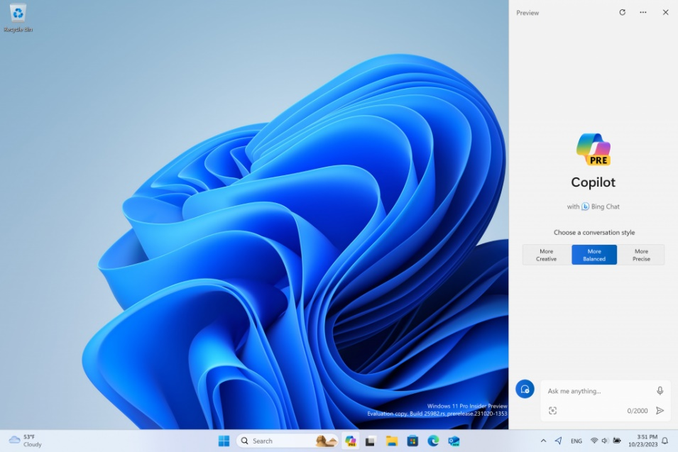
Miscellaneous Updates
Protect SQL Server 2014 workloads with Extended Security Updates
SQL Server 2014 will reach the end of its ten-year product lifecycle on July 9th, 2024.
MS announced the SQL Server 2014 Extended Security Updates. Extended Security Updates will offer up to three years of critical security updates and the ability to obtain technical support through existing support contracts.
Extended Security Updates are free for workloads running in Azure. The updates will be available for purchase for workloads on-premises and in multi-cloud environments enabled by Azure Arc. Software Assurance or software subscription is required for customers to purchase Extended Security Updates on-premises.
Announcing Windows 11 Insider Preview Build 25982 (Canary Channel)
MS ıs beginning to roll out Copilot in Windows in preview to Windows Insiders in the Canary Channel. Rolling this out in the Canary Channel to Insiders in the select global markets mentioned below will be gradual, so some Insiders will not see it immediately.

Slide 24
Miscellaneous Updates
Introducing DNR support for Windows Insiders
Discovery of Network-designated Resolvers (DNR) is an upcoming IETF standard to discover encrypted DNS servers. Before DNR, devices getting a DNS server from their local network would not be able to use encrypted DNS without manually finding out the IP address of their desired encrypted DNS server and configuring it on client side. DNR enables devices to use encrypted DNS protocols like DNS over HTTPS (DoH) and DNS over TLS (DoT) on the client side without requiring manual endpoint configuration.
It requires a DHCP server that supports DNR-specific options (OPTION_V4_DNR for DHCPv4 or OPTION_V6_DNR for DHCPv6).
Auditing Deletions of Exchange Online Public Folders
MS announced a new auditing feature added to Exchange Online public folders. The feature allows to monitor/track public folder deletions in the organization.
Public folder deletions performed using any client (Outlook desktop client, Exchange admin center, Exchange Online PowerShell etc.) are all audited.
The feature is now available for all Exchange Online tenants.
The Microsoft Purview Auditing feature is enabled by default for all the tenants with the appropriate subscription and the auditing logs are retained for 90 days for Audit (Standard).

Slide 25
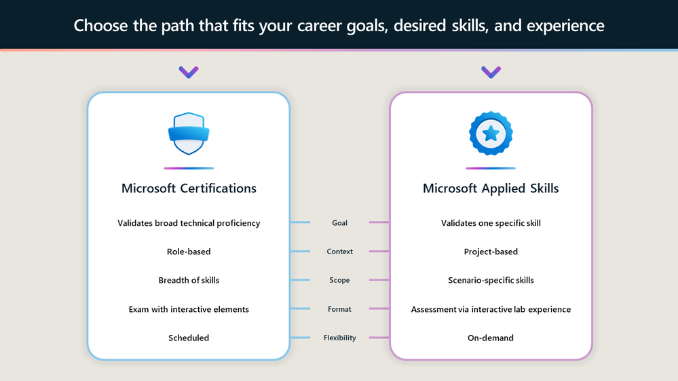
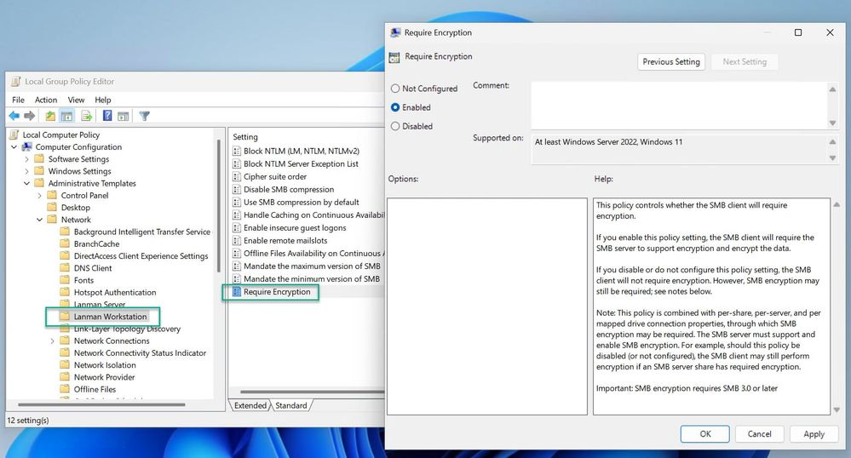
Miscellaneous Updates
Announcing Microsoft Applied Skills
MS introduced Microsoft Applied Skills, a new verifiable credential that validates that have the targeted skills needed to implement critical projects aligned to business goals and objectives. Applied Skills gives a new opportunity to put skills center stage, empowering to showcase what can do and what you can bring to key projects in your organization.
SMB client encryption mandate now supported in Windows Insider
Windows 11 Insider Preview Build 25982 (Canary Channel), SMB now supports requiring encryption of all outbound SMB client connections. With this new option, administrators can mandate that all destination servers support SMB 3.x and encryption, and if missing those capabilities, the client won’t connect. This enforces the highest level of network security as well as bringing management parity to SMB signing, which allows both client and server requirements.

Slide 26
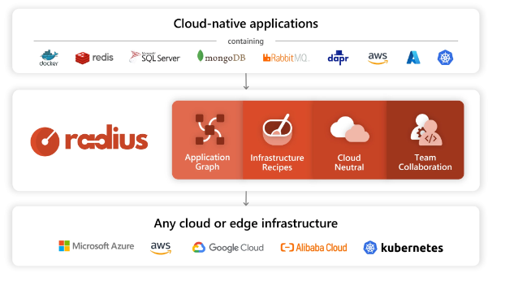
Miscellaneous Updates
Radius, a new open-source application platform for cloud-native apps
The Microsoft Azure Incubations team is excited to announce Radius, a cloud-native application platform that enables developers and platform engineers who support them to collaborate on delivering and managing cloud-native applications that follow corporate best practices for cost, operations, and security by default. Radius is an open-source project that supports deploying applications across private cloud, Microsoft Azure, and Amazon Web Services, with more cloud providers to come.
Radius features available in this first open-source release:
In this first release, the focus is on the features that are most foundational to the Radius platform and its goals of improving the productivity of application development workflows. These include:
Simplified and consistent application development experience: Deploy to any cloud provider or on-premises using the same application definition, all with a consistent set of tooling and experience. These include capabilities to automate resource access and provisioning, as well as the ability to configure environments that meet the needs of each phase of development.
Recipes and environments: Standardize and scale deployments with clear separation of concerns between developers and operators. Radius Recipes are pre-definable templates that automate the provisioning of infrastructure resources and environment configurations that can be designed to adhere to cost, security, and compliance standards.
Application graph: Gain visibility into the resources and relationships that make up an application. Radius captures the relationships between resources in an application as a part of the development activities, which can in turn be queried and understood.

Slide 27
Information

Slide 28
Information
Azure Times GitHub Repo

Slide 29
Questions

