Slide 1
Azure Times #110
March 20, 2024

Slide 2
Networking

Slide 3
Networking Updates
Retirement: Support for Application Gateway Web Application Firewall v2 Configuration is ending
On 15 March 2027, the Application Gateway WAF v2 Configuration will be retired. To continue using this service, it is required to switch to the Application Gateway WAF v2 Policy before the retirement date. The WAF Policy offers the same features as the Configuration, plus additional security enhancements and new features at no extra cost. It is possible to migrate seamlessly from WAF Configuration to WAF Policy without any downtime. Required action
From now through 15 March 2027, it is allowed to continue to use Application Gateway WAF v2 Configuration, or transition to Application Gateway WAF v2 – WAF Policy before 15 March 2027. After 15 March 2025, Application Gateway WAF v2 Configuration will no longer be supported, to avoid service disruptions, we recommend you follow these migration instructions as soon as possible.

Slide 4
Security & Identity

Slide 5
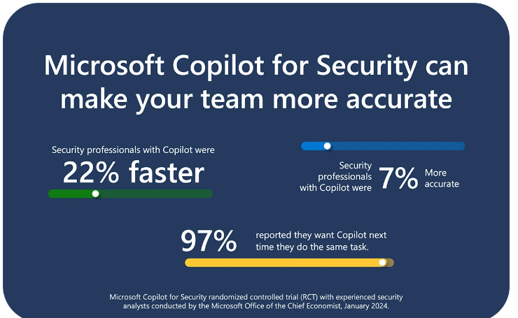
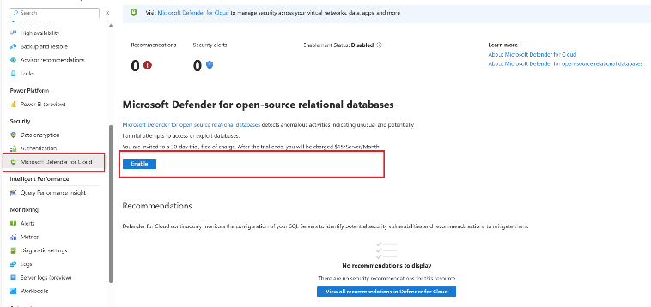
Security & Identity Updates
General Availability: Azure Defender for Microsoft Azure Database for PostgreSQL - Flexible Server
Defender for Cloud is now available for Microsoft Azure Database for PostgreSQL – Flexible Server. Defender for Cloud detects anomalous activities indicating unusual and potentially harmful attempts to access or exploit databases. When deployed, it provides an additional important security barrier to your Azure Database for PostgreSQL server beyond the built-in security features.
Microsoft Defender for Azure Database for PostgreSQL - Flexible Server currently has following limitations:
No Azure CLI or PowerShell support.
No ability to enable Cloud Defender for Azure Database for PostgreSQL - Flexible Server on subscription level.
Microsoft Copilot for Security is generally available on April 1, 2024, with new capabilities
MS announced that Microsoft Copilot for Security will be generally available worldwide on April 1, 2024. The industry’s first generative AI solution will help security and IT professionals catch what others miss, move faster, and strengthen team expertise. Copilot is informed by large-scale data and threat intelligence, including more than 78 trillion security signals processed by Microsoft each day, and coupled with large language models to deliver tailored insights and guide next steps. With Copilot, you can protect at the speed and scale of AI and transform your security operations.

Slide 6
Management & Governance

Slide 7
Management & Governance Updates
Now available: Free data transfer out to the internet when leaving Azure
MS respects customer choice, including the choice to migrate data away from Azure.
Azure now offers free egress for customers leaving Azure when taking their data out of the Azure infrastructure via the internet to switch to another cloud provider or an on-premises data center. Azure already offers the first 100GB/month of egressed data for free to all customers in all Azure regions around the world. If it is required more than 100GB/month, please follow these steps to claim credit. Contact Azure Support for details on how to start the data transfer-out process
The exemption on data transfer out to the internet fees also aligns with the European Data Act and is accessible to all Azure customers globally and from any Azure region.
You must provide advance notice of your intention to leave Azure to Azure Support by creating a support request discussed previously
You must cancel all Azure subscriptions associated with your account after your data is transferred out before you can request your invoice-level credit.
You receive credit for a maximum of 60 calendar days of egress charges starting from the date you specified as your transfer start date.
Standard charges for Azure services and data transfer out from specialized services including Express Route, Express Route Direct, VPN, Azure Front Door, and Azure Content Delivery Network (CDN) aren't included in this credit offer. Only egress charges as a result of moving Azure Storage data out of Azure are eligible for credits.
Azure reviews your request for adherence to the requirements. If we determine the customer request doesn't follow the documented process, we might not issue the credit request.
Azure might make changes regarding the egress credit policy in the future.
If a customer purchases Azure services through a partner, the partner is responsible for the credit request process, transferring data, canceling the applicable subscriptions and credit issuance to the customer.

Slide 8
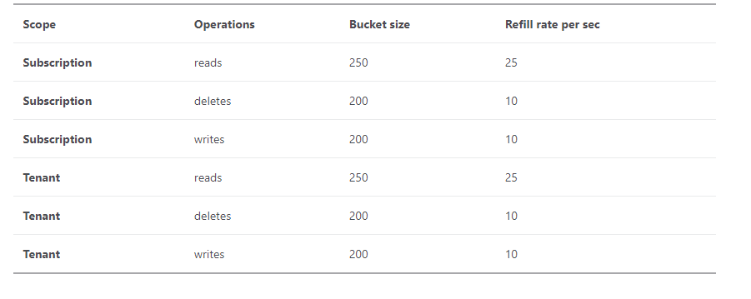
Management & Governance Updates
Public Preview: Modernizing Azure Resource Manager Throttling
Starting in 2024, Azure Resource Manager is introducing a revamped throttling experience for Azure subscriptions. These changes bring fresh limits that enhance API management.
Token Bucket Algorithm:
Azure now employs a token bucket algorithm to manage throttling. Here’s how it works:
Your account has a bucket that holds tokens (representing requests).
For example, the initial bucket size is 250 tokens for read requests.
Each API request consumes one token from the bucket.
For example, the read bucket size is 250 tokens, so you can make up to 250 read requests in one second. If you exceed 250 requests in a second, you are throttled and the remaining requests within that second fail.
Automatic Refill:
The bucket refills at a fixed rate.
If the bucket is below capacity, tokens are added back every second until it reaches the maximum bucket size.
When refill tokens arrive and the bucket is already at capacity, they are discarded. The bucket has a maximum limit and cannot hold more than its designated number of tokens.
Increased Limits and Scope:
Throttling limits have increased by roughly 30 times for writes, 2.4 times for deletes, and 7.5 times for reads. These represent significant increases compared to previous limits.
Smooth Transition:
The migration to the new architecture will be gradual, with a certain percentage of tenants being migrated at a time.
Once complete, the current architecture will retire, making way for a more efficient and dynamic throttling experience.

Slide 9
Management & Governance Updates
Azure Monitor managed service for Prometheus now supports TLS & mTLS based scraping
Azure Monitor managed service for Prometheus now supports TLS & mTLS based scraping for Prometheus instances served with TLS. To enable TLS and mTLS based scraping, configure the TLS settings in the ConfigMap, and provide a CA certificate to verify the authenticity of the server’s certificate.
The secret should be created in kube-system namespace and then the configmap/CRD should be created in kube-system namespace.
Billing for Azure Monitor stateful log search alerts
Alerts can be stateful or stateless.
Stateless alerts fire each time the condition is met, even if fired previously.
All activity log alerts are stateless.
The frequency of notifications for stateless metric alerts differs based on the alert rule's configured frequency:
Alert frequency of less than 5 minutes: a notification is sent sometime between one and six minutes.
Alert frequency of more than 5 minutes: While the condition continues to be met, a notification is sent between the configured frequency and double the frequency. For example, for an alert rule with a frequency of 15 minutes, a notification is sent sometime between 15 to 30 minutes.
Stateful alerts fire when the rule conditions are met and will not fire again or trigger any more actions until the conditions are resolved.

Slide 10
Compute

Slide 11
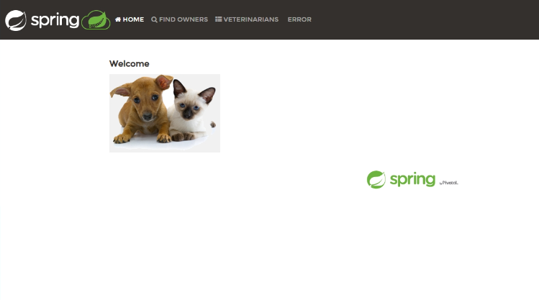
Compute Updates
Public Preview: JVM memory fit in Azure Container Apps
The Java Virtual Machine (JVM) uses memory conservatively as it assumes OS memory must be shared among multiple applications. However, a container app can optimize memory usage and make the maximum amount of memory possible available to the application. This memory optimization is known as Java automatic memory fitting. When memory fitting is enabled, Java application performance is typically improved between 10% and 20% without any code changes. All Java apps are now calibrated with JVM memory defaults for better performance and reliability in a container environment. Automatic memory fitting is enabled by default but can be disabled manually.
This feature is now available in public preview.
Public Preview: Managed Java components in Azure Container Apps
It is now possible to use managed Java components to access platform features for apps that have to be managed. Azure Container Apps now offers Spring Cloud Eureka and Spring Cloud Config server for service registration and externalized application settings in all environments.
This feature is available in public preview.
Public Preview: Tomcat support in Azure Container Apps
Azure Container Apps now supports Apache Tomcat in the code-to-cloud build process. This means that it is possible to use existing code, and configuration, to create a cloud-native container app without the hassle.
This feature is currently available in public preview.

Slide 12
Compute Updates
General Availability (GA): Managed Certificates on Azure Container Apps !
Azure Container Apps allows to bind one or more custom domains to a container app and automatically configure a free managed certificate for your custom domain.
Azure Container Apps provides a free managed certificate for your custom domain. Without any action required from you, this TLS/SSL server certificate is automatically renewed as long as your app continues to meet the requirements for managed certificates.
The requirements are:
Container app has HTTP ingress enabled and is publicly accessible.
For apex domains, A record must be pointing to Container Apps environment's IP address.
For subdomains, the CNAME record must be mapped directly to the container app's automatically generated domain name. Mapping to an intermediate CNAME value blocks certificate issuance and renewal. Examples of CNAME values are traffic managers, Cloudflare, and similar services.
Azure SQL Trigger Binding for Azure Functions goes GA
Azure SQL Database Engineering and Product Management announced that Azure SQL Trigger Binding for Azure Functions is now generally available (GA).
Azure SQL trigger uses SQL change tracking functionality to monitor a SQL table for changes and trigger a function when a row is created, updated, or deleted. It can be used in many scenarios such as change streaming from an Azure SQL database, participating in event-based architectures, as well as real time updating of web pages and applications. The SQL Bindings are available to be created using Java, C#, JavaScript, Python, and PowerShell.

Slide 13
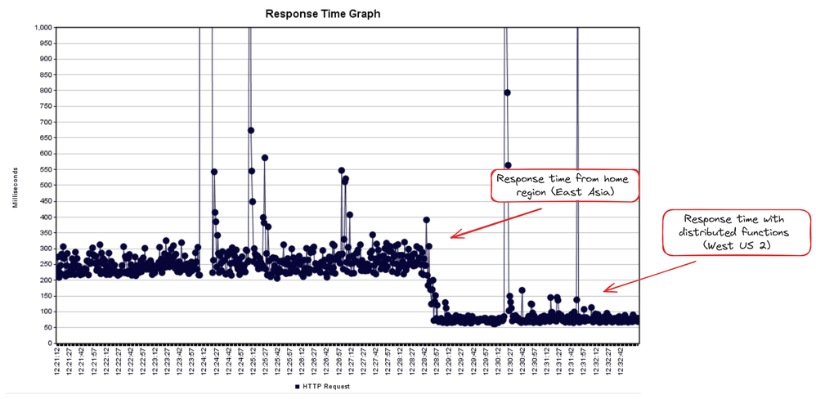
Compute Updates
Announcing Distributed Functions (Preview) for Azure Static Web Apps
MS announced Distributed Functions for Azure Static Web Apps, a feature that automatically distributes your Static Web Apps’ managed functions to regions of high demand. With distributed functions enabled on Static Web Apps resource, it can reduce the network latency for requests to backend-managed functions, improving the performance and responsiveness of full-stack web app with global audiences.
During creation of Azure Static Web App, you have to choose a home region for functions, which is where they are initially deployed. Then, if an Azure Static Web App host in a different region receives a significant amount of traffic to the managed functions, it will deploy a copy of managed functions to that region and route the traffic to this new managed function backend.
This distribution of backend functions can reduce the network latency for managed functions calls by up to 70%, depending on the distance between the user and the function region. This can be especially useful in the context of request pre-processing, where network latency is critical to providing a good user experience.
Distributed Functions is a feature that is available to the Standard SKU of Azure Static Web Apps

Slide 14
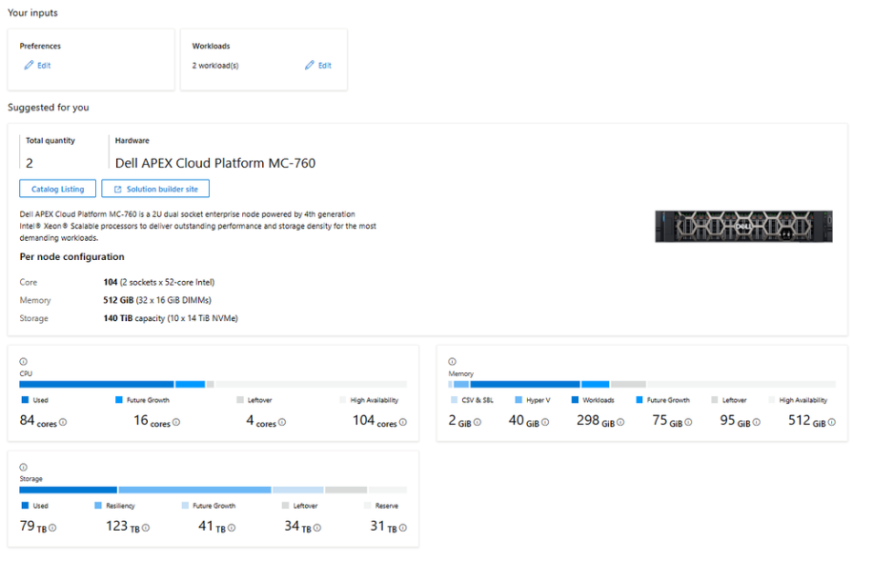
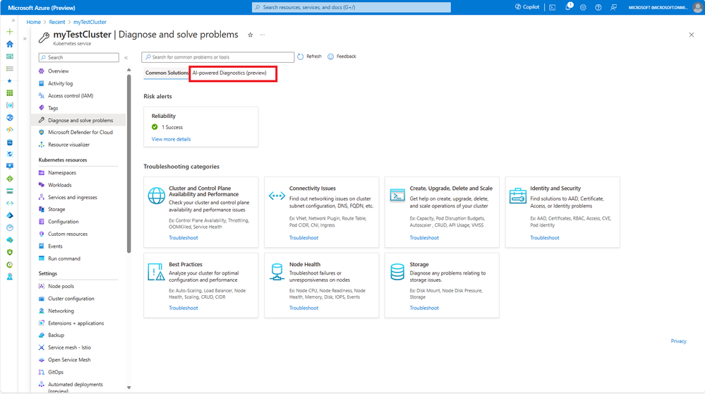
Compute Updates
Introducing Azure Virtual Desktop workload in Azure Stack HCI Sizer!
MS announced that ‘Azure Virtual Desktop’ is now available as a new workload category in Azure Stack HCI sizer! It enables customers to efficiently plan and size Azure Virtual Desktop deployments on Azure Stack HCI by calculating no. of VM required, suggesting per VM configuration and what hardware to purchase.
Announcing Conversational Diagnostics (Preview) on Azure Kubernetes Service
MS announced Conversational Diagnostics (Preview), a new feature in Azure Kubernetes Service (AKS) that leverages the powerful capabilities of OpenAI to take problem-solving to the next level. With this feature, it is possible to engage in a conversational dialogue to accurately identify the issue with AKS clusters, and receive a clear set of solutions, documentation, and diagnostics to help resolve the issue.

Slide 15
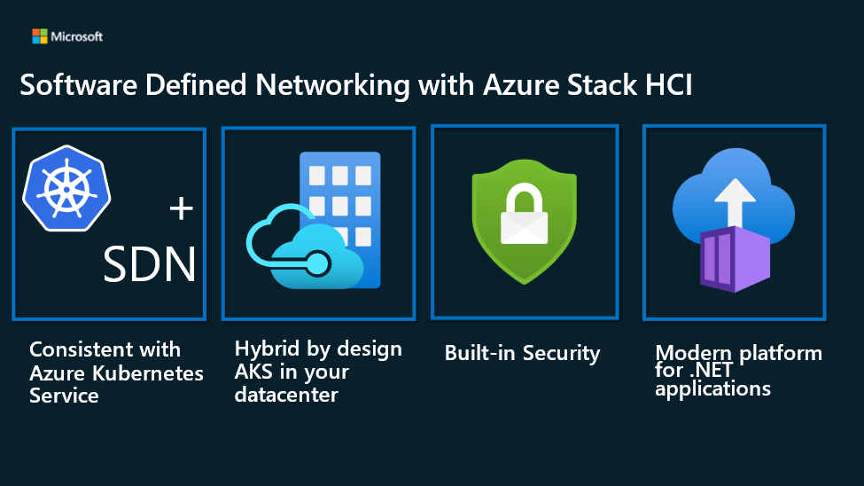
Compute Updates
Announcing Public Preview of SDN integration with AKS HCI
MS announced the Public Preview of SDN integration with AKS on Azure Stack HCI. Customers can now bring in their own networks and attach the AKS-HCI nodes to these networks. Additionally, customers can use the SDN Software Load Balancers to provide load balancer services for their containerized applications.
SDN delivers:
Consistent with Azure Kubernetes service
Hybrid by Design
Built-in security
Modern platform for applications

Slide 16
Compute Updates
Announcing the 3-year retirement of Windows Server 2022 on Azure Kubernetes Service
Windows Server 2025 and the Windows Server Annual Channel, offer a comprehensive array of enhanced features, heightened security measures, and improved overall performance, and with image portability customers can now run Windows Server 2022 based containers on these new versions. To maximize the experience for customers, not only will Windows Server 2025/Annual Channel provide the most efficient versions of Windows Server yet, but also streamline the upgrade process. In pursuit of an enhanced user experience and an unwavering commitment to safety and reliability, MS will be retiring Windows Server 2022 on Azure Kubernetes Service (AKS) in 3-years time.
Windows Server 2022 will be retiring on AKS in March 2027.

Slide 17
Storage & Data

Slide 18
Storage & Data Updates
Generally available: Azure Blob Storage Cold Tier in Poland Central, Qatar Central and Azure China
Azure Blob Storage Cold Tier has been generally available since Aug 10th, 2023. It is a new online access tier that is the most cost-effective Azure Blob offering for storing infrequently accessed data with long-term retention requirements while providing instant access.
Azure Blob Storage Cold Tier is now available in more regions, including Poland Central, Qatar Central and all regions in Azure China.

Slide 19
Databases

Slide 20
Databases Updates
General Availability: Private Link in Azure Cosmos DB for MongoDB vCore
Azure Cosmos DB for MongoDB vCore now supports private endpoint, enhancing security and connectivity within Azure. This feature allows virtual network (VNet) hosts to securely access data over Private Link, ensuring traffic between the VNet and database remains on the Microsoft backbone network, away from public internet exposure. Users can select private access during cluster setup or switch from public to private access anytime, leveraging Azure Private Link's benefits for secure, efficient database connections.
Announcing Try Azure Cosmos DB support in Vercel Integration
It is now easy to create free Azure Cosmos DB accounts within the integration with Vercel and upgrade if needed. This improves productivity as it is possible to deploy a Vercel application and create a free Azure Cosmos DB account with a database during the deployment process.

Slide 21
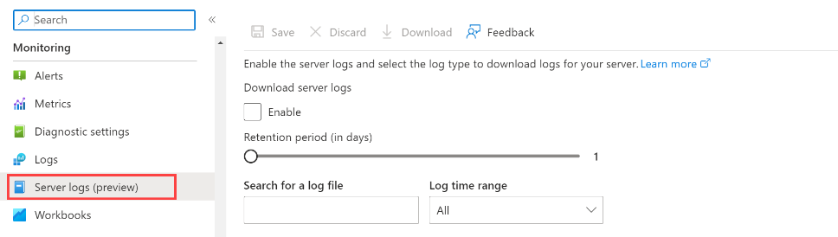
Databases Updates
General availability: Microsoft Entra ID integration with Azure Cosmos DB for PostgreSQL
It is now possible to use Microsoft Entra ID authentication on Azure Cosmos DB for PostgreSQL clusters in addition or instead of the native Postgres authentication. Microsoft Entra ID (formerly known as Azure AD) authentication integration with Azure Cosmos DB for PostgreSQL allows for improved managed database security by delegating credential management and authentication to a centralized identity provider.
Microsoft Entra ID supports advanced security features such as two-factor authentication options, password lifecycle management, applications and managed identities, and conditional access.
Microsoft Entra ID authentication integration with Azure Cosmos DB for PostgreSQL provides full support for managed identities and support for invited users.
Login with the deleted Microsoft Entra ID user can still be done till the token expires (up to 90 minutes from token issuing). If you also remove the user from Azure Cosmos DB for PostgreSQL cluster this access will be revoked immediately.
General Availability: Major version upgrade logs for Azure Database for PostgreSQL - Flexible Server
MS announced the addition of the PostgreSQL version upgrade logs (PG_Upgrade_Logs) feature to Azure Database for PostgreSQL - Flexible Server. This enhancement is designed to streamline the experience during major version upgrades, providing easy access to PostgreSQL major version upgrade logs directly through the familiar Server Logs UI. PG_Upgrade_Logs provides invaluable insights into the upgrade process, significantly improving the ability to troubleshoot effectively. These logs can be easily configured and accessed through the Azure Portal or via CLI, and integrated into existing workflow.

Slide 22
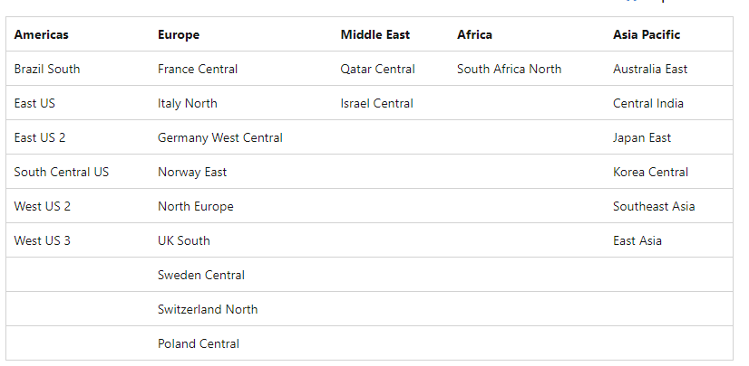
Databases Updates
Improve the resiliency of your General Purpose Azure SQL Managed Instances by upgrading to a zone-redundant configuration.
MS extended the support of the Zone Redundant configuration to more regions
Zone Redundancy support for Azure SQL Database Hyperscale Named Replica – Preview
MS announced the public preview of zone redundancy for Azure SQL Database Hyperscale Named replica. This feature leverages Azure Availability Zones to distribute Named replica compute nodes across different physical locations within an Azure region. By choosing zone redundancy for the Named replica, it is possible to enhance the resiliency of the read workload running on the Named replica to a wider range of failures, including disastrous data center outages, without any modifications of the application logic. For more details, check out Hyperscale zone redundant availability.

Slide 23
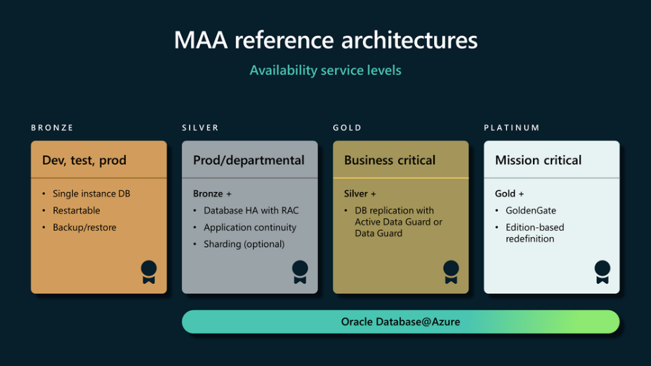
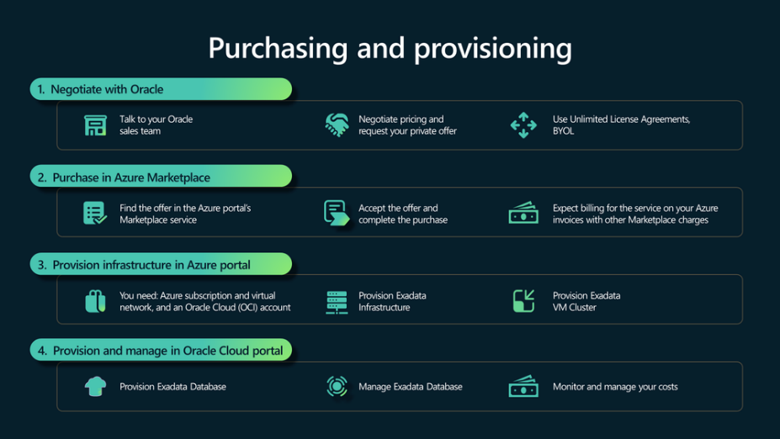
Databases Updates
Announcing Oracle Database@Azure in Germany West Central
Oracle and Microsoft are announced that they are adding five new regions for Oracle Database@Azure, bringing the total planned regions to 15 by the end of this year. The new regions are India Central, Italy North, Southeast Asia(Singapore), Sweden Central, and United Arab Emirates North. They join the 10 regions that were previously announced: US East, Germany Central, Australia East, France Central, Canada Central, Brazil South, Japan East, UK South, Central US, and South Central US.
Oracle Database@Azure in Frankfurt, businesses in EMEA can meet the performance, compliance, and business continuity needs of their critical enterprise workloads in a region near them.
The cross-availability Zone architecture using Oracle Data Guard for standby with local backups on both primary and standby provides high availability and comprehensive data protection for all types of unplanned outages, including data corruption, database failure, and site outage. Mission-critical production applications that require quick recovery time and zero or minimal data loss for all database and system outages and planned maintenance activities will benefit from the capabilities included in the reference architecture. Oracle Database@Azure offers businesses the opportunity to migrate and modernize their existing enterprise.

Slide 24
Databases Updates
General availability: Additional cache size for Azure Cache for Redis Enterprise
The Enterprise tier of Azure Cache for Redis now offers an additional cache size, the E5 SKU. The E5 SKU is our smallest offering, with 4GB of cache memory, and provides a lower price point to get started with the Enterprise tier. This additional option allows to optimize the price/performance of cache deployments while providing the same Enterprise features, like vector search capability and active geo-replication.

Slide 25
Integration

Slide 26
Integration Updates
Azure API Center Updates
MS introduced an update to Azure API Center, this update enhances the Azure API Center extension for Visual Studio Code, empowering to efficiently inventory APIs and conduct API design compliance checks directly within the Visual Studio Code environment. Already streamlining API discovery, trial, and consumption, the Azure API Center extension for Visual Studio Code now offers additional functionality to assist API producers.
Visual Studio Code - Inventory APIs: Easily register APIs with API Center, either manually or by integrating a preconfigured CI/CD pipeline for GitHub or Azure DevOps into your project.
Visual Studio Code - Shift-Left API Design Compliance: Ensure design conformance with organizational API style guides (powered by Spectral). Linting output is displayed inline within the Visual Studio Code editor as well as in the Problems window.
API Governance – API Analysis: API governance is pivotal in upholding consistency, security, and quality throughout an organization’s API landscape. You can now enable API linting and analysis within your Azure API Center.
The API Analysis Report, a robust feature in API Center, facilitates the analysis of API definitions (such as OpenAPI files) against customer-owned design guidelines.

Slide 27
ML & AI & IOT

Slide 28
ML & AI & IOT Updates
Azure IoT Edge supports Ubuntu Core Snaps
In collaboration with Canonical, MS is addressing a longstanding request from our shared customers to support Ubuntu Core Snaps in Azure IoT Edge. Tier 1 supported operating systems for Azure IoT Edge has been expanded to include Ubuntu Core Snaps on AMD 64 and ARM 64.
This expansion not only broadens the horizons for Azure IoT Edge applications, but also ensures seamless integration and development across a wider range of devices and systems. Official installation packages for AMD 64 and ARM 64 are now available from snapcraft.io.

Slide 29
DevOps & IaC & Automation

Slide 30
DevOps & IaC & Automation
Azure DevOps Server 2022.1 Patch 3
Azure DevOps Server 2022.1 Patch 3 released
Release notes
Resolved an issue where the Proxy Server stopped working after installing Patch 2.
Fixed a rendering issue on the extension details page affecting languages that were not English.
Azure DevOps Server 2020.1.2 Patch 13
Release notes
Resolved an issue where the Proxy Server stopped working after installing Patch 12.
Azure DevOps Server 2019.1.2 Patch 8
Release notes
Resolved an issue where the Proxy Server stopped working after installing Patch 7.

Slide 31
DevOps & IaC & Automation
Generally Available: Azure Chaos Studio supports new fault for Azure Event Hubs
Azure Chaos Studio now supports a new fault action for Azure Event Hubs.
Change Event Hub State: This new service-direct fault allows to fully or partially disable entities within a targeted Azure Event Hubs namespace. This can help test messaging infrastructure for maintenance or failure scenarios for an application that depends on an Event Hub.
The NuGet.org repository signing certificate will be updated as soon as April 8th, 2024
If you validate that packages are repository signed by NuGet.org using a NuGet client policy, NuGet.exe verify command, or the dotnet nuget verify command, please follow these steps by April 8th, 2024 to avoid potential disruptions when installing new NuGet.org packages.
Since 2018, NuGet.org has used an X.509 certificate to sign its NuGet packages. The certificate was last renewed on March 15, 2021, and is set to expire on May 15, 2024. As early as April 8th, a new certificate will replace it as the new NuGet.org repository signing certificate for NuGet packages. Existing packages already signed with the older certificate will retain their existing signature, but the older certificate will soon no longer be used to sign packages.
Current certificate SHA-256 fingerprint:
5A2901D6ADA3D18260B9C6DFE2133C95D74B9EEF6AE0E5DC334C8454D1477DF4
New certificate SHA-256 fingerprint:
1F4B311D9ACC115C8DC8018B5A49E00FCE6DA8E2855F9F014CA6F34570BC482D

Slide 32
Miscellaneous

Slide 33

Miscellaneous Updates
Microsoft Windows Server Summit 2024
Stay ahead of the curve and learn about the latest innovations and best practices in the world of Windows Server. Join on March 26 to 28, 2024 at the Windows Server Summit for a free virtual event sponsored by Intel®.
Azure Communication Services March 2024 Feature Updates
This month’s updates include the features listed below:
Limited access user tokens - New, limited access user tokens are now in general availability. Limited access user tokens enable customers to exercise finer grain control over user capabilities such as to start a new call/chat or participate in an ongoing call/chat.
Try Phone Calling - Try Phone Calling, now in public preview, is a tool in the Azure portal to help customers confirm the setup of a telephony connection by making a phone call. It applies to both Voice Calling (PSTN) and direct routing. Try Phone Calling enables developers to quickly test Azure Communication Services calling capabilities, without an existing app or code on their end.
UI Native Library updates – MS released several updates to the UI Native Library including moving User facing diagnostics to general availability and releasing 1:1 Calling and an iOS CallKit integrations.
PSTN Direct Offers - Azure Communication Services has continued to expand Direct Offers to new geographies. MS announced the launch of PSTN Direct Offers in general availability for 42 countries.

Slide 34
Miscellaneous Updates
Azure Classic Administrator roles are retiring on 31 August 2024
On 31 August 2024, Azure classic administrator roles will be retired. If you have active Co-Administrator or Service Admin roles, you’ll need to transition to using Azure role-based access control (RBAC) roles by then. All Azure classic resources and Azure Service Manager will also be retired on that date.
Starting 3 April 2024, you’ll no longer be able to add new Co-Administrator roles through the Azure portal.
Required action
To avoid potential disruptions in service, transition any classic admin roles that still need access to your subscription to an Azure RBAC role by 31 August 2024, when classic admin roles will no longer be supported.
Visual Studio App Center retirement
Visual Studio App Center is scheduled for retirement on March 31, 2025.
After that date it will not be possible to sign in with user account nor make API calls. App Center will continue to be supported until March 31, 2025, with critical bug fixes and technical support.

Slide 35
Information

Slide 36
Information
Azure Times GitHub Repo

Slide 37
Questions

