Slide 1
Azure Times #111
March 27, 2024

Slide 2
Networking

Slide 3
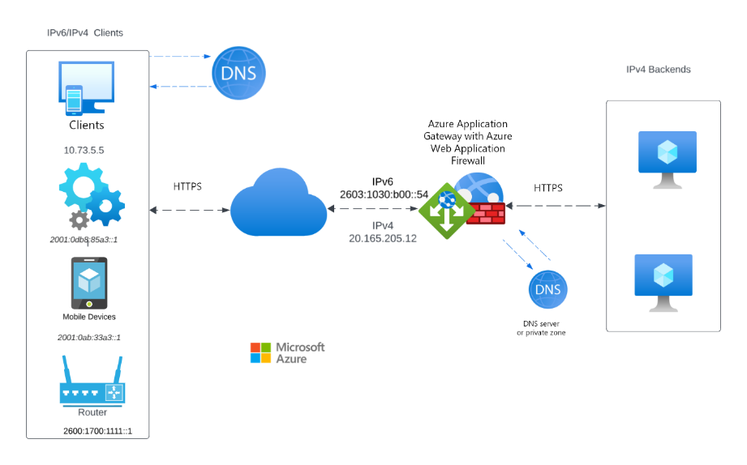
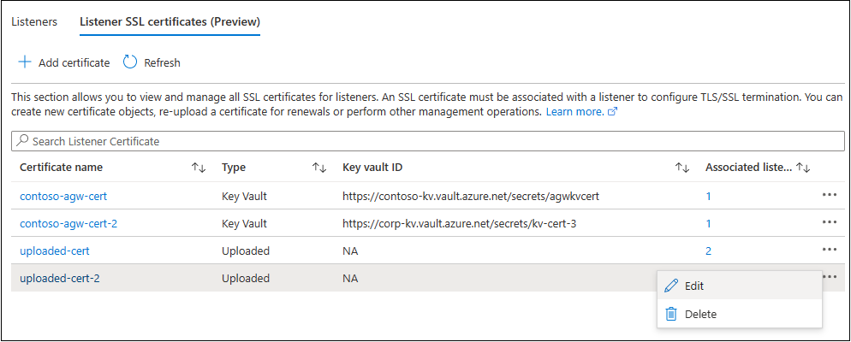
Networking Updates
Generally available: Application Gateway (v2) IPv6 support
MS announced IPv6 support for Azure Application Gateway (v2) that is now generally available.
With the addition of IPv6 support, it is now possible to take advantage of the increased address space and improved routing efficiency that IPv6 provides. This is especially important for customers who are running out of IPv4 addresses or who need to support IPv6 clients.
General availability: Listener TLS certificates management in the Azure portal
Azure Application Gateway is a Layer-7 proxy load balancer (now also supports Layer-4 proxy with TCP & TLS protocols) that enables scalable, highly available, and secure application delivery. One of its salient features is securing client traffic through Transport Layer Security (TLS) termination, which requires TLS server certificates for listeners. Large gateways with multiple HTTPS or TLS listeners could have various such .PFX certificates to manage.
Azure Application Gateway added support for TLS certificate management in the Azure portal to make the frontend certificate management convenient. This portal section lets easily list and manage all the listeners' certificates. In addition to these core management capabilities added during the public preview, the portal experience now includes certificate information like Expiry, Common Name, Thumbprint, and Issuer Name that helps quickly identify certificates during the various operational activities.

Slide 4
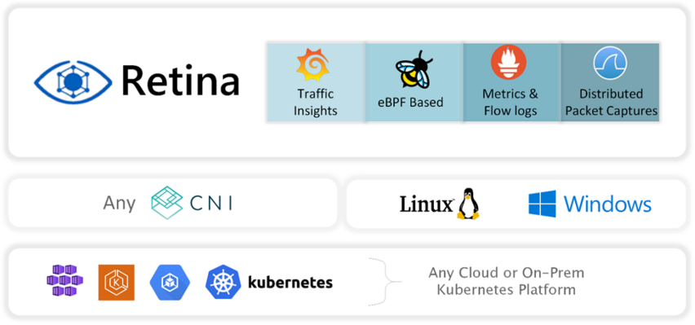
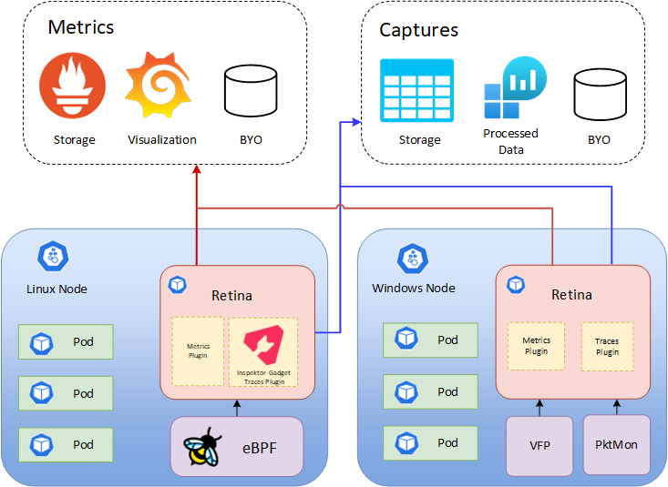
Networking Updates
Microsoft open sources Retina: A cloud-native container networking observability platform
Retina is a cloud-agnostic, open-source Kubernetes Network Observability platform which helps with DevOps, SecOps and compliance use cases. It provides a centralized hub for monitoring application and network health and security, catering to Cluster Network Administrators, Cluster Security Administrators and DevOps Engineers.
Retina collects customizable telemetry, which can be exported to multiple storage options (such as Prometheus, Azure Monitor, and other vendors) and visualized in a variety of ways (like Grafana, Azure Log Analytics, and other vendors).
Traffic Insights
eBPF Based
Metric & Flow Logs
Distributed Packet Captures
Any CNI
Any Kubernetes Platform

Slide 5
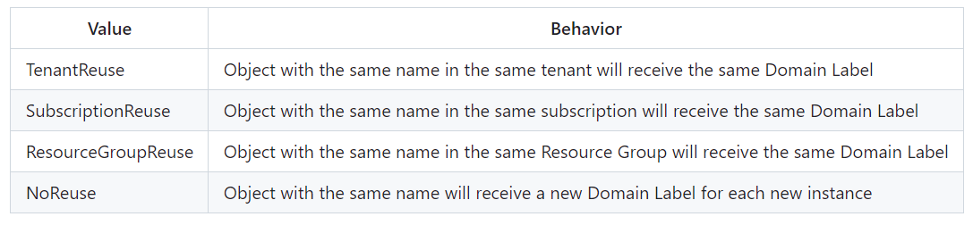
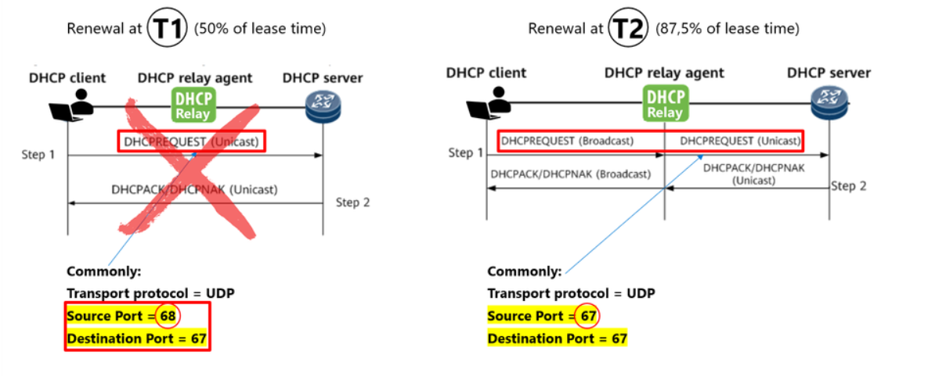
Networking Updates
Public preview: Public IP Domain Name Label Scope
MS announced the public preview for a new capability in Azure public IP address that can prevent DNS subdomain takeover while still allowing for re-use of DNS names.
Public IPs also have an optional parameter for Domain Name Label Scope, which defines what domain label an object with the same name will use. This feature can help to prevent "dangling DNS names" which can be reused by malicious actors. When this option is chosen, the public IP address' DNS name will have an additional string in between the domainnamelabel and location fields, e.g. contoso.fjdng2acavhkevd8.westus.cloudapp.Azure.com.
Rate-limiting for DHCP relayed traffic has been removed
DHCP Server in Azure was previously marked as unsupported since the traffic to port UDP/67 was rate limited in Azure. However, recent platform updates have removed the rate limitation, enabling this capability.
Any custom DHCP server in Azure deployed before the rate-limiting removal may have to be redeployed.
Only UDP 67 > 67 / UDP 68 > 68 has been unblocked. UDP 68 > 67 is still throttled and UDP 67 > 68 (the return) is blocked. Therefore, there will still be NO support for the T1 DHCP Renewals, only T2 renewals will come through.
For example, if SubscriptionReuse is selected as the option, and a customer who has the example domain name label contoso.fjdng2acavhkevd8.westus.cloudapp.Azure.com deletes and re-deploys a public IP address using the same template as before, the domain name label will remain the same. If the customer deploys a public IP address using this same template under a different subscription, the domain name label would change (e.g. contoso.c9ghbqhhbxevhzg9.westus.cloudapp.Azure.com).

Slide 6
Security & Identity

Slide 7
Security & Identity Updates
Act now: Turn on or customize Microsoft-managed Conditional Access policies
There are a few updates:
Microsoft-managed policies will no longer count towards the Conditional Access policy limit.
MS communicated that these policies would be automatically enabled 90 days after creation. However, based on customer feedback, we recognize that some customers need additional time to prepare for these policies to be enforced. As a result, we have extended the time frame before enforcing the policies for this initial set of policies. For these three policies, you will have more than 90 days to review and customize (or disable) your Microsoft-managed Conditional Access policies before they are automatically enforced. Rest assured, you’ll receive an email and a Message Center notification providing a 28-day advance notification before the policies are enforced in your tenant.

Slide 8
Management & Governance

Slide 9
Management & Governance Updates
Action recommended: Update to using Grafana version 10 for Azure Managed Grafana
On 31 August 2024, MS will retire Grafana version 9. Grafana 10 provides all of the functionality of Grafana 9 plus new ones, including:
New visualization panels
New or updated data source plugins
Tracing and correlations
Grafana version 9 will reach end-of-life support later this year and Grafana Labs will no longer provide security patches and other critical updates after that point. As a result, Azure Managed Grafana will stop offering Grafana version 9 as a supported software version on 31 August 2024. If your workspace is still using Grafana version 9 after 31 August 2024, it will be migrated to Grafana version 10 sometime in September 2024. You won’t be notified of the exact timing of this migration in advance.
To avoid support disruptions, please upgrade manually to Grafana version 10 by 31 August 2024.
Support for Connector for AWS in Cost Management is ending on 31 March 2025
The Connector for AWS, once built to consolidate Microsoft Azure and AWS cloud cost data in Microsoft Cost Management, will be retired on 31 March 2025.
The ability to add a new Connector for AWS in Cost Management will be disabled for all customers on 31 March 2024. On 31 March 2025 access to the Connector for AWS and to cost reports containing AWS data will be lost. In addition, all the AWS cost data stored in Microsoft Cost Management will be deleted. Please note that MS won’t be deleting the Cost and Usage Report (CUR) files stored in S3 bucket in the AWS console.
Required action
Please transition to choose of alternative cost management reporting for AWS and follow our instructions to delete Connector to AWS in the Azure Portal.

Slide 10
Management & Governance Updates
Azure Monitor managed service for Prometheus is available in 13 additional Azure regions
Azure Monitor managed service for Prometheus allows to collect and analyze metrics at scale using a Prometheus-compatible monitoring solution, based on the Prometheus project from the Cloud Native Computing Foundation. This fully managed service allows to use the Prometheus query language (PromQL) to analyze and alert on the performance of monitored infrastructure and workloads without having to operate the underlying infrastructure.
Azure Managed Prometheus was announced GA in May 2023 and was available in 26 regions, with this new update Azure Managed Prometheus is available in 13 additional public Azure regions.
Operator and CRD support with Azure Managed Prometheus
Azure Monitor managed service for Prometheus will support CRD-based (custom resource definitions ) configs for scrape jobs to collect metrics from workloads running in your AKS cluster. With this new update, configuring Managed Prometheus will deploy the Pod and Service Monitor custom resource definitions to allow to create own custom resources. This is similar to the OSS Prometheus Operator, and allows for easy configuration of scrape jobs in any namespace, eliminating the need to update the common ConfigMap in the kube-system namespace.

Slide 11
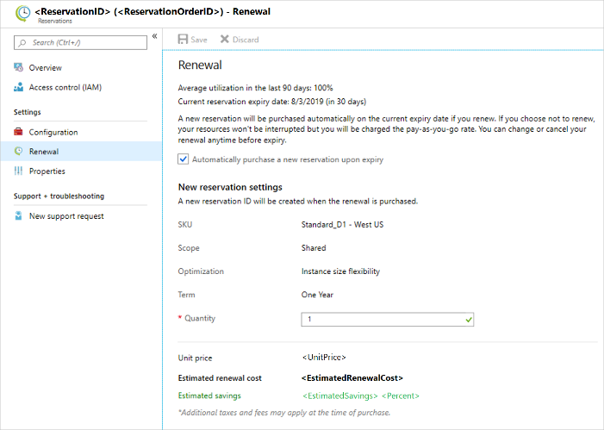
Management & Governance Updates
You can now opt in automatically renew your reservation at time of purchase.
A new options in automatically renew reservation at time of purchase is available. It allows to renew reservations to automatically purchase a replacement when an existing reservation expires. Automatic renewal provides an easy way to continue getting reservation discounts. It also saves from having to closely monitor a reservation's expiration. With automatic renewal, prevent savings benefits loss by not having to manually renew. The renewal setting is turned off by default. Enable or disable the renewal setting anytime, up to the expiration of the existing reservation.

Slide 12
Compute

Slide 13
Compute Updates
Generally Available: Kubernetes 1.29 support in AKS
AKS now supports the latest Kubernetes 1.29 preview release (mandala) that has some much-awaited features such as ReadWriteOncePod, PersistentVolume access mode, Node volume expansion Secret support for CSI drivers, and more.
Generally Available: Azure Kubernetes Service (AKS) support for 5K Node limit by default for standard tier clusters
Azure Kubernetes Service (AKS) now supports up to 5000 Node limit by default in the Standard and Premium Pricing. This feature allows large workloads such as batch processing Jobs, Machine learning, simulations and multi-tenanted clusters to run at large scale with greater performance as AKS will Automatically scale up the Kubernetes control plane based on the load in the cluster.
This feature enhances not just the number of nodes it is possible to run in a cluster but increases the overall scale envelope (number of pods, services, CRDs) of AKS clusters in accordance with the upstream kubernetes scale limits.
Both existing and new AKS clusters using the standard tier now get greater scalability and performance for Kubernetes control plane, up-to a maximum of 5,000 nodes and 200,000 pods per cluster.

Slide 14
Compute Updates
Public preview: Trusted launch support in AKS
Azure offers trusted launch as a seamless way to improve the security of Gen 2 virtual machines (VMs) by protecting against advanced and persistent attack techniques. Trusted launch is composed of several, coordinated infrastructure technologies that can be enabled independently. Each technology provides another layer of defense against sophisticated threats.
Trusted launch preview in Azure Kubernetes Service (AKS) enables administrators to deploy AKS nodes, which contain the underlying virtual machines, with verified and signed bootloaders, OS kernels, and drivers. By using secure and measured boot, administrators gain insights and confidence of the entire boot chain's integrity and can ensure workloads are trusted and verifiable.
Cluster nodes running Windows Server operating system aren't supported.
Trusted launch (preview) doesn't support node pools with FIPS enabled or based on ARM64.
Availability sets aren't supported, only Virtual Machine Scale Sets.
To enable Secure Boot on GPU node pools, you need to skip installing the GPU driver.
Ephemeral OS disks can be created with Trusted launch and all regions are supported. However, not all virtual machines sizes are supported. For more information, see Trusted launch ephemeral OS sizes.
Generally Available: HostPort auto assign in AKS
HostPort auto assign feature in AKS, now generally available, enables the automatic assignment of host ports for pod workloads, streamlining the deployment process for services requiring direct access to a node's public IP without an intermediary like a load balancer.
Generally Available: VM IP based load balancer in AKS
VM IP based load balancer feature, now generally available, introduces the capability to switch the inbound pool type in AKS, improving update and provisioning efficiency for services utilizing load balancers, particularly beneficial for clusters with large numbers of nodes.

Slide 15
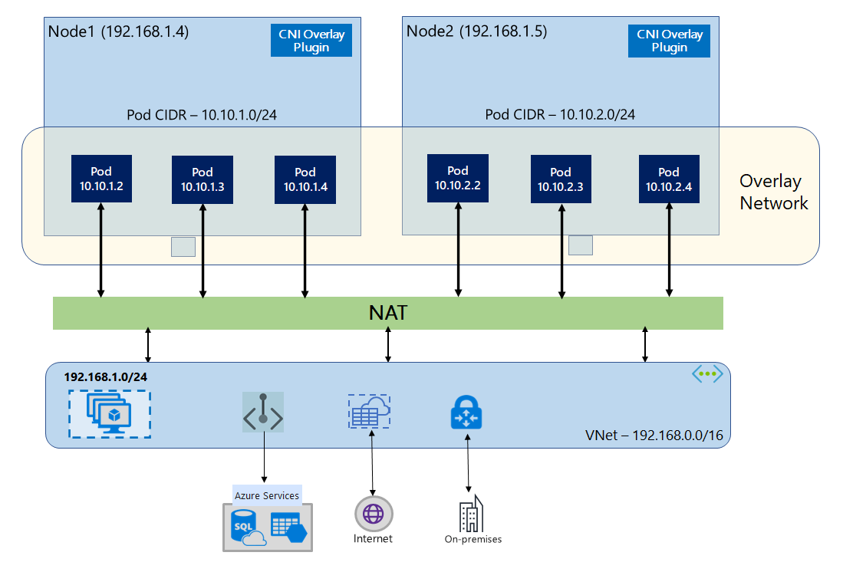
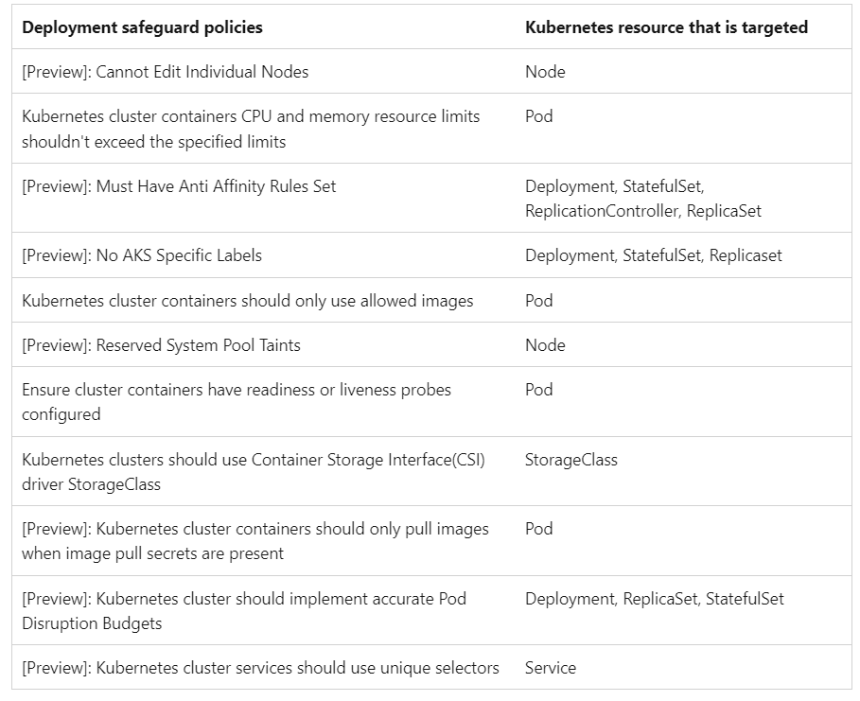
Compute Updates
Generally Available: Azure CNI overlay dual stack Support in AKS (Linux only)
This feature introduces dual stack networking in AKS using overlay networking, allowing nodes and pods to have both IPv4 and IPv6 addresses, enhancing connectivity and application compatibility.
Public preview: Deployment safeguards in AKS
Throughout the development lifecycle, it's common for bugs, issues, and other problems to arise if misconfigurations have taken place during the initial deployment of Kubernetes resources.
To make it easier to implement best practices when deploying to Kubernetes, Azure Kubernetes Service (AKS) now offers deployment safeguards - a new feature that enforces Kubernetes best practices in AKS cluster through Azure Policy controls.
Oversights of Kubernetes manifest files supports two configuration levels: 'Warning' and 'Enforcement’. ‘Warning’ level enables to receive immediate warnings for improperly configured manifest files at the time of deployment. ‘Enforcement’ level blocks such files from being deployed outright.

Slide 16
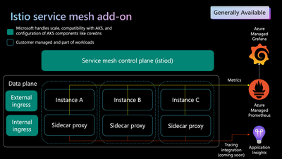
Compute Updates
Istio-based service mesh add-on for Azure Kubernetes Service now in General Availability (GA)!
MS announced the General Availability of the Istio add-on for Azure Kubernetes Service.
Windows GPUs for AKS
MS announced the public preview of Windows on AKS GPU support! This feature aims to provide customers with the options of GPU compute-intensive workloads. A few examples of where a GPU supported node would benefit workloads are video encoding, machine learning, and large simulations. Through this release we hope to increase the parity between Windows and Linux on AKS.
Required For Setup
Kubernetes version 1.29.0 or greater is required for set up.
Updating an existing Windows node pool to GPU isn’t supported.
For AKS node pools, we recommend a minimum size of Standard_NC6s_v3.
The NVv4 series (based on AMD GPUs) aren't supported on AKS.

Slide 17
Compute Updates
Generally Available: Host Network Security Group (NSG) control in AKS
AKS nodes utilizing node public IPs that host services on their host address need to have an NSG rule added to allow the traffic. Adding the desired ports in the node pool configuration will create the appropriate allow rules in the cluster network security group.
If a network security group is in place on the subnet with a cluster using bring-your-own virtual network, an allow rule must be added to that network security group. This can be limited to the nodes in a given node pool by adding the node pool to an application security group (ASG). A managed ASG will be created by default in the managed resource group if allowed host ports are specified. Nodes can also be added to one or more custom ASGs by specifying the resource ID of the NSG(s) in the node pool parameters.
When specifying the list of ports to allow, use a comma-separate list with entries in the format of port/protocol or startPort-endPort/protocol.
Examples:
80/tcp
80/tcp,443/tcp
53/udp,80/tcp
50000-60000/tcp
Generally Available: Custom kubelet configuration for Windows in AKS
Custom kubelet configuration for Windows is now generally available in AKS. It allows to modify certain default supported kubelet parameters for Windows nodepools.
{
"imageGcHighThreshold": 90,
"imageGcLowThreshold": 70,
"containerLogMaxSizeMB": 20,
"containerLogMaxFiles": 6
}

Slide 18
Compute Updates
Generally Available: Cost analysis add-on for AKS
Cost analysis add-on for AKS is now Generally Available. This Azure-native experience provides visibility into underlying cluster infrastructure costs associated with AKS workloads. Costs are broken down by Kubernetes constructs such as cluster and namespace in addition to Azure asset categories. View cost allocation data directly in the Cost Management blade of Azure portal.
Cost analysis add-on for AKS helps tackle everyday cost monitoring, allocation, and cost optimization scenarios.
Cluster must be either Standard or Premium tier, not the Free tier.
Cluster must be deployed with a Microsoft Entra Workload ID configured.
Kubernetes cost views are available only for the following Microsoft Azure Offer types. For more information on offer types, see Supported Microsoft Azure offers.
Enterprise Agreement
Microsoft Customer Agreement
Virtual nodes aren't supported at this time.
Generally Available: Windows Gen 2 VM support in AKS
Gen 2 VM SKUs are now generally available for Windows on AKS. Azure Generation 2 (Gen2) virtual machines (VMs) support key features not supported in generation 1 VMs (Gen1). This enables to bring Windows workloads to the cloud native platform more easily.
Key features for Gen 2 VMs include increased memory, Intel Software Guard Extensions (Intel SGX), and virtualized persistent memory (vPMEM). Generation 2 VMs use the new UEFI-based boot architecture rather than the BIOS-based architecture used by generation 1 VMs.
Only specific SKUs and sizes support Gen2 VMs. Check the list of supported sizes, to see if your SKU supports or requires Gen2. Gen2 VMs on Windows are supported for WS2022 only.

Slide 19
Compute Updates
Public preview: Kubernetes AI Toolchain Operator (KAITO) add-on for AKS
The Kubernetes AI Toolchain Operator (KAITO) add-on for AKS is now available in preview. You can now run specialized machine learning workloads like large language models (LLMs) on AKS more cost-effectively and with less manual configuration. The add-on is based on the open-source Kubernetes AI Toolchain Operator (KAITO).
Streamlined to a few steps, the AI toolchain operator add-on for AKS automates LLM deployment across available CPU and GPU resources by selecting optimally sized infrastructure for the model.
This add-on makes it possible to easily split inferencing across multiple lower-GPU count VMs, increasing the number of Azure regions where workloads can run, eliminating wait times for higher GPU-count VMs, and lowering overall cost.
You can also choose from preset models with images hosted by AKS, significantly reducing overall inference service setup time on your cluster.

Slide 20
Compute Updates
Optimize GPU compute costs: Pause your VMs to save!
MS announced that in April, Azure will be offering customers the ability to optimize GPU compute costs by enabling hibernation on Virtual Machines (VMs). With this feature, users can hibernate their VMs, pausing compute usage while preserving in-memory states. During hibernation, customers will only incur costs for storage and networking resources, significantly reducing compute expenses. When needed, VMs can be resumed effortlessly, allowing applications and processes to seamlessly pick up from their last state.
Specifically for GPU Virtual Machines, hibernation offers compelling use cases and is an effective cost management strategy particularly in two key scenarios:
Optimizing GPU workstations: Pause GPU VMs during off-hours to conserve resources and resume seamlessly when needed, without the need to reopen applications.
Efficient Workflows for long running VMs: For long-running GPU-intensive tasks, hibernating after prewarming tasks ensures quick start-up times and efficient use of GPU resources.
New Azure NC H100 v5 VMs Optimized for Generative AI and HPC workloads is now Generally Available
Azure NC H100 v5 virtual machines (VMs) are an excellent platform for executing diverse AI and High-Performance Computing (HPC) workloads. These workloads demand substantial computational power, large capacity of high-performance memory, and advanced GPU acceleration. In addition to AI, the Azure NC H100 v5 VMs are particularly well-suited for extreme modelling and simulation demands in the following science and mathematics disciplines: Computational Fluid Dynamics (CFD), Molecular Dynamics, Quantum Chemistry, Weather Forecasting and Climate Modeling, and Financial Analytics.
The AI landscape is constantly expanding and evolving, moving at a dizzying pace. Generative AI technology has played a pivotal role, enabling a diverse array of use cases. These range from powering AI assistants, chatbots, and search engines to facilitating creative content generation. As Generative AI applications expand at incredible speed, the fundamental language models that empower them will expand also to include both Small Language Models (SMLs) and Large Language Models (LLMs). In addition, Artificial Narrow Intelligence (ANI) models will continue to evolve focused on more precise predictions rather than creation of novel data to continue to enhance its use cases. Their applications include tasks such as image classification, object detection, and broader natural language processing.

Slide 21
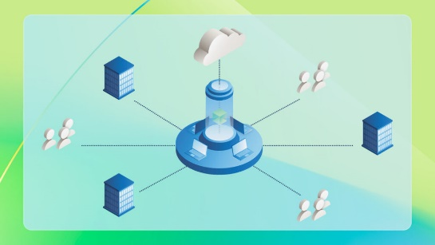
Compute Updates
Public Preview: Faster reauthentication
MS announced the public preview of faster reauthentication for Azure Virtual Desktop when single sign-on is enabled. This feature allows to use the "Every time" sign-in frequency option in Conditional Access policies that target the Microsoft Remote Desktop and Windows Cloud Login Entra ID apps. This can help you provide a more secure environment, especially for BYOD and unmanaged devices.
Reauthentication only happens when a user must authenticate to a resource. Once a connection is established, users aren't prompted even if the connection lasts longer than the sign-in frequency you've configured.
Users need to reauthenticate if there is a network disruption that forces the session to be re-established after the sign-in frequency you've configured. This can lead to more frequent authentication requests on unstable networks.
Public preview: Azure Modeling and Simulation Workbench
Now available for public preview in US East, US West 3, and US Gov Virginia, the Azure Modeling and Simulation Workbench is a fully collaborative, on-demand, secure workspace for research and engineering projects, featuring:
An easy-to-use, fully automated infrastructure build-out. Azure Modeling and Simulation Workbench automates the infrastructure deployment with state-of-the-art security management to reduce setup time of the design environment from weeks to hours.
Secure, multiparty collaboration across geographically dispersed engineering teams within or across organizations
Scalable and resilient infrastructure tuned for engineering design, simulation and interactive workloads known for unique infrastructure requirements
Enhanced security & privacy using unique identity management and access controls, implemented through data partitioning and ownership policies, over and above the layer of data security features already offered by the Azure compute, storage, and networking infrastructure.

Slide 22
Storage & Data

Slide 23
Storage & Data Updates
General Availability: Azure Files geo-redundancy for standard large file shares
Azure Files geo-redundancy for 100TiB standard SMB file shares is now generally available.
Geo-redundancy is critical to ensure high availability and to meet various compliance and regulatory requirements for your production workloads (for example, line-of-business (LOB) applications). Geo-redundant storage asynchronously replicates to a secondary region enabling to failover to the secondary region, if the primary region becomes unavailable.
In regions that are now generally available, the standard file share capacity and performance limits for new and existing geo-redundant shares have significantly increased:
Capacity per share limit increases from 5 TiB to 100 TiB (20x increase)
Max IOPS per share limit increases from 1,000 IOPS to the storage account limit (20x increase)
Max throughput per share increases from 60 MiB/s up to the storage account limit (150x increase)
Azure Files geo-redundancy for standard large file shares is now generally available in 28 regions and we will be expanding to all regions in the coming months.
Private Preview: Force detach zone redundant disks during zone outage
Force detach of zone redundant disks allows the disks to be available for use when there is a zone outage. The ZRS disks can be detach from the VM on the impacted zone and attached to a new VM in the active zone for business continuity. This allows customers to take advantage of the ZRS ability to provide an RPO of 0. Zone redundant storage (ZRS) option for Azure managed disks is supported on Premium SSDs and Standard SSDs.

Slide 24
Storage & Data Updates
General Availability: Azure NetApp Files support for 1 TiB capacity pools
It is now possible to choose a minimum size of 1TiB while creating a capacity pool. Capacity pools smaller than 2TiB in size can only be used with volumes using standard network features. This allows customers to start with 1TiB as a minimum pool size and increase with 1 TiB increments. For capacities less than 2 TiB, this Azure update saves money by allowing customers to re-evaluate volume planning to take advantage of savings of smaller capacity pools. This feature is supported in all regions with standard network features.
Generally available: Azure Health Data Services DICOM service with Azure Data Lake Storage
MS announced the general availability of Azure Data Lake Storage integration for the DICOM® service in Azure Health Data Services. The DICOM service provides cloud-scale storage for medical imaging data using the DICOMweb standard. With the integration of Azure Data Lake Storage, organizations can now enjoy full control over their imaging data and increased flexibility for accessing and working with that data through the Azure storage ecosystem and APIs.
Enable direct access to medical imaging data stored by the DICOM service using Azure storage APIs and DICOMweb APIs, providing more flexibility to access and work with the data.
Open medical imaging data up to the entire ecosystem of tools for working with Azure storage, including AzCopy, Azure Storage Explorer, and the Data Movement library.
Unlock new analytics and AI/ML scenarios by using services that natively integrate with Azure Data Lake Storage, including Azure Synapse, Azure Databricks, Azure Machine Learning, and Microsoft Fabric.
Grant controls to manage storage permissions, access controls, tiers, and rules.

Slide 25
Databases

Slide 26
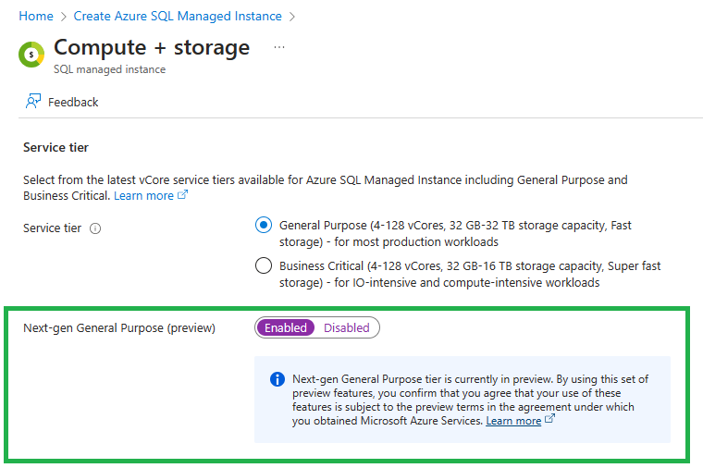
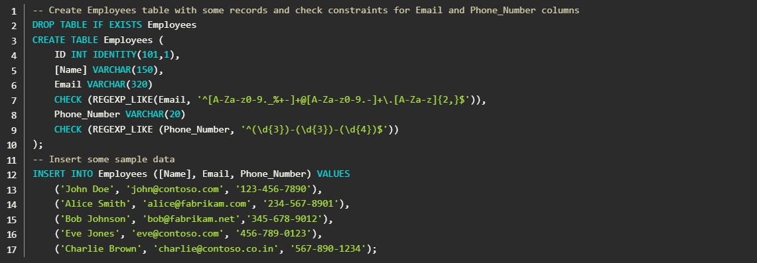
Databases Updates
Public Preview: Next generation of general purpose service tier for Azure SQL Managed Instance
The next generation of the general-purpose service tier for Azure SQL Managed Instance is a major upgrade that will considerably improve the storage performance of instances while keeping the same price as current general-purpose tier. This will greatly improve the price-performance for existing Azure SQL Managed Instance workloads and allow to migrate more of SQL workloads to Azure SQL Managed Instance. Key improvements in the next generation of general-purposes storage include support for 32 TB of storage, support for 500 DBs, lower storage latency, improved storage performance, and the ability to configure the amount of IOPS (I/O operations per second).
Introducing Regular Expression (Regex) Support in Azure SQL DB
MS pleased to announce the private preview of regular expressions (regex) support in Azure SQL Database. Regex is a powerful tool that allows you to search, manipulate, and validate text data in flexible ways. With regex support, you can enhance your SQL queries with pattern matching, extraction, replacement, and more. You can also combine them with other SQL functions and operators to create complex expressions and logic.
The Regex feature in Azure SQL DB follows the POSIX standard and is compatible with the standard regex syntax and supports a variety of regex functions, such as REGEXP_LIKE, REGEXP_COUNT, REGEXP_INSTR, REGEXP_REPLACE, and REGEXP_SUBSTR. The feature also supports case sensitivity, character classes, quantifiers, anchors, and capturing groups. The feature is available for all Azure SQL DB editions and service tiers.

Slide 27
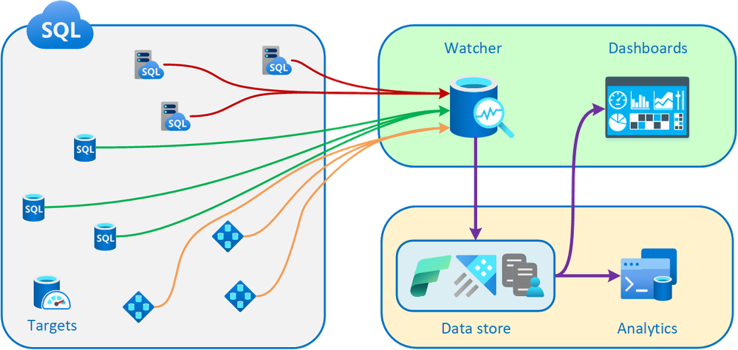
Databases Updates
Public preview: Database watcher for Azure SQL
MS announced the public preview of database watcher for Azure SQL, a managed database monitoring solution to help our customers use Azure SQL reliably and efficiently.
Database watcher, does not require deployment of any monitoring infrastructure or install and maintain any monitoring agents. It is possible to crate a new watcher and start monitoring your Azure SQL estate in minutes.
Once enabled, database watcher collects detailed monitoring data from databases, elastic pools, and managed instances into a central data store in Azure subscription. Data is collected with minimal latency – when you open a monitoring dashboard, you see database state as of just a few seconds ago.
Database watcher is powered by Azure Data Explorer, a fully managed, highly scalable data service, purpose-built for fast ingestion and analytics on time-series monitoring data. A single Azure Data Explorer cluster can scale to support monitoring data from thousands of Azure SQL resources.
Database watcher supports all service tiers and SKUs of Azure SQL Database and Azure SQL Managed Instance. This includes vCore and DTU purchasing models, provisioned and serverless compute tiers, single databases and elastic pools, and Hyperscale. It can monitor all types of secondary readable replicas, including high availability replicas, geo-replicas, and Hyperscale named secondary replicas.

Slide 28
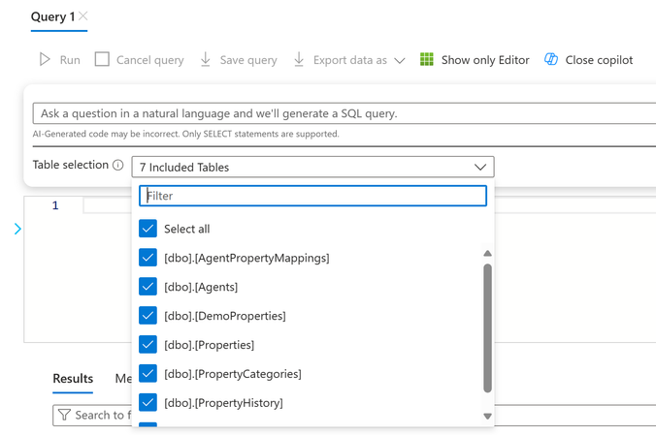
Databases Updates
Introducing Copilot in Azure SQL Database (Private Preview)
MS announced that Copilot in Azure SQL Database is now in private preview! Copilot in Azure SQL Database experiences are designed to streamline the design, operation, optimization, and health of Azure SQL Database-driven applications. It improves productivity in the Azure portal by offering natural language to SQL conversion and self-help for database administration.
Copilot in Azure SQL Database provides two Azure portal experiences:
Natural language to SQL: This experience within the Azure portal query editor for Azure SQL Database translates natural language queries into SQL, making database interactions more intuitive.
Azure Copilot integration: This experience adds Azure SQL Database skills into Microsoft Copilot for Azure, provides customers with self-guided assistance, and empowers them to manage their databases and solve issues independently.
Copilot in Azure SQL Database integrates data and formulates applicable responses using public documentation, database schema, dynamic management views, catalog views, and Azure supportability diagnostics.

Slide 29
Integration

Slide 30
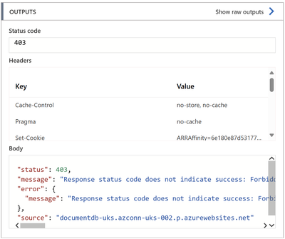
Integration Updates
Connect to Azure Cosmos DB using Managed Identity from Logic App
The Azure Cosmos DB managed connector can connect to Azure Cosmos DB using Logic App managed identity on both Logic App Consumption and Standard. The built-in connector does not support using managed identity.
In order for the connection to work, you need to assign the required permissions to Logic App managed identity on Azure Cosmos DB account. Otherwise, you will get the following error message while executing the workflow action:
Azure Event Hubs IP address changes
The infrastructure layer of Azure Event Hubs is being upgraded which will cause the IP addresses used by customer namespaces to change. These changes are being made as part of MS continuous improvements to platform. The IP addresses of services can change and should not be considered static and unchanging. The changes being made will not alter billing or cause any service interruptions.

Slide 31
DevOps & IaC & Automation

Slide 32
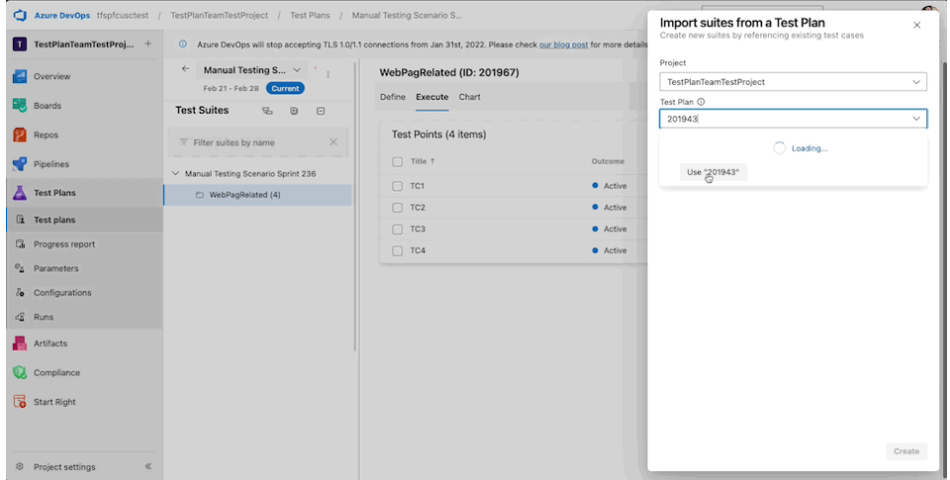
DevOps & IaC & Automation
New Boards Hub on as default
MS announced the final stage of New Board journey. They are beginning the process of making New Boards Hub the default experience for all of customers. This will happen in two waves, with the first wave kicking off in the first week of April. The rollout process for each wave will span several weeks, as gradually roll out to a different set of customers every other day. The second (final) wave will most likely start sometime in late May.
New Boards largely retains the same functionality as Old Boards. However, we have introduced several new features to entice users to switch to New Boards. Review the links below for details.
Updated Features in New Boards Experience
Improved Boards + GitHub integration
Quick Copy and Import Test Case by Plan or Suite ID
Efficiency is key in managing extensive test cases,that’s why we’re thrilled to announce an exciting enhancement to Azure Test Plans – the Quick Copy and Import test case feature, enabling you to use Test Plan or Suite ID for immediate action. Say goodbye to the delays caused by lengthy dropdown menus and enjoy the new copy and import test case workflow.

Slide 33
Miscellaneous

Slide 34
Miscellaneous Updates
Microsoft Dynamics 365 Fundamentals (ERP) Blueprinting Opportunity
Microsoft is updating a certification for Microsoft Dynamics 365 Fundamentals (ERP), and MS require input.
The blueprint determines how many questions each skill in the exam will be assigned. Please complete the online survey by April 3rd, 2024.
Microsoft Dynamics 365: Finance and Operations Apps Developer blueprint survey opportunity
Microsoft is updating a certification for Microsoft Dynamics 365: Finance and Operations Apps Developer, and we need input through our exam blueprinting survey.

Slide 35
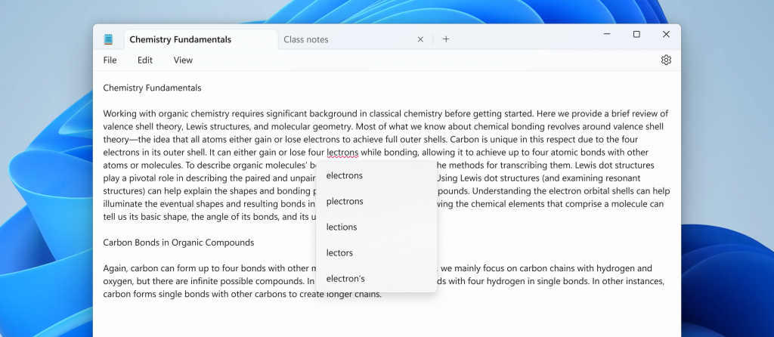
Miscellaneous Updates
System Center 2019 Update Rollup 6
MS announced the release of Update Rollup 6 for System Center 2019. As System Center 2019 is approaching the end of mainstream support next month, this Update Rollup comes with timely enhancements and bug fixes to support existing configurations. This article gives detailed information on the new enhancements.
Virtual Machine Manager
Arc blade enhancements - guidance on how to get started with Azure Arc-enabled SCVMM and install Arc agents at scale from the Azure Arc blade in the SCVMM product
Data Protection Manager
Support for Windows and Basic SMTP Authentication for sending DPM email reports and alerts.
List online recovery points for a data source along with the expiration dates.
Orchestrator
Web Console filtering is now improved for both Job and Instance views.
Microsoft adds spellcheck and autocorrect to Notepad
Notepad will now highlight misspelled words and provide suggestions so that it can easily identify and correct mistakes. They are also introducing autocorrect which seamlessly fixes common typing mistakes as you type.

Slide 36
Miscellaneous Updates
Surface for Business devices
MS announced first AI-powered Surface PCs built exclusively for business: Surface Pro 10 and Surface Laptop 6. MS designed these products from the ground up, to be packed with features business customers have been asking for—from Copilot to ports to NFC readers to security and performance, with the latest Intel® Core™ Ultra processors and integrated Neural Processing Units (NPUs) to power AI experiences with increased battery life and reduced tax on the Central Processing Unit (CPU) and Graphics Processing Unit (GPU).
These devices are built for Copilot, with the new Copilot key on Laptop 6 and on Pro 10 when paired with the new Surface Pro Keyboard, making the best AI experiences available at the push of a button.3

Slide 37
Miscellaneous Updates
Announcing Azure HPC Cache Retirement
Azure HPC Cache will be retired on 30 September 2025. It still possible to create HPC Caches through September 2025.
HPC Pack 2016 will be retired on 12 January 2027
HPC Pack 2016 follows the Fixed Lifecycle Policy and will reach the end of support. Therefore, we’ll retire HPC Pack 2016 on 12 January 2027. The existing experience that HPC Pack 2016 offers will no longer be supported starting 12 January 2027. Although you can still use HPC Pack 2016 beyond the date, this will no longer receive updates from Microsoft.
Follow the steps to migrate from HPC Pack to HPC Pack 2019. Stop the Azure deployment and create new ones with HPC Pack 2019 after 12 January 2027.
Azure HDInsight 4.0 will be retired on 31 March 2025 - migrate your HDInsight clusters to 5.1
Azure HDInsight 4.0 for cluster shapes Hadoop, Kafka, HBase and Interactive Query will retire on 31 March 2025, please transition to HDInsight 5.1 by that date.
HDInsight, 5.1 is Generally available from November 1, 2023, this release contains all the latest versions of supported software. It comes with all the improvements made in open-source versions and the integrations from Microsoft.
Customers running HDInsight 4.0 will no longer receive support and no new clusters can be created after the retirement date.

Slide 38
Miscellaneous Updates
Default Internet outbound access for Simplified node communication Batch pools without public IP addresses will be retired on 30 September 2025
In Azure, VMs that are created in a virtual network without a defined explicit outbound method are assigned a default public IP address that enables internet connectivity. On 30 September 2025, default outbound access connectivity for VMs in Azure will be retired.
From now until 30 September 2025, It is possible to use simplified compute node communication Batch pools without public IP addresses with default Internet outbound access. After that date, if you rely on this mechanism for outbound access, Batch pools, compute nodes, jobs and tasks may stop working after that date.
Azure Synapse Runtime for Apache Spark 3.2 End of Support
End of Support for Azure Apache Spark 3.2 was announced on July 8, 2023. MS recommend that to upgrade Apache Spark 3.2 workloads to version 3.3 (GA) or 3.4 (GA expected in Q1/Q2 2024). Azure Synapse runtime for Apache Spark 3.2 will be retired and disabled as of July 8, 2024.
Action required: Upgrade your App Service apps to Node 20 LTS by 30 April 2025
On 30 April 2025, extended support for Node 18 LTS will end. Apps that are hosted on App Service will continue to run, but security updates will no longer be available and we’ll no longer provide customer service for Node 18 LTS. Learn more about App Service language support.
Required action
To avoid potential security vulnerabilities and minimize risk for App Service apps, follow the steps to upgrade app to Node 20 LTS before 30 April 2025.
Basic and Standard A-series VMs on HDInsight will retire on 31 August 2024
Migrate your HDInsight VMs on A Series to Av2-series VMs before 31 August 2024
Announcing Avere vFXT for Azure Retirement
Avere vFXT for Azure will be retired on 30 September 2025. You can still create vFXT nodes and clusters through September 2025.

Slide 39
Miscellaneous Updates
Some compliance features in Microsoft Defender for Cloud will be retired on September 30, 2025
Microsoft Actions and Compliance offerings, two regulatory compliance features in public preview, will no longer be available through the Defender for Cloud portal pages starting September 30, 2025.
There are no pricing implications since those features are currently offered free of charge.
Update to Azure Functions Service Bus extension v5.x by 31 March 2025 for continued support
Azure Functions Service Bus extension v4.x is built on a version of the Azure Service Bus SDK that will be retired on 31 March 2025. As such, extension v4.x will be retired as well. Please transition to extension v5.x which is built on a newer Service Bus SDK by 31 March 2025 to get continued support.
The existing experience that extension v4.x offers will no longer be supported starting 31 March 2025. While you can still use extension v4.x beyond that date, it will no longer receive updates from Microsoft.
Required Action
To avoid service disruptions, please follow these instructions to migrate to the replacement product by 31 March 2025.
Important Notice: Azure Product Retirement: End of Life Announcement of Azure Maps Creator Feature State Service Versions 31 March 2025
Azure Maps Feature State Services will be retired on March 31, 2025.
On March 31, 2025 all Azure Maps Creator Feature State APIs will no longer be available. Any Feature State configurations created will be deleted and client applications will no longer receive Feature State updates.

Slide 40
Miscellaneous Updates
Retirement: Support for .NET 7 ends on 14 May 2024—upgrade your Azure Functions resources to .NET 8
In alignment with the end of community support, on 14 May 2024, support for .NET 7 in Azure Functions will end. Apps that are hosted on Functions will continue to run, but security updates will no longer be available, and we'll no longer provide customer service for .NET 7. Learn more about Azure Functions stack version support.
Required action
To avoid potential security vulnerabilities and take advantage of the latest features, follow the steps to upgrade your function apps to .NET 8 by 14 May 2024.
Azure Content Moderator will be retired on 15 March 2027
On 15 March 2027 Azure Content Moderator will be retired. From now through 15 March 2027, you can continue to use your existing Azure Content Moderator resources. After 15 March 2027, Azure Content Moderator won't be supported.
Please explore new offering Azure AI Content Safety that offers both new and updated capabilities to meet content moderation needs.

Slide 41
Information

Slide 42
Information
Azure Times GitHub Repo

Slide 43
Questions

