Slide 1
Azure Times #108
March 6, 2024

Slide 2
Networking

Slide 3
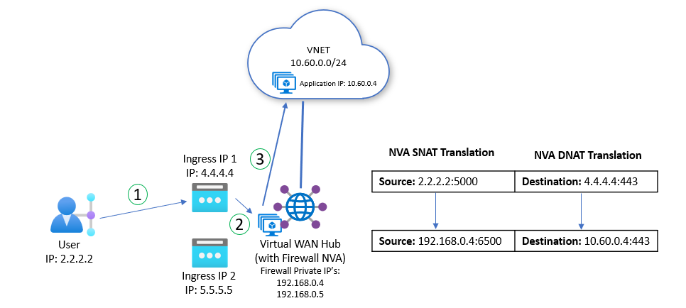
Networking Updates
Public preview: Internet inbound for Network Virtual Appliances in Virtual WAN Hubs
Destination NAT allows network administrators to publish applications to users in the broader internet without directly exposing the application or server public IP. Consumers access applications through a public IP address assigned to a Firewall Network Virtual Appliance. The NVA is configured to filter and translate traffic and control access to backend applications.
Virtual WAN customers can now associate public IP addresses to Firewall NVA’s deployed in the Virtual WAN Hub and use NVA management and orchestration software to program both Virtual WAN infrastructure and the NVA to accept and forward inbound traffic.
Destination NAT is supported only for the following NVAs: checkpoint, fortinet-sdwan-and-ngfw and fortinet-ngfw.
Public IPs that are used for Destination NAT must meet the following requirements:
Destination NAT Public IPs must be from the same region as the NVA resource.
Destination NAT Public IPs can't be in use by another Azure resource
Public IPs must be from IPv4 address spaces. Virtual WAN doesn't support IPv6 addresses.
Public IPs must be deployed with Standard SKU.
Destination NAT is only supported on new NVA deployments that are created with at least one Destination NAT Public IP
Programming Azure infrastructure components to support DNAT scenarios is done automatically by NVA orchestration software when a DNAT rule is created.
DNAT traffic in Virtual WAN can only be routed to connections to the same hub as the NVA.
Timeout for idle flows is automatically set to 4 minutes.
Inbound Traffic is automatically load-balanced across all healthy instances of the Network Virtual Appliance.

Slide 4
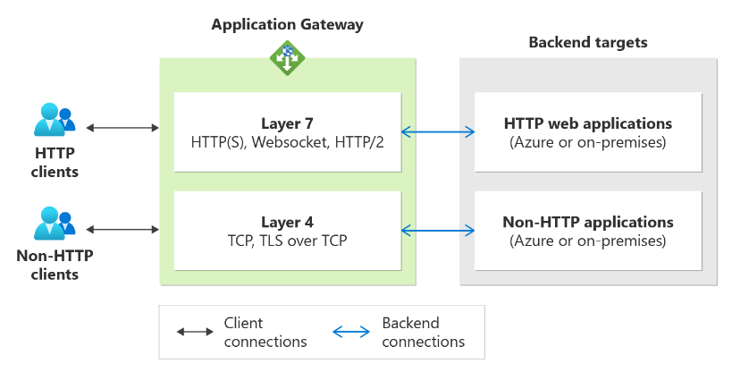
Networking Updates
Public preview: Azure Application Gateway introduces support for TLS and TCP protocols
Azure Application Gateway introduces support for TLS and TCP protocol termination in public preview. This feature lets use Application Gateway for non-HTTP applications based on protocols like SQL, MQTT, AMQP, etc. It enables to use a custom domain with Application Gateway's TLS certificate management capability to provide a secure connection to clients and access any backend service. Additionally, it offers a single endpoint for all clients as a single Application Gateway resource can support Layer 7 (HTTP/S) to Layer 4 (TCP and TLS) protocols.
The feature is available for Standard V2 and Web Application Firewall V2 SKUs.
Use a single endpoint (frontend IP) to serve HTTP and non-HTTP workloads. The same application gateway deployment can support Layer 7 and Layer 4 protocols: HTTP(S), TCP, or TLS. All your clients can connect to the same endpoint and access different backend applications.
Use a custom domain to front any backend service. With the frontend for the Application Gateway V2 SKU as public and private IP addresses, you can configure any custom domain name to point its IP address using an address (A) record. Additionally, with TLS termination and support for certificates from a private certification authority (CA), you can ensure a secure connection on the domain of your choice.
Use a backend server from any location (Azure or On-premises). The backends for the application gateway can be:
Azure resources such as IaaS virtual machines, virtual machine scale sets, or PaaS (App Services, Event Hubs, SQL)
Remote resources such as on-premises servers accessible via FQDN or IP addresses
Supported for a private-only gateway. With TLS and TCP proxy support for private Application Gateway deployments, it now supports HTTP and non-HTTP clients in an isolated environment for enhanced security

Slide 5
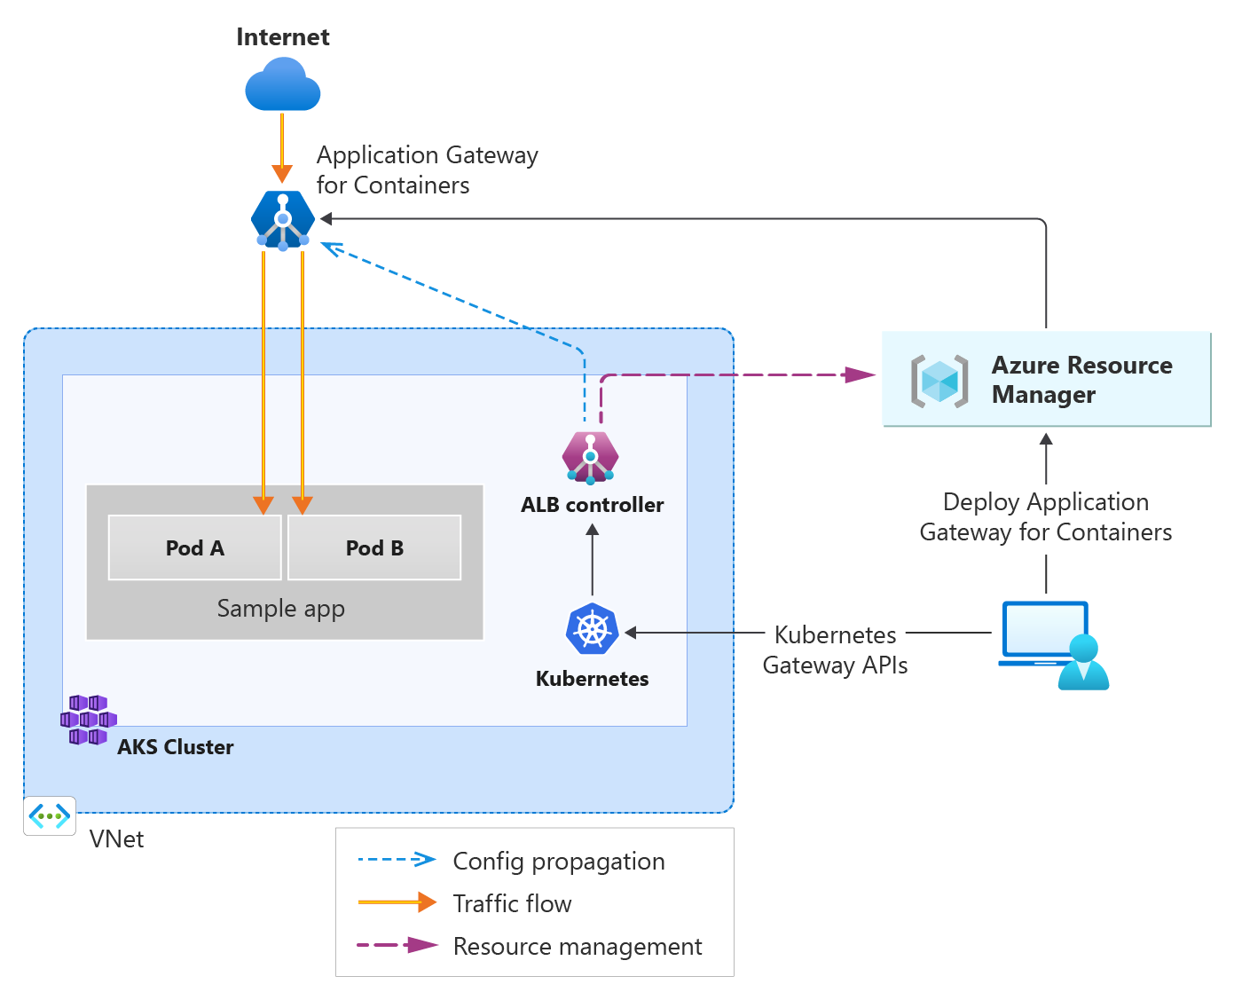
Networking Updates
General availability: Application Gateway for Containers
Application Gateway for Containers is the next evolution of Application Gateway + Application Gateway Ingress Controller, providing application (layer 7) load balancing and dynamic traffic management capabilities for workloads running in a Kubernetes cluster. Application Gateway for Containers achieves near-to-real-time convergence times to reflect add/remove of pods, routes, probes, and other load balancing configuration within Kubernetes yaml configuration.
In addition to the numerous improvements announced at public preview, general availability brings several new additions:
Features - Public preview and GA has added support for Custom Health Probes, URL Redirect, URL / Header Rewrite.
Controller High Availability – Have peace of mind if a node goes down, changes within your cluster will continue to be propagated to the network.
Gateway API v1 – Bring the familiarity and role-based access control provided by Gateway API to your network configuration.
Additional Region Availability – Take advantage of Application Gateway for Containers in a region closest to you.
SLA for Production Workloads – Feel confident in running your production workloads with Application Gateway for Containers.

Slide 6
Security & Identity

Slide 7
Security & Identity Updates
Recommendations released for preview: four recommendations for Azure Stack HCI resource type
Azure Stack HCI servers should meet Secured-core requirements
Azure Stack HCI servers should have consistently enforced application control policies
Azure Stack HCI systems should have encrypted volumes
Host and VM networking should be protected on Azure Stack HCI systems
Open Container Initiative (OCI) image format specification support
The Open Container Initiative (OCI) image format specification is now supported by vulnerability assessment, powered by Microsoft Defender Vulnerability Management for AWS, Azure & GCP clouds.
Cloud support for Defender for Containers
Azure Kubernetes Service (AKS) threat detection features in Defender for Containers are now fully supported in commercial, Azure Government, and Azure China 21Vianet clouds. Review supported features.
AWS container vulnerability assessment powered by Trivy retired
The container vulnerability assessment powered by Trivy has been retired. Any customers who were previously using this assessment should upgrade to the new AWS container vulnerability assessment powered by Microsoft Defender Vulnerability Management.
New version of Defender Agent for Defender for Containers
A new version of the Defender Agent for Defender for Containers is available. It includes performance and security improvements, support for both AMD64 and ARM64 arch nodes (Linux only), and uses Inspektor Gadget as the process collection agent instead of Sysdig. The new version is only supported on Linux kernel versions 5.4 and higher, so if you have older versions of the Linux kernel, you need to upgrade. Support for ARM 64 is only available from AKS V1.29 and above.

Slide 8
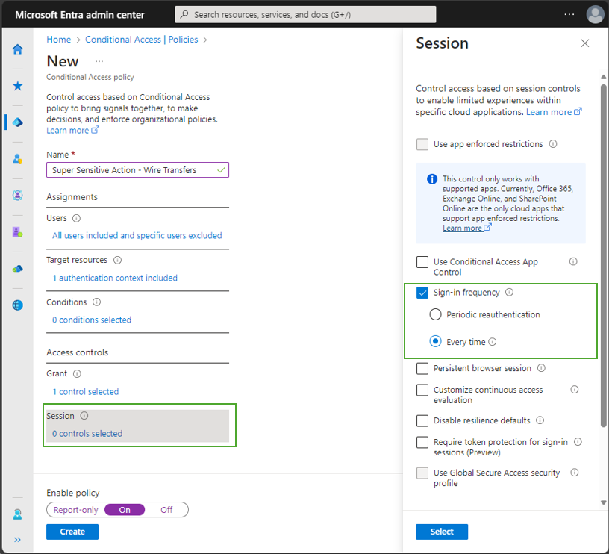
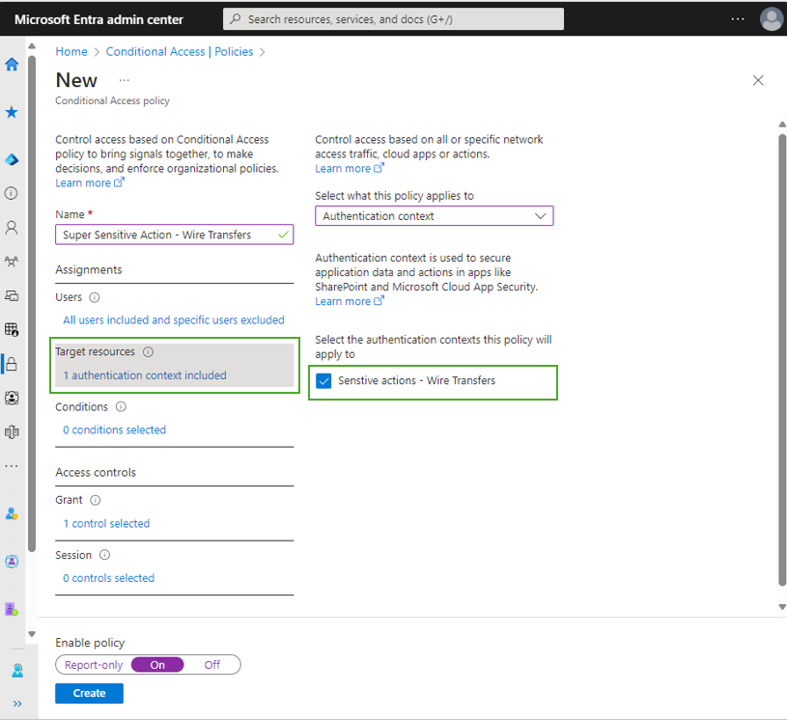
Security & Identity Updates
Prompt users for reauthentication on sensitive apps and high-risk actions with Conditional Access
MS announced support for additional capabilities for Conditional Access reauthentication policy scenarios. Reauthentication policy lets require users to interactively provide their credentials again - typically before accessing critical applications and taking sensitive actions(“Sign-in frequency – every time”).

Slide 9
Security & Identity Updates
Windows Azure Active Directory Connector for Forefront Identity Manager (FIM WAAD Connector) - The Windows Azure Active Directory Connector for Forefront Identity Manager(FIM WAAD Connector) from 2014 was deprecated in 2021. The standard support for this connector will end in April 2024. Customers should remove this connector from their MIM sync deployment, and instead use an alternative provisioning mechanism.
General Availability - Granular filtering of Conditional Access policy list - Conditional access policies can now be filtered on actor, target resources, conditions, grant control and session control. The granular filtering experience can help admins quickly discover policies containing specific configurations
General Availability - New premium user risk detection, Suspicious API Traffic, is available in Identity Protection - MS released a new premium user risk detection in Identity Protection called Suspicious API Traffic. This detection is reported when Identity Protection detects anomalous Graph traffic by a user. Suspicious API traffic might suggest that a user is compromised and conducting reconnaissance in their environment.
Plan for change - Microsoft Entra ID Identity protection: "Low" risk age out
Starting March 31st, 2024, all "low" risk detections and users in Microsoft Entra ID Identity Protection that are older than 6 months will be automatically aged out and dismissed.
Conditional Access: Authentication flows
MS added the ability to control certain authentication flows to Conditional Access.
Device code flow - Device code flow is used when signing into devices that might lack local input devices like shared devices or digital signage. Device code flow is a high-risk authentication flow that might be used as part of a phishing attack or to access corporate resources on unmanaged devices. Microsoft recommends blocking device code flow wherever possible.
Authentication transfer - Authentication transfer is a new flow that offers a seamless way to transfer authenticated state from one device to another. For example, users could be presented with a QR code within the desktop version of Outlook that, when scanned on their mobile device, transfers their authenticated state to the mobile device. This capability provides a simple and intuitive user experience that reduces the overall friction level for users.

Slide 10
Management & Governance

Slide 11
Management & Governance Updates
Enable replication for added VMware VM data disks
Azure Site Recovery now supports enabling replication for data disks that added to a VMware VM that's already enabled for disaster recovery. Support is available for VMware VMs protected using the modernized architecture.
Azure Migrate (February 2024)
Public preview: Envision savings with Azure Hybrid Benefits by bringing your existing Enterprise Linux subscriptions (RHEL and SLES) to Azure using Azure VM assessments and business case.

Slide 12
Compute

Slide 13
Compute Updates
Public preview: Kubernetes 1.29 support in AKS
AKS now supports the latest Kubernetes 1.29 preview release (mandala) that has some much-awaited features such as ReadWriteOncePod, PersistentVolume access mode, Node volume expansion Secret support for CSI drivers and more.
Public preview: Disable network policy in AKS for migration
It is now possible to use AKS update to temporarily disable network policy engine for two migration scenarios
Migration to Azure CNI overlay – Migration to overlay was limited because network policy needed to be disabled before migration could take place.
Migration to other network policy engines – It is now possible to migrate to other network policy engines. (e.g. Calico to Cilium)
Generally Available: Capacity Reservations support in AKS
It is now possible to use capacity reservation groups and assign them to node pools.
As workload demands change, it will be possible to associate existing capacity reservation groups to node pools to guarantee allocated capacity for your node pools.
CLI version 2.56 or above and API version 2023-10-01 or higher are required.
The capacity reservation group should already exist and should contain minimum one capacity reservation

Slide 14
Compute Updates
Generally Available: Node Soak Duration for Upgrades
AKS now supports node soak duration for upgrades to help stagger a node upgrade in a controlled manner. Setting a node soak time creates a waiting period between(0 and 30 minutes) draining a node, proceeding to reimage it, and moving on to the next node. Node soak time works together with the max surge and node drain timeout properties available in the node pool to deliver more refined control of upgrade speed and application availability. A short duration can minimize application downtime and allows to complete other tasks, such as checking application health, during the upgrade process.
Public preview: OS SKU in-place migration for Linux nodes
Today, traditional OS SKU migration involves creating a new node, cordoning and draining existing nodes, and then deleting existing nodes. This can involve a large surge of core count as new nodes are added, as well as manual intervention to cordon and drain.
The OS SKU in-place migration feature, now in public preview, allows to trigger a node image upgrade between one Linux SKU (i.e. Ubuntu) to another (i.e. Azure Linux) on an existing nodepool.
GA: Istio-based service mesh add-on for Azure Kubernetes Service
Azure Kubernetes Service (AKS) addon for service mesh based on Istio is now generally available. Istio addresses the challenges developers and operators face with a distributed or microservices architecture and can be used to streamline traffic management, security, and observability for service-to-service communication scenarios.
The AKS addon for service mesh builds on top of open source Istio and provides additional benefits such as compatibility testing done between Istio with supported versions of AKS, minor/patch version upgrades, plugin Certificate Authority (CA), managed external/internal ingresses, and scaling of Istio control plane components.

Slide 15
Compute Updates
Public preview: Azure Functions Support for HTTP Streams in Node.js
Azure Functions support for HTTP streams in Node.js is now in preview. With this feature, it is possible to stream HTTP requests to, and responses from, Functions Apps.
This release makes scenarios like processing large data, streaming OpenAI responses, delivering dynamic content etc. possible. This feature can be used where real time exchange and interaction between client and server over HTTP connections is needed. It is recommended to use streams to get the best performance and reliability for your apps.
HTTP Streams in Node.js is supported only in the Azure Functions Node.js v4 programming model.
Announcing NBCROW Compression in Kusto's TDS Implementation
MS excited to announce NBCROW compression as a new feature in Kusto's TDS implementation. NBCROW stands for Null Bitmap Compressed Row. It is a data type that the Tabular Data Stream (TDS) protocol supports. TDS is a binary protocol that Kusto uses to communicate with MSSQL clients and return query results. NBCROW compresses the null values in a row of data into a bitmap, where each bit represents the presence or absence of a null value. This reduces the size of null values from 1 byte to 1 bit, saving 7 bits for each null value saving network bandwidth and improving query duration.

Slide 16
Compute Updates
Announcing the release of CycleCloud 8.6
Preview: Now in CycleCloud 8.6, you can use Entra ID for user authentication to the CycleCloud UI and CLI.
Azure Managed Lustre support: AMLFS has been supported in CycleCloud for a while now thanks to the inclusion of the Lustre drivers in the Azure HPC images. Up until now it’s required using cloud-init or cluster-init projects to mount those filesystems. Starting in CycleCloud 8.6 customers can mount AMLFS directly as a native mount point, just like other NFS filesystems.
RHEL 9 support: Previously there was an issue with RHEL 9 and other more current Linux distributions due to non-ascii characters in the node metadata. This is fixed, and customers can use RedHat 9 or other variants.
Slurm users can now configure the GPU count for nodes manually. For some VM sizes, the reported number of GPUs may not match what’s actually available on the node. With this capability, customers can override that value to make sure Slurm handles GPUs correctly.
Jetpack CLI now provides a “run_on_shutdown” action that registers steps to perform before shutdown or termination if a Scheduled Event is enabled.

Slide 17
Storage & Data

Slide 18
Storage & Data Updates
Azure NetApp Files Volume and Protocol Enhancement
Azure NetApp Files uses a default volume language of C.UTF-8, which provides POSIX compliant UTF-8 encoding for character sets. The C.UTF-8 language natively supports characters with a size of 0-3 bytes, which includes a majority of the world’s languages on the Basic Multilingual Plane (BMP) (including Japanese, German, and most of Hebrew and Cyrillic).
Azure NetApp Files now supports characters outside of the BMP using surrogate pair logic, where multiple character byte sets are combined to form new characters. Emoji symbols, for example, fall into this category and are now supported in Azure NetApp Files.
Azure NetApp Files Customer-managed keys enhancement: automated managed system identity (MSI) support
Customer-managed keys enhancement: automated managed system identity (MSI) support
Customer-managed keys now supports automated MSI: you no longer need to manually renew certificates.
General Availability: Encryption at host for Premium SSD v2 and Ultra Disks is now available in more regions.
Encryption at host is now generally available for Premium SSD v2 and Ultra Disks in Canada East, West Europe, South Central US and West US 3.
When you enable encryption at host, that encryption starts on the Virtual Machine (VM) host itself, the Azure server that your VM is allocated to. The data on the VM host is encrypted at rest and flows encrypted to the Storage service.

Slide 19
Storage & Data Updates
Enhanced Performance in Additional Regions: Azure Synapse Analytics Spark Boosted by up to 77%
MS announced substantial improvements that could increase Spark performance by as much as 77%.
This performance uptick is attributable to our transition to the latest Azure v5 Virtual Machines. These VMs bring improved CPU performance, increased SSD throughput, and elevated remote storage IOPS.

Slide 20
Databases

Slide 21
Databases Updates
General availability: Azure CLI support for Azure Cosmos DB for PostgreSQL
With Azure command-line interface (CLI), it is possible to perform all cluster management operations such as cluster create, PostgreSQL server parameter change, cluster node add, or cluster node compute and storage scaling from Azure CLI in any supported operating system and environment. In addition, you can perform all these operations with Azure Cosmos DB for PostgreSQL clusters in a way that is consistent with Azure CLI operations for all other Azure services. With this new functionality, you can now unify Azure CLI management of all your Azure services including Azure Cosmos DB for PostgreSQL.
General availability: Latest PostgreSQL minor versions supported by Azure Database for PostgreSQL - Flexible Server
PostgreSQL minor versions 16.1, 15.5, 14.10, 13.13, 12.17 and 11.22 are now supported by Azure Database for PostgreSQL – Flexible Server.
These minor version upgrades are automatically performed as part of the monthly planned maintenance in Azure Database for PostgreSQL – Flexible Server. This upgrade automation ensures that your databases are always running on the most secure and optimized versions without requiring manual intervention. This release fixes two security vulnerabilities and over 40 bugs.
General availability: Azure SDKs support for Azure Cosmos DB for PostgreSQL
Azure software development kits (SDKs) now allow to perform all cluster management operations in Azure Cosmos DB for PostgreSQL. This includes cluster create, PostgreSQL server parameter change, cluster node add, or cluster node compute and storage scaling using the programming language and framework of your choice. All Azure Cosmos DB for PostgreSQL management operations are fully supported in .NET SDK, Go SDK, Java SDK, JavaScript SDK, and Python SDK.
The Azure SDKs are collections of libraries built to make it easier to use Azure services from language of choice. When use Azure SDKs, can perform all cluster management operations programmatically and consistently with management operations for the rest of Azure services.
With this release it is possible now unify Azure SDKs management for the Azure services you use including Azure Cosmos DB for PostgreSQL.

Slide 22
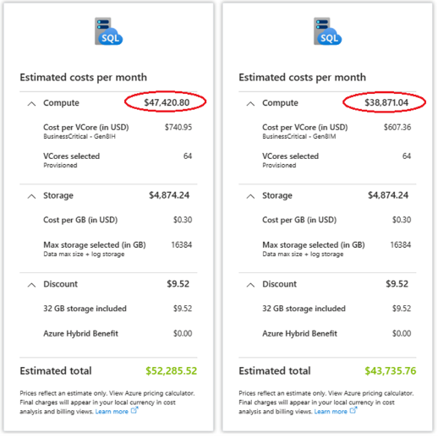
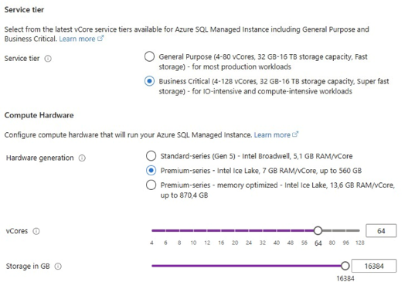
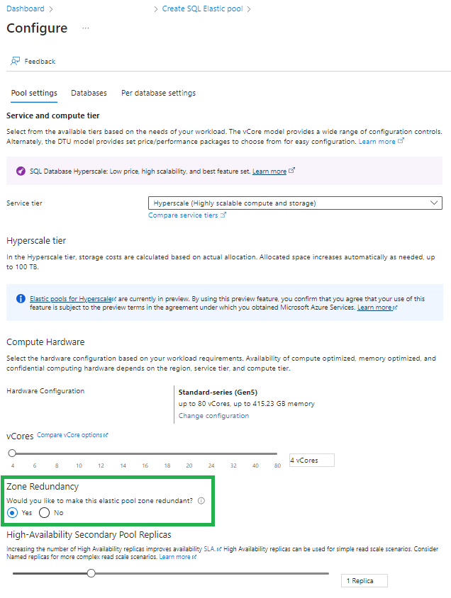
Databases Updates
Public Preview: Azure SQL updates for late-February 2024
It is now possible to enable zone redundancy for Azure SQL Database Hyperscale elastic pools for increased resiliency and higher availability.
Public Preview: Zone redundancy for Azure SQL Database Hyperscale elastic pools
The zone redundant configuration for Hyperscale elastic pools utilizes Azure Availability Zones to ensure that the various components in a Hyperscale elastic pool are placed in multiple physical locations within an Azure region. By selecting zone redundancy for a Hyperscale elastic pool, you can make it, and the Hyperscale databases within the pool, resilient to a much larger set of failures, including catastrophic datacenter outages.
16 TB of storage is now available for Premium-series in SQL Managed Instance Business Critical
Previously, to unlock 16 TB of storage in SQL MI Business Critical, customers had to opt for the memory optimized premium-series hardware generation, but not anymore; MS highlighted that SQL MI Business Critical now offers 16 TB for both premium-series and premium-series memory optimized hardware generations.

Slide 23
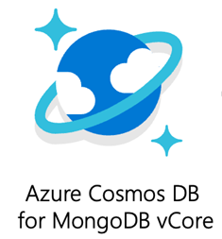
Databases Updates
Private Link in Azure Cosmos DB for MongoDB vCore is Generally Available!
It is now possible to use private endpoints for Azure Cosmos DB for MongoDB vCore clusters to allow hosts on a virtual network (VNet) to securely access data over a Private Link.
The cluster’s private endpoint utilizes an IP address from the virtual network’s address space, ensuring that traffic between hosts on the virtual network and the database nodes passes through the Microsoft backbone network. This setup eliminates exposure to the public Internet and allows applications within the virtual network to connect to the database nodes seamlessly, using the same connection strings and authorization mechanisms as they would under standard conditions.

Slide 24
ML & AI & IOT

Slide 25
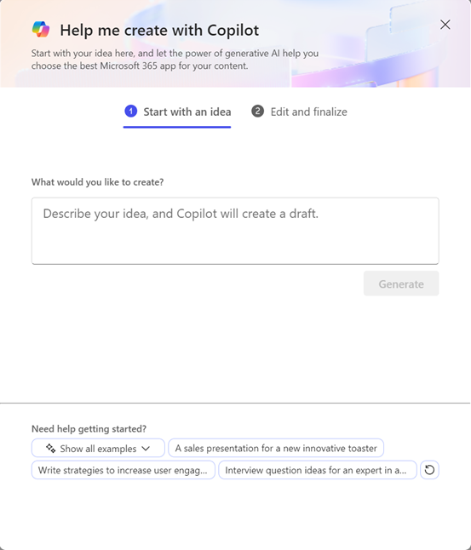
ML & AI & IOT Updates
Microsoft and Mistral AI announce new partnership to accelerate AI innovation and introduce Mistral Large first on Azure
MS announced a multi-year partnership between Microsoft and Mistral AI, a recognized leader in generative artificial intelligence. Both companies are fueled by a steadfast dedication to innovation and practical applications, bridging the gap between pioneering research and real-world solutions.
Microsoft’s partnership with Mistral AI is focused on three core areas:
Supercomputing infrastructure
Scale to market
AI research and development
Help me create in the Microsoft 365 web app
MS is rolling out a new Copilot feature named Help me create to the Microsoft 365 web app. Help me create lets focus more on what to write, with the Microsoft 365 app and Copilot suggests the best format for content.

Slide 26
ML & AI & IOT Updates
Introducing Microsoft Copilot for Finance
MS announced the public preview of Microsoft Copilot for Finance, the newest Copilot offering designed for business functions that extends Microsoft Copilot for Microsoft 365 and revolutionizes how finance teams approach their daily work. Copilot for Finance joins Copilot for Sales and Copilot for Service, now generally available, to provide AI-powered, role-based workflow automation, recommendations and guided actions in the flow of work.

Slide 27
DevOps & IaC & Automation

Slide 28
DevOps & IaC & Automation
AzureRM Provider:
A few highlights:
Support for Automation Software Update Configuration (v3.24)
Support for configuring Tables in Log Analytics (v.3.86)
Container App environments support Workload Profiles (v3.84)
Support for Application Load Balancer (v3.86)
Support for Red Hat OpenShift cluster (v3.89)
Added validations for ingress traffic weight, which fixed a bug with container apps failing to deplo... (v3.87)
Automation PowerShell 7.2 modules are now supported (v.3.85)
AzAPI provider
MS embedded code samples to the VSCode extension, which will enable automatic loading of an existing code sample in the azapi provider GitHub repo.
MS announced two new data source types:
azapi_resource_id - helps parse through Azure resource ID into subscription, resource group, and other useful attributes to take as outputs.
azapi_resource_list - helps point at a singular resource ID and get all related resources.

Slide 29
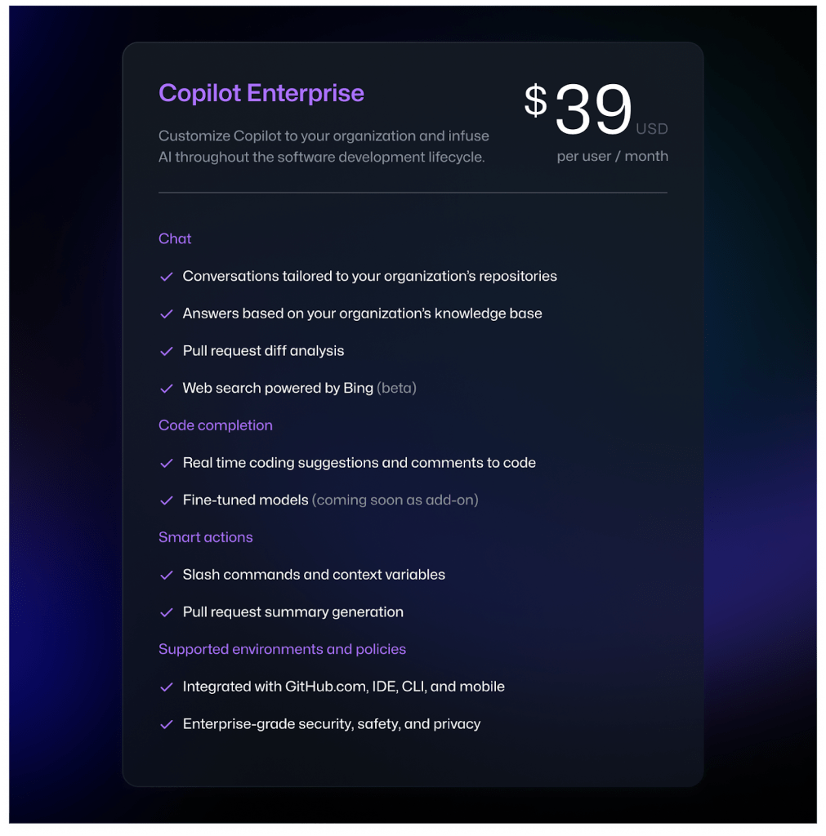
DevOps & IaC & Automation
Azure Virtual Network now supports updates without subnet property
Azure API supports the HTTP methods PUT, GET, DELETE for the CRUD (Create/Retrieve/Update/Delete) operations on your resources. The PUT operation is used for both Create and Update. For existing resources, using a PUT with the existing resources preserves them and adds any new resources supplied in the JSON. If any of the existing resources are omitted from the JSON for the PUT operation, those resources are removed from the Azure deployment.
GitHub Copilot Enterprise is now generally available

Slide 30
Miscellaneous

Slide 31
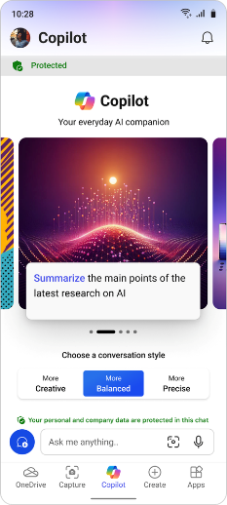
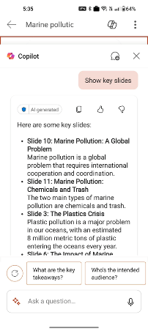
Miscellaneous Updates
Copilot now available for the Microsoft 365 mobile app
MS announced that they are rolling out the power of Copilot with commercial data protection to the Microsoft 365 mobile app, including Microsoft 365 Copilot integration in Word and PowerPoint mobile. Adding Copilot to the Microsoft 365 mobile app underlines our commitment to providing Copilot across all experiences, helping to unleash creativity, unlock productivity, and uplevel skills everywhere you work. The new Microsoft 365 app look and feel makes it easy to find Copilot alongside your content, apps, and shortcut to create something new.
New Storage and Networking MS Learn modules for Windows containers on AKS
To get started, visit the Microsoft Learn website and enroll in the following modules:
Apply storage concepts to Windows containers running on Azure Kubernetes Service (AKS) and AKS Hybri...
Apply Networking concepts to Windows containers running on Azure Kubernetes Service (AKS) and AKS Hy...

Slide 32
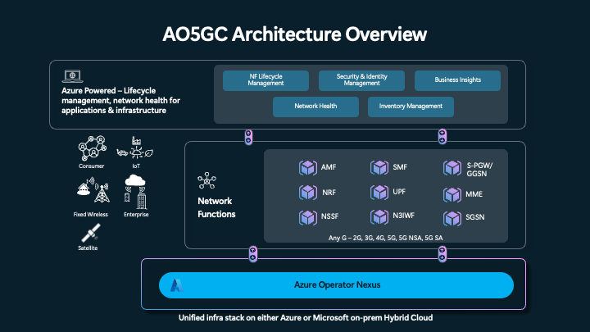
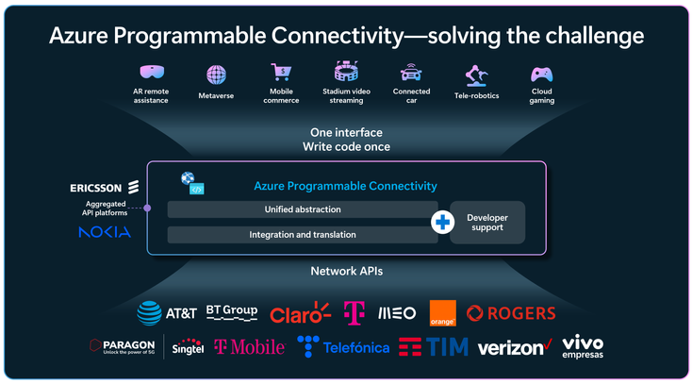
Miscellaneous Updates
Introducing Azure Operator 5G Core
One of the Microsoft announcements at Mobile World Congress 2024 in Barcelona is Azure Operator 5G Core reaching public preview. The Azure Operator 5G Core is a modern, containerized, carrier-grade, ’Any-G’, hybrid mobile packet core running on Operator Nexus. It combines field proven network functions integrated into the Azure stack with all the security and automation benefits. A highly scalable and performant core with inline user plane services (such as DPI, CGNAT, Traffic optimization) provides operators with a reduced total cost of ownership while improving the overall user experience.
Azure Programmable Connectivity: Empowering the next generation of connected applications
Azure Programmable Connectivity (APC), a groundbreaking platform that revolutionizes how developers interact with network API services from multiple mobile operators.
APC offers a seamless Azure experience, providing a unified, standard interface across multiple operator networks globally while abstracting the complexities inherent to network APIs. This ensures code consistency and reliability, even as networks continue to evolve. Developers can focus on building applications without worrying about underlying network changes.

Slide 33
Information

Slide 34
Information
Azure Times GitHub Repo

Slide 35
Questions

