Slide 1
Azure Times #105
February 14, 2024

Slide 2
Networking

Slide 3
Networking Updates
General availability: Topology
Topology allows visualizing the resources in a network, acquire system context, understand state and debug issues faster. It provides a visualized connected experience for inventory management and monitoring. The new topology experience lands users on the geo view helping them understand the geo regional distribution of their inventory.
This unified topology leads to upgrading the network monitoring and management experience in Azure. Replacing the Network Watcher topology, this topology will allow the users to draw a unified and dynamic topology across multiple subscription, regions, and resource groups (RGs) comprising of multiple resources and actionable connectivity and traffic insights.
Features that will be available in GA:
Multi-region and multi-subscription visualization
Geo view as a the landing screen helping understand inventory distribution across regions.
Drilldown from Azure region to resources inside subnet
Side-panel showing resource properties and metrics
Highlighting of nodes connected to a selected resource
Actionable connectivity insights from Connection Monitor

Slide 4
Security & Identity

Slide 5
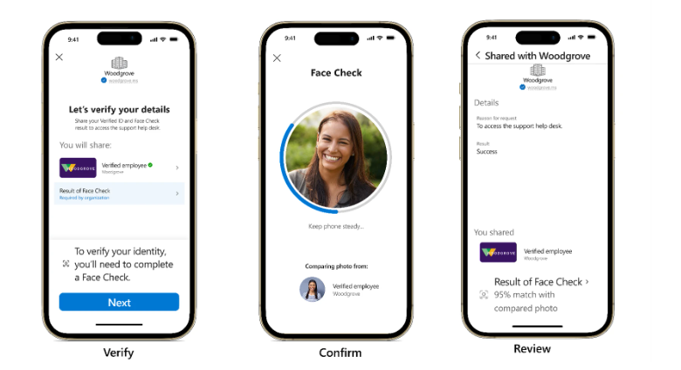
Security & Identity Updates
Conditional Access Policies in Microsoft Entra ID
MS rolled out report-only policies for over 500,000 tenants. These policies are part of our Secure Future Initiative, which includes key engineering advances to improve security for customers against cyberthreats that we anticipate will increase over time.
Multifactor authentication for admins accessing Microsoft admin portals - This policy covers 14 admin roles that we consider to be highly privileged, requiring administrators to perform multifactor authentication when signing into Microsoft admin portals.
Multifactor authentication for per-user multifactor authentication users - This policy targets licensed users with Entra ID P1 and P2, where the security defaults policy isn't enabled and there are less than 500 per-user MFA enabled enabled/enforced users. There will be no change to the end user experience due to this policy.
Multifactor authentication and reauthentication for risky sign-ins - This policy covers all users in Entra ID P2 tenants, where security defaults aren't enabled, all active users are already registered for MFA, and there are enough licenses for each user. As with all policies, ensure you exclude any break-glass or service accounts to avoid locking yourself out.
Microsoft Entra Verified ID introduces Face Check in preview
MS announced the expansion of Microsoft Entra Verified ID to include Face Check—a privacy-respecting facial matching feature for high-assurance verifications, which is now in preview.
Face Check, powered by Azure AI services, adds a critical layer of trust by matching a user’s real-time selfie and the photo from their identity document (such as a passport or driver’s license). By sharing only the match results and not any sensitive identity data, Face Check improves user privacy while allowing organizations to be sure the person claiming an identity is really them.

Slide 6
Security & Identity Updates
Removal MFA over Whats App
Meta has announced that due to an updated regulation in India not allowing over-the-top (OTT) apps like WhatsApp to be used for business communication, they will block the ability to send authentication messages via WhatsApp to users in India starting March 1st, 2024.
Back in September 2023, Microsoft Entra began delivering one-time passcodes (OTP) for multi-factor authentication (MFA) via WhatsApp for some users in India, Indonesia and New Zealand. While data showed this improved authentication completion rates for users, to comply with Meta's update Microsoft will be removing support for WhatsApp in India by March 1st, 2024.
Starting mid-February 2024, users in India who've been receiving OTP messages via WhatsApp will start receiving them via SMS as they did before.
New MS Entra recommendations
Microsoft has released a new recommendation in the Microsoft Entra admin center for organizations to move off MFA Server to Microsoft Entra multi-factor authentication. MFA Server will be retired on September 30, 2024. Any organization with MFA Server activity in the last seven days will see the recommendation that includes details about their current usage, and steps on how to move to Microsoft Entra multi-factor authentication.
New Microsoft Entra Home Page Update
Microsoft redesigned the Microsoft Entra admin center's homepage to help admins do the following:
Learn about the product suite
Identify opportunities to maximize feature value
Stay up to date with recent announcements, new features, and more!

Slide 7
Management & Governance

Slide 8
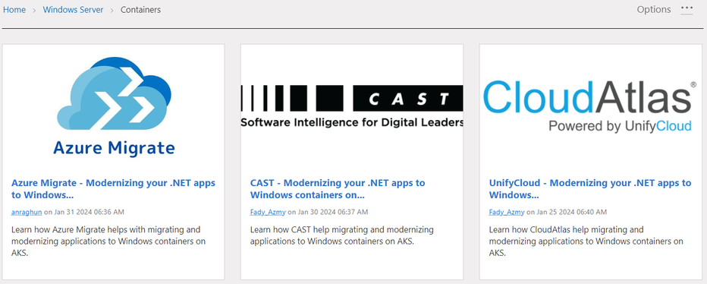
Management & Governance Updates
Migration and Modernization solutions for Windows-based applications to Azure Kubernetes Services
Microsoft released a documentation for the migration and modernization for Windows AKS

Slide 9
Compute

Slide 10
Compute Updates
Generally available: Support for up to 100 TB of storage for the FHIR service
MS announced that the FHIR service in Azure Health Data Services now supports up to 100 TB of storage. The FHIR service can store and exchange large amounts of health data, and each FHIR service instance has a 4 TB storage limit by default. However, now it is possible to ask Microsoft to increase storage up to 100 TB for your FHIR service.
By adding more storage, organizations can handle large data sets to enable analytics scenarios.
To request storage greater than 4 TB, create a support request on the Azure portal and use the issue type Service and Subscription limit (quotas).
Announcing General Availability to migrate Virtual Network injected Azure Data Explorer Cluster to Private Endpoints
MS announced that they made the migration of Azure Virtual Network injected Azure Data Explorer cluster to Private Endpoints generally available. This feature allows to migrate VNet injected ADX cluster to Private Endpoints with minimal downtime and disruption. The migration process is simple and can be done using the Azure portal, the ARM template, or any code which uses the ADX SDK.

Slide 11
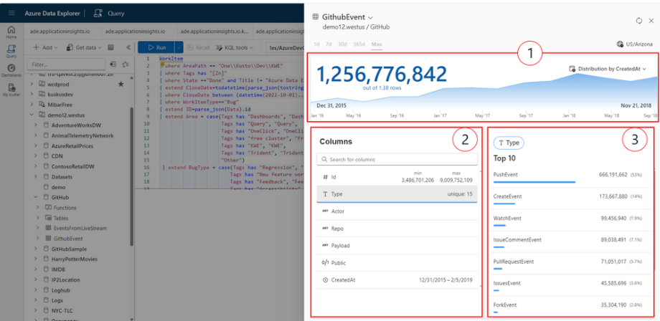
Compute Updates
Mount Azure Storage as a local share in App Service Linux Now supports NFS
NFS support is now available for App Service Linux code and container when mounting a Azure File share as a local share for the web app.
The limitations of custom-mounted storage include:
Storage firewall is supported only through service endpoints and private endpoints
FTP/FTPS access to custom-mounted storage isn't supported
Storage account shared access keys are the only means of authentication that are supported; Entra ID and RBAC Roles are not supported.
Azure CLI, Azure PowerShell, and Azure SDK support is in preview.
Mapping / or /home to custom-mounted storage isn't supported.
Azure Storage isn't supported with Docker Compose scenarios.
Storage mounts aren't included in backups.
NFS support is only available for App Service on Linux.
With VNET integration on app, the mounted drive uses an RFC1918 IP address and not an IP address from VNET.
ADX Web updates – Jan 2024
MS announced a new Data Profile feature that simplifies user experience.
Data Profile features (1) dynamic time chart showcasing data distribution based on ingestion time, alongside a comprehensive display of each table (2) columns with key statistics. For each column, there is a (3) display of top values.

Slide 12
Compute Updates
ADX Continuous Export to Delta Table – Preview
MS Announced that the continuous export to Delta table is now available in Preview.
Continuous export in ADX allows to export data from Kusto to an external table with a periodically run query. The results are stored in the external table, which defines the destination, such as Azure Blob Storage, and the schema of the exported data. This process guarantees that all records are exported "exactly once", with some exceptions. Continuous export previously supported CSV, TSV, JSON and Parquet formats.
Starting today, it is possible to continuously export to a delta table.

Slide 13
Storage & Data

Slide 14
Storage & Data Updates
Azure Ultra Disk Storage is now available in Canada East
Azure Ultra Disk Storage is now available in Canada East. Azure Ultra Disk Storage offers high throughput, high IOPS, and consistent low-latency disk storage for Azure Virtual Machines (VMs). Ultra Disk Storage is suited for data-intensive workloads such as SAP HANA, top-tier databases, and transaction-heavy workloads.
General Availability: Application consistent restore points supports Premium SSD v2 and Ultra Disks
MS announced application consistent restore points support as generally available for Premium SSD v2 and Ultra disks. Application consistent restore points already supports other Azure disks types Premium SSD, Standard SSD and Standard HDD disks.
Customers and Azure partners who are looking to build business continuity and disaster recovery solutions can use VM restore points to capture app consistent or crash consistent backups natively on the Azure platform. This can then be used to restore disks and VMs during scenarios such as data loss, data corruption, or disaster recovery.

Slide 15
Storage & Data Updates
Public Preview: Azure NetApp Files Standard Network Features - Edit Volumes in US Gov Regions
MS announced the public preview of Edit network features for Azure NetApp Files volumes in US Gov regions (VA, TX, & AZ) which has been made possible by innovative hardware and software integration. Standard Network Features provide with an enhanced Virtual Networking experience for a seamless and consistent experience along with security posture for Azure NetApp Files.
It is now possible to edit existing ANF volumes and upgrading Basic network features to Standard network features. Standard network features, support the following features for ANF volumes/delegated subnets:
Increased IP limits for the Vnets with ANF volumes
Enhanced network security with support for NSG / ASG and UDR
Connectivity over Active/Active VPN gateway setup
ExpressRoute FastPath connectivity to Azure NetApp Files.

Slide 16
Integration

Slide 17
Integration Updates
Announcing the availability of TLS 1.3 in Azure API Management in Preview
TLS 1.3 is the latest version of the internet’s most deployed security protocol, which encrypts data to provide a secure communication channel between two endpoints. TLS 1.3 eliminates obsolete cryptographic algorithms, enhances security over older versions, and aims to encrypt as much of the handshake as possible.
TLS 1.3 support in Azure API Management is planned to rollout during the first week of February 2024. The rollout will happen in stages, this means some regions will get it first as we roll out globally. Azure API Management V1 and V2 tiers will support TLS 1.3 by default for inbound traffic (incoming requests from API clients) by default.
For outbound traffic (outgoing requests from API gateway to API backends), in V1 tiers it is needed to be enabled manually, for V2 tiers outbound traffic with TLS 1.3 will come in a later update.

Slide 18
ML & AI & IOT

Slide 19
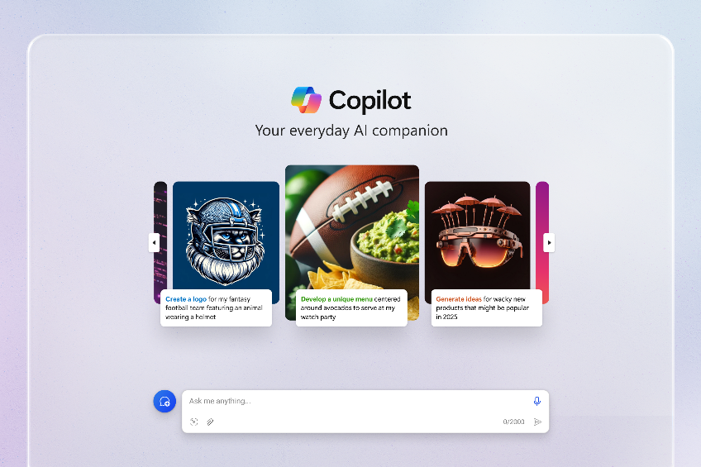
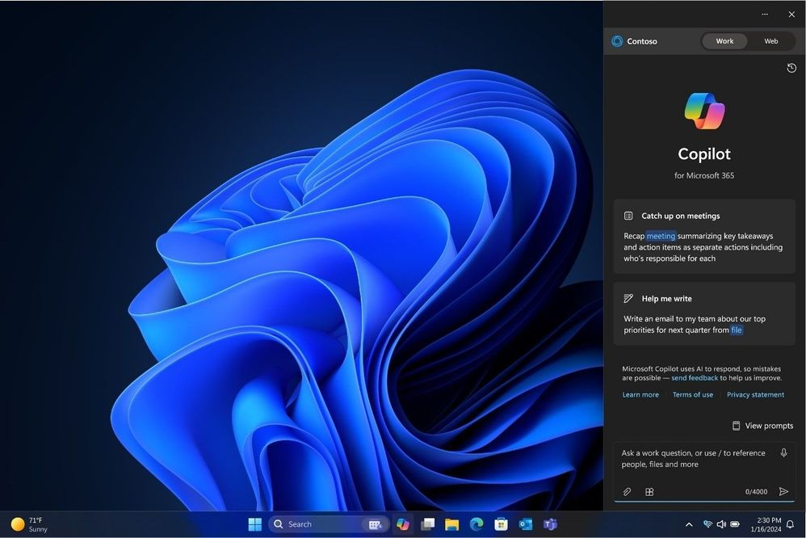
ML & AI & IOT Updates
Delivering Copilot for everyone
MS released a significant update to Microsoft Copilot experience on copilot.microsoft.com and Copilot app on iOS and Android app stores. Today when you visit Copilot, you will see a more streamlined look and feel designed to help bring ideas to life and more easily gain understanding about the world.
Copilot for Microsoft 365 capabilities now available in the Windows desktop
In the Copilot in Windows sidebar, this appears as a toggle between “Work” and “Web”, allowing users to choose between leveraging the capabilities of Copilot for Microsoft 365 or Copilot with commercial data protection (formerly known as Bing Chat Enterprise). This offers a new, easy way for users to access Copilot in Microsoft 365 features in addition to existing surfaces in Teams, Edge, and copilot.microsoft.com.

Slide 20
DevOps & IaC & Automation

Slide 21
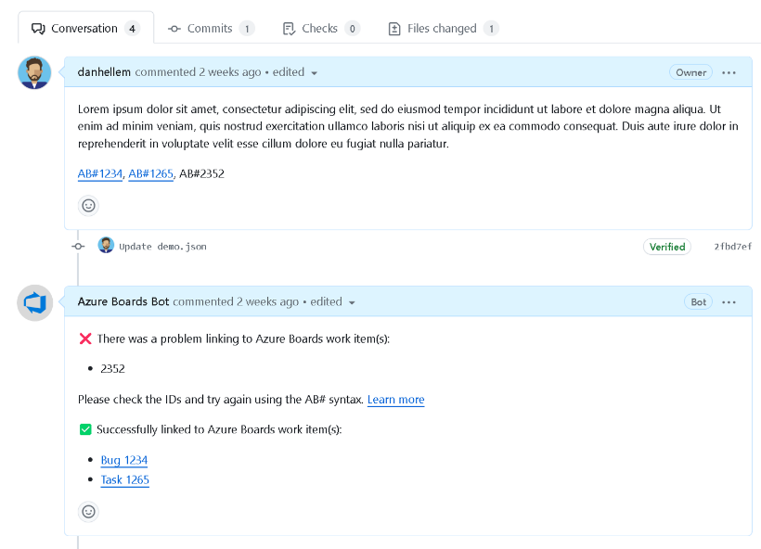
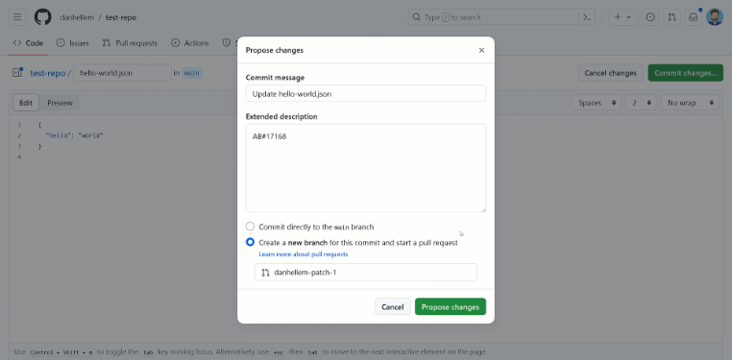
DevOps & IaC & Automation
Azure Boards + GitHub improvements in private preview
MS announced several improvements to GitHub integration:
AB# Validation
Now Azure Boards app notify users about the validity of work item links, helping to spot and fix any issues before merging a pull request.
Linking to GitHub Pull Requests and Commits (preview)
There are two types of association:
AB# Syntax: Use the AB# syntax directly from the pull request or commit.
Direct Linking: Alternatively, it is possible to link directly from the work item. In the past, the process involved copying the entire URL path of the GitHub pull request or commit and pasting it.
MS introduced a significant improvement to direct linking. Now it is possible to use a full search experience when attempting to link from the work item.
Pull request details (preview)
It is now possible to see if the pull request is in draft mode, requires a review, or is undergoing status checks. All without the need to open the pull request directly

Slide 22
Miscellaneous

Slide 23
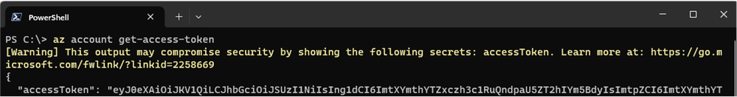
Miscellaneous Updates
ZIP package of Azure CLI is available on Windows
MS announced a new installation method for the Azure CLI that is the ZIP package. It offers two advantages: installation without admin privilege and faster installation.
Install CLI without admin privilege - One major problem with the existing MSI package is it requires the admin permission. This can be particularly troublesome on some workers' computers. ZIP package comes to the rescue. Simply unzip the package wherever you like, and it's ready to use.
Faster installation - While the MSI installation could take close to a minute to complete, the ZIP package installation is significantly quicker – typically under 20 seconds, depending on disk speed.
Download zip package from https://aka.ms/installazurecliwindowszipx64.
Unzip the package to a folder, then you can run the CLI command with: <unzipped folder path>\bin\az.cmd.
please add <unzipped folder path>\bin in PATH environment variable, then restart your terminal.
Azure command line tools secret warnings
When using one of the Azure client tools, it is likely to have a deal with secrets that are returned by the Azure APIs. A common scenario would be to retrieve a storage account key to be able to perform other operations subsequently in your pipeline. This becomes particularly important when the output of commands is stored in log files like this would be the case in GitHub actions or other DevOps runners.
MS released a new version cli with a new configuration options that allow to place warning if the output contain secrets:
Local installation, Azure DevOps, GitHub action, etc… : have this option Disabled by default.
az config set clients.show_secrets_warning=True
CloudShell has this option Disabled by default.
az config set clients.show_secrets_warning=False

Slide 24
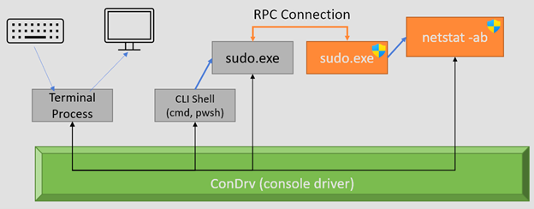
Miscellaneous Updates
Azure Communication Services February 2024 Feature Updates
There were changes only to virtual room that are:
Dial out to a PSTN user - now, users can also dial out PSTN numbers and include the PSTN participants in an ongoing call.
Remote mute call participants - Users with Presenter role can mute a participant, multiple participants, or all other participants. Users will retain the ability to unmute themselves as needed. For privacy reasons, no one can unmute other participants.
Call Recording in Virtual Rooms-Developers can now Start, Pause and Stop call recording in calls conducted in Virtual Rooms. Call Recording is a service-side capability, and developers start, pause, stop recording using server-side API calls.
Closed Captions in Virtual Rooms - Closed Captions is the conversion of a voice or video call audio track into written words that appear in real time. Closed captions are also a useful tool for end users who may prefer to read the audio text in order to engage more actively in conversations and meetings. Closed captions also help in scenarios where end users might be in noisy environments or having difficulties with their audio equipment. Closed Captions are never saved and are only visible to the user that has enabled it.
Introducing Sudo for Windows
MS announced the release of Sudo for Windows in Windows 11 Insider Preview Build 26052! Sudo for Windows is a new way for users to run elevated commands directly from an unelevated console session. It is an ergonomic and familiar solution for users who want to elevate a command without having to first open a new elevated console.
Sudo for Windows currently supports three different configuration options:
In a new window (forceNewWindow)
Input closed (disableInput)
Inline (normal)

Slide 25
Information

Slide 26
Information
Azure Times GitHub Repo
Azure Times Telegram

Slide 27
Questions

