Slide 1
Azure Times #141
November 18, 2024

Slide 2
Networking

Slide 3
Networking Updates
PP: Azure Front Door WebSocket
MS announced the public preview of WebSocket on Azure Front Door Standard and Premium. WebSocket is enabled by default without customer configurations on Azure Front Door.
WebSocket enables full duplex communication between a server and a client over a long-running TCP connection. It eliminates the needs for polling as required in HTTP, avoids some of the overhead of HTTP, and can reuse the same TCP connection for multiple request/responses resulting in a more efficient utilization of resources. This enables more interactive and real-time scenarios.
WebSocket can be used for apps or websites which require real-time updates/communications or continuous streams of data, such as chats, dashboard, finance stock info update, GPS, online education, live streaming and game apps.
Retirement: Support for Azure Load Balancer numberOfProbes property ends on September 1, 2027
Support for Azure Load Balancer numberOfProbes property ends on September 1, 2027. To avoid service disruption, upgrade your apps to API version 2022-05-01 or higher and start using Azure Load Balancer probeThreshold property. We will not be supporting the property numberOfProbes after September 1, 2027.

Slide 4
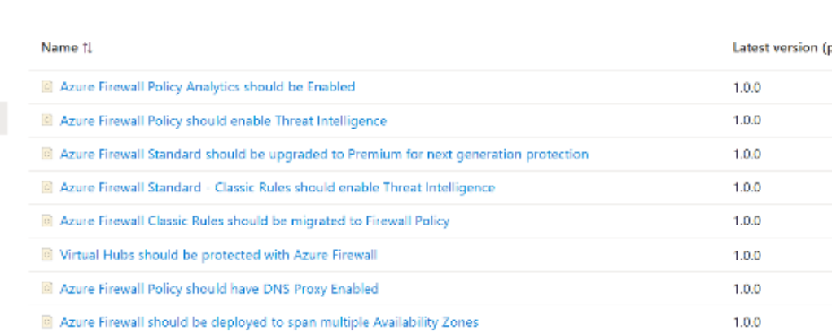
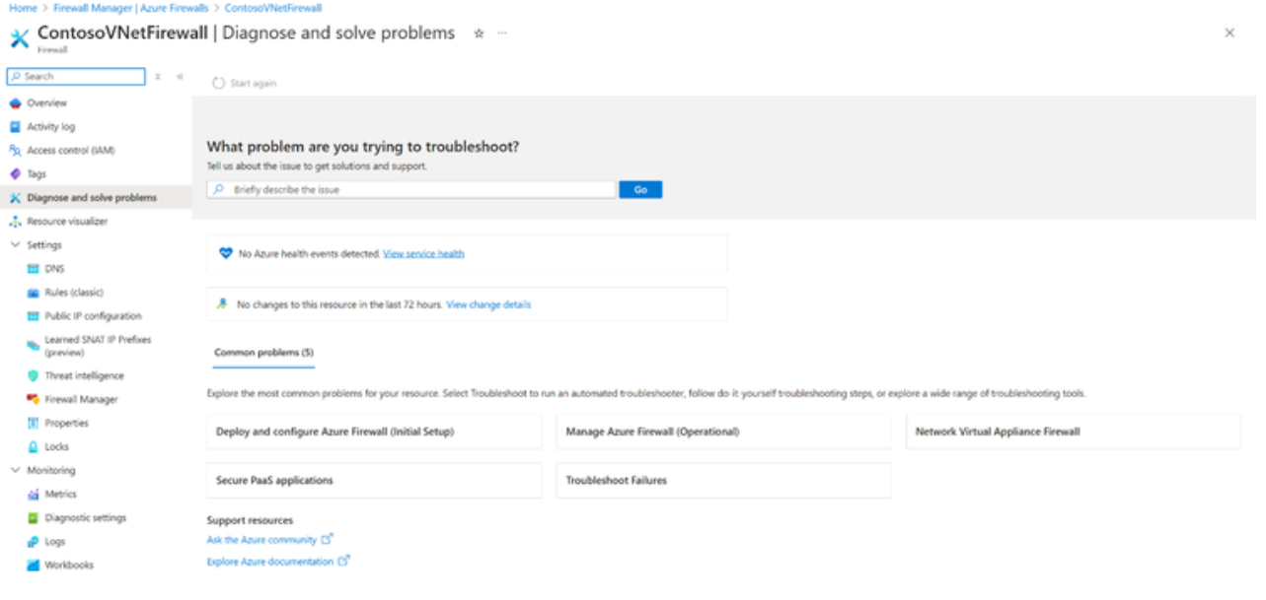
Networking Updates
Enhancements to the Azure Firewall User Experience
Built-In Azure Policies
Diagnose and Solve Blade
Management NIC Changes - An Azure Firewall Management NIC separates Firewall management traffic from customer traffic. The firewall routes its management traffic via the dedicated AzureFirewallManagementSubnet (minimum subnet size /26) and its associated public IP address. This feature was previously called Forced Tunneling, as originally, a Management NIC was required only for Forced Tunneling. However, upcoming Firewall features will also require a Management NIC. To support any of these capabilities, you must create an Azure Firewall with the Firewall Management NIC enabled or enable it on an existing Azure Firewall.
Built-In Azure Advisor Recommendations - The current Azure Advisor recommendations include the following:
Exceeding rule limitations on Firewall policy:
Exceeding IP Group limitations on Firewall policy
Exceeding Firewall Policy or Rule Collection Group size
Change Tracking (Preview) - ARG change analysis recently added support for RuleCollectionGroups. It is now possible to track changes to Azure Firewall Rule Collection Groups using an Azure Resource Graph query from the Azure Portal ResourceGraphExplorer

Slide 5
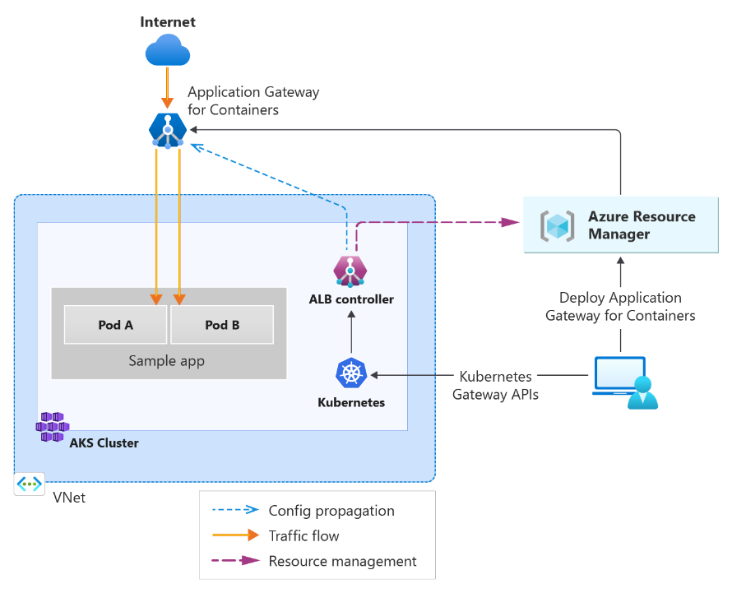
Networking Updates
Private Preview: Web Application Firewall (WAF) running on Application Gateway for Containers
Application Gateway for Containers now supports Web Application Firewall (WAF) in private preview. WAF’s Default Ruleset provides Azure Kubernetes Service (AKS) users with centralized protection against malicious attacks and exploits such as:
Cross-site scripting
Java attacks
Local file inclusion
PHP injection attacks
Remote command execution
Remote file inclusion
Session fixation
SQL injection protection
Protocol attacks
Additionally, Application Gateway for Containers WAF also supports protection against malicious bot activity via the bot manager rulesets.
If you’re interested in signing up for this private preview, please fill out this intake form to start the onboarding process.

Slide 6
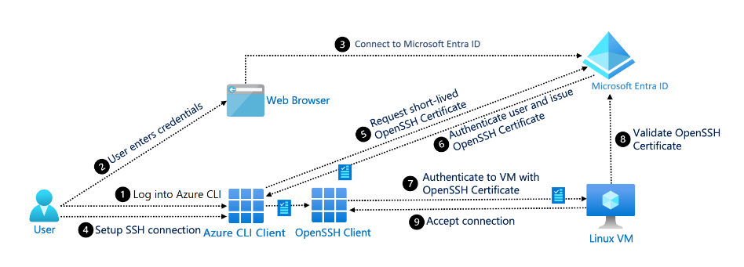
Networking Updates
GA: Entra ID support for SSH connection in portal
MS Announced that Azure Bastion now supports Microsoft Entra ID authentication for SSH connections in the portal. With Microsoft Entra ID authentication, there are two main benefits to users connecting to their virtual machines.
First, it eliminates the need for local authentication mechanisms, reducing a point of attack for malicious actors.
Second, with Microsoft Entra ID authentication set as the authentication mechanism, instead of providing additional authentication to connect, users can experience a one-click sign-on into their virtual machines.

Slide 7
Management & Governance

Slide 8
Management & Governance
Announcing the Public Preview of the Azure Arc gateway!
The new solution reduce the number of required endpoints for customers to configure their Enterprise proxy when setting up for using Azure Arc services.
Arc gateway introduces two new components:
Arc gateway – An Azure Resource with a single, unique endpoint that will handle the incoming traffic to Azure from on-prem Arc workloads. This endpoint is to be configured in customer’s enterprise proxies.
Azure Arc Proxy – A component of the Arc connected machine agent that routes all Agent and extension traffic to its destination in Azure via an Arc gateway Resource. The Arc Proxy is installed on every Arc-enabled Resource within the core Arc agent.
Limitations
TLS Terminating Proxies aren't supported (Public Preview)
ExpressRoute/Site-to-Site VPN or private endpoints used with the Arc gateway (Public Preview) isn't supported.
There's a limit of five (5) Arc gateway (Public Preview) resources per Azure subscription.
Endpoints required without Arc gateway (17) | Endpoints required with Arc gateway (8)
Arc-enabled Servers Endpoints aka.ms download.microsoft.com packages.microsoft.com login.microsoftonline.com *.login.microsoftonline.com pas.windows.net management.azure.com *.his.arc.azure.com *.guestconfiguration.azure.com azgn*.servicebus.windows.net *.blob.core.windows.net dc.services.visualstudio.com Azure Monitor Endpoints global.handler.control.monitor.azure.com <virtual-machine-region-name>.handler.control.monitor.azure.com <log-analytics-workspace-id>.ods.opinsights.azure.com <virtual-machine-region-name>.monitoring.azure.com <data-collection-endpoint>.<virtual-machine-region-name>.ingest.monitor.azure.com | Arc-enabled Servers Endpoints <URL Prefix>.gw.arc.azure.com management.azure.com login.microsoftonline.com gbl.his.arc.azure.com <region>.his.arc.azure.com packages.microsoft.com Azure Monitor Endpoints <log-analytics-workspace-id>.ods.opinsights.azure.com <data-collection-endpoint>.<virtual-machine-region-name>.ingest.monitor.azure.com

Slide 9
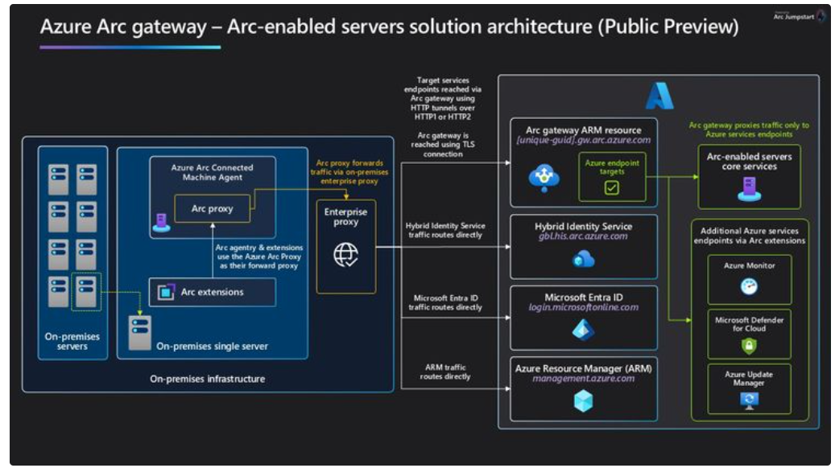

Slide 10
Security & Identity

Slide 11
Security & Identity Updates
Microsoft Security Copilot Achieves SOC 2 Certification
MS announced that Microsoft Security Copilot has successfully achieved SOC 2 certification, a significant milestone that reinforces commitment to delivering secure, compliant solutions for enterprise customers.
SOC 2 (System and Organization Controls 2) is a comprehensive auditing framework developed by the American Institute of Certified Public Accountants (AICPA). It evaluates an organization's controls across five critical trust principles: Security, Availability Processing Integrity, Confidentiality, and Privacy. The certification process involves a rigorous, independent audit that assesses the effectiveness of an organization’s systems and processes in managing these key operational areas, with a particular focus on protecting customer data. Achieving SOC 2 certification demonstrates that Security Copilot met or exceeded these rigorous requirements for managing data securely and responsibly.
Retirement: TLS 1.2 become the minimum TLS version for Azure Storage
To respond to evolving technology and regulatory standards, Azure Storage will remove support for TLS version 1.1 and 1.0, and the minimum supported version will be TLS1.2 starting November 1, 2025. TLS 1.2 is more secure and faster than older TLS versions. TLS 1.0 and 1.1 do not support modern cryptographic algorithms and cipher suites.
This change impacts existing and new storage accounts using TLS 1.0 and 1.1 in all clouds. To avoid disruptions to your applications connecting to Azure Storage, you must migrate to TLS 1.2 and remove dependencies on TLS version 1.0 and 1.1.
Azure Storage already supports TLS 1.2 which is set as the default. Customers using TLS 1.2 will not be impacted by the removal of support for TLS 1.0 and 1.1. For customers using TLS 1.0 or 1.1, to maintain your connections to Azure Storage, please update your operating systems, development libraries, frameworks, and all other solutions to their latest versions to support TLS 1.2 and update your clients to TLS 1.2 no later than Oct 31st, 2025.

Slide 12
Compute

Slide 13
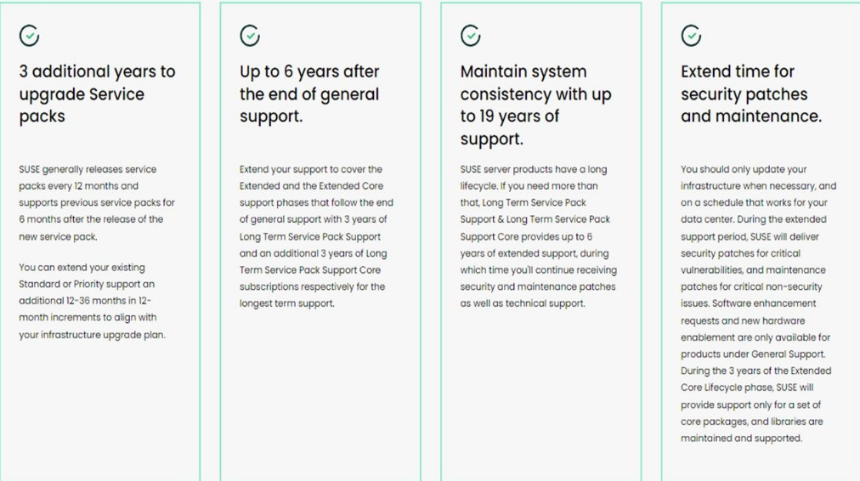
Compute Updates
Extend the lifecycle of SUSE Linux Enterprise Server in Azure
SUSE LTSS offers extended support for SLES, SLES for SAP, and SLES HPC, providing an additional 3 years of critical security patches and maintenance updates. This allows to maintain stability and security without the immediate need for a costly and time-consuming migration.
SUSE LTSS is suitable for customers who need to stay on a specific SLES version that is reaching end of support because of application requirements or needing more time to upgrade.
Key features of SUSE LTSS:
Up to 3 years of extended support
Backed by Microsoft and SUSE
Uninterrupted security patching
No need to refactor application stack
Enhanced security with access to expanded software repositories

Slide 14
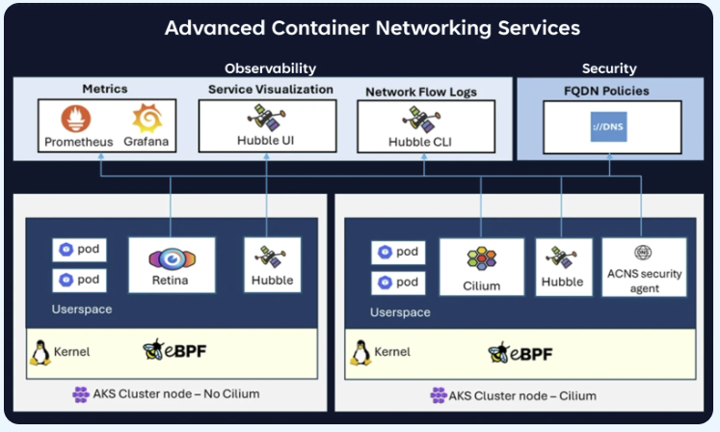
Compute Updates
Azure Kubernetes Service with Advanced Container Networking Services, now generally available
MS announced the General availability of Advanced Container Networking Services for Azure Kubernetes Services (AKS), a cloud-native purpose-built solution to enhance security and observability for Kubernetes and containerized environments. Advanced Container Networking Services focuses on delivering a seamless and integrated experience that allows to maintain robust security postures and gain deep insights into network traffic and application performance.
GA: AKS Delete a specific machine
It is now possible to specifically choose which VM to delete and remove when scaling down a node pool in AKS. This provides greater control and flexibility in managing resources within the node pool.
az aks nodepool delete-machines \
--resource-group <resource-group-name> \ -
-cluster-name <cluster-name> \
--name <node-pool-name>
--machine-names <vm-name-1> <vm-name-2>

Slide 15
Compute Updates
PP: Static egress gateway for AKS
Static egress gateway for Azure Kubernetes Service (AKS) is now in public preview. This feature allows AKS customers to configure a fixed source IP for out-of-cluster communications without incurring the significant cost of deploying a dedicated node pool with a NAT gateway. The static egress gateway enables precise control over egress traffic, simplifying integration with external systems and enhancing network security.
Static Egress Gateway isn't supported in clusters with Azure CNI Pod Subnet.
Kubernetes network policies won't apply to traffic leaving the cluster through the gateway node pool.
This shouldn't affect cluster traffic control as only egress traffic from annotated pods routed to the gateway node pool are affected.
The gateway node pool isn't intended for general-purpose workloads and should be used for egress traffic only.
Windows node pools can't be used as gateway node pools.
hostNetwork pods cannot be annotated to use the gateway node pool.
PP: Azure Linux 3.0 on Azure Kubernetes Services v1.31
Azure Linux 3.0, the next major version release of the Azure Linux container host for Azure Kubernetes Service (AKS), is now available in preview on AKS version 1.31. Azure Linux 3.0 offers increased package availability and versions, an updated kernel, and improvements to performance, security, and tooling and developer experience.

Slide 16
Compute Updates
GA: Fleet OSS announcement
Microsoft Azure Kubernetes Fleet Manager upstream team is making new multi-cluster features available to any Kubernetes operator.
For core multi-cluster workload placement there is a v1alpha1 release of staged release pipelines (ClusterStagedUpdateRun) which represents a stage-by-stage update process that applies ClusterResourcePlacement selected resources to specified clusters.
In the networking space, the upstream team is also announcing the v1alpha1 release of multi-cluster network traffic shifting for public-facing multi-cluster services using a new TrafficManagerProfile custom resource. This new custom resource provides a cloud native method for interacting with Azure Traffic Manager profiles and related backends via the TrafficManagerBackend custom resource. Azure Traffic Manager can provide DNS-based traffic load balancing for endpoints hosted on any public IP, regardless of where that IP is hosted.
PP: SeccompDefault support in AKS
SeccompDefault is available in public preview as a new parameter through custom node configuration. Secure computing mode (seccomp) is used to restrict a container’s syscalls that can be sent to the kernel. This establishes an extra layer of protection against common system call vulnerabilities exploited by malicious actors and allows to specify a default seccomp profile for all workloads in the node.
There are two allowed values for SeccompDefault:
Unconfined is the default parameter value which does not block any syscalls.
RuntimeDefault will block restricted syscalls in the containerd seccomp profile.
The RuntimeDefault profile allows a common set of syscalls while blocking those that are less likely to be used or potentially unsafe in a containerized application. This profile aims to provide a reliable set of security defaults while maintaining the functionality of the workload.

Slide 17
Compute Updates
GA: Ignore PDBson node poll deletion
Node pools in AKS can now be deleted even if there are pods monitored by a PodDisruptionBudget (PDB) – previously, the deletion of the node pool could fail due to an unsatisfied PDB. This enhancement allows the deletion to proceed by ignoring the PDB error that would previously block the deletion from continuing.
.NET 9 GA available on Azure App Service
MS rollout .NET 9 GA support on Azure App Service. On Azure App Service for Linux, .NET 9 GA will be fully integrated on day-0 across all public regions without any additional deployments.

Slide 18
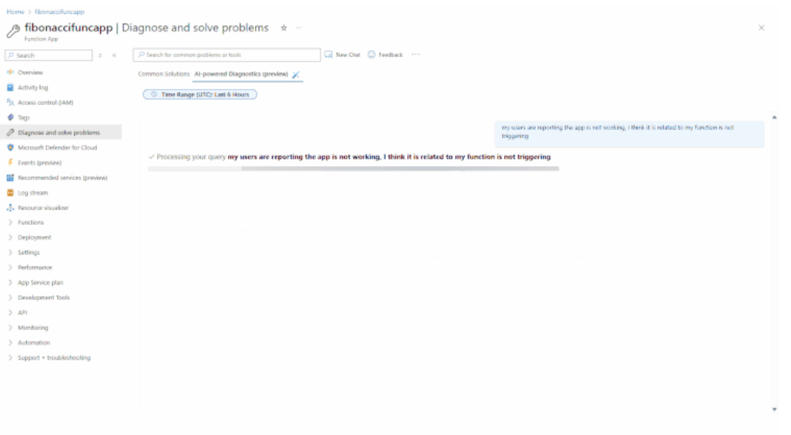
Compute Updates
Announcing Conversational Diagnostics for Azure Functions
This new functionality will be available in the "Diagnose and solve problems" section of the Azure Portal. Additionally, it will be available in Copilot in Azure, and GitHub Copilot with the help of azure.
GA: Extension of limited-time promotional discounts on Azure Databricks Serverless Compute Services
MS announced the extension of the promotional discounts on serverless compute for Notebooks, Jobs, and Pipelines (Delta Live Tables). It will be possible to get 50% off serverless compute for Jobs and Pipelines and 30% off serverless compute for Notebooks, until January 31, 2025.
Serverless compute provides rapid workload startup, automatic infrastructure scaling, and seamless version upgrades of the Azure Databricks runtime.

Slide 19
Compute Updates
Announcing Azure Boost DPU
MS introduced Azure Boost DPU, Microsoft’s first in-house DPU designed for data-centric workloads with high efficiency and low power, capable of absorbing multiple components of a traditional server into a single dedicated silicon.
A DPU (data processing unit) is a new category of processors tailored for infrastructure tasks. Unlike traditional processors, the DPU is engineered to handle specific workloads with greater efficiency. This specialized design leads to substantial improvements in performance per Watt, making it an ideal solution for modern data centers that demand both performance and efficiency.
High efficiency and low power: DPUs are processors that are purpose-built for data-centric workloads and integrate multiple components of a traditional server into a single SoC. Azure Boost DPUs enhance the overall performance and efficiency of Azure's infrastructure by offloading tasks from general purpose CPUs, thereby optimizing resource utilization and reducing power consumption.
Optimization/acceleration across cloud capabilities: Azure Boost DPU is designed to accelerate capabilities across storage, networking, security, and more. The current Azure DPUs in servers can run storage infrastructure workloads at up to 5x less power and at 2x the performance of traditional server CPUs.
Increased server density and lower TCO: The innovative architecture of Azure Boost DPUs yields resource savings that can pave the way for denser server clusters, reducing TCO and lowering carbon emissions.

Slide 20
Storage & Data

Slide 21
Storage & Data Updates
MS Fabric Updates:
Simplifying Data Ingestion with Copy Job: Upsert to SQL Database & Overwrite to Fabric Lakehouse
Legacy Timestamp Support in Native Execution Engine for Fabric Runtime 1.3

Slide 22
Databases

Slide 23
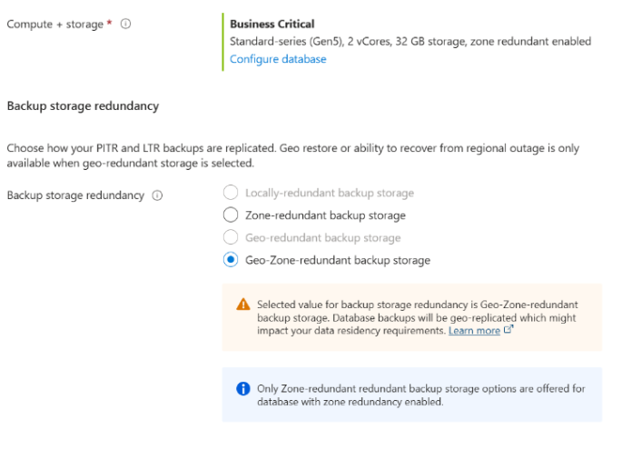
Databases Updates
Geo Zone Redundant Storage (GZRS) is now available for additional Azure SQL database service tiers
Geo Zone Redundant Storage (GZRS) is now available for service tiers such as Standard, Premium, General Purpose, and Business Critical.
Introducing support for oracle_fdw extension in Azure Database for PostgreSQL
MS announced that Azure Database for PostgreSQL now supports Oracle foreign data wrapper, unlocking the ability for users to access and interact with Oracle data sources from within their PostgreSQL databases. The extension is available worldwide for PostgreSQL server versions 12 to 17.
It simplifies workflow by enabling to not only query but also update, insert, and delete Oracle data directly from PostgreSQL environment.

Slide 24
DevOps & IaC & Automation

Slide 25
DevOps & IaC & Automation
Release: Azure SQL Migration extension for Azure Data Studio v1.5.6
MS announced the release of the latest version of the Azure SQL Migration extension for Azure Data Studio, v1.5.6.
This release provides you with Azure Database Migration Service’s new features like:
Support for Next-gen General Purpose service tier for Azure SQL Managed Instance.
Target Provisioning based upon SKU recommendation (using ARM templates) - Public Preview.
Enhanced login migration experience - Public Preview.
ProcDump 1.0 for Mac
MS announced the release of ProcDump 1.0 for Mac, a tool that generates process crash dumps with support for triggers like CPU and memory usage. ProcDump functionality is now available on Windows, Linux, and macOS so that users on all platforms can leverage the same powerful ProcDump capabilities.

Slide 26

DevOps & IaC & Automation
GA: Azure Chaos Studio is now GA in Canada Central region
Azure Chaos Studio is a managed service that uses chaos engineering to help measure, understand, and improve cloud application and service resilience. Azure Chaos Studio Resource Targeting is now available in Canada Central region.
GA: Azure Chaos Studio now supports faults for AKS clusters using managed identity authentication
Azure Chaos Studio’s faults for Azure Kubernetes Service clusters now work with managed identity authentication. Previously, local authentication through the Kubernetes API server was the only supported authentication method. To enable customers with an enhanced security posture for AKS clusters to perform fault injection, the Version 2.2 AKS Chaos Mesh faults now also support managed identity authentication. Customers using Version 2.1 faults will need to enable the new capabilities and modify the relevant experiments to use the new versions. Version 2.1 faults will be unavailable in the Chaos Studio user interface on or after January 31, 2025, but remain runnable in experiments until further notice.

Slide 27
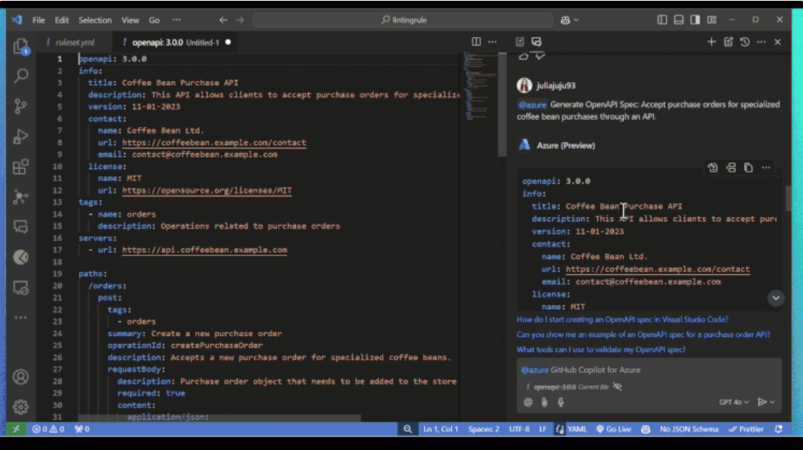
DevOps & IaC & Automation
PP:Azure API Center Plugin for GitHub Copilot for Azure
A plugin extends the capabilities of GitHub Copilot for Azure, allowing for modular customization without altering its core functionality. The API Center plugin for GitHub Copilot enables developers to incorporate Azure API Center context into their workflows. This integration helps tailor the outcomes to better meet specific needs, enhancing the overall development experience by making API creation and management more efficient and aligned with best practices. It Allows:
Generating API Specifications
Designing Compliant APIs.
November Patches for Azure DevOps Server
MS released patches for Azure DevOps Server:
Azure DevOps Server 2022.2 Patch 2
Azure DevOps Server 2020.1.2 Patch 14

Slide 28
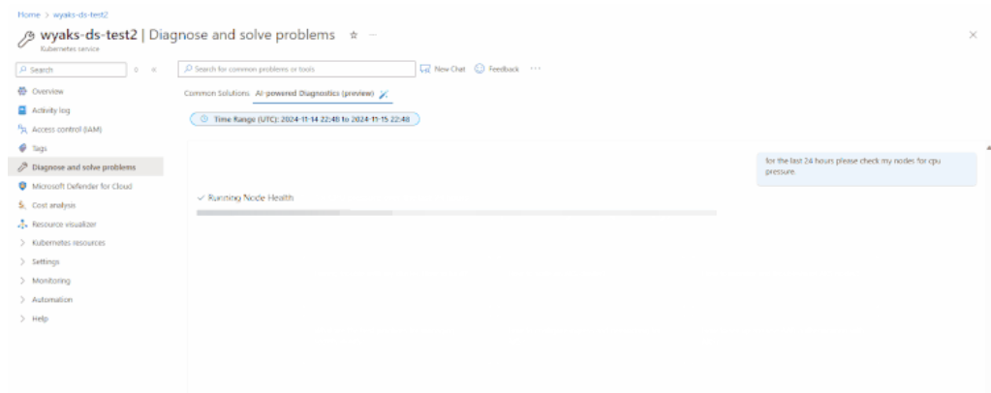
DevOps & IaC & Automation
Announcing Conversational Diagnostics for AKS at Ignite 2024
MS announced that Conversational Diagnostics is coming to Azure Kubernetes Service (AKS)! This new functionality will be available in the "Diagnose and solve problems" section of the Azure Portal, starting at Ignite 2024.
Conversational Diagnostics leverages natural language processing to help you troubleshoot and resolve issues with your AKS clusters more efficiently. By simply describing your problem in plain language, you can get targeted diagnostics and solutions, making it easier to maintain the health and performance of your AKS deployments.

Slide 29
Miscellaneous

Slide 30

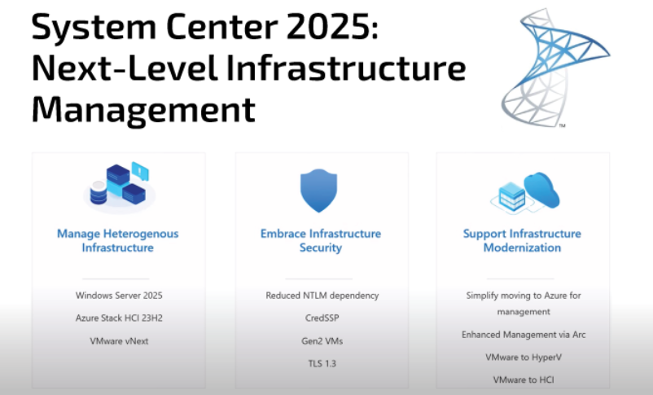
Miscellaneous Updates
Announcing the Arc Jumpstart Community Badges
MS introduced the Arc Jumpstart Community Badges, an exciting new way to recognize and reward the incredible contributions of our community members.
Announcement: System Center 2025 is GA
All System Center 2025 suite (SCVMM, SCDPM, SCOM, SCSM & SCO) is now GA

Slide 31
Information

Slide 32
Information
Azure Times GitHub Repo

Slide 33
Questions

