Slide 1
Azure Times #145
December 20, 2024

Slide 2


Slide 3


Slide 4
Security & Identity

Slide 5
Security & Identity Updates
Defender for single-core Linux servers
Microsoft Defender can now be deployed to low-resource Linux environments, including single and dual core configurations.
Previously it was a requirements to have 2 or 4 vCPU.
Microsoft Defender uses a sensor framework powered by eBPF (extended Berkeley Packet Filter) technology, when deployed on Linux servers. Unlike traditional security solutions that rely on kernel modules, eBPF allows Microsoft Defender to monitor system activities in a lightweight and non-intrusive manner, enhancing efficiency without compromising security—even in low-resource environments.

Slide 6
Management & Governance

Slide 7
Management & Governance Updates
Windows Admin Center version 2410 is now generally available!
Upgrade to .NET Core
Updated installer
Data migration
Multi-process, micro-service based
Kestrel HTTP web server
WS2025 Security baseline
Windows LAPS
GPU-P
GA: Microsoft Azure now available from new cloud region in New Zealand
The first cloud region in New Zealand is now available with Azure Availability Zones and provides organizations across the globe with access to scalable, highly available, and resilient Microsoft Cloud services while confirming its commitment to promoting digital transformation and sustainable innovation in the country. The New Zealand region connects New Zealand to the largest and trusted global cloud infrastructure, delivering the highest standards of security, privacy and regulatory-compliant data storage in the country.

Slide 8
Compute

Slide 9
Compute Updates
GA: Parallel Image Pulls by Default in AKS
There are two types of container image pulls: serialized and parallel image pulls.
In AKS versions earlier than 1.31, by default, AKS enables serialized image pulls. Starting in AKS version 1.31 preview, by default, AKS pulls container images in parallel. Typically, serialized image pulls should be less performant than parallel image pulls, particularly when the service tries to pull large or numerous container images.
However, might still experience decreased performance by using parallel image pulls compared to using serial image pulls. Trying to pull large or numerous images in a parallel manner might throttle the disk. This is especially true when for unoptimized disk and VM resources. In this situation, might notice that the time to pull the first images is faster in a serial setup, but the time to pull all images is faster in a parallel setup. Depending on your workload needs, you should consider using the following steps to scale your disk and VM resources or toggle the image pull type.
GA: Open-Source feature update: vLLM model serving in KAITO
KAITO now supports high throughput model serving with the open-source vLLM serving engine. In the KAITO inference workspace, it is possible to deploy models using vLLM to batch process incoming requests, accelerate inference, and optimize AI workload by default, preventing out-of-memory (OOM) errors and minimizing workload disruptions.

Slide 10
Compute Updates
GA: Force attach/detach API support in AKS
With the release of Kubernetes v1.30, the Azure Disk CSI driver has adopted the force detach capability. This feature allows the driver to force detach zone-redundant storage (ZRS) data disks from VM nodes in a failed zone and attach them to another VM, reducing the Recovery Time Objective (RTO).
Stateful workloads in AKS clusters can now quickly recover from zone failures by detaching ZRS data disks from affected VM nodes and reattaching them to new VMs.
GA: Vaulted backup for AKS
Azure Backup now supports vaulted backups for AKS, enabling cross-region disaster recovery, long-term retention and immutable security. This simplifies compliance and strengthens resilience for cloud-native applications.
Customers can protect clusters during a regional disaster recovery, store backup data for up to 10 years to meet compliance requirements, and secure backup data at an offsite location to safeguard against ransomware threats.

Slide 11
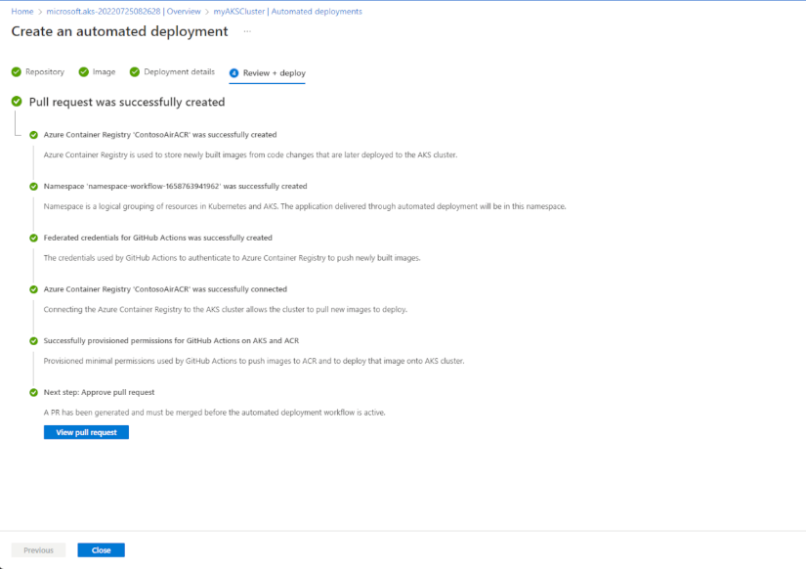
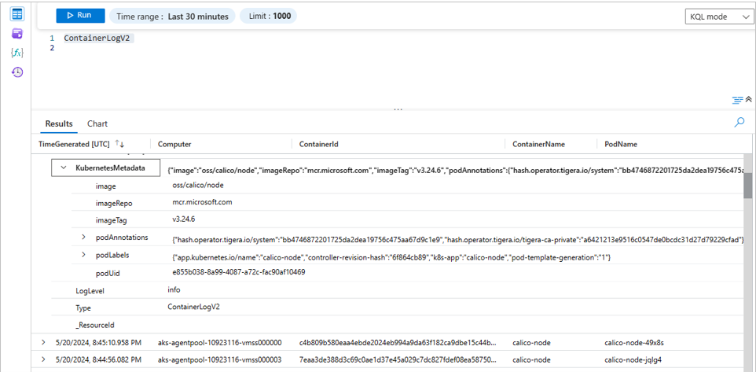
Compute Updates
GA: AKS automated deployments UI
The AKS automated deployments feature has received UI updates designed to make it easier for customers to get started with Azure Kubernetes Service. With these new improvements, it is now possible to select specific locations for saving autogenerated Dockerfiles and Kubernetes manifest files.
NOTE: Private clusters are currently not supported.
GA: Enhanced AKS logs with Kubernetes metadata and logs filtering
Azure Kubernetes Service (AKS) logs now include detailed metadata, such as PodLabels, PodAnnotations, PodUid, Image, ImageID, ImageRepo, and ImageTag. These additions provide richer context and improved visibility into workloads, aiding in troubleshooting and monitoring. The integration with Grafana further enhances this by enabling users to visualize and analyze logs more effectively, utilizing Grafana's powerful dashboard capabilities.

Slide 12
Compute Updates
PP: IMDS restriction support in AKS
Currently, all pods on AKS nodes can access the AKS worker node's Azure Instance Metadata Service (IMDS) endpoint.
Azure IMDS is a REST API that provides information about currently running virtual machine instances. This information includes the SKU, storage, network configurations, and upcoming maintenance events.
The IMDS REST API is available at a well-known, nonroutable IP address (169.254.169.254) that is by default accessible from all pods running in an AKS cluster. This default access introduces certain security risks for an AKS cluster:
Malicious users might exploit the service to obtain sensitive information such as tokens and other platform information, leading to information leakage.
Potential authentication vulnerabilities are then exposed, because applications could misuse these credentials.
You can now opt to restrict access to the IMDS endpoint for non host network pods running in your cluster. Non host network pods have hostNetwork set to false in their specs. When IMDS restriction is enabled, non host network pods are unable to access the IMDS endpoint or acquire OAuth 2.0 tokens for authorization by a managed identity. Non host network pods should rely on Microsoft Entra Workload ID after IMDS restriction is enabled.
Host network pods have hostNetwork set to true in their specs. Host network pods can continue to access the IMDS endpoint after IMDS restriction is enabled as they share the same network namespace with the host processes. Local processes in nodes can use the IMDS endpoint to retrieve instance metadata, so they're permitted to access the endpoint after the IMDS restriction is enabled.
PP: AKS Communication Manager
It Simplifies notifications for all AKS maintenance tasks by leveraging Azure Resource Notification and Azure Resource Graph frameworks.
It provides timely alerts on event triggers and outcomes, allowing to closely monitor upgrades. In case of maintenance failures, it notifies with the reasons for the failure, reducing operational hassles related to observability and follow-ups.

Slide 13
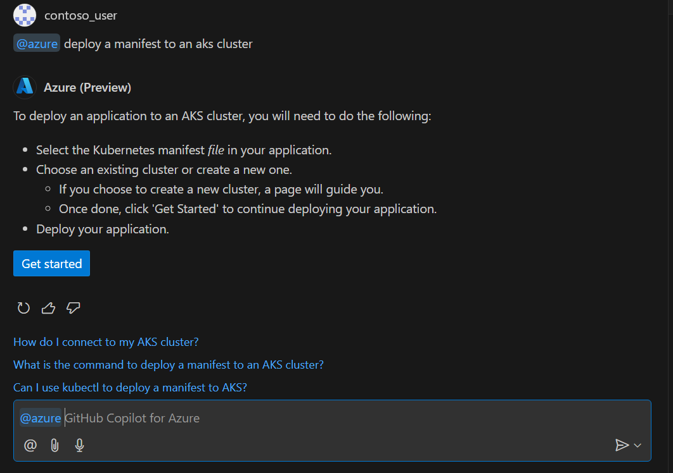
Compute Updates
PP: Windows GPU – Driver type selection
AKS now supports GPU-enabled Windows node pools, in public preview, to run compute-intensive Kubernetes workloads. AKS specifies a default GPU driver type for each supported GPU-enabled VM. Because workload and driver compatibility are important for functioning GPU workloads, it is now possible to specify the driver type for Windows GPU node.
When creating a Windows agent pool with GPU support, it is possible to have the option to specify the type of GPU driver using the --driver-type flag.
The available options are:
GRID: For applications requiring virtualization support.
CUDA: Optimized for computational tasks in scientific computing and data-intensive applications.
This feature is currently not supported for Linux GPU node pools.
Limitations:
Updating an existing Windows node pool to add GPU isn't supported.
Not supported on Kubernetes version 1.28 and below.
PP: GitHub Copilot for Azure – AKP plugins
GitHub Copilot for Azure now supports Azure Kubernetes Service (AKS) plugins. The extension, which enables AKS plugins for GitHub Copilot for Azure (@azure), allows users to perform various tasks related to AKS directly from the GitHub Copilot Chat view. These tasks include creating an AKS cluster, deploying a manifest to an AKS cluster, and generating Kubectl commands.

Slide 14
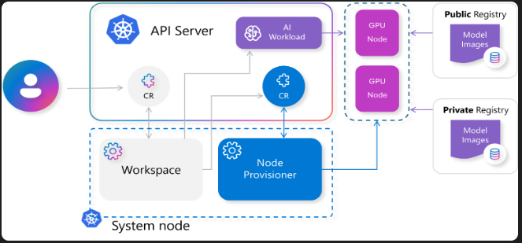
Compute Updates
PP: KAIOT managed add-on now available in the AKS VS Code
The AI toolchain operator (KAITO) managed add-on is now available in the Azure Kubernetes Service (AKS) Visual Studio Code extension. With an intuitive and visually engaging UI, this add-on is designed to simplify AI inference development. Customers can enable KAITO, browse through the supported options, and choose an open-source AI model to deploy to their AKS cluster. Once deployed, they can access model logs, test performance, and fully engage with the model workspace directly from VSCode.
PP: AKS support for private ingress on cluster create or through API
During provisioning of the application routing add-on with NGINX, it creates an ingress controller configured with a public facing Azure Load Balancer. Starting with Kubernetes 1.30, it is possible to control this behavior when enabling the add-on by choosing if it gets a public or an internal IP.
Here are the possible configuration options:
None: The default Nginx ingress controller is not created and will not be deleted if it already exists. Users should delete the default NginxIngressController custom resource manually if desired.
Internal: The default Nginx ingress controller is created with an internal load balancer. Any annotations changes on the NginxIngressController custom resource to make it external will be overwritten.
External: The default Nginx ingress controller created with an external load balancer. Any annotations changes on the NginxIngressController custom resource to make it internal will be overwritten.
AnnotationControlled (default): The default Nginx ingress controller is created with an external load balancer. Users can edit the default NginxIngressController custom resource to configure load balancer annotations.

Slide 15
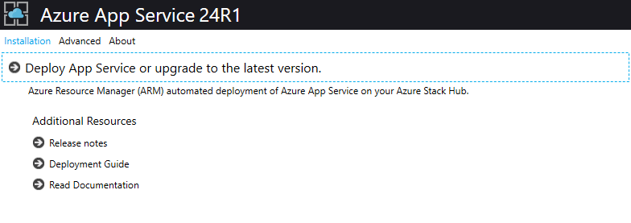
Compute Updates
Azure App Service on Azure Stack Hub 24R1 Released
Azure App Service on Azure Stack Hub 24R1 is now available for customers to download and update their Azure Stack Hub deployments. This release contains a number of new capabilities, updates to application stacks and improvements to Azure App Service on Azure Stack Hub and we encourage customers to review the full release notes, follow the update documentation to deploy to their systems and take advantage of this new update.
Windows 365 Cloud PCs
Granular move enhancement – With the new granular move enhancement, admins get more flexibility and can move Cloud PCs in smaller batches instead of moving all Cloud PCs in a policy at once.
Enhanced tracking and reporting – In addition to the flexibility of granular move, admins now have visibility into the progress of an initiated move. Track the progress status of the granular move at a batch level in Cloud PC actions report to see the progress, success or failure status, and time elapsed. Learn more about the Cloud PC action report.
Cloud PC move now supported for Windows 365 Frontline – Previously, Cloud PC move supported only Windows 365 Enterprise Cloud PCs, but it now also supports Windows 365 Frontline dedicated Cloud PCs. Administrators can select these Cloud PCs the same as any.

Slide 16
Storage & Data

Slide 17
Storage & Data Updates
Synapse Data Explorer (SDX) to Eventhouse Migration Capability (Preview)
Synapse Data Explorer (SDX), part of Azure Synapse Analytics, is an enterprise analytics service that enables you to explore, analyze, and visualize large volumes of data using the familiar Kusto Query Language (KQL).
The next generation of SDX offering is evolving to become Eventhouse, part of Real-Time Intelligence in Microsoft Fabric. Eventhouse offers the same powerful features and capabilities as SDX, but with enhanced scalability, performance, and security. Eventhouse is built on the same technology as SDX, and is compatible with all the applications, SDKs, integrations, and tools that work with SDX.
It is now possible to migrate Data Explorer pools from Synapse workspace to Eventhouse effortlessly. To initiate the migration of SDX cluster to Eventhouse, simply create a support ticket.
GA: Storage account default maximum request rate limit increate to 40K request per second
The default maximum request rate for general-purpose v2 and Blob storage accounts has been increased from 20,000 to 40,000 requests per second in the most of the regions.

Slide 18
Integration

Slide 19
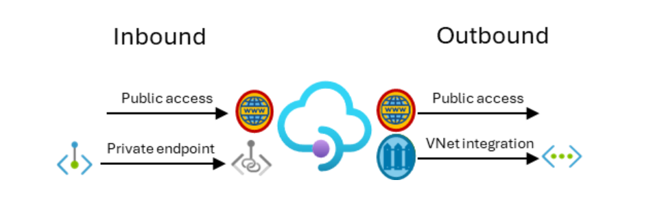
Integration Updates
Inbound private endpoint for Standard v2 tier of Azure API Management
Customers can now configure an inbound private endpoint (preview) for API Management Standard v2 instance to allow clients in private network to securely access the API Management gateway over Azure Private Link.
It allows:
Create multiple Private Link connections to an API Management instance.
Use the private endpoint to send inbound traffic on a secure connection.
Use policy to distinguish traffic that comes from the private endpoint.
Limit incoming traffic only to private endpoints, preventing data exfiltration.
Combine with outbound virtual network integration to provide end-to-end network isolation of API Management clients and backend services.

Slide 20
ML & AI & IOT

Slide 21
ML & AI & IOT Updates
Phi-4 SLM is GA
MS introduced Phi-4, 14B parameter state-of-the-art small language model (SLM) that excels at complex reasoning in areas such as math, in addition to conventional language processing. Phi-4 is the latest member of Phi family of small language models. Phi-4 is currently available on Azure AI Foundry under a Microsoft Research License Agreement (MSRLA).
Meta Llama 3.3 is GA
MS announced that the Meta Llama 3.3 70B is now available in the Azure AI Foundry Model Catalog. This milestone is part of ongoing collaboration with Meta to deliver open generative AI models that combine performance, accessibility, and responsibility. The Meta Llama 3.3 70B, embodies the best of what Meta has to offer and offers performance similar to Meta Llama 405B making it easier for developers to build, experiment, and deploy AI-driven solutions at scale at a lower cost.

Slide 22
ML & AI & IOT Updates
Announcing the o1 model in Azure OpenAI Service
This multimodal model brings advanced reasoning capabilities and improvements that will significantly enhance AI applications and solutions. The o1 model supports both text and vision inputs, making it ideal for a wide range of applications from complex problem-solving to contextual AI experiences.
The o1 model introduces several new features:
Vision input: Developer messages: Developer messages are like system messages in GPT models, allowing for instructions and context to be passed for specific use cases with the “role”: “developer” attribute.
Reasoning effort parameter: The reasoning effort parameter allows to adjust the model’s cognitive load with options for low, medium, and high reasoning levels, offering greater control over the model’s performance.
Expanded context window: The o1 model now boasts an expanded context window of 200K tokens and a maximum output of 100K tokens, providing ample space for complex and detailed responses.
Structured outputs: o1 now adds support for structured outputs to help simplify the generation of well-defined, structured outputs constrained with JSON schemas.
Tools: Now you can use the o1 model output to generate input for functions just like the previous models.
Lower latency: o1 uses on average 60% fewer reasoning tokens than o1-preview for a given request.

Slide 23
ML & AI & IOT Updates
PP: Risk and Safety evaluations for image and multimodal model content in Azure AI Foundry
Risk and safety evaluations for images and multimodal content are now available in public preview in Azure AI Foundry. These evaluations can help organizations assess the frequency and severity of harmful content in human and AI-generated outputs to prioritize relevant risk mitigations in their generative AI applications.
Announcing the General Availability of Document Intelligence v4.0 API
The Document Intelligence v4.0 API is now generally available! This latest version of Document Intelligence API brings new and updated capabilities across the entire product including updates to Read and Layout APIs for content extraction, prebuilt and custom extraction models for schema extraction from documents and classification models. Document Intelligence has all the tools to enable RAG and document automation solutions for structured and unstructured documents.

Slide 24
Information

Slide 25
Information
Azure Times GitHub Repo

Slide 26
Questions

