Slide 1
Azure Times #100
December 20, 2023

Slide 2
Networking

Slide 3
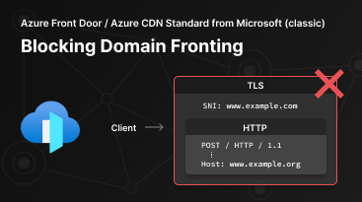
Networking Updates
Delaying Domain Front Block on AFD and CDN services
Due to customer interest and feedback on the upcoming enforcement of blocking domain fronting on existing Azure Front Door and Azure CDN Standard from Microsoft (classic), MS is postponing domain fronting blocking enforcement to January 22, 2024, and will provide two log fields “SNI” and “Result” by December 25, 2023, to help customers in determining if the Azure Front Door and Azure CDN Standard from Microsoft (classic) resources display domain fronting behavior.
Domain fronting is a network technique that enables an attacker to conceal the actual destination of a request by sending traffic to a different domain in HTTP host header than the one used in the TLS/SSL handshake. For example, an attacker can use a valid domain www.example.com in the TLS/SSL handshake but send traffic to a different domain www.example.org by specifying a different host header in subsequent http requests. The domain www.example.org might have certain restrictions (regional access restrictions, etc.) on it. With domain fronting, it is possible for the attacker to circumvent these restrictions. To the outside observers, all subsequent traffic appears to be headed to www.example.com, with no ability to discern the intended destination of www.example.org for requests within that traffic.

Slide 4
Security & Identity

Slide 5
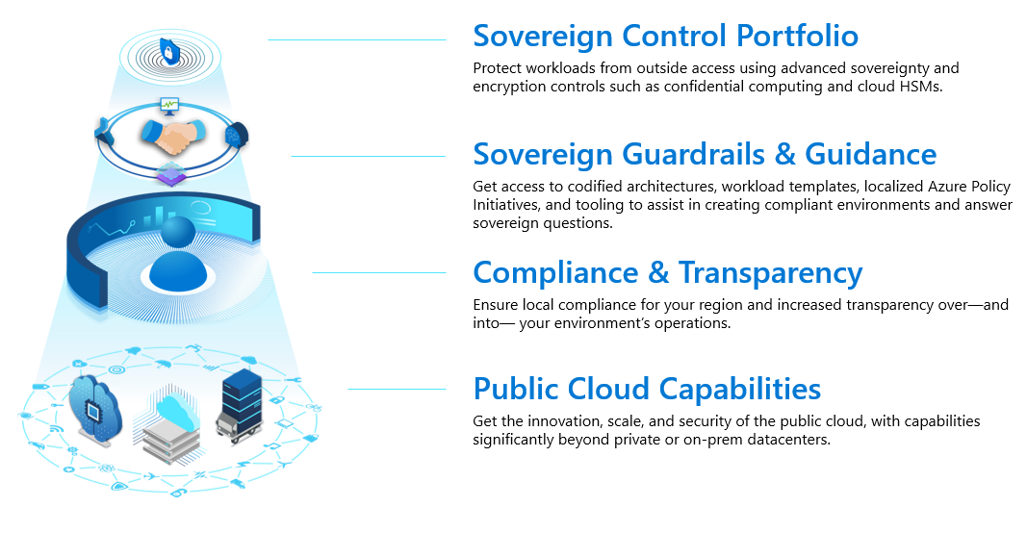
Security & Identity Updates
Microsoft Cloud for Sovereignty now generally available, opening new pathways for government innovation
Today, MS announced the general availability of Microsoft Cloud for Sovereignty across all Azure regions. Microsoft Cloud for Sovereignty helps governments meet their compliance, security, and policy requirements while utilizing the cloud to provide superior value to their citizens.
Microsoft Cloud for Sovereignty — offering governance, security, transparency and sovereign technology — supports the digital transformation of government customers unlike any other cloud provider in the world. Customers gain automation of best practices to address regulatory requirements while benefiting from the rapid pace of innovation in the hyperscale cloud.

Slide 6
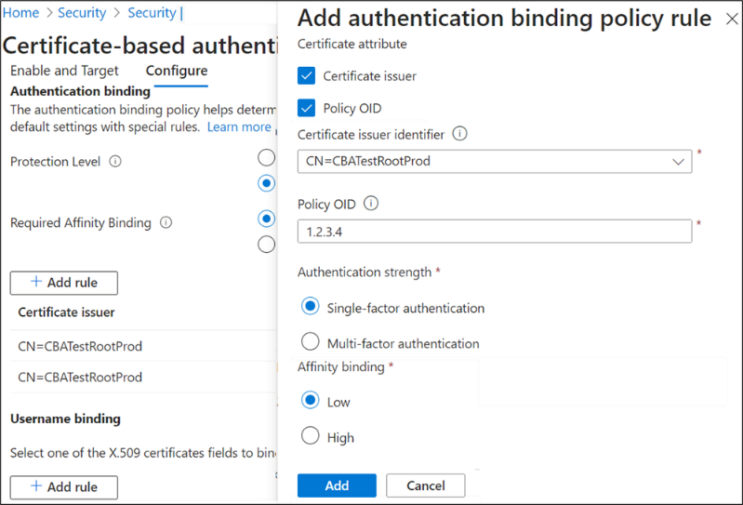
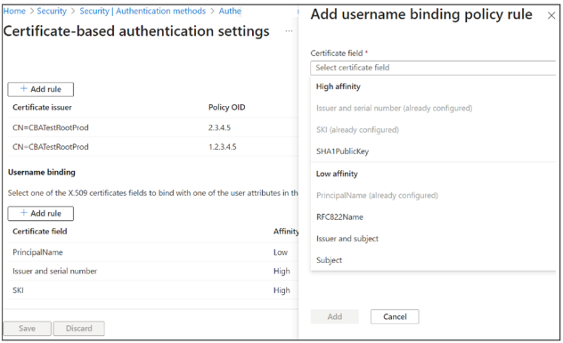
Security & Identity Updates
Enhancements to Microsoft Entra certificate-based authentication
CBA username bindings CBA added support for three remaining username bindings and is now at parity with on-premises Active Directory. The three bindings that are being added are:
IssuerAndSerialNumber
IssuerAndSubject
Subject Only
The username binding policy allows admins to customize how Entra ID will match the certificate being presented by the user with their user account in Entra ID. By default, MS map Principal Name in the subject Alternative Name (SAN) attribute of the certificate to UserPrincipalName in the user object. An admin can override the default and create a custom mapping.
CBA Authentication policy rules help determine the strength of authentication as either single-factor or multi-factor. Unlike other authentication methods available in Entra ID, which are either always, CBA is capable of being either. MS likes to refer to this as CBA being a multi-factor capable authentication method, and the authentication policy rules allow the admin to configure protection levels to determine when Entra ID should consider a certificate to be single-factor or multi-factor. Multiple custom authentication binding rules can be created to assign default protection level for certificates based on the certificate attributes (Issuer or Policy OID or by combining the Issuer and OID).

Slide 7
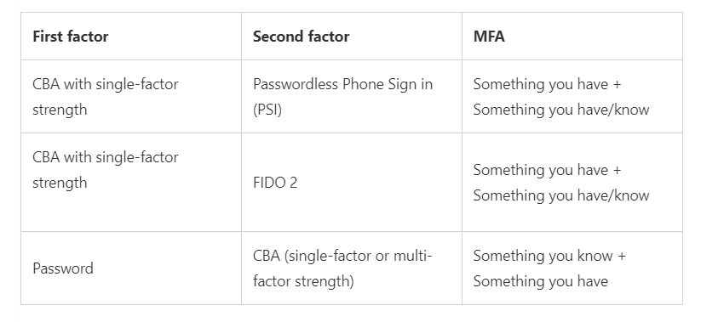
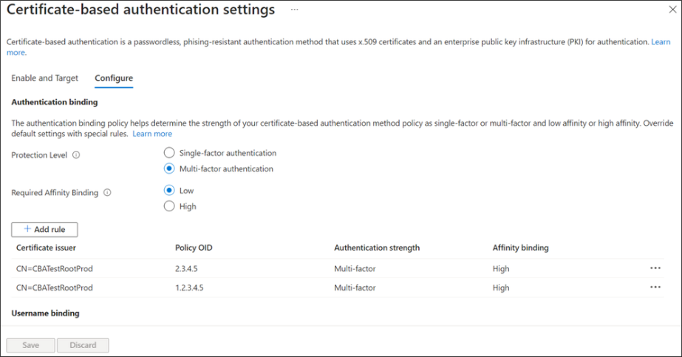
Security & Identity Updates
CBA Affinity Binding refers to certificate attributes used for validating a certificate for user authentication. As MS introduced earlier, there are several ways a certificate can be bound or matched to a user object. Some methods rely on properties of a user’s certificate that are easily reusable. This reusability characteristic is the key indicator to whether a particular user binding method is High (strong) or Low (weak) affinity.
CBA as second factor will now support CBA as one of the factors to get multifactor authentication (MFA) to access Entra resources.

Slide 8
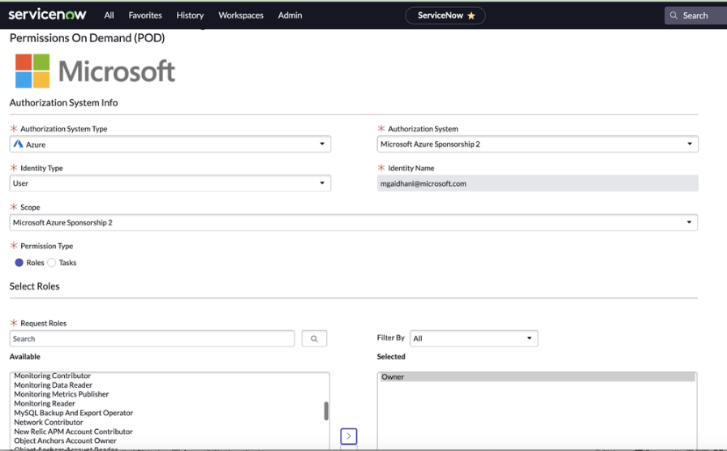
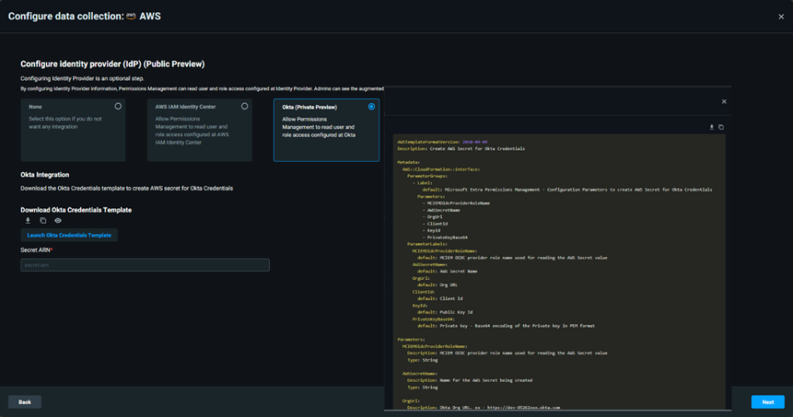
Security & Identity Updates
New Features of Microsoft Entra Permissions Management
Permissions Management app in the ServiceNow app store (Generally Available)
Users can now request time-bound, on-demand permissions for multicloud environments (Microsoft Azure, Amazon Web Services (AWS), and Google Cloud Platform (GCP)) via the ServiceNow portal. This integration will strengthen organizations’ Zero Trust posture by adding permission requests to existing approval workflows in ServiceNow, making it possible to enforce the principle of least privilege in multicloud environments
Integration with Microsoft Defender for Cloud (Public Preview)
MS Enhanced the cloud-native application protection program (CNAPP) by delivering basic permissions management insights through Microsoft Defender for Cloud. This integration strengthens the prevention of security breaches that can occur due to excessive permissions or misconfigurations in cloud environments. This enables organizations to implement the principle of least privilege for cloud resources and receive actionable recommendations for resolving permissions risks across Azure, AWS, and GCP.
Okta and AWS IAM Identity Center support
Permissions Management customers can now detect identities originating from Okta and AWS IAM Identity Center.

Slide 9
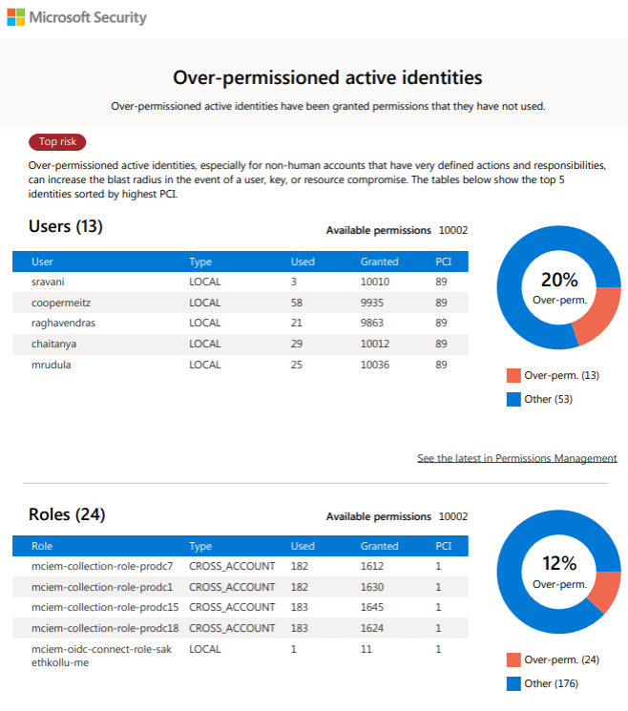
Security & Identity Updates
Permissions Analytic Report (Public Preview)
This report lists findings across identities and resources in Permissions Management. This report can be directly viewed on the Permissions Management page, downloaded in Excel format, and exported as a PDF. It’s available for all supported cloud environments, which include Microsoft Azure, AWS, and GCP.

Slide 10
Management & Governance

Slide 11
Management & Governance Updates
Windows Admin Center version 2311 is now generally available!
Azure Arc onboarding at-scale: MS extended the onboarding experience to All Connections page (the first page after sign-in)
Platform upgrade: In Windows Admin Center, every tool, every solution, and every experience that is built on Angular. MS upgrade it from Angular 11 to Angular 15.
UI updates: MS announced a series of UI updates to Windows Admin Center, bringing it closer to Azure Portal. Pivots have been redesigned, and typography improved with updated font sizes and semi-bold headings.
Tools update:
Improved virtual switches management for the virtual machines
MS updated the underlying logic to handle certain scenarios, improving the meaning and relevance of errors.
Errors and alerts were reviewed and approved
Azure Migrate
MS introduced a new experience in the Virtual Machines tool for assessing Hyper-V VMs for migration to Azure and generate both an assessment and business case
Public Preview Announcement: Azure VM Regional to Zonal Move
MS announced the public preview of single instance VM regional to zonal move, a new feature that allows to move an existing VM in a regional configuration (deployed without any infrastructure redundancy) to a zonal configuration (deployed into specific Azure availability zone) within the same region.
This feature is intended for single instance VMs in regional configurations only and not for VMs already in availability zones, or VMs part of an availability set (AvSet) or Virtual Machine Scale Sets (VMSS).
This feature also provides a built-in dependency analysis to identify the dependent resources of the VM (E.g.: VNET, Public IPs, NICs etc.) and makes the migration workflow much simpler.
Upon specifying the target zone number for the VM(s), a built-in dependency analysis is done to identify the dependent resources of the VM (E.g.: VNET, Public IPs, NICs etc.).
A copy of the source VM and disk is created in the specified availability zone (within the same region) and the source VM is shut down and configuration left intact, to ensure a seamless roll back and no data loss move. There will be a brief downtime of few minutes during the move process.
You can leverage the Single Instance VM Regional to Zonal Move capability through a variety of means including Azure Portal, Azure CLI, Azure PowerShell, and Azure SDKs.

Slide 12
Management & Governance Updates
Public Preview: IT Service Management Connector (ITSMC) is now certified with ServiceNow Vancouver version
MS is certifying IT Service Management Connector (ITSMC) on Vancouver version of ServiceNow.
Azure services like Log Analytics and Azure Monitor provide tools to detect, analyze and troubleshoot issues with your Azure and non-Azure resources to enable work item integration with IT Service Management products. The ITSM connector provides a bi-directional connection between Azure and ITSM tools to help track and resolve issues faster.
Announcing Preview of Run Command on Arc-enabled servers
MS announced the Public Preview of Run Command on Azure Arc-enabled servers. This feature is a game-changer for remotely and securely managing your Azure Arc-enabled servers. It allows to start using Azure CLI or API for Run Command, without requiring any additional extensions or configurations, and at no additional cost.
Run Command is built in the Connected Machine agent and supports not just the ability to run scripts but to centralize script management across creation, update, deletion, sequencing, and listing operations.
Experiences: Run Command is currently supported through Azure CLI and PowerShell.
Operating Systems: Run Command supports both Windows and Linux operating systems.
Environments: Run Command supports non-Azure environments including on-premises, VMware, SCVMM, AWS, GCP, and OCI.
Cost: Run Command is free of charge, however storage of scripts in Azure may incur billing.
Configuration: Run Command doesn't require more configuration or the deployment of any extensions. The Connected Machine agent version must be 1.37 or higher.

Slide 13
Management & Governance Updates
Public Preview of the Arc Visual Studio Code Extension
MS announced the public preview of the Arc VS Code Extension - a one-stop-shop for all developer needs. The Arc VS Code extension is a home for Enterprise and ISV developers alike. The features built into the extension can help accelerate development for both workloads that running on the Edge, as well as services that building to publish on the Azure Marketplace.
Public Preview for Azure Migrate ASP.NET Assessments & Business Case for Windows Containers
MS announced the public preview of ASP.NET Assessments and the Business Case features for Windows Containers on Azure Kubernetes Services (AKS) and App Service via Azure Migrate.
With these new features, Azure Migrate now provides the following for ASP.NET web apps:
Cloud readiness for AKS, and App Service
A recommended configuration of Node SKUs and Node count (or App Service plan)
The yearly cost savings by running these apps on Azure

Slide 14
Compute

Slide 15
Compute Updates
General Availability - Snapshots feature of Azure App Configuration
MS Announced General Availability of Snapshots in App Configuration. With Snapshots, App Configuration provides
Production Stability Assurance: Safeguard production configuration against unintended changes.
Efficient Rollbacks, minimal Downtime: Navigate through Configuration changes seamlessly by keeping last known good configuration quickly accessible.
Comprehensive Audit Trail: Delve into an in-depth history of Configuration changes and gain insights into your application's evolution.
Public preview: Intel TDX based confidential VMs now available in the Azure portal, Azure CLI and ARM templates
MS Announced the availability of the DCesv5 and ECesv5-series confidential virtual machines (VMs) in the Azure portal and via the CLI and ARM templates. These VMs are powered by 4th Gen Intel® Xeon® Scalable processors with Intel® Trust Domain Extensions (Intel® TDX) and enable organizations to bring confidential workloads to the cloud without code changes to applications.

Slide 16

Compute Updates
Announcing the release of Kubernetes v1.29: Mandala (The Universe), the last release of 2023!
Announcing the release of Kubernetes v1.29: Mandala (The Universe), the last release of 2023!
Similar to previous releases, the release of Kubernetes v1.29 introduces new stable, beta, and alpha features. The consistent delivery of top-notch releases underscores the strength of our development cycle and the vibrant support from our community.
This release consists of 49 enhancements. Of those enhancements, 11 have graduated to Stable, 19 are entering Beta and 19 have graduated to Alpha.

Slide 17
Databases

Slide 18
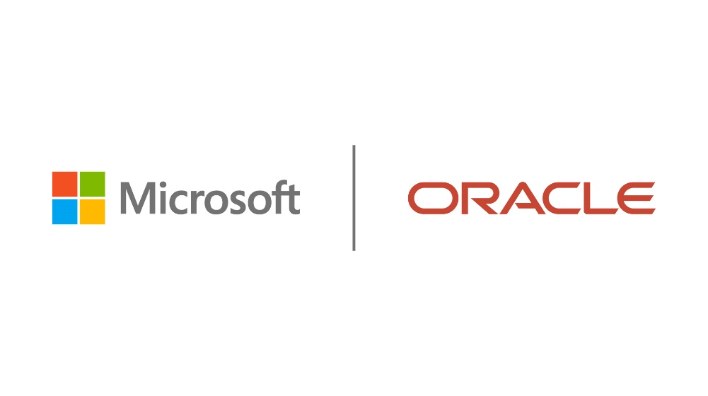
Databases Updates
Microsoft and Oracle announce that Oracle Database@Azure is now generally available
MS announced that Oracle Database@Azure is generally available in the Azure East United States region. It is now possible to use Oracle database services running on OCI hardware deployed in Azure data centers. This streamlines the migration of Oracle database workloads to Azure, where you can integrate and innovate with the breadth of Microsoft Cloud services like Azure AI and our application platform and developer services. You’ll be able to purchase this Oracle-managed service, running on OCI inside Azure datacenters, from the Azure Marketplace with the same features and pricing as Oracle Exadata cloud service on OCI. And, you can use your existing Azure and Oracle commitments, program benefits, and licenses to do so.
Exadata Database Service is the first service to be available along with support for Oracle Real Application Clusters (RAC), Oracle GoldenGate, and Oracle Data Guard technologies.

Slide 19
Integration

Slide 20
Integration Updates
Azure Event Grid releases public preview support for events from services like Microsoft Entra ID, Microsoft Outlook, and Microsoft Teams.
Using Azure Event Grid, allows to automate workflows in response to changes to a wide range of Microsoft resources. For example, if you are interested in providing additional access levels to an employee who changed roles, your application can receive Microsoft Entra ID’s user events notifying you about the changes in the employee’s position.
MS announced the public preview availability of events from Microsoft resources through the integration of Microsoft Graph API with Azure Event Grid. Among others, It is now possible to receive events about state changes in resources of Microsoft Entra ID (formerly Azure Active Directory), Microsoft Outlook, Microsoft Teams, OneDrive, and SharePoint. This set of event notifications enables to create solutions that react to changes as they happen and avoid wasting computer resources by constantly querying resources.

Slide 21
ML & AI & IOT

Slide 22
ML & AI & IOT Updates
Now Available: Models as a Service for Llama 2
Now Available: Models as a Service for Llama 2 : MS released Meta’s Llama 2 available in Models as a Service through Azure AI in public preview, enabling Llama-2-7b (Text Generation), Llama-2-7b-Chat (Chat Completion), Llama-2-13b (Text Generation), Llama-2-13b-Chat (Chat Completion), Llama-2-70b (Text Generation), and Llama-2-70b-Chat (Chat Completion).
Now Available: GPT-4 Turbo with Vision: MS announced that GPT-4 Turbo with Vision is now in public preview in Azure OpenAI Service and in Azure AI Studio. GPT-4 Turbo with Vision is a large multimodal model (LMM) developed by OpenAI that can analyze images and provide textual responses to questions about them. It incorporates both natural language processing and visual understanding. This integration allows Azure users to benefit from Azure's reliable cloud infrastructure and OpenAI's advanced AI research.
Now Available: Fine Tuning for GPT 3.5 Turbo and Other Models: fine-tuning will be generally available for models including Babbage-002, Davinci-002, GPT-35-Turbo. Developers and data scientists can now customize these Azure OpenAI Service models for specific tasks.
Expansion to the Azure AI Model Catalog
Phi-2
DeciLM
DeciDiffussion
DeciCoder
Orca 2
Mixtral 8x7b

Slide 23
Miscellaneous

Slide 24
Miscellaneous Updates
Announcing updates to Copilot for Microsoft 365 availability
MS announced that Copilot for Microsoft 365 will be available to purchase for faculty and staff with Microsoft 365 A3 and A5 licenses beginning January 1, 2024. Also, starting in early February 2024, Microsoft Copilot (formerly Bing Chat Enterprise) will be available for all faculty users and Higher Education students who are 18 years or older.
Copilot for Microsoft 365 will be generally available for Microsoft 365 A3 and A5 faculty for $30 per user per month with a 300-seat minimum per tenant.
Azure DevOps Server
The following versions of the products have been patched. Check out the links for each version for more details.
Azure DevOps Server 2022.1
Azure DevOps Server 2020.1.2
The updates includes:
Prevent setting requested for when queuing a pipeline run
Fixed a bug where pre deployment approval security inheritance was not working in pipelines stages.

Slide 25
Information

Slide 26
Information
Azure Times GitHub Repo

Slide 27
Questions

