Slide 1

Azure Times #
June 22, 2026

Slide 2

Networking

Slide 3
Networking Updates (Preview)
Public Preview: Route-Maps for Azure Route Server
Route maps for Azure Route Server are now available in public preview, providing fine-grained control over inbound and outbound routing across hybrid connections. Customers can manage routes advertised to and from Azure Route Server BGP peerings with Network Virtual Appliances (NVAs), ExpressRoute gateways, and VPN gateways in the same virtual network. Route-maps provide the following capabilities:
Route summarization: Summarize routes when on-premises networks connect to the virtual network through ExpressRoute or VPN.
Route control: Control routes entering and leaving Azure Route Server between on-premises networks, NVAs, and virtual networks.
Path selection: Modify BGP attributes such as AS-PATH to make routes more or less preferred.
Route tagging: Tag routes by using the BGP Community attribute.

Slide 4
Networking Updates (General Available)
Generally Available: HTTP header insertion in Azure Firewall
Azure Firewall now supports HTTP header insertion, enabling organizations to add or overwrite HTTP/HTTPS request headers directly from Azure Firewall application rules. This capability helps customers enforce security controls, support tenant restriction scenarios, integrate with backend services, and simplify application access management without relying on third-party proxies or on-premises infrastructure.
The feature is especially useful for scenarios such as Microsoft Entra tenant restrictions, Azure Virtual Desktop, VDI, SaaS access control, and enterprise egress filtering. By enabling header insertion natively in Azure Firewall, customers can reduce proxy dependencies, avoid routing traffic back on premises solely for header injection, and improve operational efficiency.
HTTP header insertion is supported in Azure Firewall Premium for HTTP traffic and HTTPS traffic decrypted using TLS Inspection. In Standard and Basic SKUs, it is supported for HTTP traffic. The feature can be configured through Azure Portal, Azure CLI, PowerShell, REST APIs, Terraform, and Azure Firewall Draft + Deploy.
Generally Available: NAT64 on StandardV2 NAT Gateway
StandardV2 NAT Gateway now supports NAT64, enabling IPv6 workloads to communicate with IPv4-only internet destinations by translating synthesized outbound IPv6 traffic into IPv4 traffic. NAT64 relies on a DNS64-capable resolver to synthesize IPv6 addresses by embedding the IPv4 address within the NAT64 Well-Known Prefix 64:ff9b::/96 – so client traffic is naturally addressed to NAT64 for translation.

Slide 5

Security & Identity

Slide 6
Security & Identity Updates (Preview)
Public Preview: Symmetric keys on Azure Key Vault Premium
Azure Key Vault Premium now supports hardware-protected symmetric keys in public preview, enabling organizations to manage AES-based encryption keys directly within Azure Key Vault using the new oct-HSM key type. Customers can perform encrypt, decrypt, wrap, and unwrap operations while benefiting from Azure's hardware-backed security, compliance, and centralized key management.
The preview introduces support for 256-bit AES keys, aligned with CNSA 2.0 recommendations, helping organizations prepare for future cryptographic and post-quantum security requirements. Symmetric keys integrate seamlessly with existing Azure security workflows, providing consistent governance, auditing, and lifecycle management across Azure services.
Currently, symmetric key management is available through Azure CLI and ARM templates, with Azure Portal support rolling out. This enhancement expands Azure Key Vault's cryptographic capabilities, allowing customers to centrally manage both asymmetric and symmetric keys within a single, enterprise-grade Hardware Security Module (HSM) platform.
Public Preview: Azure Enclave
Azure Enclave is now available in public preview for Microsoft Azure, Azure Government, Azure Government Secret, and Azure Government Top Secret. The service provides a managed foundation for deploying highly isolated cloud environments designed for government agencies and organizations operating sensitive or regulated workloads.
Azure Enclave simplifies the deployment of secure environments by providing predefined architectural patterns, managed infrastructure, and isolated virtual networking by default. Customers can establish secure connectivity using controlled endpoints, enforce role-based access control (RBAC), implement network segmentation, and apply centralized monitoring to protect critical applications and data.
This capability helps organizations accelerate the deployment of secure cloud environments while maintaining strict security, compliance, and isolation requirements. For government and regulated industries, Azure Enclave provides a standardized approach to building and managing sensitive workloads with reduced operational complexity and stronger governance.

Slide 7
Security & Identity Updates (General Available)
Now Generally Available: Built-in CIS Benchmark Auditing for Linux on Azure
Built-in CIS Benchmark auditing for Linux is now generally available on Azure, enabling organizations to continuously assess Linux virtual machines against the Center for Internet Security (CIS) Benchmarks without deploying third-party assessment tools. The capability provides automated security configuration checks to help identify deviations from industry-recognized hardening standards.
The service evaluates Linux systems against CIS recommendations and surfaces compliance results, failed controls, and remediation guidance through Azure's native management and security experience. This allows security and operations teams to continuously monitor security baselines, simplify compliance reporting, and quickly identify configuration drift across their Linux estate.
For enterprises running Linux workloads on Azure, built-in CIS auditing reduces operational overhead, strengthens security governance, and helps demonstrate compliance with internal policies and regulatory requirements. It also supports standardized Linux hardening by integrating security assessments directly into Azure's native management and monitoring ecosystem.

Slide 8

Management &
Governance

Slide 9
Management & Governance Updates (Preview)
Public Preview: Azure Monitor Logs mirroring into Microsoft Fabric
Azure Monitor now supports sharing Log Analytics telemetry directly with Microsoft Fabric, making observability data available in OneLake as Delta Parquet without duplicating data and with near real-time synchronization. The integration supports all Azure Monitor log tiers, including Analytics, Basic, and Auxiliary, enabling organizations to analyze operational telemetry using Microsoft Fabric services such as Eventhouse, Power BI, and Spark.
By combining Azure Monitor logs with business data from systems like ERP, CRM, and other enterprise applications, organizations can correlate operational events with business outcomes, enabling richer cross-domain analytics and faster decision-making. The open Delta Parquet format also supports advanced analytics, machine learning, long-term trend analysis, and enterprise reporting using the broader Microsoft Fabric ecosystem.
This integration strengthens the connection between IT operations and business intelligence, allowing organizations to perform unified analytics across operational telemetry and enterprise data while reducing data duplication and simplifying observability architectures.

Slide 10
Management & Governance Updates (General Available)
Generally Available: Single-click purchase for public SaaS offers
Eligible SaaS products on Microsoft Marketplace now support a simplified purchase experience in Azure portal. Customers can review plan, billing, resource group, contact details, and terms information on a single page for completing the purchase. This experience isn’t currently supported for SaaS offers that use a custom purchasing experience
Generally Available: Microsoft Azure now available from new cloud region in India (India South Central)
Microsoft announces the opening of its fourth datacenter region in India, India South Central, with campuses in Hyderabad, Telangana. The region will provide customers with local, secure, state-of-the-art cloud infrastructure designed with AI readiness as a key focus. It supports growing demand for cloud and AI services, customer digital transformation, local data residency, improved latency, and resilient cloud capacity in India.

Slide 11
Management & Governance Updates (General Available)
Announcing: Reservation exchanges for Azure services supported by savings plans will no longer be available starting February 1, 2027
Starting February 1, 2027, Azure reservations exchanges will no longer be available for services covered by savings plans. At the time of this announcement, this includes reservations for the following services:
Compute services: Azure Virtual Machines, including exchanges between non-premium and premium storage, Azure Dedicated Host, and Azure App Service.
Database services: Azure Database for PostgreSQL, Azure Database for MySQL, Azure DocumentDB, Azure Cosmos DB, Azure SQL Database, and Azure SQL Managed Instance.
Each active reservation for impacted services purchased before February 1, 2027, will retain the right to one final exchange after that date.
This reservation exchange policy update excludes products or services that are deprecated and approaching end of life, as well as cloud environments that don’t currently support savings plans.
As savings plans coverage expands, reservations for those services will follow this policy and will not support exchanges.

Slide 12

Compute

Slide 13
Compute Updates (Preview)
Public Preview: Maximum allowed failures for update runs in Azure Kubernetes Fleet Manager
In fail-fast update rollouts, a small number of member cluster update failures can halt progress across a broader update deployment. Maximum Allowed Failures for update runs in Azure Kubernetes Fleet Manager, now available in preview, introduces an optional setting that allows update runs to continue when some member cluster updates fail.
Customers can define failure thresholds at either the stage or group level using fixed counts or percentages. This gives platform teams more control over the balance between rollout correctness and continued update progress, enabling more flexible and failure-tolerant update strategies across fleet-managed clusters.
Public Preview: Prepared Image Specification
Organizations running large-scale, AI, GPU, Windows, and other performance-sensitive workloads on AKS often experience longer node startup times because new nodes must repeatedly download container images and perform initialization tasks before workloads can run.
With AKS Prepared Image Specification, now in preview, customers can create preconfigured node images that include required container images and customizations ahead of time, enabling new nodes to start in a ready-to-run state. This helps workloads achieve faster and more predictable scaling, reduce application startup latency, and improve operational efficiency during growth and burst traffic events.

Slide 14
Compute Updates (General Available)
Generally Available: Application Routing with Gateway API
Managing ingress routing while adopting newer Kubernetes standards can require balancing modernization efforts with existing deployments. Application Routing with Gateway API is now generally available on AKS, bringing the Kubernetes Gateway API to ingress management without requiring a service mesh.
Existing ingress-nginx-based Application Routing remains supported until November, and customers can migrate to the Gateway API-based model at their own pace using the open-source ingress2gateway tool. This enables technical practitioners to adopt a standardized routing model while maintaining a lightweight footprint and supporting a gradual transition from existing ingress configurations.
Generally Available: Resource placement in Azure Kubernetes Fleet Manager
Managing Kubernetes resources across multiple clusters can require significant manual effort to apply updates and maintain consistency. Resource placement in Azure Kubernetes Fleet Manager is now generally available and enables platform and application teams to consistently distribute Kubernetes resources across multiple AKS and Arc-enabled clusters.
This release includes the Resource Placement Kubernetes APIs in v1 and introduces a new Azure portal experience for creating, viewing, and managing placements across a fleet. By using placement policies that select target member clusters based on labels and properties, teams can reduce the effort and risk associated with applying, updating, and tracking resources on a cluster-by-cluster basis.

Slide 15
Compute Updates (General Available)
Generally Available: Azure Automation supports PowerShell 7.6 runbooks and Runtime environment
Azure Automation is pleased to announce: General Availability of in-support PowerShell 7.6 runbooks
Runtime Environment GA, enabling customers to seamlessly upgrade their outdated scripts to supported runtime versions.
Support for Azure CLI commands in PowerShell 7.6 runbooks GA
Benefits:
Stay current – Access to new language versions for improved security and performance.
Faster Runbook upgrade – Easy portability of runbooks across different versions to keep pace with PowerShell and Python releases.
Granular control – Complete control to configure the script execution environment, without worrying about conflicting module versions.
Efficient Code organization – Eliminate the need to create multiple Automation accounts to segregate different versions of modules or conflicting modules.

Slide 16

Storage & Data

Slide 17
Storage & Data Updates (Preview)
Public Preview: Support for SMB Opportunistic Locking (Oplocks) configuration
Azure NetApp Files now supports configuration of SMB opportunistic locking (oplocks) for SMB and dual-protocol volumes. Opportunistic locks (Oplocks) improve SMB client caching and are enabled by default.
It is possible to configure oplocks on new volumes or update the setting on existing volumes. System default is the default selection and enables opportunistic locks on the volume. A cross-region replication destination volume can use an oplock setting independent of its source volume.

Slide 18

Databases

Slide 19
Databases Updates (Preview)
Public Preview: Azure SQL updates for late-July
In late-July 2026, the following update and enhancement was made to Azure SQL:
Regex-based dynamic data masking (DDM) extends the built-in DDM feature with pattern‑based masking to hide sensitive data like emails, phone numbers, and identifiers—centrally enforced at the database layer.

Slide 20
Databases Updates (General Available)
Generally Available: Azure Database for PostgreSQL flexible server in India South Central
Now it is possible to deploy Azure Database for PostgreSQL flexible server in the India South Central Azure region.

Slide 21
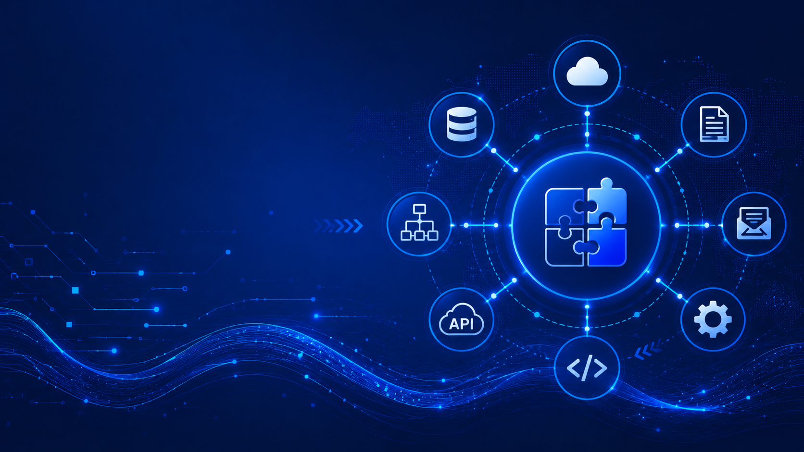
Integration

Slide 22
Integration Updates (Preview)
Public Preview: AI Gateway in Azure API Management
Microsoft has introduced the AI Gateway tier for Azure API Management (APIM), providing a dedicated gateway designed specifically for AI workloads. Built on the Azure API Management platform, AI Gateway enables organizations to centrally expose, secure, and govern AI models, Model Context Protocol (MCP) servers, and AI tools using consistent enterprise controls.
The new tier offers a unified experience for managing AI assets with built-in authentication, policy enforcement, OpenTelemetry-based observability, security, and operational governance. It supports AI models hosted on Microsoft Foundry, as well as external providers including OpenAI, Anthropic, AWS Bedrock, and Google Vertex AI. AI Gateway also enables organizations to publish MCP servers created from existing backends, OpenAPI definitions, or connectors.
For enterprises adopting generative AI at scale, AI Gateway provides a centralized control plane for AI services, helping platform teams standardize security, monitoring, and access management across multiple AI providers. This simplifies AI operations while enabling consistent governance and reducing integration complexity across enterprise AI ecosystems.

Slide 23

ML & AI & IOT

Slide 24
ML & AI & IOT Updates (General Available)
Introducing Kimi K3 through Fireworks AI on Microsoft Foundry
Kimi K3 is now available in Microsoft Foundry through Fireworks AI, expanding Foundry's growing catalog of enterprise AI models. The model is designed for advanced reasoning, coding, long-context understanding, and AI agent scenarios, enabling developers to build sophisticated generative AI applications using a managed deployment platform.
By accessing Kimi K3 through Fireworks AI in Microsoft Foundry, organizations can rapidly deploy and scale the model while benefiting from Foundry's built-in capabilities for model management, governance, evaluation, observability, and enterprise security. The integration allows developers to use Kimi K3 alongside other leading foundation models within the same AI development environment.
The addition of Kimi K3 further strengthens Foundry's multi-model AI ecosystem, giving customers greater flexibility to select the most appropriate model for coding assistants, enterprise agents, retrieval-augmented generation (RAG), and complex reasoning workloads. This reinforces Microsoft's strategy of making Foundry a unified platform for developing and operating enterprise-grade AI solutions regardless of the underlying model provider.
Azure Sphere OS version 26.09 RC1 is now available for evaluation
Microsoft has released Azure Sphere OS 26.09 RC1 for evaluation, giving developers and device manufacturers early access to upcoming operating system improvements before the general availability release. The release candidate enables organizations to validate applications, hardware compatibility, and deployment processes in advance, helping ensure a smooth transition to the next Azure Sphere OS version.
The update includes the latest security patches, reliability improvements, bug fixes, and platform enhancements across the Azure Sphere ecosystem. Customers are encouraged to test their IoT devices and applications with the new release to identify any compatibility issues before production rollout.
For organizations using Azure Sphere to secure connected devices, evaluating the RC1 release helps reduce deployment risk, maintain device security, and prepare for future production updates. This continues Microsoft's commitment to delivering a secure, continuously updated platform for Internet of Things (IoT) solutions.

Slide 25
DevOps & IaC & Automation (Preview)
Terraform AzureRM provider 5.0 now generally available
Terraform AzureRM Provider 5.0 is now generally available, introducing the next major release of the provider used to provision and manage Azure resources with Terraform. The release includes new Azure service support, enhanced resource capabilities, and a number of breaking changes aimed at improving consistency, performance, and alignment with the latest Azure Resource Manager APIs.
Version 5.0 expands support for newer Azure services and features while refining existing resource definitions and deprecating legacy behaviors. Organizations adopting the new version should review the upgrade guidance, as some resource schemas and provider settings have changed and may require updates to existing Infrastructure-as-Code deployments.
For platform engineering teams, AzureRM Provider 5.0 provides a more modern and consistent foundation for automating Azure infrastructure. Upgrading enables access to the latest Azure capabilities while helping standardize Terraform deployments and maintain long-term compatibility with Microsoft's evolving cloud platform.

Slide 26

Information

Slide 27
Information
Azure Times GitHub Repo

Slide 28

Questions

