Slide 1
Azure Times #152
February 24, 2025

Slide 2
Management & Governance

Slide 3
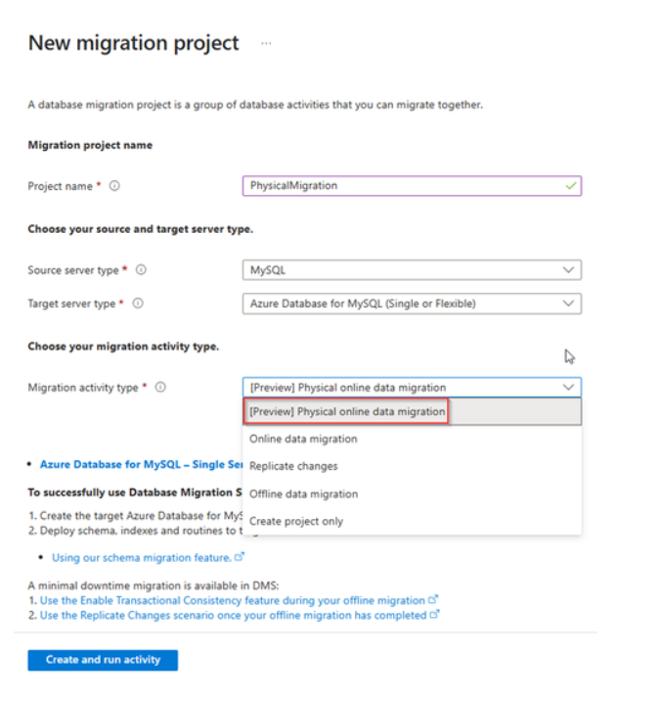
Management & Governance Updates
Public Preview announcement - Unified migration experience in Azure DMS
MS announced that Azure Database Migration Service (DMS) now supports seamless migration of MySQL on-premises or Virtual Machine (VM) workloads to Azure Database for MySQL - Flexible Server. This new feature, now available in public preview, allows to use physical backup files of the MySQL server for migration.
By restoring physical data files directly to target Flexible Server, it is possible to migrate multi-terabyte workloads quickly and effortlessly with minimal downtime ensuring a smooth and efficient transition to Azure Database for MySQL - Flexible Server, enabling to take full advantage of the platform's capabilities.
To migrate workloads using the Physical Online Data Migration option in Azure DMS, take backups of workload on the source server using Percona Xtrabackup utility. After taking a backup, upload the backup files to Azure Blob Storage. DMS can read the uploaded backup files from Azure Blob Storage and apply them on the target flexible server for rapid movement of large workloads to MySQL flexible server.

Slide 4
Management & Governance Updates
Public Preview: Azure Migrate Supports Premium SSD v2 Disks
Azure Migrate now supports migration to Premium SSD v2 disks, providing with advanced disk options that offer greater flexibility and enhanced performance.
These disks are ideal for mission-critical applications that require high IOPS & throughput, low latency, scalability, reliability, and competitive pricing compared to their predecessors. During assessments in regions where Premium SSD v2 disks are available, Azure Migrate will recommend them as a target for data disks, ensuring a migration experience that is on par with other disks supported by Azure Migrate.
Log Analytics Agent-based Azure Management Services: Shut down starting 28 February 2025
Azure Automation Update Management and Azure Change Tracking & Inventory solutions will be completely shut down starting 28th February 2025.
Both solution Azure Automation Update Management & Azure Change Tracking & Inventory will not be available.
For Azure Automation Update Management, no new periodic assessments or patching data corresponding to configured machines will be populated.
For Change Tracking & Inventory with LA agent, no new changes or inventory logs will be captured.
Note: Historical data for the last 30 days will continue to be available in LA workspace and can be directly queried from the LA tables
Azure Change Tracking & Inventory with LA agent:
Move to Change Tracking & Inventory with AMA
Move to FIM with MDE (part of Defender for Servers Plan 2)
Azure Automation Update Management
Migrate to Azure Update Manager

Slide 5
Management & Governance Updates
GA: Azure Site Recovery Pricing Calculator for Azure to Azure Managed Disks
MS announced the availability of the Azure Site Recovery (ASR) Pricing calculator.
This new tool helps organizations estimate the total cost of ownership (TCO) for Azure-to-Azure ASR scenarios. The calculator's goal is to achieve detailed cost breakdown to provide customers the clarity on ASR pricing and better financial planning helping ASR users align with their respective Financial Operations teams.
This release is only for Azure-to-Azure scenario.

Slide 6
Compute

Slide 7

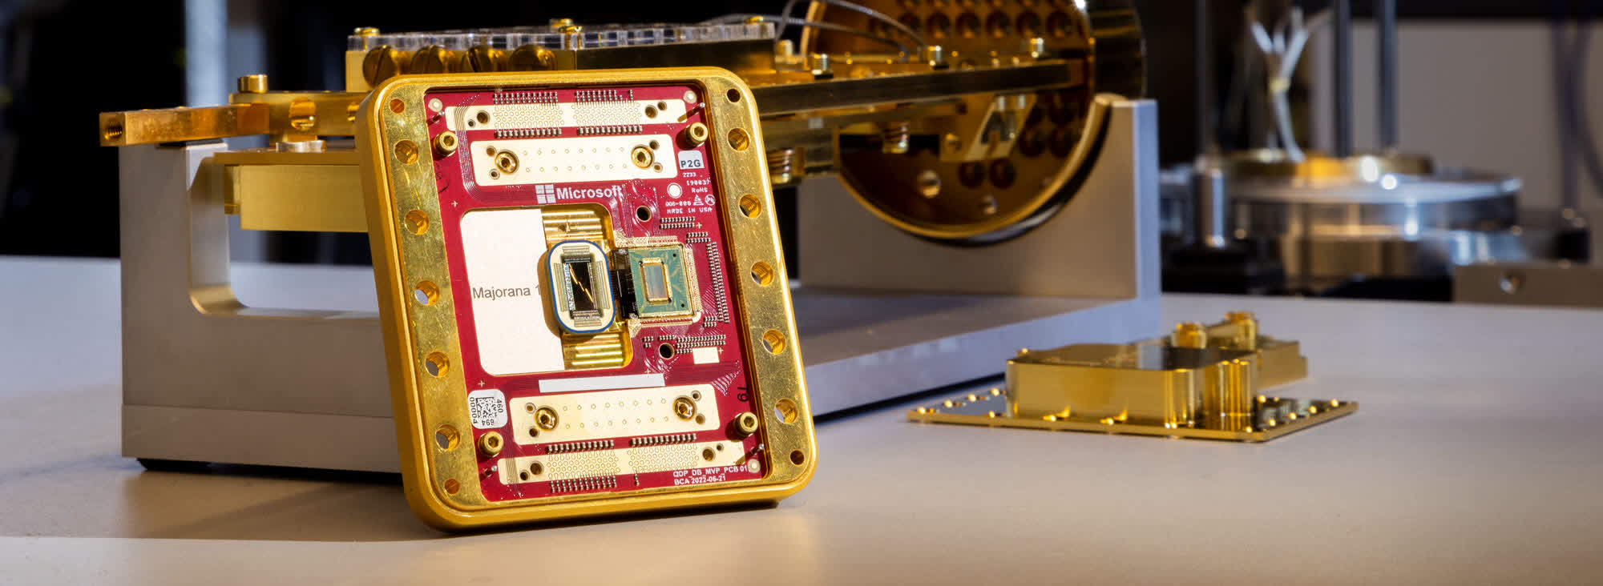
Compute Updates
General Available: 6th generation Intel-based VMs – Dv6 / Ev6
MS announced the general availability of the D and E family VMs built on the new 5th Gen Intel® Xeon® Platinum 8537C (Emerald Rapids) processor.
These VMs will offer:
Up to 27% higher vCPU performance and 3x larger L3 cache than the previous generation Intel Dl/D/Ev5 VMs
Up to 192vCPU and >18TiB of memory
Azure Boost which enables:
Up to 400k IOPS and 12 GB/s remote storage throughput
Up to 200 Gbps VM network bandwidth
46% larger local SSD capacity and >3X read IOPS
NVMe interface for local and remote disks
Enhanced security through Total Memory Encryption (TME) technology
Microsoft unveils Majorana 1, the world’s first quantum processor powered by topological qubits
Microsoft has unveiled a new quantum chip called "Majorana 1" that claims will make scaled, real-world quantum computing a reality in just years rather than decades. It's palm-sized and has a delightfully retro look yet Microsoft claims it will eventually pack more theoretical computing power than all the world's current classical computers combined.
The Majorana 1 comes after nearly two decades of research. The big claims come thanks to Microsoft's unique approach to the quantum problem. Scientists at the company have engineered a first-of-its-kind "topoconductor" material that they say exploits an exotic "topological" state of matter, bridging the gap between quantum physics and practical engineering.
Microsoft adds that this topological state enables smaller, faster, and more stable quantum bits (qubits).

Slide 8
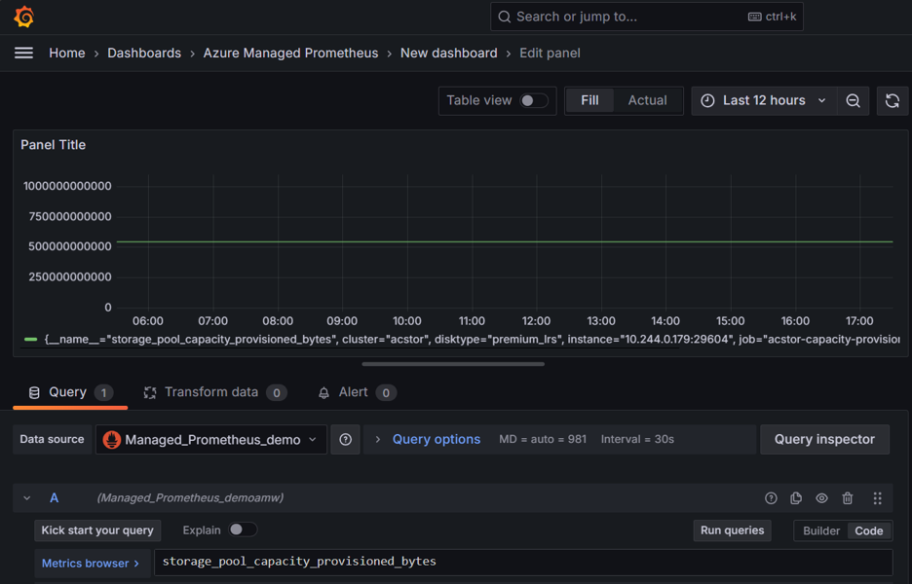
Compute Updates
Node 22 now available on Azure App Service
MS announced that App Service now supports apps targeting Node 22 across all public regions on Linux App Service Plans.
Public Preview: Azure Container Storage on managed Prometheus
Azure Container Storage is a cloud-based volume management, deployment and orchestration service and works with Azure Kubernetes Service (AKS) to effectively scale across storage services while providing a cost-effective, container-native experience.
Customers using Azure Container Storage (ACStor) on AKS clusters can now collect storage pool and disk metrics with Azure Managed Prometheus and view/query metrics in Azure Managed Grafana.
When customers enable ACStor on an AKS cluster where Managed Prometheus is enabled, metrics will be automatically collected and ingested along with other metrics.

Slide 9
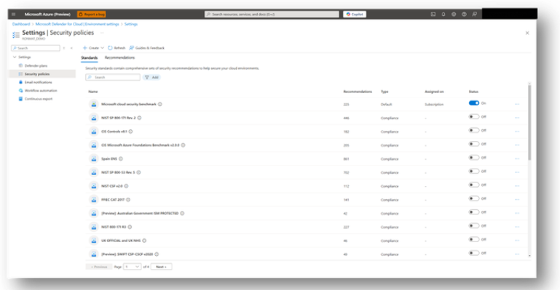
Compute Updates
New regulatory compliance frameworks for multicloud environments now available in public preview
Unified compliance posture assessments actualized to the latest versions with parity across Azure, AWS, and GCP. New regulatory compliance standards include:
E.U. Network and Information Security Directive 2 (NIS2)
CIS GCP Foundations v3.0
U.S. Criminal Justice Information Services (CJIS) Security Policy, Version 5.9.5
U.S. Federal Financial Institutions Examination Council Cybersecurity Assessment Tool (FFIEC CAT)
U.K. National Cyber Security Centre (NCSC) Cyber Essentials v3.1
U.K. National Cyber Security Centre (NCSC) Cyber Assurance Framework (CAF) v3.2
GA: Azure Functions Support for Java 21 LTS
Azure Functions support for Java 21 is now generally available.
It is now possible to develop apps using Java 21 locally and deploy them to all Azure Functions plans on Linux and Windows.

Slide 10
Storage & Data

Slide 11
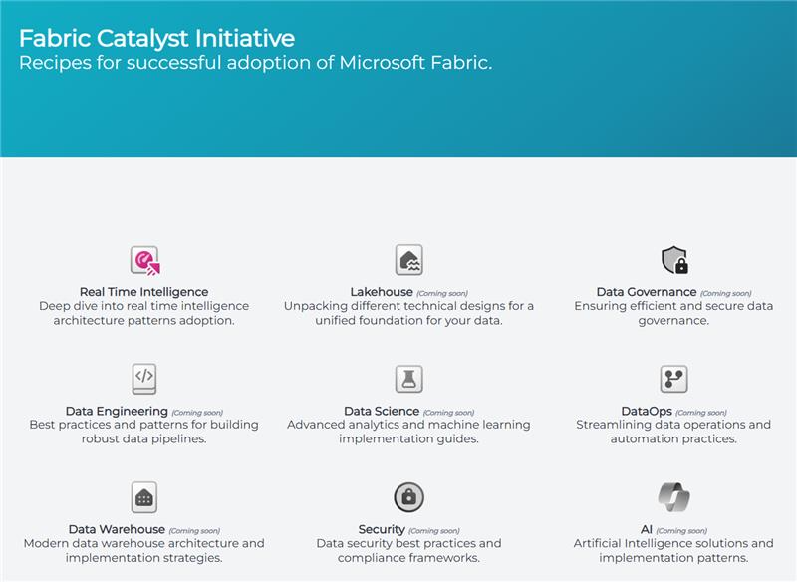
Storage & Data Updates
Fabric Catalyst Portal
Fabric Catalyst is a collaborative knowledge hub aimed at scaling technical expertise and providing partners with the right resources to drive high-impact solutions with Fabric. This initiative is backed by the Fabric engineering teams and Partner Solution Architects (PSAs), ensuring that partners have access to proven methodologies, architecture designs, demos, POC accelerators, and customer success stories.
GA: Azure Ultra Disk Storage is Now Available in New Zealand North
Azure Ultra Disk Storage is now available in New Zealand North. Azure Ultra Disk Storage offers high throughput, high IOPS, and consistent low latency disk storage for Azure virtual machines (VMs). Ultra Disk Storage is suited for data-intensive workloads such as SAP HANA, top-tier databases, and transaction-heavy workloads.

Slide 12
Databases

Slide 13
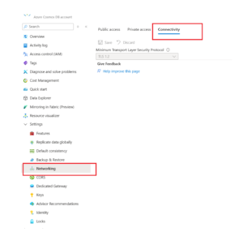
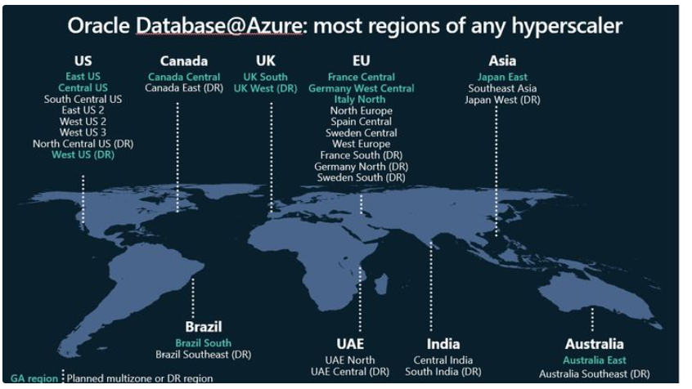
Databases Updates
Moving to TLS 1.2 for Azure Cosmos DB: Ensuring Secure Connections
Starting August 31, 2025, all Azure Cosmos DB database accounts must use TLS 1.2 or higher. Support for TLS 1.0 and 1.1 will be discontinued, ensuring that all data transmissions are secured with the latest encryption standards.
Announcing Oracle Database@Azure in Japan East, Central US and UK West
Microsoft and Oracle announced the expansion of Oracle Database@Azure availability to Japan East, Central US and UK West regions.
Oracle Database@Azure is now available in 12 regions globally – Australia East, Brazil South, Canada Central, East US, Central US, France Central, Germany West Central, Italy North, Japan East, UK South, UK West and West US.
By the end of 2025, the service will expand to 20 additional regions, enhancing scalability and resilience worldwide.

Slide 14
ML & AI & IOT

Slide 15
ML & AI & IOT Updates
Introducing Azure AI Foundry Labs
MS Launched the Azure AI Foundry Labs, a hub for developers, startups, and enterprises to explore groundbreaking innovations from research at Microsoft. Projects across models and agentic frameworks include:
Aurora: A large-scale atmospheric model providing high-resolution weather forecasts and air pollution predictions, outperforming traditional tools.
ExACT: An open-source project enabling agents to learn from past interactions and improve search efficiency dynamically.
Magentic-One: A multi-agent system solving complex problems by orchestrating multiple agents, built on the AutoGen framework.
MatterSim: A deep learning model for atomistic simulations, predicting material properties with high precision.
OmniParser v2: A vision-based module converting UI screenshots into structured elements, enhancing agents’ action generation.
TamGen: A generative AI model for drug design, using a GPT-like chemical language model for target-aware molecule generation and refinement.
https://ai.azure.com/labs

Slide 16
DevOps & IaC & Automation

Slide 17
DevOps & IaC & Automation
Announcing the Azure SDK for Rust Beta.
MS announced the first beta releases for the Official Azure SDK for Rust! These releases include libraries for Identity, Key Vault secrets & keys, Event Hubs, and Cosmos DB. These libraries are designed to provide a seamless and idiomatic experience for Rust developers working with Azure services.

Slide 18
Information

Slide 19
Information
Azure Times GitHub Repo

Slide 20
Questions

