Slide 1
Azure Times #151
February 17, 2025

Slide 2
Networking

Slide 3
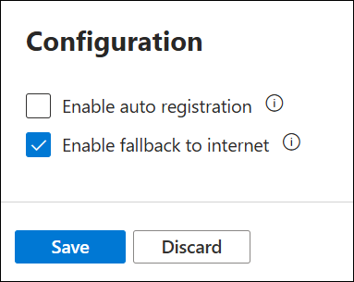
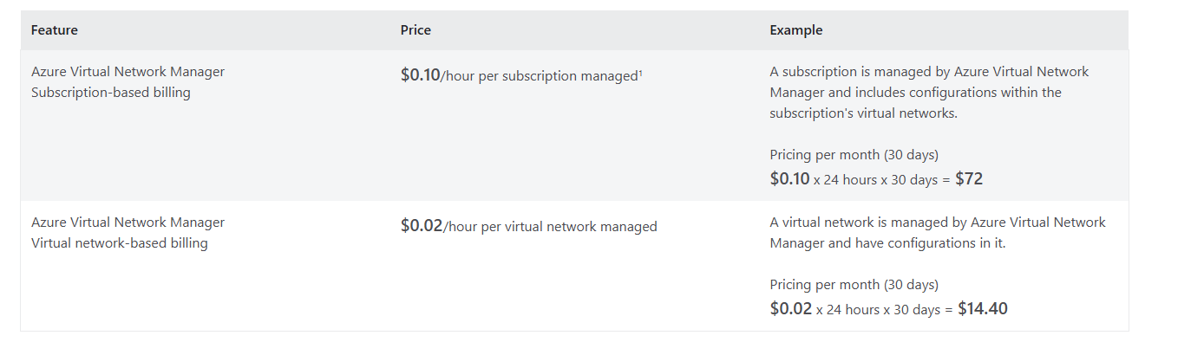
Networking Updates
GA: Fallback to internet for Azure Private DNS zones
Fallback to internet in Azure Private DNS is a fully managed native solution. This property enables public recursion via Azure’s recursive resolver fleet when an authoritative NXDOMAIN response is received for a private link zone. This Resolution policy is enabled at the virtual network link level. In the Azure portal, this resolution policy property is enabled by selecting Enable fallback to internet in virtual network link configuration.
GA: Azure Virtual Network Manager new pricing
Starting February 11, 2025, all newly created Azure Virtual Network Manager instances will incur charges based on the number of virtual networks where an active Azure Virtual Network Manager configuration is deployed, replacing the subscription-based pricing. These charges apply only with Azure Virtual Network Manager’s configuration features, such as connectivity, security admin, and routing. This virtual network-based pricing is closely aligned to usage of Azure Virtual Network Manager, offering a more flexible approach for a wider range of customers.
Existing Azure Virtual Network Manager instances can be switched from subscription-based pricing to this virtual network-based pricing. No pricing changes will be automatically applied to existing Azure Virtual Network Manager instances until February 2028, allowing to maintain current billing structure without immediate changes.

Slide 4
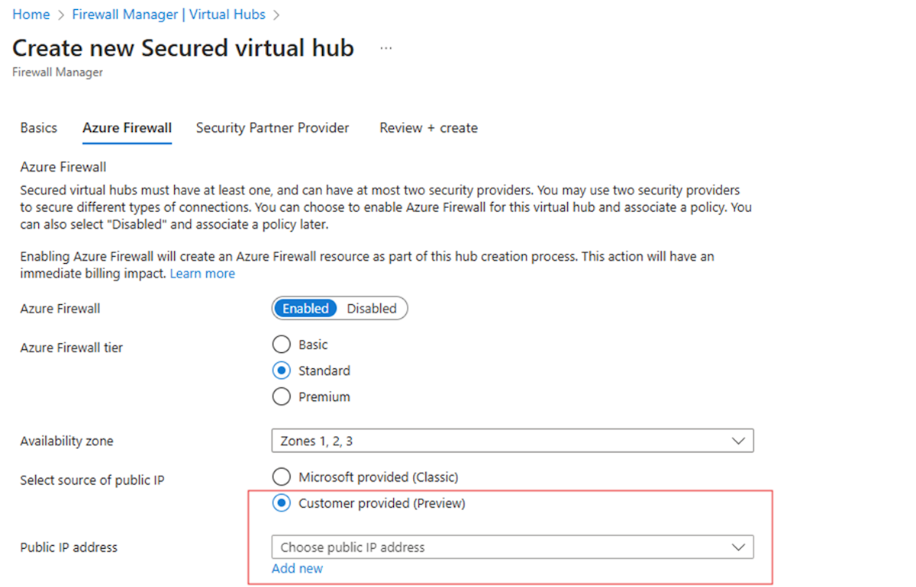
Networking Updates
GA: Azure Firewall IP Groups Limits
Increased IP Group Limits: MS doubled the IP Group limit in Azure Firewall policies from 100 to 200 per policy.
Key benefits:
Better policy organization – Manage more IP addresses within firewall policies.
Greater flexibility – Optimize configurations for complex network security needs.
PP: Azure Firewall Updates – BYOIP support for Secure Hub
Virtual WAN hub deployments can now associate customer tenant public IP addresses with secured hub Azure Firewalls.
The capability is available only to new deployments of secured hub Firewalls. For existing secured virtual WAN hubs, delete the hub firewall and redeploy a new Firewall during scheduled maintenance hours.

Slide 5
Security & Identity

Slide 6
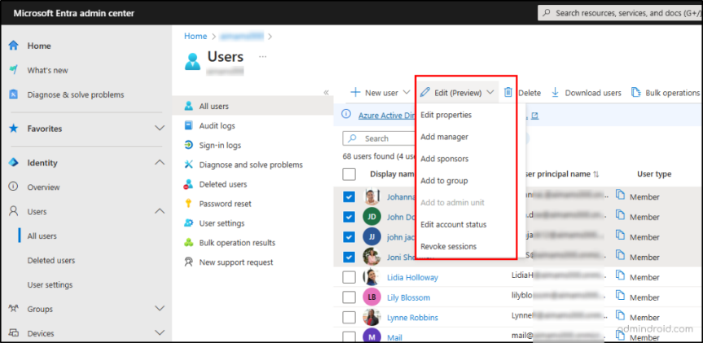
Security & Identity Updates
New bulk edit features for users in Microsoft Entra ID
New functionality has been added to the Microsoft Entra admin portal which enables admins to perform bulk edits to existing users.

Slide 7
Management & Governance

Slide 8
Management & Governance Updates
GA: The Modern Version of the Azure Storage Data Movement Library
This update simplifies data movement experience when storing data in Azure Blob and Azure File Storage. The enhanced functionality includes the ability to track transfer progress, pause and resume transfers, and checkpointing.
General Availability: Monitoring and Logging for Azure Managed HSM in Azure Portal
MS announced the general availability of Azure Monitor with Azure Managed HSM in the Azure portal. The enhanced Azure Managed HSM portal experience will allow get visibility into HSM environments more easily and proactively identify issues and get notified.
For each managed HSM view the following metrics are available:
Overall service API latency
Overall service availability
Total service API hits

Slide 9
Compute

Slide 10
Compute Updates
General Available: 6th generation Intel-based VMs – Dv6 / Ev6
MS announced the general availability of the D and E family VMs built on the new 5th Gen Intel® Xeon® Platinum 8537C (Emerald Rapids) processor.
These VMs will offer:
Up to 27% higher vCPU performance and 3x larger L3 cache than the previous generation Intel Dl/D/Ev5 VMs
Up to 192vCPU and >18TiB of memory
Azure Boost which enables:
Up to 400k IOPS and 12 GB/s remote storage throughput
Up to 200 Gbps VM network bandwidth
46% larger local SSD capacity and >3X read IOPS
NVMe interface for local and remote disks
Enhanced security through Total Memory Encryption (TME) technology
PP: Upgrade Existing Azure Gen 1 VMs to Gen 2
Azure Virtual Machines supports upgrading Generation 1 virtual machines (VM) to Generation 2 by upgrading to the Trusted launch security type.
Trusted launch is a way to enable foundational compute security on Azure Generation 2 VMs and protects against advanced and persistent attack techniques like boot kits and rootkits. It does so by combining infrastructure technologies like Secure Boot, virtual Trusted Platform Module (vTPM), and boot integrity monitoring on VM.
NOTE: It will not be possible to extend Windows OS disk system volume after MBR to GPT conversion. Recommendation is to extend system volume for future before executing the upgrade.
Get-AzVM -ResourceGroupName myResourceGroup -VMName myVm | Update-AzVM -SecurityType TrustedLaunch -EnableSecureBoot $true -EnableVtpm $true

Slide 11
Compute Updates
New ADX Dashboards Customization Features
MS introduced new dashboard customization features to enhance control, usability, and performance. From managing data series visibility to improving navigation and map behavior, these updates help create a clearer, more efficient dashboard experience.
Legend Number Configuration
Adjustable Panel Width
Crosshair Tooltip Number Configuration
Map Centering Configuration

Slide 12
Storage & Data

Slide 13
Storage & Data Updates
GA: Azure Premium SSD V2 Disk is now available in the New Zeeland.
Azure Premium SSD v2 Disk Storage is now available in New Zealand North region. This next-generation storage solution offers advanced general-purpose block storage with the best price performance, delivering sub-millisecond disk latencies for demanding IO-intensive workloads at a low cost. It is well-suited for a wide range of enterprise production workloads, including SQL Server, Oracle, MariaDB, SAP, Cassandra, MongoDB, big data analytics, gaming on virtual machines, and stateful containers.
Announcing billing for Workspace monitoring
Workspace Monitoring, is an observability feature within Fabric that enables monitoring capabilities across two key areas:
Logging: gain insights into system events and actions.
Performance metrics: get insights on performance metrics and queries in Fabric.
Workspace monitoring allows Fabric developers and admins to access detailed logs and performance metrics for their workspaces. This helps troubleshoot performance issues, investigate errors, optimize queries, and minimize data downtime.
MS announced an activation of billing for this feature that will commence on March 10, 2025, please read on for more details on billing.

Slide 14
Databases

Slide 15
Databases Updates
General availability: Discover of PostgreSQL Installed on Azure Arc-Enabled Servers
MS announced that Azure Arc-enabled servers now have the capability to automatically identify PostgreSQL installations. This new feature allows to use Azure-based management for overseeing servers running PostgreSQL at-scale. It allows effortlessly find, group, and view all servers running PostgreSQL from a single, easy-to-use interface.
PP: Virtual Canary Maintenance Program
MS introduced the Virtual Canary maintenance program, a new initiative designed to provide with early access to Azure Database for MySQL maintenance updates. This program empowers to stay ahead by testing workloads against new features and updates before they are broadly rolled out. With Virtual Canary, you can ensure compatibility, identify opportunities for optimization, and contribute valuable feedback to shape the future of Azure MySQL.

Slide 16
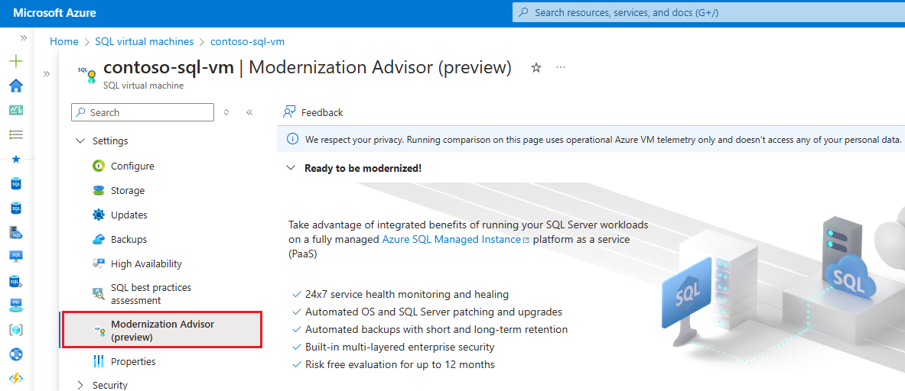
Databases Updates
Public Preview: Azure SQL Updates For Mid-February 2025
MS announced the latest improvement in the Azure SQL Database conversion process to Hyperscale
Shorter cutover time - cutover time has been reduced from ~6 minutes to less than ~1 minute.
Support for higher log generation rate - MS now support up to 50 MiBps log generation on source instead of 8 MiBps
Manual cutover – Allows to initiate the conversion process and pause it when the database is ready to cutover to Hyperscale. It give up to 72 hours to perform the cutover. If the manual cutover is not completed within the given timeframe, the process is automatically canceled, and the database remains on the original service tier, without any data loss.
Granular progress reporting - customers can monitor the entire conversion process at a granular level
Public Preview: Modernization Advisor for SQL Server on Azure Virtual Machines
Modernization Advisor helps modernize SQL Server on Azure Virtual Machines workloads using fully managed PaaS by identifying suitable configurations and price points of Azure SQL Managed Instance. Modernizing with Azure SQL Managed Instance helps realize benefits that impact total cost of ownership, from built-in high availability of up to 99.995% to automated updates, backups, and enterprise grade security.

Slide 17
Databases Updates
GA: Azure Database for PosgreSQL pg_signal_autovaccum_worker role
It is now possible to use the pg_signal_autovacuum_worker role backported from PostgreSQL version 18 with Azure Database for PostgreSQL Flexible Server versions 15 and later. The autovacuum process, once it is triggered, blocks the execution of DDL statements until the time it gets executed. This role allows to cancel the autovacuum process that gets triggered as part of maintenance activity on the PostgreSQL server using pg_terminate_backend()/pg_cancel_backend() statements. This is a significant improvement as it allows users with non-superuser privileges to cancel the autovacuum process.

Slide 18
DevOps & IaC & Automation

Slide 19
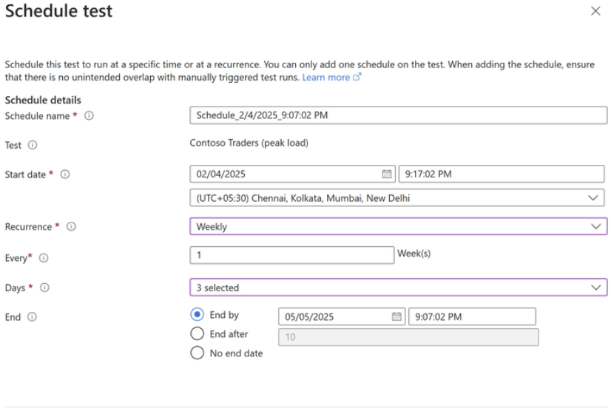
DevOps & IaC & Automation
Multiple JMeter Files and Fragments in Azure Load Testing
MS announced a significant update to Azure Load Testing that allows to use multiple JMeter files and fragments in test configurations. This feature allow users to:
Modularity - Using multiple JMeter files allows you to break down test scenarios into smaller, manageable units.
Reusability - JMeter fragments are reusable components of test plans
Collaboration Across Teams - With modular scripts, different team members can work on specific JMeter files or fragments simultaneously, improving collaboration and accelerating test development.
Easier Debugging and Maintenance - Debugging a modular test setup is more straightforward, as you can isolate and troubleshoot specific files or fragments without affecting the entire test plan
Introducing Scheduled Load Tests in Azure Load Testing
It is now possible to automate test runs at a predefined time or cadence, ensuring seamless performance validation without manual intervention. Azure Load Testing’s scheduling functionality offers flexible options to meet different testing needs:
Customizable scheduling – Set up tests to run once, hourly, daily, weekly, or monthly.
Cron-based scheduling – Define complex recurrence patterns using cron expressions.
Controlled test runs – Set an end condition based on a specific date or number of occurrences.
Failure handling – If three consecutive test runs fail, the schedule is automatically disabled, ensuring you can resolve issues before resuming testing to avoid unnecessary costs.

Slide 20
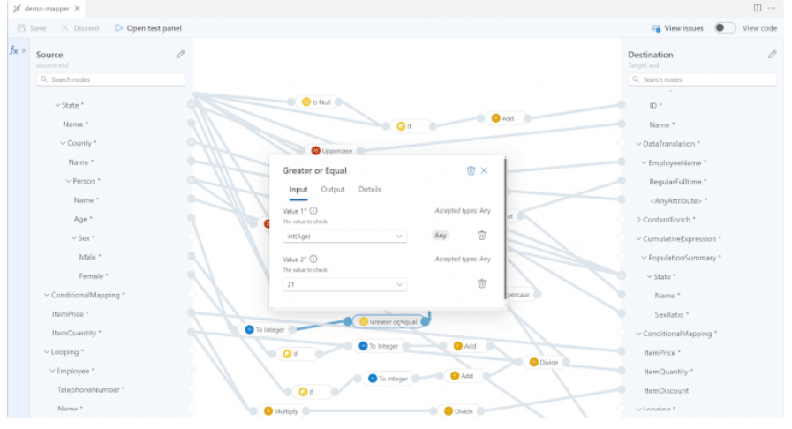
DevOps & IaC & Automation
New & Improved Data Mapper UX in Azure Logic Apps – Now in Public Preview
MS announced that a UX update for Data Mapper in Azure Logic Apps is now in Public Preview!
Easier navigation
Side-by-side function panel
Automatic looping for repeating nodes
Real-time error detection
Test Your Map Instantly
Announcing the end of support for Node.js 18.x in the Azure SDK for JavaScript
After July 10, 2025, the Azure SDK for JavaScript will no longer support Node.js 18.x, which reaches end-of-life on April 30, 2025.

Slide 21
ML & AI & IOT

Slide 22

DevOps & IaC & Automation
Introducing Stability AI Generative Visual Models to Azure AI Foundry
Microsoft brings Stable Diffusion 3.5 Large, Stable Image Ultra, and Stable Image Core to the model catalog in Azure AI Foundry.
At 8.1 billion parameters, Stable Diffusion 3.5 is the most powerful model in the Stable Diffusion family.

Slide 23
Information

Slide 24
Information
Azure Times GitHub Repo

Slide 25
Questions

