Slide 1
Azure Times #163
May 26, 2025

Slide 2
Networking

Slide 3
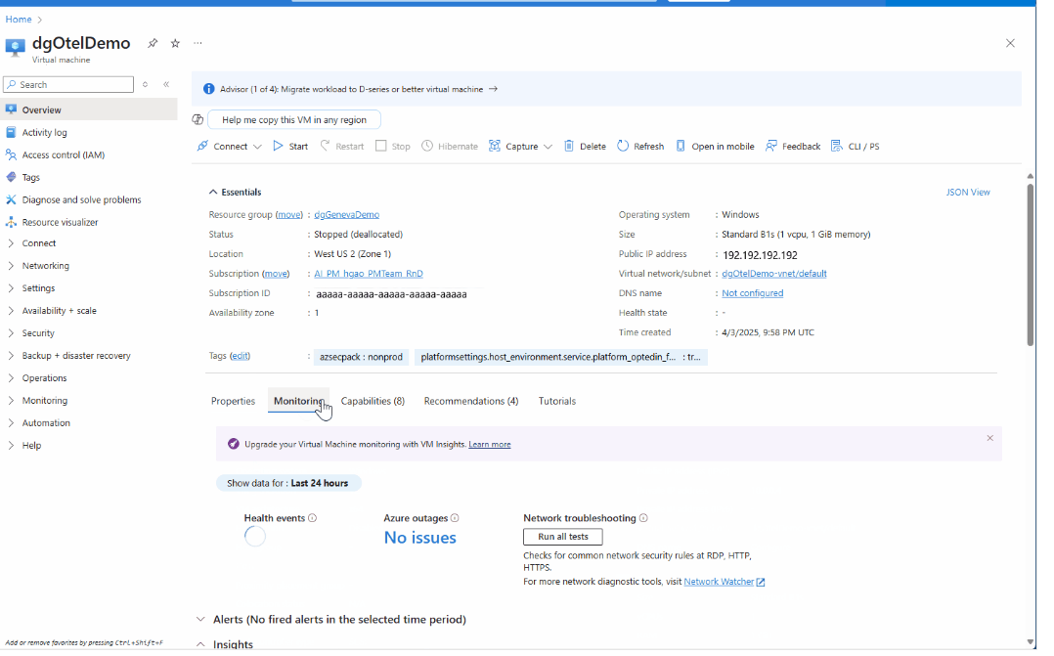
Networking Updates (1/2)
Public Preview: VM Network Troubleshooter
Blocked ports on Virtual Machines (VMs) are one of the most common connectivity issues faced by Azure customers. The VM Network Troubleshooter helps customers quickly check if commonly used ports are blocked on their Azure virtual machine.
The VM Network Troubleshooter checks for the following ports:
Port 80 (HTTP)
Port 443 (HTTPS)
Port 3389 (RDP)
The VM Network Troubleshooter is built on top of the NSG diagnostics tool. The troubleshooter simulates traffic to the VM for common ports. It returns whether the flow is allowed or denied with detailed information about the security rule allowing or denying the flow. Customers can clickthrough from the results to the NSG rules and edit them as needed.

Slide 4
Networking Updates (2/2)
Generally Available: Azure Traffic Manager SLA raised to 100%
Azure Traffic Manager has raised its service level agreement (SLA) to 100% for global DNS resolution, ensuring that all DNS queries consistently resolve to a healthy endpoint.
No changes are required from customers to benefit from this SLA update. All existing Azure Traffic Manager profiles are covered under the new DNS resolution SLA.
Generally Available: Private endpoint support in Azure Container Apps for workload profiles environments
This allows to connect to Container Apps environment using a private IP address in Azure Virtual Network, eliminating exposure to the public internet and securing access to their applications. With private endpoints, it is possible to connect directly from Azure Front Door to workload profile environments over a private link instead of the public internet. A workload profile determines the amount of compute and memory resources available to the container apps deployed in an environment
This feature is supported for both Consumption and Dedicated plans in workload profile environments. Private endpoints are supported for both new and existing environments, so that customers can leverage the new capabilities without re-provisioning their environment. This capability also introduces the public network access setting, enabling customers to configure Azure networking policies.

Slide 5
Security & Identity

Slide 6
Security & Identity Updates (1/1)
Public Preview: Registry-agnostic agentless runtime container vulnerability assessment (Microsoft Defender for Cloud)
This capability provides comprehensive vulnerability assessment and remediation for container images, regardless of their registry source. With this, organizations expand vulnerability assessment coverage to include running containers with images from any registry (not restricted to supported registries).
Vulnerability information powered by Microsoft Defender Vulnerability Management is added to the cloud security graph for contextual risk, calculation of attack paths, and hunting capabilities.
Container images are collected from the runtime environment and scanned for vulnerabilities. Scanned images include customer owned containers, Kubernetes add-ons, and third-party tools running on the cluster. Runtime environment images are collected in an agentless manner every 24 hours.

Slide 7
Management & Governance

Slide 8
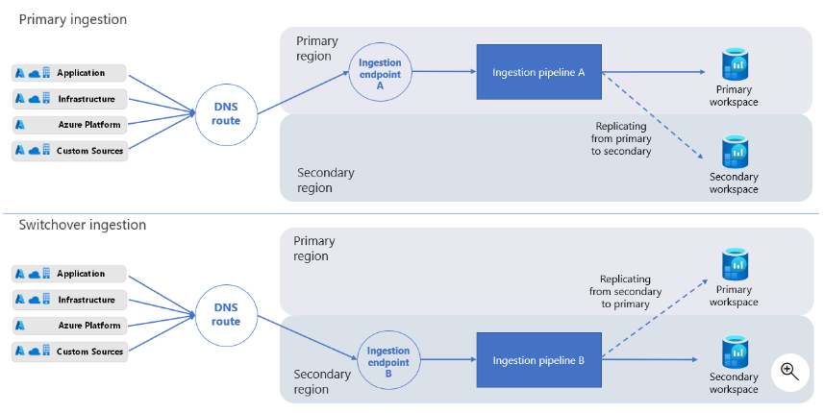
Azure Log Analytics Updates (1/3)
Generally Available: Log Analytics cross-regional Workspace Replication
MS announced the general availability of Log Analytics Workspace Replication. Cross-regional workspace replication enhances resilience to regional incidents by enabling workspace owners to switch over to another region as necessary. A copy of the workspace is established in another region (selected by the workspace administrator). When replication is enabled, logs are ingested in both regions, ensuring continued observability through dashboards, alerts, and advanced solutions such as Microsoft Sentinel. Replication covers the entire workspace and is billed based on the replicated gigabytes.
The secondary workspace is a "shadow" workspace for resilience purposes only and it can not be used.
Workspace replication fully replicates all table schemas, but only sends new logs ingested since replication was activated. Logs ingested to the workspace before you enable workspace replication aren't copied over.
Generally Available: Azure Monitor Log Analytics UI query limit increased to 100K records
Azure Monitor Log Analytics UI now supports up to 100,000 records per query, a significant increase from the previous 30,000-record limit. This enhancement enables deeper investigations and broader data analysis directly within the portal, allowing users to view and explore larger datasets without needing to rely on external tools.
This update balances expanded query capacity with browser performance and stability, ensuring a reliable experience in Log Analytics.
To take advantage of this improvement, select “Max. limit” in the “Show” pill within the Logs UI, or configure it as your default setting.
We are actively monitoring usage and performance with this change, and based on results, we will explore the possibility of increasing the limit further in the future.

Slide 9
Azure Log Analytics Updates (2/3)
Public Preview: Granular RBAC in Azure Monitor Log Analytics
Many organizations emphasize the need to segregate and control access to data in a granular manner, while maintaining a centralized logging platform. On top of the existing capabilities of Azure Monitor Log Analytics Workspace and table level access, you can now maintain all your data in a single Log Analytics workspace and provide least-privilege access at any level, using Azure Attribute-Based Access Control (ABAC) as part of your Azure role assignment.
Granular role-based access control (RBAC) in Azure Monitor Log Analytics allows you to filter workspace data that each user can view or query, based on conditions you specify to meet your business and security needs. Benefits of this access control include:
Row level access
Table level access
Separation of control and data planes
Public Preview: Smarter Troubleshooting in Azure Monitor with AI-powered Investigation
AI-powered Investigations enable fast troubleshooting, diagnosing and resolving problems efficiently with less human toil.
Key benefits include:
Comprehensive analysis: AI-powered investigation analyzes telemetry collected by Azure Monitor to identify anomalies, including applications and infrastructure metrics, application logs, resource health, related alerts, diagnostic data, and more.
AI-Actionable Insights: Investigation provides a list of findings that include a summary of what happened, potential causes, and how to further troubleshoot the issue.
User-Driven AI Insights: User inputs directly shape the AI Investigation analysis, leading to more precise and tailored insights.

Slide 10
Azure Log Analytics Updates (3/3)
Private Preview: Customizable Email Subjects for Log Search Alerts V2
MS announced the launch of a new feature in Azure Monitor: Customizable Email Subjects for Log Search Alerts V2, available during May.
Key Benefits:
Personalized Alert Emails: This feature enables customers to personalize the subject lines of alert emails, making it easier to quickly identify and respond to alerts with more relevant and specific information.
Dynamic Values: Ability to override email subjects with dynamic values by concatenating information from the common schema and custom text.
Public Preview: Simple Log Alerts in Azure Monitor
This new feature is designed to provide a simplified and more intuitive experience for monitoring and alerting, enhancing ability to detect and respond to issues in near real-time. Unlike Log Search Alerts that aggregate rows over a defined period, Simple Log Alerts evaluate each row individually.
Key Benefits
Simplified Query Language: Unlike Log Search Alerts that use complex queries, Simple Log Alerts use the transform Kusto Query Language (KQL).
Low Latency Alerting: By evaluating each row individually, Simple Log Alerts provide faster alerting compared to Log Search Alerts. This means that alerts are triggered in near real-time, allowing for quicker incident response.
Broad Applicability: Simple Log Alerts support multiple log tiers, including Analytics and Basic Logs, which previously did not have any alerting solution.
NOTE: Simple log alert rule queries don't support print, datatable, and let.

Slide 11
Management & Governance Updates (1/6)
Generally Available: Vaulted Backups by Azure Backup for Azure Database for PostgreSQL – Flexible Server in all regions
MS announced the general availability (GA) of vaulted backups by Azure Backup for Azure Database for PostgreSQL - flexible server, a robust and scalable backup solution designed to meet the needs of enterprises and developers alike.
Key benefits:
Enhanced Security and Cyber Resilience: Safeguard backups from ransomware and unauthorized access using immutable vaults and role-based controls.
Compliance with Regulations: Secure Long-Term Retention (LTR) for up to 10 years in accordance with global standards.
At scale management: Enterprise grade features and management via Azure Business Continuity Center, which offers a single pane of glass experience to manage, operate and govern all protected resources.
Retirement: MICROSOFT AZURE OPERATED BY 21VIANET - Action required to migrate to Azure China North 3 region by July 1, 2026 due to China North 1 and China East 1 region retirement
With this in mind, Azure in China announces the 2 first-generation regions, China North 1 and China East 1, will be retired on July 1, 2026, as the infrastructure of these regions does not support advanced Azure products and workloads.
Azure in China will continue to operate in multiple regions, such as China North 3, which provide enhanced capabilities to the China North 1 and China East 1 regions. As long as customer migrates out of these regions before July 1, 2026, this will not impact the ability to use Azure in China.
Beginning July 1, 2026, China North 1 and China East 1 regions will be retired, and customers will experience disruption in their services if they have not migrated their Azure resources from these two regions.

Slide 12
Management & Governance Updates (2/6)
Generally Available: Azure Arc enabled Azure Container Apps
The capability to run Azure Container Apps on Azure Arc-enabled Kubernetes clusters (AKS and AKS-HCI) is now generally available. The cluster can be on-premises or hosted in a third-party cloud. This approach allows developers to take advantage of the features and developer productivity of Azure Container Apps. Meanwhile it allows IT Administrators to maintain corporate compliance by hosting the application in Hybrid environments.
By deploying an Arc extension on the Azure Arc-enabled Kubernetes cluster, IT administrators gain control of the underlying hardware and environment, while still enabling the high productivity of Azure PaaS services from within a hybrid environment.
Public Preview: Managed Prometheus visualizations in Azure Monitor for Arc-enabled Kubernetes clusters
Container insights visualizations were previously powered by metric data from Log Analytics. This new feature offers customers the option to power these visualizations using managed Prometheus data, offering a more cost-efficient and performant solution.
Optimize costs by migrating from Log Analytics based metrics to managed Prometheus
Improve performance with faster metric query load times
Integrate with the new Prometheus based recommended alerts
Monitor at scale with the improved multi-cluster view

Slide 13
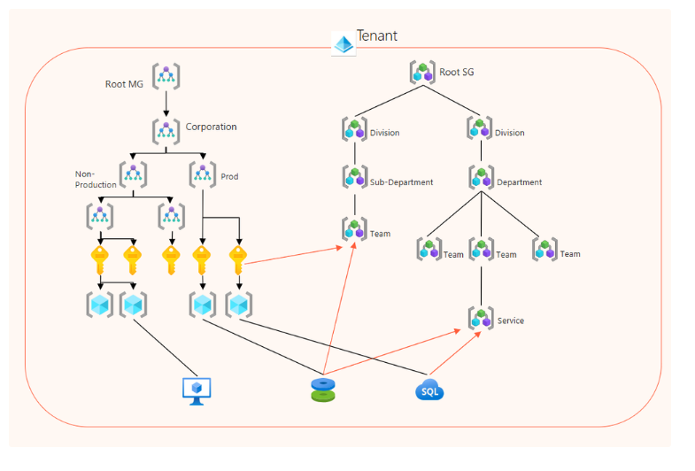
Management & Governance Updates (6/6)
Azure Service Groups - Public Preview
A Service Group (SG) is a new grouping structure in Azure that supports flexible grouping of cross-subscription resources and multiple hierarchies of groups. Service Groups provide a unified view and management capabilities, enabling:
Low Privilege Management: Service Groups are designed to operate with minimal permissions, ensuring that users can manage resources without needing excessive access rights and appealing to multiple personas.
Flexible Cross-Subscription Grouping: Azure resources and scopes, from anywhere in the tenant, can become members of one or multiple service groups.
Varying Hierarchies: Service Groups can be self-nested providing the ability to have multiple hierarchy structures of resource containers.
Data Aggregation & Views: Aggregate data from resources across subscriptions for practical workloads. View application health (via Health Model) and important data values centered around your wanted perspective.

Slide 14
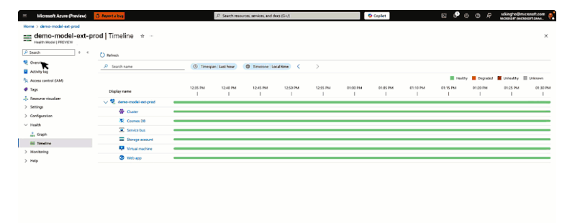
Management & Governance Updates (3/6)
Azure Local with Disconnected Operations
Available in preview to pre-qualified customers, Azure Local with disconnected operations extends these capabilities even further – enabling organizations to deploy, manage, and operate cloud-native infrastructure and services in completely disconnected or air-gapped networks.
Disconnected operations is an add-on capability of Azure Local, delivered as a virtual appliance, that enables the deployment and lifecycle management of your Azure Local infrastructure and Arc-enabled services, without any dependency on a continuous cloud connection.
Key Benefits
Consistent Azure Experience: It is possible to operate disconnected environment using the same tools already know - Azure Portal, Azure CLI and ARM Templates extended through a local control plane.
Built-in Azure Services: Through Azure Arc, you can deploy, update, and manage Azure services such as Azure Local VMs, Azure Kubernetes Service (AKS), etc.
Data Residency and Control: You can govern and keep data within your organization's physical and legal jurisdiction to meet data residency, operational autonomy, and technological isolation requirements.
Announcing the Public Preview of Azure Monitor health models
Azure Monitor health models enable customers to monitor the health of their applications with ease and confidence. These models use the Azure-wide workload concept of Service Groups to infer the scope of workloads and provide out-of-the-box health criteria based on platform metrics for Azure resources.
Azure Monitor health models provide a simplified out-of-the-box health experience built using Azure Service Group membership.

Slide 15
Management & Governance Updates (4/6)
Public Preview: Azure Monitor introduces Prometheus community recommended alerts for Azure Arc-enabled Kubernetes
Azure Monitor now offers one-click enablement of Prometheus recommended alerts directly in the Azure Portal for Azure Arc-enabled Kubernetes clusters. These alerts, based on enhanced Prometheus community rules, provide comprehensive coverage across cluster, node, and pod levels. Previously, enabling these alerts required manual template downloads and CLI deployment.
Generally Available: Managed Prometheus visualizations and enhanced monitoring experience in Azure Monitor for AKS
Managed Prometheus visualizations in Azure Monitor are now generally available, along with an enhanced, unified monitoring experience for Azure Kubernetes Service (AKS).
This release brings comprehensive monitoring capabilities into a single, streamlined view—designed to address common challenges customers face when managing AKS clusters.
Previously, Container insights visualizations were powered by metric data from Log Analytics. Customers now have the option to power these visualizations using managed Prometheus data, offering a more cost-efficient and performant solution.

Slide 16
Management & Governance Updates (5/6)
Generally Available: Send a Custom Event from the Azure Monitor OpenTelemetry Distro
Custom Events offer developers a way to track user or system actions that matter to their business or observability objectives.
For example, a developer may want to track an end-user action such as selecting a button, submitting a form, or completing a purchase. These events can be sliced and diced in Application Insights Experiences including the Usage Analysis Views.
Custom Events have long been a staple of Azure Monitor Application Insights. Now that they're available in the Azure Monitor OpenTelemetry Distro, it removes an impediment to migrate to OpenTelemetry.
Azure Migrate: Migration to Confidential Virtual Machines (CVMs)
Azure Migrate now supports the migration of both Generation 1 and Generation 2 virtual machines (VMs) from on-premises or other cloud platforms to Azure Confidential Virtual machine (CVM) in Private Preview.
Customers can seamlessly migrate their VMs to Confidential Virtual Machines (CVMs) using the Simplified Agent-Based Migration method or the VMware Agentless Migration flow.

Slide 17
Compute

Slide 18
Virtual Machines(1/1)
Announcing Preview of New Azure Dnl/Dn/En v6 VMs powered by Intel 5th Gen processor & Azure Boost
Azure's first Network Optimized VMs powered by the latest 5th Gen Intel® Xeon® processor offering unparalleled performance and flexibility. The network optimized VMs will be relevant for workloads such as network virtual appliances, large-scale e-commerce applications, express route​, application gateway, central DNS and monitoring servers​, firewall​s, media processing tasks that involve transferring large amounts of data quickly, and any workloads that require the ability to handle a high number of user connections and data transfers.
Compared to the current Intel Dl/D/Ev6 VMs, the network optimized VMs have:
Up to 3x improvement in NW BW/vCPU
2x vNIC allocation on smaller vCPU sizes
Up to 200 Gbps VM network bandwidth
Up to 8x CPS connections enhancement across sizes
Up to 192vCPU and >18GiB of memory
Azure Boost which enables:
Up to 400k IOPS and 12 GB/s remote storage throughput
Up to 200 Gbps VM network bandwidth
NVMe interface for local and remote disks
Enhanced security through Total Memory Encryption (TME) technology
Announcing the General Availability of Azure FXv2-series Virtual Machines
New Azure FXv2-series Virtual Machines (VMs), powered by the 5th Generation Intel® Xeon® Platinum 8573C (Emerald Rapids) processor. This release includes Compute-optimized VMs FXmsv2-series and FXmdsv2-series. The FXv2-series VMs are optimally designed and purpose-built for compute-intensive workloads such as databases, data analytics, and electronic design automation (EDA), demanding substantial memory, high-performance storage, and I/O bandwidth.
Azure FXv2-series VMs have been engineered to deliver exceptional CPU performance of up to 50% better than the previous generation FXv1-series VMs. Azure FXv2-series VMs feature an all-core-turbo frequency up to 4.0 GHz. The FXv2-series offers VM sizes up to 96 vCPUs, which is twice the number of vCPUs compared to the previous generation. Furthermore, these new VMs offer up to 1,832 GiB memory with a memory to core ratio of 21GiB/vCPU.

Slide 19
Azure Function Updates (1/4)
Generally Available: Durable functions v3 in Azure Functions
Major improvements in this new major version include improved cost efficiency for usage of Azure Storage v2 accounts and an upgrade to the latest Azure Storage SDKs, as well as the .NET Framework used by the extension.
Specifically, the Microsoft.Azure.WebJobs.Extensions.DurableTask v3.x package (referred to as Extensions.DurableTask from now on) is introduced, which represents a breaking change for durable functions C# apps that use the in-process model. Since the durable functions .NET isolated package, namely Microsoft.Azure.Functions.Worker.Extensions.DurableTask, references Extensions.DurableTask as its underlying assembly, the improvements mentioned above also apply to the isolated package starting from version 1.2.x.
Public Preview: Azure Functions Flex Consumption now supports availability zones and 512 MB instances
It is now possible to enable availability zones for Flex Consumption apps during create or post-create and choose the 512 MB instance memory size.
Availability zones are physically separate groups of datacenters within each Azure region. When one zone fails, services can fail over to one of the remaining zones. When availability zones are enabled, instances are distributed across availability zones for increased reliability.

Slide 20
Azure Function Updates (2/4)
Generally Available: New regions for Azure Functions Flex consumption
Beyond the already generally available regions, Microsoft added 22 new regions, a few listed below:
Australia Southeast
Brazil South
Canada Central
Central India
Central US
France Central
Germany West Central
Italy North
Japan East
Korea Central
North Central US
Norway East
South Africa North
Generally Available: Azure Functions integration with Azure AI Foundry Agent Service
Integrating Azure Functions with AI Foundry Agent service enables to build intelligent, event-driven applications that are scalable, secure, and cost-efficient. Azure Functions act as custom tools that AI agents can call to execute business logic, access secure systems, or process data dynamically in response to events like HTTP requests or queue messages.
This integration allows for modular AI workflows, where agents can reason through tasks and trigger specific functions as needed—ideal for scenarios like customer support, document processing, or automated insights—without the need to manage infrastructure.

Slide 21
Azure Function Updates (3/4)
Generally Available: Azure Functions support for HTTP streams in Python
With this feature, customers can stream HTTP requests to and responses from their Function Apps, using function exposed FastAPI request and response APIs.
Previously with HTTP requests, the amount of data that could be transmitted was limited at the SKU instance memory size. With HTTP streaming, large amounts of data can be processed with chunking.
This feature enables new scenarios including processing large data streaming OpenAI responses and delivering dynamic content. It is possible to leverage this feature for use cases where real time exchange and interaction between client and server over HTTP connections is needed. Additionally, FastAPI response types are supported with this feature.
Public Preview: Azure Functions MCP extension now supports additional capabilities
The Model Context Protocol (MCP) is a way for apps to provide capabilities and context to a large language model. Azure Functions recently introduced an MCP extension as an early preview to enable conversations with the community. The extension makes it easy to build remote MCP servers that run at cloud scale.
The preview now includes functions written in Java, enabling even more teams to create remote MCP servers with this model. The extension has also been updated with additional support for returning server instructions and metadata and defining required tool properties. Function authors can use these new options to customize how LLMs interacts with their tools. MCP tool trigger invocations are now also instrumented to provide insights into app behavior and assist in debugging MCP servers.

Slide 22
Azure Function Updates (4/4)
Public Preview: SDK type bindings in Azure Functions for Azure Blob Storage, Azure Service Bus, Azure Cosmos DB and Azure Event Hubs
Azure Functions triggers and bindings enable to easily integrate event and data sources with function applications. This feature enables to use types from service SDKs and frameworks, providing more capability beyond what is currently offered.
Azure Blob Storage:
SDK type bindings for Azure Blob Storage enable the following key scenarios:
Downloading and uploading blobs of large sizes, reducing current memory limitations and GRPC limits.
Enabling advanced operations including partial reads, parallel uploads, and direct property manipulations.
Improved performance by using blobs with Azure Functions
Public Preview: Enhanced Azure Functions experience in Azure Container Apps
MS introduced a new, streamlined method for running Azure Functions directly in Azure Container Apps. This integration allows to leverage the full features and capabilities of Azure Container Apps while benefiting from the simplicity of auto-scaling provided by Azure Functions.
With the new native hosting model, it is possible to deploy Azure Functions directly onto Azure Container Apps using the Microsoft.App resource provider by setting “kind=functionapp” property on the container app resource.

Slide 23
Azure App Service Updates (1/2)
Public Preview: .NET Aspire support on Azure App Service
.NET Aspire simplifies cloud-native development with opinionated APIs, integrations, and orchestration features. It boosts productivity, and provides a dashboard for managing services, making it easier to build and deploy distributed applications.
With .NET Aspire 9.2 the team is introducing Publishers to help write code that will define how application gets packaged and deployed for different platforms.
App Service team is working with.NET Aspire team to offer a publisher that targets App Service and other Azure PaaS resources to host your application.
Generally Available: New Availability Zone Features for Azure App Service
Enhanced Availability Zone support for Azure App Service is now generally available. This update simplifies the pre-requisites to enable zone resilience, reduces the cost of running in high availability, and enhances reliability and resilience for your apps.
Key Updates
Reduced minimum instance requirement for enabling Availability Zones from three to two, while still maintaining a 99.99% SLA.
Some App Service plans with two or more instances may be able to automatically support Availability Zones without additional setup.
The zone redundant setting for App Service plans and App Service Environment v3 is now mutable throughout the life of the resources.
Enhanced dashboard for visibility into Availability Zone information, including physical zone placement and zone counts.
Eliminates minimum instance fee for App Service Environment v3.

Slide 24
Azure App Service Updates (1/2)
Public Preview: Azure App Service - New Premium v4 Offering
The new Premium v4 includes sizes starting fPremium v4 offering provides faster processors, NVMe local storage, and memory-optimized options, running on the latest Azure hardware. rom 1 vCPU and 4GB of memory all the way up to 32 vCPU and 256GB memory.

Slide 25
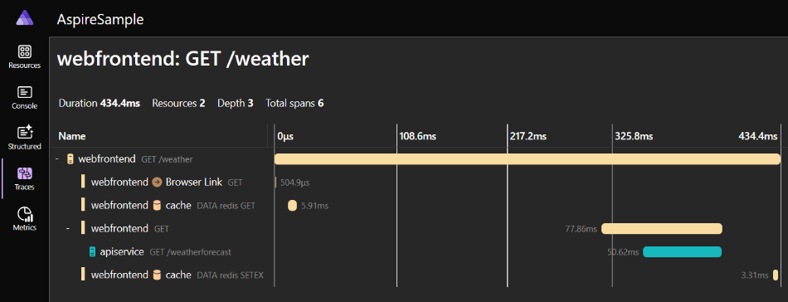
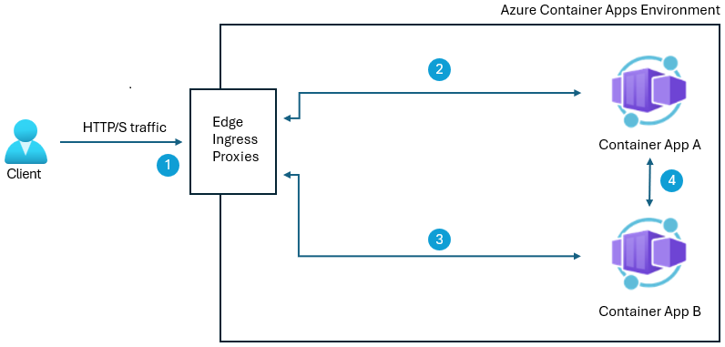
Azure Container Apps (1/4)
Public Preview: Premium Ingress in Azure Container Apps
Azure Container Apps now supports premium ingress in public preview. This feature introduces environment-level ingress configuration options, with the primary highlight being customizable ingress scaling. This capability supports the scaling of the ingress proxy, enabling customers to better handle higher demand workloads, such as large performance tests. By configuring ingress proxy to run on workload profiles, it is possible to scale out more ingress instances to handle more load. Running the ingress proxy on a workload profile will incur associated costs.
Generally Available: Aspire Dashboard in Azure Container Apps
Azure Container Apps .NET 8’s Aspire dashboard is now generally available, and it is possible to access live data about project and containers in the cloud to evaluate the performance of applications and debug errors with comprehensive logs, metrics, traces, and more.
As well as access the Aspire dashboard in Azure Portal for project in Azure Container Apps, which previously could only locally.

Slide 26
Azure Container Apps (2/4)
Generally Available: OpenTelemetry agent in Azure Container Apps
OpenTelemetry agent in Azure Container Apps is now generally available. This feature enables to use open-source standards to send app’s data without setting up the OpenTelemetry collector yourself.
Once enabled, the agent runs in Container Apps environment and automatically collects and exports telemetry data. It is possible to send data to Azure Monitor Application Insights (logs, traces), Datadog (metrics, logs, traces), or any generic OTLP-configured endpoint (logs, metrics, traces). It is possible to configure and manage the agent today using the Azure portal, ARM templates, Bicep, Terraform, or the Azure CLI.
Generally Available: Planned maintenance in Azure Container Apps
This feature allows to control when non-critical updates are applied to Container Apps environment to minimize downtime and impact to applications. Non-critical updates include minor security patches, bug fixes, and new releases. Critical and urgent updates, however, are applied as needed to ensure security and reliability compliance, even outside of planned maintenance windows.
To configure a weekly maintenance window, specify a day of week, a start time in the UTC time zone, and a duration. This can be done using Azure CLI as well as Azure portal.

Slide 27
Azure Container Apps (3/4)
Generally Available: Dedicated GPU in Azure Container Apps
Dedicated GPU support in Azure Container Apps is now generally available. Dedicated GPUs provide additional compute options tailored for AI applications, making them ideal for AI scenarios which require continuous availability and don’t scale to zero.
This feature supports NC A100 v4 series GPUs that are optimized to support AI workloads. GPU workload profiles are offered as part of the Dedicated Plan and only supported in the Workload Profiles type environment.
Public Preview: Durable task scheduler support in Azure Container Apps
Durable task scheduler, a fully managed backend for durable execution, is now available in public preview in Azure Container Apps. The durable task scheduler features a managed workflow engine responsible for scheduling workflow execution and persisting workflow state. Additionally, the durable task scheduler includes an out-of-the-box monitoring and management dashboard, making it easy to debug and manage workflows on demand.
With the durable task SDKs, which are client SDKs that connect directly to the durable task scheduler managed workflow engine, you can author your workflows as code and rely on the durable task scheduler for efficient task scheduling and state persistence.
The durable task scheduler offers:
A fully managed backend for workflow task scheduling and persistence
Superior performance and scalability
A workflow debugging and management dashboard
Security best practices with identity-based authentication
A local emulator for a simple development experience

Slide 28
Azure Container Apps (4/4)
Public Preview: Azure Container Apps serverless GPUs now support Azure AI Foundry models
Azure AI Foundry Models have two deployment options - serverless APIs and managed compute. Azure Container Apps serverless GPU offers a balanced deployment option for you to deploy the Foundry Models on-demand with serverless scaling that goes back down to zero when not in use and comply with your data residency needs.
With serverless GPUs, using Foundry Models gives you the full flexibility to run any supported model with automatic scaling, pay-per-second-pricing, full data governance, out of the box enterprise networking/security support, and more.

Slide 29
Azure Kubernetes Service (AKS) (1/8)
Public Preview: Agentless runtime vulnerability assessment for AKS-owned images (Microsoft Defender for Cloud)
This new public preview capability allows users to distinguish AKS-owned images from customer-owned images, provides visibility into any CVEs in the AKS image, and provides recommendations on the AKS version or release containing the fixes for the vulnerabilities.
Generally Available: Custom certificate authority support in AKS
Custom certificate authority (CA) support in AKS is now generally available.
CAs allow to establish trust between Azure Kubernetes Service (AKS) cluster and workloads as private registries, proxies, and firewalls. A Kubernetes secret is used to store the certificate authority's information until it is passed to all nodes in the cluster.
Limitations:
Windows node pools aren't supported.
Installing different CAs in the same cluster isn't supported.

Slide 30
Azure Kubernetes Service (AKS) (2/8)
Generally Available: HTTP proxy can now be enabled on an existing AKS cluster
The HTTP proxy feature adds HTTP proxy support to AKS clusters, exposing a straightforward interface that can be used to secure AKS-required network traffic in proxy-dependent environments. With this feature, both AKS nodes and pods are configured to use the HTTP proxy. The feature also enables installation of a trusted certificate authority onto the nodes as part of bootstrapping a cluster.
HTTP Proxy can now be enabled on an existing cluster by updating the cluster to add an HTTP Proxy configuration. AKS will automatically reimage all node pools in the cluster when you update the proxy configuration on your cluster using the az aks update command. You can use Pod Disruption Budgets (PDBs) to safeguard disruption to critical pods during reimage.
Public Preview: Onboarding of individual AKS clusters in Microsoft Defender for Cloud
Microsoft Defender for Cloud now supports, in public preview, onboarding of individual AKS clusters. Instead of having a pre-requisite for onboarding an entire subscription, Microsoft Defender for Cloud now allows for resource level onboarding for AKS clusters. This provides agentless and sensor-based alerts in AKS dashboard, sensor onboarding/offboarding, and cluster operator view of security findings within AKS portal.

Slide 31
Azure Kubernetes Service (AKS) (3/8)
Public Preview: Gating vulnerable deployments in AKS (Microsoft Defender for Cloud)
This feature allows to evaluate deployments in Kubernetes and ensure each image is safe before deployment, based on Vulnerability Assessment and organization security policy. Gating involves both auditing and blocking deployments, as well as terminating existing deployments which do not adhere to the required policies.
This feature is based on two new capabilities:
Vulnerability findings artifact: Generation of findings for each container image scanned for vulnerability assessment.
Customized security rules: It is possible to customize security rules and configure required actions - 'audit' or 'deny' - for various environments, for Kubernetes clusters, or for namespaces, tailored to specific organization needs and compliance requirements.
Public Preview: Managed namespaces for Azure Kubernetes Service
Platform admins who provide shared clusters for their developer teams frequently end up implementing scripts and processes to create namespaces, set resource limits, apply network policies, and grant team access via role-based access control. Designing and creating such self-service setup from scratch often takes months.
Managed namespaces for AKS, now in public preview, addresses this need. With managed namespaces, it is possible to configure all that via the Azure CLI, ARM/Bicep, REST API, and the Azure portal, providing a foundation on which more complex platform engineering configuration can be built.

Slide 32
Azure Kubernetes Service (AKS) (4/8)
Generally Available: Automated deployments in AKS now supports Azure DevOps (ADO), AKS-ready templates and service connectors
Automated deployments in AKS now supports the following features:
Azure DevOps support
AKS-ready templates
Built-in Horizontal Pod Autoscaler (HPA) configs
Secure securityContext settings for container hardening
Fully templated readiness, liveness, and startup probes
Optional Ingress with managed TLS certificates via app routing
Service connector support
Provision secure bindings to Azure services
Automatically inject credentials into your application via Kubernetes secret objects — no manual setup needed
Generally Available: Smart VM defaults in AKS
Smart VM defaults are now generally available in AKS. Smart VM defaults automatically select the optimal default VM SKU based on available capacity and quota. This feature ensures that deployments are matched with the best possible SKU, enhancing performance and reliability while optimizing resource utilization. Previously, the default AKS VM SKU was typically Standard_DS2_V2, but now it will be a dynamic outcomes in default provisioning based on SKU availability.

Slide 33
Azure Kubernetes Service (AKS) (5/8)
Generally Available: Azure Monitor Prometheus community recommended alerts for AKS
Azure Monitor now offers one-click enablement of Prometheus recommended alerts directly in the Azure Portal for AKS clusters. These alerts, based on enhanced Prometheus community rules, provide comprehensive coverage across cluster, node, and pod levels. Previously, enabling these alerts required manual template downloads and CLI deployment.
To use these alerts, cluster must have Azure Monitor managed service for Prometheus enabled. They serve as the replacement for the legacy Container insights recommended alerts (custom metrics) (preview).
By enabling these alerts, customers will:
Receive timely notifications on critical cluster issues.
Accelerate triage and troubleshooting with preconfigured signal coverage.
Improve cluster reliability and performance with minimal configuration.
Generally Available: Every AKS version is now long term support (LTS) compatible
AKS will now ensure that every community version released (GA) is compatible with long term support (LTS), starting with version 1.28 LTS from April 2025. Versions 1.27, 1.28, 1.29, and 1.30 are now LTS, with 1.31 and 1.32 expected soon. LTS provides an additional year of support beyond the community support EOL period, ensuring all core AKS components, add-ons, and Kubernetes components are supported and promptly patched for CVEs and fixes by AKS.

Slide 34
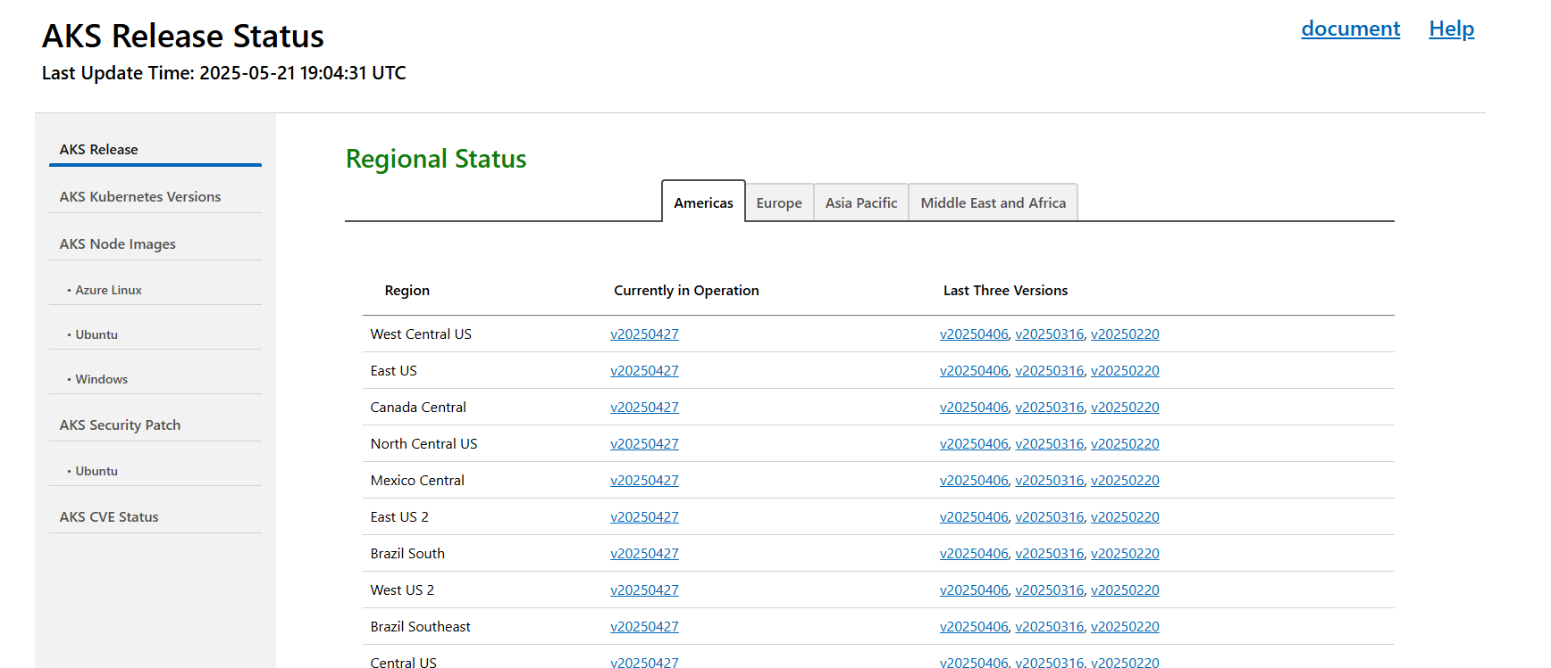
Azure Kubernetes Service (AKS) (6/8)
Generally Available: Track AKS supported Kubernetes version regional updates in AKS release tracker
AKS supported Kubernetes version release updates are available in AKS release tracker. Users can check current in-support Kubernetes versions and LTS versions for a specific region and track new patches version release progress with release tracker.
https://releases.aks.azure.com/webpage/index.html
Generally Available: Entity Tags (eTags) for Concurrency Control in AKS
Cluster operators and platform teams managing shared Azure Kubernetes Service (AKS) environments often face challenges with conflicting update requests—especially when multiple users or systems interact with the same resource simultaneously. This can result in unintended overwrites or inconsistent states.
The Entity Tags (eTags) feature in AKS, now generally available, provides a built-in mechanism to detect and prevent conflicting operations. AKS now performs concurrency checks during update requests, comparing the provided eTag with the latest stored version. If there’s a mismatch, the request is automatically rejected—ensuring that only the most recent and valid changes are applied to your cluster. This improves reliability and safeguards your configurations during concurrent operations.

Slide 35
Azure Kubernetes Service (AKS) (7/8)
Public Preview: Automated deployments support in Azure Kubernetes Fleet Manager
This feature adds support for attaching GitHub repositories to a Fleet Manager hub cluster, allowing the application to be built and staged ready for placement.
Automated deployments can use existing artifacts, or it can containerize and publish the repository source code to an image in an Azure Container Registry and generate Kubernetes manifests. The resulting GitHub Action workflow is triggered on any source code updates, providing a continuous deployment experience.
Public Preview: Azure Kubernetes Fleet Manager now supports placement drift detection and takeover
Azure Kubernetes Fleet Manager’s cluster resource placement has two new preview features to provide more control over placement conflict resolution.
Using the new “applyStrategy”, an operator can define how Fleet Manager resolves conflicts when attempting to place a workload where a clashing workload exists and how to treat configuration drift of a placed workload.
Additionally, using the new “ReportDiff” apply mode, an operator can inspect the drift state of a workload across all clusters on which it is deployed.

Slide 36
Azure Kubernetes Service (AKS) (8/8)
Public Preview: Azure Kubernetes Fleet Manager now supports DNS-based public load balancing
Azure Kubernetes Fleet Manager now supports DNS-based public load balancing, delivered via a Kubernetes-native integration with Azure Traffic Manager. Kubernetes services placed on multiple clusters in a fleet can be included in a TrafficManagerBackend which is exposed via a public load balanced endpoint defined in a TrafficManagerProfile. An Azure Traffic Manager weighted profile is used to route traffic across clusters, with configurable health checks allowing automatic control over when unhealthy clusters stop receiving requests.
Public Preview: Vulnerability assessment and malware detection for AKS nodes (Microsoft Defender for Cloud)
Microsoft Defender for Cloud now offers, in preview, vulnerability assessments and malware detection for nodes within Azure Kubernetes Service (AKS).
To receive the new capabilities, the Agentless scanning for machines toggle needs to be enabled as part of Defender CSPM, Defender for Containers, or Defender for Servers P2 plan on your subscription.
Vulnerability Assessment - A new recommendation is now available in Azure portal: AKS nodes should have vulnerability findings resolved. Using this recommendation, you can now review and remediate vulnerabilities and CVEs found on Azure Kubernetes Service (AKS) nodes.
Malware detection - New security alerts are triggered when the agentless malware detection capability detects malware in AKS nodes. Agentless malware detection uses the Microsoft Defender Antivirus anti-malware engine to scan and detect malicious files. When threats are detected, security alerts are directed into Defender for Cloud and Defender XDR, where they can be investigated and remediated.

Slide 37
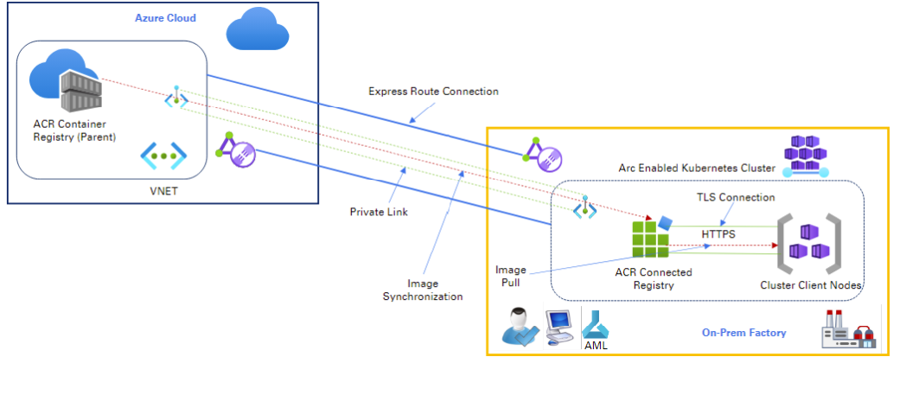
Azure Compute Updates (1/4)
Generally Available: Connected registry in Azure Container Registry (ACR)
A connected registry is an on-premises or remote replica that synchronizes container images with cloud-based Azure container registry. Use a connected registry to help speed-up access to registry artifacts on-premises or remote.
The connected registry provides a performant, on-premises registry solution that regularly synchronizes content with a cloud-based Azure container registry.
Scenarios for a connected registry include:
Connected factories
Point-of-sale retail locations
Shipping, oil-drilling, mining, and other occasionally connected environments

Slide 38
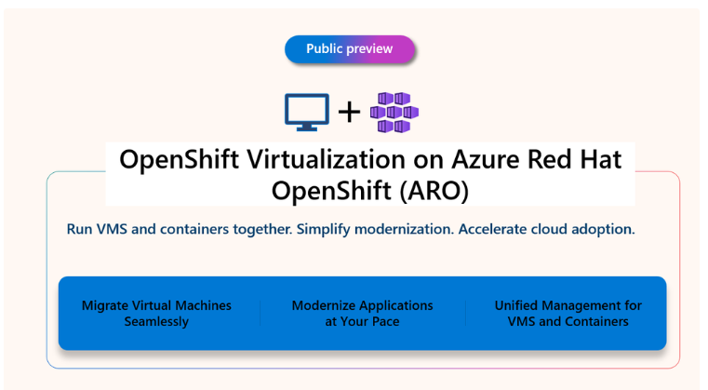
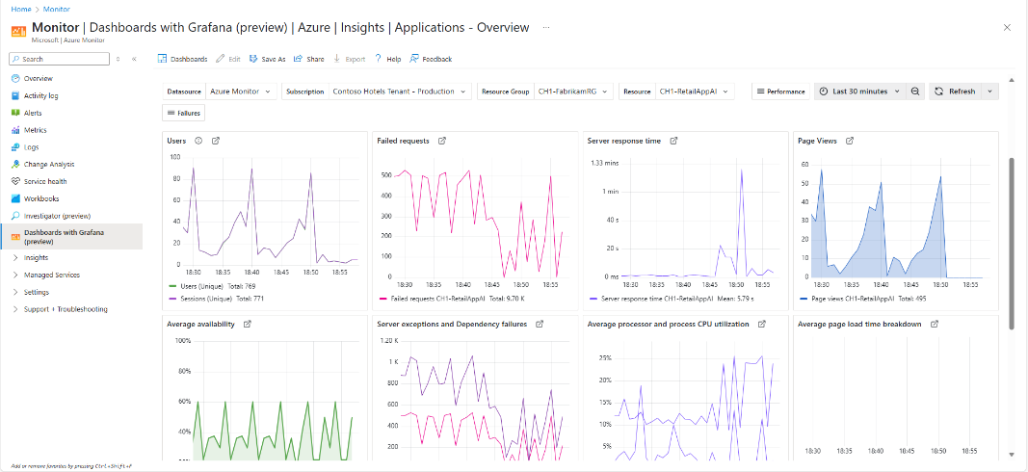
Azure Compute Updates (2/4)
Red Hat OpenShift Virtualization on Azure Red Hat OpenShift in Public Preview
Red Hat OpenShift Virtualization is a self-managed operator included with Azure Red Hat OpenShift that provides a unified platform for migrating and running traditional virtual machines alongside containers. It addresses the challenge of transitioning VM-bound workloads to containers by offering a flexible approach where VMs can leverage cloud-native management capabilities while organizations modernize at their own pace.
Public Preview: Azure Monitor dashboards with Grafana
It is now possible to:
Create and edit dashboards directly in the Azure portal for free and without administrative overhead.
Import dashboards from thousands of publicly available Grafana community dashboards.
Apply a wide range of Grafana visualizations and client-side transformations to Azure monitoring data.
Manage Grafana dashboards as native Azure resources, including using Azure RBAC and automation via ARM template and Bicep templates.

Slide 39
Azure Compute Updates (3/4)
Generally Available: Availability Set support for Premium SSD v2 Disk Storage
Support for Availability Sets is now available with Premium SSD v2 (Pv2) disk storage in regions without Availability Zones: Australia Southeast, Canada East, North Central US, UK West, West Central US and West US.
Pv2 disk delivers low-latency, consistent performance with the flexibility to scale throughput and IOPS independently, making it ideal for a broad spectrum of enterprise production workloads including SQL Server, Oracle, SAP, and big data environments. It is particularly well suited for customers seeking to optimize performance and cost across diverse workloads, without over-provisioning.
By enabling Availability Set support, customers in these regions can now achieve higher availability and fault tolerance for their Pv2-backed workloads, even in the absence of Availability Zones.
Public Preview: Azure Databricks Azure AI Foundry Connector
It is now possible to create AI agents in Azure AI Foundry with Azure Databricks data. New Azure Databricks Azure AI Foundry connector, allows:
Connect Azure AI Foundry agents with Azure Databricks for real-time data processing.
Build and deploy reliable enterprise-ready AI agents using existing Azure Databricks data.
Maintain data governance with authorizations between Azure AI Foundry and Azure Databricks Unity Catalog.
Benefit from the responsible AI and content safety features in Azure AI Foundry.
Streamline advanced analytics and AI through a unified experience within Azure.

Slide 40
Azure Compute Updates (4/4)
Generally Available: Cross-cloud data governance with Unity Catalog on Azure Databricks
Unity Catalog access to Amazon S3 data on Azure Databricks is now generally available. This release gives you seamless, multicloud data governance by unifying permissions and access controls across S3 and Azure Data Lake Storage.
With cross-cloud data governance on Unity Catalog, benefit from:
Unified governance. Manage access policies, security controls, and compliance standards from one place without juggling siloed systems.
Frictionless data access. Securely discover, query, and analyze data across clouds in a single workspace, eliminating silos and reducing complexity.
Stronger security and compliance. Gain centralized visibility, tagging, lineage, data classification, and auditing across all your cloud storage.
Previously, accessing AWS S3 data from Azure Databricks required extracting, transforming, and loading (ETL) the data into ADLS, a process that was both costly and time-consuming. With this GA release, it is possible to set up an external cross-cloud S3 location directly from Unity Catalog on Azure Databricks.

Slide 41
Storage & Data

Slide 42
Storage & Data Updates (1/3)
Generally Available: Azure Premium SSD v2 and Ultra Disk are now available in Indonesia Central
Azure Premium SSD v2 and Ultra Disk are now available in Indonesia Central region.
Generally Available: GRS and CRR support for Azure VMs using Premium SSD v2 in Azure Backup availability in more regions
Premium SSD v2 delivers high-performance block storage with sub-millisecond latency, high IOPS, and throughput—at a low cost. With Geo Redundant Storage (GRS) and Cross-Region Restore (CRR) support, you can safeguard VMs against data loss and perform on-demand restores in a secondary region for audits or disaster recovery.
Enabling GRS vaults for VMs using Premium SSD v2 are available in Brazil South, South Central US, North Central US, East US 2, Central US, UK West, UK South, Canada East, Canada Central, West US, West Central US , West US 2, Australia Southeast, Australia East. To learn more and keep track of region support, refer to the VM backup support matrix.

Slide 43
Storage & Data Updates (2/3)
Public Preview: Encryption in Transit for Azure Files NFS Shares
Azure Files NFS shares now support in-transit encryption using AZNFS Mount Helper, ensuring end to end encryption of all traffic between clients and servers. The AZNFS mount helper enables seamless, flexible mounting of shares with or without TLS helping organizations stay secure and compliant. Enhance data security posture with minimal operational changes
Azure Files NFS v4.1 volumes enhance network security by enabling secure TLS connections, protecting data in transit from interception, including MITM attacks.
Using Stunnel, an open-source TLS wrapper, Azure Files encrypts the TCP stream between the NFS client and Azure Files with strong encryption using AES-GCM, without needing Kerberos. This ensures data confidentiality while eliminating the need for complex setups or external authentication systems like Active Directory.

Slide 44
Storage & Data Updates (3/3)
Enhance data prep with AI-powered capabilities in Data Wrangler (Preview)
SharePoint files destination the first file-based destination for Dataflows Gen2
AI-powered development with Copilot for Data pipeline – Boost your productivity in understanding and updating pipeline
What’s new with Fabric CI/CD – May 2025
Fabric CLI: explore and automate Microsoft Fabric from your terminal (Generally Available)
On-premises data gateway May 2025 release
Efficient JSON loading to Eventhouse in Fabric Real-Time Intelligence
Simplifying Data Ingestion with Copy job – Introducing Change Data Capture (CDC) Support (Preview)
Continuous Ingestion from Azure Storage to Eventhouse (Preview)
New Copilot experience in Dataflow Gen2: Natural language to custom column
Extracting deeper insights with Fabric Data Agents in Copilot in Power BI
Encrypt data at rest in your Fabric workspaces using customer-managed keys (Preview)
Warehouse Snapshots in Microsoft Fabric (Preview)
Mirroring for SQL Server in Microsoft Fabric (Preview)
Fabric May 2025 Feature Summary
New Shortcut Type for Azure Blob Storage in OneLake shortcuts
Simplifying Medallion Implementation with Materialized Lake Views in Fabric
Digital twin builder in Microsoft Fabric Real-Time Intelligence – Revolutionizing digital twin creation and management
Get to insights faster with SaaS databases and “chat with your data”
That’s a wrap for Build 2025!

Slide 45
Databases

Slide 46
Azure Database for PostgreSQL (1/4)
Public Preview: Azure Database for PostgreSQL Semantic Operators
Semantic operators in Azure Database for PostgreSQL bring a new intelligence layer to relational algebra, directly integrated into the SQL query engine. Semantic operators use large language models to understand operational data. It will use it to extract and act on hidden semantic relationships in data, enabling to enrich the reasoning power of generative AI (GenAI) apps and agents. Four operators:
generate()
is_true()
extract()
rank()
Generally Available: Apache AGE extension for Azure Database for PostgreSQL
With this release, it is possible to unlock powerful graph database capabilities, enabling to efficiently manage and analyze complex relationships within data. The Apache AGE extension enhances PostgreSQL by providing advanced graph querying features, making it easier to gain insights and elevate data management and analytics.
Apache AGE extension on Azure Database for PostgreSQL offers a cost-effective, managed graph database service powered by PostgreSQL engine

Slide 47
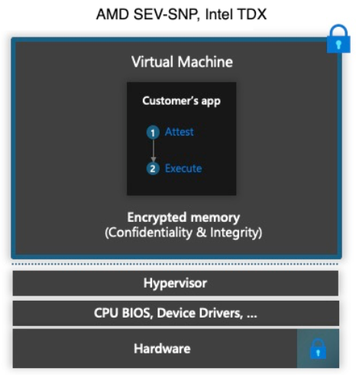
Azure Database for PostgreSQL (2/4)
Public Preview: Confidential computing for Azure Database for PostgreSQL flexible server
MS announced support of confidential computing in Azure Database for PostgreSQL flexible server. With confidential computing enabled, it is possible to enhance the security of sensitive and regulated data, helping mitigate unwanted data access by cloud providers, administrators, or external users. Azure confidential computing encrypts data in hardware-based trusted execution environments (TEEs), processing data only when the cloud environment has been verified.
Confidential Computing is only available in the UAE North.
High Availability isn't supported for Confidential Compute SKUs.
Point-in-time Restore (PITR) from nonconfidential compute SKUs to confidential ones isn't allowed.
Compute scaling operation between confidential and nonconfidential compute options.

Slide 48
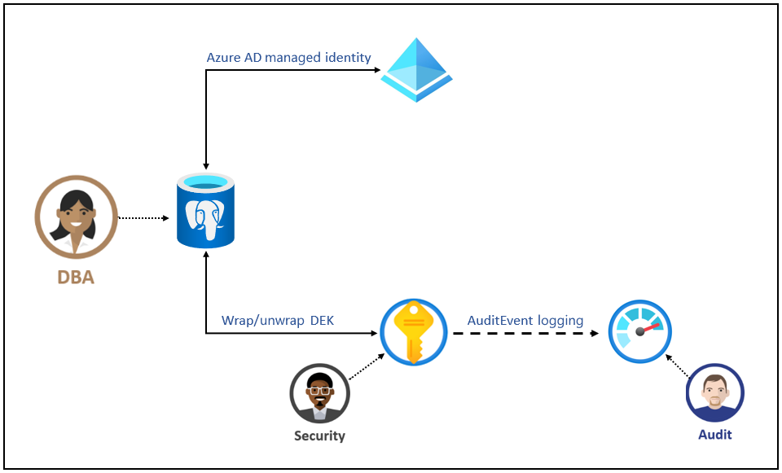
Azure Database for PostgreSQL (3/4)
Generally Available: Versionless customer managed keys in Azure Database for PostgreSQL flexible server
It is no longer need to manage the key version for customer-managed keys (CMKs) in Azure Database for PostgreSQL flexible server. Versionless keys automate the propagation of newly rotated CMKs independent of the rotation method (auto-rotation or manual).
Long-term Backups in Azure Database for PostgreSQL – Flexible Server Now Generally Available
MS announced the general availability of Long-Term Retention (LTR) backups for Azure Database for PostgreSQL flexible server across all Azure regions. This powerful new capability addresses critical enterprise needs for compliance, audit readiness, and long-term data durability

Slide 49
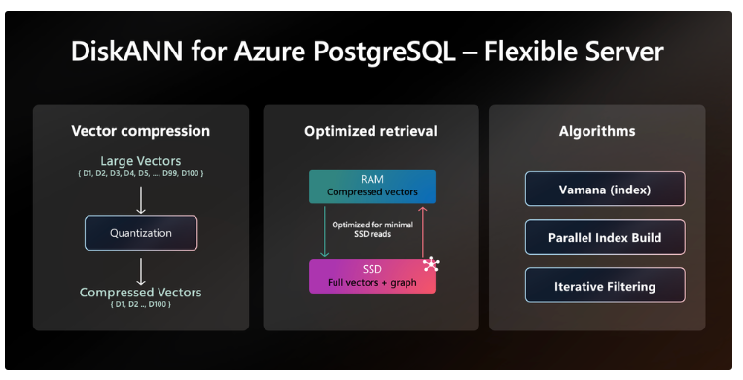
Azure Database for PostgreSQL (4/4)
Public Preview: Azure Database for PostgreSQL Azure AI extension managed identity support
With managed identity support in the Azure AI extension on Azure Database for PostgreSQL – Flexible Server, it is no longer needed to store secrets (access tokens) to Azure OpenAI, Azure AI Services, and Azure Machine Learning services within the PostgreSQL database itself. This change simplifies access management, removes the need for secret rotation and prevents accidental secret exposure in your environment.
Generally Available: DiskANN on Azure Database for PostgreSQL
MS announced the general availability of DiskANN—one of the fastest vector indexing algorithms on the market—on Azure Database for PostgreSQL.
DiskANN is a high-performance approximate nearest neighbor (ANN) search algorithm built for scalable vector search. It delivers the high recall, high throughput, and low latency required by today’s most demanding agentic AI and retrieval-augmented generation (RAG) workloads.

Slide 50
Azure Cosmos DB for MongoDB (1/4)
Generally Available: Migrate from Azure Cosmos DB Mongo DB RU-based to vCore-based via Azure portal
It is now possible to move to vCore-based Azure Cosmos DB for MongoDB at no cost using the Azure portal, with no additional resources required.
With this new feature, it is possible to perform a seamless, free, and no-installation migration process. The entire migration is portal-based, enabling to manage everything directly from the Azure portal without needing any extra software or tools.
This feature supports both online and offline migration, enabling to transition to vCore-based without the financial burden.
Generally Available: Microsoft Entra ID for Azure Cosmos DB for MongoDB (vCore)
Azure Cosmos DB for MongoDB (vCore) now supports authentication via Microsoft Entra ID, enhancing security and simplifying identity management. With this update, it is possible to add Entra ID accounts directly to MongoDB vCore clusters and use them for secure database access. Previously, authentication was limited to native, per-cluster database users.
This integration streamlines administrative tasks by enabling centralized identity management across multiple clusters. It also supports enforcement of Microsoft Entra ID policies, such as password complexity and multifactor authentication, without the need for repetitive user setup on each individual cluster.

Slide 51
Azure Cosmos DB for MongoDB (2/4)
Generally Available: DiskANN in vCore-based Azure Cosmos DB for MongoDB
DiskANN is now generally available in vCore-based Azure Cosmos DB for MongoDB, giving a powerful vector search capabilities directly within database.
With support for up to 4,000 dimensions, this release makes it easier to work with modern embedding models and large-scale AI workloads. DiskANN uses an optimized compression algorithm (PQ) to store and search vectors efficiently, reducing memory consumption while boosting search speed.
Generally Available: Filtered vector search in Azure Cosmos DB for MongoDB (vCore)
Filtered vector search is now generally available in Azure Cosmos DB for MongoDB (vCore). With this release, it is possible to narrow down search space, filtering before running a vector search to make results more accurate and performance significantly faster—especially on large datasets.
This feature works with all supported vector indexes, including inverted file index (IVF), hierarchical navigable small world (HNSW), and DiskANN.

Slide 52
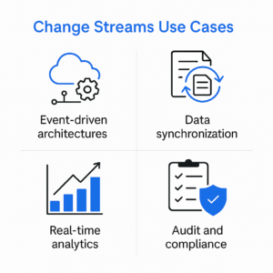
Azure Cosmos DB for MongoDB (3/4)
Public Preview: Azure Cosmos DB for MongoDB (vCore) trigger and bindings for Azure Functions
Integration between Azure Functions and Azure Cosmos DB for MongoDB (vCore) is now available in public preview. It is now possible to respond to changes in collections using Azure Functions triggers and bindings, enabling to easily build real-time, event-driven applications. The public preview supports Azure Functions triggers in C# for Azure Cosmos DB for MongoDB (vCore).
General Availability of Change Streams in vCore-Based Azure Cosmos DB for MongoDB
MS announced the general availability (GA) of Change Streams for Azure Cosmos DB for MongoDB (vCore)—empowering developers to build real-time, event-driven applications with ease and scale.
With Change Streams now in GA, applications can react instantly to data changes in the database, enabling low-latency use cases such as live dashboards, alerting systems, and reactive microservices.

Slide 53
Azure Cosmos DB for MongoDB (4/4)
Generally Available: Change streams for Azure Cosmos DB for MongoDB (vCore)
It is now possible to capture real-time data changes using change streams in Azure Cosmos DB for MongoDB (vCore). This new capability eliminates polling overhead and enables real-time analytics, automation, and synchronization across distributed systems. And with native support for the PyMongo driver, Kafka, and Azure Functions, integrating change streams into your workflows is simple and scalable.

Slide 54
Azure Cosmos DB for NoSQL (1/2)
Generally Available: Phrase search in Azure Cosmos DB for NoSQL
It is now possible to use phrase search in Azure Cosmos DB for NoSQL to find exact sequences of words. This capability makes full-text search more precise and powerful. With phrase search, applications can match entire phrases rather than just individual keywords, helping return results that are more relevant and contextually accurate.
This capability is especially useful when users are searching for specific product names, titles, quotes, or multiple-word terms where word order matters. Instead of retrieving documents that contain the right words in the wrong context, phrase search ensures your results match exactly what the user intended.
In any application needing highly relevant text search—from content and knowledge management to GenAI, e-commerce, and customer support experiences—phrase search gives you the control to deliver more targeted and meaningful results from searching your Azure Cosmos DB data.
Public Preview: Multiple-language full-text search in Azure Cosmos DB for NoSQL
It is now possible to perform full-text search and scoring in multiple languages with Azure Cosmos DB for NoSQL. Previously limited to English, full-text indexing and BM25-based ranking now support a growing set of languages, enabling to build intelligent, multilingual search and GenAI experiences directly within your database.
This release makes it easier to serve global audiences with culturally relevant and linguistically accurate results.
Language-specific tokenization, normalization, and scoring ensure that your search results stay relevant and precise across diverse regions without requiring external search engines or services.

Slide 55
Azure Cosmos DB for NoSQL (2/2)
Generally Available: Full text and hybrid search in Azure Cosmos DB for NoSQL
Native full-text and hybrid search capabilities in Azure Cosmos DB for NoSQL are now generally available.
Key capabilities include:
Full-text search. Efficiently perform powerful text searches directly within your Azure Cosmos DB accounts. Use advanced text analytics such as tokenization and stemming for precise, relevant results.
BM25 text ranking. Enhance search accuracy with BM25 ranking, a proven algorithm that considers term frequency, document length, term significance, and other factors to surface the most relevant documents from text searches.
Hybrid search. Achieve superior relevancy and accuracy by combining vector search with BM25-based text ranking. Utilizing Reciprocal Rank Fusion (RRF), hybrid search merges and ranks search results to deliver highly contextual and precise outcomes.

Slide 56
Azure Cosmos DB Updates (1/6)
Public Preview: Filtered Vector Search with DiskANN
It is now possible to use filtered DiskANN in Azure Cosmos DB for NoSQL to run fast, filter-aware vector searches that adapt dynamically to data and query shape. Filtered DiskANN delivers even lower latency, higher recall, and lower cost efficiency on filtered vector search without post-processing or complex setup.
Filtered DiskANN intelligently chooses the best execution path based on the structure of query and how selective filters are. If query includes a VectorIndexShardKey (configured using sharded DiskANN and included in your filter), Azure Cosmos DB uses that to route the search to the correct vector index shard. This filtering improves performance and lowers costs by narrowing the search space early.
Generally Available: Change capacity mode from serverless to provisioned throughput in Azure Cosmos DB
It is now possible to change the capacity mode of an Azure Cosmos DB account from serverless to provisioned capacity in-place using the Azure portal or Azure CLI. This new capability makes it easy for you to transition to the performance and comprehensive service-level agreement provided by provisioned capacity mode.
This is one time migration that is; the account can't be reversed to serverless capacity mode again.
There's no SLA associated with the duration of migration.
Any management operation can't be executed while the migration is in progress.
In cases where you need to restore a deleted Cosmos DB account, the account is restored to provisioned throughput if the capacity mode was changed from serverless to provisioned, irrespective of the backup timestamp.
In cases where you need to restore a deleted serverless container within an existing account, which was migrated from serverless to provisioned throughput, contact Microsoft support.

Slide 57
Azure Cosmos DB Updates (2/6)
Public Preview: Throughput buckets in Azure Cosmos DB
It is possible to control application's throughput consumption by configuring throughput buckets in a container and specifying a maximum throughput percentage for each one. When a bucket exceeds its assigned limit, incoming requests are throttled to maintain isolation and avoid contention between different applications sharing the same container.
Public Preview: Per Partition Automatic Failover for Azure Cosmos DB
MS announced an expanded active-active support to strong consistency through per partition automatic failover. This enables to achieve near zero downtime and zero data loss with strong consistency guarantees in an entirely automatic manner. This new capability enhances the continuity and resilience of applications by automatically responding to service disruptions without any manual intervention.
Per Partition Automatic Failover (PPAF) helps ensure that service remains available by intelligently routing requests to healthy partitions during localized or regional outages, helping maintain a seamless experience for services. By enabling partition-aware write region election, it minimizes the scope of impact and improves recovery speed, all while adhering to your configured region priorities.

Slide 58
Azure Cosmos DB Updates (3/6)
Public Preview: Aggregated diagnostics Logs for Azure Cosmos DB
The Aggregated Diagnostics Logs (Preview) feature is designed to deliver significant cost savings and enhanced troubleshooting capabilities with Azure Cosmos DB diagnostics logs. Traditionally, logging detailed per-request traces in the diagnostics logs can incur substantial costs, especially in environments with high volumes of requests. This new feature provides an efficient solution by aggregating the diagnostic data into 5-minute and 15-minute intervals, creating a compact yet comprehensive table that encapsulates all the necessary data to troubleshoot common scenarios. By switching from detailed per-request trace logs to aggregated data points, you can see an estimated 90% reduction in costs related to logging activities in the CDBDataplaneRequests table
Public Preview: Fuzzy text search in Azure Cosmos DB for NoSQL
It is now possible to use fuzzy search in Azure Cosmos DB for NoSQL to deliver more flexible and forgiving search experiences—directly within database. With fuzzy search in public preview, applications can return relevant results even when users make typos, use alternate spellings, or enter incomplete terms.
Whether you’re building GenAI apps, customer support tools, or e-commerce experiences, fuzzy search helps you improve recall and usability without relying on external search engines or complex integrations. Combined with the existing full-text and hybrid search capabilities in Azure Cosmos DB for NoSQL, it is now possible to create rich, intelligent search experiences that scale globally and perform with the efficiency of a native feature built right into the database.

Slide 59
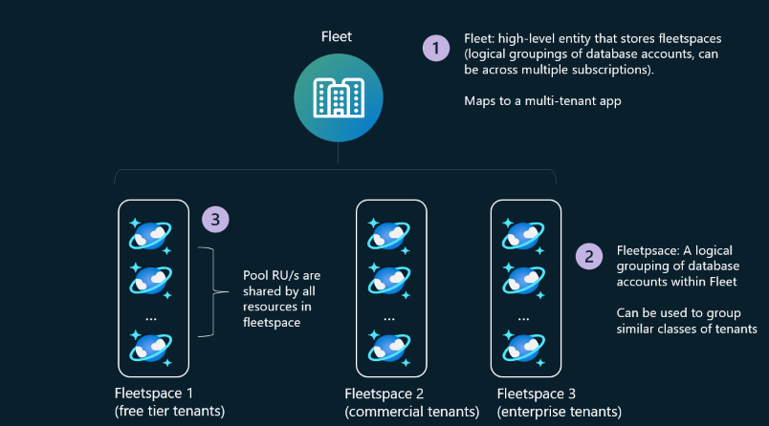
Azure Cosmos DB Updates (4/6)
Public Preview: Azure Cosmos DB fleets
Now you can more easily operate your Azure Cosmos DB accounts at scale.
It is possible to simplify capacity management by creating a pool of throughput (RU/s) that can be shared by accounts in the fleet. Getting all the security and performance isolation benefits of creating one Azure Cosmos DB account to represent a tenant or end customer, while also efficiently sharing RU/s resources across tenants to avoid overprovisioning at the per-tenant level.
Azure Cosmos DB fleets introduce two key capabilities—pools and fleet analytics and monitoring—to simplify capacity management and provide at-scale visibility across your tenant environments.
Public Preview: Azure Cosmos DB global secondary index
The Azure Cosmos DB global secondary index public preview now offers more functionality to optimize queries. Previously known as materialized views, global secondary indexes are read-only containers that automatically sync data from a source container. They have an independent partition key, data model, and index policy, allowing you to fine-tune them for any query pattern.
To ensure that global secondary index containers stay up to date with source data, they must use autoscale throughput. Compatibility with other features has also increased, including continuous backups, which are required before enabling global secondary indexes.

Slide 60
Azure Cosmos DB Updates (5/6)
Generally Available: Azure Cosmos DB integration in Azure AI Agent Service
It is now possible to use the data stored in Azure Cosmos DB accounts to power AI solutions built in Azure AI Foundry.
Azure Cosmos DB is the first Azure database able to power Azure AI Foundry agents and models in Azure AI Foundry with real-time, operational data. It is possible to connect and access Azure Cosmos DB data using the Azure AI Foundry portal or natively in application code with the Azure AI Foundry SDK.
Public Preview: At-scale Insights dashboard for Azure Cosmos DB
The redesign of the At-scale Insights dashboard for Azure Cosmos DB provides a central view for monitoring Azure Cosmos DB workloads, along with new features and integrations to help manage resources at scale.
The updated dashboard enables to drill down into performance metrics at both the database and collection levels, offering more detailed insights. It works with Azure Monitor Alerts, displaying critical alerts directly in the dashboard, and includes Azure Recommendations for optimization suggestions. New metrics insights, such as percentage of throttled requests and count of accounts/ApiType per region, give visibility into request load across regions. The redesigned interface improves usability, so you can quickly analyze results and respond to issues for optimizing Azure Cosmos DB workloads.

Slide 61
Azure Cosmos DB Updates (6/6)
Public Preview: Document indexing with Azure Logic Apps and Azure Cosmos DB
It is now possible to quickly turn documents into searchable data using new Azure Logic Apps workflow templates designed to streamline semantic search in Azure Cosmos DB for NoSQL. With just a few clicks, it is possible to extract text from files—including PDFs, Microsoft Office documents, images, markdown, and plain text—then chunk that content, generate vector embeddings using Azure OpenAI, and insert it into Cosmos DB collection for both vector similarity and full-text search.
These prebuilt workflows help pull in documents from Azure Blob Storage or Microsoft SharePoint, then use either a standard text parser or Azure Document Intelligence to extract readable text—even from scanned images or PDFs using optical character recognition (OCR). This new capability simplifies a previously complex, multiple-step process and allows to build GenAI, search, and retrieval augmented generation (RAG) applications faster and more reliably.
Generally Available: Vector search in DocumentDB
Vector search is now generally available in DocumentDB, the open-source engine powering vCore-based Azure Cosmos DB for MongoDB. It allows to build smarter applications that go beyond keyword search. Vector search helps find similar items in data—like matching product descriptions, identifying related content, or analyzing unstructured inputs such as images or embeddings. Built directly into DocumentDB, this update means it is not needed to integrate separate services or move data elsewhere.

Slide 62
Azure SQL Updates (1/3)
Public Preview: JSON Index
In mid-May 2025, the following updates and enhancements were made to Azure SQL:
New JSON index can be used to index JSON documents stored in a column of JSON type.
JSON index allows for efficient searching of JSON documents using JSON functions and relational operators.
Public Preview: SQL Server 2025 enterprise AI-ready database from ground to cloud
SQL Server 2025, now in public preview, is built on a foundation known for best-in-class security and performance. It provides built-in, extensible AI support, enhanced developer productivity, and seamless integration with Azure and Microsoft Fabric—all within the SQL Server engine, using the familiar T-SQL language.
Boost search intelligence by using advanced semantic search alongside full-text search and filtering.
Processing and manage data flows more simply and efficiently using native JSON support, built-in REST API, Change Event Streaming for real-time data updates, and more.
Leverage the most secure database to improve credential management, reduce potential vulnerabilities, with support for Microsoft Entra-managed identities through Azure Arc.
Increase workload uptime and improve concurrency for SQL Server applications with enhanced query optimization, optimized locking, and improved failover reliability.
Achieve zero-ETL, real-time analytics by replicating SQL Server data to Microsoft OneLake with Fabric database mirroring.

Slide 63
Azure SQL Updates (2/3)
Generally Available: Improved free Azure SQL Managed Instance offer
The free offer for SQL Managed Instance is now generally available, making it very easy to try out SQL Managed Instance for workload. The free offer applies to existing Pay-As-You-Go, Enterprise Agreement, Azure Plan, and many other subscription types. When you’re ready to move workload into production, it’s easy—with two clicks, convert it, get the 99.99% uptime service-level agreement, and a myriad of configuration options.
It allows to utilize a General Purpose or Next-Gen General Purpose (preview) Azure SQL Managed Instance at no cost for up to 12 months. With support for up to 500 databases, that allows to:
Build applications with functionalities such as cross-database queries,
Evaluate strategies to migrate your SQL Server applications to Azure,
Explore some of the state-of-the-art PaaS capabilities like automated backups, availability, and more
The free SQL Managed Instance Offer includes:
One General Purpose or Next-Gen General Purpose (preview) SQL managed instance per subscription.
720 vCore hours every month (renews every month, unused credits are lost).
64 GB of data storage.
SQL license for the instance.
Automatically backed up databases retained for up to 7 days.
Default workday start/stop schedule from 9-5 to ensure frugal utilization of your free credits.
Creation of up to 500 databases
The instance is automatically stopped when you reach the monthly vCore limit. If the start/stop schedule is set on the instance the next scheduled start succeeds when credits are available gain.

Slide 64
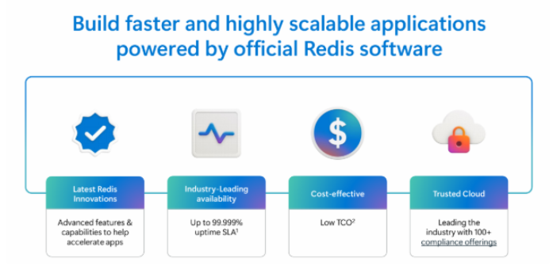
Azure SQL Updates (3/3)
Generally Available: Azure Managed Redis
Azure Managed Redis brings the latest Redis innovations with enhanced availability and cost-effective operations. Azure Managed Redis boosts AI application performance, supports session management, and interoperates seamlessly with various Azure services. Azure Managed Redis boosts AI application performance, supports session management, and interoperates seamlessly with various Azure services.
With four tiers, it is possible to customize Redis solution to match specific performance and memory requirements. Azure Managed Redis also delivers up to 99.999% availability for uninterrupted access to mission-critical apps, while offering enterprise-level security and password-free authentication through Microsoft Entra ID.

Slide 65
Integration

Slide 66
Azure Logic Apps Updates (1/3)
Public Preview: Build Agentic Business Processes with the Agent Loop in Azure Logic Apps
Introducing the agent loop, a groundbreaking new action now in public preview in Azure Logic Apps.
Unlike traditional business processes that follow step-by-step instructions, the agent loop enables goal-based automation. Just define the outcome, and the system figures out how to achieve it, adapting, reasoning, and learning in real time. This marks a fundamental shift from deterministic automation to agentic, intelligent business processes.
With the Agent Loop, Azure Logic Apps is evolving into a platform for agentic business process orchestration, enabling goal-driven, adaptive business processes powered by reasoning engines with:
Enterprise-grade scalability and security
Hybrid and on-premises integration with Logic Apps Standard
Agent orchestration through integration with Semantic Kernel
1400+ connectors for fast integration across your stack
This innovation unlocks automation scenarios that were previously too complex or dynamic to tackle empowering your organization to build next-gen intelligent workflows with full flexibility and control.
Generally Available: Azure Logic Apps Rules Engine
Announcing the general availability of the Azure Logic Apps Rules Engine, bringing low-code, flexible business logic capabilities to your cloud-native workflows.
Business Rules Engines (BRE) enable organizations to define, manage, and update business logic without writing code or redeploying applications. This is especially valuable in decentralized, microservices-based architectures, where rules engines help ensure consistency, compliance, and maintainability across distributed systems.
Key Highlights:
Low-code, high-productivity rule creation using Visual Studio Code
RETE runtime engine support, consistent with the one used in BizTalk Server
Support for .NET and XML facts, making it easy to build rules around structured business data
Migration-ready for BizTalk customers, including those using SWIFT-based solutions
BRE rule reuse, enabling existing BizTalk Business Rules to be brought into Logic Apps (note: export each policy individually as policies are no longer grouped)

Slide 67
Azure Logic Apps Updates (2/3)
Public Preview: Streamlined Document Ingestion into Azure Cosmos DB with Azure Logic Apps
Native integration between Azure Cosmos DB and Azure Logic Apps for document ingestion enabling a faster, low-code path to bring your data into Cosmos DB from a wide variety of sources.
Out-of-the-box templates and connectors, allows to create end-to-end ingestion workflows in just a few clicks. This seamless experience allows to:
Ingest documents from diverse data sources with minimal effort
Trace each ingestion step via Logic Apps run history for full observability
Accelerate Retrieval-Augmented Generation (RAG) scenarios by grounding AI agents in your unique knowledge base stored in Cosmos DB
This integration represents a major step forward in enabling AI-ready data pipelines with Cosmos DB making it easier to build intelligent, context-aware applications.
Public Preview: Automated Testing Framework for Azure Logic Apps (Standard)
This new capability empowers developers and integration specialists to build more reliable workflows by simplifying the unit testing experience within their local development environment.
Starting with version 5.58.8 of the Azure Logic Apps (Standard) extension for Visual Studio Code, it is possible to:
Generate unit tests from existing workflow runs or saved workflow definitions.
Edit and customize these tests directly within VS Code.
Execute tests locally, enabling faster validation and iteration before deploying to production.
This enhancement is designed to improve confidence in Logic Apps deployments and streamline CI/CD pipelines by enabling early detection of errors and regressions.

Slide 68
Azure Logic Apps Updates (3/3)
Announcement: Azure Logic Apps Document Indexer in Azure Cosmos DB
Logic Apps connectors and templates helps to ingest documents directly into Cosmos DB’s vector store—powering AI workloads like Retrieval-Augmented Generation (RAG) with ease.
This new capability orchestrates the full ingestion pipeline—from fetching documents to parsing, chunking, embedding, and indexing—allowing you to unlock insights from unstructured content across your enterprise systems.

Slide 69
Azure API Management Updates (1/5)
Public Preview: Model Context Protocol support in Azure API Management and Azure API Center
With this new capability, enterprises can transform their existing APIs into dynamic, agent-ready tools, while improving security and simplifying management.
Enhanced Security for MCP Servers:
Apply gateway policies to protect MCP servers by enforcing authentication, authorization, rate limiting, and other security measures.
Transform Existing APIs into MCP Servers:
Easily expose any APIM-managed API as an MCP server, transforming your existing APIs into dynamic, agent-ready tools with minimal effort.
Private MCP Registry for Enterprise Organizations:
Use Azure API Center as a private remote MCP registry for your organization, giving you full control over what services are exposed.
Streamlined MCP Discovery and Consumption:
Expose APIs as MCP servers in Azure API Center (APIC) for a better developer experience and smoother API consumption.
Generally Available: Support for AWS Bedrock API in AI Gateway Capabilities in Azure API Management
Announcing expanded support for AWS Bedrock model endpoints across all Generative AI policies in Azure API Management’s AI Gateway. This release enables you to apply advanced management and optimization features such as Token Limit Policy, Token Metric Policy, and Semantic Caching Policy to AWS Bedrock models, empowering you to seamlessly manage and optimize your multi-cloud AI workloads.
Key benefits:
Apply token limiting, tracking, and logging to AWS Bedrock APIs for better control
Enable semantic caching to enhance performance and response times for Bedrock models
Achieve unified observability and governance across multi-cloud AI endpoints

Slide 70
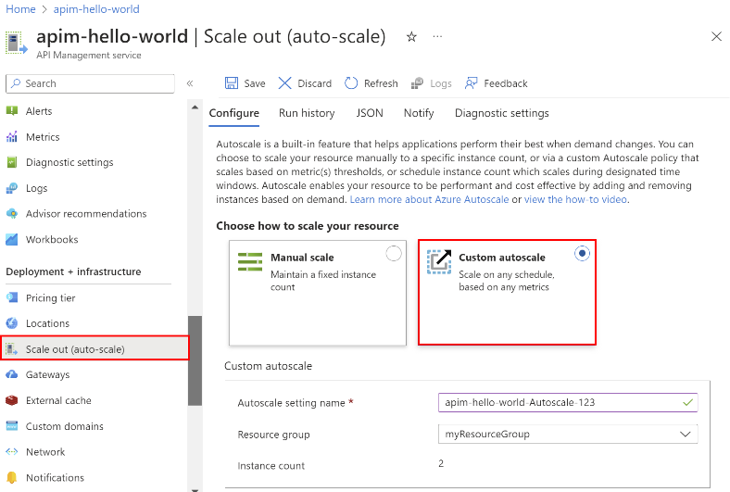
Azure API Management Updates(2/5)
Public Preview: Premium v2 Tier for Azure API Management
The Premium v2 tier introduces a new architecture that separates management traffic from the customer VNet, simplifying private networking and enhancing security.
Key capabilities include:
Improved VNet injection: No need for network security group rules, route tables, or service endpoints. Microsoft and customers can manage their respective infrastructure and workloads independently.
Flexible networking configuration: Route outbound traffic through an NVA, enforce forced tunneling, or monitor inbound traffic with a WAF—without architectural constraints.
Enterprise-grade scale and performance: Unlimited included calls, highest entity limits, and high availability to meet the needs of complex API landscapes.
Generally Available: Workspace Gateway Autoscaling in Azure API Management
With the introduction of autoscaling in workspace gateways, customers can now increase the reliability of their deployments. Autoscaling dynamically adjusts the scale of a workspace gateway based on real-time demand, ensuring seamless performance during traffic spikes while maintaining efficient usage during quieter periods. Autoscaling can be configured using rules—for example, based on gateway metrics, such as CPU and memory utilization, or a schedule.
This capability not only enhances operational reliability but also optimizes platform costs by scaling resources precisely to the needs of your API environment.

Slide 71
Azure API Management Updates(3/5)
Public Preview: Applications in Azure API Management
API Management now supports built-in OAuth 2.0 application-based access to product APIs using the client credentials flow. This feature allows API managers to register Microsoft Entra ID applications, streamlining secure API access for developers through OAuth 2.0 authorization.
API managers can now identify specific products which are protected by Microsoft Entra identity by enabling "Application based access". This ensures that only valid client applications which have a secure OAuth token from Microsoft Entra identity can access the APIs associated with this product.
Generally Available: Import from Azure AI Foundry to Azure API Management’s AI Gateway
Announcing the general availability of importing model endpoints from Azure AI Foundry directly into Azure API Management’s AI Gateway. This capability simplifies onboarding of large language model (LLM) APIs by enabling seamless integration through the Azure portal.
Key benefits:
Rapid onboarding of LLM endpoints from Azure AI Foundry
Configure token limiting, token tracking, semantic caching, and content safety
Centralized API governance and observability for generative AI workloads

Slide 72
Azure API Management Updates(4/5)
Public Preview: New Monitoring and Alerting Capabilities in Azure Integration Environment
Azure Integration Environment has a new features that further simplify monitoring and manage integration applications across Azure.
Now in public preview, Azure Integration Environment offers:
A simple, intuitive single-pane user experience to configure alerts at scale across Azure Logic Apps, Azure API Management, and Azure Service Bus
An integrated health monitoring view that provides real-time visibility into the status and performance of all integration applications
These enhancements build on the core promise of Azure Integration Environment—unified observability, logical organization, and business context for your integration resources.
Public Preview: New Free Tier in Azure API Center
Announcing Azure API Center is transitioning from a 90-day free trial period to offering a free tier. Azure API Center serves as a centralized hub to catalog, discover, and manage MCP servers and APIs, regardless of their type or deployment location within your organization. Using API Center customers can drive reuse, consistency, and collaboration at scale. And using the VS Code plugin or the new managed developer portal, their developers can quickly find and use the APIs and agent tools that power their application and AI workloads.

Slide 73
Azure API Management Updates(5/5)
Announcing Federated Logging in Azure API Management
Federated logging centralizes insights for platform teams while empowering API teams with focused access to logs specific to their APIs, streamlining monitoring in large-scale API ecosystems.
Centralized Monitoring for Platform Teams: Complete visibility into API health, performance, and usage trends across the organization.
Autonomy for API Teams: Direct access to their own API logs, reducing reliance on platform teams and speeding up resolution times.
Federated logging is enabled using Azure Log Analytics and workspaces in Azure API Management:
Platform teams configure logging to a centralized Log Analytics workspace for the entire API Management service, including individual workspaces.
Platform teams can access centralized logs through the “Logs” page in the API Management service in the Azure portal or directly in the Log Analytics workspace.
API teams can access logs for their workspace APIs through the “Logs” page in their API Management workspace in the Azure portal. Access control is enforced via Azure Log Analytics’ resource context mechanism, ensuring role-based log visibility.
Workspace Gateway Metrics and Autoscale in Azure API Management
API Management workspace gateways now support two metrics:
CPU Utilization (%): Represents CPU utilization across workspace gateway units.
Memory Utilization (%): Represents memory utilization across workspace gateway units.
Both metrics should be used together to make informed scaling decisions.

Slide 74
Azure Integration Updates
Azure Event Grid updates
General Availability
Cross-tenant event delivery using a managed identity – It supports delivery to Event Hubs, Service Bus, Storage Queues, and dead letter storage using managed identity with federated identity credentials (FIC) from Azure Event Grid topics, domains, system topics, and partner topics.
Public Preview
Support of Network Security Perimeter (NSP) in Azure Event Grid topics and domains, for inbound and outbound communication. This perimeter defines a boundary with implicit trust access between each resource, where you can have sets of inbound and outbound access rules.
Message ordering now support within single MQTT client sessions, ensuring reliable sequential event delivery, and a connection rate limit of one attempt per second per session, which maintains system stability.
OAuth 2.0 JWT authentication support - This feature enables secure client authentication via JSON Web Tokens (JWT) issued by OpenID Connect (OIDC) compliant providers, providing a lightweight, secure, and flexible authentication option for clients not provisioned in Azure
Custom Webhook Authentication - has been introduced, allowing dynamic client authentication through webhooks or Azure Functions, with Entra ID JWT validation for centralized and customizable strategies.

Slide 75
ML & AI & IOT

Slide 76
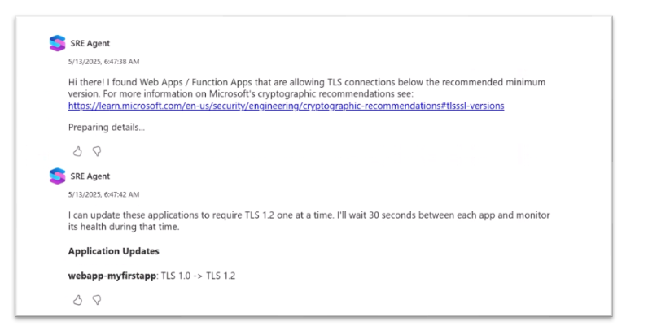
ML & AI & IOT Updates (1/6)
Introducing Azure SRE Agent
MS introduced Azure SRE Agent, an AI-powered tool that makes it easier to sustain production cloud environments. SRE Agent helps respond to incidents quickly and effectively, alleviating the toil of managing production environments.
Evaluating usage and performance trends
Proactive detection and remediation of security vulnerabilities
Automated incident response and Faster root cause analysis
Incident mitigation
Close the loop with developers
Public Preview: GitHub Copilot app modernization capabilities for Java and .NET
Upgrading and modernizing applications can be complex and time consuming for developers. GitHub Copilot now offers app modernization capabilities that enable developers to rapidly update, upgrade and modernize Java and .NET applications using autonomous AI agents.
The GitHub Copilot app modernization capabilities are divided into two key scenarios:
App modernization for Java: This capability provides comprehensive support for modernizing applications to Azure. The AI-based tool assesses application readiness for the cloud, proposes solutions and recommendations for target Azure services, remediates code and configurations, and automatically fixes code with human validation. Integrated into Visual Studio Code, it helps developers confidently modernize and run their applications on Azure, accelerating the entire modernization process.
Upgrade for Java and .NET: This capability offers AI-based solutions to upgrade Java and .NET applications, dependencies, and frameworks with minimal manual effort (for .NET we currently support core to core upgrade experience). Integrated into Visual Studio Code (Java) and Visual Studio(.NET), it provides end-to-end support for the upgrade process, including generating an upgrade plan, offering step-by-step transition guidance, automatically fixing issues, and providing summaries. Human validation and review are incorporated to ensure accuracy and reliability of the upgrade.

Slide 77
ML & AI & IOT Updates (2/6)
Generally Available: GitHub Copilot for Azure
GitHub Copilot for Azure is now generally available, bringing disruption-free cloud development, Infrastructure as Code (IaC) support, and intelligent diagnostics to streamline your workflow. It helps to create deployments with Bicep and Terraform, efficient issue identification and resolution, and deep integration with Azure resources, GitHub Copilot for Azure empowers developers to build, manage, and troubleshoot applications effortlessly.
Generally Available: Natural Language App Code Generation
In this new update, we are making it easier than ever for developers to get started creating their AI application with Azure..
Key Features:
App generation: By describing the desired app in natural language, developers can have the app code built for them automatically, streamlining the development process.
Seamless integration with vscode.dev/azure: The gallery connects with vscode.dev/azure, enabling developers to get started with their AI projects in minutes, providing a smooth transition from template selection/creation to customization deployment.
Natural language search: Developers can easily find the templates they are looking for by simply describing what they need in natural language, making the search process more intuitive and efficient.
Template hardening: improved UX for quota, capacity, and region availability.
Adding new templates: 20+ new templates across different AI topics.

Slide 78
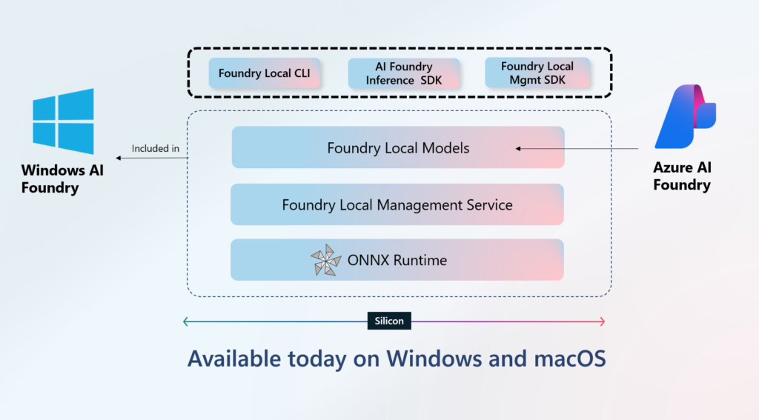
ML & AI & IOT Updates (3/6)
Generally Available: Azure AI Foundry Agent Service
It supports multi-agent workflows, allowing specialized agents to handle complex tasks, accelerate decisions, and boost operational efficiency. With open protocols like Agent-to-Agent (A2A) and Model Context Protocol (MCP), it enables seamless interoperability while maintaining control over orchestration.
The service integrates with knowledge sources like Bing, SharePoint, Databricks, and Microsoft Fabric, and includes a centralized catalog of tools and pre-built agent templates for easy customization. It also leverages a unified runtime that combines Semantic Kernel and AutoGen, offering a consistent experience for building, testing, and deploying agents locally or in the cloud.
Public Preview: Foundry Local for on-device AI
Foundry Local makes it easy to run AI models, tools and agents directly on-device, whether Windows 11 or MacOS . Foundry Local includes model inferencing, models, agents as a service, and model playground for fast and efficient local Al development. This new capability brings the power of open-source models in Azure Al Foundry Models to client devices including Windows 11 and MacOS, starting today.

Slide 79
ML & AI & IOT Updates (4/6)
Public Preview: Native Integration of Azure Logic Apps with Azure AI Search for RAG Workflows
Announcing the public preview of native Azure Logic Apps integration with Azure AI Search, delivering a seamless Bring Your Own Search (BYOS) experience for document ingestion in Retrieval-Augmented Generation (RAG) scenarios.
This new experience empowers developers and enterprises to:
Ingest content from diverse sources using Logic Apps templates and connectors
Push data directly into Azure AI Search vector stores with ease
Build personalized AI agents grounded in proprietary knowledge sources
Drive faster insights through efficient, intelligent retrieval
Reduce the complexity of AI workflow design with low-code automation
Announcement: Power your Agents in Azure AI Foundry Agent Service with Azure Logic Apps
Public Preview of two major integrations that bring the power of Azure Logic Apps to AI Agents in Foundry:
Logic Apps as tools: It is now possible to Logic Apps workflows—and their 1400+ connectors—as tools within the Azure Foundry AI Agent Service. This unlocks seamless integration between AI agents and enterprise-grade automation—enabling agents to reason and act through Logic Apps.
AI Agent Service connector: A new Logic Apps connector for the AI Agent Service is now available, allowing you to build workflows that can trigger agents based on events across hundreds of applications. This enables your agents to respond proactively and continuously—bringing event-driven autonomy to your AI solutions.

Slide 80
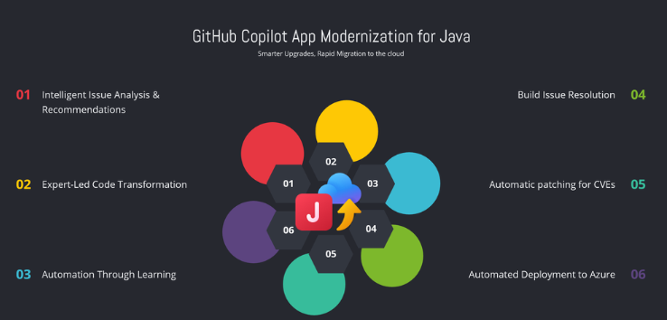
ML & AI & IOT Updates (5/6)
Azure AI Content Understanding Pro Mode
Pro mode enables enhanced reasoning, validation, and information aggregation capabilities.
These updates allow the service to aggregate and compare results across sources, enrich extracted data with context, and deliver decisions as output. While Standard mode continues to offer reliable and scalable field extraction, Pro mode extends the service to support more complex content interpretation scenarios—enabling workflows that reflect the way people naturally reason over data.
Multi-Content Input
Process and aggregate information across multiple content files in a single request. Pro mode can build a unified schema from distributed data sources, enabling richer insight across documents.
Multi-Step Reasoning
Go beyond basic extraction with a process that supports reasoning, linking, validation, and enrichment.
Knowledge Base Integration
Seamlessly integrate with organizational knowledge bases and domain-specific datasets to enhance field inference. This ensures outputs can reason over the task of generating the output using the context of your business.
Public Preview: GitHub Copilot App Modernization for Java
GitHub Copilot App Modernization for Java is a powerful solution designed to simplify and accelerate your journey to the cloud. App Modernization and upgrade for Java offers an intelligent, guided approach that automates Java version upgrade and repetitive tasks and improves consistency — saving time, reducing risks, and accelerating time-to-cloud.

Slide 81
ML & AI & IOT Updates (6/6)
Azure MCP Server now includes support for Azure Database for PostgreSQL
Azure MCP Server has extended its capabilities to include support for Azure Database for PostgreSQL. The Azure MCP Server, introduced in Public Preview last month, leverages the Model Context Protocol (MCP) to allow AI agents to seamlessly interact with various Azure services (including Azure AI Search, Azure Cosmos DB, Azure Storage, and Azure Monitor) to perform context-aware operations such as querying databases and managing cloud resources.

Slide 82
DevOps & IaC & Automation

Slide 83
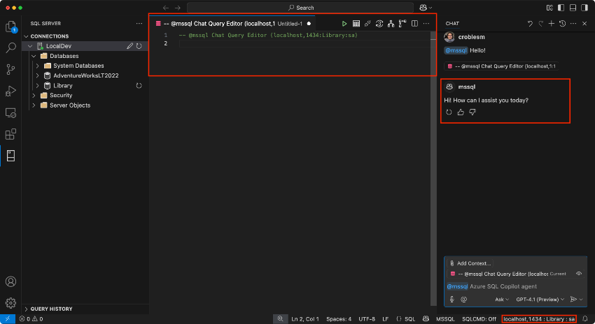
DevOps & IaC & Automation (1/4)
Public Preview: MSSQL Extension Integrates GitHub Copilot in VS Code
The MSSQL extension for Visual Studio Code now works with GitHub Copilot, bringing AI-powered SQL assistance directly into development workflow. This integration enables to work with database schema using GitHub Copilot. With just a few clicks in Visual Studio code, it is possible to generate T-SQL and ORM code, explore schemas, and, even if you’re new to SQL, build, analyze, and optimize queries—all with help from GitHub Copilot.
MSSQL Extension for VS Code: New UI Goes GA
Connection Dialog: Quickly connect to local or cloud databases using parameters, connection strings, or Azure browsing. Easily access saved and recent connections.
Object Explorer: Navigate complex database hierarchies with advanced filtering by object type, name, and schema.
Table Designer: Visually build or update tables, define relationships and constraints, and publish schema changes with a T-SQL preview.
Query Results Pane: Export, sort, and inspect query results in-grid or in a new tab. Includes Estimated and Actual Execution Plan buttons for performance analysis.
Query Plan Visualizer: Explore query execution plans with zoom, metrics, and node-level insights to help you identify and resolve performance bottlenecks.

Slide 84
DevOps & IaC & Automation (2/4)
Public Preview: Visual Studio Code extension for DocumentDB
The DocumentDB Visual Studio Code extension is now available in public preview. This free, open-source extension integrates seamlessly into VS Code, giving a powerful and intuitive graphical user interface for managing databases across various environments.
Now it is possible to connect to DocumentDB resources with built-in authentication and intuitively manage data, executing queries and editing documents in real-time.
Public Preview: PostgreSQL extension for Visual Studio Code with GitHub Copilot
MS announced the public preview of the PostgreSQL extension for Visual Studio Code. With this powerful tool, allows to connect to PostgreSQL Database instances, run queries, create and manage connection profiles, and take advantage of Entra ID support, context-aware IntelliSense, syntax highlighting, and SQL formatting. Designed to boost your productivity and streamline development, the extension includes automated local database container deployments in Docker and the ability to chat with GitHub Copilot. With this extension, you can manage your PostgreSQL databases directly within your IDE, eliminating the need for context switching.

Slide 85
DevOps & IaC & Automation (3/4)
Public Preview: Empower AI development with new features in Microsoft Dev Box
With the new capabilities in Dev Box, developers can build AI apps effectively with quick, controlled access to serverless GPU resources, streamlined project-based configurations, and new AI-powered workflows.
Ready-to-code environments for AI development
Serverless GPU support: Developers can use serverless GPU resources on demand for critical workloads like AI model training and inferencing. (Preview)
Preconfigured Azure AI resources: Developers can now access Azure AI resources directly from their dev boxes within organizational guardrails. (Preview)
MCP server: The Dev Box MCP server exposes APIs to agents, enabling developers to create, customize, and control dev boxes with natural language. (Preview)
Team customizations and imaging: Dev leads can create project-based configurations for teams, with tools, packages and settings in a single config file and convert them into images. (Generally available)
Authoring agent: Dev leads can quickly setup team customizations without manually creating config files by using GitHub Copilot agent mode in VS Code. (Preview)
Public Preview: AI-powered actionable insights in Azure Load Testing
Azure Load Testing now offers AI-driven actionable insights (Preview) to help identify and resolve performance issues more quickly and confidently. This new capability automatically analyzes test run data to detect regressions, highlight bottlenecks, and surface patterns that are often hard to identify manually.
By correlating client-side and server-side telemetry, Azure Load Testing generates AI-powered summaries with root cause analysis and targeted recommendations—enabling you to focus on resolving issues instead of analyzing raw metrics.
To get started, enable server-side metrics when configuring test. Actionable insights will be available in the Azure portal once your run completes.

Slide 86
DevOps & IaC & Automation (4/4)
Generally Available: New fine-tuning capabilities in Azure AI Foundry
Azure AI Foundry supports Reinforcement Fine-Tuning (RFT) with the o4-mini model in Azure OpenAI, enabling adaptive learning for context-aware applications. Alongside RFT, MS introduced Global Training, allowing fine-tuning from 12+ Azure regions at reduced costs, and promoted Global Standard and Regional Provisioned Throughput deployment types to general availability, offering more cost and data residency flexibility.
To support rapid experimentation, a new Developer Tier was launched, providing free 24-hour hosting for fine-tuned GPT-4.1 and GPT-4.1-mini models with pay-per-token pricing. This tier is ideal for quick testing and model comparison before production.
Additionally, MS extended support for fine-tuned GPT-4o and GPT-4o-mini models, allowing continued deployment for 12 months post-retirement at no extra cost, providing continuity for long-term projects.

Slide 87
Miscellaneous

Slide 88
Miscellaneous Updates (1/2)
Generally Available: SQL Server Management Studio (SSMS) 21
With the release of SSMS 21, built on Visual Studio 2022, the platform continues to advance with 64-bit support, a modern installer, and automatic updates. This latest version introduces Git integration, initial dark theme support, and enhancements to the query editor, results grid, and Azure authentication. A few highlights include:
Installation and automatic updates via the Visual Studio Installer
Git integration available via the Code tools Workload
Smaller installation footprint and customizable installation via Workloads and Individual Components
A new, Modern connection dialog experience (Preview)
New options for customizing your SSMS experience (vertical tabs, tab coloring by project or file type, minimum and maximum tab width, font and background color for results grid cells containing NULL values, and more)
Always Encrypted Assessment available via the Always Encrypted Wizard
Migration assistance via the Hybrid and Migration Workload
Public Preview: Copilot in SQL Server Management Studio (SSMS) 21
Copilot in SQL Server Management Studio (SSMS) is an AI assistant to help with writing, editing, and fixing T-SQL queries using natural language. Copilot in SSMS grounds its responses in database context, providing responses customized to environment. Copilot in SSMS helps answer questions about database administration and maintenance, implementation and configuration, and more for SQL databases on-premises and in the cloud.

Slide 89
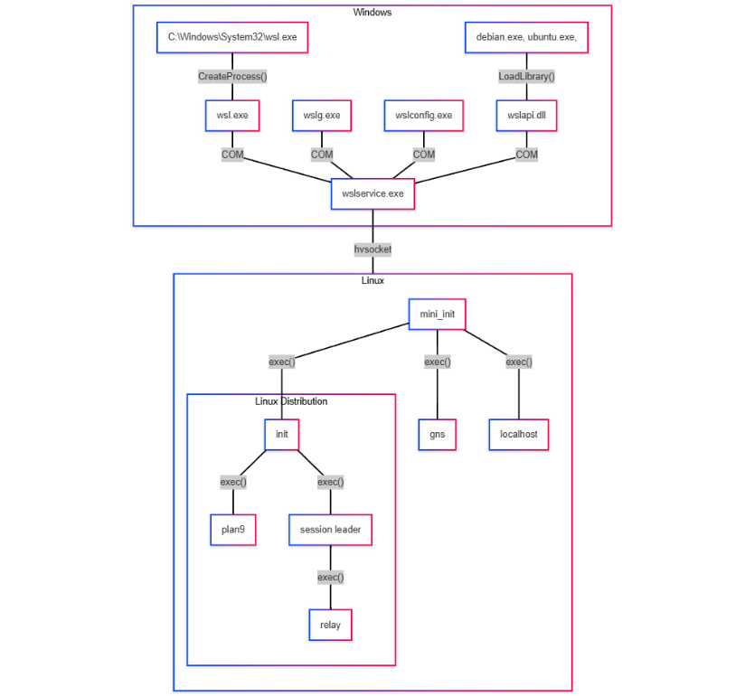
Miscellaneous Updates (2/2)
Microsoft Planetary Computer Pro — Now in Public Preview
Public preview of Microsoft Planetary Computer Pro — a turnkey platform that makes it dramatically easier for organizations to harness geospatial data for real-world impact.
Planetary Computer Pro is built on the trusted foundation of Microsoft Planetary Computer, which offers access to over 120 distinct geospatial datasets totaling over 50PB in volume. Planetary Computer Pro is a new Azure-native service purpose-built to help organizations manage, transform, and operationalize geospatial data at enterprise scale.
The Windows Subsystem for Linux is now open source
WSL is made of a set of distribution components. Some run in Windows, and some run inside the WSL 2 virtual machine. Here’s an overview of WSL’s architecture:

Slide 90
Information

Slide 91
Information
Azure Times GitHub Repo

Slide 92
Questions

