Slide 1
Azure Times #155
March 17, 2025

Slide 2
Networking

Slide 3
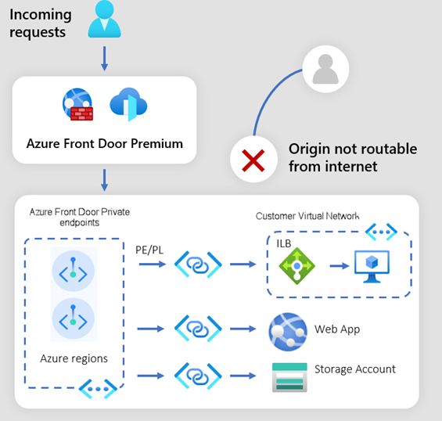
Networking Updates
Public Preview: New Origin Types for Azure Front Door Premium Private Link-Enabled Origins
It is now possible to configure Application Gateway, API Management, and Container Apps as Private Link-enabled origins in Front Door Premium profile.
Private Link-enabled origins in Front Door allow to deliver content to end-users through public Front Door endpoints while ensuring that origins remain inaccessible to the public internet.
Generally Available: Azure Virtual Network Manager Network Verifier
This feature enables to check if network policies allow or disallow traffic between Azure network resources.
It evaluates the following features:
Network security group (NSG) rules
Application security group (ASG) rules
Azure Virtual Network Manager security admin rules
Azure Virtual Network Manager mesh topology (connected group)
Virtual network peering
Route tables
Service endpoints & access control lists
Private endpoints
Virtual WAN
Azure Firewall (static L4 only)
It is possible to delegate network verifier resources to non-network manager users so they can troubleshoot reachability across the network manager’s scope without elevating their permissions at the subscription or management group level — effectively democratizing troubleshooting.

Slide 4
Security & Identity

Slide 5
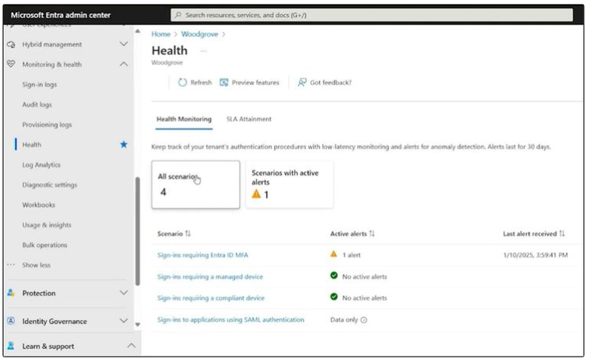
Security & Identity Updates
Introducing Microsoft Entra Health alerts
MS announced the launch of Microsoft Entra Health alerts, a new capability for detecting potential tenant health degradations, that layers on top of existing health metric data streams to enhance the observability of your tenant.

Slide 6
Management & Governance

Slide 7
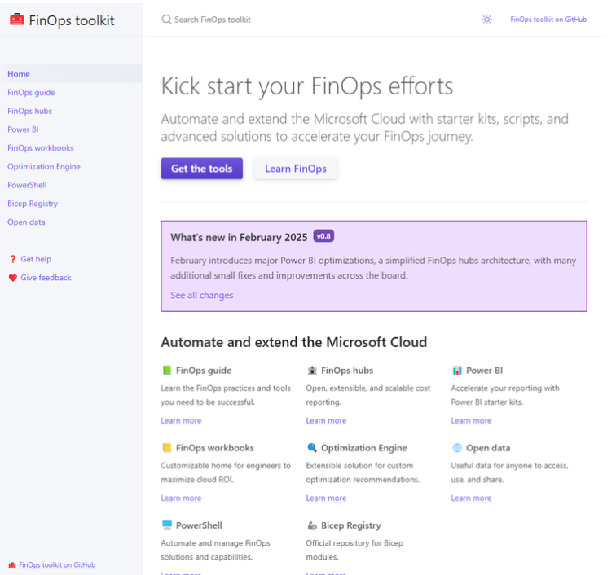
Management & Governance Updates
FinOps toolkit 0.8
Updates:
Website refresh with documentation on Microsoft Learn
Power BI report design refresh
Calculating savings for both EA and MCA accounts
Performance improvements for Power BI reports
Important note for organizations that spend over $100K
New Data Explorer dashboard for FinOps hubs
About the FinOps hubs data model
Simplified network architecture for public routing
Managing exports and hubs with PowerShell
Other new and noteworthy updates
Thanking our community

Slide 8
Management & Governance Updates
Support for Application Insights Status Monitor v1 will End on March 31, 2025
Status Monitor v1 is being retired because it was replaced by Application Insights Agent (formerly named Status Monitor v2) in 2019. Customers seeking auto-instrumentation for .NET workloads on-premises servers should use Application Insights Agent.
Generally Available: Enhanced Performance Guidance in Azure Advisor for Azure Database for PostgreSQL
It is now possible to proactively identify and resolve more performance scenarios in Azure Database for PostgreSQL – Flexible Server using Azure Advisor recommendations.
Three new Advisor recommendations are available, and improvements to existing recommendations provide more precise details.

Slide 9
Management & Governance Updates
Public Preview: MySQL Discovery and Assessment in Azure Migrate
It is now possible to use Azure Migrate to discover and assess MySQL resources. Azure Migrate provides a centralized hub for discovering, assessing, and migrating on-premises assets, such as servers, databases, and web applications hosted on physical environments, to Azure targets at scale—both platform as a service (PaaS) and infrastructure as a service (IaaS).
Public preview release of the MySQL discovery and assessment feature in Azure Migrate allows to discover MySQL instances and their attributes within your environment, assess their readiness for migration to Azure Database for MySQL – Flexible Server, and obtain recommendations on the suitable compute and storage options, along with the associated costs.
Seamless end-to-end SQL Server migration to Azure with Azure Arc
Migrating on-premises SQL Server to Azure used to require multiple tools and involve several disconnected steps. New solution eliminates the need for additional software or tools, requiring only Arc-enablement of your SQL Server to complete the entire end-to-end migration journey.
The Arc-enabled migration integrates all steps of the migration journey into a single, simple-to-use experience. The solution starts by providing an overview of the benefits of Azure SQL services and modernizing your SQL Server in Azure. It offers continuous automated assessments of SQL Server databases, providing recommendations for migration to various Azure SQL destinations. Based on these recommendations, an appropriate Azure SQL destination is suggested, tailored to your workload needs. Thereafter, it is possible to choose to provision the recommended Azure SQL service in Azure and start the migration process. Throughout the process, it is possible to monitor the ongoing migrations, evaluate data replicated in Azure, and control the cutover point to Azure according to business requirements.

Slide 10
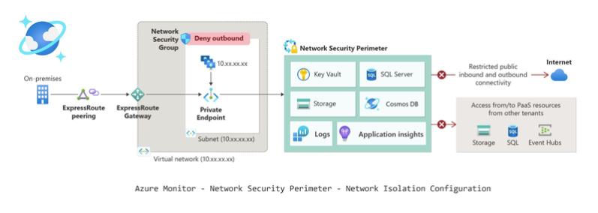
Management & Governance Updates
Azure Monitor Network Security Perimeter - Features available in 56 Public Cloud Regions
MS announced the expansion of Network Security Perimeter features in Azure Monitor services from 6 to 56 Azure regions.
The Network Security Perimeter (NSP) provides several key benefits for securing and managing Azure PaaS resources:
Enhances security
Centralized management
Granular access control
Microsoft Cost Management updates
Optimizing AKS (Azure Kubernetes Service) costs
Asset's view showing Idle costs per asset
Namespace's view showing Idle charges for the cluster
AWS (Azure Web Services) connector deprecation
The Connector for AWS, once built to consolidate Microsoft Azure and AWS cloud cost data in Microsoft Cost Management, will be retired on March 31st, 2025.
Microsoft Azure OpenAI Service Provisioned Reservations
Azure OpenAI Service provisioned throughput by committing to a reservation for your provisioned throughput units (PTUs) usage for a duration of one month or one year.

Slide 11
Compute

Slide 12
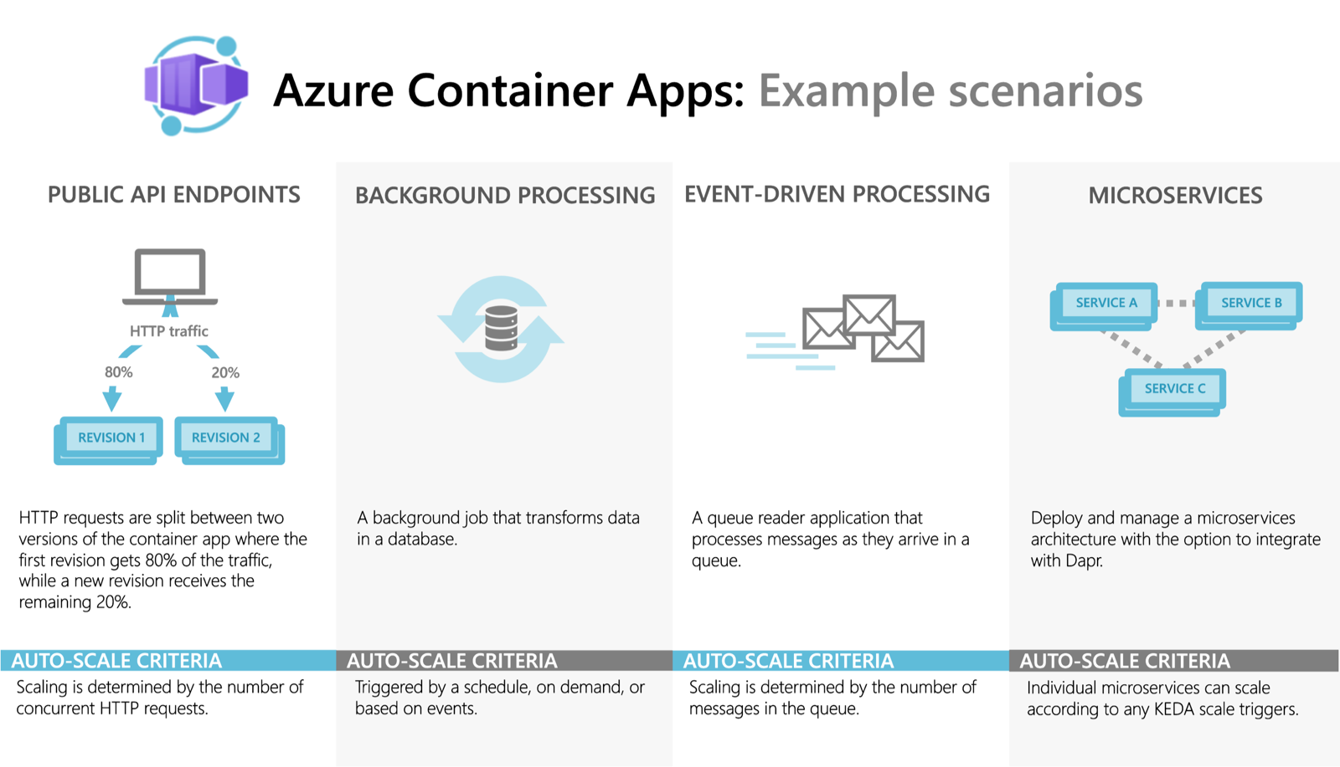
Compute Updates
Generally Available: Azure Container Apps in Australia SE, France South, Japan West and Spain Central
Azure Containers Apps is now generally available in four additional regions: Australia Southeast, France South, Japan West, and Spain Central (Availability Zone Enabled.)
Azure Container Apps is a fully managed serverless container service which offers a platform for application developers who want to run microservices, APIs, and more using containers without managing infrastructure.
Container Apps is built on a foundation of powerful open-source technology. Behind the scenes, every container app runs using the Kubernetes API, with KEDA, Dapr, and Envoy baked in.
Windows App to replace Remote Desktop app for Windows
Starting May 27, 2025, the Remote Desktop app for Windows from the Microsoft Store will no longer be supported or available for download and installation. Users must transition to Windows App to ensure continued access to Windows 365, Azure Virtual Desktop, and Microsoft Dev Box.
Windows App provides several improvements over the Remote Desktop app for Windows, including:
Unified access to multiple Windows services, including Cloud PCs and virtual desktops from a single, streamlined interface.
Customizable home screens, multimonitor support, and dynamic display resolutions.

Slide 13
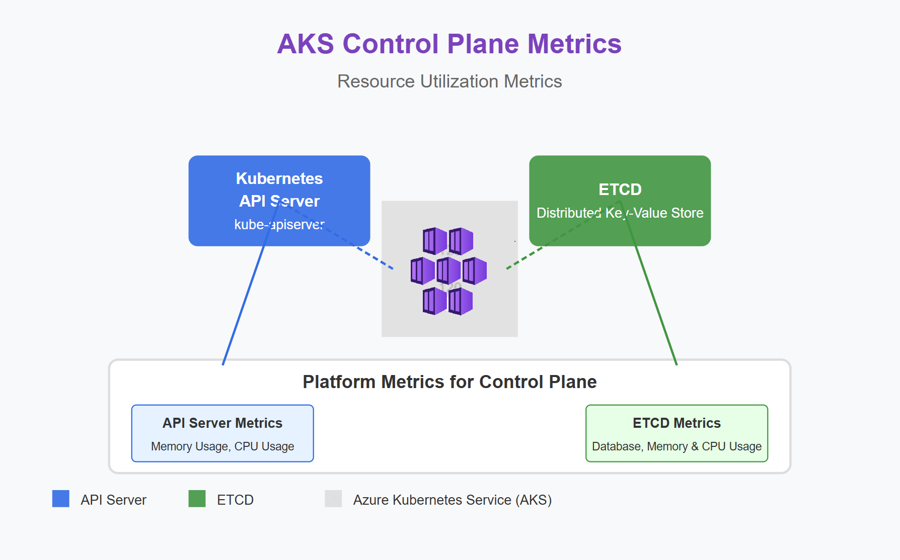
Compute Updates
Azure Platform Metrics for AKS Control Plane Monitoring
Azure Kubernetes Service (AKS) now offers free platform metrics for monitoring control plane components. This enhancement provides essential insights into the availability and performance of managed control plane components, such as the API server and etcd.
Previously, detailed control plane metrics were only available through the paid Azure Managed Prometheus feature. Now, these metrics are automatically collected for free for all AKS clusters and are available for creating metric alerts. This democratizes access to critical monitoring data and helps all AKS users maintain more reliable Kubernetes environment
The following platform metrics are now available for your AKS clusters:
Name | Display Name | Description
apiserver_memory_usage_percentage | API Server (PREVIEW) Memory Usage Percentage | Maximum memory percentage (based off current limit) used by API server pod across instances
apiserver_cpu_usage_percentage | API Server (PREVIEW) CPU Usage Percentage | Maximum CPU percentage (based off current limit) used by API server pod across instances
etcd_memory_usage_percentage | ETCD (PREVIEW) Memory Usage Percentage | Maximum memory percentage (based off current limit) used by ETCD pod across instances
etcd_cpu_usage_percentage | ETCD (PREVIEW) CPU Usage Percentage | Maximum ETCD percentage (based off current limit) used by ETCD pod across instances
etcd_database_usage_percentage | ETCD (PREVIEW) Database Usage Percentage | Maximum utilization of the ETCD database across instances

Slide 14
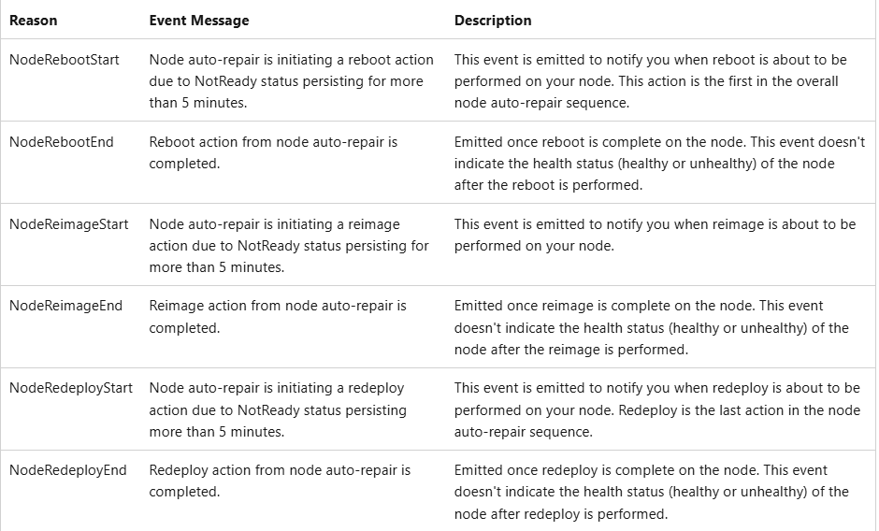
Compute Updates
Generally Available: Node Auto-Repair Kubernetes Events in AKS
It is now possible to monitor node auto-repair using the new Kubernetes events, which will notify whenever node auto-repair initiates and finishes repair actions in cluster. Node auto-repair is a built-in process which automatically detects unhealthy nodes and attempts to repair them through reboot, reimage, and redeploy actions. It is possible to create alerts on the new events and be notified if there are any errors with the process.
Generally Available: Message of the Day supports in AKS
Message of the day (MOTD) is now generally available on AKS. It is possible to pass the --message-of-the-day flag with the location of the file to replace the Message of the Day on Linux nodes at cluster creation or node pool creation. This is often used in combination with Federal Information Process Standard (FIPS) enabled node pools.
The message of the day can be used to communicate information to end users, the contents of /etc/motd are displayed after a successful login but just before it executes the login shell.

Slide 15
Compute Updates
Generally Available: Default Ephemeral OS Disk Sizing in AKS
If you select a VM SKU that supports Ephemeral OS disks but don't specify an OS disk size, AKS by default provisions an Ephemeral OS disk with a size that scales according to the total temp storage of the VM SKU so long as the temp is at least 128GiB.
If you want to use the temp storage of the VM SKU, you need to specify the OS disk size during deployment, otherwise it’s consumed by default.
Retirement: GPU image (Preview) in AKS
On January 10, 2025, the AKS GPU Image (preview) retired. New node pool creations with the GPU image (preview) are now blocked. Existing node pools using the GPU Image (preview) are now unsupported.
Required Action
Migrate existing AKS workloads from GPU VHD-enabled node pools to GPU-enabled node pools created using the supported alternative solutions.
Alternative solutions include:
Create a node pool with a supported GPU VM sku and manually install the NVIDIA device plugin.
Create a node pool with a supported GPU VM sku, skip automatic driver installation, and manually install the NVIDA GPU Operator.

Slide 16
Compute Updates
Public Preview: Windows Support for Virtual Machines Node Pools in AKS
Windows support for Virtual Machines Node Pools is now available in Azure Kubernetes Services. With Virtual Machines node pools, Azure Kubernetes Services directly manages the provisioning and bootstrapping of every single node. When deploying a workload onto Azure Kubernetes Services (AKS), each node pool typically can only contain one virtual machine (VM) type or SKU. Virtual Machines node pools allow the capability to add multiple VM SKUs of a similar family to a single node pool.
Limitations
Cluster autoscaler is currently not supported.
InifiniBand isn't available.
Windows node pools aren't supported.
This feature isn't available in Azure portal.
Node pool snapshot isn't supported.
All VM sizes selected in a node pool need to be from a similar virtual machine family.
Virtual Machines node pools allow up to five different virtual machine sizes per node pool.
Public Preview: Azure Linux 3.0 Support in AKS
Azure Linux 3.0, the next major version release of the Azure Linux container host for Azure Kubernetes Service (AKS), is now available in preview and default on Kubernetes version 1.32. Azure Linux 3.0 offers increased package availability and versions, an updated kernel, and improvements to performance, security, and tooling and developer experience.

Slide 17
Compute Updates
WebAssembly System Interface (WASI) Node Pools in AKS
Azure Kubernetes Service will no longer support the WebAssembly System Interface (WASI) nodepools (preview). Starting on May 5, 2025 It will no longer be possible to create new WASI nodepools.
If you'd like to run WebAssembly (WASM) workloads, you can deploy SpinKube to Azure Kubernetes Service (AKS) from Azure Marketplace.
WebAssembly (Wasm) is a binary format that is optimized for fast download and maximum execution speed in a Wasm runtime. A Wasm runtime is designed to run on a target architecture and execute Wasm components in a sandbox, isolated from the host computer, at near-native performance. By default, Wasm components can't access resources on the host outside of the sandbox unless it's explicitly allowed.
Generally Available: Azure Site Recovery Update Rollup 77 – March 2025
This update provides the following improvements for the latest version of Azure Site Recovery components.
Mobility Service: New Linux OS distros for Azure to Azure:
OEL 8.10
Alma 8
Alma 9
Ubuntu 2404
Added support for kernels in Linux OS for Azure to Azure:
Debian 11
Debian 12
SLES 12
SLES 15

Slide 18
Storage & Data

Slide 19
Storage & Data Updates
Generally Available: Azure Data Factory – Azure Database for PostgreSQL Connector Version 2.0
MS announced the release of the new Azure Data Factory – Azure Database for PostgreSQL connector. This updated connector now supports the latest TLS version 1.3 and multiple SSL modes for enhanced authentication. To ensure the best performance, MS recommend selecting driver version 2.0 for future connections between Azure Data Factory and Azure Database for PostgreSQL – Flexible Server, Elastic Cluster, and Azure Cosmos DB for PostgreSQL. These enhancements, bring improved security features, faster connection times, and reduced latency, so you can focus on what matters most to your business.

Slide 20
Databases

Slide 21
Databases Updates
General Available: Azure Database for PostgreSQL Supports postgresql-hll Extension
With the general availability of the postgresql-hll extension in Azure Database for PostgreSQL, it is possible to efficiently approximate unique elements using the HyperLogLog data structure, which is ideal for large-scale analytics.
HyperLogLog is a fixed-size, set-like structure used for distinct value counting with tunable precision. A hll is a combination of different set/distinct-value-counting algorithms that can be thought of as a hierarchy, along with rules for moving up that hierarchy.
General Available: Azure Database for PostgreSQL Support for Topn Extensions
With the general availability of the topn extension in Azure Database for PostgreSQL, it is possible to quickly compute the most frequently occurring values in datasets, making it perfect for large data analysis and real-time dashboards.
TopN is an open-source PostgreSQL extension that returns the top values in a database according to some criteria. TopN takes elements in a data set, ranks them according to a given rule, and picks the top elements in that data set. When doing this, TopN applies an approximation algorithm to provide fast results using few compute and memory resources.
The TopN extension becomes useful when it is needed to materialize top values, incrementally update these top values, and/or merge top values from different time intervals. If you're familiar with the PostgreSQL HLL extension.

Slide 22
Databases Updates
Generally Available: Azure Database for PostgreSQL Supports pg-repack Extensions Version 1.1.1
Now it is possible to install pg_repack extension version 1.5.1 for PostgreSQL major versions 13 and later.
pg_repack is aт extension which lets remove bloat from tables and indexes, and optionally restore the physical order of clustered indexes. Unlike CLUSTER and VACUUM FULL it works online, without holding an exclusive lock on the processed tables during processing. pg_repack is efficient to boot, with performance comparable to using CLUSTER directly.
Generally Available: Azure Database for PostgreSQL Support for New Zealand North Region
It is now possible to deploy Azure Database for PostgreSQL in the New Zealand North region.

Slide 23
Databases Updates
Generally Available: Azure Database for PostgreSQL – Flexible Server Supports the tdigest Extension
With the general availability of the tdigest extension in Azure Database for PostgreSQL, it is possible to nowperform accurate quantile estimation for numeric data, making it easier to analyze percentiles and distributions at scale.
Azure Database for MySQL triggers for Azure Functions (Public Preview)
It is now possible to invoke an Azure Function based on changes to an Azure Database for MySQL table. This new capability is made possible through the Azure Database for MySQL triggers for Azure Functions.
The Azure Database for MySQL trigger uses change tracking functionality to monitor a MySQL table for changes and trigger a function when a row is created, updated, or deleted enabling customers to build highly-scalable event-driven applications.
Similar to the Azure Database for MySQL Input and Output bindings for Azure Functions, a connection string for the MySQL database is stored in the application settings of the Azure Function to trigger the function when a change is detected on the tables.

Slide 24
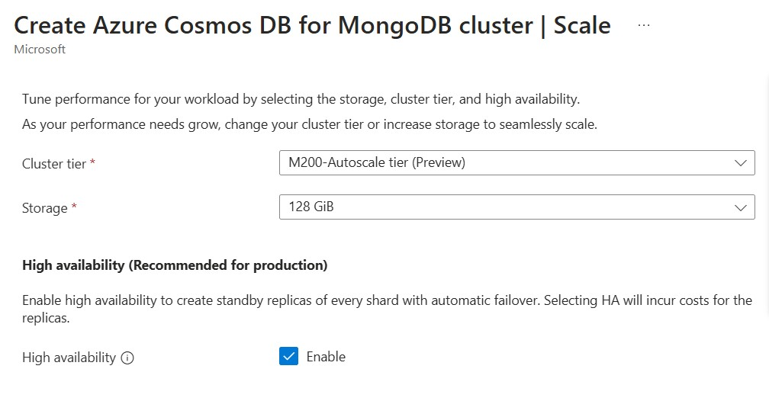
Databases Updates
Making MongoDB workloads more affordable with M10/M20 tiers in vCore-based Azure Cosmos DB
vCore based Azure Cosmos DB for MongoDB is expanding its offerings with the new cost-effective M10 and M20 tiers for vCore-based deployments. These tiers lower the entry barrier for organizations adopting MongoDB within the Azure ecosystem, offering market-leading affordability while maintaining Azure’s enterprise-grade reliability and features.
Effortless Scaling: Autoscale goes GA on vCore-based Azure Cosmos DB for MongoDB
MS announced that Autoscale is now generally available (GA) for vCore-based Azure Cosmos DB for MongoDB! Autoscale dynamically adjusts database capacity in real time, ensuring peak performance exactly when you need it.
Cluster Tier | vCores | RAM | Storage | Base Price
M10 | 1 vCore | 2 GiB | Up to 128 GB | $0.0191/hr
M20 | 2 vCores | 4 GiB | Up to 128 GB | $0.0764/hr

Slide 25
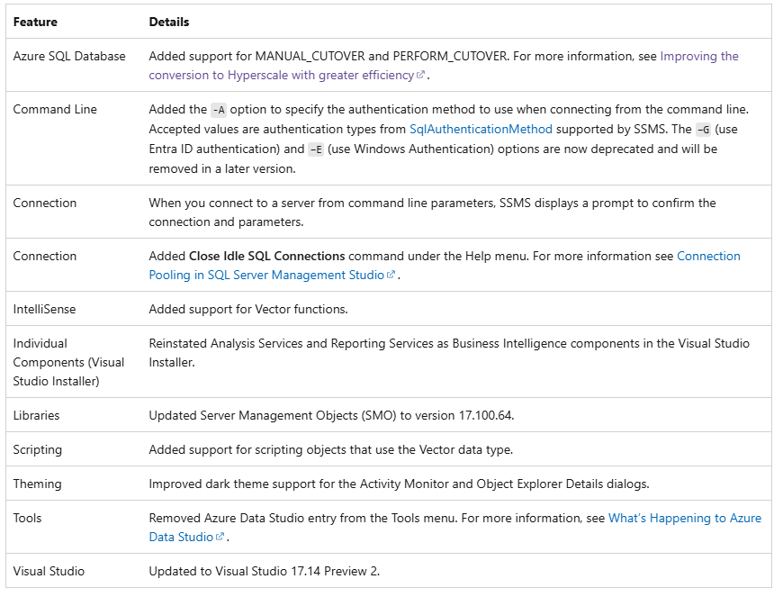
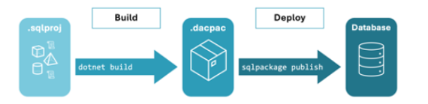
Databases Updates
Announcing the release of SSMS 21 Preview 5
The Microsoft.Build.Sql project SDK is now generally available
The Microsoft.Build.Sql project SDK provides a cross-platform framework for database-as-code such that the database obejcts are ready to be checked into source control and deployed via pipelines like any other modern application component.
SQL projects are a .NET-based project type for SQL objects, compiling a folder of SQL scripts into a database artifact (.dacpac) for manual or continuous deployments.

Slide 26
DevOps & IaC & Automation

Slide 27
DevOps & IaC & Automation
Generally Available: Azure Chaos Studio Now in Germany West Central Region
Azure Chaos Studio is a managed service that uses chaos engineering to help measure, understand, and improve cloud application and service resilience. Azure Chaos Studio Resource Targeting is now available in Germany West Central region.
March Patches for Azure DevOps Server
MS Released patches for Azure DevOps Server.
The following versions of the product has been patched.
Azure DevOps Server 2022.2
Azure DevOps Server 2020.1.2
Azure DevOps Server 2019.1.2

Slide 28
Information

Slide 29
Information
Azure Times GitHub Repo

Slide 30
Questions

