Slide 1
Azure Times #157
Marc 31, 2025

Slide 2
Networking

Slide 3
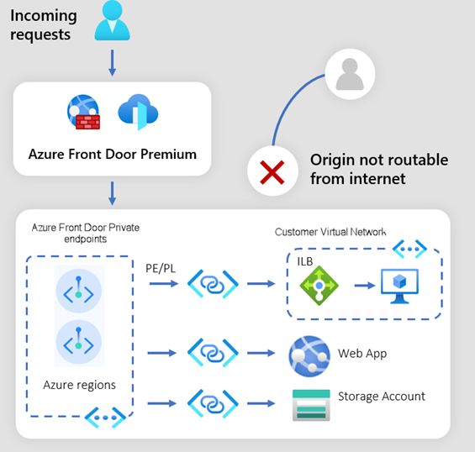
Networking Updates
Generally Available: New Regions for Azure Front Door Premium with Private Link Enabled Origins
AFD is now supported in the West US 2 and South East Asia as regions for Private Link-enabled origins in Front Door Premium profile. Private Link-enabled origins in Front Door allow to deliver content to end-users through public Front Door endpoints while ensuring that origins remain inaccessible to the public internet.
Generally Available: Azure Firewall Updates - Parallel IP Group Updates
Admins can now update multiple IP Groups in parallel or simultaneously with firewall or firewall policies.
Key benefits:
Faster & scalable updates – Update up to 20 IP Groups simultaneously, up to twice as fast as before.
Improved visibility - With enhanced error messaging, it is possible to quickly identify and address issues during updates. Even if one IP Group fails to update, the remaining changes continue smoothly, keeping overall system health intact.

Slide 4
Security & Identity

Slide 5
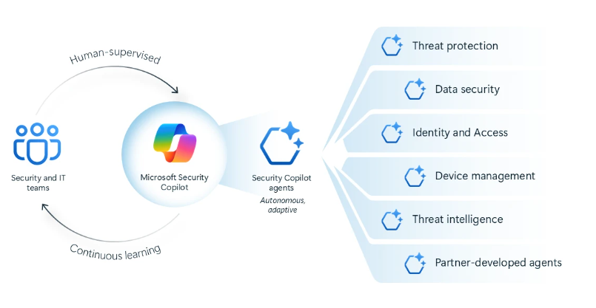
Security & Identity Updates
Microsoft Security Copilot agents and new protections for AI
The six Microsoft Security Copilot agents enable teams to autonomously handle high-volume security and IT tasks while seamlessly integrating with Microsoft Security solutions. Purpose-built for security, agents learn from feedback, adapt to workflows, and operate securely—aligned to Microsoft’s Zero Trust framework.
Phishing Triage Agent in Microsoft Defender triages phishing alerts with accuracy to identify real cyberthreats and false alarms. It provides easy-to-understand explanations for its decisions and improves detection based on admin feedback.
Alert Triage Agents in Microsoft Purview triage data loss prevention and insider risk alerts, prioritize critical incidents, and continuously improve accuracy based on admin feedback.
Conditional Access Optimization Agent in Microsoft Entra monitors for new users or apps not covered by existing policies, identifies necessary updates to close security gaps, and recommends quick fixes for identity teams to apply with a single click.
Vulnerability Remediation Agent in Microsoft Intune monitors and prioritizes vulnerabilities and remediation tasks to address app and policy configuration issues and expedites Windows OS patches with admin approval.
Threat Intelligence Briefing Agent in Security Copilot automatically curates relevant and timely threat intelligence based on an organization’s unique attributes and cyberthreat exposure.

Slide 6
Security & Identity Updates
Microsoft Azure Cloud HSM is now in public preview
Azure Cloud HSM is a highly available, FIPS 140-3 Level 3 validated single-tenant hardware security module (HSM) service designed to meet the highest security and compliance standards. With full administrative control over HSM, customers can securely manage cryptographic keys and perform cryptographic operations within their own dedicated Cloud HSM cluster.
Azure Cloud HSM:
Fully Managed
Customer owned, highly available, single-tenant HSM as a service
Single-Tenant HSM Clusters
FIPS 140-3 Level 3 compliance
It provides:
Azure Cloud HSM is Not a Bare-Metal HSM appliance.
Azure Cloud HSM is Not a Secret Store.
Azure Cloud HSM is Not a Certificate Lifecycle Management offering.
Microsoft Azure Cloud HSM does not integrate with other PaaS/SaaS Azure services

Slide 7
Management & Governance

Slide 8
Management & Governance Updates
Generally Available: Log Analytics Delete Data API
The Delete Data API lets make asynchronous requests to remove data, such as sensitive, personal, or corrupt from Log Analytics workspace. This API is more performant than Purge API since tagging logs as deleted, rather than performing heady delete operation. It's recommended to use this API for all non-GDPR data deletion.
Support up to 10 Delete Data requests per hour in a single Log Analytics workspace.
The Analytics table plan supports data deletion. To delete data from a table with the Basic plan, change the plan to Analytics and then delete the data. The Auxiliary plan doesn't support data deletion.
Jumpstart Agora - Contoso Motors v2
Version 2 of the Contoso Motors scenario, part of Jumpstart Agora was released. This update brings key updates that streamline deployment, improve maintainability, and reduce operational costs.
Migrating to Rancher K3s for a Lighter for More Efficient Deployment
Leveraging the GA Version of Azure IoT Operations
Optimized Container Image Management
Helm Chart Improvements for Simplified Networking
Cost Optimization: Reduced VM Requirements

Slide 9
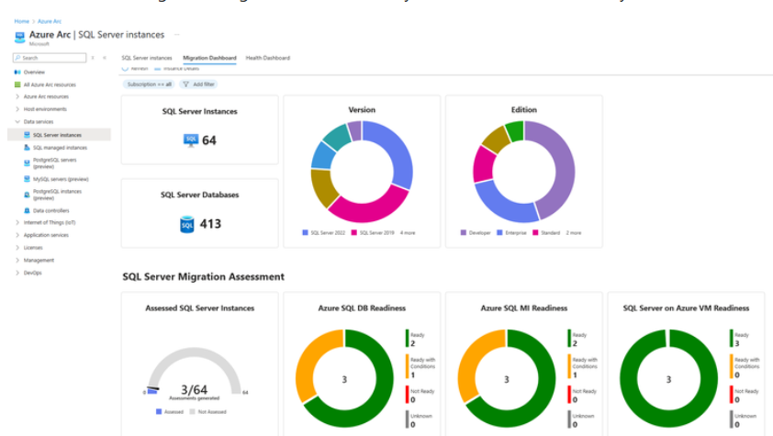
Management & Governance Updates
Migration Dashboard for SQL Server enabled by Azure Arc
MS announced a new Migration Dashboard feature in the Azure portal. SQL Server enabled by Azure Arc, automatically produces an assessment for migration to Azure. The dashboard:
Provides an overview of SQL Server instances and databases discovered.
Provides an overview of the SQL Server instances which have assessments generated.
Provides migration readiness summary for each of the Azure SQL offerings.
Provides rich filtering capabilities enabling you to tailor the view to your needs.

Slide 10
Compute

Slide 11
Compute Updates
Retirement: Ubuntu 18.04 Node Pools in AKS
Ubuntu 18.04 on Azure Kubernetes Service will be retired on June 17, 2025. Please transition to a supported Ubuntu version by that date.
Ubuntu 18.04 has been replaced by newer supported versions, including Ubuntu 22.04. MS encourage to transition to Ubuntu 22.04 prior to June 17, 2025 to experience the capabilities of Ubuntu 22.04 including kernel updates and security improvements.
Starting on June 17, 2025, AKS will no longer create new node images for Ubuntu 18.04 or provide security updates. Existing node images will be deleted.
Retirement: Support for Desired State Configuration Extension for Azure Virtual Machines to Be Retired on March 31, 2028
Desired State Configuration Extension for Azure Virtual Machines will be retired on March 31, 2028, please transition to Azure Machine Configuration by that date.
It provides a new capabilities including:
Configurations are now assigned natively in Azure Resource Manager without the need for an Automation Account
Azure Policy provides at-scale assignment of configurations to machines
When machines drift from the desired state, you control when remediation occurs
Manage multiple configurations for the same machine
Advanced reporting through Azure Resource Graph including resource ID and state
Linux and Windows both consume PowerShell-based DSC resources
From now to March 31, 2028 it is possible to continue to use Desired State Configuration Extension for Azure Virtual Machines without disruption. After 31 March 2028 the extension will no longer be supported. Resources to aid in migration can be found in the following sections.

Slide 12
Compute Updates
Retirement: Docker Compose Feature for Azure App Service to Be Retired on March 31, 2027 – Replaced by Sidecars in Azure App Service
The docker compose feature will be retired on March 31, 2027, please transition to the sidecar container by that date. The sidecar containers allow to create multi-container applications with a more intuitive configuration and integration with all other features of Azure App Service.
MS encourage to transition to sidecar containers prior to the retirement date. Sidecar provides several benefits over docker compose, including:
An easier configuration system to deploy and manage multi-container applications.
Full Azure portal integration allows to manage each container separately, check the status and logs.
Seamless integration with Azure App service features like VNet and Managed Identity.
Retirement: Docker Content Trust on March 31, 2028 – Replaced by the Notary Project and Azure Key Vault
Azure Container Registry (ACR) implements Docker Content Trust (DCT), allowing image publishers to sign their images and image consumers to verify that the images they pull are signed. With advancements in technology, Docker Content Trust no longer meets the requirements of modern supply chain security for containers. As a result, Docker Content Trust will be deprecated and no longer available in ACR after March 31, 2028.

Slide 13
Compute Updates
Retirement: Announcing the 3-Year Retirement of Current Architecture for AKS on Windows Server 2019 and Windows Server 2022
Azure Kubernetes Service's current architecture on Windows Server 2019 and Windows Server 2022 will be retired on March 27, 2028. Replace existing Azure Kubernetes Service clusters on Windows Server 2019, Windows Server 2022 or Azure Local, version 22H2 with Azure Kubernetes Service on Azure Local, version 23H2 or later.
Azure Kubernetes Service on Azure Local, version 23H2 or later has improved capabilities – at-scale deployment, management of Kubernetes clusters using Azure and improved pricing.
Azure Virtual Desktop metadata database available in Southeast Asia
MS announced that the Azure Virtual Desktop metadata database is now generally available in Southeast Asia.

Slide 14
Storage & Data

Slide 15
Storage & Data Updates
Public Preview: Azure NetApp Files Flexible service level
Flexible service level allows independently configure storage capacity and throughput, optimizing costs and performance by right-sizing. This new service level avoids overprovisioning by supporting a customizable throughput which could be up to five times that of the Ultra service level. This makes it ideal for demanding workloads (like Oracle or SAP HANA) offering higher throughput for smaller capacity pools, and for creating high-capacity volumes with low throughput needs.
Flexible service level is supported with manual QoS capacity pools, where throughput can be adjusted between 128 MiB/s to 640 MiB/s per provisioned TiB. A baseline throughput of 128 MiB/s is provided for every pool irrespective of the size, at no additional cost. This provides a way to save on costs for capacity-heavy workloads with lower performance needs by offering lower throughput on larger capacity footprints and for demanding workloads requiring higher throughput with smaller capacity needs.
The Flexible service level is only available for manual QoS capacity pools.
The Flexible service level is only available on newly created capacity pools. You can't convert an existing capacity pool to use the Flexible service level.
Flexible service level capacity pools can't be converted to the Standard, Premium, or Ultra service level.
Cool access isn't currently supported with the Flexible service level.
Only single encryption is currently supported for Flexible service level capacity pools.

Slide 16
Storage & Data Updates
Generally Availability: AzAcSnap 11 — Azure Application Consistent Snapshot Tool Updates
Version 11 of the AzAcSnap tool is now generally available. Azure Application Consistent Snapshot Tool (AzAcSnap) is a command-line tool that enables customers to simplify data protection for third-party databases in Linux and Windows environments. AzAcSnap 11 introduces the following new capabilities and improvements:
Features moved to GA (generally available):
Microsoft SQL Server 2022 on Windows.
Dependency updates:
Updated to .NET 8( List of supported operation systems .NET 8 - Supported OS versions.)
Azure SDK updated to Track 2 (latest security and significant performance improvements).
Fixes and Improvements:
(NEW) Configurable Data Volume backup attempts
Backup (-c backup) changes: Storage snapshot retention management is now performed after the database exits "backup-mode" to minimize the duration the database remains in a "backup-enabled" state.

Slide 17
Databases

Slide 18
Databases Updates
Public Preview: Azure Database for MySQL Triggers for Azure Functions
Azure Database for MySQL triggers for Azure Functions, allows to enable change tracking and develop event-driven applications at scale on any MySQL table. Azure Functions can be invoked when a row in a MySQL table is created, updated, or deleted through the Azure Database for MySQL triggers for Azure Functions.
Generally Available: On-Demand Backups for Azure Database for PostgreSQL – Flexible Server
Now it is possible to create physical snapshots of Azure Database for PostgreSQL – Flexible Server based on business needs. This new feature complements the scheduled automated backups offered by the service, while adding the flexibility to delete the on-demand backups.

Slide 19
Databases Updates
Generally Available: Long-Term Backup Retention for Azure Database for PostgreSQL – Flexible Server
Azure Database for PostgreSQL - Flexible Server now offers a backup solution for supporting long-term backup retention and improved compliance for PostgreSQL databases using Azure Backup. This release enables to take advantage of a rich set of capabilities, such as flexible database backup policies, management of individual backups, and streamlined configuration, and retain data for up to 10 years for compliance.
Retirement: SQL Server Connector V1 Actions and Triggers to Be Retired on March 31, 2025 – Transition to V2 Actions and Triggers
On March 31, 2023, MS announced that SQL Server connector’s V1 actions and triggers will be retired on March 31, 2024. Based on feedback, MS is extending the retirement date to June 30, 2025, to allow more time to plan transition.
Because V2 actions and triggers on the SQL Server connector now provide stable, faster and reliable actions and triggers on the V2 versions, ms will retire the older (V1) operations and triggers of this connector.
In addition to the familiar features are using, here’s a quick comparison between SQL Server connector’s V1 actions and triggers, and SQL Server connector’s V2 operations.

Slide 20
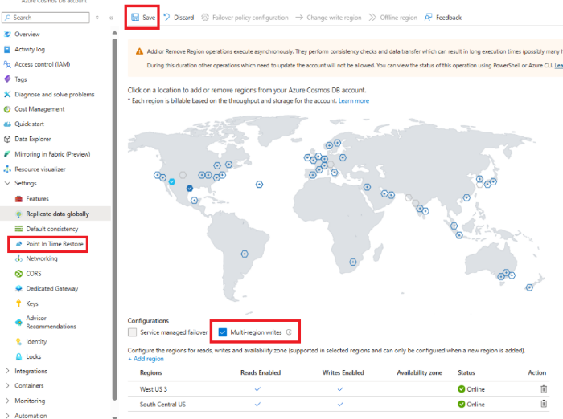
Databases Updates
Public Preview: Point-in-Time Restore Capability for Multiregion Write Accounts in Azure Cosmos DB
With this feature, it is possible create multiregion write accounts with point-in-time restore capability in Azure Cosmos DB and enable point-in-time restore for multiregion write accounts. To use this feature, you must enable your multiregion write accounts with point-in-time restore or create new multiregion accounts with this capability.
Retirement: Azure SQL Database FSV2-Series Offer
In 2020, MS launched FSV2-series as a hardware choice Azure SQL Database. MS is retiring support for the FSV2-series hardware option for Azure SQL Database on October 1, 2026.
Starting On October 1, 2025, customers who haven’t already deployed Azure SQL Database on FSV2-series won’t be able to create new databases on FSV2-series.
Existing Azure SQL Database FSV2-series customers can continue to use the databases until October 1, 2026 but should plan to migrate out of the FSV2-series HW on to other options within Azure SQL Database before then.
After October 1, 2026, Azure SQL Databases running on FSV2-series HW will no longer be supported. Remaining databases running on FSV2-series HW will be migrated to General-purpose tier with similar configurations.

Slide 21
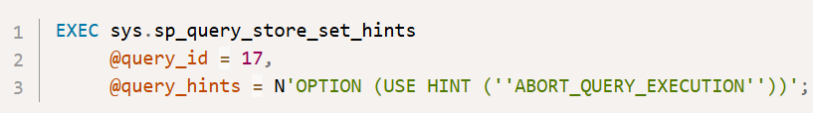
Databases Updates
ABORT_QUERY_EXECUTION query hint - public preview
MS announced the public preview of a new query hint, ABORT_QUERY_EXECUTION. The hint is intended to be used as a Query Store hint to let administrators block future execution of known problematic queries, for example non-essential queries causing high resource consumption and affecting application workloads.
The hint is now available in Azure SQL Database for all databases without restrictions. The hint will later be available in Azure SQL Managed Instance with the always-up-to-date update policy, as well as in a future version of SQL Server.

Slide 22
ML & AI & IOT

Slide 23
ML & AI & IOT Updates
Generally Available: Anthropic Gen AI Models in Azure Databricks
MS announced that as of March 26, 2025, Microsoft Azure customers can access and use Anthropic models within their existing Azure Databricks workspaces.
This integration is a collaborative effort between Microsoft and Databricks, aimed at enhancing data and AI capabilities.

Slide 24
DevOps & IaC & Automation

Slide 25
DevOps & IaC & Automation
Generally Available: Azure Chaos Studio Auto-Tagging of Experiment Resources for Private Networking Now Available
Previously, while customers could apply tags to their experiments, the underlying container and gateway resources created as part of the experiment execution were not taggable, leading to potential conflicts with Azure Policy enforcement. With this update, Chaos Studio will now automatically tag the resources we create on your behalf with the same tags applied to experiment. This ensures seamless policy compliance, improved resource tracking, and better integration with existing governance frameworks. This feature is available only for customers using private networking, as Chaos Studio does not deploy resources for experiments without private networking enabled.
Public Preview: Enhance Performance and Security with Standard Load Balancer and Standard SKU Public IP Addresses in Azure DevTest Labs
MS announced enhancements in Azure DevTest Labs to support Azure’s retirement of Basic Load Balancer and Basic SKU public IP addresses. Azure DevTest Labs will now use Standard Load Balancer to manage traffic for VMs created with Shared IPs. Also, a Standard SKU Public IP address resource with static IP allocation will be created when you create a Public IP VM in Azure DevTest Labs. These enhancements in Azure DevTest Labs are being rolled out to different regions in phases.

Slide 26
Miscellaneous

Slide 27
Miscellaneous Updates
Retirement: Azure Maps Traffic APIs Version 1.0 to Be Retired on March 31, 2028
The following Azure Maps Traffic APIs version 1.0 will be retired on March 31, 2028:
Get Traffic Flow Segment
Get Traffic Flow Tile
Get Traffic Incident Detail
Get Traffic Incident Tile
Get Traffic Incident Viewport
Please transition to Azure Maps Traffic Incident API version 2025-01-01 and/or Azure Maps Get Map Tile API version 2024-04-01 by that date.
Retirement: Azure Maps Route APIs Version 1.0 to Be Retired on March 31, 2028
The following Azure Maps Route APIs version 1.0 will be retired on March 31, 2028:
Get Route Directions
Get Route Directions Batch
Post Route Directions
Post Route Direction Batch
Post Route Directions Batch Sync
Get Route Matrix
Post Route Matrix
Post Route Matrix Sync
Get Route Range
Please transition to Azure Maps Route APIs version 2025-01-01 by that date.

Slide 28
Miscellaneous Updates
Retirement: Azure Storage Data Movement Library (v2) Announcement
The legacy version of the Azure Storage Data Movement Library (v2) will be retired on March 31, 2026. To ensure continued support and access to the latest features, users should migrate to the modern version before this date.
The modern version of the Azure Storage Data Movement Library offers important upgrades like checkpointing and shared infrastructure with Azure Storage v12 client libraries, providing improved performance and reliability.
Retirement: Azure Intelligent Recommendation Service to Be Retired
Azure Intelligent Recommendations service will be retired on March 31, 2026.
This service is being retired due to changes in strategy and focus with the onset of the Copilot era. We encourage you to identify alternative options.
From now to March 31, 2026 existing customers can continue to use Intelligent Recommendations without disruption. New customer deployments will stop immediately.

Slide 29
Miscellaneous Updates
Announcing the Extension of Some QnA Maker Functionality
MS announced the deprecation of QnA Maker by March 31, 2025 with a recommendation to migrate to Custom Question Answering (CQA). MS decided to extend the availability of certain functionalities in QnA Maker until October 31, 2025.
Inference Support: QnA Maker bots remain operational and can be used as they are currently configured until October 31, 2025.
Portal Shutdown: The QnA Maker portal will no longer be available after March 31, 2025. You will not be able to make any edits or changes to your QnA Maker bots through the online QnA Maker portal.
Programmatic Bot Changes: You will be able to make changes to your QnA Maker bots programmatically via the QnA Maker API.

Slide 30
Information

Slide 31
Information
Azure Times GitHub Repo

Slide 32
Questions

