Slide 1
Azure Times #158
April 7, 2025

Slide 2
Networking

Slide 3
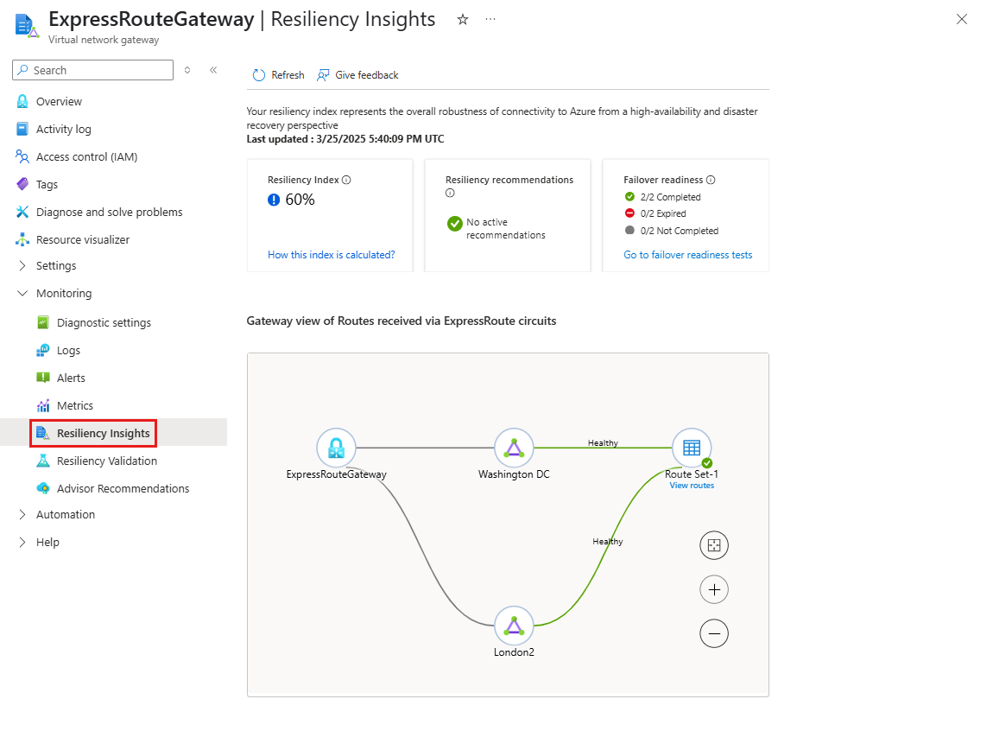
Networking Updates
Public Preview: ExpressRoute Resiliency Enhancements
MS announced a couple of enhancements to ExpressRoute resiliency validation and insights:
Resiliency validation: This feature allows to:
Simulate circuit failover - Connections are disconnected temporarily from the gateway of interest to the selected ExpressRoute circuit to simulate a failover from one peering location to another.
Route redundancy - Insights into duplicate routes are provided for all prefixes received from the selected peering location.
Traffic visualization - Visualize traffic on the ExpressRoute gateway and all connections associated to it during testing.
Test history - Detailed information of previously conducted tests.
Resiliency insights is an assessment capability designed to measure network's reliability for ExpressRoute workloads. At the core of this capability is the resiliency index, a percentage score calculated based on factors such as route resilience, zone-redundant gateway usage, advisory recommendations, and resiliency validation tests. This index evaluates the control plane resiliency of the ExpressRoute connectivity between Virtual Network Gateway and on-premises network(s).

Slide 4
Networking Updates
Public Preview: Increased VNet limits for Private Endpoints
Today it is possible to deploy 1,000 private endpoints within a singular Virtual Network. Any attempts to create additional endpoints will result in an error that can only be resolved by either deleting existing private endpoints or raising a support request to increase the current limit.
Additionally, it is recommended to deploy up to 4,000 Private Endpoints in total across peered virtual networks. Infringing on this recommendation may result in connectivity issues with private endpoint traffic.
If you would like higher limits, it is recommended to upgrade to High Scale Private Endpoints. This will raise private endpoint default limits to 5,000 in a singular VNet and 20,000 across your peered virtual
NOTE: Upgrading or downgrading this feature triggers a platform update and results in a one-time connection reset.
Public Preview: Azure Front Door Custom Cipher Suite
Azure Front Door now supports custom cipher suite in public preview. It is possible now to use either a predefined policy or a custom policy per your needs.
Azure Front Door offers several predefined TLS policies. These predefined policies are configured keeping in mind the best practices and recommendations from the Microsoft Security team. MS recommend that you use the newest TLS policies to ensure the best TLS security.
If a TLS policy needs to be configured for your own business and security requirements, it is possible to create a Custom TLS policy. With a custom TLS policy, there is a complete control over the minimum TLS protocol version to support, as well as the supported cipher suites.

Slide 5
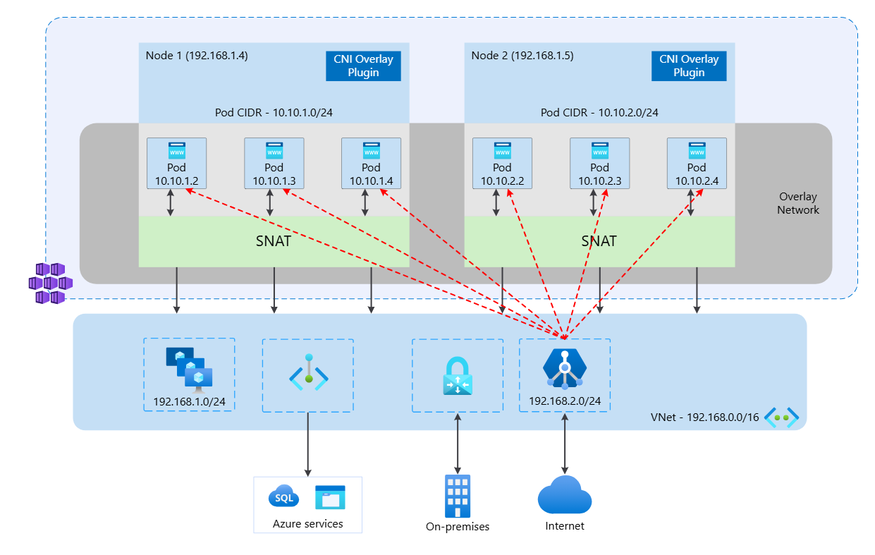
Networking Updates
Public Preview: CNI Overlay for Application Gateway for Containers and AGIC
It is now possible to load balance workloads with scalability and resilience across AKS services in an Azure CNI Overlay cluster using Application Gateway for Containers and Application Gateway Ingress Controller (AGIC).
Conserve IP addresses: Conserve VNet IP address space and support maximum cluster scale with CNI Overlay.
Control ingress: Manage cluster ingress from external clients and services to specified services within the private overlay network of the AKS cluster, ensuring that traffic remains within the private overlay network to reduce exposure to external threats and enhance overall security.
Simplify deployment: Automatically detect the appropriate network configuration for CNI Overlay or CNI with Application Gateway for Containers and Application Gateway Ingress Controller, requiring no additional configuration.

Slide 6
Security & Identity

Slide 7
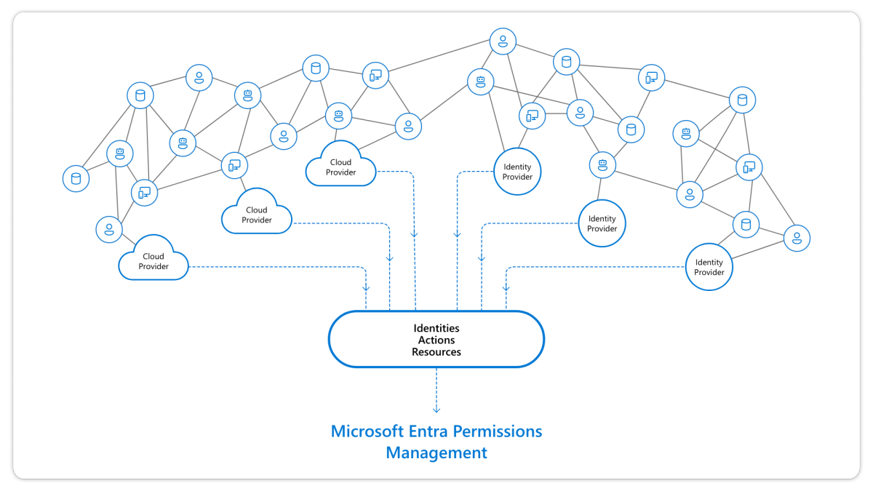
Security & Identity Updates
Microsoft Entra Permissions Management end of sale and retirement
Effective April 1, 2025, Microsoft Entra Permissions Management (MEPM) will no longer be available for sale to new Enterprise Agreement or direct customers. Additionally, starting May 1, it will not be available for sale to new CSP customers. Effective October 1, 2025, MS will retire Microsoft Entra Permissions Management and discontinue support of this product.
Existing customers will retain access to this product until September 30, 2025, with ongoing support for current functionalities. MS has partnered with Delinea to provide an alternative solution, Privilege Control for Cloud Entitlements (PCCE), that offers similar capabilities to those provided by Microsoft Entra Permissions Management (CloudKnox).
Public Preview - Track and investigate identity activities with linkable identifiers in Microsoft Entra
Microsoft will standardize the linkable token identifiers and expose them in both Microsoft Entra and workflow audit logs. This allows customers to join the logs to track, and investigate, any malicious activity. Currently linkable identifiers are available in Microsoft Entra sign in logs, Exchange Online audit logs, and MSGraph Activity logs.
Microsoft includes certain identifiers in all tokens that can be used to link activities from one root authentication. Linkable identifiers help threat hunters and analysts investigate and remediate identity-related attacks.
There are two types of linkable identifiers:
One is based on session ID (SID). It helps link all authentication artifacts issued from a single root authentication with the same identifier, which can be used to link or connect tokens in a single chain together. For example, a SID-based linkable identifier can track all the activities done by all the access tokens issued from a long-lived token, like a refresh token (RT) or session cookies.
Another tracks activities done by a specific token access, like an access token (AT) or ID token.

Slide 8
Security & Identity Updates
General Availability- Conditional Access reauthentication policy
Require reauthentication every time can be used for scenarios where you want to require a fresh authentication, every time a user performs specific actions like accessing sensitive applications, securing resources behind VPN, or Securing privileged role elevation in PIM.
General Availability- Custom Attributes support for Microsoft Entra Domain Services
This capability allows customers to use Custom Attributes in their managed domains. Legacy applications often rely on custom attributes created in the past to store information, categorize objects, or enforce fine-grained access control over resources. Modifying legacy applications can be costly and risky, and customers might lack the necessary skills or knowledge to make these changes.
Microsoft Entra Domain Services now supports custom attributes, enabling customers to migrate their legacy applications to the Azure cloud without modification.
Microsoft Entra Domain Services can synchronize the following types of extensions from Microsoft Entra ID, so you can also use apps that depend on custom attributes with Domain Services:
onPremisesExtensionAttributes are a set of 15 attributes that can store extended user string attributes.
Directory extensions allow the schema extension of specific directory objects, such as users and groups, with strongly typed attributes through registration with an application in the tenant.

Slide 9
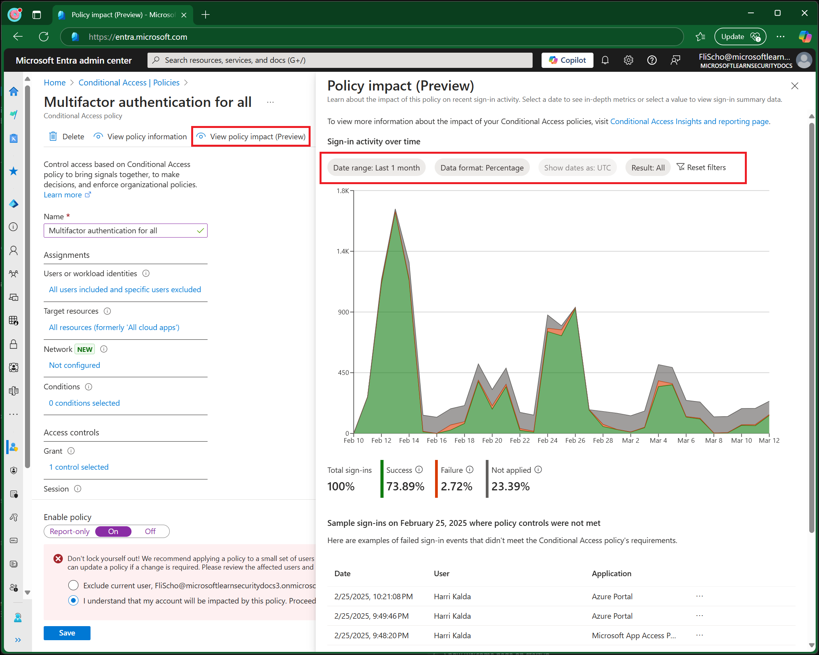
Security & Identity Updates
Public Preview - Conditional Access Per-Policy Reporting
The policy impact view of Conditional Access lets admins with at least the Security Reader role see a snapshot of information about the potential or existing impacts of policies on interactive sign-ins in your organization. This functionality lets you explore impact over a period of the past 24 hours, 7 days, or 1 month
Public Preview - Limit creation or promotion of multitenant apps
A new feature has been added to the App Management Policy Framework that allows restriction on creation or promotion of multitenant applications, providing administrators with greater control over their app environments.
Administrators can now configure tenant default or custom app policy using the new 'audiences' restriction to block new app creation if the signInAudience value provided in the app isn't permitted by the policy. In addition, existing apps can be restricted from changing their signInAudience if the target value isn't permitted by the policy.

Slide 10
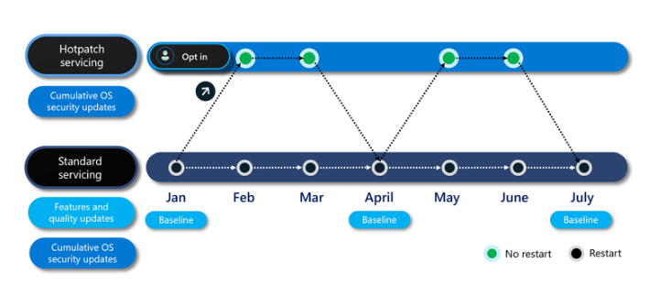
Security & Identity Updates
Hotpatch for Windows client now available
Hotpatch updates for Windows 11 Enterprise, version 24H2 for x64 (AMD/Intel) CPU devices are now available. With hotpatch updates, it is now possible quickly take measures to help protect organization from cyberattacks, while minimizing user disruptions.
SSH Posture Control for Linux is now GA!
SSH Posture Control provides a comprehensive solution to ensure servers are configured according to best practices and environment specific requirements.
Key Features:
Comprehensive Auditing: SSH Posture Control performs a thorough audit of your SSH server settings, and identifying potential misconfigurations.
Automated Configuration: Save time and reduce errors with automated configuration options that align your SSH server settings with industry best practices.
Support for Multiple Distros: Whether you're using Ubuntu, Red Hat, Azure Linux, or other supported distributions, SSH Posture Control has you covered.
Azure Governance: SSH Posture Control integrates seamlessly with Azure Governance services such as Azure Policy and Machine Configuration.

Slide 11
Security & Identity Updates
General Availability for agentless VM scanning support for CMK in Azure
Agentless scanning for Azure VMs with CMK encrypted disks is now Generally Available. Both the Defender CSPM plan, and the Defender for Servers P2 provide support for agentless scanning for VMs, now with CMK support across all clouds
Customizable on-upload malware scanning filters in Defender for Storage (Preview)
On-upload malware scanning now supports customizable filters. Users can set exclusion rules for on-upload malware scans based on blob path prefixes, suffixes as well as by blob size. By excluding specific blob paths and types, such as logs or temporary files, you can avoid unnecessary scans and reduce costs.

Slide 12
Security & Identity Updates
Kubernetes gated deployment (Preview)
MS released the Kubernetes gated deployment (Preview) feature to the Defender for Containers plan. Kubernetes gated deployment is a mechanism for enhancing Kubernetes security by controlling the deployment of container images that violate organizational security policies.
This capability is based on two new functionalities:
Vulnerability findings artifact: Generation of findings for each container image scanned for vulnerability assessment.
Security rules: Addition of security rules to alert or prevent the deployment of vulnerable container images into Kubernetes clusters.
Customized security rules: Customers can customize security rules for various environments, for Kubernetes clusters within their organization, or for namespaces, to enable security controls tailored to specific needs and compliance requirements.
Configurable actions for a security rule:
Audit
Deny

Slide 13
Management & Governance

Slide 14
Management & Governance Updates
Generally Available: AKS Cost Recommendations in Azure Advisor
To help optimize AKS clusters, Azure Advisor now offers AKS cost recommendations. These advisors are designed to identify cost savings opportunities and provide actionable insights to enforce AKS cost best practices. The recommendations are tailored to cluster configuration and target rightsizing, autoscaling, visibility, and SKU selection scenarios.

Slide 15
Compute

Slide 16
Compute Updates
Public Preview: Azure Monitor Application Insights Auto-Instrumentation for Java and Node Microservices on AKS
It is now possible easily monitor Java and Node deployments without changing code by leveraging auto-instrumentation that is integrated into the AKS cluster.
This integration currently supports Java or Node kubernetes deployments running on Linux node pools. With this feature enabled, the AKS platform will instrument popular Node and Java libraries in code and automatically send correlated Open Telemetry- based application-level logs, metrics, and distributed tracing to your Application Insights resource.
Additionally, this integration enables efficient identification of whether issues originate from the infrastructure or the application by using Open Telemetry Resource Attributes to link application telemetry with infrastructure signals. This facilitates the inclusion of Container Insights data into Application Insights and introduces Application Insights to Container Insights transition experiences.
Generally Available: Azure Linux 3.0 Support in AKS
Azure Linux 3.0, the next major version release of the Azure Linux container host for Azure Kubernetes Service (AKS), is now generally available and defaults on Kubernetes version 1.32. Azure Linux 3.0 offers increased package availability and versions, an updated kernel, and improvements to performance, security, and tooling and developer experience.

Slide 17
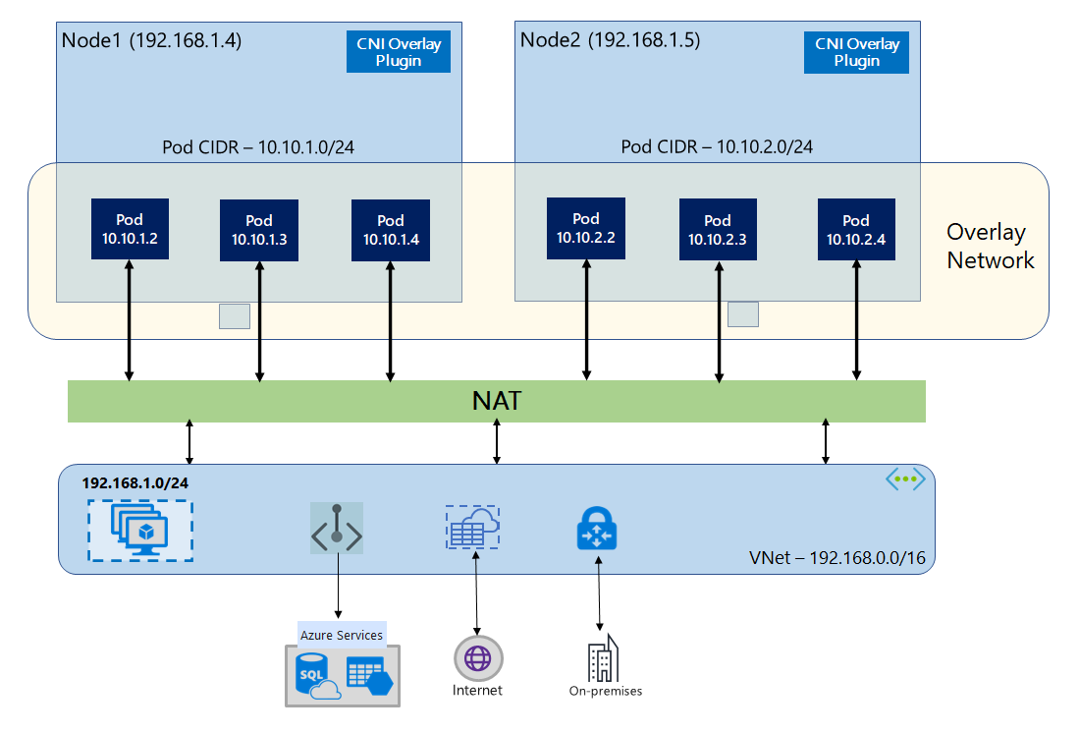
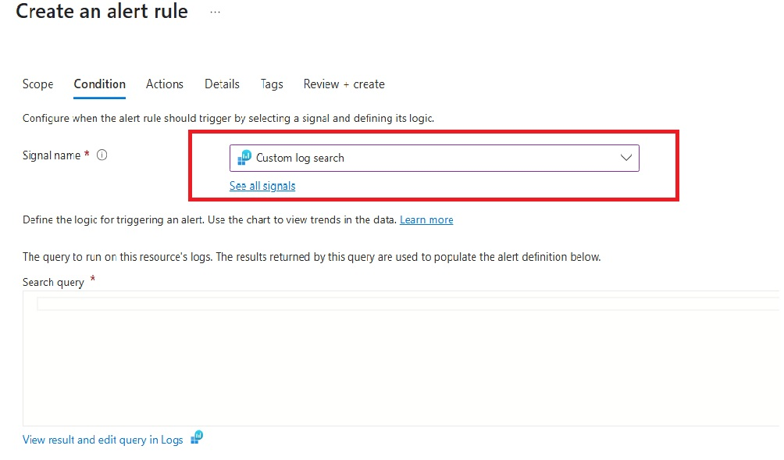
Compute Updates
Generally Available: AKS Communication Manager
The AKS communication manager streamlines notifications for all AKS maintenance tasks by using Azure Resource Notification and Azure Resource Graph frameworks.
This tool enables to monitor upgrades closely by providing timely alerts on event triggers and outcomes. If maintenance fails, it notifies with the reasons for the failure, reducing operational hassles related to observability and follow-ups.
Generally Available: Azure CNI Overlay Dual-stack with Cilium Dataplane Support
Azure CNI overlay now supports dual-stack networking with Azure CNI powered by Cilium, enabling customers to enforce IPv6 network policies and leverage Advanced Container Networking Services (ACNS) in dual-stack environments.
This update allows customers using Cilium with overlay mode to fully utilize IPv4 and IPv6 together, enhancing security, scalability, and networking capabilities in AKS.

Slide 18
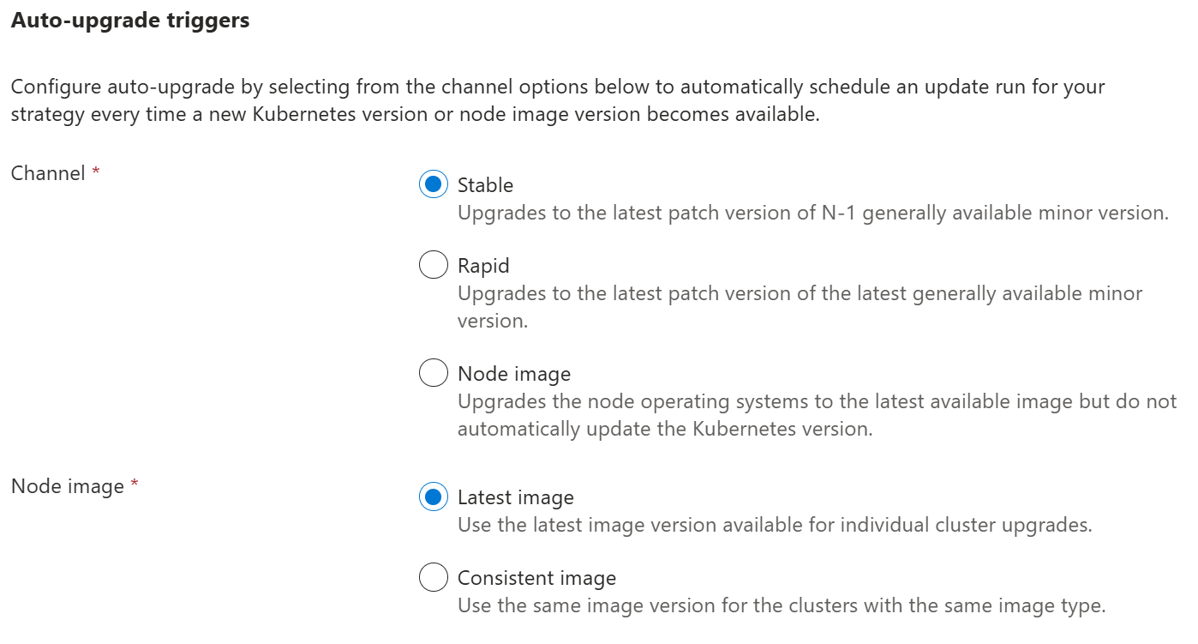
Compute Updates
Generally Available: Multi-cluster Auto-upgrade in Azure Kubernetes Fleet Manager
Platform administrators managing large number of Kubernetes clusters face the challenge of updating Kubernetes or node images in a way that is safe and predictable. To address this challenge, Azure Kubernetes Fleet Manager (Fleet Manager) provides update runs which are used to deploy updates across multiple Kubernetes clusters using safe deployment practices.
Fleet Manager is announcing the general availability of Auto-upgrade support, which provides an automated trigger for update runs based on new Kubernetes or node image versions being published to Azure. Admins can create multiple auto-upgrade profiles for their fleet to capture combinations of Kubernetes and node image version updates. Additionally, existing update run strategies can be used to determine the order in which clusters are updated, while guaranteeing cluster upgrades occur within the maintenance windows configured at each cluster.

Slide 19
Compute Updates
Public Preview: Default Inference with vLLM with AI Toolchain Operator Add-on
By default, the AI toolchain operator add-on now deploys model inferencing workloads using the high-throughput vLLM serving engine. vLLM offers a significant speed-up to process incoming requests and flexibility to use OpenAI-compatible APIs, DeepSeek R1 models, and a range of pre-trained HuggingFace models. Alternatively, it is possible to switch from vLLM to HuggingFace Transformers for KAITO inference deployments at any time.
Public Preview: maxUnavailable Setting for Upgrades in AKS
AKS now supports setting a maxUnavailable option for upgrading nodepools to a newer version of both Kubernetes and node images. With maxUnavailable, you no longer need to use surge nodes to begin the upgrade process. AKS will instead simply cordon and drain existing nodes on the nodepool.

Slide 20
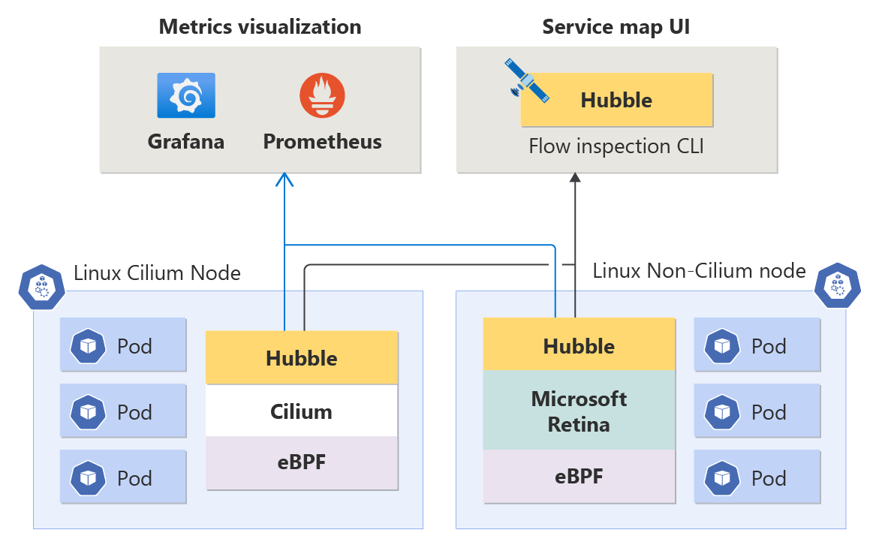
Compute Updates
Public Preview: Standard Load Balancer (SLB) Health Probe Redesign in AKS
AKS now offers improved load balancing for services using externalTrafficPolicy: Cluster. This enhancement enables the standard load balancer (SLB) to probe kube-proxy directly instead of backend applications. This new capability enhances reliability, reduces misconfigurations, and improves traffic routing.
Public Preview: AKS Support for Persistent Network Flow Logging for Advanced Container Networking Service
To enable better security auditing, performance analysis, and troubleshooting of network flows within AKS clusters, AKS now supports persistent network flow logging with Advanced Container Networking Services. This enhancement allows to capture and retain detailed network traffic logs over time, providing valuable insights into network behavior and helping to ensure the security and efficiency of your deployments.

Slide 21
Compute Updates
Public Preview: Multiple Load Balancers for AKS
To address existing SLB rule limits and private link constraints, AKS now supports multiple standard load balancers (SLB) per cluster. This enhancement allows for better scalability, workload distribution, and flexibility in managing network traffic across large deployments.
Public Preview: Cilium WireGuard Encryption Support in AKS
AKS supports WireGuard encryption in Advanced Container Networking Services + Cilium data plane clusters. This enables seamless node-to-node encryption for improved security. This integration provides a lightweight, high-performance encryption mechanism for traffic between nodes in an AKS cluster, ensuring that data in transit remains secure without significant performance overhead.

Slide 22
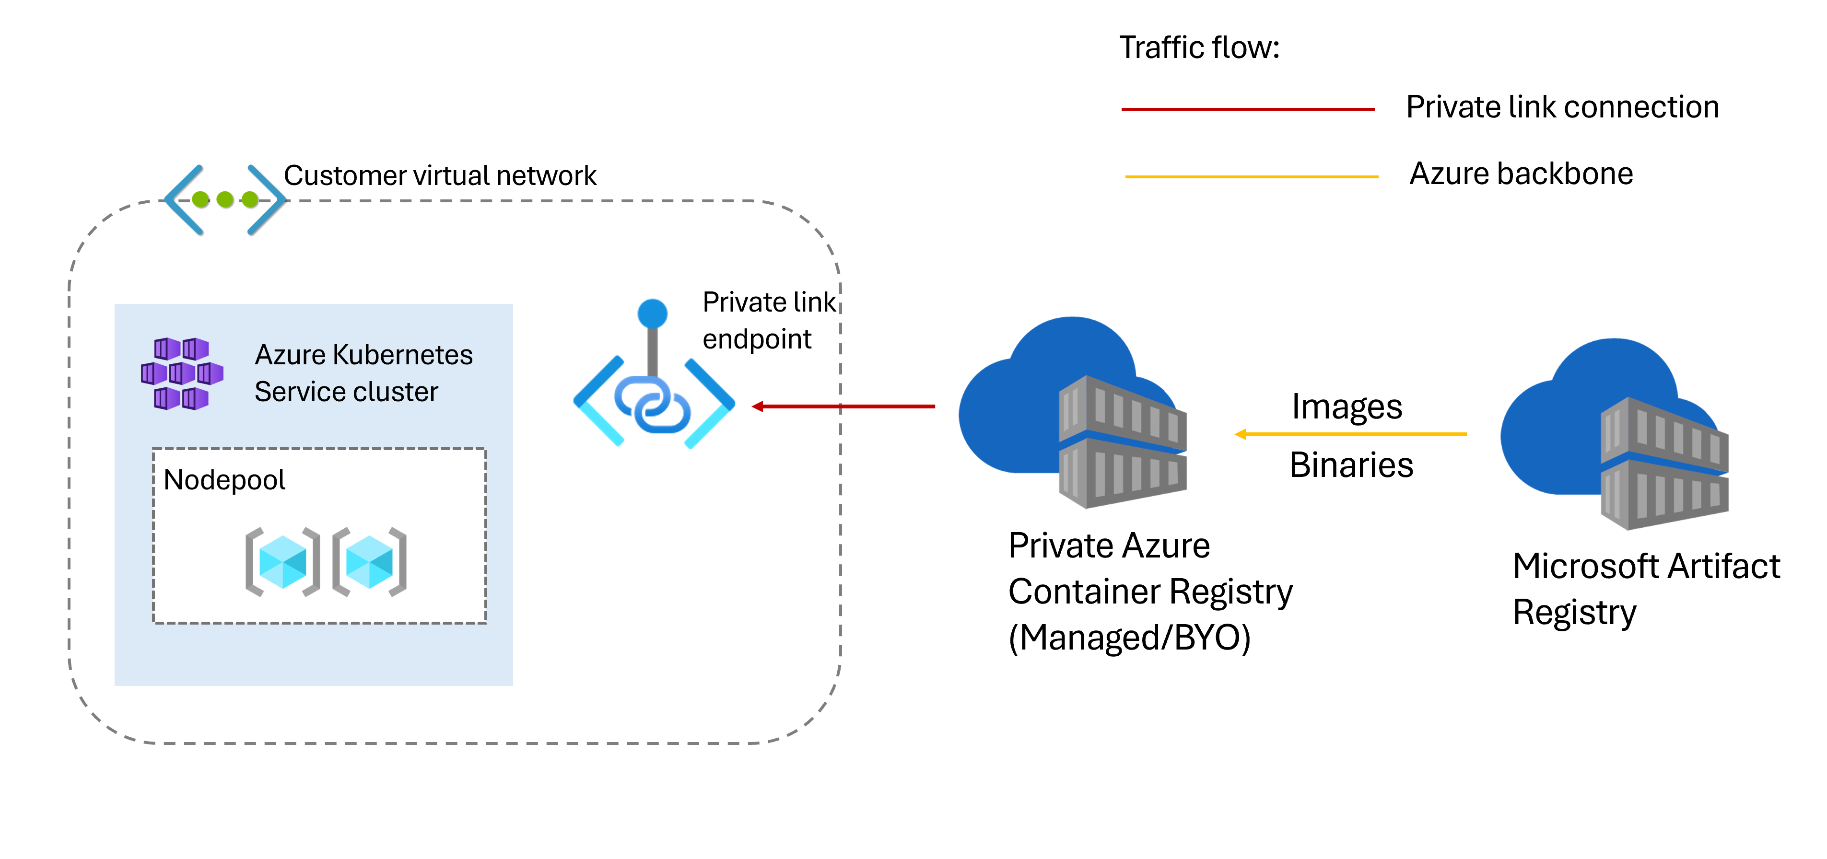
Compute Updates
Public Preview: Advanced Container Networking Services Cilium L7 Policies Support in AKS
AKS now supports Layer 7 (L7) network policies in Advanced Container Networking Services + Cilium clusters, enabling fine-grained control over application traffic. With L7 policies, customers can define security rules based on application-layer attributes, improving zero-trust security models within AKS.
Generally Available: Network isolated cluster in AKS
Today it is possible to control an AKS cluster's egress traffic using Azure Firewall. While this configuration is intended to isolate the cluster to protect sensitive business or customer data, it adds an additional layer of management complexity and cost.
AKS now provides the option to use network isolated clusters to simplify the process of restricting network access and reduce the risk of unintentional exposure of the cluster's public endpoints to prevent security breaches.

Slide 23
Compute Updates
Public Preview: Service Allowed IP Ranges in AKS
AKS now allows to define both IP ranges and service tags for Service LoadBalancers, providing more flexible traffic control than loadBalancerSourceRanges. This eliminates the need for manual service tag updates and ensures seamless traffic management across on-premises and Azure services.
Generally Available: Cilium Endpoint Slices in AKS
AKS now supports Cilium endpoint slices, improving scalability and efficiency of network endpoint management. By reducing API server load and optimizing service discovery, endpoint slices enhance networking performance for AKS clusters using the Cilium dataplane.

Slide 24
Compute Updates
Public preview: Multi-cluster Workload Rollout Strategies and Runs with Azure Kubernetes Fleet Manager
Operators using Azure Kubernetes Fleet Manager’s Cluster Resource Placement for intelligent execution of multi-cluster workload placement can now define reusable staged rollout strategies using ClusterStagedUpdateStrategy custom resource. A ClusterStagedUpdateStrategy specifies the ordering of clusters across stages, supporting soak time and approvals between stages. An Operator can use a strategy to deploy a workload via creating and submitting a ClusterStagedUpdateRun custom resource.
Generally Available: Skip Automatic GPU Driver Installation
By default, AKS installs NVIDIA GPU drivers when a node pool is created using a VM size that supports NVIDIA GPUs. The ability to skip automatic driver installation on GPU-enabled node pools is now generally available. This option allows to self-install custom GPU drivers or use the GPU Operator on Linux and Windows node pools.

Slide 25
Compute Updates
Public Preview: Multi-cluster Eviction and Disruption Budgets with Azure Kubernetes Fleet Manager
Operators using Azure Kubernetes Fleet Manager’s Cluster Resource Placement for intelligent execution of multi-cluster workload placement now have additional controls. With the introduction of ClusterResourcePlacementEviction, Fleet Manager’s workload placement provides operators with a way to forcibly remove placed resources from member clusters. When this happens, it is important for operators to be able to control eviction across their Fleet. For this purpose, a newly available ClusterResourcePlacementDisruptionBudget custom resource can help operators ensure that workload availability is maintained in the event of workload eviction.
Generally Available: Azure CNI Node Subnet + Cilium Support
To improve compatibility and flexibility for customers transitioning to ePBF-based networking, AKS now supports the Cilium dataplane with Azure CNI Node Subnet. This enhancement allows you to leverage Cilium’s advanced networking capabilities while using Node Subnet IP allocation, maintaining your existing IP allocation strategies.

Slide 26
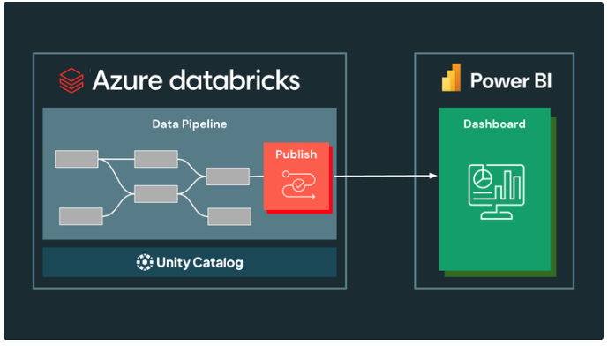
Compute Updates
A new Power BI task type to Azure Databricks Workflows
MS extended the deep integration between Azure Databricks and Microsoft Power BI with the Public Preview of the Power BI task type in Azure Databricks Workflows. This new capability allows users to update and refresh Power BI semantic models directly from their Azure Databricks workflows, ensuring real-time data updates for reports and dashboards. By leveraging orchestration and triggers within Azure Databricks Workflows, organizations can improve efficiency, reduce refresh costs, and enhance data accuracy for Power BI users.

Slide 27
Compute Updates
Retirement: Azure App Service Will No Longer Support Linked Databases as a Part of Custom Backups After March 31, 2028
Beginning March 31, 2028, the Azure App Service custom backup feature will no longer back up linked databases configured as part of the Azure App Service custom backup feature.
Before March 31, 2028, the App Service team will remove the ability to include linked databases as part of new custom backup configurations for App Service web applications.
The schedule for this change is as follows:
November 2025 for linked MySQL and PostgreSQL databases
April 2026 for linked Azure SQL and SQL Server databases
App Service web applications with existing custom backups that already include linked databases will continue to back up the linked databases until retirement of the App Service custom backup linked database feature on March 31, 2028.
Retirement: Add-ons Feature in Azure Container Apps
The public preview add-ons feature in Azure Container Apps will be retired on September 30, 2025. To prepare for this change, transition to Azure managed services, such as Azure Cache for Redis or Azure Database for PostgreSQL.

Slide 28
Compute Updates
Retirement: Azure Synapse Data Explorer (Preview) to Be Retired on October 7, 2025
Synapse Data Explorer (Preview) will be retired on October 7, 2025. The next generation of Synapse Data Explorer offering is evolving to become Eventhouse in Real-Time Intelligence, part of Microsoft Fabric.​
Key Dates:
March 31, 2025: Last day of public preview. After this date it is not possible to use Synapse Data Explorer without any disruption in existing subscriptions.
October 7, 2025: Retirement day of Synapse Data Explorer. After this date, workloads running on Synapse Data Explorer will be deleted, and the associated application data will be lost.
Retirement: Upgrade Your Entra Domain Services to TLS 1.2 by August 31, 2025
Entra Domain Services customers who are using TLS 1.0 and 1.1 need to migrate to 1.2 by August 31, 2025.
Microsoft is enhancing security by disabling TLS versions 1.0 and 1.1 as communicated on November 10, 2023.
TLS 1.2 or later versions provide improved security features, including perfect forward secrecy and stronger cipher suites. This change helps protect customer data and ensures compliance with industry standards.

Slide 29
Compute Updates
Retirement: D, Ds, Dv2, Dsv2, and Ls Series Virtual Machines to Be Retired on May 1, 2028
D, Ds, Dv2, Dsv2, and Ls series Azure Virtual Machines will retire on May 1st, 2028. These VMs will no longer be able to be used or purchased after this date.
To ensure any applications and workloads running on these VMs will be operating in the future, migrate VMs workloads to a newer VM generation
Three-year reserved instances for these VMs can also no longer be purchased or renewed starting on May 1, 2025. One-year reservations for these VMs will be available to purchase or renew until 2027.
Retirement: Prepare for the Retirement of Manually Registered Azure VPN Clients on March 31, 2028
On March 31, 2028, MS will be retiring manually registered Azure VPN clients for point-to-site connections with Microsoft Entra ID authentication.
To improve security, MS will only be supporting Microsoft-registered VPN clients after that date. Beginning 30 December 2025, it will no longer be possible to create point-to-site connections with a manually registered client.

Slide 30
Compute Updates
Retirement: Cloud Services (Extended Support) to Be Retired on March 31, 2027
On March 31, 2027, MS will retire the Cloud Services (extended support) deployment model. Before that date, we will need to migrate services that were deployed using this model to Service Fabric managed cluster which enhances the scalability, flexibility, and reliability of your Azure deployments.
Retirement: Azure Machine Learning SDK v1 Will Be Retired on March 31, 2025 – Transition to Machine Learning SDK v2
Starting on June 30, 2026, Azure Machine Learning Software Development Kit version 1 (SDK v1) will no longer be supported.

Slide 31
Compute Updates
Retirement: Log Analytics Beta API to Be Retired on March 31, 2026
On March 31, 2026, MS will be retiring the beta API in Azure Monitor Log Analytics. After that date, queries using this API will no longer work. This API version is being retired to comply with Azure’s Versioning Policy.
To avoid service disruptions, move to the standard request API and format for Azure Monitor Log Analytics data access API by March 31, 2026. When adjusting workloads that currently use the beta API, start using the v1 version of the API and adhere to the alternative request and response API formats.

Slide 32
Storage & Data

Slide 33
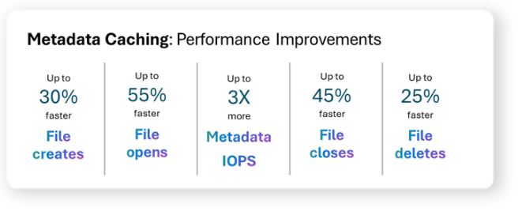
Storage & Data Updates
Generally Available: Azure File Sync support for managed identities
Managed Identity eliminates the need for shared keys as a method of authentication to Azure file shares by utilizing a system-assigned managed identity provided by Microsoft Entra ID.
Storage Sync Service authentication to Azure file share
Registered server authentication to Azure file share
Registered server authentication to Storage Sync Service
To simplify authentication and enhance security, managed identities are now enabled by default for new Storage Sync Services.
Azure File Sync with managed identities is available in all Azure Public and Government regions at no additional cost. We encourage you to take advantage of this feature for a simpler and more secure authentication experience.
Metadata Caching for Azure Files
For metadata intensive applications MS introduced a major boost in metadata performance. Applications experience up to 55% lower latency and 2–3x more consistent response times, ensuring greater reliability. Workloads with high metadata interaction, such as AI/ML pipelines, see the biggest gains with 3x higher parallel metadata IOPS for improved efficiency and scalability. Removing metadata bottlenecks allows more data operations too. We've seen workloads increase data IOPS and throughput up to 60%.
Azure Files SSD (premium), this enhancement accelerates metadata operations for both SMB and REST protocols, benefiting new and existing file shares at no extra cost.

Slide 34
Storage & Data Updates
MS Fabric Updates:
Enhancing AI productivity in Fabric notebooks with Copilot updates
The next evolution of OneLake security (Preview)
Migration Assistant for Fabric Data Warehouse (Preview)
Fabric Data Factory: What’s New and Latest Roadmap
Introducing Autoscale Billing for Spark in Microsoft Fabric
Copilot and AI Capabilities will be accessible to all paid SKUs in Microsoft Fabric
Easily load Fabric OneLake data into Excel — OneLake catalog and Get Data are integrated into Excel for Windows (Preview)
New Solace PubSub+ Connector: seamlessly connect Fabric Eventstream with Solace PubSub+ (Preview)
Terraform Provider for Microsoft Fabric (Generally Available)
High Concurrency mode for notebooks in pipelines (Generally Available)
Exciting New Features for Mirroring for Azure SQL in Fabric
Folder REST API (Preview)

Slide 35
Databases

Slide 36
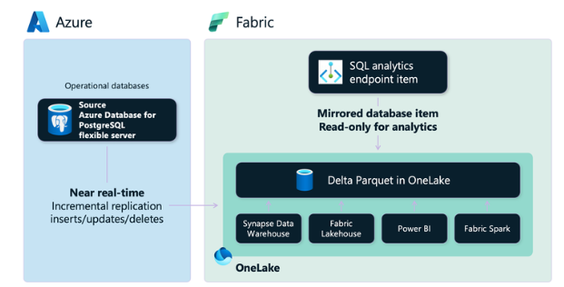
Databases Updates
Announcing Oracle Database@Azure in Australia Southeast (Melbourne) and East US 2
Microsoft and Oracle are pleased to announce the expansion of Oracle Database@Azure availability to Australia Southeast (Melbourne) and East US 2!
Oracle Database@Azure is now available in 15 regions globally – Australia East, Australia Southeast, Brazil South, Canada Central, Central US, East US, East US 2, France Central, Germany West Central, Italy North, Japan East, Southeast Asia, UK South, UK West and West US.
Announcing Mirroring for Azure Database for PostgreSQL in Microsoft Fabric for Public Preview
MS announced Public Preview milestone, giving customers the ability to leverage friction-free near-real time replication from Azure Database for PostgreSQL flexible server to Fabric OneLake in Delta tables, providing a solid foundation for reporting, advanced analytics, AI, and data science on operational data with minimal effort and impact on transactional workloads.

Slide 37
ML & AI & IOT

Slide 38
ML & AI & IOT Updates
Azure AI Speech’s HD voices are generally available and more
MS announced that Azure AI Speech’s Dragon HD neural text to speech (language model-based TTS, similar to model design for text LLM) voices, is now general availability (GA).
These voices have gained significant traction across various scenarios and have received valuable feedback from our users. This milestone is a testament to the extensive feedback and growing popularity of Azure AI Speech’s HD voices.
Announcing the General Availability of Azure AI Video Indexer enabled by Azure Arc
zure AI Video Indexer enabled by Azure Arc allows you to run video and audio analysis, as well as generative AI, on devices located in distributed locations such as, but not limited to, Azure Local. This solution is designed to operate on Azure Arc-enabled Kubernetes clusters, supporting a wide range of video formats and languages, making it a versatile tool for global applications. The extension also supports bringing your own pre-trained custom models that customers can incorporate and run as part of Video Indexers insight pipeline. It provides now:
Expanded language support: Supports transcription in over 35 languages, as well as translation to English.
Generative AI: Users can create textual video summaries, allowing to leverage state of the art, multimodal models to generate textual summaries of videos in various styles.

Slide 39
ML & AI & IOT Updates
New capabilities in Azure AI Foundry
Microsoft continues to evolve the technologies it offers to customers and partners so they can push the boundaries of innovation! Here is a summary of just a few announcements for Microsoft’s 50th anniversary. Check out the blog for more!
General availability of agent framework allows to simplify the orchestration of multi-agent systems for customers.
The advanced observability suite for evaluations, tracing, and A/B testing
AI Red Teaming Agent (public preview) helps uncover safety risks through comprehensive reports, tracking improvements over time.
With Azure AI Foundry extension for Visual Studio Code (public preview), developers can build, test, and deploy agent-based applications entirely within their Integrated Development Environment (IDE)—no context switching required.

Slide 40
DevOps & IaC & Automation

Slide 41
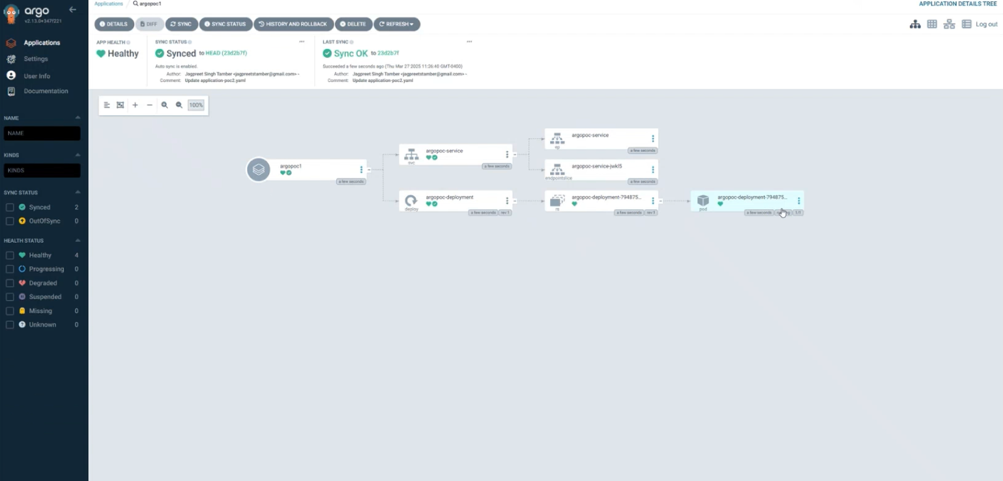
DevOps & IaC & Automation
​​Generally Available: New Microsoft Dev Box Regional Availability​
Microsoft Dev Box is now available in Spain Central. For more information on Dev Box regional availability,
Announcing Private Preview: ArgoCD through Microsoft GitOps
MS announced the Private Preview for Microsoft GitOps ArgoCD. Delivered as a cluster extension across Azure Kubernetes Service (AKS) and Azure Arc-enabled Kubernetes, Microsoft GitOps delivers a consistent and robust management, security, and deployment experience for ArgoCD across heterogeneous environments.
This capability complements Microsoft GitOps existing support for Flux, which is currently in General Availability.
Advantages of the current Microsoft GitOps experience for ArgoCD include:
Simplified, templatized deployment as a cluster extension
Managed and automated upgrade reducing overhead
Official supportability and security for enterprise readiness
Integration with Azure identity and authentication

Slide 42
DevOps & IaC & Automation
Improve the security of Generation 2 VMs via Trusted Launch in Azure DevTest Labs
MS announced the public preview of the Trusted Launch feature for Generation 2 (Gen2) Virtual machines (VMs) in Azure DevTest Labs! This game-changing feature is designed to enhance security of virtual machines (VMs), protecting against advanced and persistent attack techniques. Here are the key benefits:
Securely deploy VMs with verified boot loaders, OS kernels, and drivers.
Protect keys, certificates, and secrets within VMs securely.
Gain insights and confidence in the integrity of the entire boot chain.
Ensure workloads are trusted and verifiable.

Slide 43
Information

Slide 44
Information
Azure Times GitHub Repo

Slide 45
Questions

