Slide 1
Azure Times #182
October 13, 2025

Slide 2
Networking

Slide 3
Networking Updates
Generally Available: Azure Firewall updates - Customer provided public IP address support in secured hubs
Azure Firewall in Virtual WAN secured hubs now supports the use of customer-provided public IP addresses. This capability enables organizations to bring their own public IP addresses when deploying Azure Firewall in a secured Virtual WAN hub, providing greater flexibility and control over network infrastructure.
With this feature, instead of relying on Azure-managed public IP addresses, it is possible to set own public IP addresses that are already allocated in Azure subscription.
NOTE: For existing secured virtual WAN hubs, remove all the public IPs assigned to the Hub, stop/deallocate the hub firewall, and allocate the Firewall with a public IP during scheduled maintenance hours.
Generally Available: Azure Firewall Updates - IP Group limit increased to 600 per Firewall Policy
Azure Firewall Policy now supports up to 600 IP Groups per policy, up from the previous limit of 200. This enhancement enables to:
Reduce rule complexity by replacing long lists of IPs with more well-organized IP Groups, making rule sets easier to manage and audit.
Supports large-scale architectures and microsegmentation: Enterprises often manage hundreds of app tiers, networks, and subnets.
Improves troubleshooting: Named groups make it easier to understand rule intent (e.g., HR-Network, IT-Network, etc.) in logging during debugging or reviews.

Slide 4
Management & Governance

Slide 5
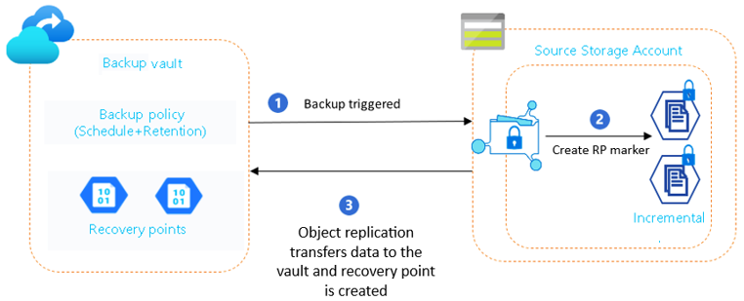
Management & Governance Updates
Public Preview: Introducing Vaulted Backup for Azure Data Lake Storage
Azure Backup now supports vaulted protection for ADLS, delivering secure, off-site backups that ensure business continuity and compliance—even in cases of accidental deletion, malicious activity, or ransomware. Vaulted backups maintain an independent copy of your data, isolated from the source account.
Key Capabilities:
Off-site protection: Recover data even if the source account is compromised. Restore to original or alternate accounts.
Resilience against deletion and attacks: Isolated backups protect against insider threats and ransomware.
Automated & flexible scheduling: Configure daily/weekly schedules or trigger on-demand backups.
Long-term retention: Store backups for up to 10 years to meet compliance and archival needs.
Security-first design: Features like soft-delete, immutability, encryption, and multi-user authorization safeguard vault data.

Slide 6
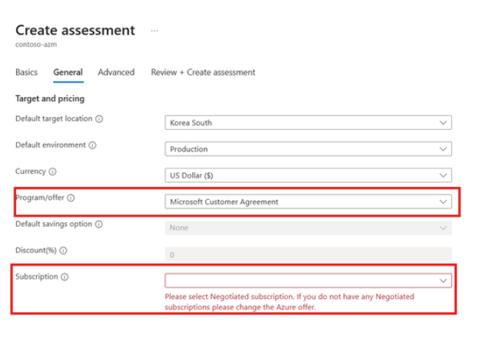
Management & Governance Updates
Empower your migration decisions with negotiated agreements (EA/MCA) in Azure Migrate
Previously, Azure Migrate assessments used standard retail pricing, which often didn’t reflect negotiated terms. This created uncertainty and slowed decision-making. Now, by integrating MCA pricing:
No More Guesswork: Assessments reflect your actual negotiated rates.
True Cost Visibility: Understand the real financial impact of your migration strategy.
Better Planning: Prioritize workloads and optimize budgets with confidence.
Cut migration costs with B-Series and Cobalt 100 VM support in Azure Migrate
Azure Migrate now supports B-Series and Cobalt 100 VMs, empowering you to plan migrations smarter, optimize costs, and get the right performance fit for every workload.

Slide 7
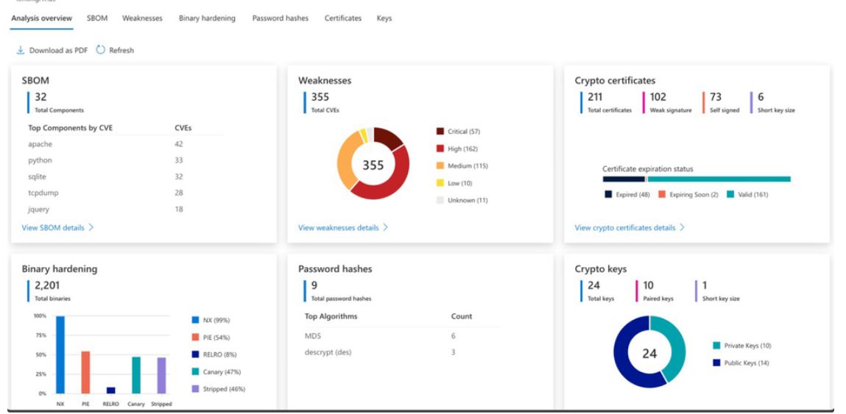
Management & Governance Updates
Generally Available: Firmware analysis enabled by Azure Arc
Firmware analysis brings deep visibility into the software that powers IoT/OT and network devices—systems that often operate as “black boxes” with limited insight into their security posture.
Firmware analysis examines the low-level software (firmware) that powers IoT, OT and network devices, with no agent required on the device. Upload a firmware image (for example, an extracted embedded Linux image), and the cloud service performs an automated security inspection.
Software inventory & vulnerability scanning
Security configuration and hardening check
Credential and secrets discovery
Comprehensive report
Firmware analysis workspaces are currently available as a Free Firmware Analysis Workspace SKU with capacity limits.

Slide 8
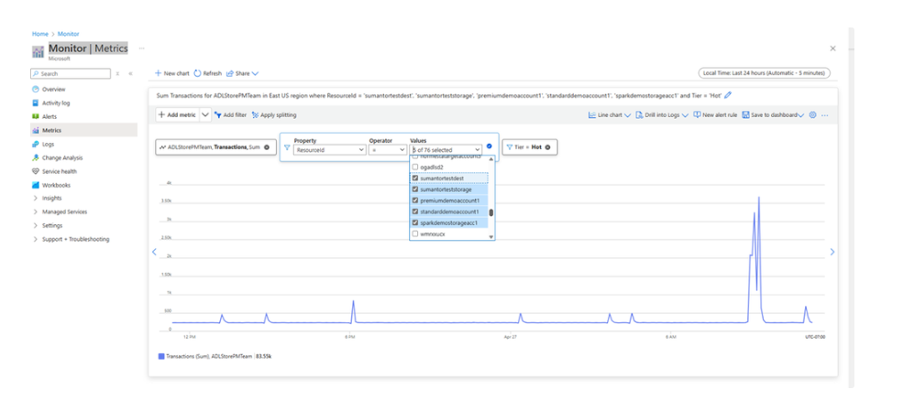
Management & Governance Updates
Introducing Cross-Resource Metrics and Alerts Support for Azure Storage
With this new capability, it is now possible to monitor and visualize metrics across multiple storage accounts in a single chart and configure alerts across multiple accounts — within the same subscription and region. This makes managing large fleets of storage accounts significantly easier and more powerful.
Cross Resource Metrics Support
Visualize aggregated metric data across multiple storage accounts.
Break down metrics by individual resources in a sorted and ordered way.
Cross Resource Alerting Support
Create a single alert rule that monitors a metric across many storage accounts and triggers an action when thresholds are crossed on any resource.
Full Metric Namespace Support
Works across Blob, File, Table, and Queue metric namespaces.
All existing storage metrics are supported for cross resource visualization and alerting.

Slide 9
Management & Governance Updates
Retirement: Legacy Authentication in Azure Monitor - Container Insights will be retired on September 30, 2026.
Legacy Authentication in Azure Monitor - Container Insights will be retired on September 30, 2026. Legacy authentication has been replaced by the more secure Managed Identity authentication method. Migrating to Managed Identity also gives customers access to newer Container Insights features like Syslog collection and High Scale mode which are available only with Managed Identity.
Customers must migrate to the new Managed Identity authentication before September 30, 2026. Customers can migrate their clusters with a single click from the Azure portal. Azure Monitor documentation also has command line options and a bulk migration script.

Slide 10
Compute

Slide 11
Compute Updates
Generally Available: AI toolchain operator add-on (KAITO) for AKS
The AI toolchain operator add-on (KAITO) is now generally available on AKS, streamlining the deployment of AI inference and fine-tuning workflows using popular open-source frameworks. With vLLM as the default inference engine, this addon reduces management overhead for both AI app developers and cluster operators by automating the setup and lifecycle of key AI/ML components, accelerating development and simplifying operations.

Slide 12
Compute Updates
Retirement: Azure Network Policy Manager (NPM) for Windows nodes on AKS to Be Retired by September 30, 2026
On September 30, 2026, MS will end support for Azure Network Policy Manager (NPM) on Windows nodes in AKS. To ensure setup continues to receive support, security updates, and deployment compatibility, please explore alternative options, such as using Network Security Groups (NSGs) on the node level or open-source tools like Project Calico by that date.
The existing experience that Azure Network Policy Manager for Windows nodes offers will no longer be supported starting September 30, 2026.

Slide 13
Storage & Data

Slide 14
Storage & Data Updates
Generally Available: Custom port support for Azure Database for MySQL – Flexible Server
It is now possible to use custom ports (25001–26000) during server creation for both public and private access-enabled servers.
Feature highlights:
Custom port configuration (25001–26000)
One port per server
Supported scenarios for custom port: server creation, restore (cross-port restore supported), read replica creation, high availability enablement.
Current limitations:
Custom ports can’t be changed after they’re created.
Geo-restore and geo-replication aren’t yet supported.
Generally Avaialbe: Azure NetApp Files short-term clones
Azure NetApp Files short-term clones enable space-efficient, instant read/write access to data by creating temporary thin clones from existing volume snapshots, eliminating the need for full data copies and enabling capacity savings.
Ideal for software development, analytics, disaster recovery and testing, short-term clones support large datasets and allow quick refreshes from the latest snapshots.
Short-term clones remain temporary and space-efficient for up to 32 days, consuming capacity only for incremental changes. This capability accelerates development and analytics workflows, improves quality and resilience, and reduces costs by avoiding full copy storage and minimizing operational overhead. This capability is now generally available in all Azure NetApp Files supported regions.

Slide 15
Storage & Data Updates
Azure unmanaged disks will be retired on 31 March 2026 (formerly 30 September 2025)
This functionality will be completely retired on March 31, 2026 (extended from September 30, 2025).
If you use unmanaged disks, you should start planning your migration now. Migrate your data from Azure unmanaged disk storage to managed disks before March 31, 2026.

Slide 16
Databases

Slide 17
Databases Updates
Generally Available: Latest PostgreSQL minor versions supported by Azure Database for PostgreSQL – Flexible Server
PostgreSQL minor versions 17.6, 16.10, 15.14, 14.19, 13.22, and 18 Beta 3 are now supported by Azure Database for PostgreSQL – Flexible Server.
These minor version upgrades are automatically performed as part of the monthly planned maintenance in Azure Database for PostgreSQL – Flexible Server. This upgrade automation ensures that databases are always running the latest optimized versions without requiring manual intervention.

Slide 18
Databases Updates
Retirement: Azure Cache for Redis is retiring on September 30, 2028
Azure Cache for Redis (Basic, Standard and Premium) will be retired on September 30, 2028 and MS recommend migrate workloads to use Azure Managed Redis before September 30, 2028. Azure Cache for Redis instances that are not migrated by September 30, 2028 will be shut down.
Azure Cache for Redis is built on a fork of the Redis open source software (OSS). Azure Managed Redis uses the Redis Enterprise software. Redis Enterprise essentially builds on Redis OSS with advanced features designed for scalability, reliability, and enterprise-grade security.
Retirement: Azure Cache for Redis Enterprise is retiring on March 30, 2027
Azure Cache for Redis Enterprise and Enterprise Flash tiers is retiring on March 31, 2027 and MS recommend migrate workloads to use Azure Managed Redis by that date. Starting April 1, 2026, users will not be able to create new instances of Azure Cache for Redis Enterprise. All remaining Azure Cache for Redis Enterprise and Enterprise Flash instances will be migrated to Azure Managed Redis automatically after April 1, 2027

Slide 19
ML & AI & IOT

Slide 20
ML & AI & IOT Updates
Retirement: Azure AI Health Insights and related models
As part of a strategic review of AI portfolio, Azure AI Health Insights service and the Clinical Trials Matcher and Radiology Insights models will be retired on December 31, 2025, and will no longer be available for use or integration.
As a result, effective December 31, 2025:
All endpoints and container images for these models will be removed from the Microsoft Artifact Registry.
Any deployments of the models in your own hosting environment will cease to function.
Endpoints for the service and models will no longer be available via the Azure Portal.
API calls to these models will no longer return results.

Slide 21
DevOps & IaC & Automation

Slide 22
DevOps & IaC & Automation
Announcing the new Azure DevOps Server RC Release
MS announced the release candidate (RC) of Azure DevOps Server, bringing new features previously available in the hosted version.

Slide 23
Information

Slide 24
Information
Azure Times GitHub Repo

Slide 25
Questions

