Slide 1
Azure Times #183
October 20, 2025

Slide 2
Networking

Slide 3
Networking Updates
Public Preview: Private Link Service Direct Connect
Azure Private Link service allows service providers to make their applications available to their customers privately and securely by placing them behind a standard load balancer. Private Link service Direct Connect expands on this capability and allows customers to directly connect a private link service to any privately routable destination IP address. This configuration is particularly useful for scenarios that provide private connectivity to applications that require direct IP-based routing, such as database connections or custom applications.
Private Link service (PLS) Direct Connect allows you to:
Route traffic directly to a specific, privately routable destination IP address within virtual network.
Bypass load balancer requirements for scenarios that need direct IP connectivity.
Support custom routing scenarios where you need precise control over traffic destination.
Configure expanded scenarios such as secure access to on-premises resources, third-party SaaS, and virtual appliances.
Limitations
Note these limitations when using the Private Link service Direct Connect:
Minimum 2 IP configurations required: At least 2 IP configurations, or multiples of 2 (limit of 8 max) are required to deploy a PLS Direct Connect.
Maximum of 10 PLS per subscription: There is a hardware limitation of 10 PLS per region per subscription.
Bandwidth limitation: Each PLS Direct Connect can support a bandwidth of up to 10 Gbps.
Static IP requirement: The destination IP must be private, static, and directly reachable, dynamically changing IPs are not supported.
Cross-region limitation: The source private endpoint, private link service, and client VM must be in the same region. This restriction is to be removed when the feature is generally available.
Regional availability: This feature is available in limited regions (North Central US, East US 2, Central US, South Central US, West US, West US 2, West US 3, Asia Southeast, Australia East, Spain Central).

Slide 4
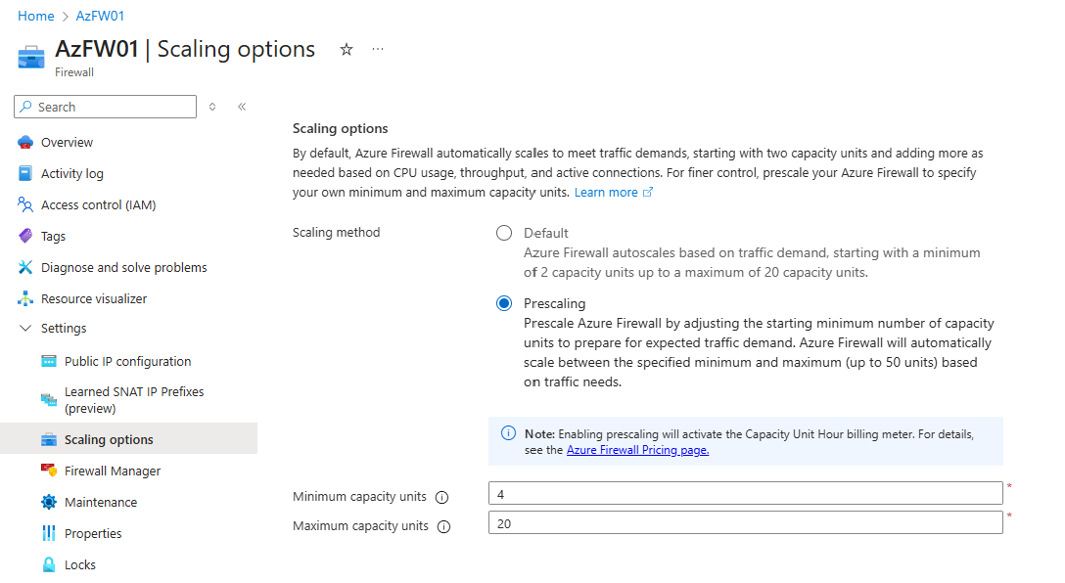
Networking Updates
Generally Available: Prescaling in Azure Firewall
Azure Firewall now supports prescaling, a feature that enables admins to provision and reserve capacity units in advance to handle expected traffic loads – such as seasonal peaks or planned business events. This helps to ensure consistent throughput, faster scaling response, and greater control over capacity.
Key highlights:
Proactive planning: Pre-allocate capacity to meet demand spikes and critical workloads
New observability metric: View current and historical capacity usage in the Observed Capacity Metric to provide strategic insight into planning
Flexible billing: Pay only for the provisioned capacity units, with the flexibility to adjust as your needs evolve.
Prescaling is available for Azure Firewall Standard and Premium SKUs in all public regions.

Slide 5
Networking Updates
Generally Available: Observed capacity metric in Azure Firewall
Azure Firewall now includes the observed capacity metric — a new observability signal designed to help administrators understand how their firewalls are scaling in practice. Observed capacity tracks the number of capacity units actively utilized over time, offering valuable insight into real-world scaling patterns and performance behavior.
Key highlights:
Validate setup: You can validate prescaling or autoscaling setup is performing as expected.
Proactive alerting: Set alerts when usage near defined thresholds and diagnose whether scaling keeps paced with demand
Forecasting: Plan future capacity needs using historical and current traffic trends

Slide 6
Security & Identity

Slide 7
Security & Identity Updates
Public Preview: Azure Integrated HSM
Azure Integrated HSM, is a Hardware Security Module (HSM) cache and crypto accelerator designed to enhance the security and performance of cryptographic operations in virtual machines. For customers who heavily rely on cryptography and have performance-intensive workloads, Azure Integrated HSM provides a secure way to store cryptographic keys for quick and secure retrieval. This feature is available as part of our AMD D and E series v7 preview.
Azure Integrated HSM is designed to meet the Federal Information Processing Standards (FIPS) 140-3 Level 3 Security Requirements for Cryptographic Modules. Azure Integrated HSM protects keys and security assets while these assets are in-use. Azure Integrated HSM has specialized hardware cryptographic accelerators to perform encryption, decryption, signing, and verification operations while they remain within the bounds of the integrated HSM.
Azure Integrated HSM is now available to use in preview on the AMD v7 preview platform with support for our general purpose Dasv7-series, Dadsv7-series, Easv7-series and Eadsv7-series for 8 vCores VMs and above.

Slide 8
Management & Governance

Slide 9
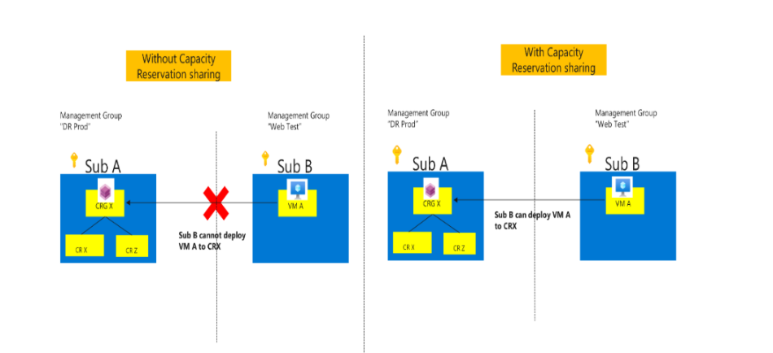
Management & Governance Updates
Private Preview: New planned datacenter region in Malaysia (Southeast Asia 3)
Microsoft is expanding its digital infrastructure footprint further with a new datacenter region, Southeast Asia 3, planned in Malaysia. This datacenter region will feature Microsoft's most comprehensive and strategic cloud services, designed to support advanced workloads and evolving customer needs from across the area.
Public Preview for Sharing Capacity Reservation Groups - now available
Previously, customers could deploy VMs in a Capacity Reservation Group within the same subscription only. On-demand Capacity Reservation Group (CRG) can now be shared with other subscriptions. Using this option can make it easier to manage some common configuration needs like resource reuse, centralized capacity management, more cost-effective scale-out and separating security and capacity concerns.
Provider subscription – the subscription that creates and hosts the Capacity Reservation Group and member Capacity Reservations.
Consumer subscription - another subscription that is granted access to the reserved capacity, obtaining the ability to deploy virtual machines (VMs) with the Capacity Reservation Service Level Agreement (SLA).

Slide 10
Management & Governance Updates
Generally Available: Locations API Update for UK Azure Regions
To align with evolving compliance and regulatory requirements, Azure is updating the geographyGroup and regionalDisplayName metadata for UK-based regions in the Locations API.
These changes will take effect this month, October 2025, and will apply to the existing UK South and UK West regions. It will introduce a new geographyGroup value: "UK", and the regionalDisplayName prefix will also be updated from "Europe" to "UK".
{
"name": "uksouth",
"displayName": "UK South",
"regionalDisplayName": "(UK) UK South",
"metadata": {
"geography": "United Kingdom",
"geographyGroup": "UK"
}
}
Generally Available: Azure Site Recovery support for Ultra Disks
This release enables organizations to replicate, failover, and failback virtual machines with Ultra Disks across Azure regions with minimal impact on production performance. ASR offers automated recovery orchestration, cost-efficient replication, and non-disruptive testing, helping businesses ensure operational resilience, meet compliance needs, and minimize downtime. With this milestone, customers can now confidently extend enterprise-grade protection and continuity to their Ultra Disk–backed workloads using Azure Site Recovery.
Ultra Disks are the most performant block storage option for Azure virtual machines offering consistent low sub-millisecond latency, extremely high performance. This makes Ultra disk ideal for a broad spectrum of the most demanding enterprise production workloads, such as SAP HANA, top-tier databases, and transaction-heavy systems that require the highest levels of performance.

Slide 11
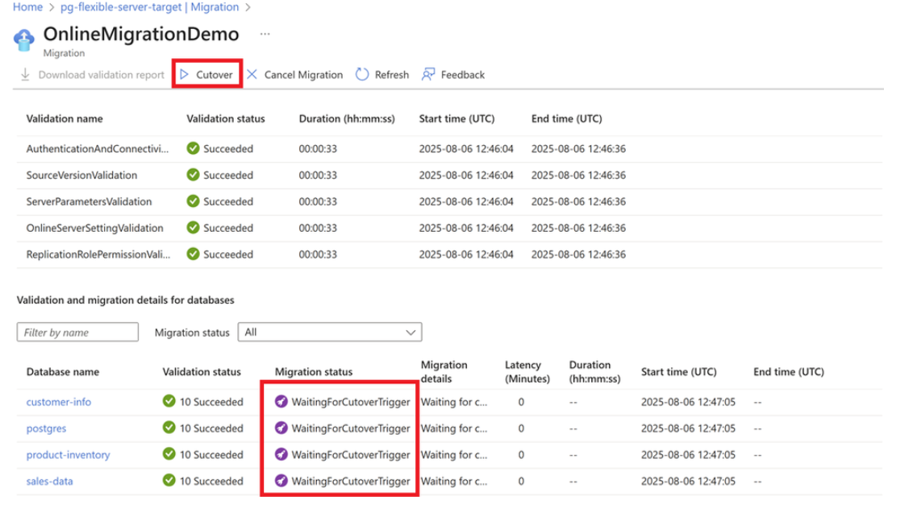
Management & Governance Updates
Generally Available: PowerShell, Az cmdlets, and Python SDK for Azure Database Migration Service
Announcing the general availability (GA) of automation support for Azure Database Migration Service (DMS) through PowerShell, custom cmdlets, and the Python SDK.
Using Azure PowerShell Az.DataMigration or Azure CLI az datamigration, it is now possible to migrate databases by automating the creation of Azure DMS, configuring database migrations for online migration, and performing a cutover. For more commands and functionality, see Azure Samples.
This milestone unlocks powerful, stable, and scalable automation options for database migration workflows—making it easier than ever to integrate DMS into your DevOps pipelines and enterprise migration strategies.
General Availability of Online Migration to Azure Database for PostgreSQL Flexible server
Online migration minimizes downtime by keeping source database operational during the migration process, with continuous data synchronization until cut over.
A cutover is performed when the Azure Database for PostgreSQL - Flexible Server is in complete sync with the Postgres source, resulting in minimal downtime.

Slide 12
Compute

Slide 13
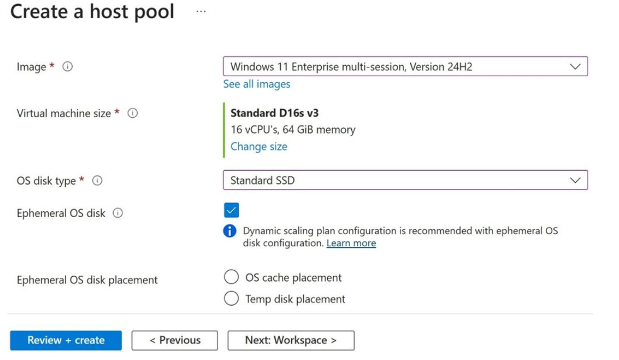
Compute Updates
Now in public preview: Ephemeral OS disk support on Azure Virtual Desktop
Azure Virtual Desktop announced the public preview of Ephemeral OS disk support. Designed for stateless workloads, Ephemeral OS disk stores the operating system on the virtual machine’s local storage, rather than remote storage. This enables a faster session host creation experience and improved performance, while maintaining a consistent and responsive user experience. Ephemeral OS disk offers:
Faster provisioning and reimaging: Session hosts can be created or reset.
Improved Performance: By keeping read/write operations local, users experience faster access times and reduced latency.
Optimized for stateless workloads: Ideal for environments that do not need to retain session host state information between uses.

Slide 14
Compute Updates
Generally Available: Azure Functions support for Python 3.13
It is now possible to develop functions using Python 3.13 locally and deploy them to Azure Functions.
Starting with Python 3.13, Functions introduces runtime version control, a new opt-in feature that lets target specific versions of the Functions Python runtime used by app. Python 3.13 also introduces several enhancements to Functions that improve performance and reliability. In Python 3.13+, Azure Functions no longer supports custom worker extensions and shared memory for large payloads, requiring migration to supported alternatives and gRPC-based messaging.
Generally Available: New OS SKU enum to migrate to Azure Linux 3.0
It is now possible to migrate to Azure Linux 3.0 with a new OS SKU enum, ‘AzureLinux3’, in Kubernetes version 1.28-1.36.
This new option provides increased control over OS upgrades by decoupling them from Kubernetes upgrades. Customers using LTS version 1.28-1.31 can now migrate from Azure Linux 2.0 to Azure Linux 3.0 without a Kubernetes upgrade.

Slide 15
Compute Updates
Generally Available: Availability Zones and network restricted Key Vault and App Configuration references for Flex Consumption
It is now possible to enable availability zones for Azure Functions Flex Consumption apps during both creation and post-deployment. When enabled, instances are automatically distributed across zones, enhancing reliability and fault tolerance.
New Region Support: Availability zones are now also supported in East US and Southeast Asia.
Flex Consumption apps now support Key Vault and App Configuration references as app settings, even when those resources are network restricted. To use this feature, ensure that the app has outbound networking configured and confirm it can reach the referenced services.
Generally Available: Spot Placement Score
MS announced Azure Spot Placement Score, a feature that allows assessing the likelihood of deployment success for Spot virtual machines. Spot availability can vary across different combinations of Azure locations, availability zones, or VM sizes. Spot Placement Score provides the ability to evaluate the chance of deployment success on a near real-time basis, by assigning a rating of High, Medium, or Low for a given number of Spot VMs before deployment. This feature provides increased clarity and control, enabling to make more informed decisions about which Spot VMs to deploy and where.
Using Spot Placement Score allows:
A clear evaluation of how likely Spot deployment is to succeed based on specified parameters.
Identify the most suitable combination of regions and VM sizes to maximize Spot VM availability based on placement scores.
Improve the overall success rate of deploying Spot VMs by leveraging data-driven placement scores, reducing the risk of capacity issues or failures during deployment.

Slide 16
Compute Updates
Retirement: Confidential Containers preview on AKS is Closing Down
The public preview of Confidential Containers on AKS will be shutting down.
This feature has been available in preview since 202. What this means:
Existing node pools using KataCcIsolation will continue to operate until March 2, 2026.
After March 2, 2026, Confidential Container functionality will no longer be supported, and new node pools using this runtime cannot be created.
Retirement: The F, Fs, Fsv2, Lsv2, G, Gs, Av2, Amv2, and B series VMs are retiring in 2028
The F, Fs, Fsv2, Lsv2, G, Gs, Av2, Amv2, and B series of Azure Virtual Machines will retire on November 15th, 2028. These VMs will no longer be able to be used or purchased after this date.
Three-year reserved instances for these VMs can no longer be purchased or renewed starting on Novermber 15th, 2025. One-year reserved VM instances for these VMs will not be available for purchased or renewal after November 15th, 2027.

Slide 17
Storage & Data

Slide 18
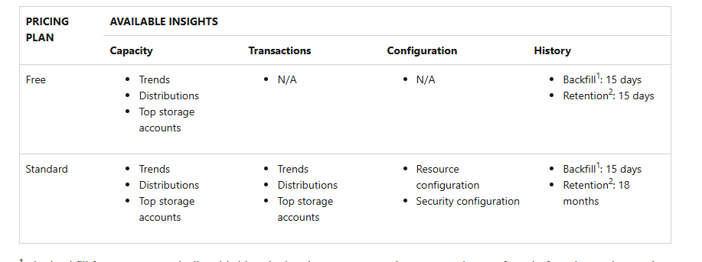
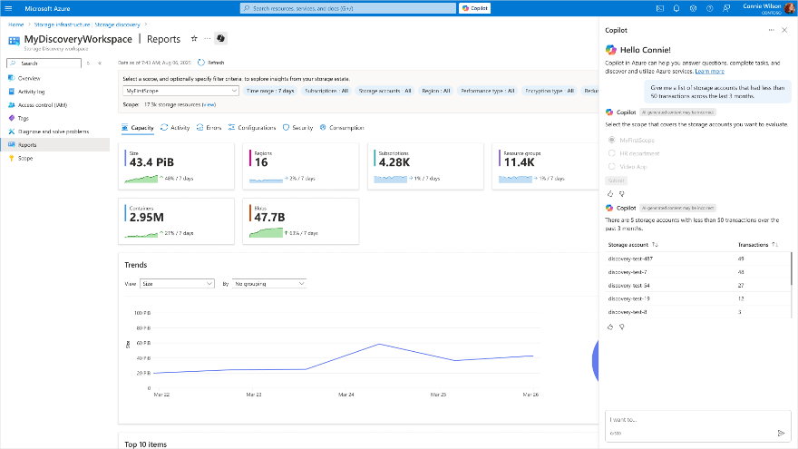
Storage & Data Updates
Generally Available: Azure Storage Discovery
Azure Storage Discovery is a fully managed service that provides enterprise-wide visibility into your Azure Blob Storage and Azure Data Lake Storage estate. In a single pane of glass you can understand and analyze how your data estate evolved over time, optimize costs, enhance security, and drive operational efficiency.
Azure Storage Discovery integrates with Copilot in Azure, enabling you to unlock insights and accelerate decision-making without utilizing any query language.

Slide 19
Storage & Data Updates
Generally Available: SAP Business Data Cloud Connect to Azure Databricks
SAP Business Data Cloud (BDC) Connect to Azure Databricks is now generally available, enabling secure, bi-directional, zero-copy data sharing between SAP BDC and Azure Databricks using Delta Sharing, so teams can unify SAP and external data for analytics, BI, and AI without replication or governance gaps. This integration streamlines pipelines, reduces maintenance, and ensures SAP business context remains intact, powering advanced data products and AI on a trusted, governed foundation. Get started today in Azure Databricks to unlock live, contextual SAP data for your analytics and machine learning needs.

Slide 20
Databases

Slide 21
Databases Updates
Public Preview: PostgreSQL 18 on Azure Database for PostgreSQL – Flexible Server
It is now possible to use PostgreSQL 18 in public preview on Azure Database for PostgreSQL – Flexible Server.
PostgreSQL 18 introduces new performance, scalability, and developer productivity improvements. With this preview, you get early access to the latest community release on a fully managed Azure service. By running PostgreSQL 18 on flexible server, you can test application compatibility, explore new SQL and performance features, and prepare for upgrades well before general availability.
Microsoft Entra ID authentication not yet available in preview (support coming soon).
Limited extension availability (see supported list).
Query store and index tuning not available.
Available only in East Asia region during preview.
Generally Available: Microsoft Entra ID token refresh code samples in Python and .NET
It is now possible to access code samples for Entra ID token refresh using Python and .NET in Azure Database for PostgreSQL. These samples are designed to help securely manage authentication tokens when connecting to PostgreSQL database with Entra ID, ensuring seamless access without manual token handling.

Slide 22
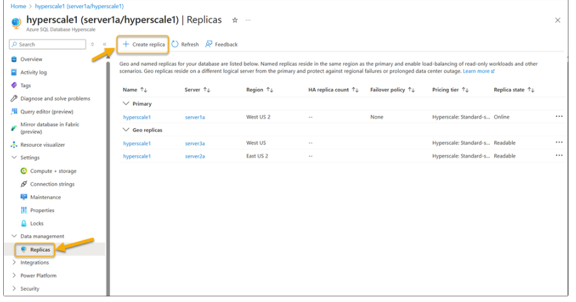
Databases Updates
Multiple geo-replicas for Azure SQL Hyperscale is now in public preview
Active geo-replication for Azure SQL is a business continuity solution that lets perform quick disaster recovery of individual databases if there is a regional disaster or a large-scale outage. Up to four geo-secondaries could be created for an Azure SQL database, except for Hyperscale, until now.
MS announced that Azure SQL Database Hyperscale support for up to four geo-replicas is available now in public preview. This enhancement gives you greater flexibility for disaster recovery, regional scale-out, and migration scenarios.
Limitations & Notes
You can create up to four geo-replicas per database.
Geo-replicas must be created on different logical servers.
Chaining (creating a geo-replica of a geo-replica) is not supported.
If you would like zone redundancy enabled for the geo-replica, you must configure that setting during the create geo-replica process since the setting is not automatically inherited from the primary database.

Slide 23
Integration

Slide 24
Integration Updates
Public Preview: Environmental sustainability features in Azure API Management
These capabilities help organizations minimize the carbon footprint of their API infrastructure by making API traffic and policy behavior carbon-aware.
With these new features, it is possible:
Shift and load-balance API traffic to backend regions with lower carbon intensity.
Shape API traffic dynamically based on real-time carbon emissions in API Management region.
Build carbon-intelligent policies using the new context.Deployment.SustainabilityInfo.CurrentCarbonIntensity property to adapt caching, telemetry, or rate-limiting based on emission levels.

Slide 25
Integration Updates
Generally Available: Azure Event Grid new capabilities
Multiple new Azure Event Grid features have reached General Availability, supporting real-time telemetry, automation, and hybrid workloads.
Features now in General Availability:
MQTT OAuth 2.0 Authentication: Authenticate MQTT clients using JSON Web Tokens (JWTs) issued by any OpenID Connect (OIDC)-compliant identity provider, enabling seamless integration with Microsoft Entra ID (formerly Azure AD), custom identity platforms, or third-party IAM solutions.
MQTT Custom Webhook Authentication: Use external webhooks or Azure Functions to dynamically validate client connections. Authorize with shared access signatures (SAS), API keys, custom credentials, or X.509 certificate fingerprints to support scenarios requiring granular control across large, dynamic fleets of devices or multitenant environments.
MQTT Assigned Client Identifiers: Assign deterministic, pre-approved client identifiers to MQTT clients to offer session continuity, better device tracking, simplified diagnostics, and improved auditability—critical for managing long-lived connections and operational visibility in regulated industries.
First Class integration with Fabric : Route MQTT messages and Cloud Events from Event Grid Namespace to Fabric Event Streams for real-time analytics, storage, visualization of IoT data without using Event Hubs.

Slide 26
ML & AI & IOT

Slide 27
ML & AI & IOT Updates
Sora 2 now available in Azure AI Foundry
Sora 2 in Azure AI Foundry stands out by combining OpenAI’s most advanced video generation capabilities with the trusted infrastructure and security controls of Microsoft Azure.
And through Azure AI Foundry and responsible AI principles, MS empower customers with embedded security, safety, and privacy controls. Azure AI Foundry offers a curated catalog of generative media models, including OpenAI’s Sora, GPT-image-1 and GPT-image-1-mini, Black Forest Lab’s Flux 1.1 and Kontext Pro, and more to empower developers in your and customer organizations to serve creatives with new and unique capabilities, all without sacrificing the safety, reliability, and integration businesses expect.

Slide 28
ML & AI & IOT Updates
Retirement: Azure Custom Vision will be retired on September 25, 2028
Microsoft is announcing the planned retirement of the Azure Custom Vision service.
Microsoft will provide full support for all existing Azure Custom Vision customers until 9/25/2028. During this support window, customers are encouraged to begin planning and executing their transition to alternative solutions. Depending on your use case, we recommend the following paths for transition:
For creating custom models for both image classification and object detection, Azure Machine Learning AutoML offers the ability to train both custom model types using classic machine learning techniques
Microsoft is also investing in Generative AI-based solutions that increase accuracy in custom scenarios using prompt engineering and other techniques.

Slide 29
Information

Slide 30
Information
Azure Times GitHub Repo

Slide 31
Questions

