Slide 1
Azure Times #174
August 11, 2025

Slide 2
Networking

Slide 3
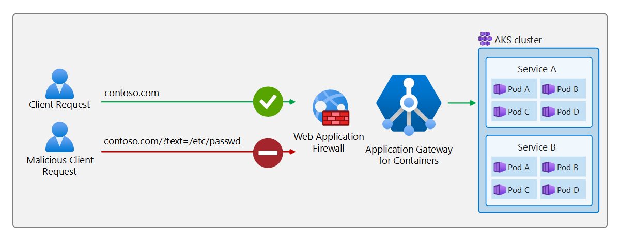
Networking Updates
Public Preview: Azure Virtual Network Manager mesh now supports 5,000 virtual networks
Azure Virtual Network Manager mesh connectivity is now in public preview, enabling to group up to 5,000 virtual networks in supported regions. A mesh topology creates bi‑directional connectivity between every virtual network in a mesh connectivity configuration, so selected Virtual networks communicate directly, eliminating manual peerings, avoiding extra hops, and delivering low‑latency traffic flows under a unified control plane.
A common scenario for mesh is to let spoke virtual networks in a hub‑and‑spoke topology talk to each other without traversing through the hub. This reduces latency by bypassing the hub router. You can still preserve security and oversight by implementing security admin rules in Azure Virtual Network Manager (evaluated before NSGs) or NSG rules per virtual network, and monitor all traffic with virtual network flow logs for comprehensive auditing and troubleshooting.
Public Preview: Web Application Firewall on Application Gateway for Containers
Application Gateway for Containers now supports Web Application Firewall (WAF) policy in public preview. Using WAF’s Default Ruleset, Azure Kubernetes Service (AKS) administrators and developers can protect their workloads against malicious attacks and exploits such as:
Cross-site scripting
Java attacks
Local file inclusion
PHP injection attacks
Remote command execution
Remote file inclusion
Session fixation
SQL injection protection
Protocol attacks

Slide 4
Networking Updates
Public Preview : Azure Bastion integration with AKS
This integration enables continuous secure access to private AKS clusters and also applies to AKS public clusters with API server authorized IP ranges. This integration introduces a seamless way for customers to tunnel into their AKS clusters using Azure Bastion, eliminating the need for complex networking setups like VPNs or jump boxes.
With this integration, users can now connect to their clusters and easily use native Kubernetes tooling (e.g., kubectl) from their local machines—simplifying access, reducing setup time, and enhancing security by eliminating the need to expose public endpoints.

Slide 5
Networking Updates
Generally Available: Private Application Gateway on Azure Application Gateway v2
Application Gateway v2 is announcing general availability of Private Application Gateway, which is a collection of new capabilities to the Application Gateway v2 SKU to further enhance control over network exposure.
The following capabilities are now generally available in Application Gateway v2:
Private IP only frontend configuration (elimination of Public IP)
Enhanced control over Network Securtiy Groups
Eliminate GatewayManager service tag requirement
Enable definition of Deny All Outbound rule
Enhanced control over Route Table rules
Forced Tunnelling Support (learning of 0.0.0.0/0 route via BGP)
Route Table rule of 0.0.0.0/0 next hop Virtual Appliance
Private link configuration is not supported
WAF Rate Limiting is not supported
Private IP frontend configuration only with AGIC
Private Endpoint connectivity via Global VNet Peering is not supported

Slide 6
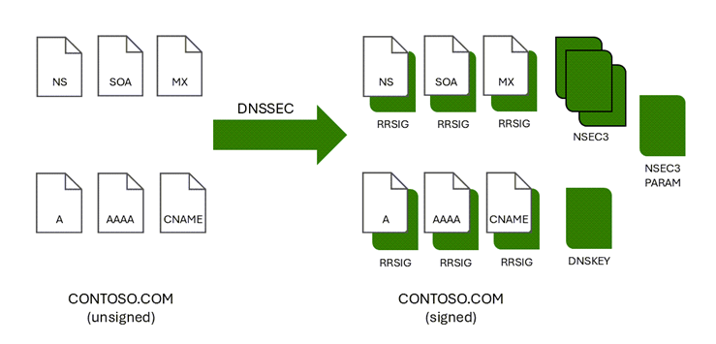
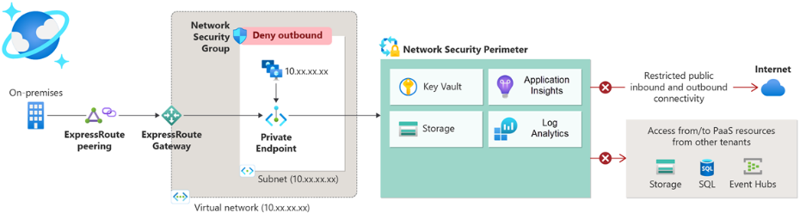
Networking Updates
Generally Available: Network security perimeter
Network security perimeter allows organizations to define a logical network isolation boundary for PaaS resources (for example, Azure Storage account and SQL Database server) that are deployed outside organization’s virtual networks. It restricts public network access to PaaS resources within the perimeter; access can be exempted by using explicit access rules for public inbound and outbound.
Features of a network security perimeter include:
Resource to resource access communication within perimeter members, preventing data exfiltration to non-authorized destinations.
External public access management with explicit rules for PaaS resources associated with the perimeter.
Access logs for audit and compliance.
Unified experience across PaaS resources.
Generally Available: Azure DNS Public Zones DNS Security Extensions (DNSSEC) is now available in our US Gov and China regions
Announcing the general availability of Domain Name System Security Extensions (DNSSEC) for Azure DNS Public Zones in US Gov and China regions. With this release it is possible now to enable DNSSEC on all existing and new public DNS Zones hosted on Azure DNS. This significant update enhances the security and integrity of DNS infrastructure by providing cryptographic authentication of DNS data. With DNSSEC, Azure DNS Public Zones can now offer protection to our customers against various types of attacks, such as cache poisoning and man-in-the-middle attacks.

Slide 7
Security & Identity

Slide 8
Security & Identity Updates
Group SOA conversion: Cloud governance for legacy groups
Group SOA conversion changes that — enabling cloud-first governance of legacy AD groups without breaking compatibility. Group SOA conversion brings modern governance to legacy groups by enabling you to:
Manage groups in the cloud- Shift the source of authority for AD groups to Microsoft Entra ID, giving you a single place to manage membership with greater flexibility and visibility.
Simplify on-premises cleanup- Once governed in the cloud, unused or redundant groups can be safely removed from Active Directory, reducing clutter and improving manageability.
Extend governance to on-premises apps- With Group SOA conversion and group writeback, you can apply modern governance policies, including request workflows, expiration, and AI-assisted reviews, to groups that still control access to on-premises applications.
Microsoft Entra now integrates Verified ID and Face Check directly into Entitlement Management
This integration allows you to:
Automate privacy-respecting identity verification. Match a user’s selfie to a government-issued credential before granting access to an Access Package.
Accelerate onboarding. Eliminate manual checks and reduce delays for users entering regulated or privileged roles.
Strengthen access assurance. Ensure only the right people get access to the right resources, with confidence and compliance.
The Result: faster onboarding, fewer delays, and stronger security — delivered without compromising user experience.

Slide 9
Management & Governance

Slide 10
Management & Governance Updates
Public Preview: Increase ingestion quota for Azure Managed Prometheus with an ARM API
Azure Monitor workspaces have default limits and quotas for ingestion. Customers can now request for an increase in quota for ingestion of Managed Prometheus metrics into Azure Monitor Workspace using an Azure Resource Manager API. The API supports request for increase up to 20 M events per minute, or 20 M Active timeseries.

Slide 11
Management & Governance Updates
Auxiliary Logs Enhancement and Reduced Pricing
Enhanced Query Capabilities
Expanded KQL Support: All KQL operators on a single table are now supported, including the lookup operator to Analytics tables.
Performance Boosts: Built on Delta Parquet, Auxiliary Logs now benefit from improved encoding and partitioning to make queries much more efficient, though indexed technologies like Basic Logs and Analytics Logs will perform better.
Extended Time Range: Queries are no longer limited to the last 30 days - you can now query across any time period.
Cost Estimation Preview: Get a cost estimate before running your query.
Search Jobs: More Power, More Flexibility
Search jobs allow users to scan vast amounts of data asynchronously and ingest the results into Analytics table for further investigation Based on customer feedback, we’ve made the following improvements:
Enabling more results to be loaded, up to 100 million records (coming soon)
Improved user interface that streamlines the search job execution
Providing a cost prediction before running a search job
Increasing concurrently and removing additional limits.
Added support for all KQL operators on a single table with the lookup operator to Analytics tables (coming soon).
Public Preview of KQL Transformations for Auxiliary Logs – it is now possible to apply filtering and transformation logic at ingestion time, enabling a more strategic and cost-effective approach to managing high-volume, low-fidelity logs. By using Data Collection Rules (DCRs) with Kusto Query Language (KQL) expressions:
Filter out noise to reduce data volume.
Parse and shape fields to prepare logs for efficient downstream consumption.
Split data across multiple tables or tiers, for cost-performance optimization.

Slide 12
Compute

Slide 13
Compute Updates
Private Preview: Agentic experience for AKS in the Azure CLI
The Azure Kubernetes Service (AKS) team is introducing a new agentic AI-powered CLI experience through the “az aks agent” command. This feature brings the intelligence of agentic reasoning directly into the Azure CLI, enabling developers and operators to interact with their clusters using natural language powered by agentic AI.
This current set of capabilities focuses on enabling users to diagnose and resolve cluster issues using natural language prompts. Users can run ‘az aks agent’ with a short description of their query/issue, which will trigger an agentic loop that intelligently gathers signals from multiple sources, analyzes telemetry and diagnostics, identifies health issues and the likely root causes, and provide actionable recommendations.
This agentic experience is powered by HolmesGPT, an open-source project co-maintained by the AKS team and currently under review for inclusion in the CNCF Sandbox.

Slide 14
Compute Updates
Public Preview: Confidential VMs for Azure Linux
Confidential Virtual Machines (CVM) offer strong security and confidentiality for tenants. CVM for Azure Linux in AKS is now in public preview and enables node pools with CVM to target the migration of highly sensitive container workloads to AKS without any code refactoring while benefiting from the features of AKS.
Now it is possible create new node pools using supported CVM vm sizes with Azure Linux 3. The nodes in a node pool created with CVM use a customized Azure Linux 3 image specially configured for CVM.
Public Preview: LocalDNS for AKS
LocalDNS for Azure Kubernetes Service (AKS) is now available in public preview.
With LocalDNS, a DNS proxy is deployed on each node, which enables faster, more reliable DNS resolution. It removes DNS bottlenecks in large clusters, lowers query latency via local handling, and ensures continued resolution during upstream outages with configurable serve-stale settings.
LocalDNS delivers instant performance gains without application level changes, plus advanced DNS customization for both internal and external domains.

Slide 15
Compute Updates
Public Preview: Disable HTTP proxy
The HTTP proxy feature adds HTTP proxy support to AKS clusters, exposing a straightforward interface that can be used to secure AKS-required network traffic in proxy-dependent environments. With this feature, both AKS nodes and pods are configured to use the HTTP proxy. This feature also enables installation of a trusted certificate authority onto the nodes as part of bootstrapping a cluster.
It is now possible to disable the HTTP proxy feature on existing AKS clusters. When creating a cluster, HTTP proxy is enabled by default.
Once disabled HTTP proxy on a cluster, the proxy configuration is saved in the database, but the proxy variables are removed from the pods and nodes.
The following scenarios are not supported:
Different proxy configurations per node pool
User/Password authentication
Custom certificate authorities (CAs) for API server communication
AKS clusters with Windows node pools
Node pools using Virtual Machine Availability Sets (VMAS)
Using * as wildcard attached to a domain suffix for noProxy
Public Preview: Multiple Standard Load Balancers support in AKS
AKS now supports multiple Standard Load Balancers (SLBs) per cluster in public preview. Azure Kubernetes Service (AKS) normally provisions one Standard Load Balancer (SLB) for all LoadBalancer Services in a cluster. Because each node NIC is limited to 300 inbound load‑balancing rules and 8 private‑link services, large clusters or port‑heavy workloads can quickly exhaust these limits.
This feature allows customers to scale beyond the 300 inbound rule limit per node NIC and isolate traffic by assigning different SLBs to different agent pools and workloads.
AKS automatically manages node and Service placement based on configurable criteria like pool name, labels, and namespace selectors.

Slide 16
Compute Updates
Public Preview: Managed Namespaces in AKS
Managed namespaces for AKS allows users to get a list of namespaces they have access to across a subscription, resource group, and cluster, and then retrieve credentials that will give them the ability to deploy to those namespaces. Users can configure managed namespaces via the Azure CLI, ARM/Bicep, REST API, or the Azure Portal, allowing a user to interact with managed namespaces where they’re most comfortable doing so.
Public Preview: Azure Virtual Network Verifier for AKS (VNV) for AKS
Azure Virtual Network Verifier for AKS, now in public preview and available through the Azure Portal, is a tool which allows to detect and troubleshoot outbound connectivity issues in AKS cluster.
It is possible to us the Virtual Network Verifier feature to run a connectivity analysis to check the traffic flow between cluster and a public egress endpoint (for example, mcr.microsoft.com).
The analysis results will detect any misconfigured Azure networking resources which may be blocking outbound traffic such as Azure firewall, network security groups (NSG), and load balancers.

Slide 17
Compute Updates
Public Preview: AKS Model Context Protocol (MCP) server
Model Context Protocol (MCP) server for AKS is now available as an open source release. This foundational component enables AI agents to interact with AKS clusters and simplifies cluster management.
AKS MCP server offers a standardized interface to orchestrate complex workflows such as diagnostics, remediation, and cluster lifecycle operations for AKS clusters and attached Azure services. It abstracts the intricacies of Kubernetes and Azure APIs and provides a unified way to plug in reasoning agents, language models, and intelligent tools to drive operational efficiency across environments.
The AKS MCP server is fully open-source and includes tools to:
Managed and perform operations (create, scaling, upgrade) on AKS clusters
Retrieve monitoring data from AKS clusters such as metrics and logs
Retrieve details on related Azure resources (VNets, Subnets, NSGs, Route Tables, etc.).
Public Preview: Encryption in Transit for Azure Files NFS shares in AKS
Azure Kubernetes Service (AKS) now supports Encryption in Transit (EiT) for Azure Files NFS v4.1 volumes via the Azure File CSI driver.
This builds on the recent General Availability (GA) of EiT for Azure Files NFS shares in June, which introduced TLS 1.3-based encryption to secure data in transit across supported regions.
Now, AKS customers can benefit from the same enterprise-grade security for their containerized workloads.
What’s New in AKS
Preview support for EiT in AKS 1.33+ clusters using the Azure File CSI driver.
Built-in integration with the AZNFS mount helper and Stunnel for seamless TLS encryption.
No application changes required—after enabling in storage class, EiT works transparently with your existing NFS workloads.

Slide 18
Compute Updates
Generally Available: Azure 128 & 192 vCPU sizes for the Esv6 and Edsv6 series VMs
These new VM sizes offer up to 192 vCPUs and 1832 GiB of RAM, making them ideal for enterprise-scale applications such as in-memory analytics, large relational databases, and in-memory cache workloads. With Intel® Total Memory Encryption (Intel TME) and NVMe-enabled local and remote storage, these VMs deliver both performance and security at scale.
Key Highlights
Memory-Optimized Performance: Up to 1832 GiB of RAM for memory intensive workloads.
Azure Boost: Up to 400K IOPS and 12 GB/s remote storage throughput with 200 Gbps network bandwidth.
Security First: Intel TME ensures data protection in system memory.
NVMe Interface: 3X improvement in local storage IOPS for low-latency access.
Generally Available: Confidential VMs for Ubuntu 24.04 in AKS
Confidential Virtual Machines (CVM) offer strong security and confidentiality for tenants. Now generally available, CVM for Ubuntu 24.04 in AKS enables node pools with CVM to target the migration of highly sensitive container workloads to AKS without any code refactoring while benefiting from the features of AKS.
Now it is possible to create new node pools using supported CVM vm sizes with Ubuntu 24.04. The nodes in a node pool created with CVM use a customized Ubuntu 24.04 image specially configured for CVM. Ubuntu 24.04 is not yet the default OS version on AKS, meaning you’ll need to specify `Ubuntu2404` as the OsSku during node pool creation.

Slide 19
Compute Updates
Generally Available: Static egress gateway public prefix support in AKS
Static egress gateway public prefix support in AKS is now generally available. This feature allows AKS customers to create a dedicated gateway node pool that routes outbound traffic from annotated pods through a static public IP prefix (/28 to /31). It enables customers to achieve consistent and predictable egress IPs for firewall whitelisting, compliance, and partner integration scenarios.
Limitations and considerations
Static Egress Gateway isn't supported in clusters with Azure CNI Pod Subnet.
Static Egress Gateway does not support Private IP's assigned to the gateway node pool. The gateway node pool must have a public IP prefix assigned to it.
Kubernetes network policies won't apply to traffic leaving the cluster through the gateway node pool.
This shouldn't affect cluster traffic control as only egress traffic from annotated pods routed to the gateway node pool are affected.
The gateway node pool isn't intended for general-purpose workloads and should be used for egress traffic only.
Windows node pools can't be used as gateway node pools.
hostNetwork pods cannot be annotated to use the gateway node pool.
Pods can only use a gateway node pool if they are in the same namespace as the StaticGatewayConfiguration resource.

Slide 20
Compute Updates
Generally Available: Deployment safeguards in AKS
Misconfigurations during Kubernetes development can lead to bugs and deployment issues. Azure Kubernetes Service (AKS) now offers generally available deployment safeguards to help prevent these problems by enforcing Kubernetes best practices.
These safeguards operate in two modes: Warning, which surfaces alerts for noncompliant configurations without blocking them, and Enforcement, which actively blocks or modifies deployments that don't meet best practices. This helps ensure more reliable and secure application deployments in your AKS clusters.
Generally Available: AKS Security Dashboard
The AKS Security Dashboard provides a centralized view of security posture and runtime threat protection for AKS cluster within the Azure Portal. It highlights software vulnerabilities, critical security issues, compliance gaps, and active threats, helping prioritize remediation. Use this dashboard to monitor workload protection, cluster configuration, and threat detection in real time.
The AKS Security Dashboard allows the user to:
View the security posture of the cluster.
Enable Defender for Containers plan and configure settings for the specific cluster resource.
Review vulnerability assessment recommendations.
Review configurations of the cluster and running containers that deviate from security best practices ("misconfigurations"), together with guided or automated remediation.
Assign an owner to a recommendation or misconfiguration responsible for remediation by a specified date.

Slide 21
Compute Updates
Generally Available: Control Plane Improvements in AKS
MS is making improvements to API server resiliency per Kubernetes Enhancement Proposal (KEP) 5116 – Streaming Encoding for LIST Responses.
This enhancement significantly reduces API server memory usage by approximately 10x during large LIST calls to the API server. By lowering memory pressure, it helps improve list call latency and improves the resiliency of the kube-apipserver by reducing the probability of Out-of-Memory (OOM) issues. AKS has backported this upstream feature to make it available to customers using versions below v1.33 with AKS
This improvement is now available in AKS Kubernetes v1.31.9 and higher
AKS Kubernetes v1.32.6 and higher will be available soon
Announcing General Availability of App Service Inbound IPv6 Support
It is now generally available across all public Azure regions, Azure Government, and Microsoft Azure operated by 21Vianet for multi-tenant apps on all Basic, Standard, and Premium SKUs, Functions Consumption, Functions Elastic Premium, and Logic Apps Standard!

Slide 22
Storage & Data

Slide 23
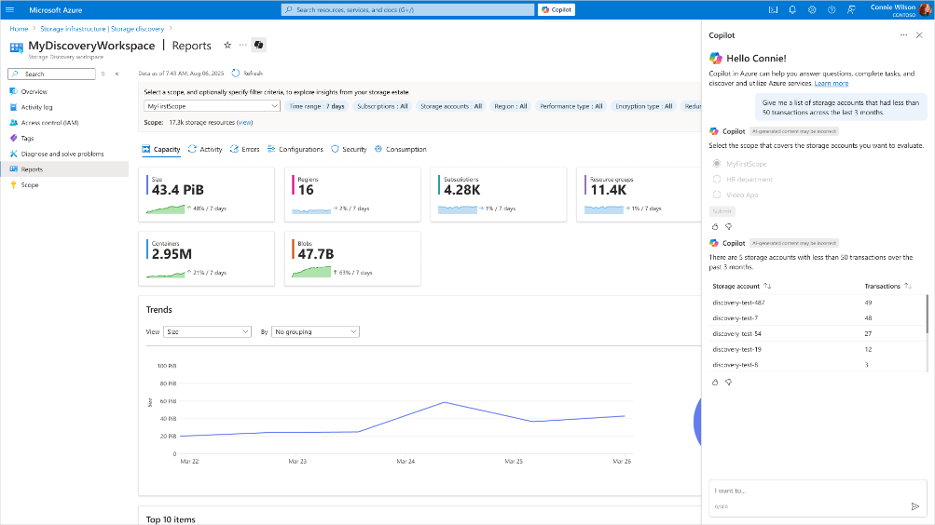
Storage & Data Updates
Public Preview: Azure Storage Discovery
Azure Storage Discovery (preview) is a fully managed service that provides enterprise-wide visibility into Azure Blob Storage data estate. In a single pane of glass it is possible to understand and analyze how data estate evolved over time, optimize costs, enhance security, and drive operational efficiency.
Measure how much data is stored across all storage accounts.
Identify regions experiencing the highest growth.
Find opportunities to reduce costs by locating infrequently used data.
Assess whether storage configurations align with security and compliance best practices.

Slide 24
Storage & Data Updates
Generally Available: Azure Storage Actions is now in 22 more regions
Azure Storage Actions is now available in several more Azure regions, enabling expanded global access and greater data residency options.
Azure Storage Actions is a fully managed platform designed to automate data management tasks for Azure Blob Storage and Azure Data Lake Storage.
Generally Available: Azure Data Box Next Gen is now generally available in additional regions
Azure Data Box Next Gen is now Generally Available in NEW regions including Australia, Japan, Singapore, Brazil, Hong Kong, UAE, Switzerland and Norway.
With these new additions:
Both - Azure Data box 120TB and 525 TB generally available (GA) in the US, UK, Canada, EU, US Gov, Australia, Japan and Singapore.
Azure Data Box 120TB is GA in Brazil, UAE, Hong Kong, Switzerland and Norway.

Slide 25
Databases

Slide 26
Databases Updates
General Availability - Schema Migration support in Azure Database Migration Service (DMS)
It is now possible to deploy missing schema objects along with either selective or all Tables from the source database to the target Azure SQL Database with a single step. By enabling the schema migration checkbox during SQL migration setup, the service automatically includes the following schema components in the migration process alongside the data:
Schemas
Tables
Indexes
Views
Stored Procedures
Synonyms
DDL Triggers
Defaults
Full-Text Catalogs
Plan Guides
Roles
Rules
Application Roles
User-Defined Aggregates
User-Defined Data Types
User-Defined Functions
User-Defined Table Types
User-Defined Types
Users (limited user types)
XML Schema Collections
This enhancement streamlines the migration workflow, reduces manual effort, and ensures consistency between source and target environments.

Slide 27
Integration

Slide 28
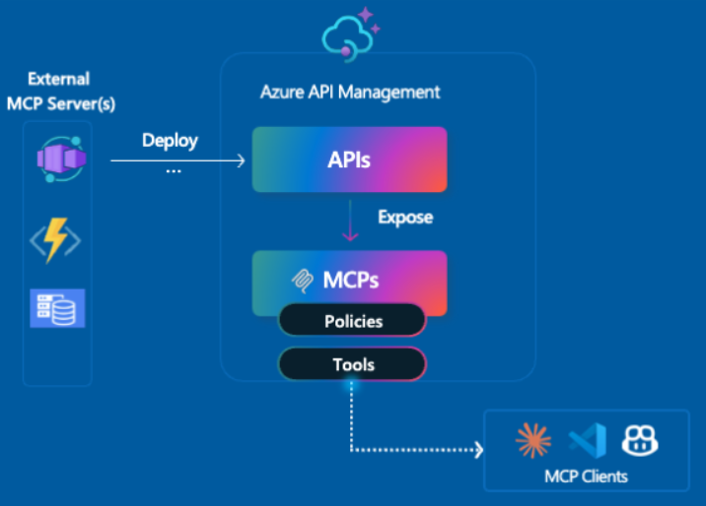
Integration Updates
New in Azure API Management: MCP in v2 SKUs + external MCP-compliant server support
MCP support in v2 SKUs - Previously available only in classic tiers (Basic, Standard, Premium), MCP support is now in public preview for v2 SKUs — Basic v2, Standard v2, and Premium v2 — with no pre-requisites or manual enablement required.
Expose existing MCP-compliant servers (pass-through scenario) - Already using tools hosted in Logic Apps, Azure Functions, LangChain or custom runtimes? Now you can govern those external tool servers by exposing them through API Management.

Slide 29
ML & AI & IOT

Slide 30
ML & AI & IOT Updates
GPT-5 in Azure AI Foundry
MS Announced the general availability of OpenAI’s new flagship model, GPT-5, in Azure AI Foundry. This is more than a new model release; it is the most powerful LLM ever released across key benchmarks. GPT-5 in Azure AI Foundry pairs frontier reasoning with high-performance generation and cost efficiency, delivered on Microsoft Azure’s enterprise-grade platform so organizations can move from pilots to production with confidence.
In Azure AI Foundry, the GPT-5 models are available via API and orchestrated by the model router. The GPT-5 series spans complementary strengths:
GPT-5, a full reasoning model provides deep, richer reasoning for analytics and complex tasks, like code generation, with a 272k token context.
GPT-5 mini powers real-time experiences for apps and agents that require reasoning, tool calling to solve customer problems.
GPT-5 nano is a new class of reasoning model which focuses on ultra-low-latency and speed with rich Q&A capabilities.
GPT-5 chat enables natural, multimodal, multi-turn conversations that remain context-aware throughout agentic workflows, with 128k token context.
Available today: GPT-5 in Microsoft 365 Copilot
MS Announced that GPT‑5—OpenAI’s best AI system to-date—is rolling out today in Microsoft 365 Copilot and Microsoft Copilot Studio across the world. GPT-5 is a significant leap in intelligence and becomes even more powerful when applied to work.

Slide 31
ML & AI & IOT Updates
OpenAI’s open‑source model: gpt‑oss on Azure AI Foundry and Windows AI Foundry
gpt‑oss-120b and gpt‑oss-20b are available on Azure AI Foundry. gpt‑oss-20b is also available on Windows AI Foundry and will be coming soon on MacOS via Foundry Local.
gpt‑oss-120b is a reasoning powerhouse. With 120 billion parameters and architectural sparsity, it delivers o4-mini level performance at a fraction of the size, excelling at complex tasks like math, code, and domain-specific Q&A—yet it’s efficient enough to run on a single datacenter-class GPU. Ideal for secure, high-performance deployments where latency or cost matter.
gpt‑oss-20b is tool-savvy and lightweight. Optimized for agentic tasks like code execution and tool use, it runs efficiently on a range of Windows hardware, including discrete GPUs with16GB+ VRAM, with support for more devices coming soon. It’s perfect for building autonomous assistants or embedding AI into real-world workflows, even in bandwidth-constrained environments.

Slide 32
Miscellaneous

Slide 33
Miscellaneous Updates
ACS Email now Generally Available in Azure Government
Microsoft announced the General Availability (GA) of its Email Communication Service within Azure Government, a milestone that marks a significant advancement in secure and compliant digital communication for U.S. federal, state, and local government agencies. This release also includes FedRAMP High authorization, aligning the service with the most rigorous standards for cloud security and data protection.

Slide 34
Information

Slide 35
Information
Azure Times GitHub Repo

Slide 36
Questions

