Slide 1
Azure Times #175
August 18, 202

Slide 2
Security & Identity

Slide 3
Security & Identity Updates
Malware scanning add-on is now generally available in Azure Gov Secret and Top-Secret clouds
Microsoft Defender for Storage now includes malware scanning for Azure Government Secret and Top Clouds. This update aligns cloud storage protection features across both commercial and government cloud services.
This feature is available exclusively in the Defender for Storage plan (per storage account). Azure Government customers using the classic Defender for Storage plan (per-transaction) are encouraged to upgrade to the latest version to take advantage of comprehensive sensitive data discovery, and malware scanning and to benefit from ongoing and future enhancements to Defender for Storage.
Defender for Storage is an agentless solution that does not require additional infrastructure. It enables detection and prevention of malicious content from entering storage accounts and spreading throughout organization’s environments. Malware scanning includes two triggers that can be used to begin protecting the environment immediately.
Upload
On-Demand

Slide 4
Management & Governance

Slide 5
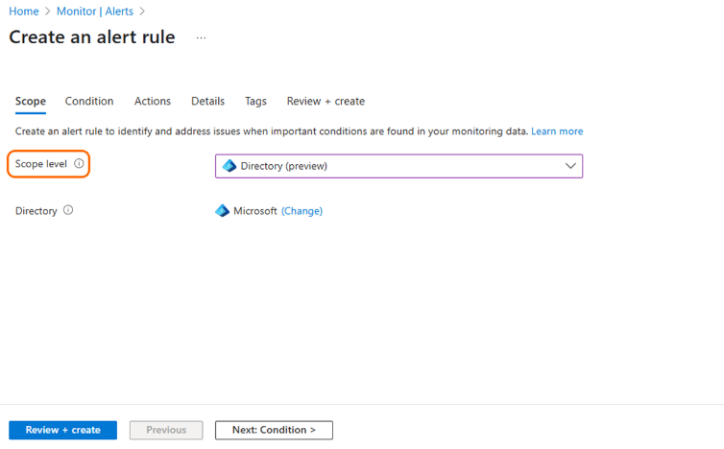
Management & Governance Updates
Public Preview: Announcing Tenant-Level Service Health Alerts in Azure Monitor
Introducing Tenant-Level Service Health Alerts - a new preview capability in Azure Monitor that enables customers to receive proactive notifications about service health issues impacting their entire tenant, not just individual subscriptions. With this feature, it is possible to create alert rules scoped at the directory (tenant) level directly from the Service Health page or the alert rule creation wizard in the Azure portal.
This enhancement ensures broader visibility and faster response to incidents affecting tenant-scoped services. To maximize coverage, MS recommend configuring both subscription-level and tenant-level Service Health alerts.
Public Preview: Auto agent upgrade for Azure Arc-enabled servers
This feature is a major leap forward in simplifying agent lifecycle management across hybrid environments. Once enabled, Connected Machine agents will automatically upgrade to the latest supported version without requiring manual intervention or scripting.
Auto Agent Upgrade is built into the Connected Machine agent and can be enabled via Azure CLI or PowerShell by setting the enableAutomaticUpgrade property to true. Once opted in, agents will be upgraded within one version of the latest release, with rollout batches designed to maintain stability across regions. It is now possible to view upgrade status directly in the Azure Portal under the agentUpgrade property.
Note: This feature is only available on agents running version 1.48 or greater.

Slide 6
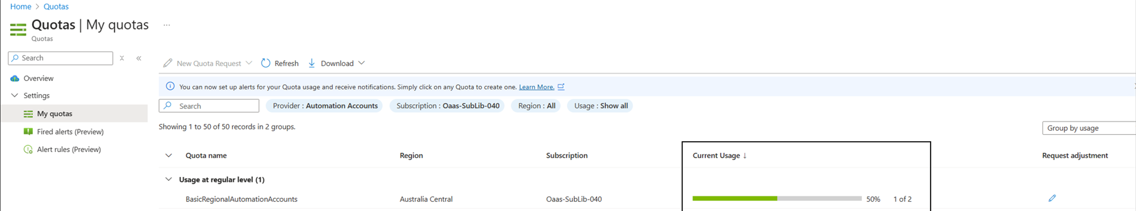
Management & Governance Updates
Generally Available: Deployment resumption - Azure Automation revised Service and Subscription limits
Azure Automation is resuming deployments of the revised Service and Subscription limits from August 11, 2025. This update will ensure fair distribution of cloud resources across all customers and further improve reliability and performance of the service.
Limits for following resources is being revised:
Maximum number of Automation accounts in a subscription in a region.
Maximum number of concurrent running jobs at the same instance of time per Automation account
SQL Server enabled by Azure Arc is now generally available in the US Government Virginia region
Arc-enabled SQL Server resources in US government Virginia can be onboarded and viewed in the Azure Government portal just like any Azure resource, giving a single pane of glass to monitor and organize your SQL Server estate in the Gov cloud.
Currently, in the US Government Virginia region, Azure Arc-enabled SQL Server provides the following features:
Connect SQL Server to Azure Arc (onboard) a SQL Server instance to Azure Arc.
SQL Server inventory which includes the following capabilities in the Azure portal:
View SQL Server instances as Azure resources.
View databases Azure resources.
View the properties for each server.
Subscribe to Extended Security Updates in a production environment.
Manage licensing and billing of SQL Server enabled by Azure Arc.
License virtual cores. Review licensing limitations.
All other features aren't currently available.

Slide 7
Compute

Slide 8
Compute Updates
Windows 365 Reserve is now in limited public preview!
Windows 365 Reserve is a standalone, Windows 365 offering that provides temporary, secure, and dedicated Cloud PC access when a user's primary PC is unavailable, granting users up to 10 days of Cloud PC access per year. With this solution, organizations can proactively establish protections that reduce both financial and operational impacts when disruptions arise. If a user's device unexpectedly fails, administrators can swiftly provide secure, pre-configured Cloud PCs—ensuring employees regain access and productivity from any secondary device while their primary device is repaired or replaced. Through Windows 365 Reserve, organizations can:
Proactively cover employees for quick response to unexpected device interruptions
Deploy on-demand Cloud PCs with all necessary corporate applications and settings
Manage these temporary Cloud PCs alongside other devices within Microsoft Intune
Enable secure employee access from any secondary device, anywhere via the web or Windows App

Slide 9
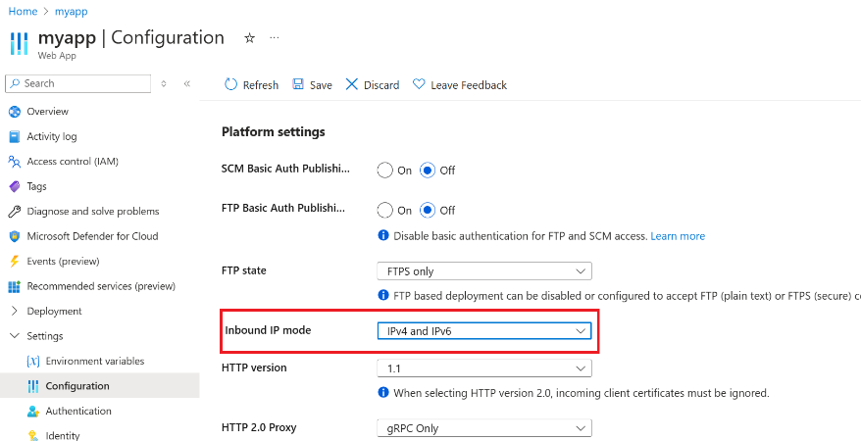
Compute Updates
Generally Available: App Service Inbound IPv6 Support
Inbound IPv6 support on public multi-tenant App Service is now generally available across all public Azure regions for multi-tenant apps on all Basic, Standard, and Premium SKUs, Functions Consumption, Functions Elastic Premium, and Logic Apps Standard.

Slide 10
Storage & Data

Slide 11
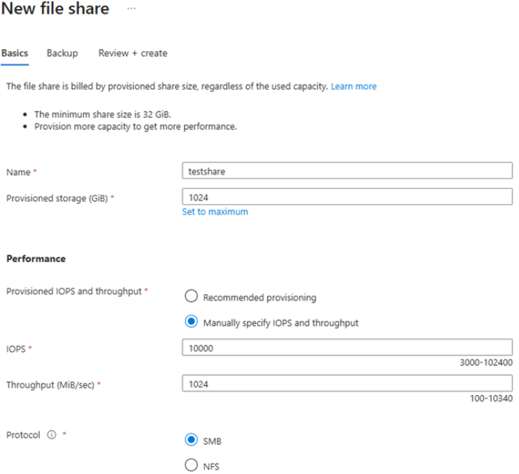
Storage & Data Updates
Generally Available: Azure Files provisioned v2 billing model for SSD (premium)
Azure Files now supports the provisioned v2 billing model on the SSD (premium) media tier. Provisioned v2 enables independent provisioning of storage, IOPS, and throughput, allowing to create a file share that meets exact storage and performance requirements. Additionally, the provisioned v2 model offers an increased file share size range from 32 GiB to 256 TiB.

Slide 12
Databases

Slide 13
Databases Updates
Public Preview: Azure Cosmos DB for MongoDB (vCore) encryption with customer-managed key
Data stored in Azure Cosmos DB for MongoDB (vCore) cluster is automatically and seamlessly encrypted with keys managed by Microsoft. Now, in addition to this service-managed key encryption (SMK), it is possible to have the option to add another layer of security by enabling encryption with a customer-managed key (CMK).
Many organizations require full control of access to data using a CMK and the ability to make their data stored in the cloud inaccessible. Data encryption with CMK for Azure Cosmos DB for MongoDB (vCore) enables to bring own encryption key to protect data at rest. It also enables organizations to implement separation of duties in the management of keys and data.
With CMK for data encryption, you're responsible for, and in full control of, an encryption key's life cycle, key usage permissions, and auditing of operations on keys. Data encryption with CMK for Azure Cosmos DB for MongoDB (vCore) is set at the cluster level. Data—including backups and logs, and temporary files—is encrypted on disk.
Public Preview: Azure Managed Instance for Apache Cassandra v5.0
It is now possible to use Cassandra 5.0 in Azure Managed Instance for Apache Cassandra, available in public preview.
This release gives access to the latest Cassandra features—like better performance and new indexing—without the hassle of managing infrastructure. It’s a faster, more scalable way to run your Cassandra workloads in the cloud.

Slide 14
Databases Updates
Generally Available: Upsert and Script Activity in Azure Data Factory and Azure Synapse Analytics for Azure Database for PostgreSQL
This enhancement enables to perform efficient, scalable, and declarative data transformations directly within pipelines.
With the Upsert method, it is now possible to merge incoming data into existing tables without writing complex logic, reducing overhead and improving performance.
With the Script activity, execute custom SQL scripts as part of data workflows, enabling advanced transformations, procedural logic, and fine-grained control over data operations.
These capabilities streamline extract, transform, load (ETL) and extract, load, transform (ELT) processes and unlock new flexibility for building robust data integration solutions using Azure Database for PostgreSQL as a source or sink.
Generally Available: Azure Database for PostgreSQL flexible server in Malaysia West
Now it is possible to deploy Azure Database for PostgreSQL flexible server in the Malaysia West Azure region.

Slide 15
Databases Updates
Announcing Extended Support for Azure Database for MySQL
MS introduced an Extended Support for Azure Database for MySQL as a paid offering designed to help customers continue running workloads on older MySQL versions with confidence, even after community support ends.
With Extended Support, customers will continue to receive:
SLA-backed availability: MySQL servers remain covered by Azure’s enterprise-grade SLA.
Security updates: MS will continue to deliver critical security patches to help protect workloads.
Technical support: Azure support engineers will remain available to assist with troubleshooting and operational issues.
Seamless and Predictable Experience
Automatic enrollment
Grace period
Pay-as-you-go pricing
Automatic exit
The pricing for Extended Support will be announced by Q3 2025 and will be available via the Azure pricing calculator at that time.

Slide 16
Integration

Slide 17
Integration Updates
General Availability: Enhanced Data Mapper Experience in Logic Apps (Standard)
MS announced the General Availability (GA) of the redesigned Data Mapper UX in the Azure Logic Apps (Standard) extension for Visual Studio Code. This release marks a major milestone in journey to modernize and streamline data transformation workflows for integration developer.
Opening V1 maps in V2: Seamlessly open and edit existing maps you have already created with latest visual capabilities.
Load schemas on Mac: Addressed schema-related crashes on macOS for a smoother experience.
Function documentation updates: Improved guidance and examples for built-in collection functions that apply on repeating nodes.

Slide 18
ML & AI & IOT

Slide 19
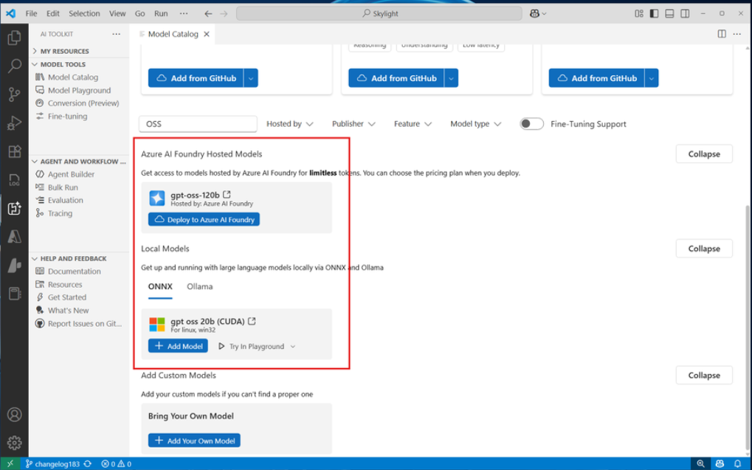
ML & AI & IOT Updates
Generally Available: Azure Databricks connector for Microsoft Power Platform
Azure Databricks connector for Power Platform is now generally available. The new connector enables to:
Support real-time data access without the need for data copying.
Create dynamic applications that take advantage of large datasets directly from Azure Databricks.
Easily set up connections through support for API key authentication and additional developer options.
Efficiently visualize and work with data using the Power FX formula language.
Set up Azure Databricks as a knowledge source for Microsoft Copilot Studio to leverage large data for AI insights.
This powerful combination enhances productivity and provides robust data insights, making Azure Databricks a valuable tool for modern data-driven applications.
GPT-5 Family of Models & GPT OSS Are Now Available in AI Toolkit for VS Code
AI Toolkit v0.18.3 is here—and it’s a major milestone. This release introduces full support for:
The latest GPT-5 family of models
OpenAI’s open-source models (GPT OSS) via Azure AI Foundry and ONNX Runtime

Slide 20
DevOps & IaC & Automation

Slide 21
DevOps & IaC & Automation
Public Preview: Introducing Azure App Testing: Scalable End-to-end App Validation
Azure App Testing now enables developers and QA teams to run large-scale functional and performance tests to pinpoint issues in their applications, across frameworks like Playwright, JMeter, or Locust.
It brings together two powerful testing capabilities—Azure Load Testing (Generally available) and Playwright Workspaces (now in Public Preview)—into a single hub in the Azure Portal, providing a consistent experience for resource provisioning, access control, and consolidated billing.

Slide 22
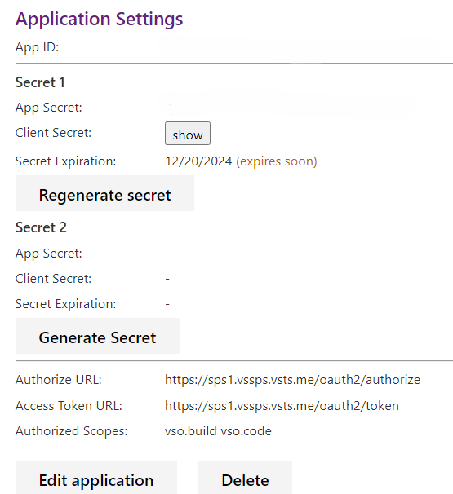
DevOps & IaC & Automation
Real-Time Security with Continuous Access Evaluation (CAE) comes to Azure DevOps
MS announced that Continuous Access Evaluation (CAE) is now supported on Azure DevOps, bringing a new level of near real-time security enforcement to development workflows.
Continuous Access Evaluation (CAE) is a feature from Microsoft Entra ID that enables near real-time enforcement of Conditional Access policies. Traditionally, Microsoft Entra access tokens in Azure DevOps are valid for up to an hour, meaning that even after a user’s account is disabled or a password is changed, access may persist until the token expires. CAE changes that.
With CAE, Azure DevOps can revoke access quickly after critical events occur, such as:
User deletion or disablement
Password changes or resets
Admin-triggered token revocations
Multi-factor Authentication enablement
IP/location changes
Azure DevOps OAuth Client Secrets Now Shown Only Once
MS is making an important change to how Azure DevOps displays OAuth client secrets to align with industry best practices and improve overall security posture. Starting September, newly generated client secrets will be shown only once at the time of creation. After that, they will no longer be retrievable via the UI or API.
This update helps reduce the risk of accidental exposure and encourages secure storage practices, such as saving secrets in Azure Key Vault or other secure vaults. These changes will go into effect for all apps by September 2, 2025.

Slide 23
Information

Slide 24
Information
Azure Times GitHub Repo

Slide 25
Questions

