Slide 1
Azure Times #176
September 1, 2025

Slide 2
Networking

Slide 3
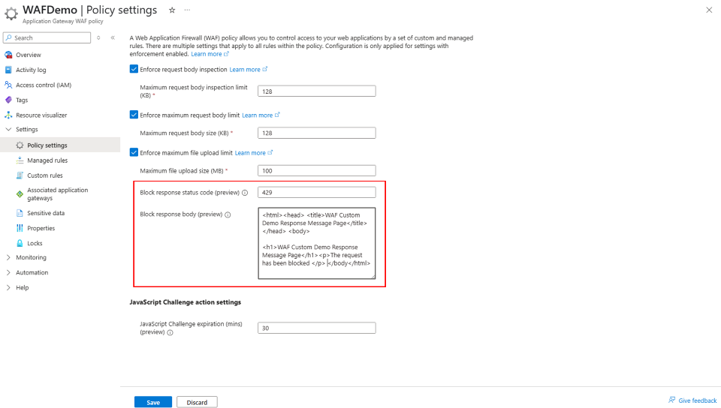
Networking Updates
Public Preview: Azure Bastion now supports connectivity to private AKS clusters via tunneling
With this release, it is now possible to establish a secure tunnel from local machine—via Azure Bastion—directly to AKS API server using standard Kubernetes tooling. This enables seamless access to both private clusters and public clusters with API server authorized IP ranges.
Now, you can securely connect to your cluster’s API server from anywhere, without the need for complex VPNs, jump boxes, or exposing public endpoints. This is a significant leap forward in simplifying secure access for developers, operators, and partners working with private AKS environments.
Public Preview: Custom block response code and body for Application Gateway WAF
Azure WAF integrated with Application Gateway now supports customizable response status codes and bodies for blocked requests, enabling greater flexibility and control.
By default, when the WAF blocks a request due to a matched rule, it returns a 403 status code with a "The request is blocked" message.
As with WAF with Azure Front Door, now customers can also define a custom response status code and message with Application Gateway when WAF blocks a request. This customization is a policy-level setting, ensuring that all blocked requests receive the same custom response status and message.

Slide 4
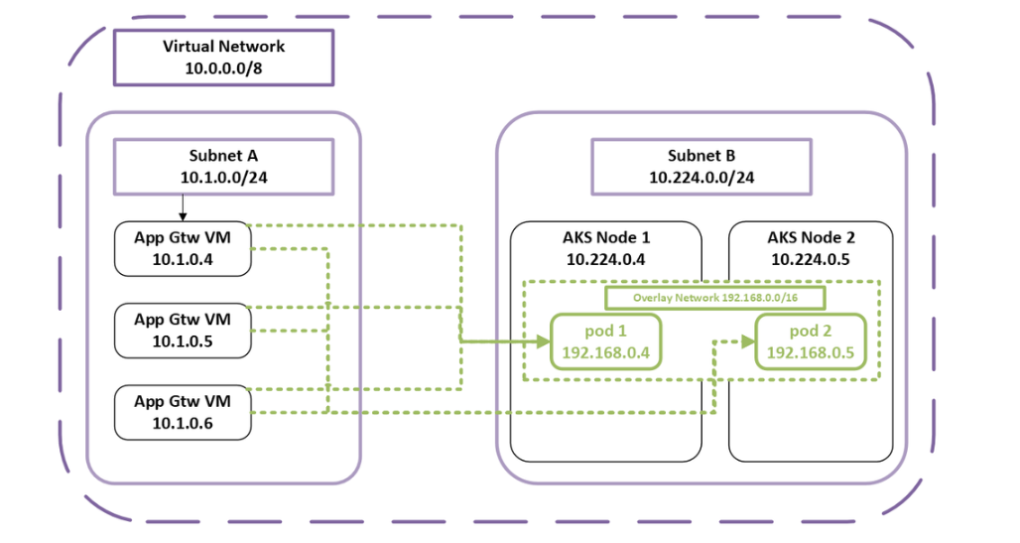
Networking Updates
Generally Available: CNI Overlay for Application Gateway for Containers and AGIC
Azure CNI Overlay with Application Gateway for Containers and AGIC is now generally available.
Azure CNI Overlay enables AKS clusters to use pod IPs from a separate CIDR, conserving VNet IP space and simplifying multi-cluster deployments. Paired with Application Gateway and Application Gateway for Containers, enable secure, efficient load balancing for AKS services, while the overlay network remains local to the AKS cluster.
Key benefits of this solution include:
Efficient IP address management: Conserve VNet IP address space and maximize cluster scale with CNI Overlay.
Controlled ingress: Manage external ingress to designated services within the AKS cluster’s private overlay network, enhancing security and reducing exposure to external threats.
Simplified deployment: Network configuration for CNI Overlay or CNI with Application Gateway for Containers and Application Gateway Ingress Controller is detected automatically; no additional configuration is required.

Slide 5
Networking Updates
Generally Available: Application Gateway adds MaxSurge support for zero-capacity-impact upgrades
Azure Application Gateway now supports MaxSurge, enabling new instances to be provisioned during rolling upgrades without taking existing ones offline. This allows customers to transition to newer gateway versions without any capacity degradation, ensuring:
Full traffic handling throughout the upgrade
Minimized deployment risk
This enhancement offers greater resiliency and reliability for mission-critical applications, especially those requiring consistent performance during infrastructure updates.

Slide 6
Security & Identity

Slide 7
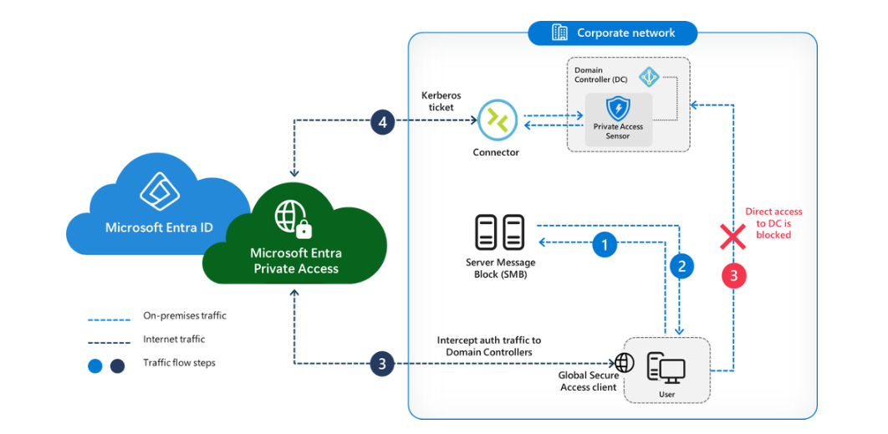
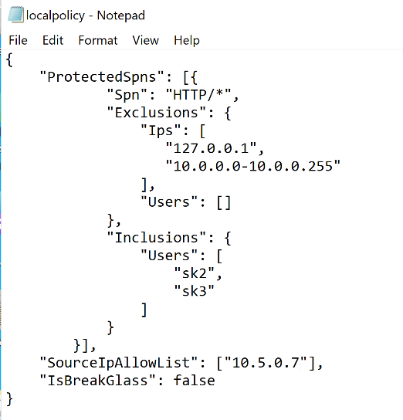
Security & Identity Updates
Microsoft Entra Private Access for Domain Controllers is now in Public Preview
As part of Microsoft’s Security Service Edge (SSE), this feature lets organizations use Conditional Access and multi-factor authentication (MFA) for internal resources that authenticate through Kerberos, managed via Global Secure Access.
Microsoft Entra Private Access delivers consistent identity and network security controls across on-premises, remote, and hybrid environments. Every authentication request to domain authenticated resources is validated against Conditional Access policies, replacing perimeter-based trust with continuous verification, regardless of user location.
Admins can set detailed SPN-level policies, such as requiring MFA for cifs/* file shares, enabling compliant device access to MSSQL/* servers, and applying step-up authentication for sensitive RDP servers. This allows for precise risk-based segmentation and tailored service access.

Slide 8
Security & Identity Updates
Retirement: Microsoft Sentinel Deprecation in Microsoft Azure operated by 21Vianet Announcement
MS continuously assess services to uphold the high standards of protection and reliability for customers. After a thorough evaluation, MS have determined that due to increasing infrastructure and operational complexity, it is no longer feasible to maintain the expected levels of stability and effectiveness for Microsoft Sentinel in Microsoft Azure operated by 21Vianet, also known as Azure in China.
As a result, MS plan to retire and remove all features and services related to Microsoft Sentinel within Microsoft Azure operated by 21Vianet on August 18, 2026. After this date, customers will no longer be able to access the Microsoft Sentinel portal, or any associated Microsoft Sentinel services or features in this environment operated by 21Vianet.
Retirement: Microsoft Defender for Cloud Deprecation in Microsoft Azure Operated by 21Vianet Announcement
MS continuously assess services to uphold the high standards of protection and reliability for customers. After a thorough evaluation, MS have determined that due to increasing infrastructure and operational complexity, it is no longer feasible to maintain the expected levels of stability and effectiveness for Microsoft Defender for Cloud in Microsoft Azure operated by 21Vianet, also known as Azure in China.
As a result, MS plan to retire and remove all features and services related to Microsoft Defender for Cloud within Microsoft Azure operated by 21Vianet on August 18, 2026. After this date, customers will no longer be able to access the Microsoft Defender for Cloud portal, or any associated Microsoft Defender for Cloud services or features in this environment operated by 21Vianet.

Slide 9
Management & Governance

Slide 10
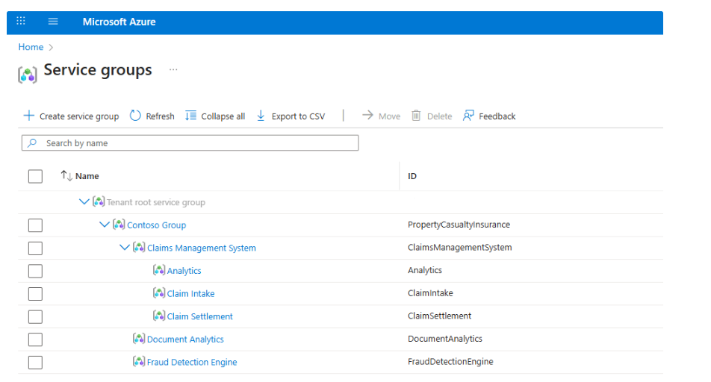
Management & Governance Updates
Announcing Public Preview for Azure Service Groups!
Service Groups are a new resource container enabling management and observability scenarios where flexibility in hierarchy and membership is needed. Service Groups are tenant level resources so they can have members across the tenant but do not interfere or use tenant-wide RBAC or Policy abilities.
Low Privilege Management: Service Groups are designed to operate with minimal permissions, ensuring that users can manage resources without needing excessive access and appealing to multiple personas. Access to a Service Group does not grant role-based access control or policy inheritance to its members.
Flexible and Varying Hierarchies: Azure resources and scopes, from anywhere in the tenant, can become members of one or multiple service groups. Additionally, Service Groups can be nested providing the ability to have multiple hierarchy structures, i.e. Cost Center, Product, Organization, and more!
Monitoring Capabilities: From your application to infrastructure health, Azure Monitor features (such as Health Models) are now available to help you troubleshoot, investigate, and monitor your Service Group.

Slide 11
Management & Governance Updates
Introducing the VM Conversion tool in Windows Admin Center – Public Preview
This agentless, cost-free tool streamlines the conversion of virtual machines from VMware to Windows Server with Hyper-V, providing customers flexibility with their on-premises virtualization environments while enabling a seamless transition path to Azure when desired. With minimal infrastructure requirements, the tool is particularly beneficial for small and medium-sized organizations.
Agentless, appliance-free discovery
Minimal downtime
Group servers
Boot configuration
OS agnostic
Multi-disk VM support

Slide 12
Management & Governance Updates
Generally Available: Microsoft Azure now available from cloud region in Austria
Microsoft announces the opening of its cloud region in Austria to accelerate digital transformation and AI innovation. The cloud region will enable companies and public administration in Austria to store and process their data securely, in compliance with data protection regulations and locally.
Log Analytics search job enhancement
Log Analytics search job now supports up to 100 million results in results sets. It can search across all log analytics Tiers

Slide 13
Management & Governance Updates
Generally Available: Azure Migrate now supports migration to disks with Zone-Redundant Storage (ZRS) redundancy
With the introduction of this new feature in Azure Migrate, it is now possible to select ZRS as the redundancy option during server migration. This automatically provisions a disk with ZRS redundancy for the migrated virtual machine, enhancing availability and resilience.
ZRS synchronously replicates data across three physically separate availability zones within a region—each with independent power, cooling, and networking—enhancing disk resiliency and availability. In the event of a zonal failure, these disks can be force-detached from the affected VM and reattached to another VM, ensuring workload continuity. ZRS redundancy is available for Premium SSD and Standard SSD managed disks.
You can now take advantage of this disk support and ensure your migration strategy reflects the latest in Azure resiliency.
Generally Available: Schema migration is now available in Azure Database Migration Service (DMS)
Announcing that Azure DMS now supports schema migration for Azure SQL Database—making cloud migration journey smoother and more efficient than ever.
With just a single checkbox, it is now possible to migrate missing schema objects along with your data. This includes:
Tables
Views
Stored procedures
Indexes
User-defined types
Roles, rules, synonyms, and more
It is possible to streamline the migration process, reduce manual intervention, and maintain consistency between source and target environments.

Slide 14
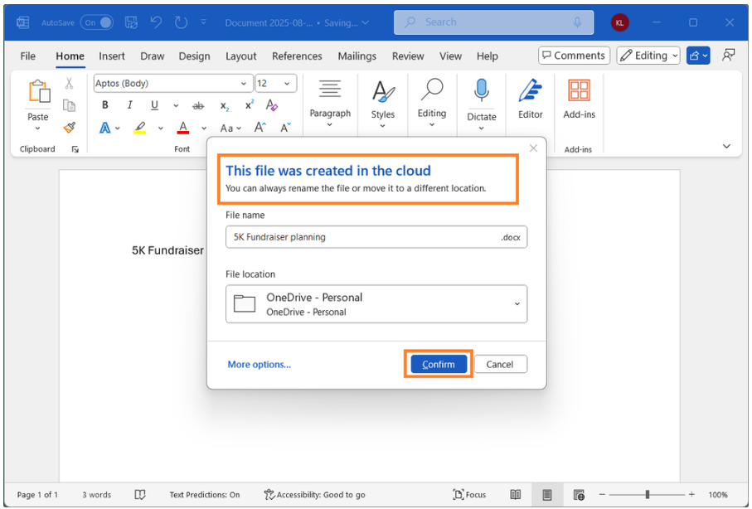
Management & Governance Updates
Windows Backup for Organizations is now available
MS announced the general availability of Windows Backup for Organizations! This new feature allows organization to seamlessly back up Windows 10 or Windows 11 settings and effortlessly restore them on a Microsoft Entra joined device.
To use the backup functionality, ensure:
Devices are Microsoft Entra joined or Microsoft Entra hybrid joined.
Devices are running a supported version of Windows 10, version 22H2 or Windows 11, version 22H2 or later.
Devices have the August 2025 Windows security update or newer. This update includes the Windows Backup app for backing up Windows settings and the list of Microsoft Store apps.
The backup policy is enabled via mobile device management (MDM) or Group Policy.
Save new files automatically to the cloud in Word for Windows
Anything new created will be saved automatically to OneDrive or preferred cloud destination.

Slide 15
Compute

Slide 16
Compute Updates
Private Preview: DCesv6 and ECesv6 series confidential VMs with Intel® TDX
The DCesv6 and ECesv6 series are Azure’s next generation of Confidential Virtual Machines powered by the 5th Gen Intel® Xeon® processors (code-named Emerald Rapids) with Intel® Trust Domain Extensions (Intel® TDX). This will help to enable organizations to bring confidential workloads to the cloud without code changes to applications. The supported SKUs include the general-purpose families DCesv6-series and the memory optimized families ECesv6-series.
Confidential VMs are designed for tenants with high security and confidentiality requirements, providing a strong, hardware-enforced boundary. They ensure that your data and applications stay private and encrypted even while in use, keeping your sensitive code and other data encrypted in memory during processing. Additionally, we offer in-guest attestation support, enabling customers to confidently attest to and verify the integrity of their machines.
Public Preview: Roslyn Analyzer for Durable Functions in .NET isolated
Durable Functions running in the .NET isolated model now has support for the Roslyn Analyzer, a real-time code analyzer that helps developers adhere to durable orchestrations’ coding constraints.
This analyzer is enabled by default to analyze Durable Functions code and generate warnings and errors should there's any.

Slide 17
Compute Updates
Generally Available: Azure Functions Flex Consumption plan now supports 512 MB instance size and diagnostic settings
Azure Functions now allows to choose 512 MB in addition to 2048 MB and 4096 MB as the memory instance size for Flex Consumption apps. This enables to further cost optimize apps that require less resources and allows apps to scale out further within the default quota.
Diagnostic settings allow you to collect Flex Consumption application logs and resource metrics, then send to different destinations like Log Analytics, storage account, event hub, or partner solutions for monitoring and analysis.
Generally Available: Azure Functions support for Node.js 22
Azure Functions support for Node.js 22 is now Generally Available. You can now develop functions using Node.js 22 locally and deploy them to all Azure Functions plans on Linux and Windows.

Slide 18
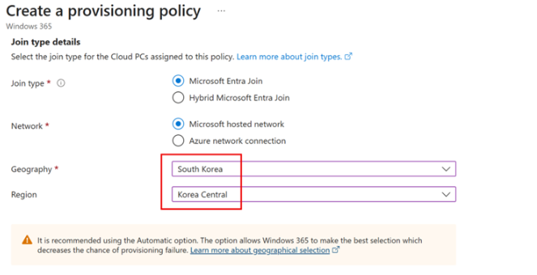
Compute Updates
Windows 365 is now supported in Korea Central
MS announced that we have enabled Windows 365 in Korea Central.
Now it is possible to create Cloud PCs with data stored in the Korea Central region. This helps meet performance and data residency needs for organizations operating in Korea.
Bring Your Own License (BYOL) Support for JBoss EAP on Azure App Service
MS announced that Azure App Service now supports Bring Your Own License (BYOL) for JBoss Enterprise Application Platform (EAP), enabling enterprise customers to deploy Java workloads with greater flexibility and cost efficiency.
BYOL allows customers with existing Red Hat subscriptions to apply those licenses directly to their JBoss EAP deployments on Azure App Service. This model complements the existing Pay-As-You-Go (PAYG) option, giving customers more control over licensing costs and compliance.
With BYOL, customers:
Avoid paying the built-in license fee in PAYG plans.
Leverage their Red Hat Cloud Access entitlements.
Maintain consistency with on-prem licensing strategies.

Slide 19
Compute Updates
.NET 10 Preview Now Available on Azure App Service!
MS announced that .NET 10 Preview is now available on Azure App Service for both Windows and Linux!

Slide 20
Storage & Data

Slide 21
Storage & Data Updates
Public Preview: Azure NetApp Files Flexible service level now supports cool access
Flexible service level in Azure NetApp Files allows customers to independently configure storage capacity and throughput, making it ideal for workloads with unique performance and sizing requirements—such as high-capacity volumes with low throughput or low-capacity volumes with high throughput. This flexibility helps optimize performance and cost across diverse application scenarios.
With the addition of cool access support, customers can now configure volumes in Flexible service level capacity pools to automatically tier cold data to Azure storage accounts. This reduces storage costs by offloading infrequently accessed data to a lower-cost tier, while maintaining seamless access and performance for active data. Cool access also supports cross-region replication for destination-only volumes, ensuring data protection without impacting source latency. This enhancement is available in all ANF regions.
Public Preview: Azure NetApp Files short-term clones
Azure NetApp Files short-term clones enable space-efficient, instant read/write access to data by creating temporary thin clones from existing volume snapshots, eliminating the need for full data copies and enabling capacity savings.
Ideal for software development, analytics, disaster recovery and testing, short-term clones support large datasets and allow quick refreshes from the latest snapshots. Short term clones remain temporary and space-efficient for up to one month, consuming capacity only for incremental changes. This capability accelerates development and analytics workflows, improves quality and resilience, and reduces costs by avoiding full copy storage and minimizing operational overhead.
By default, short-term clones convert to regular volumes after 32 days.

Slide 22
Storage & Data Updates
Generally Available: Azure Blob Storage Archive Tier Now in Malaysia West
The Archive access tier for Azure Blob Storage is now generally available in the Malaysia West region.
With this regional expansion, customers in Malaysia can now store infrequently accessed data in the cost-effective Archive tier, while meeting data residency and compliance requirements locally. The Archive tier is ideal for long-term backup, compliance, and archival scenarios, offering the lowest-priced storage option in Azure.
Generally Available: Azure NetApp Files file access logs
Azure NetApp Files file access logs feature is now generally available, delivering enterprise-grade visibility into file-level operations across SMB, NFSv4.1, and dual-protocol volumes.
This feature empowers organizations to enhance their security posture, streamline operations, and meet compliance requirements by capturing detailed telemetry on file access activities—including user identity, operation type, and timestamps. Capabilities provided through this feature are in alignment with Azure's Well-Architected Framework security best practices.

Slide 23
Storage & Data Updates
Generally Available: Entra ID and RBAC support for GetAccountInfo and other supplemental APIs for Azure Storage
To align with security best practices, Entra ID and RBAC support is now generally available for the following APIs for Azure Storage:
Get Account Information
Get / Set Container ACL
Get / Set Queue ACL
Get / Set Table ACL
These APIs now support OAuth 2.0 based Authentication via Entra ID on storage.
Previously, if you tried to use these APIs with OAuth, MS returned a 404 status code. Now, if you use these APIs with OAuth but do not have the right permissions, MS will return a 403 status code (unauthorized access).
If you send an anonymous request for bearer challenge, MS will return a 401 status code, which is the same behavior as with the other APIs.

Slide 24
Databases

Slide 25
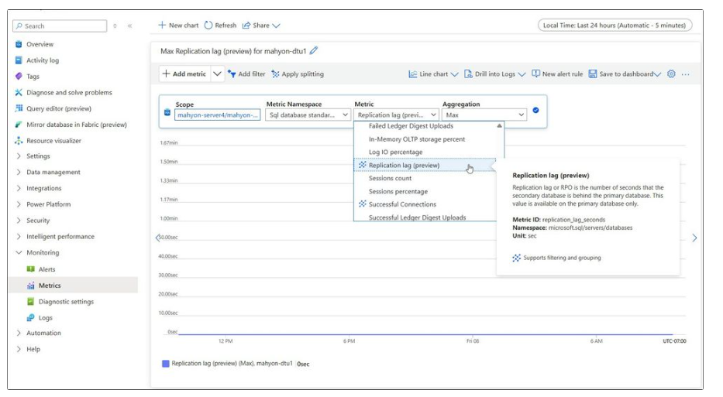
Databases Updates
Public Preview - Azure SQL Database now offers a replication lag metric
This feature provides real-time visibility into the recovery point objective (RPO) when Geo-DR is enabled.
Replication lag is the time span in seconds from the point of transaction commit on the Primary and the acknowledgement by the Secondary that the transaction log update has been persisted. This value is available on the primary database only.
Public Preview: Azure Cosmos DB for MongoDB (vCore)—add shards and rebalance data
Now it is possible to add physical shards as Azure Cosmos DB for MongoDB (vCore) clusters grow.
When you add physical shards, they’re always created next to the other physical shards in the same region and given the same compute and storage configurations as the existing shards in the cluster.
After it’s added, the new physical shard is immediately available for write operations. Often, there is a significant data skew between the existing nodes and the newly added empty shard. To address this imbalance, you can initiate data rebalancing, redistributing data from heavily loaded nodes to those with little or no data. Data rebalancing requires no configuration and is executed with zero cluster downtime.

Slide 26
Databases Updates
Public Preview: Azure Database for PostgreSQL Entra ID group login using user credentials
The public preview of Entra ID group login using user credentials, now available on newly provisioned servers. This anticipated feature simplifies user management and improves security within the Azure Database for PostgreSQL Flexible Server environments.
Both administrators and users benefit from a more streamlined process:
Changes in Entra ID group memberships are synchronized on a periodic basis. This scheduled syncing ensures that access controls are kept up to date, simplifying user management and maintaining current permissions.
Users can log in with their own credentials, simplifying authentication, and improving auditing and access management for PostgreSQL environments.
As organizations continue to adopt cloud-native identity solutions, this update represents a major improvement in operational efficiency and security for PostgreSQL database environments.
SQL Server 2025 Preview: Now Supporting Ubuntu 24.04 and TLS 1.3
SQL Server 2025 Preview now supports Ubuntu 24.04. This enables seamless deployment in Dev/Test environments using the Enterprise Evaluation Edition, which is valid for 180 days.
Note: Production workloads on Ubuntu 24.04 are not yet supported; for production, use SQL Server 2022 on Ubuntu 22.04 or RHEL 9.
Starting in SQL Server 2025 Preview (RC0), TLS 1.3 is enabled by default.

Slide 27
Databases Updates
Generally Available: Azure SQL updates for late-August 2025
In late August 2025, the following updates and enhancements were made to Azure SQL and SQL Server:
Easily spin up local SQL Server containers. Now generally available, the local SQL Server container enables container creation in the MSSQL extension for Visual Studio Code—no Docker commands needed.
Design tables more easily with Schema Designer, now generally available—a powerful new way to visually create and modify database schemas without writing T-SQL.
Streamline database development using Schema Compare to effortlessly compare database schemas, pinpoint differences, and apply updates seamlessly between databases or files.
Full-Length SQL Audit Statements Now Supported for Azure SQL DB
Previously, audit records were limited to storing 4,000 characters for fields like statement and data_sensitivity_information. Any content beyond that threshold was truncated, potentially leaving out critical details from lengthy queries or sensitive data traces.
With this update, statements are no longer truncated. Audit logs now capture the entire content of auditable actions, ensuring complete visibility and traceability for security and compliance teams.
Improved Security & Compliance
Enhanced Customer Experience
Feature Parity with SQL Server and Managed Instance

Slide 28
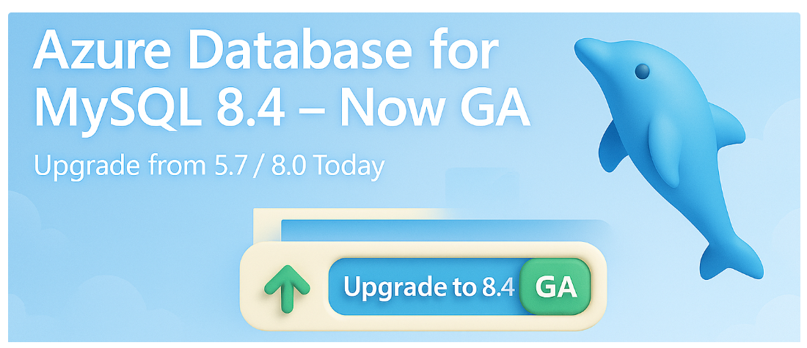
Databases Updates
Azure Database for MySQL 8.4 Now Generally Available
MS announced that Azure Database for MySQL – Flexible Server now supports MySQL 8.4 in General Availability (GA). This allows to create new MySQL 8.4 servers on Azure fully supported for production workloads. MySQL 8.4 is a long-term supported release from the MySQL community, bringing the latest features and improvements while emphasizing stability.

Slide 29
ML & AI & IOT

Slide 30
ML & AI & IOT Updates
Azure Machine Learning now supports Large-Scale AI Training and Inference with ND H200 v5 VMs
Azure Machine Learning now offers ND H200 v5 VMs ​accel​erated ​​by NVIDIA H200 Tensor Core GPUs, purpose‑built to train and serve modern generative AI more efficiently at cloud scale. With massive on‑GPU memory and high intra‑node bandwidth, it is possible to fit larger models and batches, keep tensors local, and cut cross‑GPU transfers - doing more with fewer nodes. Start with a single VM or scale out to hundreds in a managed cluster to capture cloud economics, while Azure’s AI‑optimized infrastructure delivers consistent performance across training and inference.

Slide 31
ML & AI & IOT Updates
Fine-tuning gpt-oss-20b Now Available on Managed Compute
gpt-oss-20B is a powerful, open-source model. Fine-tuning enables:
Domain-specific adaptation (e.g., customer support, education)
Multilingual reasoning (English, Spanish, French, Italian, German)
Efficient training with LoRA adapters—only 1% of parameters are updated

Slide 32
Miscellaneous

Slide 33
Miscellaneous Updates
Azure Communication Services is now Generally Available in Azure Government
MS announced that Azure Communication Services (ACS) is now Generally Available in Azure Government, including Video and Chat capabilities. This milestone empowers U.S. government agencies and their partners to deliver modern, secure, and compliant communication experiences - all within their own applications

Slide 34
Information

Slide 35
Information
Azure Times GitHub Repo

Slide 36
Questions

