Slide 1
Azure Times #177
September 8, 2025

Slide 2
Networking

Slide 3
Networking Updates
Generally Available: Multiple address prefixes for subnets in Azure Virtual Networks
Support for multiple address prefixes in a subnet is now generally available in Azure Virtual Networks.
Azure Virtual Network subnets supported only a single address prefix, which limited the scale out for certain applications when the address space was exhausted. This capability now allows adding additional address prefixes to the subnet, expanding the available address space without the need to empty the subnet to resize.
The key benefits of this approach are –
Dynamic subnet expansion without impacting existing workloads in subnet
Efficient subnet address space usage with scope for expansion when needed
The feature only supports virtual machines and virtual machine scale sets and doesn't support Bare Metal or VNet injection for Containers, especially PodSubnet IPAM mode in AKS clusters. Any delegated subnet can't use this feature (except for GatewaySubnets delegated to VPN Gateway and ExpressRoute Gateway services).
This feature is only available currently via command line (PowerShell, CLI) or Azure Resource Manager Templates. Azure portal support is limited. Once additional address prefixes are added, under the Subnets blade, you'll be able to see the correct count of Available IPs from all the prefixes, but only the first prefix is listed.
$subnet = @{ Name = 'subnet-1' AddressPrefix = '10.0.0.0/24', '10.0.1.0/24' } $subnetConfig = New-AzVirtualNetworkSubnetConfig @subnet

Slide 4
Networking Updates
Generally Available: Azure Front Door Standard and Premium are now available in Azure China.
Azure Front Door Standard and Premium are now generally available in the Azure China regions (China North 3 and China East 3), operated by 21Vianet. With this release, customers in China can deliver secure, reliable, and high-performance applications using the same modern capabilities available worldwide, tailored for local compliance requirements such as ICP filing for custom domains.
Azure Front Door provides global load balancing with instant failover, application acceleration through edge caching and protocol optimizations, and enterprise-grade security features including Web Application Firewall (WAF), DDoS protection, and TLS/SSL offload. Customers in China can also take advantage of end-to-end observability with Azure Monitor metrics, logging, and analytics.
This launch enables organizations operating in China to reduce latency for end users, improve application resilience, and simplify operations with a consistent platform experience across global and China regions.

Slide 5
Networking Updates
Retirement: Azure CDN will be retired on December 1 2025 in China
Azure CDN will be retired on December 1, 2025 in China.
To avoid service disruption:
Please migrate to Azure Front Door or an alternative CDN provider in China before November 15, 2025.
If you don’t migrate by November 15, 2025, Azure Front Door team will migrate eligible Azure CDN profiles to Azure Front Door in China. However, if Azure CDN profile is disabled or has no active request in the past 3 months, or Azure CDN profile isn’t compatible for migration based on the gap mentioned in Migration from Azure CDN to Azure Front Door, Azure Front Door can’t and won’t migrate profile and your service will experience service disruption starting December 1, 2025.
Retirement: Azure CDN – Migrate to Azure Front Door on December 1, 2025
Azure CDN which is currently provided in Microsoft Azure operated by 21Vianet (“Azure China”) will be retired on December 1, 2025. This change affects all customers currently using Azure CDN in China.
Azure CDN is built on top of local CDN providers’ POPs with API integrations. Due to this architecture, Azure CDN lacks native and deep integration with the Azure platform. As demand grows for more integrated and developer-friendly solutions with built-in security features such as Web Application Firewall and Private Link to origins, we are introducing Azure Front Door as a native CDN service in Azure China and retiring the Azure CDN service.
Migrate to Azure Front Door or an alternative CDN provider before November 15, 2025. After validation successfully, please delete the CDN resources before November 15, 2025.

Slide 6
Management & Governance

Slide 7
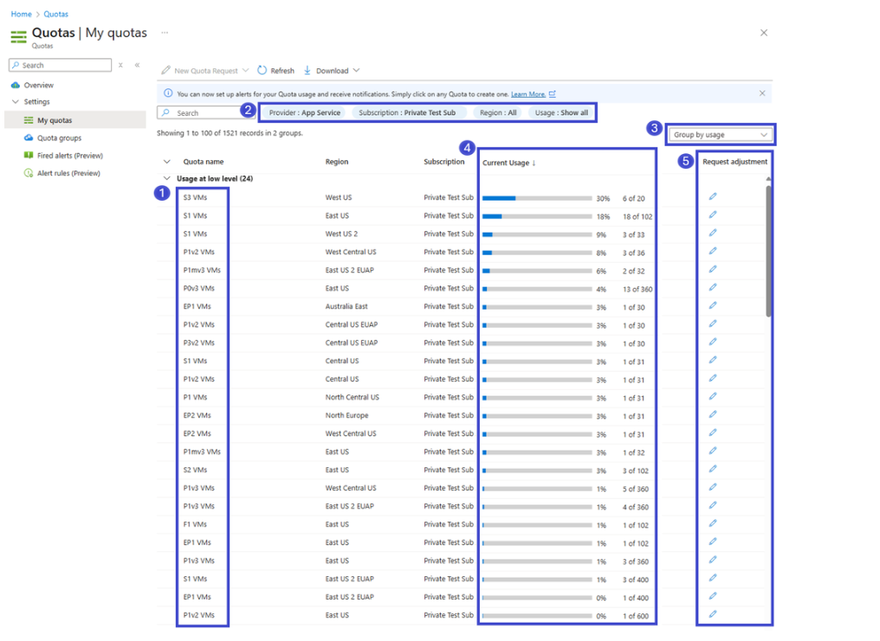
Management & Governance Updates
Public Preview of the New App Service Quota Self-Service Experience
The updated experience introduces a dedicated App Service Quota blade in the Azure portal, offering a streamlined and intuitive interface to:
View current usage and limits across the various SKUs
Set custom quotas tailored to your App Service plan needs

Slide 8
Management & Governance Updates
Broadcom VMware Licensing Changes: What Azure VMware Solution Customers Need to Know
Broadcom is changing its VMware licensing policies across all hyperscaler platforms to require customers to “bring your own” portable subscription for VMware Cloud Foundation (VCF). This means customers must purchase portable VCF subscriptions directly from Broadcom to use with cloud services in the future, including Azure VMware Solution.
Microsoft will stop selling AVS with VCF subscriptions included after October 15, 2025. After this date, new AVS node purchases will require you to provide a VCF subscription purchased from Broadcom.
Microsoft will honor existing Reserved Instance commitments to AVS customers. If you purchase AVS Reserved Instances (RIs) on or before October 15, 2025, you can continue to use your AVS nodes without any licensing or product changes until your RI term ends.
AVS with license included PayGo nodes can continue to operate without any licensing or product changes through October 31, 2026. Alternatively, customers can switch from AVS PayGo and purchase an AVS RI with license included by October 15, 2025.
Generally Available: Azure Red Hat OpenShift Now Available in UAE Central and US Gov Texas
Azure Red Hat OpenShift is now generally available in two new regions: UAE Central and US Gov Texas, bringing enterprise-grade managed OpenShift capabilities to customers in the Middle East and southwestern United States. These expansions provide local deployment options with reduced latency and enhanced data residency compliance for organizations operating in these strategic markets.
The GA release in both regions includes full feature parity with other Azure regions, supporting managed identity capabilities, and comprehensive networking options. Customers can now deploy production workloads with confidence, benefiting from Azure's robust infrastructure and Red Hat's enterprise Kubernetes platform in these locally available regions.

Slide 9
Compute

Slide 10
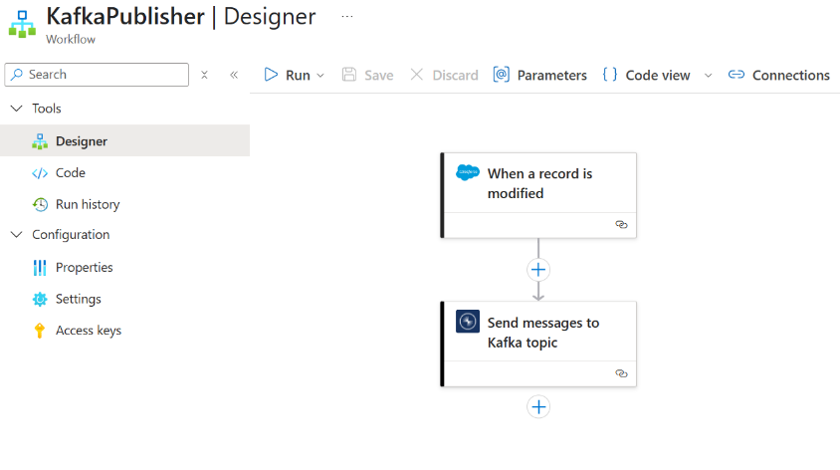
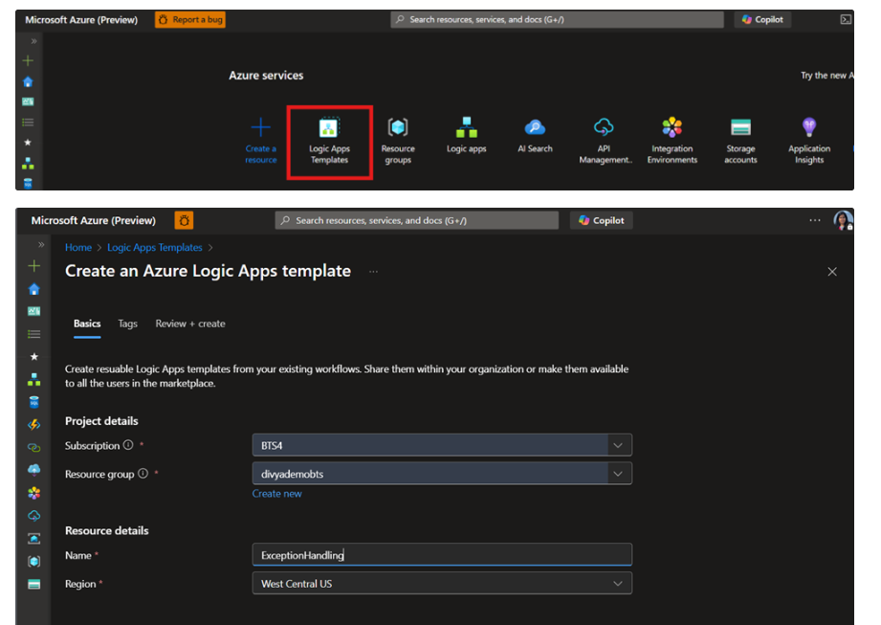
Compute Updates
Public Preview: Confluent Kafka Connector in Azure Logic Apps (Standard)
Announcing the public preview of the Confluent Kafka Connector in Azure Logic Apps (Standard). This new connector allows to both send and receive messages between Logic Apps and Confluent Kafka.
Confluent Kafka is a distributed streaming platform widely used for building real-time data pipelines and streaming applications across industries such as financial services, retail, IoT, and more. With the new connector, it is possible to publish and subscribe to streams of records directly from Logic Apps, enabling real-time integration scenarios.
The connector supports both triggers (receive) and actions (publish), making it easier to integrate event-driven workflows with Confluent Kafka in Logic Apps.
Public Preview: Organizational Templates in Azure Logic Apps
Announcing the public preview of Organizational Templates in Azure Logic Apps. This feature empowers teams to author, share, and reuse automation patterns within their own organization, helping standardize integration practices at scale.
Organizational Templates extend the existing Logic Apps Templates experience by allowing templates to be published and scoped to Azure tenant or subscription. Teams can create templates directly from workflows using a new UI, share them securely across the organization, and manage their lifecycle from test to production.
With integration to Azure RBAC and subscription-level scoping, you can control who can author, view, and deploy templates ensuring the right teams get access to the right automation patterns while maintaining security and governance.

Slide 11
Compute Updates
Public Preview: Azure Functions support for Python 3.13
It is now possible to develop functions using Python 3.13 locally and deploy them to Azure Functions.
Starting with Python 3.13, Functions introduces runtime version control, a new opt-in feature that lets you target specific versions of the Functions Python runtime used by your app.
Python 3.13 also introduces several enhancements to Functions that improve performance and reliability. In Python 3.13+, Azure Functions no longer supports custom worker extensions and shared memory for large payloads, requiring migration to supported alternatives and gRPC-based messaging.

Slide 12
Compute Updates
Generally Available: Azure Logic Apps Standard Automated Test Framework
Azure Logic Apps Standard Automated Test Framework, enabling developers to build, test, and maintain enterprise-grade workflows with confidence.
The framework allows teams to create unit tests for workflow definitions and runs directly in Visual Studio Code, simulating external dependencies and validating workflow behavior before deployment. GA introduces key enhancements, including broader support for mocked actions (built-in and managed connectors), access to workflow settings for assertions, and inline script actions for JavaScript, enabling more comprehensive and reliable testing of complex workflows.
With these improvements, developers can ensure workflow logic, environment settings, and scripts behave as expected, supporting faster, safer, and more maintainable integration solutions.
Generally Available: Custom Code support in Azure Logic Apps Standard with .NET 8
Announcing the general availability of Custom Code support in Azure Logic Apps Standard with .NET 8. This release enables developers to embed .NET 8 code directly in workflows, unlocking advanced logic scenarios, code reuse, and seamless integration with existing .NET libraries and services.
Key enhancements in GA include the ability to bring your own NuGet packages without dependency conflicts, native support for Dependency Injection for more maintainable code, and an improved authoring experience with better tooling, templates, and local debugging in Visual Studio and Visual Studio Code.
With these updates, developers can build more powerful, flexible, and enterprise-grade integration workflows on Azure Logic Apps Standard.

Slide 13
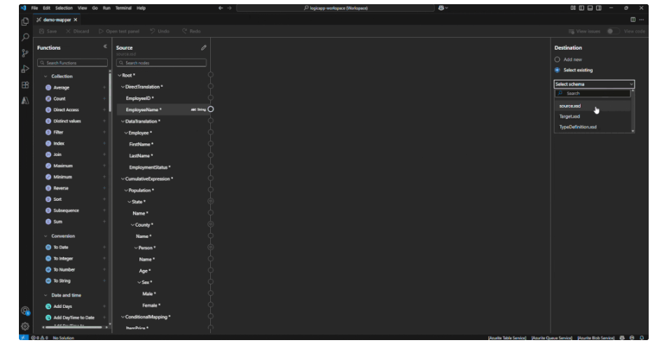
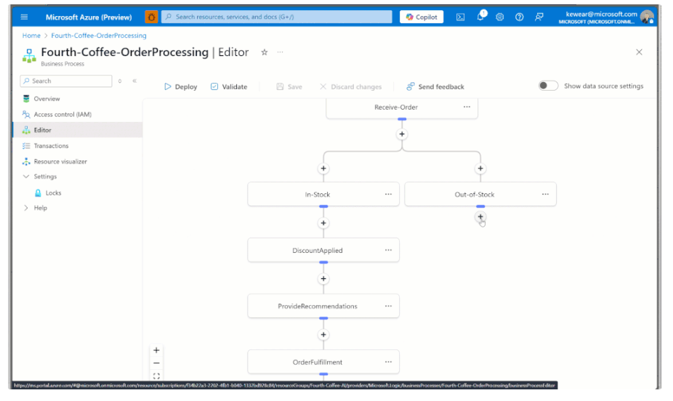
Compute Updates
Generally Available: Business Process Tracking in Azure Logic Apps (Standard)
Announcing the general availability of Business Process Tracking in Azure Logic Apps (Standard). This capability provides business stakeholders with timely insights by tracking key data properties throughout workflows in production environments.
With Business Process Tracking, you can define stages and map critical business data to your Logic Apps implementation. As workflows run, the data is sent to Azure Data Explorer (ADX), where it can be visualized using the business process overlay, giving teams a clear view of process execution and outcomes.
This feature helps organizations monitor and analyze workflows efficiently, bridging the gap between technical implementation and business insights.
Generally Available: Enhanced Data Mapper Experience in Logic Apps (Standard)
Introduced the redesigned Data Mapper UX in the Azure Logic Apps (Standard) extension for Visual Studio Code is now generally available. The new experience, which was in public preview, becomes the default for creating and editing maps.
This release is a major step forward in modernizing data transformation workflows. It delivers a more stable, performant, and intuitive experience, shaped directly by feedback from our integration developer community.
With GA, developers can seamlessly open and edit existing V1 maps in the updated V2 experience, work reliably on macOS with schema-related crashes resolved, and benefit from clearer documentation and examples for built-in collection functions on repeating nodes.

Slide 14
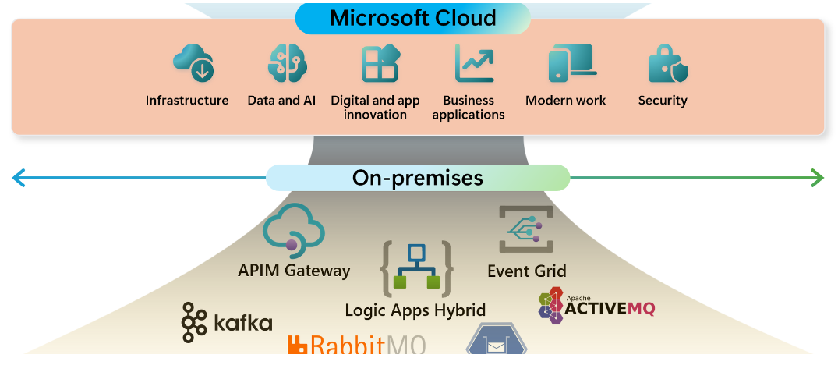
Compute Updates
Generally Available: Logic Apps Hybrid Deployment Model
Announcing the general availability of the Logic Apps Hybrid Deployment Model, offering customers unprecedented flexibility and control over where their integration workloads run. You can now host Logic Apps on customer-managed infrastructure, including on-premises, private cloud, or third-party public cloud environments.
This deployment model helps organizations meet regulatory, data privacy, and network requirements while still leveraging the capabilities of Azure Logic Apps. It supports a semi-connected architecture with local workflow processing, storage, and network access, enabling higher throughput and direct access to local data sources.
With built-in connectors executing on local compute, the Logic Apps Hybrid Deployment Model ensures your workflows can process sensitive data securely while maintaining enterprise-grade performance and connectivity.
Generally Available: Upgrade existing Azure Gen1 VMs to Gen2-Trusted launch
MS announced a general availability support to enable Trusted launch on existing Azure Gen1 VMs by upgrading the Gen1 VM to Gen2-Trusted launch. This will help improve the foundational security of existing Azure VMs.
Trusted Launch VMs provide foundational compute security to Azure Generation 2 VMs by enabling Secure Boot and vTPM capabilities. Trusted Launch protects OS against rootkits, boot kits and enables attestation by measuring the boot chain of VM.
VM size of given VM or Scale set is supported for Trusted launch
VM or Scale set is running operating system supported with Trusted launch
VM or Scale set is not dependent on Azure features currently not supported with Trusted launch.
Azure Backup, if enabled for VMs, should be configured with the Enhanced Backup policy
Azure site recovery (ASR), if enabled for VMs, should be disabled prior to upgrade
Disable any Windows OS volume encryption including BitLocker before upgrade if enabled

Slide 15
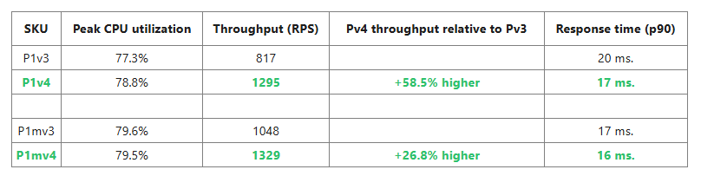
Compute Updates
Generally Available: Azure App Service - New Premium v4 Offering
The new Premium v4 offering provides faster processors, NVMe local storage, and memory-optimized options, running on the latest Azure hardware. Premium v4 is available for both Windows and Linux customers, and includes sizes starting from 1 vCPU and 4GB of memory all the way up to 32 vCPU and 256GB memory.
Premium v4 delivers at least 25% better price-to-performance compared to the prior Premium v3 offering. With updated Windows pricing, customers using pay-as-you-go can save up to 24%, with even higher discounts available in some regions through reserved instances or savings plans.
Public Preview: .NET 10 Preview Now Available on Azure App Service
Announcing .NET 10 Preview is now available on Azure App Service for both Windows and Linux! Whether building modern web apps with ASP.NET, experimenting with Blazor, or exploring the simplicity of Minimal APIs, it is possible now take advantage of the latest .NET 10 features directly in App Service.Like with previous preview versions, any app targeting the .NET 10 preview will be automatically updated to the latest .NET 10 Preview releases as they become available on the platform all the way up to RC and GA.

Slide 16
Compute Updates
New Mbv3 Size, Standard_M416bs_v3, General Availability
MS expanded the Mbv3 portfolio to better support large-scale, mission-critical database workloads—especially for healthcare organizations operating EHR (Electronic Health Records) database on Azure with the new Mbv3 size, Standard_M416bs_v3.
The Mbv3 series are based on the 4th generation Intel® Xeon® Scalable processors, scale for workloads up to 4TB, and deliver with NVMe interface for higher remote disk storage performance.
This VM size, newly added to the Mbv3 series, Standard_M416bs_v3, offers 416 vCPU which is over 2x the vCPU of the largest launched Mbv3 VM.
The Standard_M416bs_v3 offers high remote storage performance with up to 550,000 IOPS and 10 GBps of remote disk storage bandwidth.
The increased remote storage performance of Mbv3 series is ideal for storage throughput-intensive workloads such as relational databases and data analytics applications.

Slide 17
Compute Updates
Retirement: Confidential VM SKUs DCesv5, DCedsv5, ECesv5, ECedsv5 SKUs
Microsoft is announcing the retirement of Confidential VM SKUs DCesv5, DCedsv5, ECesv5, ECedsv5 SKUs, which will be succeeded by the DCesv6 and ECesv6 SKUs.
MS recently announced the public preview of our next-generation Confidential VM sizes: DCesv6 and ECesv6. These new sizes are the next generation of Confidential VMs with benefits such as integration with OpenHCL, and will be our primary focus moving forward.
As part of this transition, MS plan to stop all new and existing DCesv5, DCedsv5, ECesv5, and ECedsv5 series deployments by September 12, 2025. This means that no new VMs can be created after September 12, 2025, and rebooted VMs after that date will no longer be available.
Required action
Delete existing v5 VMs and resources and sign up for the DCesv6 and ECesv6 preview by September 12, 2025.
Once enabled for the v6 preview, you’ll need to redeploy your VMs to the new regions available. VM Sizes with persistent local storage will be available in preview soon, and we’ll keep you informed once they’re ready.

Slide 18
Storage & Data

Slide 19
Storage & Data Updates
Generally Available: Azure Ultra Disk Price Reduction in UK South
Cost Savings - 15-60%
Generally Available: Azure Ultra Disk Price Reduction in Central US
Cost Savings – 20-40%
Generally Available: Azure Ultra Disk Price Reduction in West US 2
Cost Savings – 10-40%
Generally Available: Azure NetApp Files migration assistant
Azure NetApp Files migration assistant (with SnapMirror) provides efficient and cost-effective data migration leveraging ONTAP's built-in replication engine for seamless transition from on-premises or CVO/other cloud providers to Azure NetApp Files (ANF). This feature offers benefits aligned with the goal to accelerate and simplify migrations of business-critical applications and data to Azure. The feature is currently only available with the REST API and is now Generally Available.
Storage-efficient data transfer that reduces network transfer costs for both baseline and incremental updates
Low cutover/downtime window ensuring faster and more efficient final updates, minimizing disruption to customer operations
Volume migration using migration assistant includes source volume snapshots for primary data protection, and directory and file metadata maintaining security attributes

Slide 20
Databases

Slide 21
Databases Updates
Generally Available: Near-zero-downtime maintenance in Azure Database for MySQL
It is now possible to take advantage of near-zero-downtime maintenance for Azure Database for MySQL – Flexible Server with high availability (HA) enabled. This capability is now generally available and is supported by new HA architecture based on a dedicated Azure Standard Load Balancer design. With this release, planned maintenance operations are applied seamlessly without disrupting your application’s connectivity or performance.
With new design, maintenance is now faster and no longer impacted by client-side DNS caching, which previously caused brief connection drops in some scenarios.

Slide 22
Integration

Slide 23
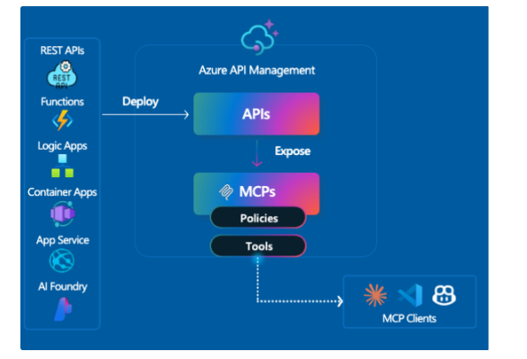
Integration Updates
Public Preview: Expanded support for the Model Context Protocol (MCP) in Azure API Management
MCP support is now available in public preview for Basic v2, Standard v2, and Premium v2 SKUs, enabling to expose REST APIs as MCP servers, secure them with Microsoft Entra ID, API keys, or tokens, and register tools in Azure API Center. In addition, it is possible to bring external MCP-compliant servers, including Logic Apps, Azure Functions, LangChain, or custom runtimes, under governance with API Management to apply security, monitoring, and discovery.

Slide 24
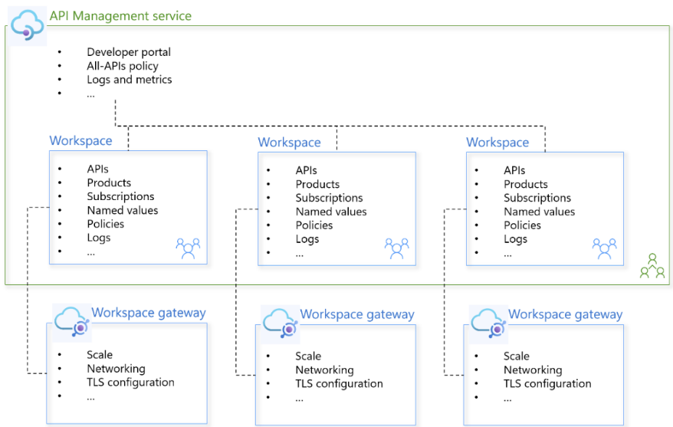
Integration Updates
Generally Available: Gateway level metrics and native autoscaling for Azure API Management v2 tiers
Gateway-level metrics include CPU and memory usage per gateway instance, providing the insights needed for monitoring, diagnostics, and intelligent scaling. With these metrics, it is possible to define autoscale rules in Azure Monitor to automatically increase or decrease gateway instances, ensuring consistent performance without manual intervention.
Autoscaling helps maintain reliability during traffic spikes, improves operational efficiency, and optimizes costs by scaling in when demand drops. It’s ideal for APIs with unpredictable traffic, enterprise workloads requiring resilience, and teams looking to balance performance and cost.
CPU Percentage of Gateway – Available in Basic v2, Standard v2, and Premium v2
Memory Percentage of Gateway – Available in Basic v2 and Standard v2
Generally Available: Workspaces and workspace gateways in the Premium v2 tier of Azure API Management
Announcing the general availability of workspaces and workspace gateways in the Premium v2 tier of Azure API Management. (Note: Premium v2 remains in preview at the time of this announcement.)
Workspaces enable organizations to manage and govern APIs at scale. They make it easier to support large portfolios across teams or business units, while maintaining central governance, observability, and security. This federated model helps teams innovate independently without losing enterprise-wide control.

Slide 25
ML & AI & IOT

Slide 26
ML & AI & IOT Updates
Announcing gpt-realtime on Azure AI Foundry
MS announced the general availability of latest advancement in speech-to-speech technology: gpt-realtime. This new model represents a significant leap forward in commitment to providing advanced and reliable speech-to-speech solutions.
gpt-realtime is a new S2S (speech-to-speech) model with improved instruction following, designed to merge all of our speech-to-speech improvements into a single, cohesive model. This model is now available in the Real-time API, offering enhanced voice naturalness, higher audio quality, and improved function calling capabilities.
Key Features
New, natural, expressive voices
Improved Instruction Following
Enhanced Voice Naturalness
Higher Audio Quality
Improved Function Calling
Image Input Support
Azure AI Translator API (Public Preview)
MS announced a new Azure AI Translator API which provides flexibility to choose general neural machine translation (NMT), or a list of generative AI large language models (LLMs) at a request level. Using generative AI models, the new API offers new capabilities to produce tone translation, gender translation, and adaptive custom translation.
Service capabilities (Preview):
In a single request it is possible to translate source text in different languages and using different models.
During preview the API supports general NMT, gpt-4o and gpt-4o-mini models.
Leverage generative AI LLMs to translate text in different tones – formal, informal, and neutral.
Leverage generative AI LLMs to translate text in different gender – male, female, and neutral.
Provide up to five reference translations for generative AI LLMs to treat them as a few shot examples and produce translations with similar style.
Languages evaluated and supported for generative AI LLM translations are listed here.

Slide 27
DevOps & IaC & Automation

Slide 28
DevOps & IaC & Automation
Generally Available: Playwright Workspaces in Azure App Testing
Playwright Workspaces enables to run end-to-end tests with high parallelization across multiple browsers and devices, to validate the functionality of applications at scale.
With this release, Azure App Testing brings together Playwright Workspaces and Azure Load Testing into a unified experience. Developers and QA teams can now run large-scale functional and performance tests using tools such as Playwright, JMeter, and Locust - all from a single, integrated hub in the Azure Portal

Slide 29
Miscellaneous

Slide 30
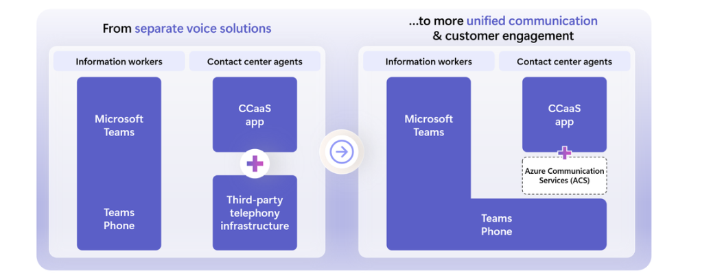
Miscellaneous Updates
General Availability of Teams Phone extensibility
MS announced the general availability of Teams Phone extensibility (TPE) powered by Azure Communication Services. This enables Contact Center as a Service (CCaaS) vendors to integrate seamlessly with Teams Phone, offering benefits such as consolidated telephony for Unified Communications as a Service (UCaaS) and Contact Center as a Service (CCaaS), conversational AI integration, extended UCaaS capabilities, agent notification handling, cost efficiency and broader geographic availability.
Key Features
Conversational AI Integration
Provisioning for Seamless Integration
Call Routing and Mid-Call Controls
Convenience Recording
On-Behalf-Of (OBO) Calling
Leverage Call Automation
Leverage Client SDK
Emergency Calling
Billing
Telemetry

Slide 31
Information

Slide 32
Information
Azure Times GitHub Repo

Slide 33
Questions

