Slide 1
Azure Times #186
December 1, 2025

Slide 2
Networking

Slide 3
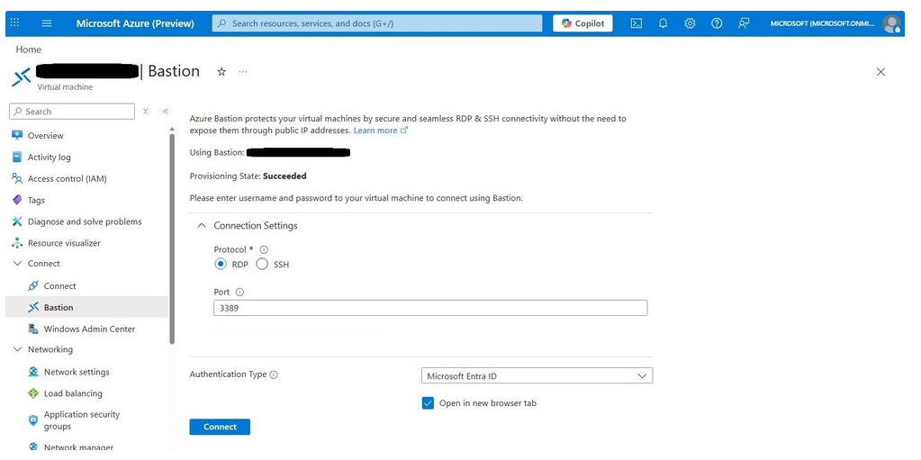
Networking Updates
Public Preview: Entra ID support for RDP connections
When Bastion users connect to Windows VMs through the portal, they authenticate using either a VM password or a password stored in Azure Key Vault. By leveraging Microsoft Entra ID, authentication becomes identity-based, eliminating the need for local credentials and reducing complexity. This approach provides a seamless, one-click sign-in experience, making it easier for users to access their Windows VMs without managing separate passwords. Beyond convenience, Entra ID strengthens organizational security by centralizing identity management and enforcing robust access controls. The result is a simplified, secure, and user-friendly way to connect to virtual machines while improving the overall security posture.
Prerequisites:
AADLoginForWindows extension should be enabled on the VM. Microsoft Entra ID Login can be enabled during VM creation by checking the box for Login with Microsoft Entra ID or by adding the AADLogin extension to a pre-existing VM.
One of the following required roles should be configured on the VM for the user:
  Virtual Machine Administrator Login: This role is necessary if you want to sign in with administrator privileges.
  Virtual Machine User Login: This role is necessary if you want to sign in with regular user privileges.

Slide 4
Networking Updates
Public Preview: Managed Identity support in Network Watcher VNET flow log, traffic analytics and packet capture
Azure Network Watcher now supports managed identities for VNET flow logs, Traffic Analytics, and packet capture—eliminating the need to manage credentials manually.
VNET Flow Logs capture IP traffic flowing through VNets, subnets, and NICs and store the data in Azure Storage for monitoring, troubleshooting, security, and compliance.
Traffic Analytics processes and enriches flow logs to deliver insights into network activity, performance, visualization, and security patterns.
Packet Capture enables capturing packets directly from virtual machines for deep diagnostics and network analysis.
With Microsoft Entra ID managed identities, these features can securely access Azure Blob Storage or Log Analytics workspaces without storing secrets. After assigning the required permissions, Network Watcher components automatically use the managed identity to request access tokens and interact with the target resources securely.

Slide 5
Security & Identity

Slide 6
Security & Identity Updates
Enhance protection of Microsoft Entra ID authentication by blocking external script injection
MS added a new Content Security Policy header to the Microsoft Entra sign-in experience to enhance security and harden against unauthorized script injection.
Only allow script downloads from Microsoft trusted CDN domains.
Only allow inline script execution from Microsoft trusted source.
Note that the updated Content Security Policy will only apply to browser-based sign-in experiences, only for URLs that start with login.microsoftonline.com.

Slide 7
Compute

Slide 8
Compute Updates
Announcing Public Preview of the latest Azure NCv6 GPU Virtual Machine Platform
The NCv6 series represents a generational leap in Azure’s visual compute portfolio, designed to be the dual engine for both Industrial Digitalization and cost-effective LLM inference.
By leveraging NVIDIA Multi-Instance GPU (MIG) capabilities, the NCv6 platform offers affordable sizing options similar to legacy NCv3 and NVv5 series. This provides a seamless upgrade path to Blackwell performance, enabling customers to run complex NVIDIA Omniverse simulations and multimodal AI agents with greater efficiency.
The Power of NVIDIA RTX PRO 6000 Blackwell Server Edition GPU
Host Performance: Intel Granite Rapids
Optimized Sizing for Every Workflow
Specification | Details
GPU | NVIDIA RTX PRO 6000 Blackwell Server Edition (96 GB GDDR7)
Processor | Intel Xeon Granite Rapids (up to 4.2 GHz Turbo)
vCPUs | 16 – 320 vCPUs (Scalable across GP, Compute, and Memory optimized sizes)
System Memory | 64 GB – 1,280 GB DDR5
Network | Up to 200,000 Mbps (200 Gbps) Azure Accelerated Networking
Storage | Up to 2TB local temp storage; Support for Premium SSD v2 & Ultra Disk

Slide 9
Compute Updates
Public Preview: Azure Logic Apps Connectors as MCP Tools in Microsoft Foundry
This unlocks a seamless way for developers to give agents secure, governed access to the systems they rely on—without writing boilerplate authentication code or managing API plumbing.
With this feature, agents can now use any Logic Apps connector—including SAP, ServiceNow, Dynamics, Salesforce, SQL, GitHub, and hundreds more—as a first-class MCP tool inside Foundry. This builds on our recent Public Preview of Logic Apps MCP Servers, which enable both connectors and workflows to be exposed as MCP tools.
Azure Local 22H2 Clusters: End of Service and Feature Degradation
Azure Local (formerly Azure Stack HCI) version 22H2 reached End of Service (EOS) on May 31, 2025. As communicated earlier, this means:
No further security updates or bug fixes will be provided.
CSS support is limited to upgrade assistance of the existing environment only.
Around February 23, 2026, Microsoft will begin degrading features on 22H2 clusters. These changes align with Microsoft’s Modern Lifecycle Policy, which requires customers to stay current with servicing and system requirements to maintain support. Under this policy, failure to upgrade can lead to significant degradation of product functionality, starting with:
Disabling ESU: Extended Security Updates will no longer be available.
Disabling WSS: Windows Server Subscription benefits will be removed.

Slide 10
Storage & Data

Slide 11
Storage & Data Updates
Generally Available: Azure File Sync in New Zealand North
Azure File Sync enables seamless tiering of data from on-premises Windows Servers to Azure Files for hybrid use cases and simplified migration. It also enables you to leverage the performance, flexibility and compatibility of your on-premises File Server while leveraging the scale and cost effectiveness of Azure Files.
The expansion into New Zealand North brings the service closer to organizations in these regions, offering lower latency, better performance, and support for local data residency requirements.

Slide 12
Databases

Slide 13
Databases Updates
Generally Available: Regex support in T-SQL
Azure SQL and SQL Server 2025 now support native regular expressions (regex) in T-SQL, enabling advanced pattern matching directly within queries. This enhancement simplifies code, improves maintainability, and removes the need for external processing or custom scripts—making complex data validation, extraction, and text processing easier and more efficient.
Generally Available: Azure MCP Server for Azure Database for MySQL
Azure MCP Server now integrates natively with Azure Database for MySQL, enabling AI agents and applications to interact with MySQL data through natural language using the Model Context Protocol (MCP).
With this capability, developers can ask questions like:
“Retrieve schema details for the customers table.”
“Show the last 7 days of failed orders.”
“Summarize anomalies by region.”
All interactions use Microsoft Entra authentication, removing the need for password management and providing enterprise-grade security.
By adding MySQL to the existing Azure MCP Server ecosystem—which already includes Azure AI Search, Azure Cosmos DB, Azure Storage, and more—organizations gain:
A unified interface for agentic, context-aware workflows
Simplified integration and reduced development overhead
Faster schema exploration and MySQL-driven insights
The ability to automate MySQL business logic directly from familiar tools

Slide 14
Integration

Slide 15
Integration Updates
Generally Available: Model Context Protocol support in Azure API Management and Azure API Centera
Announcing the public preview of Model Context Protocol (MCP) support in Azure API Management and Azure API Center. With this new capability, enterprises can transform their existing APIs into dynamic, agent-ready tools, while improving security and simplifying management.
Enhanced Security for MCP Servers:
  Apply gateway policies to protect MCP servers by enforcing authentication, authorization, rate limiting, and other security measures.
Transform Existing APIs into MCP Servers:
  Easily expose any APIM-managed API as an MCP server, transforming your existing APIs into dynamic, agent-ready tools with minimal effort.
Private MCP Registry for Enterprise Organizations:
  Use Azure API Center as a private remote MCP registry for your organization, giving you full control over what services are exposed.
Streamlined MCP Discovery and Consumption:
  Expose APIs as MCP servers in Azure API Center (APIC) for a better developer experience and smoother API consumption.

Slide 16
ML & AI & IOT

Slide 17
ML & AI & IOT Updates
Announcing AI Foundry Agent Service Connector v2 (Preview)
MS introduced major enhancements to the AI Foundry Agent Service connector for Azure Logic Apps, enabling seamless integration with the latest AI Foundry Agent API. These improvements provide secure, governed connectivity, accelerate deployment through low-code workflows, and scale reliably across global environments. With this update, enterprises can embed advanced AI directly into their business processes without custom code, reducing integration complexity and speeding time-to-value.
The new capabilities unlock several high-impact use cases:
Event-driven AI workflows — Leverage Logic Apps’ extensive connector library and triggers to subscribe to enterprise events and pass relevant content to a Foundry-hosted agent.
Intelligent email automation — Logic Apps can poll mailboxes for new messages that meet specified criteria, retrieve the message body and attachments, and hand them off to the Foundry agent for classification, summarization, routing, or other AI-driven actions.
Multi-agent, agentic business processes — Combine Logic Apps with Agent Loop and Foundry agents to build coordinated, multi-agent workflows where Logic Apps acts as both an orchestrator and participant in the broader agent ecosystem.
Public Preview: Claude Opus 4.5 Available in Microsoft Foundry
Claude Opus 4.5 is now available in public preview on Microsoft Foundry, delivering next-generation intelligence for advanced coding, agentic workflows, and enterprise productivity. This latest frontier-class model offers major improvements in reasoning, accuracy, and versatility—surpassing previous Claude releases while providing a more accessible price point.
Fully integrated with Foundry Models, Playground, and Agent Service, Opus 4.5 enables organizations to build and scale secure AI solutions across scenarios such as:
Software development and code generation
Enterprise analytics and financial modelling
Cybersecurity workflows and threat analysis
Complex, multi-step agentic automation
Running on Azure, the model benefits from enterprise-grade security, compliance, and reliability.
Pricing:
$5 per million input tokens
$25 per million output tokens
Regions: Available now in East US 2 and Sweden Central.

Slide 18
DevOps & IaC & Automation

Slide 19
DevOps & IaC & Automation
Generally Available: Azure Load Testing in Italy North
Azure Load Testing capability in Azure App Testing is now generally available in Italy North.
Customers can now use Azure Load Testing, a fully managed load-testing service to generate high scale load and run simulations, easily identify performance bottlenecks through a rich dashboard of client-side and server-side metrics, get AI powered actionable insights, and integrate load tests into their CI/CD workflows.
Customers can get started without any knowledge of load-testing tools, or use their existing Apache JMeter or Locust scripts.

Slide 20
Miscellaneous

Slide 21
Miscellaneous Updates
Architecting for resiliency on Azure Infrastructure – https://ignite.microsoft.com/en-US/sessions/BRK178?source=sessions.
Architect resilient apps with Azure backup and reliability features – https://ignite.microsoft.com/en-US/sessions/BRK148?source=sessions
Cloud Native Innovations with Mark Russinovich – https://ignite.microsoft.com/en-US/sessions/BRK431?source=sessions
Inside Azure Innovations with Mark Russinovich - https://www.youtube.com/watch?v=CmihM2eVtlQ
What’s new in Azure innovations - https://www.youtube.com/watch?v=mNKH7RfCbzg

Slide 22
Information

Slide 23
Information
Azure Times GitHub Repo

Slide 24
Questions

