Slide 1
Azure Times #193
February 16, 2026

Slide 2
Networking

Slide 3
Networking Updates
Public Preview: Azure Front Door Premium now supports Azure Private Link origins in UAE North
It is now possible to use UAE North as a region for Azure Private Link-enabled origins in the Azure Front Door Premium profile. Azure Private Link-enabled origins in Azure Front Door allow to deliver content to end-users through public Azure Front Door endpoints while ensuring that origins remain inaccessible to the public internet.
Public Preview: Application Gateway for Containers - AKS managed add-on
A public preview introduces a managed add-on for Azure Kubernetes Service that simplifies how teams deploy and operate Application Gateway for Containers and its ALB Controller.
With the add-on, organizations can enable the gateway using a single command through Azure CLI, ARM, or Bicep, whether the cluster is new or already running. Installation and lifecycle management of the controller are handled automatically, removing the need to maintain Helm charts or perform manual upgrades.
The solution also uses managed identity with least-privilege access, improving the security posture while reducing configuration effort. For environments using AKS-managed virtual networking, connectivity is streamlined, making the onboarding process faster and more predictable.
In addition, the add-on works together with AKS’ managed Gateway API integration, so Gateway API custom resources can be managed consistently inside the cluster

Slide 4
Security & Identity

Slide 5
Security & Identity Updates
Sentinel: Microsoft 365 Copilot data connector (public preview)
The Microsoft Sentinel connector for Microsoft 365 Copilot delivers direct visibility into Copilot usage, audit activity, and user behavior across the organization.
Once onboarded, security teams can immediately use this telemetry to power detections, analytics rules, hunting queries, automation, and investigations. It becomes much easier to identify anomalies, potential misuse, or violations of internal AI usage policies without building custom pipelines.
Organizations can also route this data into the Sentinel data lake to support advanced scenarios such as long-term analytics, relationship mapping, or integrations with MCP-based workflows. This approach provides both cost-efficient ingestion and flexible retention while preserving the depth of insight required by modern SOC operations.
Sentinel: Find high-risk anomalous behavior faster with an enhanced UEBA essentials solution (public preview)
The Microsoft Sentinel UEBA Essentials solution helps SOC teams detect high-risk anomalous behavior faster across hybrid and multi-cloud environments, including Amazon Web Services, Google Cloud, and Okta.
With expanded anomaly coverage and new queries powered by the anomalies table, analysts can rapidly surface the most suspicious activity, build accurate behavioral baselines, and understand what is truly abnormal without chasing fragmented signals. Activity is mapped to MITRE ATT&CK techniques, complex malicious IP patterns are highlighted, and a rich anomaly profile for each user can be generated in seconds. The result is better signal quality and significantly reduced investigation time.
UEBA Essentials is available through the Sentinel Content Hub and includes more than 30 prebuilt queries that can be deployed immediately. Behavior analytics can also activate automatically as new connectors are onboarded, helping teams translate new data sources into actionable detections with minimal effort.

Slide 6
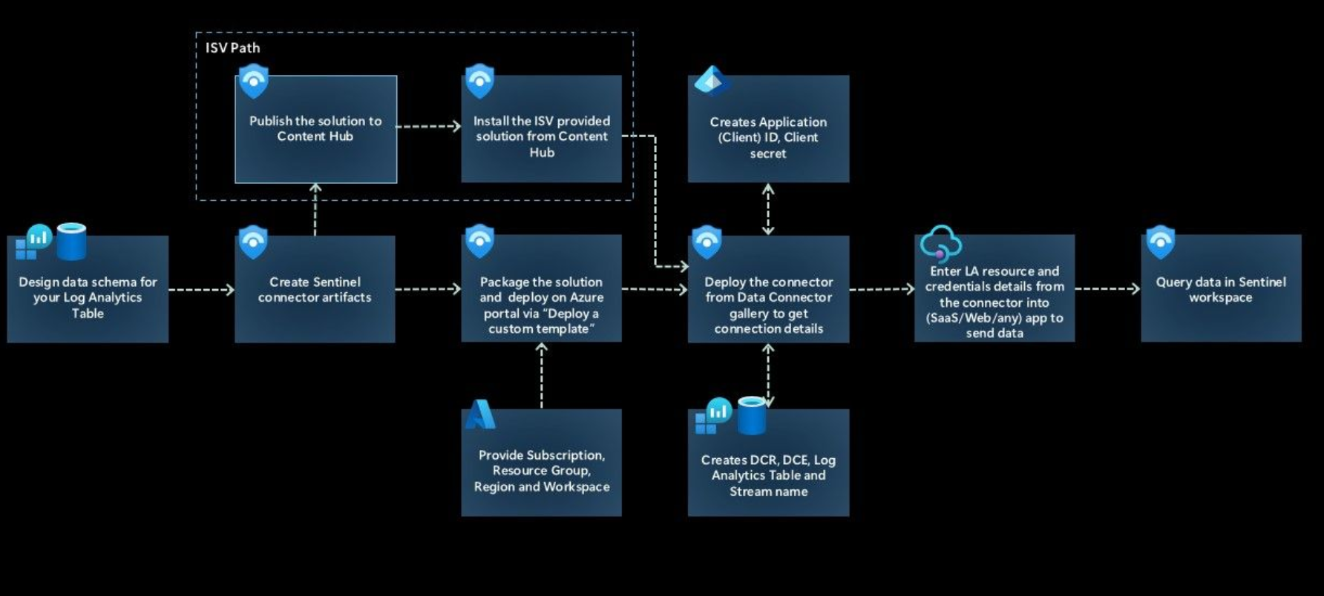
Security & Identity Updates
Public Preview Announcement: Empower Real-Time Security with Microsoft Sentinel’s CCF Push Feature
Microsoft has introduced the CCF Push capability in public preview, designed to make it dramatically easier to stream security data into Sentinel in real time.
Most connectors today rely on polling partner APIs at intervals. With push, partners and customers can send events directly to a Sentinel workspace the moment they occur. Faster ingestion means faster detection and response.
What changes with CCF Push
Previously, publishing a connector meant preparing multiple building blocks such as:
Data Collection Endpoints
Data Collection Rules
Entra app registrations
Secrets and RBAC assignments
Now, selecting Deploy automates this setup. Sentinel provisions the required resources behind the scenes, removing heavy prerequisites and reducing onboarding effort.

Slide 7
Security & Identity Updates
Sentinel: Seamlessly onboard security data with growing out-of-the-box connectors (general availability)
Microsoft Sentinel continues to broaden its integration landscape, helping SOC teams centralize security data across cloud, SaaS, and on-premises environments. With faster onboarding and richer normalization, analysts gain better correlation, improved detections, and stronger investigative context across the entire estate.
Newly available out-of-the-box connectors
Mimecast – Audit Logs
CrowdStrike – Falcon Endpoint Protection
Vectra AI – XDR
Palo Alto Networks – Cloud NGFW
SOC Prime
Proofpoint – Proofpoint on Demand (POD)
Pathlock
MongoDB
General Availability: IP Network Firewalls for Azure Managed HSM
IP Firewall for Managed HSM is now generally available across all public regions. Organizations can restrict access to the HSM data plane by allowlisting specific IPv4 addresses or CIDR ranges—ideal for services that use static or well-known IPs.
Up to 10 CIDR ranges can be configured. The rules apply only to data plane operations; control plane actions aren’t affected. Access through tools such as the Azure portal must originate from within the trusted boundary defined by your network rules.
This release helps teams strengthen network isolation while keeping deployment and governance simple. If you’re designing high-security crypto or key-management architectures, this gives you another strong layer of defense without changing how the service is operated.

Slide 8
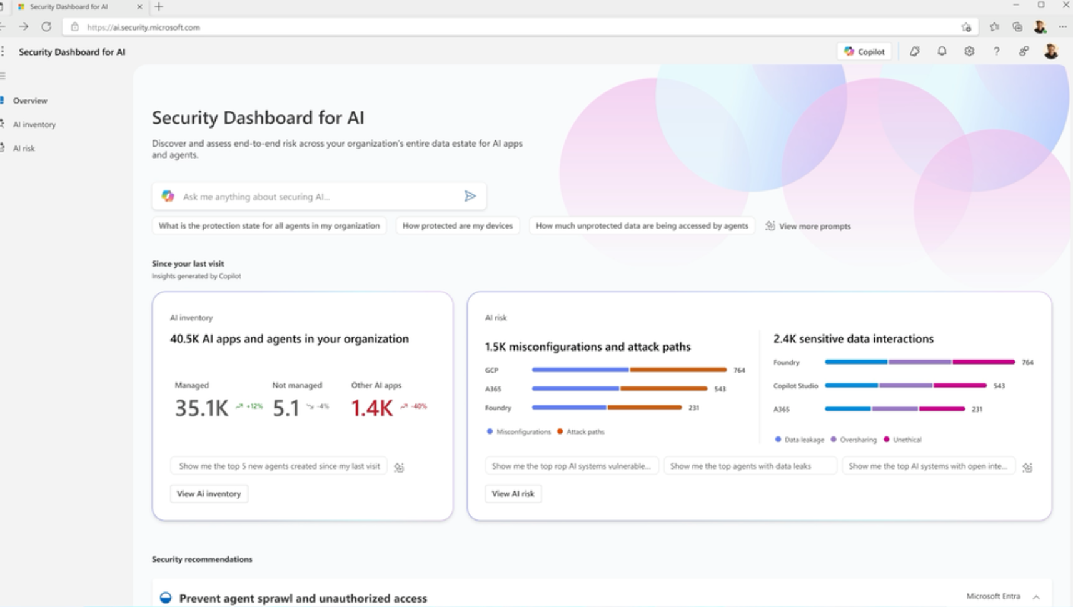
Security & Identity Updates
Introducing Security Dashboard for AI (Now in Public Preview)
Microsoft has introduced the Security Dashboard for AI, now in public preview, a unified security console designed to help organizations understand and manage AI-related risk across their environments. The dashboard aggregates real-time signals from multiple Microsoft security products—including Microsoft Entra, Microsoft Defender, and Microsoft Purview—into a single pane of glass to give security leaders clear visibility into AI posture and threats. It provides a comprehensive inventory of AI assets (including Copilot, AI agents, and third-party models), highlights security gaps, and offers prioritized recommendations and remediation paths. Integrated with AI-powered insights and reporting tools, the dashboard enables teams to investigate risk, monitor compliance, and collaborate more effectively on AI governance and protection efforts.

Slide 9
Management & Governance

Slide 10
Management & Governance Updates
Release Announcement of SQL Server Migration Assistant (SSMA) v10.5
Advancing AI-assisted modernization with Sybase Copilot, enhanced Oracle conversions, and improved Azure SQL MI reliability - The release expands AI-assisted code conversion, improves overall translation accuracy, and enhances reliability based on lessons learned from large, real-world migration programs. These updates help reduce manual remediation, lower project risk, and accelerate timelines.
Introducing AI‑assisted Code Conversion with Microsoft Copilot in SSMA for SAP ASE - Copilot helps translate complex Sybase T-SQL objects—procedures, functions, triggers, and more—into code compatible with SQL Server and Azure SQL, dramatically reducing manual fixes.
Improved Code Conversion Quality for Oracle with Support for Larger Source Scripts - The engine now supports much larger source scripts, with 2× more input tokens and significantly higher output limits for clearer, more complete explanations. This means complex PL/SQL packages can be converted in one go, with greater reliability and fewer retries.
Improved Reliability of Oracle PL/SQL Conversions on Azure SQL Managed Instance - The release updates the SSMA extension components that emulate Oracle compatibility behaviors, including patterns such as autonomous transactions. Connection handling has been improved to better align with modern security and encryption defaults in the target platform.

Slide 11
Management & Governance Updates
Azure Arc Jumpstart Template for Hybrid Logic Apps Deployment
A new Jumpstart Drop delivers a single-command deployment to stand up a full hybrid Logic Apps environment on an Arc-enabled AKS cluster. It’s built for teams that want to quickly test or validate hybrid integration scenarios without spending days wiring the platform together.
Hybrid Logic Apps let you run workflows on your own infrastructure—on-prem, private cloud, or another public cloud—while still using Azure for governance and management. The trade-off is complexity. This template removes most of it.
What the template deploys automatically
The script provisions the core building blocks and validates them step by step:
AKS cluster as the Kubernetes runtime
Arc onboarding for centralized control
Azure Container Apps extension, custom location, connected environment
Azure SQL for runtime/state storage
Azure Storage for SMB artifacts
Hybrid Logic Apps resource

Slide 12
Compute

Slide 13
Compute Updates
Generally Available: Azure Databricks Supervisor Agent
A new capability called Supervisor Agent is now generally available in Azure Databricks as part of the Agent Bricks platform.
It introduces a dynamic supervision pattern that interprets the intended outcome of a task and coordinates the best execution path in real time.
With Supervisor Agent, teams can bring together previously isolated, single-purpose agents into a coordinated system that works as one. This helps improve efficiency, reliability, and overall workflow performance, while governance and security are maintained through Unity Catalog.
Designed for production use, the capability supports organizations that want to scale agent-driven automation with stronger control, visibility, and operational consistency.
Generally Available: AKS support for Kubernetes version 1.34
Kubernetes version 1.34 is now generally available for AKS. The release brings 58 upstream enhancements, including 23 Stable, 22 Beta, and 13 Alpha features.
For platform and operations teams, this means stronger maturity for production workloads, early access to upcoming innovations, and clearer upgrade planning. Stable features can be adopted with confidence, Beta capabilities can be evaluated for near-term adoption, and Alpha items give visibility into where the ecosystem is heading.
Overall, Kubernetes 1.34 helps organizations modernize cluster operations, unlock new functionality, and maintain a predictable, well-governed lifecycle across environments.

Slide 14
Compute Updates
Windows 365 now supported in New Zealand North
Windows 365 is now available in the New Zealand North region, extending Microsoft’s Cloud PC footprint closer to customers in New Zealand and the surrounding region. This expansion delivers lower latency, improved performance, and local data residency, helping organizations meet compliance, sovereignty, and user-experience requirements.
With this addition, Microsoft strengthens its global Windows 365 coverage and supports organizations looking to modernize end-user computing with secure, flexible, cloud-based desktops—without relying on physical hardware—while keeping data within national borders.
Announcing Application Insights SDK 3.x for .NET
The latest Application Insights SDK significantly simplifies modernization. Previously, moving from the classic SDK to the Azure Monitor OpenTelemetry Distro required reinstalling components and updating code. Now, most teams can migrate just by upgrading the SDK version.
A built-in mapping layer automatically translates existing Track* API calls into OpenTelemetry signals behind the scenes, so current instrumentation keeps working while you transition.
It Provides:
Vendor-neutral telemetry going forward - You can start writing new instrumentation using OpenTelemetry APIs immediately, aligning with industry standards and improving long-term portability.
Access to the wider ecosystem - Community libraries and integrations become plug-and-play. Scenarios that were previously difficult—like collecting Redis dependency telemetry—are much easier.
Multiple export destinations - Send data to Azure Monitor and to other platforms (for example, SIEM or analytics backends) at the same time.

Slide 15
Compute Updates
DCasv6 and ECasv6 confidential VMs in Azure Government Cloud
The DCasv6 and ECasv6-series virtual machines built on 4th Generation AMD EPYC™ processors are the first in Azure Government to implement AMD SEV-SNP. This generation introduces several controls that change both security posture and operational readiness:
Hardware-Enforced Memory Isolation: AMD SEV-SNP provides full, AES-128 encrypted memory with keys generated and managed by the onboard AMD Secure Processor.
Online key rotation: Support for the online key rotation with the introduction of Virtual Machine Metablob disk (VMMD).
Programmatic Attestation for Audit and Zero-Trust: Before provisioning any workload, customers can perform an attestation. This cryptographic procedure validates the integrity of the hardware and software, producing a signed report that proves the VM is a genuine confidential instance.
Confidential OS Disk Encryption with Flexible Key Management: Cryptographic protection extends beyond runtime memory to the operating system disk itself. The disk's encryption keys are bound to the VM's virtual Trusted Platform Module (vTPM), which is protected within the TEE.

Slide 16
Databases

Slide 17
Databases Updates
Public Preview: Azure SQL updates for mid-February 2026
Several improvements landed to make development, migration, and resiliency easier for teams working with Azure SQL.
Visual Studio Code experience gets better.
A new SQL Projects Publish dialog simplifies deployments, reducing friction when pushing schema and database changes from local environments into Azure.
Move from Azure Data Studio smoothly.
The Connections Migration dialog helps import existing workflows and connection settings into VS Code, so teams can transition tools without rebuilding everything from scratch.
Stronger disaster recovery design.
Failover groups now support up to four secondary replicas instead of just one. This enables more advanced multi-region topologies, additional read scale, and greater flexibility when planning resilience and regional coverage.

Slide 18
Information

Slide 19
Information
Azure Times GitHub Repo

Slide 20
Questions

