Slide 1
Azure Times #209
June 8, 2026

Slide 2
Security & Identity

Slide 3
Microsoft Defender for Cloud
Public Preview: Microsoft Defender for Cloud support for Azure Container Apps (Serverless Containers Posture)
Microsoft Defender for Cloud now supports Azure Container Apps within its Serverless Containers Posture Management experience, providing security teams with centralized visibility and governance across their serverless container environments. Organizations can now assess Container Apps resources for security risks related to identity, networking, container configuration, and container image security from a single security management workflow.
The integration enables consistent security posture assessment across container platforms and leverages attack path analysis to identify potential exposure and security weaknesses more quickly. By bringing Azure Container Apps into the broader Defender for Cloud posture management framework, organizations gain improved visibility, reduced operational effort, and stronger governance for business-critical containerized applications.
This enhancement helps security teams apply a unified security strategy across Kubernetes, serverless containers, and Azure-native container services while improving compliance and reducing risk.
SQL Vulnerability Assessment Express Configuration now available for Azure SQL Managed Instance and Synapse (Preview)
SQL Vulnerability Assessment (VA) Express Configuration is now available in preview for Azure SQL Managed Instance and Azure Synapse Analytics Workspaces. This Microsoft-managed storage tool for vulnerability baselines and scan results extends the same experience already available for Azure SQL Database at no extra cost.
With this release, customers using Azure SQL Managed Instances or Synapse Workspaces can now enable SQL VA without configuring a customer-managed storage account. Express Configuration is the recommended enablement mode and provides the same security value as Classic Configuration (customer-managed storage), with a simplified setup experience.

Slide 4
Microsoft Defender for Cloud
Scanning support for Docker Hardened container images (preview)
Microsoft Defender for Cloud's vulnerability scanner, powered by Microsoft Defender Vulnerability Management, is extending its scanning coverage to Docker Hardened container images, and identify vulnerabilities in Docker Images to validate that they're shipping the most secure builds possible. As additional image types are being scanned, your bill might increase. The rollout of this change will occur gradually over several weeks and requires no user action.
Malware detection for EKS and GKE nodes (Preview)
Malware detection is now in preview for Amazon Elastic Kubernetes Service (EKS) nodes and Google Kubernetes Engine (GKE) nodes.
This update expands Kubernetes node malware coverage beyond Azure Kubernetes Service (AKS) so you can detect malware in more multicloud environments.

Slide 5
Microsoft Defender for Cloud
Generally Available: Microsoft Defender for open source relational databases on AWS RDS
Defender for open-source relational databases now provides GA support for security capabilities designed for enterprise cloud environments, including:
Amazon Aurora for PostgreSQL
Amazon Aurora for MySQL
Amazon RDS for PostgreSQL
Amazon RDS for MySQL
Amazon RDS for MariaDB
Update to Defender for SQL servers on machines plan for Fairfax customers
The Defender for SQL Server on machines plan in Microsoft Defender for Cloud protects SQL Server instances hosted on Azure, AWS, GCP, and on-premises machines.
To simplify onboarding and improve protection coverage, MS is releasing an enhanced agent solution for Fairfax customers at the end of April. The new solution uses the existing SQL infrastructure, so you no longer need to deploy the Azure Monitor Agent (AMA).

Slide 6
Microsoft Defender for Cloud
General availability of container security capabilities in Azure Government cloud
The service helps U.S. federal and government agencies, including the Department of Defense (DoD) and civilian agencies, secure Kubernetes workloads by providing cloud security posture management, vulnerability assessment, and runtime threat protection for containerized environments.
The Defender for Containers plan in Azure Government cloud now aligns with the commercial cloud offering in feature coverage, including agentless Kubernetes discovery, comprehensive inventory, attack path analysis, enhanced risk hunting, vulnerability assessment, compliance and runtime protection capabilities.
General availability of Defender for Storage integration in Azure portal Storage Center
This integration brings Defender for Storage insights directly into the native storage management experience. This approach makes it easier for customers to understand and improve their storage security posture at scale.
Customers can now view Defender for Storage threat protection and security posture coverage directly in Storage Center, next to their storage resources.
Storage Center provides a centralized, storage-native view of Defender for Storage protection status. This view helps customers quickly understand:
Which storage accounts are protected, partly protected, or not protected
Where malware scanning, activity monitoring, and sensitive data discovery are enabled
Where security gaps exist across Azure Blob Storage and Azure Files storage

Slide 7
Microsoft Defender for Cloud
DNS Detection for Kubernetes is now generally available
DNS Detection for Kubernetes is now generally available in Defender for Containers for Azure Kubernetes Service (AKS), Amazon Elastic Kubernetes Service (EKS), and Google Kubernetes Engine (GKE).
DNS Detection monitors DNS queries from containerized workloads to detect suspicious activity such as communication with malicious domains and DNS tunneling. The feature requires the Defender sensor deployed via Helm.
Anti-malware detection and blocking is now generally available
Container runtime anti-malware detection and blocking is now generally available in Defender for Containers for Azure Kubernetes Service (AKS), Amazon Elastic Kubernetes Service (EKS), and Google Kubernetes Engine (GKE).
Anti-malware detection and blocking detect and block malware when a container runs an executable that the system identifies as malicious software. You can define anti-malware policies that set conditions for alerts and blocking to distinguish legitimate activity from potential threats.

Slide 8
Microsoft Defender for Cloud
Defender for Containers runtime protection on EKS Bottlerocket is now generally available
Defender for Containers runtime protection now supports AWS Bottlerocket operating systems on Amazon Elastic Kubernetes Service (EKS) in general availability.
General availability of Microsoft Defender for Cloud and GitHub Advanced Security integration
The native integration between Microsoft Defender for Cloud and GitHub Advanced Security (GHAS) is now generally available. This integration connects runtime security signals from Defender for Cloud with code-level vulnerability management in GHAS, enabling developers and security teams to prioritize and remediate vulnerabilities based on actual production risk.

Slide 9
Microsoft Defender for Cloud
General availability of Defender for Cloud integration into the Defender portal
Microsoft Defender for Cloud is now integrated into the Microsoft Defender portal, unifying cloud security posture management and threat protection in a single experience. This integration provides a centralized view across hybrid and multicloud environments, including Azure, Amazon Web Services (AWS), and Google Cloud Platform (GCP).
Daily score calculation enhancement for risk-based Cloud secure score
MS improved how daily Cloud secure score values are calculated to more accurately reflect posture and the impact of actions taken throughout the day.
Daily scores represent end-of-day snapshots instead of averaged values over the course of the day, providing a more consistent and precise view of the score at each point in time. This helps you better understand score changes and correlate them with changes introduced during the day.
Historical values have been recalculated to align with this definition, so you may notice slight differences when comparing trends across this period.

Slide 10
Microsoft Defender for Cloud
General availability of on-demand malware scanning of Azure Files in Microsoft Defender for Storage
On-demand malware scanning of Azure Files in Microsoft Defender for Storage is now generally available.
This feature extends on-demand malware scanning so you can scan Azure Storage accounts that contain blobs and files
Public Preview - Automate setting or clearing user attributes values in Lifecycle workflows
MS introduced the User Attribute Updates task in Lifecycle Workflows, extending existing attribute change trigger capabilities with a built-in, customer-ready way to automate attribute updates (set or clear values) directly within a workflow. With a secure, consistent, and auditable experience, organizations can reduce manual effort, improve governance, and scale identity automation with greater confidence.

Slide 11
MS Entra ID Updates
Public Preview - Enable soft-delete for Microsoft Entra Device objects
Device Soft Delete, now available in preview, enables administrators to safely remove device objects by moving them to a recoverable state instead of permanently deleting them. This feature allows organizations to restore devices within a defined retention period while preserving critical data such as device identity and associated security artifacts.
Public Preview - Sensitivity labels for Microsoft Entra security groups
Microsoft Entra ID now supports applying Microsoft Purview sensitivity labels to Entra cloud security groups in public preview.
Administrators can use labels to govern security group settings such as guest access using the same labels and policies that apply to Microsoft 365 groups today.
Labels can be managed in Microsoft Purview and applied through the Microsoft Entra Admin Center, Azure portal, and Microsoft Graph.

Slide 12
MS Entra ID Updates
General Availability - Manage Agent ID sponsorship lifecycle with Lifecycle Workflows
One of the most important parts of governing agent identities is making sure that a delegated human user is always assigned to make sure the agent identity's access to resources are current. If the sponsor is leaving the organization, sponsorship of the agent identities is automatically transferred to their manager. With sponsorship transferred, there's always a human user accountable for managing the access and lifecycle of the agent identities. Microsoft Entra ID Governance features can help streamline this process within your organization. Lifecycle workflows include multiple tasks around notifying cosponsors, and managers of sponsors, of impending sponsorship changes.
Expanded policy storage for passkeys (FIDO2) in Microsoft Entra ID
MS increased the passkey (FIDO2) policy size limit in the authentication methods policy to a dedicated 20-KB allocation.
Previously, all authentication methods shared a single 20-KB policy size limit. With this update, a dedicated 20-KB limit is now allocated specifically to the passkey (FIDO2) policy, while the remaining authentication methods continue to use their existing limit.
This change helps address scenarios where tenants approach the overall policy size limit, which can block configuration of passkey profiles. By separating passkey policy storage, organizations can more easily adopt passkeys and configure advanced targeting scenarios.
In addition, the maximum number of passkey profiles per tenant has been increased from 3 to 10.

Slide 13
MS Entra ID Updates
General Availability - High Scale Compatibility (HSC) mode for Microsoft Entra External ID
High Scale Compatibility (HSC) mode enables organizations to migrate to Microsoft Entra External ID while preserving their existing user directory. It's designed for large, established customer identity platforms transitioning from Azure AD B2C.
With HSC mode, customers can rebuild applications on External ID while maintaining continuity for existing users, supporting a seamless, phased migration at scale. Some advanced customization capabilities are limited in this mode and will continue to evolve
General Availability - System-preferred authentication expanded to first-factor in Microsoft Entra ID
MS is extending system-preferred authentication to apply to the first factor in Microsoft-managed configurations (in addition to the second factor). With this change, the system evaluates the credentials registered for a user and selects the highest-ranked authentication method for each step of the sign-in flow.
As a result, users with strong, phishing-resistant credentials (such as passkeys) might be signed in without needing to use a password, improving both security and user experience.
This behavior applies only to the Microsoft-managed state, where system-preferred authentication now covers both first- and second-factor authentication. The rollout is currently in progress and will be fully deployed to all Microsoft-managed tenants by the end of June.

Slide 14
MS Entra ID Updates
General Availability - Support for passkeys in Microsoft Entra ID registration campaign
Microsoft Registration Campaigns now supports Passkeys (FIDO2) as an authentication method. Administrators can configure registration campaigns to nudge users to register passkeys during sign-in, helping organizations drive passkey adoption at scale. This first rollout experience is optimized for users who are in a passkey profile that doesn't have any restrictions.
General Availability - Modernized My Account pages
MS announced the upcoming general availability of three redesigned pages in the My Account portal (myaccount.microsoft.com), bringing a modernized experience to help end users manage their account with greater ease and clarity.
The redesigned Devices page features a modernized layout that makes it easier for users to view and manage their registered devices. BitLocker recovery keys are now more prominently surfaced, reducing the need to contact IT helpdesk for key retrieval.
The new Personal Info page gives users a centralized view of their profile information alongside language and region settings - making it simple to review and update personal details in one place.
The redesigned Organizations page delivers a modernized experience and resolves a longstanding issue where users were unable to successfully leave an organization.

Slide 15
MS Entra ID Updates
General Availability - Cross tenant group synchronization
Cross-tenant group synchronization allows organizations to synchronize security groups across Microsoft Entra tenants. This feature enables centralized management of group membership in a source tenant while making those groups available in one or more target tenants, simplifying cross-tenant collaboration and reducing administrative overhead associated with managing duplicate groups.
With cross-tenant group synchronization, organizations can extend their existing cross-tenant synchronization configurations to include groups, supporting scenarios such as shared application access, resource authorization, and consistent group-based access control across tenants. Admins can opt in to this functionality and configure attribute mappings and cross-tenant access policies to enable group synchronization into target tenants. Use of cross-tenant group synchronization requires Microsoft Entra ID Governance licenses. Existing licensing requirements for cross tenant user synchronization features remains
General Availability - Account Discovery
Account discovery for connected applications is now generally available in Microsoft Entra ID Governance. This capability provides administrators with visibility into all accounts that exist within connected applications, including orphan accounts.
By generating discovery reports directly from the provisioning experience, organizations can identify accounts in connected applications that aren't assigned to the enterprise application in Microsoft Entra and simplify onboarding the application.

Slide 16
Management & Governance

Slide 17
Management & Governance Updates
Public Preview: Ingestion Volume Change dashboard in Metrics Usage Insights
Metrics Usage Insights now includes an Ingestion Volume Change dashboard to help you compare ingestion volume over time. Quickly detect spikes or drops in time series counts and event ingestion rates, enabling faster investigation of cost changes and more effective capacity planning.
Public Preview: Azure Infrastructure Resiliency Manager
Azure Infrastructure Resiliency Manager is now in public preview, offering a unified, goal-driven experience to design, assess, and improve application resiliency across Azure. It brings together capabilities across Availability Zones, Azure Advisor, Chaos Studio, Azure Monitor, and Copilot into a single workflow for end-to-end resilience. With AI guidance, actionable recommendations, and built-in drills, organizations can proactively build, improve, and validate resiliency end to end.

Slide 18
Management & Governance Updates
Announcing Confidential Live Migration in Azure
Confidential Live Migration is now available for Azure Confidential Computing, enabling Azure to move running Confidential Virtual Machines (CVMs) between physical hosts without requiring a reboot or application downtime. Previously, maintenance events often required VM restarts, impacting workload availability and operational continuity. With live migration, Azure can perform planned infrastructure maintenance while preserving workload execution and maintaining the security guarantees provided by confidential computing. The migration process protects encrypted memory and sensitive data throughout the move, ensuring that trusted execution environment (TEE) protections remain intact. This capability improves availability for mission-critical and regulated workloads that rely on Confidential VMs for processing sensitive data. By combining hardware-backed security with improved operational resilience, Azure makes confidential computing more practical for enterprise production environments.
Protect Azure Cosmos DB with vaulted backups using Azure Backup (public preview)
Azure Backup now supports vaulted backups for Azure Cosmos DB in public preview, providing an additional layer of protection against accidental deletion, corruption, ransomware, and other data loss scenarios. Unlike standard operational backups stored within the Cosmos DB service boundary, vaulted backups are stored in a dedicated Recovery Services Vault, improving data isolation and resilience.
This capability enables organizations to retain Cosmos DB backups independently of the source database lifecycle, supporting stronger disaster recovery, compliance, and long-term retention requirements. Security teams benefit from enhanced protection against malicious deletion or compromise of production resources, while backup administrators gain centralized backup governance through Azure Backup.
By integrating Cosmos DB with Azure Backup, organizations can apply consistent backup policies across Azure services, improve recoverability of critical NoSQL workloads, and strengthen overall business continuity and cyber-resilience strategies.

Slide 19
Management & Governance Updates
Generally Available: Simple log alerts in Azure Monitor
MS announced the General Availability of Simple log alerts in Azure Monitor, available starting today. This feature is designed to provide a simplified and more intuitive experience for monitoring and alerting, enhancing your ability to detect and respond to problems in near real-time. Unlike Log Search Alerts that aggregate rows over a defined period, Simple Log Alerts evaluate each row individually.
Generally Available: Azure Monitor Service Level Indicators (SLI)
Azure Monitor now includes Service Level Indicators (SLIs) and Service Level Objectives (SLOs), giving teams a clearer way to measure how customers actually experience their applications. Instead of relying only on infrastructure signals like CPU or isolated alerts, SLIs help determine whether an issue is truly affecting users. This shifts the focus from simply asking whether an app is up to understanding whether it is fast, reliable, and meeting expectations.

Slide 20
Management & Governance Updates
Generally Available: Ingest OTLP signals into Azure Monitor with the OpenTelemetry Collector
Azure Monitor's support for native ingestion of OpenTelemetry Protocol (OTLP) signals is now generally available. This enables sending telemetry data directly from OpenTelemetry-instrumented applications and platforms to Azure Monitor.
It is possible to configure OpenTelemetry Collector to send data directly to Azure Monitor cloud ingestion endpoints to ingest OTLP metrics, logs and traces using Microsoft Entra for authentication.
Ingested OTLP metrics are stored in Azure Monitor Workspaces and can be queried and alerted upon with Prometheus query language (PromQL). OTLP logs and traces are stored in Log Analytics workspaces using new OpenTelemetry tables and semantics.
Generally Available: OpenTelemetry Metrics, Visualizations, and Enhanced Monitoring in Azure Monitor for Azure VMs and Arc Servers
OpenTelemetry metrics and visualizations in Azure Monitor are generally available, delivering an enhanced, unified monitoring experience for Azure Virtual Machines and Arc Servers. This release consolidates key monitoring capabilities into a single experience and introduces a simplified onboarding experience, helping customers more efficiently observe, diagnose, and optimize their environments.
Previously, VM monitoring visualizations were powered by metric data from Log Analytics which continues to be fully supported. Customers now also have the option to power these visualizations using OpenTelemetry (OTel) Gues OS metrics, offering a more cost-efficient and performant solution.

Slide 21
Management & Governance Updates
Generally Available: Additional support for OpenTelemetry destinations (New Relic, Dynatrace, Elastic)
Azure Container Apps enhances its OpenTelemetry (OTel) capabilities by expanding support for third-party observability platforms. This update introduces additional endpoint options for commonly used monitoring tools such as New Relic, Dynatrace, and Elastic, extending the existing managed OpenTelemetry experience with simpler setup for additional third-party observability platforms.
This update makes it easier to send logs, metrics, and traces to more destinations without deploying or managing your own agents. Teams can now use a more consistent OpenTelemetry-based pipeline across Azure Monitor, Datadog, New Relic, Dynatrace, Elastic, and OTLP-compatible endpoints, with less configuration overhead and more flexibility to route telemetry where they need it, including support for OTLP/HTTP endpoints, enabling integration with any OpenTelemetry-compatible backend.
Generally Available: Dynamic threshold for Log search alerts
Dynamic Thresholds for Azure Monitor Log Search Alerts are now generally available, enabling organizations to create smarter alerts without manually defining static threshold values. The feature uses machine learning to analyze historical log query results, automatically calculate appropriate alert thresholds, and continuously adapt as data patterns change.
Key Benefits
No Manual Threshold Tuning
Machine Learning-Based Detection
Seasonality Awareness
Automatic Adaptation
Multi-Dimensional Monitoring

Slide 22
Management & Governance Updates
Generally Available: Azure Files assessments are now available worldwide using Azure Migrate
Azure Migrate now generally supports discovery and assessment of SMB and NFS file shares hosted on Windows and Linux servers, helping organizations plan migrations to Azure Files with greater accuracy and confidence.
Key Benefits
Automated File Share Discovery
Migration Planning and Assessment
Cost and Business Case Analysis
Azure Files Sizing Recommendations
Alternative Migration Paths

Slide 23
Compute

Slide 24
Compute Updates
Public Preview: Go language support on Azure Functions
Azure Functions now supports Go as a first-class language option in public preview. With this release, developers can author event-driven serverless apps in Go using the Azure Functions Go programming model and SDK, while still benefiting from Azure Functions capabilities such as triggers, bindings, and integrated observability.
Go support helps teams that standardize on Go deliver cloud-native APIs, automation, and integration workloads without introducing a second language stack. Developers can use familiar Go tooling and patterns while building Functions that respond to HTTP requests, scheduled events, messaging systems, and storage events.
In preview, Go language is supported on the Azure Functions Flex Consumption plan. This enables rapid scaling, pay-per-use economics, and streamlined deployment for Go workloads on Azure.
Public Preview: Azure Functions now includes managed connectors to integrate with 1400+ of your favorite systems
Azure Functions now includes managed connectors - the same 1,400+ connector ecosystem behind Logic Apps and Power Platform - as first-class triggers and operations. This enables customers to build integrated systems across the broader ecosystem such as Office 365, Teams, SharePoint, Salesforce, and other SaaS services, using familiar Functions workflows.
With connectors natively available, developers can build event-driven integrations without custom polling logic or manual SDK integration, simplifying development and reducing integration friction.
This feature eliminates the need to build custom integration logic, enabling direct connections to services like Microsoft 365, Salesforce, ServiceNow, SAP, Dynamics, and 1400+ other systems.

Slide 25
Compute Updates
Public Preview: Serverless agents runtime for Azure Functions
Azure Functions now supports AI agents as a first-class workload, introducing a markdown-first programming model that allows developers to build event-driven serverless agents using natural language instead of complex framework code. The new Serverless Agents Runtime enables agents to respond to conversations, process business events, and perform actions across enterprise systems while leveraging the familiar Azure Functions ecosystem.
Developers can trigger agents using any Azure Functions trigger, including HTTP, Timer, Service Bus, Event Hub, Event Grid, Cosmos DB, Storage, and connector-based triggers such as Teams messages, Outlook emails, and calendar events. Agents can also consume MCP servers, invoke enterprise connectors as tools, perform browser automation, execute sandboxed code in Azure Container Apps Dynamic Sessions, and optionally expose built-in chat interfaces, APIs, and MCP endpoints without additional development effort.
Running on the Azure Functions Flex Consumption Plan, the solution benefits from s
Preview: Azure Cobalt 200 Arm-based Dpsv7, Dplsv7, Epsv7, Mpsv4, and Lpsv5-series Virtual Machines
The general purpose Dpsv7 and Dplsv7, memory-optimized Epsv7, high-memory Mpsv4, and dense storage Lpsv5 VMs are now available in preview. These virtual machines deliver significant enhancements over the previous generation Cobalt 100 VMs, offering improved CPU performance, greater scalability, and expanded configuration options to meet the demands of a wide range of workloads. Key improvements include:
Up to 50% improvement in CPU performance (workload dependent)
20% improvement in remote storage IOPS with NVMe
10% better remote storage throughput with NVMe
15% improvement in network bandwidth

Slide 26
Compute Updates
Public Preview: Azure Logic Apps Automation SKU for agentic business process automation.
Azure Logic Apps Automation SKU introduces a unified platform for agentic business process automation, allowing developers to orchestrate Logic Apps workflows, APIs, and Microsoft Foundry Hosted Agents together. The new SKU simplifies the creation of AI-driven business processes by providing built-in support for agent invocation, evaluation, guardrails, observability, and scalable workflow orchestration. By reducing infrastructure complexity and eliminating the need for custom integration layers between workflows and AI agents, organizations can accelerate the delivery of production-ready enterprise automation that combines deterministic workflows with AI-powered reasoning.
Public Preview: Knowledge as a Service with Azure Logic Apps.
Azure Logic Apps now provides native Retrieval-Augmented Generation (RAG) capabilities, allowing developers to build grounded AI applications without managing complex RAG infrastructure. Documents can be uploaded directly into workflows, where content is automatically ingested, chunked, vectorized, and made available for retrieval. Retrieval becomes a built-in workflow action, eliminating the need to separately manage vector databases, embedding pipelines, and retrieval services. This significantly simplifies the development of AI agents, copilots, and intelligent business applications, enabling teams to move faster from prototype to production while reducing operational complexity and infrastructure overhead.

Slide 27
Compute Updates
Public Preview: Azure Databricks Lakebase branching with GitHub Copilot agent mode
Azure Databricks Lakebase Branching enables developers to create a copy-on-write branch of a production database with a single command, allowing AI applications and agents to be tested against realistic production data without impacting live systems. The branched database can be connected directly to GitHub Copilot Agent Mode, providing a safe environment for debugging, validation, and development.
Key Benefits
Production-Like Testing
Copy-on-Write Architecture
GitHub Copilot Agent Integration
Reduced Development Time
Enterprise Governance
Public preview: Azure Linux 4.0 for Azure Virtual Machines and VM Scale Sets
Azure Linux 4.0 (Public Preview) is Microsoft's next-generation, Azure-optimized Linux distribution for Azure Virtual Machines and VM Scale Sets. Designed specifically for Azure workloads, it delivers improved performance, stronger security, simplified operations, and a modern software stack while remaining free to use with Azure compute services.
Key Highlights
Modern Platform Stack
Azure-Optimized Performance
Security by Default
Minimal Attack Surface
Microsoft-Owned Supply Chain
Predictable Lifecycle
No Additional Licensing Cost
Container Ecosystem

Slide 28
Compute Updates
Private Preview: Guest RDMA on Azure Boost
Guest RDMA is now in preview on Azure, starting in the UK South region, bringing high-throughput, ultra-low latency networking directly into guest VMs within the same region.
By using Azure Boost to enable RDMA in the guest OS, applications can bypass the traditional networking stack and offload transport to the NIC, reducing CPU overhead and improving communication performance.
Key benefits include low latency through kernel bypass, high throughput of up to 100 Gb/s in preview depending on VM SKU, and lower CPU usage from hardware-based data movement.
The preview is designed for workloads with frequent or large data transfers, including AI/ML training and inference, distributed storage and databases, and HPC workloads.
In preview, Guest RDMA supports VM-to-VM connections within the same VNet and region. Load balancers, private endpoints, VNet encryption, flow logging, UDRs, and IP forwarding are not yet supported, but are planned for GA.
Windows platform Updates:
Coreutils for Windows – a set of Linux-like command line utilities that run natively on Windows, now generally available.
WSL containers – a built-in way to create, run and interact with Linux containers using familiar CLI & API, coming soon to public preview.
Intelligent Terminal – intentionally brings context-aware intelligence to your favorite agents directly into a terminal based experience to help debug errors, run multi-step tasks so you can stay in your flow, available in experimental preview.
Windows Developer Configurations – powered by WinGet, sets up a distraction-free dev environment with VS Code, GitHub Copilot, WSL, PowerShell 7 and developer-optimized settings with one command on any Windows 11 device, now generally available.
Windows 365 with Developer configuration – Windows 365 comes pre-configured with the same Windows developer configuration, available in public preview.
Introducing Microsoft Execution Containers (MXC) SDK
OpenClaw runs natively on Windows leveraging MXC
NVIDIA is bringing OpenShell to Windows built on MXC
Windows 365 for Agents

Slide 29
Compute Updates
Private Preview: Storage optimized Lasv5 and Laosv5 Azure VM series
Lasv5 and Laosv5 Azure Virtual Machines (Preview) introduce the latest generation of storage-optimized Azure VMs, powered by 5th Gen AMD EPYC™ (Turin) processors. These VM families are designed for workloads requiring high-performance local NVMe storage, high throughput, and large-scale data processing.
Key Highlights
Latest AMD EPYC Turin Processors
Up to 35% higher average CPU performance compared to previous generations.
Sizes ranging from 2 to 160 vCPUs.
High-Speed Local NVMe Storage
720 GB NVMe storage per vCPU.
Up to 30.7 TB local storage on Lasv5.
Up to 138 TB local storage on Laosv5.
High Network Performance
Up to 200 Gbps network bandwidth.

Slide 30
Compute Updates
Generally Available: Azure Functions Support for Node.js 24
Azure Functions support for Node.js 24 is now generally available.
It is now possible to develop Node.js 24 apps locally and deploy them to supported Azure Functions plans on Linux and Windows, including the Flex Consumption plan.
Please note that Remote Build on Flex Consumption for Node.js 24 is rolling out and will be available in all public regions in the coming week.
Generally Available: Azure Functions now supports hosting MCP Apps
Azure Functions now supports building and hosting MCP Apps through the Azure Functions MCP Extension, enabling developers to deliver rich, interactive user experiences directly within AI chat conversations. Instead of being limited to plain text responses, MCP Apps can render forms, dashboards, visualizations, status monitors, and rich media interfaces inside compatible chat clients.
The capability is available across Python, TypeScript, .NET, and Java, allowing developers to build interactive MCP experiences using familiar languages and Azure Functions' serverless architecture. MCP Apps help reduce conversational back-and-forth by allowing users to complete complex tasks, configure settings, explore data, and monitor live information without leaving the chat interface.
By combining serverless scalability, Model Context Protocol (MCP) integration, and interactive UI capabilities, Azure Functions provides a powerful platform for building next-generation AI assistants, operational dashboards, business workflows, and enterprise applications that blend conversational AI with rich user experiences.

Slide 31
Compute Updates
Generally Available: Built-in Grafana dashboards for Azure Functions
Azure Functions now includes built-in Grafana dashboards, providing a zero-configuration monitoring experience directly within the Azure Portal. Customers can immediately access a centralized view of function app health, performance, scaling activity, and operational metrics without deploying a separate Grafana instance, configuring data sources, or incurring additional costs.
The default dashboard is specifically designed for Azure Functions and consolidates key operational insights, including execution volume, success and failure rates, latency, resource utilization, scaling events, and recent errors correlated with application telemetry. Teams can also duplicate and customize dashboards to meet their monitoring and operational requirements.
This enhancement simplifies observability for Azure Functions by delivering a single pane of glass for monitoring serverless workloads, reducing setup complexity and enabling faster troubleshooting and performance analysis.
Generally Available: Monitor HTTP traffic in Azure Container Apps
Azure Container Apps now provides a dedicated ContainerAppHTTPLogs diagnostic category in Azure Monitor, delivering detailed HTTP access logs for incoming application traffic. This new logging capability gives operations teams deeper visibility into request-level behavior, making it easier to troubleshoot issues that were difficult to diagnose using platform logs alone.
The logs capture detailed information about HTTP requests and responses, helping teams investigate failed requests, latency issues, retries, routing decisions, WebSocket disconnects, and backend connectivity problems. Designed specifically for high-volume traffic scenarios, the feature provides a scalable logging surface for business-critical applications running on Azure Container Apps.
By adding granular request-level observability, ContainerAppHTTPLogs improves troubleshooting efficiency, accelerates root cause analysis, and increases operational confidence when running and scaling production containerized workloads.

Slide 32
Compute Updates
Azure Container Linux (ACL) now generally available on Azure Kubernetes Service (AKS)
Azure Container Linux is a new container-optimized, immutable operating system for AKS node pools, derived from Flatcar Container Linux and built on Azure Linux packages. It provides a minimal, locked-down host environment specifically designed for running Kubernetes workloads at scale. The operating system is immutable by design, with a read-only root filesystem, dm-verity integrity verification, and no package manager, eliminating configuration drift and ensuring consistent node states. Security is strengthened through SELinux enforcement, Trusted Launch, and Unified Kernel Image (UKI) boot verification, protecting nodes from startup through runtime. Built on the Azure Linux ecosystem, it benefits from Microsoft's security patching, CVE response process, and enterprise support. This makes Azure Container Linux well suited for organizations seeking improved security, consistency, and operational reliability for AKS environments.
Generally Available: Azure Kubernetes Fleet Manager for Arc-enabled clusters
Azure Kubernetes Fleet Manager now supports Azure Arc-enabled Kubernetes clusters (GA), allowing organizations to manage any CNCF-compliant Kubernetes distribution as part of a unified fleet. By joining Arc-enabled clusters as fleet members, teams gain centralized visibility into cluster health and operations across AKS, on-premises environments, and other cloud providers. Fleet Manager can intelligently distribute applications, namespaces, and configurations across all member clusters regardless of where they are hosted. This provides a consistent operational model for hybrid and multi-cloud Kubernetes environments. Organizations can reduce dependence on third-party multi-cluster management platforms, lowering complexity and licensing costs while improving governance and operational consistency.

Slide 33
Compute Updates
Generally available: Generally available: Managed system node pools in AKS Automatic
Managed System Node Pools in AKS Automatic remove the operational burden of managing Kubernetes system infrastructure. Azure automatically provisions, scales, patches, and maintains the node pools that host core Kubernetes system components, eliminating the need for administrators to create and manage dedicated system node pools.
Key Benefits
Reduced Operational Overhead
Improved Reliability
Automatic Platform Maintenance
Simplified AKS Operations
Generally Available: Confidential Compute support on Azure Container Apps
Confidential Compute for Azure Container Apps is now generally available, enabling organizations to run containerized workloads within hardware-backed Trusted Execution Environments (TEEs). This capability extends protection beyond data at rest and in transit by securing data in use, helping prevent unauthorized access to sensitive information while it is being processed.
Key Benefits
Hardware-Enforced Isolation
Protection for Data in Use
Compliance and Regulatory Support
Serverless Confidential Computing
Workload Profile Integration

Slide 34
Compute Updates
Generally Available: Azure Logic Apps MCP Server.
Azure Logic Apps MCP Server is now generally available (GA), enabling organizations to expose existing Azure Logic Apps workflows as MCP-compatible tools that AI agents can discover and invoke directly. This removes the need to build and maintain custom APIs or integration layers solely to connect agents with enterprise workflows
Generally Available: Rolling updates in Flex Consumption
Rolling Updates for Azure Functions Flex Consumption (GA) enable zero-downtime deployments by gradually replacing running instances instead of restarting all instances at once. During updates, the platform drains existing instances while scaling out the new version, ensuring uninterrupted execution for HTTP, non-HTTP, and Durable Functions workloads. Rolling updates can be enabled through the Azure Portal or by setting siteUpdateStrategy.type = RollingUpdate in ARM/Bicep templates. This feature improves application availability during deployments, though automatic rollback is not currently supported.

Slide 35
Compute Updates
General Availability: Backup your ledger files for audit with Azure confidential ledger’s new tool
Localized Web Ledger Explorer provides a secure way for auditors, security teams, and third-party assessors to independently verify the integrity and authenticity of Azure ledger data. By importing exported ledger files into the web-based tool, users can validate cryptographic proofs, inspect ledger contents, and visually verify the Merkle tree structure that chains all ledger records together. This enables independent trust verification without requiring direct access to the production ledger service. Azure administrators continue to have access to similar ledger inspection capabilities through the Azure Portal, while the standalone explorer simplifies audit and compliance validation workflows.
Generally Available: Azure Red Hat OpenShift in Belgium Central
Azure Red Hat OpenShift (ARO) is now generally available in Azure Belgium Central, expanding regional availability for OpenShift deployments across Europe. With the launch of Microsoft’s first Azure region in Belgium, customers can now run fully managed OpenShift clusters closer to their users and data, improving performance and reducing latency for cloud-native applications.
This new region enables organizations to deploy Kubernetes-based workloads while meeting local data residency and regulatory requirements. Built with multiple availability zones, Belgium Central supports resilient, production-grade architectures for mission-critical applications running on ARO. Customers can take advantage of consistent OpenShift operations across hybrid and multi-cloud environments, while benefiting from Azure-native integration and enterprise-grade support.
The availability of ARO in Belgium Central provides a strong foundation for regulated industries and enterprises that require in-country infrastructure. It also supports modern application development patterns, including AI-enabled and data-intensive workloads, with improved proximity, control, and scalability.

Slide 36
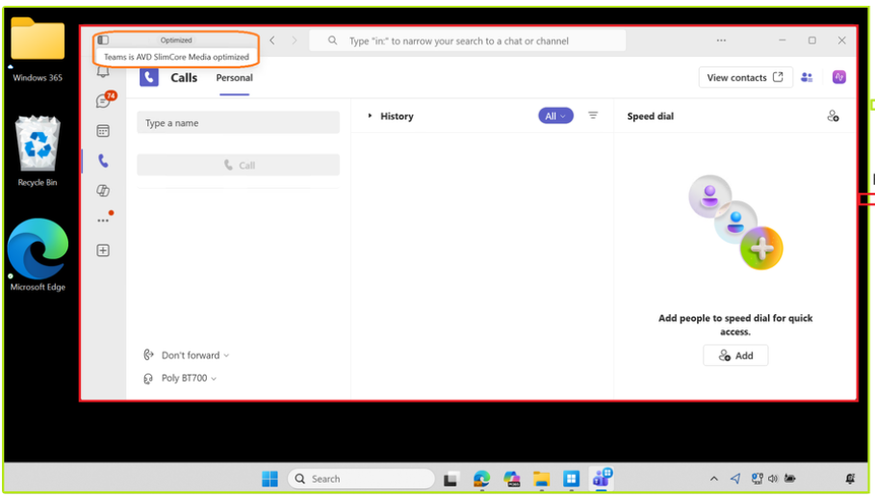
Compute Updates
Teams Remote App/ Cloud App optimization for Windows 365 and Azure Virtual Desktop now GA
The new optimization improves audio and video performance, reliability, and security, and simplifies ongoing support by enabling media engine updates without frequent upgrades to the infrastructure or client.
This feature will be available to anyone using Microsoft Teams as a Remote App on Azure Virtual Desktop or Cloud Apps on Windows 365 from Windows endpoints.
Teams users running in Remote App will automatically transition to the new optimization:
Audio and video performance and reliability are improved compared to the legacy WebRTC optimization.
Media engine updates no longer require frequent upgrades to the VDI infrastructure or client.
Pod CIDR Expansion Generally Available and IP Address Planning on Azure CNI Overlay
Pod CIDR Expansion for Azure CNI Overlay is now generally available, allowing AKS clusters to expand pod IP address capacity without rebuilding or redeploying existing clusters. This addresses one of the most common operational challenges in Kubernetes environments—running out of pod IP addresses as applications scale. Administrators can now increase the available Pod CIDR range, enabling cluster growth while minimizing disruption to running workloads. The feature simplifies long-term IP address planning and reduces the need for oversized network allocations during initial cluster deployment. It is particularly valuable for large-scale AKS environments, multi-tenant clusters, and rapidly growing applications. By improving network flexibility and scalability, Azure CNI Overlay helps organizations optimize IP utilization while supporting future cluster expansion.

Slide 37
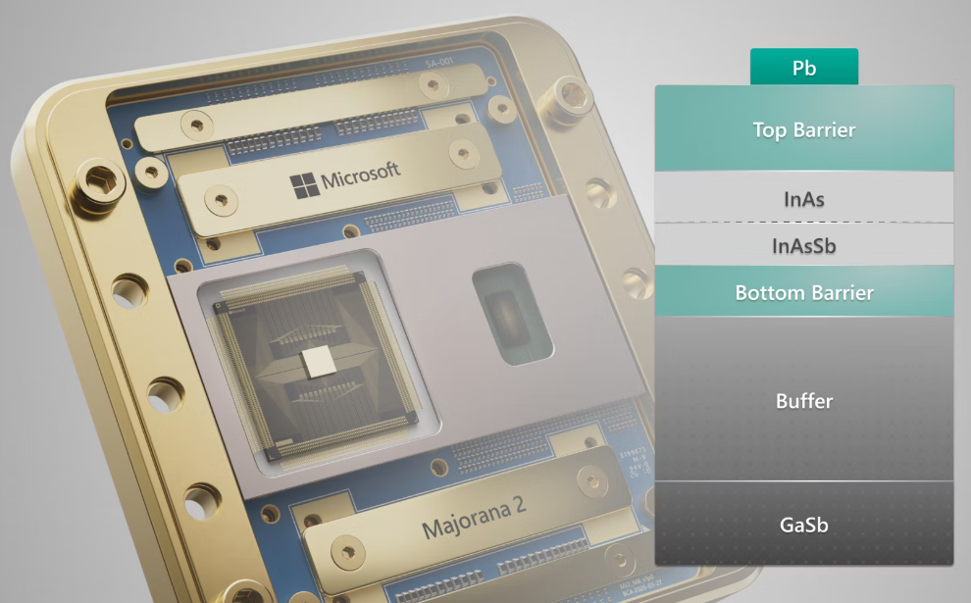
Compute Updates
Generally Available: Override Scale Rules in Azure Functions on Azure Container Apps
Azure Functions on Container Apps now supports custom KEDA scaling rule overrides through the new allowScalingRuleOverride property. Previously, Azure automatically generated KEDA scaling rules based on configured triggers, but customers can now replace platform-managed scaling behavior with their own custom KEDA configurations.
This capability is particularly valuable for workloads that require fine-grained control over scaling, such as custom queue thresholds, HTTP concurrency tuning, or organization-wide scaling standards. It also addresses scenarios where platform-generated scaling rules may not align with application requirements or where specific trigger types are not fully supported.
By enabling direct control over KEDA scaling policies while retaining the native Azure Functions on Container Apps architecture, organizations gain greater flexibility to optimize performance, control costs, and standardize scaling behavior across serverless and containerized workloads.
Majorana 2 – Microsoft's Scalable Quantum Processor With Reliable, Long-Lasting Qubits
Majorana 2 Quantum Processor is Microsoft's next-generation quantum computing chip designed to enable fault-tolerant, scalable quantum computing using a fundamentally different architecture based on topological qubits.

Slide 38
Compute Updates
Retirement: Azure VMware Solution AV36 node End of Support on September 30, 2027
Reminder: Microsoft’s support lifecycle is evolving in alignment with VMware’s roadmap. Broadcom will end support for the current AV36 VCF version on September 30, 2027, and the AV36 SKU is not compatible with VMware Cloud Foundation (VCF) 9, the next-generation platform.
As part of this transition, all AV36 SDDCs will be retired after September 30, 2027, regardless of individual RI expiration dates. On October 1, 2027, these SDDCs will no longer be accessible. Microsoft will securely retain customer data for a limited period (up to 60 days) to support retrieval if needed.
The details above only impact AV36 nodes. AVS AV36P, AV48, AV52 and AV64 remain available.

Slide 39
Storage & Data

Slide 40
Storage & Data Updates
Generally Available: File share centric management model (Microsoft.FileShares) for Azure Files
The new file share service management experience for Azure Files is now generally available for NFS 4.1 shares on SSD storage. Powered by the Microsoft.FileShares resource provider, file shares are now top-level Azure resources that you can create, secure, scale, and bill independently, without a storage account. Key benefits:
Top-level resource with a familiar, NAS-like management model.
Independent performance for each share through the provisioned v2 billing model, with dynamic scaling up and down and no noisy-neighbor impact.
Share-level security and networking, including per-share billing, encryption in transit, policies, and network configuration.
Support for up to 10,000 shares per subscription per region, with approximately 2.5× faster provisioning.
Snapshot support: up to 200 incremental, point-in-time snapshots per share, with metadata editing capability.
Per-share billing for cost tracking.

Slide 41
Databases

Slide 42
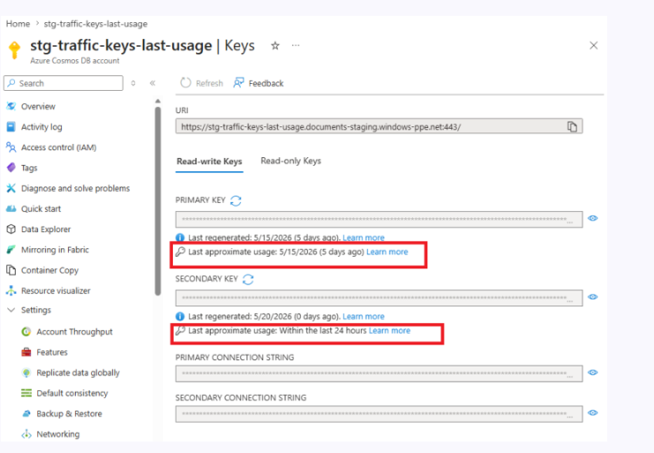
Databases Updates
Public Preview: Safe key rotation for Azure Cosmos DB
The safe key rotation feature helps confidently rotate Azure Cosmos DB account keys by providing visibility into when each key was last used. Without this insight, you risk rotating a key that may still be actively used by your applications, which can lead to unexpected service disruptions.
With safe key rotation, you can identify active and inactive keys before taking action, enabling you to make informed decisions and improve your security posture. This capability supports safer migrations, including transitioning to Microsoft Entra ID, by ensuring keys are no longer in use before disabling access. By reducing operational risk and increasing transparency, safe key rotation helps you maintain application reliability while strengthening key management practices.
Public Preview: Introducing AI Assistant in the Azure Cosmos DB extension for Visual Studio Code
It is now possible to use AI assistance in the Azure Cosmos DB extension for Visual Studio Code to work with data faster and with less manual effort. You can ask questions in plain English and get optimized Azure Cosmos DB queries, use chat participant commands to explain and refine queries, and rely on intelligent auto completion while writing queries and code.
You also get an Azure Cosmos DB Shell experience powered by Model Context Protocol (MCP), so the agent can use Shell operations to navigate your databases and containers and execute the right queries for you. You can spend less time on syntax, reduce trial-and-error, and move from idea to insight more quickly. Whether you are exploring data, troubleshooting queries, or building application logic, you get a more guided and productive development experience directly in Visual Studio Code.

Slide 43
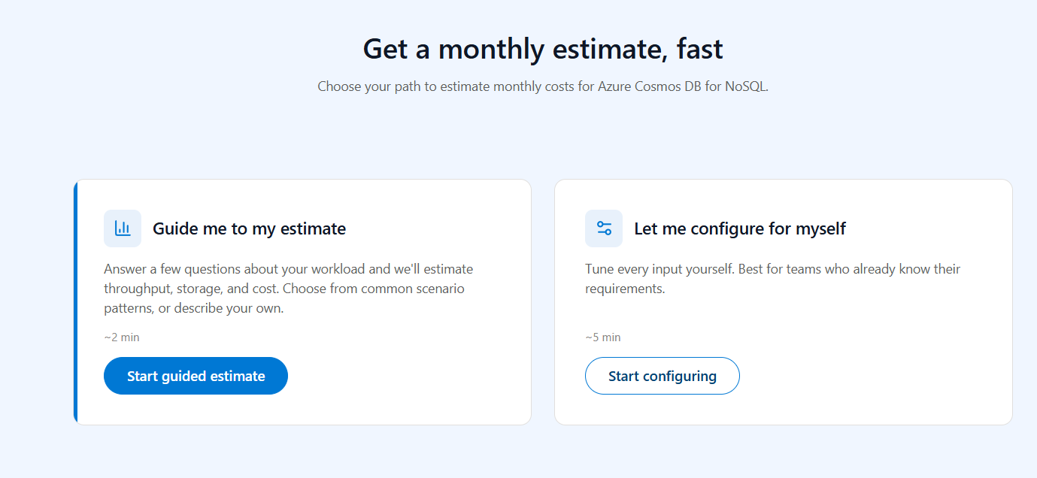
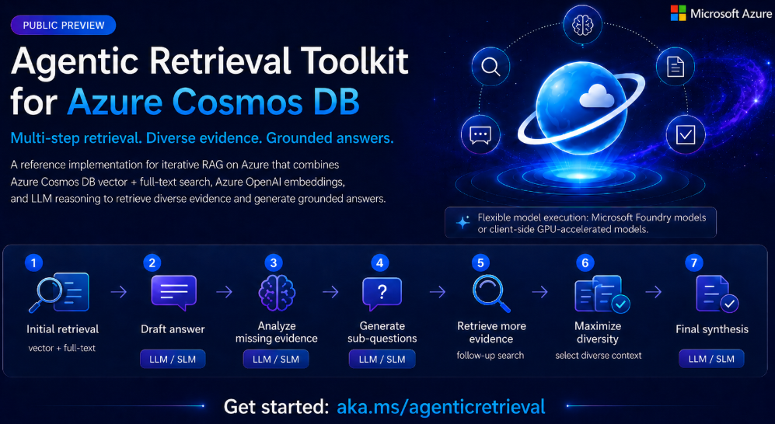
Databases Updates
Public Preview: New Azure Cosmos DB cost estimator
The Azure Cosmos DB cost estimator is now in public preview, giving a fast, accurate way to model throughput, storage, regions, and capacity mode before provision a single account. Whether you are building a new transactional app, modernizing a legacy database, or pricing out AI workloads with vector search, the estimator turns your design choices into a monthly cost projection in minutes. The pricing model reflects current Azure list rates and Microsoft's canonical vector cost methodology, so you can compare configurations, share a quote with your team, and walk into your next architecture review with a number you trust.
Public Preview: Agentic Retrieval Toolkit for Azure Cosmos DB
MS announced the public preview of the Agentic Retrieval Toolkit for Azure Cosmos DB. Motivated by GraphRAG and multiple-hop reasoning problems, this new capability helps build advanced retrieval-augmented generation (RAG) applications that go beyond single-pass retrieval by dynamically identifying information gaps and iteratively retrieving additional context. The toolkit combines hybrid search across vector and full-text indexes, diversity-aware document selection, and multiple-round reasoning to produce more complete, grounded responses.
With agentic retrieval, it is possible to improve answer quality for complex, multiple-step questions where relevant information is spread across many documents or data sources.

Slide 44
Databases Updates
Public Preview: AI-powered Azure Cosmos DB Migration Assistant for RDBMS to NoSQL
Azure Cosmos DB Migration Assistant (Public Preview) helps organizations modernize relational database applications by simplifying migration from RDBMS platforms to Azure Cosmos DB for NoSQL. The tool analyzes existing relational schemas, data models, and application patterns, then provides recommendations and guidance for converting them into a document-oriented NoSQL design.
Announcing the Public Preview of Integrated Embeddings in Azure Cosmos DB: Build AI Apps With Embeddings That Stay in Sync
Azure Cosmos DB Integrated Embeddings (Public Preview) enables organizations to generate and maintain vector embeddings directly within Azure Cosmos DB, eliminating the need for separate embedding pipelines and synchronization processes. When data is created or updated, Cosmos DB can automatically generate embeddings and keep them aligned with the latest document content, ensuring vector indexes remain current without custom code or external orchestration.

Slide 45
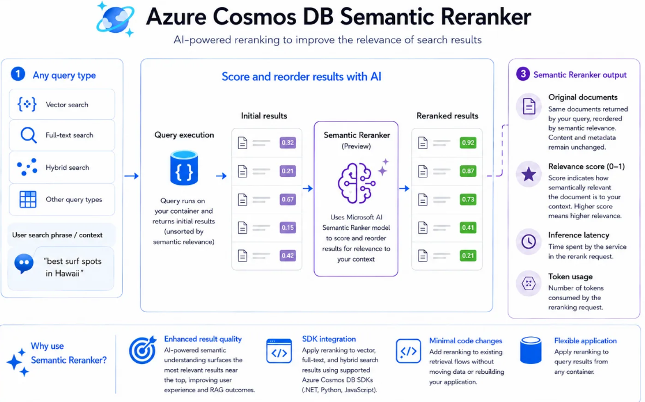
Databases Updates
Public Preview: Change streams (multi-shard) in Azure DocumentDB
Azure DocumentDB Change Streams are now available in public preview with multi-node support, enabling developers to build real-time, event-driven applications that react to data changes as they occur. Applications can capture inserts, updates, and deletes from Azure DocumentDB and use them to drive analytics, automation, synchronization, and integration workflows.
Announcing the Public Preview of Semantic Reranker in Azure Cosmos DB for NoSQL
A new AI-powered capability that improves the relevancy of your search results with just a few lines of code. If you’ve ever run a vector, full-text, or hybrid search and wished the most relevant documents bubbled to the very top, this one’s for you.
Semantic Reranker uses an AI model to score and reorder the results of any query based on how well each document matches the user’s intent. It’s built right into the Azure Cosmos DB SDKs (Python, .NET, and Java), so you can reorder results from any container with minimal code changes. Whether you’re building a search experience or grounding an agent with Retrieval Augmented Generation (RAG), better ranking means better answers.

Slide 46
Databases Updates
Public Preview: Pre-upgrade validation checks for Azure Database for PostgreSQL
Azure Database for PostgreSQL Flexible Server now supports pre-upgrade validation for Major Version Upgrades (MVU), allowing administrators to assess upgrade readiness before starting the actual upgrade process. The validation checks both Azure PostgreSQL upgrade requirements and PostgreSQL pg_upgrade compatibility rules, identifying potential issues such as unsupported extensions, replication slots, prepared transactions, configuration conflicts, and other upgrade blockers. Administrators can review and remediate findings, rerun validations, and proceed with the upgrade only when the environment is fully prepared. This proactive approach improves first-time upgrade success rates, reduces troubleshooting effort, and provides greater predictability when planning upgrades for production databases.
Public Preview: Microsoft Defender security assessments for Azure Database for PostgreSQL
Microsoft Defender Security Assessments for Azure Database for PostgreSQL are now available, providing continuous evaluation of your database security posture directly through Microsoft Defender for Cloud. The capability automatically identifies security vulnerabilities, configuration weaknesses, and compliance gaps, helping organizations prioritize remediation based on risk. Security teams gain actionable recommendations aligned with Microsoft best practices and regulatory requirements, enabling proactive protection of PostgreSQL workloads. By integrating database security assessments into the broader Defender for Cloud platform, organizations can improve governance, strengthen security baselines, and maintain ongoing visibility into the security health of their PostgreSQL environments.

Slide 47
Databases Updates
Public Preview: Azure Database PostgreSQL - Flexible Server cross-tenant customer-managed keys
Azure Database for PostgreSQL Flexible Server now supports cross-tenant Customer-Managed Keys (CMK) in public preview, allowing database encryption keys to be stored and managed in an Azure Key Vault located in a different Microsoft Entra tenant. This capability is particularly valuable for SaaS providers and enterprises that require strict separation between application hosting and encryption key ownership.
Key benefits include:
Customer-controlled encryption keys stored in a separate tenant.
Separation of duties between service providers and customers.
Full customer ownership of key lifecycle management, including rotation and revocation.
No access to key material by the PostgreSQL service.
Federated Microsoft Entra authentication enables secure cross-tenant access between PostgreSQL Flexible Server and the customer-managed Key Vault.
Public Preview: Azure HorizonDB
Azure HorizonDB (Public Preview) is a new PostgreSQL-compatible database platform designed for large-scale, AI-enabled, mission-critical workloads. It combines PostgreSQL compatibility with cloud-native scalability, high performance, and built-in AI capabilities.
Azure HorizonDB represents Microsoft's next-generation PostgreSQL platform, combining:
Traditional transactional database workloads
AI-native application development
Vector search and semantic retrieval
Hyperscale storage and compute
This makes it particularly attractive for AI-powered applications, RAG solutions, intelligent search platforms, SaaS products, and large-scale enterprise workloads that require both PostgreSQL compatibility and advanced AI capabilities within a single managed service.

Slide 48
Databases Updates
Public Preview: Advanced filtering for DiskANN vector search in Azure HorizonDB
Azure HorizonDB now supports Advanced Filtering for DiskANN Vector Search (public preview), enabling organizations to combine vector similarity search with relational filters such as category, date range, price, geography, tenant ID, or other business attributes without the performance degradation typically associated with filtered vector queries.
Traditional vector databases often struggle when combining semantic search with complex business filters. HorizonDB's advanced filtering capability allows organizations to perform hybrid semantic and metadata-aware retrieval at scale while keeping all data in a single PostgreSQL-compatible platform. This simplifies architecture, reduces operational overhead, and improves both the speed and relevance of AI-powered search and retrieval applications.
Public Preview: BM25 full-text search in Azure HorizonDB
Azure HorizonDB now supports BM25 full-text search (public preview), bringing production-grade keyword search capabilities directly into PostgreSQL. The feature uses the industry-standard BM25 relevance ranking algorithm, widely adopted by Elasticsearch, Solr, and Azure AI Search, eliminating the need for a separate search platform for many workloads.
Key capabilities include:
BM25 relevance scoring with term frequency saturation, document length normalization, and inverse document frequency (IDF) weighting for improved search quality.
Higher relevance and performance compared to PostgreSQL's native ts_rank implementation, particularly for complex multi-keyword searches.
Fuzzy matching to support typo tolerance and user-friendly search experiences.
Phrase search with configurable word proximity controls.
Boolean query support including AND, OR, and NOT operators.
Native PostgreSQL integration, allowing applications to use advanced search without deploying and synchronizing data to an external search engine.

Slide 49
Databases Updates
Public Preview: AI pipelines in Azure HorizonDB
AI Pipelines in Azure HorizonDB enable developers to define end-to-end AI ingestion and retrieval workflows directly in SQL, including chunking, embedding generation, extraction, ranking, and content processing. The pipelines run natively inside the database and provide durable, fault-tolerant execution, automatically handling retries, checkpoints, and recovery from failures. Embeddings remain synchronized with source data through change-based processing, ensuring that only new or modified records are reprocessed. Large-scale re-indexing and model changes are simplified through built-in backfill capabilities that resume from the last checkpoint rather than restarting from scratch. By combining AI Pipelines with pgvector, DiskANN, full-text search, and Azure AI model management, HorizonDB delivers a complete AI retrieval platform within a single PostgreSQL-compatible database. This significantly reduces application complexity by eliminating the need for external ingestion, embedding, and synchronization services.

Slide 50
Databases Updates
Public Preview: Azure SQL Database provisioning in the MSSQL extension
Azure SQL Database Provisioning in VS Code (Public Preview) allows developers to create and connect to an Azure SQL Database Free Tier directly from the MSSQL extension for Visual Studio Code, without leaving their development environment. A guided deployment wizard simplifies provisioning by allowing users to configure the subscription, resource group, SQL server, and database in a single workflow, with the database connection automatically added once deployment completes.
Key Benefits
Provision Azure SQL directly from VS Code
Free Tier Support
Rapid Application Development
Integrated Developer Experience
End-to-End Development Workflow
Public Preview: Advanced full-text search in Azure DocumentDB
Now you can unify your search operations in a single database. Azure DocumentDB has added fuzzy search, proximity search, more language support, and BM25 ranking to its full-text capabilities, bringing vector and advanced text search operations together.

Slide 51
Databases Updates
Transparent data encryption in Azure SQL Database now supports AES keys (Public Preview)
Azure SQL Database now supports AES symmetric keys for Transparent Data Encryption (TDE) with Customer-Managed Keys (CMK), providing an alternative to the traditional RSA-based key protection model. This enhancement helps organizations improve encryption performance while maintaining control of encryption keys in Azure Key Vault or Managed HSM. AES keys can offer lower cryptographic overhead and are well-suited for high-scale database workloads. The feature strengthens compliance and security by allowing customers to manage key ownership, rotation, and lifecycle according to their own policies. Organizations with strict regulatory requirements can further align Azure SQL encryption with enterprise key management standards. This preview continues Microsoft's focus on expanding customer-controlled encryption capabilities across Azure data services.

Slide 52
Databases Updates
Generally Available: Azure Cosmos DB global secondary indexes
Global secondary indexes (GSIs) for Azure Cosmos DB are now generally available, giving a powerful way to accelerate query performance without adding complexity to application code. GSIs are read-only containers that automatically stay in sync with source container using the change feed. Each GSI has its own throughput, partition key, and indexing policy, so you can optimize them for any query pattern. With GSIs, you can convert expensive cross-partition queries into efficient single-partition lookups by storing data under a different partition key. Using GSIs means lower Request Unit (RU) consumption, reduced latency, and better performance isolation for your workloads.
Generally Available: Change partition keys in Azure Cosmos DB for NoSQL API
It is now possible to change the partition key of an Azure Cosmos DB NoSQL container directly from the Azure portal with just a few clicks. The process supports both online and offline modes by copying data from the source container to a new container through the Change Partition Key option in Data Explorer.

Slide 53
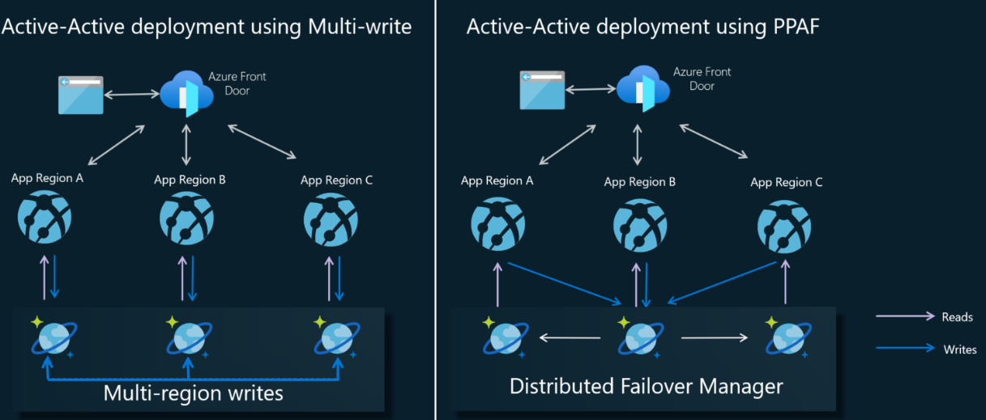
Databases Updates
Generally Available: Azure Cosmos DB Linux emulator (vNext)
MS announced the general availability of the Azure Cosmos DB Linux emulator (vNext), a cross-platform, Docker-based emulator for local development and testing against Azure Cosmos DB for NoSQL.
The vNext emulator runs as a lightweight Docker container on Linux, macOS, and Windows, with native support for both x64 and ARM64 architectures.
Generally Available: Per-partition automatic failover for Azure Cosmos DB
Per-partition automatic failover (PPAF) is now generally available in Azure Cosmos DB, bringing faster recovery and higher availability to mission-critical applications.
With PPAF, it is no longer necessary to fail over an entire account during a regional disruption. Azure Cosmos DB automatically fails over only the impacted partitions, while healthy partitions continue serving traffic. This approach sharply reduces disruption, shortens recovery times, and removes the need for manual intervention during outages.
PPAF helps you meet stringent availability and durability requirements without redesigning your application or operating multiple write regions. You can run highly resilient workloads with predictable performance, while Azure Cosmos DB transparently handles partition-level recovery behind the scenes.

Slide 54
Databases Updates
Azure Cosmos DB MCP Toolkit Is Now Generally Available — Bringing Your Database to AI Agents at Scale
Azure Cosmos DB MCP Toolkit is now generally available (v1.1.2), providing a production-ready framework for connecting AI agents to Azure Cosmos DB through the Model Context Protocol (MCP). Building on customer feedback from the preview release, the GA version introduces deeper Microsoft Foundry integration, broader multi-provider embedding support, and improved reliability for enterprise deployments.
Production-Ready MCP Integration
Microsoft Foundry Integration
Multi-Provider Embedding Support
Enterprise Reliability Improvements
Azure Cosmos DB All Versions and Deletes Change Feed Mode is Now Generally Available
Azure Cosmos DB All Versions and Deletes Change Feed is now generally available, providing complete visibility into data lifecycle events within Azure Cosmos DB. Unlike the traditional change feed, which only captures the latest version of a document, this mode records all document versions and delete operations, enabling more comprehensive event-driven architectures and auditing scenarios.

Slide 55
Databases Updates
Generally Available: Service-managed failover in Azure DocumentDB
Azure DocumentDB now provides general availability of service-managed failover for multi-region clusters, improving resilience and availability for globally distributed deployments. In the event of a regional outage, Azure DocumentDB automatically promotes the configured secondary region to become the new primary region without requiring manual intervention. This capability reduces recovery times, minimizes operational effort, and helps maintain application availability during regional disruptions. By automating failover, organizations can simplify disaster recovery planning while ensuring business-critical workloads remain accessible. The feature strengthens the platform's high-availability capabilities for multi-region production environments.
Generally Available: Azure DocumentDB Migration Extension in Visual Studio Code
The Azure DocumentDB Migration Extension for Visual Studio Code is now generally available, enabling developers to create, manage, and execute migrations from MongoDB deployments to Azure DocumentDB directly within VS Code. The extension simplifies migration projects by eliminating the need for additional migration infrastructure or specialized tooling. Users can securely migrate selected databases and collections from on-premises or cloud-hosted MongoDB environments while maintaining full visibility and control throughout the process. The solution integrates into a familiar developer workflow, reducing migration complexity and accelerating modernization initiatives. It also supports non-disruptive migrations, helping organizations move workloads to Azure DocumentDB with minimal impact on running applications.

Slide 56
Databases Updates
Generally Available: Graceful failover with zero data loss guarantee
Azure DocumentDB now provides general availability of Graceful Failover (Graceful Promote) for replica clusters, enabling planned regional failovers with zero data loss. Unlike the existing Force Promote capability, which prioritizes availability and may promote a replica before all data has been replicated, Graceful Promote ensures that all pending replication is completed before the replica cluster becomes the new primary. This makes it ideal for planned workload migrations, regional traffic shifts, and operational maintenance scenarios where consistency is critical. Organizations can seamlessly move write traffic closer to users in another region while preserving data integrity. Together, Force Promote and Graceful Promote provide flexibility to balance availability and consistency requirements based on the business scenario.
Generally Available: Azure DocumentDB instant free tier clusters
Azure DocumentDB now offers near-instant provisioning for Free Tier clusters, allowing developers and teams to start building and testing applications within minutes. This enhancement significantly reduces setup time and eliminates the waiting period traditionally associated with database deployment. Organizations can quickly evaluate Azure DocumentDB, develop proofs of concept, and begin application development without upfront infrastructure costs. The faster provisioning experience improves developer productivity and lowers the barrier to adopting MongoDB-compatible workloads on Azure DocumentDB.

Slide 57
Databases Updates
Generally Available: Oracle schema conversion to Azure PostgreSQL in Visual Studio Code
Oracle-to-PostgreSQL Schema Conversion in VS Code is now available through the PostgreSQL extension for Visual Studio Code, providing a guided migration experience from Oracle databases to Azure Database for PostgreSQL Flexible Server. Developers can load Oracle schemas, automatically convert database objects, validate results using a PostgreSQL scratch database, and review conversion issues through generated Review Tasks before deployment. The project-based workflow centralizes schema conversion, validation, and remediation within a single development environment, improving visibility, reducing migration complexity, and accelerating Oracle modernization projects.
Generally Available: Azure Database for PostgreSQL flexible server pg_ivm extension
pg_ivm Extension Support is now available for Azure Database for PostgreSQL Flexible Server, enabling customers to install and use the Incremental View Maintenance (pg_ivm) extension. The extension automatically maintains materialized views by incrementally applying changes as underlying data is modified, eliminating the need for full materialized view refresh operations. This can significantly improve query performance and reduce maintenance overhead for reporting, analytics, and aggregation workloads that rely on frequently updated materialized views. By supporting pg_ivm, Azure Database for PostgreSQL provides developers with an efficient way to keep derived datasets up to date while reducing compute consumption and refresh latency.

Slide 58
Databases Updates
Generally Available: Azure HorizonDB Agentic Advisor Solution Accelerator
Agentic Advisor Solution Accelerator for Azure HorizonDB is now generally available, providing a reference architecture for building financial services-focused multi-agent applications. Built with Python, LangGraph, and Mem0, the accelerator uses Azure HorizonDB as the central data, memory, and intelligence platform.
The accelerator provides a practical blueprint for building next-generation financial advisor, wealth management, customer support, and decision-assistance solutions. By combining multi-agent orchestration, graph intelligence, hybrid retrieval, and AI-native database capabilities, organizations can accelerate development of more context-aware, explainable, and responsive agentic applications while reducing architectural complexity.
Generally Available: Data API builder with built-in GitHub Copilot in MSSQL extension
Data API Builder with GitHub Copilot Integration is now generally available in the MSSQL extension for Visual Studio Code, enabling developers to generate REST, GraphQL, and MCP (Model Context Protocol) APIs directly from SQL database schemas without manually building backend services.
Key Benefits
Rapid API Generation
GitHub Copilot Integration
Visual API Design
Fine-Grained Data Exposure
Configuration as Code
Local Testing

Slide 59
Databases Updates
Generally Available: Azure Database for MySQL Flexible Server self-service quota management experience
Azure Database for MySQL Flexible Server now supports self-service quota management through the Azure Quotas experience in the Azure Portal. Administrators can view current quota usage and limits, request quota increases, and track approval status without opening a support ticket.
Key Benefits
Self-Service Quota Requests
Request quota increases directly from the Azure Portal.
Eliminates the need for manual support tickets in most scenarios.
Faster Approvals
Eligible requests can be automatically evaluated and approved.
Reduces waiting times from days to minutes.
Centralized Visibility
View quota consumption and limits across subscriptions in a single location.
Improves capacity planning and governance.
Reduced Deployment Delays
Identify quota constraints before deployments fail.
Generally Available: GitHub Copilot integration in Schema Designer for the MSSQL extension
GitHub Copilot integration with Schema Designer (GA) in the MSSQL VS Code extension enables developers to design and modify database schemas using natural language. Copilot can generate schema changes, visualize them in Schema Designer, track modifications with source-control-style change tracking, and generate ORM migration scripts. Combined with Data API Builder, it provides an end-to-end workflow from database design to backend API generation directly within Visual Studio Code.

Slide 60
Databases Updates
Generally Available: Azure Database for MySQL now available in new regions and expanded availability zones
Azure Database for MySQL Flexible Server continues to expand its global presence with support for new regions, including Denmark East, Austria East, and Belgium Central. These regions provide customers with local deployment options that help meet data residency requirements while benefiting from Azure's managed MySQL service, including zone-redundant high availability and geo-redundant backups.
In addition, Azure has expanded availability zone support in Taiwan North, Japan West, South Central US, and US Gov Arizona, giving organizations more flexibility to distribute workloads across physically separate datacenters within a region. This improves resilience, increases deployment options, and supports highly available architectures for mission-critical applications.
The expansion strengthens Azure's global database footprint, enabling customers to deploy MySQL workloads closer to users, reduce latency, improve disaster recovery capabilities, and build more resilient database platforms with enterprise-grade availability and business continuity features.

Slide 61
Integration

Slide 62
Integration Updates
Public Preview: Azure API Management now supports token metrics for all token types
Azure API Management now provides enhanced AI token observability, enabling organizations to track and analyze a broader range of token types used by modern AI models. In addition to traditional prompt, completion, and total tokens, teams can now collect metrics for cached tokens, reasoning tokens, thinking tokens, and other model-specific token categories. These metrics are logged to Application Insights, providing deeper visibility into AI consumption patterns and costs.
The capability supports multiple AI providers and API formats, including OpenAI Chat Completions, OpenAI Responses API, Anthropic Messages API, and models hosted through Microsoft Foundry, Azure OpenAI, AWS Bedrock, Google Vertex AI, and other platforms. Organizations can build more accurate dashboards, improve cost allocation and forecasting, enhance budget monitoring and alerting, and gain better insight into how advanced reasoning models consume resources.
This enhancement strengthens governance and financial management for enterprise AI workloads by providing a unified view of token usage across multi-model and multi-provider environments.
Public Preview: APIM Support for Foundry Models in Azure AI Search
Microsoft Foundry brings Azure API Management support to all Foundry model integrations in Azure AI Search, now in public preview. Enterprise platform engineers and AI solution teams running large-scale RAG pipelines can place Foundry and Azure OpenAI models behind APIM for the GenAI Prompt Skill, embedding models, and vectorizer operations used at indexing and query time. APIM provides traffic shaping, load balancing, custom domains, identity governance, and private connectivity in front of every model endpoint a Search workload depends on. Customers can eliminate indexing failures caused by endpoint throttling or outages, stabilize high-throughput ingestion, and consolidate authentication and policy management into a single control plane. Operations teams gain consistent observability and audit trails across enrichment dependencies, while RAG systems hold accuracy and freshness as content volume grows.

Slide 63
Integration Updates
Generally Available: Azure API Management adds support for Agent-to-Agent (A2A) APIs
Azure API Management now supports JSON-RPC–based Agent-to-Agent (A2A) APIs, enabling organizations to govern AI agent communications using the same platform that manages REST, GraphQL, MCP, and AI model APIs. This allows platform teams to apply existing security, authentication, mediation, rate limiting, and governance policies to agent interactions without introducing separate gateways or tooling. The integration also provides end-to-end observability and tracing for agent communications, improving visibility into multi-agent workflows. By bringing A2A traffic under Azure API Management, organizations can manage agent ecosystems alongside traditional APIs through a unified operational model. This helps enterprises scale agentic AI architectures while maintaining consistent security, compliance, and operational controls.
Generally Available: Azure API Management now supports AI gateway capabilities for Anthropic and Vertex AI models.
Azure API Management now extends its AI Gateway capabilities to support Anthropic and Google Vertex AI models, enabling consistent governance across multi-model AI environments. Organizations can apply the same runtime security and governance policies used for Azure-hosted models, including content safety controls, token limits, semantic caching, and traffic management. The integration also provides centralized logging, tracing, metrics, and observability for Anthropic and Vertex AI model interactions. This gives platform teams a unified approach to managing AI services from multiple providers through a single API gateway. The result is improved security, compliance, operational visibility, and governance for enterprise AI deployments spanning multiple model vendors.

Slide 64
Integration Updates
Generally Available: Azure API Management now supports content safety controls for MCP and A2A APIs.
Azure API Management now extends Content Safety controls to MCP (Model Context Protocol) tools and Agent-to-Agent (A2A) APIs, enabling centralized governance for agentic AI ecosystems. Organizations can apply consistent content filtering, safety policies, and compliance controls across AI models, MCP-integrated tools, and multi-agent interactions from a single management layer. This reduces the risk of unsafe, harmful, or non-compliant outputs while eliminating the need for fragmented, custom policy implementations. By moving content safety enforcement into the API management layer, enterprises gain stronger governance, auditability, and operational consistency across AI agents and agent-driven workflows. The capability helps organizations scale agentic systems while maintaining enterprise-grade security and compliance standards.
Generally Available: Azure API Management workspaces now support the built-in gateway
Azure API Management now allows workspaces to be associated directly with the built-in gateway, reducing the cost and complexity of adopting workspace-based API governance. Previously, workspaces required a dedicated workspace gateway and typically a Premium-tier deployment. With this enhancement, organizations can use API Management workspaces across all tiers except Consumption, and in any region where API Management is available. Workspaces also gain access to built-in gateway capabilities such as multi-region deployments, custom hostnames, and Private Link connectivity, which are not available with workspace gateways. This makes it easier for enterprises to implement team-based API ownership, delegated administration, and scalable governance models while minimizing infrastructure overhead. The feature is currently rolling out to v2 API Management tiers, with support for classic tiers expected to follow.

Slide 65
Integration Updates
Generally Available: Azure API Center now provides a data plane MCP server for enterprise-wide discovery of APIs and AI assets.
Azure API Center now introduces a data plane MCP (Model Context Protocol) server, providing a single enterprise discovery endpoint for APIs, AI assets, MCP servers, and tools. Instead of configuring connections to individual MCP servers, developers and AI agents can connect to one centralized endpoint to discover and access the organization's entire catalog of registered resources.
Key benefits include:
Centralized discovery of enterprise APIs, AI models, tools, and MCP servers.
Automatic exposure of newly registered assets, eliminating manual reconfiguration.
Simplified agent integration, allowing AI agents to dynamically discover and consume available enterprise capabilities.
Reduced operational complexity by replacing multiple MCP server connections with a single entry point.
Improved governance and visibility across enterprise AI ecosystems.
This capability helps organizations scale agentic AI architectures by making enterprise resources easier to discover, consume, and govern, while improving developer productivity and reducing integration overhead.
Generally Available: Azure Event Grid - MQTT v5 Subscription Identifier
Azure Event Grid Standard Namespace now supports MQTT v5 subscription identifier capabilities in GA.
Now each MQTT subscription can include an identifier that is delivered with incoming messages, enabling applications to route events immediately based on subscription context rather than parsing topic strings. This results in cleaner application logic and faster message handling for scenarios such as dashboards, alerts, and analytics pipelines.

Slide 66
ML & AI & IOT

Slide 67
ML & AI & IOT Updates
Public Preview: OneLake Catalog integration for Foundry IQ Knowledge Sources
Microsoft Foundry IQ adds public preview support for OneLake Catalog as a knowledge source, so agents can ground responses on lakehouse tables, files, and shortcuts already governed in Microsoft Fabric.
Data engineers register the OneLake catalog once and Foundry IQ ingests the cataloged items, respecting Fabric permissions and sensitivity labels at query time. Analysts get agent answers that cite the same curated datasets used in dashboards and reports, instead of duplicate copies sitting in a separate vector store. The integration removes a common gap between BI data and AI applications, letting customers reuse their Fabric investment for agent grounding.
Public Preview: Image serving in Foundry IQ knowledge bases
Foundry IQ knowledge bases now surface document-extracted images at query time in public preview. When ingestion pulls figures, screenshots, and diagrams out of PDFs, slides, and Office files, Foundry IQ retains each image alongside the text it appeared with and can return it as part of a retrieval result. Agents can show the original chart to the user instead of describing it secondhand, so answers about technical diagrams, product photos, and report figures stay anchored to the source artwork. Customers building support assistants, internal research tools, and knowledge portals can render visual context inline without building a separate image pipeline. The capability is available across all Foundry IQ-supported document types.

Slide 68
ML & AI & IOT Updates
Public Preview: Incremental SharePoint permissions sync for Azure AI Search and Foundry IQ
Azure AI Search and Foundry IQ Knowledge Sources now support incremental SharePoint permissions synchronization (public preview). This capability keeps document-level, site, library, and list access control lists (ACLs) aligned with SharePoint permission changes. Permission updates are applied during each indexer run, eliminating the need for full re-indexing when access rights change. This helps ensure that AI Search, RAG applications, and enterprise agents enforce the same security model as SharePoint. The feature improves governance, security, and compliance by reducing the risk of AI systems exposing content to unauthorized users.
Public Preview: MCP Server Knowledge Source in Microsoft Foundry IQ
Microsoft Foundry IQ now supports external MCP (Model Context Protocol) servers as federated knowledge sources (public preview). This enables AI agents to retrieve information directly from systems such as Salesforce, ServiceNow, Atlassian, and Confluence without requiring data to be copied into a separate index. Foundry IQ automatically selects the most relevant sources for each query and combines results into a single response with citations. The MCP-based approach allows organizations and partners to integrate any compliant data source without building custom connectors. Access control remains enforced by the source systems, ensuring agents only retrieve data the requesting user is authorized to view. This capability simplifies the creation of enterprise AI agents that can securely access and reason across multiple systems of record.

Slide 69
ML & AI & IOT Updates
Public Preview: Toolbox connectors and triggers in Microsoft Foundry
Microsoft Foundry Tools now supports connectors and time-based triggers (public preview), enabling the creation of event-driven AI agents without custom orchestration code. Agents can automatically respond to events from Microsoft 365, Azure, and third-party systems, or execute on scheduled intervals such as daily or hourly. The feature uses a centrally managed toolbox endpoint for connector discovery and authentication, simplifying integration management. Administrators retain governance by controlling which connectors and triggers are approved for use within the organization. This capability allows enterprises to build automated, reactive AI workflows that integrate directly with business processes and operational events.
Public Preview: MAI-Transcribe-1.5 in Microsoft Foundry model catalog
MAI-Transcribe-1.5 is now available in Microsoft Foundry (public preview) as Microsoft's next-generation speech-to-text model. The model delivers improved transcription accuracy, particularly for long-tail languages and regional dialects, while reducing word error rates compared to previous versions. It also provides faster real-time and batch transcription with more predictable latency. Key use cases include call center analytics, meeting transcription, voice agents, and media captioning. Available through Azure Speech and Microsoft Foundry, the model benefits from Foundry-native governance, regional deployment options, and content safety controls. This release helps organizations build more accurate and scalable speech-driven AI solutions.

Slide 70
ML & AI & IOT Updates
Public Preview: Purview admin access auditing for sensitivity-labeled content in Azure AI Search
Azure AI Search now supports Microsoft Purview admin access auditing for sensitivity-labeled content (public preview). Administrative actions involving Purview-labeled documents in Azure AI Search, knowledge retrieval, and Foundry IQ knowledge bases are now recorded in Microsoft Purview’s unified audit log. This provides security and compliance teams with end-to-end visibility across AI search and retrieval environments, alongside existing Microsoft 365 auditing. The capability covers index management, data source configuration, and access changes related to labeled content. It integrates with existing Purview retention, governance, and access control policies and is enabled without requiring application changes.
Public Preview: Trace Replay and trace visualizations for Foundry agents
Microsoft Foundry Observability now includes Trace Replay and enhanced trace visualizations (public preview) to simplify debugging of AI agents and multi-step workflows. Trace Replay allows developers to step through an execution trace, showing model calls, tool invocations, agent interactions, inputs, outputs, latency, and token consumption in sequence. New visualizations group nested traces by agent and tool, making it easier to identify failures, bottlenecks, and performance issues. Observability data is integrated with Azure Monitor Application Insights, providing a unified monitoring platform for AI workloads and other Azure services. This capability helps accelerate troubleshooting and improve the reliability of complex agent-based applications.

Slide 71
ML & AI & IOT Updates
Public Preview: Hosted Agents in Microsoft Foundry Agent Service
Microsoft Foundry Agent Service now introduces Hosted Agents (public preview), a fully managed runtime for deploying custom AI agents built with frameworks such as Microsoft Agent Framework, LangGraph, Semantic Kernel, or proprietary code. Hosted Agents run in isolated per-session VM sandboxes with persistent storage, automatic scale-to-zero, and a dedicated Microsoft Entra identity configured at deployment time. The service supports multiple agent protocols, including Responses, Invocations, Activity, and Agent-to-Agent (A2A) communication within a single deployment. It also includes OpenTelemetry-based observability and support for bring-your-own virtual networks for secure outbound connectivity. This allows organizations to focus on agent development while Microsoft manages hosting, scaling, identity, and operational infrastructure, reducing complexity and accelerating production deployment of enterprise AI agents.
Public Preview: Foundry Memory preview refresh
Foundry Memory has been enhanced in public preview with a redesigned storage architecture, improved retrieval controls, and deeper integration with Microsoft Foundry Agent Service. Agents can now write, search, and update user-scoped and session-scoped memories through a unified tool interface. New capabilities such as semantic deduplication and time-to-live (TTL) policies help keep memory stores relevant and prevent information drift over time. The update also introduces content safety filtering, expanded regional availability, and enhanced observability, with memory operations visible directly in Foundry tracing. This release is designed for AI agents that require persistent user context across multiple conversations and sessions, improving personalization and continuity in long-running interactions.

Slide 72
ML & AI & IOT Updates
Public Preview: Azure Logic Apps now enables developers to invoke Microsoft Foundry Agents directly from workflows.
Azure AI Foundry and Azure Logic Apps now offer enhanced integration, making it easier to operationalize AI agents within enterprise workflows. Organizations can invoke Foundry Hosted Agents directly from Logic Apps, combining AI-driven decisions with business process automation. This enables agents to be orchestrated alongside APIs, connectors, enterprise applications, schedules, and event-driven workflows. Businesses can trigger AI-powered actions from operational events while leveraging Logic Apps' built-in scalability, monitoring, and governance capabilities. The integration helps bridge the gap between AI agent development and real-world business automation, accelerating the deployment of production-grade agentic workflows.
Public Preview: Purview sensitivity labels in Azure AI Search knowledge sources
Azure AI Search now supports Microsoft Purview sensitivity labels for Knowledge Sources (public preview). Sensitivity labels applied to content in source systems are preserved throughout ingestion and carried into Azure AI Search indexes, knowledge bases, and Foundry-powered agents. This ensures that vector search, retrieval-augmented generation (RAG), and agentic workflows respect the same data classification and protection policies defined by security teams. Organizations working with regulated or sensitive data can maintain consistent governance without implementing custom controls at the retrieval layer. The feature provides end-to-end label fidelity and serves as a foundation for future Purview-aware AI orchestration and compliance scenarios.

Slide 73
ML & AI & IOT Updates
Public Preview: Azure Policy Coverage for Model Router in Foundry Models
Azure Policy now provides centralized governance for model router deployments, helping organizations enforce consistent AI deployment standards across Azure environments. Built-in policy definitions allow administrators to control approved models, deployment regions, routing configurations, and logging requirements. Policies can be applied across management groups and subscriptions, enabling automated compliance monitoring and detection of configuration drift. Organizations can leverage existing Azure Policy capabilities for reporting, remediation, exemptions, and governance workflows without additional tooling. This helps regulated enterprises adopt AI services more quickly while maintaining security, compliance, and operational control over model routing decisions.
Public Preview: Benchmark evaluations for fine-tuned models in Microsoft Foundry
Benchmarks in Microsoft Foundry (preview) provide a standardized way to evaluate and compare AI models and agents throughout the development lifecycle. Organizations can run well-known open-source benchmarks against any model deployment or agent to measure performance under consistent conditions. Results can be compared side-by-side using the evaluation group view, making it easier to identify regressions caused by model, prompt, tool, or workflow changes. The capability supports both portal-based and API-driven execution, enabling integration into development and CI/CD processes. This helps teams make data-driven decisions on model and agent selection, improving reliability and reducing the risk of deploying underperforming AI solutions.

Slide 74
ML & AI & IOT Updates
Public Preview: Code-first observability for Foundry Agents in VS Code
Code-First Observability for Microsoft Foundry (public preview) is now available through an Observe Skill integrated into the Foundry Plugin for VS Code Copilot Chat. Developers can manage the entire evaluation and optimization lifecycle directly from their development environment using natural language commands. The skill automatically generates evaluators and test datasets, executes batch evaluations, analyzes and clusters failures, recommends prompt improvements, and compares agent versions side-by-side. It leverages Foundry MCP tools to streamline observability, testing, and deployment workflows. By bringing observability into the IDE, the feature reduces context switching, accelerates agent development, and promotes more consistent evaluation and quality control practices.
Public Preview: User feedback logging in Microsoft Foundry
Microsoft Foundry now introduces end-user feedback logging semantics, enabling developers to capture structured feedback such as thumbs up/down, ratings, and custom annotations from users interacting with AI agents. Feedback is automatically correlated with the underlying request traces and telemetry in Azure Monitor, creating a direct link between user experience and system behavior. This allows teams to analyze agent quality, identify issues, and understand how users perceive AI responses in production. The captured feedback becomes part of the existing observability and monitoring pipeline, alongside performance and evaluation metrics. Organizations can use these real-world signals to drive continuous model improvement, agent optimization, and data-driven product enhancements.

Slide 75
ML & AI & IOT Updates
Public Preview: Tool search in Microsoft Foundry toolboxes
Microsoft Foundry Tool Search is now available in public preview, helping developers efficiently discover and use tools within large Foundry toolboxes. Instead of loading all tool definitions into the model context, Tool Search dynamically retrieves only the most relevant tools at runtime, reducing token consumption and improving performance. Agents can identify and select tools based on their intent and task requirements, eliminating the need to manually browse extensive tool catalogs. The capability also gives toolbox administrators greater control over how tools are surfaced and discovered across teams. This improves scalability, lowers operational costs, and enables more efficient agent-driven tool orchestration in enterprise AI environments.
Public Preview: Voice sync for avatar support in Voice Live API in Microsoft Foundry
Microsoft Foundry now supports avatar voice synchronization with custom voices in the Voice Live API (public preview). This allows organizations to combine custom neural voices with real-time avatars, enabling branded and persona-specific digital experiences. Previously, avatars could only be paired with a limited set of predefined voices. The new capability delivers low-latency, lip-synced avatar rendering while preserving an organization's unique voice identity. It simplifies the development of virtual agents, digital humans, kiosks, retail assistants, and accessibility solutions by unifying voice and avatar functionality within a single real-time pipeline. As a preview feature, regional availability and configuration options may continue to evolve before general availability.

Slide 76
ML & AI & IOT Updates
Public Preview: Fabric IQ Ontology Knowledge Source in Microsoft Foundry IQ
Microsoft Foundry IQ now treats a Microsoft Fabric Ontology as a federated knowledge source in public preview, giving agents a way to query the semantic layer customers already curate in Fabric. Foundry IQ translates natural language questions into ontology-grounded queries and SQL against the entities, relationships, and bindings the Fabric team has defined, then returns results with citations back to the underlying Fabric tables. Analytics and platform teams can expose governed business definitions to agents without exporting data or maintaining a parallel schema. The source plugs into the same Foundry IQ retrieval flow as document and database sources, so a single agent call can combine ontology-grounded answers with unstructured knowledge. This release helps customers bring trusted business semantics into agentic applications.
Introducing OmniVec: An Open-Source Embedding Platform for AI Apps on Azure
OmniVec is a new open-source embedding platform introduced by Microsoft for building AI applications on Azure. It provides a unified framework for generating, managing, and serving embeddings across multiple AI models and providers, helping organizations simplify vector-based AI architectures.
Key Benefits
Multi-Model Embedding Support
Standardized Embedding Pipeline
Built for AI Applications
Azure Integration
Open Source

Slide 77
ML & AI & IOT Updates
Public Preview: Azure SQL as a knowledge source in Foundry IQ
Azure SQL Database is now available as a first-class Knowledge Source in Azure AI Search (public preview). This enables organizations to use Azure SQL tables and views directly as searchable knowledge for Copilots, RAG applications, Knowledge Bases, and Foundry agents. The integration leverages the familiar Azure AI Search indexer framework, simplifying ingestion and management without requiring custom data pipelines. Developers can ground AI responses using live operational data, such as customer records, transactions, and reference datasets, alongside unstructured content sources. Azure SQL joins other supported knowledge sources such as SharePoint and OneLake under a unified configuration model. This creates a consolidated enterprise knowledge layer, improving the accuracy, relevance, and business value of AI-powered applications.
Public Preview: SharePoint in Microsoft 365 indexer supports ASPX pages and Lists
The Azure AI Search SharePoint for Microsoft 365 Indexer now supports indexing ASPX site content and SharePoint Lists in addition to traditional document libraries. The indexer connects through a Microsoft Entra application registration using either application or delegated permissions and supports incremental synchronization, automatically detecting new, updated, and deleted content. Administrators can define inclusion and exclusion rules to control which SharePoint sites, libraries, lists, or folders are indexed and can map additional SharePoint columns as searchable fields. The indexer continues to support ACL preservation and, in preview, Microsoft Purview sensitivity label ingestion, helping ensure that AI Search, RAG applications, and Copilot experiences respect enterprise security and compliance requirements. This enhancement enables organizations to build richer knowledge bases by incorporating both structured SharePoint data and traditional document content into a unified search experience.

Slide 78
ML & AI & IOT Updates
Public Preview: Content Understanding chunking and image verbalization in Azure AI Search
Azure AI Search now supports Content Understanding chunking and image verbalization (public preview), enhancing document processing and retrieval quality for AI-powered search and RAG applications. During indexing, the service can automatically split documents into semantically meaningful chunks and generate text descriptions for embedded images, charts, diagrams, and visual content.
Key benefits include:
Semantic chunking that improves retrieval accuracy by preserving document context instead of relying solely on fixed-size text segmentation.
Image verbalization, which converts visual content into searchable text representations, ensuring important information contained in diagrams, charts, and images is included in search and AI responses.
Improved RAG performance, as each chunk can contain both textual and visual context, leading to more accurate and complete answers.
Support for complex content types such as slide decks, technical documentation, engineering diagrams, manuals, and scanned forms.
Integration with existing Azure AI Search skillsets and integrated vectorization workflows, allowing organizations to enhance current indexes without redesigning their architecture.
Public Preview: Neural HD voice update (HDv2.5) in Azure AI Speech
Azure AI Speech is rolling out an updated Neural HD text-to-speech model (HDv2.5), replacing the previous DragonHDLatest model in public preview. The upgrade delivers higher audio quality, more natural speech synthesis, and enhanced expressiveness while maintaining compatibility with existing APIs and SSML implementations.
Key improvements include:
Improved speech quality and naturalness, resulting in more human-like voice output.
Support for style and paralinguistic tags in English voices, enabling richer emotional expression, tone variation, and conversational delivery.
Reduced word error rates in secondary languages including Spanish, French, German, and Japanese, improving multilingual voice experiences.
No application changes required, as existing endpoints, SDKs, and SSML markup continue to function without modification.
More consistent voice quality across languages, helping organizations deliver a uniform customer experience in global deployments.

Slide 79
ML & AI & IOT Updates
Public Preview: Copilot-assisted coding & agent skills to build, deploy, and run Azure Functions faster in VS Code, CLI, and azd
Azure Functions AI Assistant Skills (Public Preview) provide a set of agent skills and plugins that enhance AI coding assistants such as GitHub Copilot, Claude Code, and Codex with up-to-date Azure Functions expertise. With a simple installation, developers gain access to AI guidance grounded in the latest Azure documentation, best practices, and operational knowledge rather than relying solely on a model's training data.
Key Benefits
More Accurate AI Assistance
Works Across Multiple AI Assistants
End-to-End Azure Functions Support
Grounded in Official Azure Guidance
Public Preview: MAI-Voice-2 in Microsoft Foundry
MAI-Voice-2 (Public Preview) is Microsoft's new first-party voice generation model available through Microsoft Foundry. The model enables organizations to create highly natural speech experiences with support for more than 10 languages, voice cloning, and prompt-based voice customization.
Key Capabilities
Multilingual Speech Generation
Voice Cloning
Voice Prompting
Unified Foundry Experience
Microsoft-Managed Governance

Slide 80
ML & AI & IOT Updates
Public Preview: Evaluations with Intelligent Trace Sampling
Microsoft Foundry observability introduces intelligent trace filtering and sampling for evaluations in public preview. Instead of running evaluations against all production traces, Foundry now select a representative subset of traces using a multi-stage MinHash farthest-first diversity algorithm, including deduplication, hard filers, aggregation and diversity-based selection for evaluation. This approach improves cost efficiency while producing significantly higher lexical diversity and diverse coverage compared to random sampling. Intelligent sampling is particularly effective for: evaluation and benchmarks, rubric generation and finetuning dataset curation.
Public Preview: Domain filter for specialized model discovery in Foundry model catalog
Microsoft Foundry model catalog adds a domain filter in public preview, helping developers narrow the catalog of over 1,900 models to the ones trained for a specific industry or use case. Filters cover domains such as robotics, biomedical sciences, materials discovery, and coding. The filter sits alongside existing filters for publisher, modality, deployment type, and capability, so a developer searching for a robotics-tuned reasoning model can find it in a few clicks instead of scrolling through hundreds of general-purpose entries. The same filter is exposed through the catalog REST API, which lets internal model-discovery portals built on top of Foundry surface domain-specific shortlists for their developer audiences.

Slide 81
ML & AI & IOT Updates
Public Preview: TextPII NextGen Playground updates in Microsoft Foundry
In public preview, Microsoft Foundry now offers an updated TextPII NextGen Playground with a refreshed API Configuration Panel, including preview features introduced at Ignite 2025. This update lets developers test predefined PII categories, redaction modes, and language settings interactively before integrating the API into production workflows. By providing a single interactive environment to validate configurations against sensitive text inputs, the playground reduces the learning curve for new preview capabilities and helps teams govern the AI lifecycle by catching misconfigurations early. The experience supports common PII detection scenarios such as document sanitization, transcript redaction, and dataset preparation for analytics. Preview availability and exact configuration options may evolve before general availability. To get started, open the TextPII playground in Microsoft Foundry and explore the updated configuration panel.
Public Preview: Rubric evaluator in Microsoft Foundry
Microsoft Foundry introduces rubric evaluators for measuring agent quality, now in public preview for single-turn and multi-turn agent flows. Rubric evaluators enable developers to define context-specific evaluation criteria using agent prompts, production traces and context-specific files with weighted dimensions and optional human review, ensuring that quality is measured against what truly matters for each scenario. This establishes a reliable baseline that is powering downstream workflows, including evaluation, optimization, regression testing and deployment gates.

Slide 82
ML & AI & IOT Updates
Azure Sphere OS version 26.06 is now available
Azure Sphere OS version 26.06 is now available in the Retail feed. This release includes updates to both the Azure Sphere OS and SDK. If your devices are connected to the internet, they will receive the updated OS from the cloud.
The 26.06 OS Retail release includes significant underlying build system updates and addresses several CVEs, whilst the SDK release includes various bug fixes.

Slide 83
ML & AI & IOT Updates
Generally Available: Region-agnostic reservations for Global PTU in Microsoft Foundry
Microsoft Foundry now supports region-agnostic reservations for Global Provisioned Throughput Units (PTUs) at general availability. Organizations can purchase PTU capacity once and use it across any supported Azure region, eliminating the need for region-specific reservations. This provides greater flexibility for multi-region AI deployments and allows workloads to be moved between regions as demand changes. Reservation discounts are applied automatically, simplifying cost management for both engineering and finance teams. The capability supports Foundry Models, including Azure OpenAI models such as GPT-5 and GPT-4.1. Existing region-specific reservations remain unaffected and continue under their current terms.
Generally Available: Managed identity for Foundry billing calls from Azure AI Search
Azure AI Search now supports managed identity authentication for billing operations against Microsoft Foundry resources, replacing key-based authentication. Search services can use system-assigned or user-assigned managed identities to securely access Foundry models for embeddings, chat completions, and data extraction. This eliminates the need for long-lived secrets, improving security and simplifying credential management. Organizations also gain Microsoft Entra ID-based auditing and governance for cross-service interactions. The feature applies to indexer skillsets that invoke Foundry models and is available in regions where Azure AI Search and Microsoft Foundry are co-located.

Slide 84
ML & AI & IOT Updates
Generally Available: GenAI prompt skill and chat completion in Azure AI Search knowledge sources
The GenAI Prompt Skill in Azure AI Search is now generally available, enabling indexers to invoke chat completion models directly during data enrichment without custom code. Organizations can use prompt templates that reference indexed fields and write the model output back into the search index as structured data. This supports use cases such as content classification, summarization, entity extraction, normalization, and data cleansing. The same capability is also available within knowledge sources, allowing retrieval-augmented agents to process retrieved content before returning responses. Authentication supports managed identities, eliminating the need for secrets and keeping interactions within the customer's Microsoft Entra tenant. This simplifies AI-powered enrichment and reduces the need for separate Azure Functions or Logic Apps in ingestion pipelines.
Generally Available: Content Understanding extractionMode for documents
Content Understanding in Microsoft Foundry now supports an extractionMode setting, allowing organizations to choose how documents are processed based on their use case. Users can select a layout-aware mode for structured documents where tables, sections, and reading order are important, or a text-only mode optimized for generating clean Markdown for RAG and search indexing scenarios. The Analyze API continues to return extracted fields, confidence scores, and source grounding, enabling automated workflows and human-review decisions based on extraction confidence. The feature is available through both the Foundry portal and REST API and is included in the GA 2025-11-01 API version. This provides greater flexibility and efficiency for document processing, knowledge extraction, and AI-powered content workflows.

Slide 85
ML & AI & IOT Updates
Generally Available: Adaptive custom translation in the Azure AI Foundry NextGen playground
Adaptive Custom Translation (AdaptCT) is now generally available in the Azure AI Foundry NextGen playground for Azure Translator. It enables organizations to customize translations using small domain-specific datasets without the need to retrain translation models. Instead, relevant examples are dynamically applied during translation through a few-shot grounding approach, improving terminology accuracy and consistency. This helps teams accelerate multilingual content delivery, maintain consistent business terminology, and reduce translation management overhead. AdaptCT is particularly valuable for product documentation, support content, and customer-facing digital experiences that require frequent updates across multiple languages.
Public Preview: Content Understanding NextGen in Microsoft Foundry
Microsoft Foundry now includes Content Understanding directly in the portal (public preview), allowing developers to perform OCR and document analysis without switching to a separate tool. New Read and Layout playgrounds provide capabilities for text extraction and structural analysis of documents, including tables, figures, sections, and hyperlinks. Prebuilt document and image analyzers are available as native Foundry resources, with results displayed in Markdown, table, or JSON formats. Advanced capabilities such as custom analyzer creation, labeling, and model tuning remain available through Content Understanding Studio. This integration enables teams to manage AI models, agents, deployments, and document intelligence solutions from a single Foundry workspace.

Slide 86
ML & AI & IOT Updates
Generally Available: Managed virtual network for evaluations in Microsoft Foundry
Microsoft Foundry now provides general availability of managed virtual network (VNET) support for evaluations, enabling secure testing of models and agents that are accessible only through private endpoints. Evaluation jobs can connect to model deployments, datasets, storage accounts, and tool endpoints without requiring public network exposure, bastion hosts, or self-hosted runners. The Foundry-managed VNET maintains consistent network isolation, private DNS resolution, and outbound access controls aligned with enterprise security policies. Audit and monitoring data integrate with existing Microsoft Defender and Microsoft Purview governance workflows. This allows organizations to securely incorporate AI model and agent evaluations into CI/CD pipelines while maintaining compliance and network security standards. The capability is enabled by default for new evaluation jobs in supported regions.
Generally Available: Voice Live integration with Microsoft Foundry Agent Service
Microsoft Foundry Agent Service now provides general availability of Voice Live integration, enabling developers to add real-time voice capabilities to AI agents without building custom audio pipelines. Agents can natively leverage speech-to-text, text-to-speech, tool calling, knowledge sources, memory, guardrails, and enterprise integrations through a single platform. The service supports low-latency streaming audio, interrupt handling, turn-taking, barge-in functionality, connection management, natural voices, and avatars for conversational experiences. This simplifies the development of customer service assistants, learning companions, digital agents, and in-car voice assistants. By combining agent logic and voice interactions in one managed service, organizations can accelerate deployment while reducing integration complexity and operational overhead.

Slide 87
ML & AI & IOT Updates
Generally Available: Text Analytics for Health NextGen Playground in Azure AI Language
Azure AI Language now brings the next-generation Text Analytics for Health (TA4H) playground to general availability in Microsoft Foundry. Healthcare organizations, clinical informatics teams, and ISVs can analyze clinical documents such as doctor’s notes, discharge summaries, and research papers to extract diagnoses, medications, symptoms, temporal references, and clinical relationships. The service includes UMLS entity linking, relation extraction, and assertion detection, helping improve healthcare data understanding and interoperability. Results are returned in both FHIR-compliant formats and standard JSON, enabling easier integration with electronic health record (EHR) systems. The same Foundry resource powers both the playground and production APIs, simplifying development and validation of healthcare AI solutions.
Generally Available: Private Connectivity for Azure AI Search and Foundry Knowledge Bases
Azure AI Search and Foundry Knowledge Bases now support private end-to-end network connectivity between search resources and Microsoft Foundry services. Organizations can use Shared Private Link or Network Security Perimeter (NSP) to ensure that ingestion, enrichment, retrieval, and agent traffic remains on private networks and never traverses the public internet. This capability is particularly valuable for regulated, sensitive, and compliance-driven workloads using RAG pipelines, Knowledge Bases, and AI agents. Existing search indexes, indexers, and Knowledge Base configurations continue to work and can be enhanced with private connectivity through the portal or infrastructure-as-code deployments. Combined with Azure RBAC and customer-managed keys, the feature provides a comprehensive security model aligned with enterprise network isolation requirements.

Slide 88
ML & AI & IOT Updates
Generally Available: Custom Avatar and Custom Video portal in Microsoft Foundry
Azure AI Speech now brings Custom Avatar and Custom Video authoring directly into the Microsoft Foundry portal (GA). Approved customers can create and manage custom video avatars by uploading actor recordings, training avatars, and generating synthetic talking-head videos within the same Foundry project used for speech and voice workloads. The portal also supports Photo Avatar, which uses a single image and Microsoft's VASA model to create head-only animated avatars. Avatars can be combined with Custom Neural Voice, Personal Voice, or Voice Sync for Avatar capabilities to create realistic multimedia experiences. Generated avatars are accessible through both batch and real-time synthesis APIs. Custom Avatar remains a Limited Access feature and requires responsible AI review and approval before use.
Generally Available: Photo Avatar standard and custom in Azure AI Speech
Photo Avatar in Azure AI Speech is now generally available, offering both Standard and Custom avatar options. Standard Photo Avatar generates a talking-head video from a single image at 512×512 resolution, while Custom Photo Avatar allows organizations to create a personalized avatar using their own image and approximately one minute of consented audio for voice matching. Both options use the same batch and real-time synthesis APIs already available for video avatars, ensuring compatibility with existing avatar implementations. Built on Microsoft's VASA-1 model family, Photo Avatar also integrates with Voice Live, enabling low-latency, interactive conversational experiences with visual avatars. This capability is ideal for virtual assistants, customer service agents, training solutions, and digital human applications that require a realistic visual presence.

Slide 89
ML & AI & IOT Updates
Generally Available: Document translation for image files (synchronous, single document)
Azure AI Translator now supports synchronous single-document image translation (GA), enabling organizations to translate images through a single API call and receive immediate results. The service supports common image formats such as JPEG and PNG and preserves the original layout and formatting of the source document. By combining OCR and translation into one managed service, it eliminates the need to build and maintain separate image recognition and translation pipelines. The feature uses the same enterprise-grade security, compliance, and regional availability model as Document Translation. Common use cases include mobile applications, retail signage, restaurant menus, kiosks, forms, and real-time multilingual customer experiences. This capability simplifies image localization workflows while reducing development and operational complexity.
Generally Available: LLM Speech API in Azure AI Speech
Azure AI Speech makes the LLM Speech API generally available, delivering state-of-the-art LLM-powered transcription and translation for audio files, with multi-lingual support across 25 languages (90+ locales), improved accuracy, expanded regions, and enhanced prompt-tuning capabilities.

Slide 90
ML & AI & IOT Updates
Generally Available: OneLake catalog integration for Azure AI Search knowledge sources
Azure AI Search now provides general availability of OneLake Catalog integration for Knowledge Sources, enabling organizations to register a OneLake item once and reuse it across multiple knowledge sources, RAG applications, and Foundry agents. The integration preserves existing OneLake permissions, sensitivity labels, data lineage, ownership, and governance policies, ensuring that access changes made in Microsoft Fabric are automatically reflected in dependent AI solutions. Developers can select cataloged OneLake assets directly instead of manually configuring storage paths, while metadata such as schema information, freshness indicators, and ownership details is automatically inherited. This simplifies data onboarding, reduces duplicate registrations, and creates a unified knowledge layer between Microsoft Fabric, Azure AI Search, and Microsoft Foundry. The capability helps organizations build more secure, governed, and maintainable AI solutions on top of their existing OneLake data estate.
Generally Available: Image translation inside Office documents for batch document translation
Azure AI Translator now supports translation of text embedded within images inside Word (.docx) documents (GA) as part of its batch document translation capability. The service automatically detects images, performs OCR, translates the extracted text, and reinserts the translated content while preserving the original layout, fonts, formatting, and document structure. The feature is integrated into the existing batch translation REST APIs and SDKs, using the same Azure Blob Storage source and destination workflow. Pricing combines standard character-based translation charges for document text with per-image translation costs for embedded images. This enhancement is particularly valuable for multilingual documentation containing screenshots, diagrams, scanned content, forms, and graphical text, reducing the need for manual translation and document reformatting.

Slide 91
ML & AI & IOT Updates
Generally Available: Improved PDF batch document translation in Azure AI Translator
Azure AI Translator has introduced general availability enhancements for PDF translation, improving the accuracy and layout preservation of translated documents. The service leverages Azure AI Document Intelligence to extract structure from both digital-native and scanned PDFs, then translates the content while maintaining the original reading order, headings, tables, columns, and image placement. The enhanced processing pipeline significantly reduces formatting drift in complex documents such as reports, forms, manuals, and multi-column publications. The capability is available through the existing batch document translation APIs, using Azure Blob Storage for source and destination documents. Authentication options remain unchanged, supporting both managed identities and SAS tokens, while pricing continues under the standard character-based document translation model.
Generally Available: Github Copilot modernization
GitHub Copilot modernization agent is now generally available
Coordinated orchestration from estate to code. Scale application assessments and upgrades across your entire app portfolio with GitHub Copilot modernization agent (GA), connecting high-level estate planning to hands-on code transformation.
Modernize your way. Custom skills (GA) let teams and partners extend agent behavior with domain-specific expertise, tailoring modernization to the patterns and institutional knowledge unique to their environment

Slide 92
ML & AI & IOT Updates
Generally Available: Self-serve custom photo avatar creation in Microsoft Foundry
Microsoft Foundry brings self-serve custom photo avatar creation to GA in the Foundry NextGen fine-tuning portal. Enterprise customers building voice agents with avatars or producing content with avatar and speech often need a branded avatar instead of a standard one, but until now the only path ran through a manual white-glove engagement that was slow and dependent on internal teams. With this release, customers create custom photo avatars directly in the portal through a guided self-serve workflow, integrated alongside other model customization capabilities in NextGen fine-tuning. Teams iterate on a brand-aligned avatar in hours rather than weeks and deploy to production scenarios such as customer-facing voice agents and interactive training content, removing the bottleneck that limited avatar creation to a small number of partners.
Generally Available: Microsoft Foundry IQ
Microsoft Foundry IQ reaches general availability, giving developers a managed knowledge layer that grounds agents in enterprise data without rebuilding retrieval pipelines for each project. Teams connect to SharePoint, OneLake, Azure Blob, and other sources once, then Foundry IQ handles ingestion, chunking, vector indexing, and access enforcement using the calling user's permissions. Agents query a single knowledge base and receive ranked, source-cited results, so answers stay tied to the documents customers control. Foundry IQ runs inside the same Foundry project as the agent and shares its identity, observability, and content safety configuration. Customers can ship grounded copilots faster, reduce duplicated retrieval code across teams, and keep sensitive data inside the tenant boundary.

Slide 93
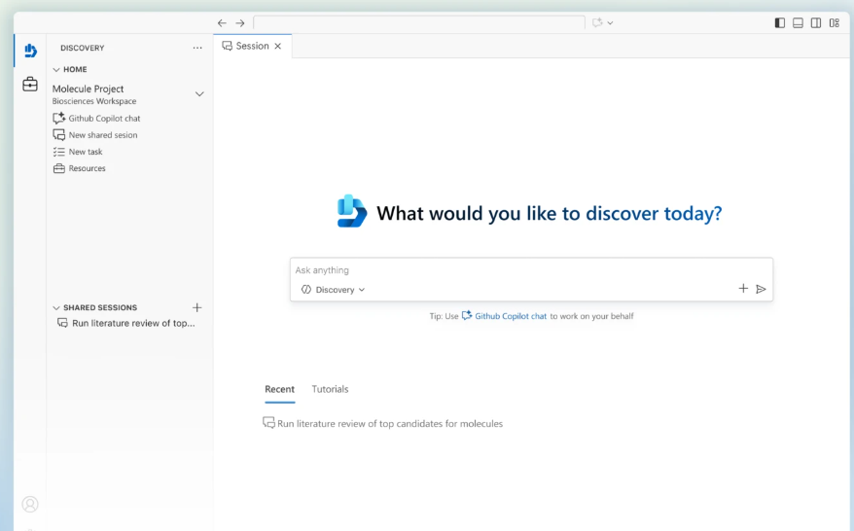
ML & AI & IOT Updates
Generally Available: Microsoft Foundry for Visual Studio Code (June Build 2026 refresh)
The Microsoft Foundry extension for Visual Studio Code reaches general availability with a Build 2026 refresh that brings the full model catalog, model playground, and Hosted agent deployment into the editor. Developers can sign in with their Azure account, create or open a Foundry project, browse over 1,900 models with filters for publisher and capability, and deploy a model into the project without leaving VS Code. The extension also generates starter code for Python, .NET, JavaScript, or Java in the SDK and authentication style the developer prefers. For Hosted agents, the extension supports both local development and one-click deploy to Foundry Agent Service, with side-by-side model and agent playgrounds for fast iteration.
Announcing Microsoft Discovery general availability
Microsoft Discovery is now generally available, providing a new AI-powered platform designed to accelerate scientific research and innovation by combining advanced AI, simulation, and scientific reasoning capabilities. The platform helps researchers, engineers, and R&D teams explore complex scientific problems, generate hypotheses, analyze data, and accelerate discovery workflows across domains such as chemistry, materials science, pharmaceuticals, energy, and manufacturing.

Slide 94
DevOps & IaC & Automation

Slide 95
DevOps & IaC & Automation
Public Preview: Azure Logic Apps Codeful Workflows with Logic Apps Standard SDK.
Modern integration and automation teams increasingly want the flexibility of writing workflows directly in code while still benefiting from managed orchestration, enterprise connectors, and cloud-scale operational capabilities. Traditional workflow models can create friction for pro developers who prefer imperative programming patterns and code-first development experiences.
With Codeful Workflows, Azure Logic Apps extends Logic Apps Standard with a code-first authoring and execution model built on .NET and a first-class Logic Apps Standard SDK.
Regional Endpoints for Azure Container Registry Geo-Replication — Now in Public Preview
Azure Container Registry (ACR) now introduces regional endpoints for geo-replicated registries, allowing clients to connect directly to a specific regional replica instead of relying on a global registry endpoint. This improves performance by reducing latency and keeping image pulls and pushes closer to the workloads consuming them. Regional endpoints also enhance resiliency by allowing applications and CI/CD pipelines to continue operating against a local replica during regional connectivity issues. The feature provides greater control over traffic routing, helping organizations optimize container image distribution across multi-region deployments. It is particularly beneficial for global AKS, Azure Container Apps, and Kubernetes environments that require predictable performance and reduced cross-region data transfer. This enhancement strengthens ACR's support for large-scale, geographically distributed container platforms while improving availability and operational flexibility.

Slide 96
DevOps & IaC & Automation
Public Preview: Deployment Templates support packaging deployment configurations in registries for curated deployment
Deployment templates in Azure Machine Learning add public preview support for deploying from registries, expanding the set of model registries that customers can use as the source for a templated deployment. Deployment templates package a model, deployment configuration, and container information into a reusable artifact that platform teams can share with development teams. This update makes it easier for platform owners to standardize how a team deploys curated models from registries, while preserving governance through the template itself.

Slide 97
DevOps & IaC & Automation
Generally Available: Speech SDK 1.50 for Azure AI Speech
Speech SDK 1.50 ships as a generally available release across all supported languages: C#, C++, Java, JavaScript, Python, Objective-C, Swift, and Go. The release rolls up the latest speech-to-text and text-to-speech features behind a stable API surface and is published to the standard NuGet, Maven, npm, PyPI, and CocoaPods feeds. Existing apps can move to 1.50 with a package version bump in most cases. The SDK continues to support real-time and offline scenarios against local devices, files, Azure Blob Storage, and input/output streams.
Generally Available: Azure AI Translator SDKs for the latest text translation API
Azure AI Translator publishes generally available SDKs that target the latest text translation REST API across four languages: C#/.NET, Java, JavaScript, and Python. The SDKs expose Translator API v4 SDK to GA across all four supported programming languages, giving developers a single client surface to choose between traditional neural machine translation and LLM-based translation per request. Teams building multilingual products and support content have had to manage two parallel translation paths, with different SDKs, request shapes, and quality profiles, making it hard to mix models within one workflow.
With the new SDK, developers can set the translation model, output tone, target gender, and adaptive settings on every call from the same Translator client. The release simplifies integration code, makes feature parity across .NET, Python, Java, and JavaScript clients consistent, and aligns the SDK surface with Translator API v4 capabilities including LLM model selection and the latest adaptive translation features.

Slide 98
Miscellaneous

Slide 99
Miscellaneous Updates
Public Preview: Observability developer experience in Azure Developer CLI (azd)
Use the Azure Developer CLI (azd) CLI evaluation experience to add a measured quality loop to an agent created with Microsoft Foundry. It empowers users on the hosted-agent lifecycle in azd, where you create, provision, deploy, initialize evaluation assets, run a first evaluation, inspect the run, and reuse the evaluation recipe for later runs.
Announcing Intelligent Terminal 0.1
Microsoft has introduced Intelligent Terminal v0.1, an experimental AI-powered command-line experience designed to make terminal interactions more intuitive and productive. The tool combines traditional shell capabilities with AI assistance, helping users understand commands, troubleshoot errors, generate scripts, and perform complex tasks using natural language. Rather than replacing the terminal, Intelligent Terminal augments it by providing contextual guidance and command suggestions directly within the command-line workflow. It can help developers and administrators reduce time spent searching documentation, deciphering error messages, and constructing complex commands. The project is open source and aims to explore how AI can improve developer productivity while preserving the flexibility and power of command-line environments. This release represents Microsoft's vision for a more intelligent, conversational terminal experience that integrates AI assistance directly into everyday development and operations tasks.

Slide 100
Miscellaneous Updates
Public Preview: CLI and SDK support for Deployment Templates
Azure Machine Learning Deployment Templates now support management through the Azure CLI and Python SDK, enabling platform teams to automate model deployment standards using Infrastructure-as-Code practices. Previously managed primarily through the Azure portal, deployment templates can now be created, updated, listed, and deleted using CLI commands and SDK APIs.
This enhancement allows organizations to store deployment templates in Git repositories, manage them through pull requests, and integrate them into Azure DevOps and GitHub Actions pipelines. Teams can deploy standardized model configurations consistently across multiple projects using automated deployment workflows, improving governance and operational consistency.
By bringing deployment templates into CI/CD pipelines, Azure Machine Learning enables repeatable, auditable, and scalable model deployment processes, reducing manual effort and helping organizations enforce deployment standards across their AI and machine learning environments.

Slide 101
Miscellaneous Updates
Generally Available: Microsoft Discovery
Microsoft Discovery is now generally available, providing research and development organizations an enterprise platform for building and governing agentic AI workflows across scientific and engineering disciplines. Also available in preview is the Microsoft Discovery app, a local desktop experience that helps researchers and scientific teams begin working with agentic discovery today without requiring cloud infrastructure.

Slide 102
Information

Slide 103
Information
Azure Times GitHub Repo

Slide 104
Questions

