Slide 1
Azure Times #196
March 9, 2026

Slide 2
Networking

Slide 3
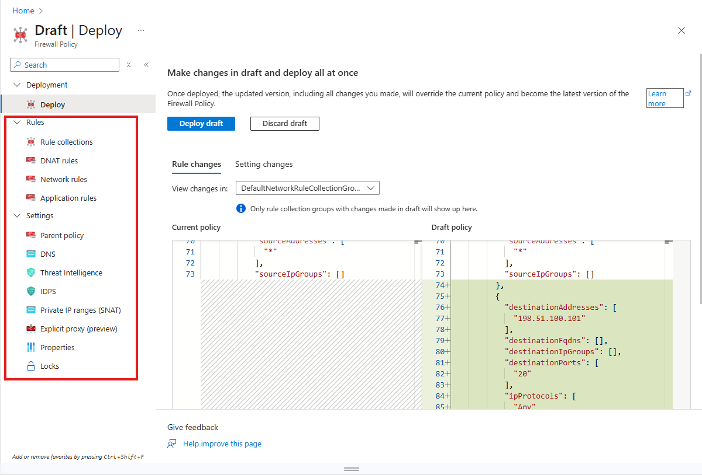
Networking Updates
Generally Available: Draft & Deploy on Azure Firewall
The new Draft & Deploy feature for Azure Firewall Policy introduces a streamlined, two-phase approach to managing firewall policies, significantly reducing deployment time and disruption. Traditionally, any policy update would trigger a full deployment of both the policy and the attached firewall, taking 2–4 minutes per change.
With Draft & Deploy, users can collaboratively make multiple changes in a draft version cloned from the current policy without affecting the live environment. Once finalized, all changes can be deployed at once, replacing the existing policy.
A draft is created as a clone of the currently applied policy. Any changes made to the applied policy after the creation of the draft isn't reflected in the draft unless manually updated.
Deploying a draft replaces the entire applied policy. Changes made to the applied policy after the draft is created aren't preserved unless they're also added to the draft.
Creating a new Rule Collection Group (RCG) isn't supported directly within a policy draft.
Only one draft can exist for a policy at any given time.

Slide 4
Security & Identity

Slide 5
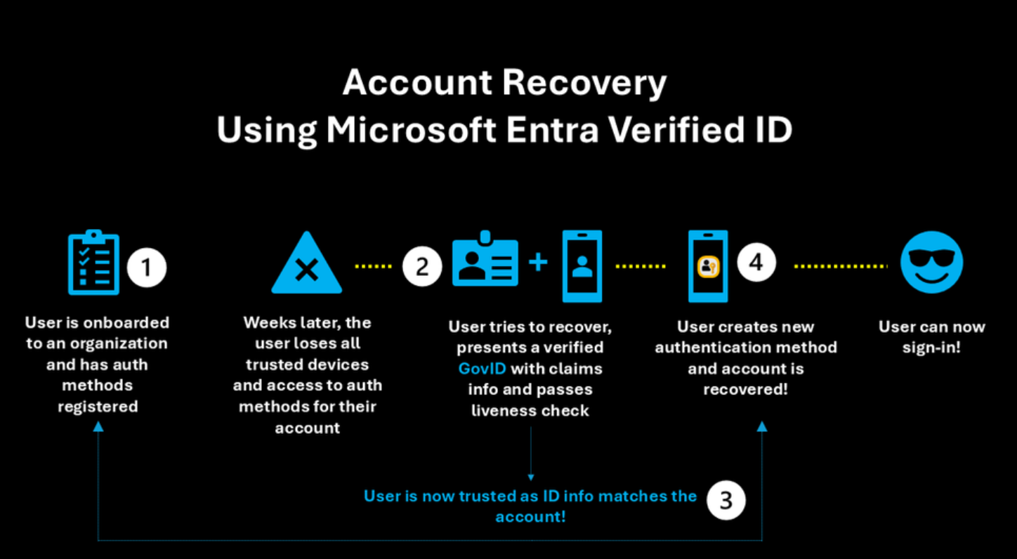
Security & Identity Updates
The Future of Identity: Self-Service Account Recovery (Preview) in Microsoft Entra
Most organizations currently rely on one of two methods for recovery, both of which have significant drawbacks:
Self-Service Password Reset (SSPR): Often relies on "weak" factors like SMS codes or security questions. These are easily intercepted or guessed and don't help a user who is trying to move away from passwords entirely.
The Help Desk: Requires an agent to "vouch" for a user. Attackers can impersonate employees, use voice-cloning technology, or provide leaked personal information to trick an agent into issuing a Temporary Access Pass (TAP).
The new Entra flow removes the human element from the validation process, ensuring that the person regaining access is exactly who they claim to be.
The recovery process is built on the concept of "identity proofing," utilizing government-issued documents and biometric liveness checks.
Integration with Verification Partners
The Verification Process
Issuance of a Verified ID
The Final Handshake: Face Check
Bootstrapping the New Device

Slide 6
Management & Governance

Slide 7
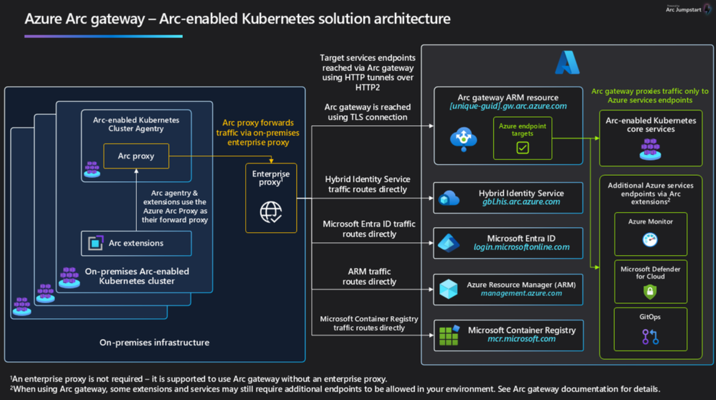
Management & Governance Updates
Announcing the General Availability of the Azure Arc Gateway for Arc-enabled Kubernetes!
The Arc Gateway for Arc-enabled Kubernetes is now Generally Available (GA).
It significantly simplifies network connectivity requirements when connecting Kubernetes clusters to Azure Arc.
Previously, organizations had to allow many outbound endpoints for Azure Arc services. With the Arc Gateway, traffic is consolidated through a smaller, predictable set of endpoints, reducing complexity for enterprise networking and security teams.
For enterprises running Kubernetes clusters behind strict firewalls, proxies, or egress filtering, onboarding Azure Arc often required:
Multiple firewall change requests
Security team approvals
Complex proxy configurations
With Arc Gateway, outbound traffic is aggregated through fewer endpoints, making connectivity easier to manage.

Slide 8
Management & Governance Updates
Retirement: Azure Policy faster enforcement and retirement of login/logout workaround
In light of cache refresh optimizations that are now in place, we’re removing the ‘login/logout workaround’ that triggered faster propagation of policy changes in your environment.
Starting April 30, 2026, the ‘login/logout’ workaround will no longer be available, enabling further enhancements in performance and reliability for all customers.

Slide 9
Compute

Slide 10
Compute Updates
Generally Available: Azure Databricks update workspace network configuration
Azure Databricks workspaces have two network configurations – Azure Databricks-managed VNet and VNet Injection. The ability to update the Network Configuration of your workspace is now generally available.
This enhancement provides greater flexibility and control over Azure Databricks Network Configuration, enabling users to meet evolving security and compliance requirements.
With this capability, it is possible to transition an Azure Databricks-managed VNet to own VNet via VNet injection.
Generally Available: Azure Databricks Lakebase
MS announced the General Availability of Azure Databricks Lakebase, a managed PostgreSQL environment with next-generation separation of storage and compute for OLTP, providing instant availability, instant clones, and scale-to-zero. Lakebase lets us build intelligent, transactional applications and AI agents on the same governed data foundation already used for analytics, BI, and machine learning in Azure Databricks.
With Lakebase, operational data is written directly to lakehouse storage instead of siloed OLTP systems and shadow databases. This eliminates brittle ETL pipelines, reduces data duplication, and enables real‑time insights and AI on fresh operational data without complex data movement.
Developers can use familiar Postgres tools and libraries while Azure handles security, identity, networking, and compliance. Lakebase offers autoscaling, scale‑to‑zero, point‑in‑time recovery, and instant database branching so teams can move faster from prototype to production while maintaining enterprise‑grade reliability.
Running on Azure Databricks, Lakebase unifies operational and analytical workloads on open data formats, making it easier to power AI‑driven customer experiences, real‑time operational analytics, and modern line‑of‑business applications—all with the global scale and enterprise trust of the Microsoft cloud.

Slide 11
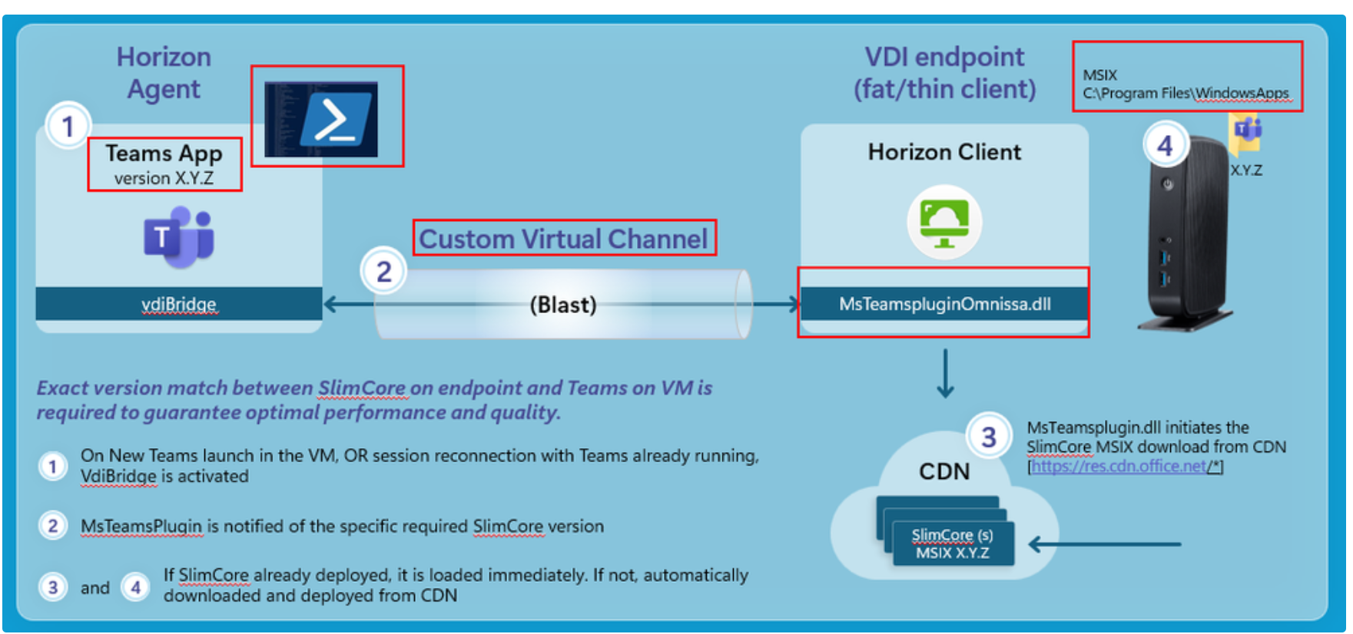
Compute Updates
Announcing Public Preview: New Microsoft Teams VDI Optimization for Omnissa
MS announced the tech preview of the new Microsoft Teams VDI optimization for Omnissa Horizon environments, bringing a modern, high-performance collaboration experience to customers running Teams in virtual desktops.
With thew new optimization now in available in tech preview for Omnissa Horizon, customers can deliver a native-like Teams experience while continuing to benefit from the operational and security advantages of VDI.
This release brings Omnissa customers onto the same next generation optimization architecture already powering Teams across other supported VDI platforms.

Slide 12
Databases

Slide 13
Databases Updates
Managed Identity Support for Azure SQL Database Import & Export services (preview)
Azure SQL Database Import & Export services now support authentication using User-Assigned Managed Identity (UAMI).
This eliminates the need to store or manage credentials such as:
SQL passwords
Storage account access keys
SAS tokens
Import and export operations can now securely access Azure SQL Database and Azure Storage using Azure AD-based identity.

Slide 14
Databases Updates
GA of update policy SQL Server 2025 for Azure SQL Managed Instance
Microsoft announced General Availability of the SQL Server 2025 update policy for Azure SQL Managed Instance. This policy allows organizations to use the newest SQL engine innovations while maintaining compatibility with SQL Server 2025.
This is particularly relevant for environments where database portability to on-prem SQL Server versions must be preserved, while still leveraging Azure SQL platform capabilities.
Instances configured with SQL Server 2025 update policy receive all SQL engine innovations introduced in the Always-up-to-date policy over recent years.
Optimized Locking
Mirroring in Microsoft Fabric
Regular Expression Functions
Vector Data Type and Functions
JSON Data Type and Aggregation Functions
HTTP REST Endpoint Invocation
Backup to Immutable Azure Blob Storage
Change Event Streaming (Private Preview)

Slide 15
ML & AI & IOT

Slide 16
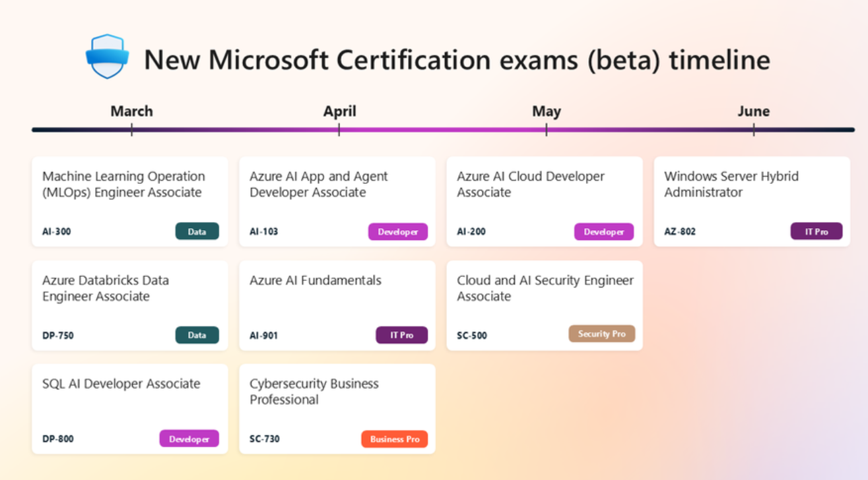
ML & AI & IOT Updates
What’s new in cloud, AI, and security Certifications
The new Certification exams roll out in beta beginning this month, with additional releases following over the next few months and are expected to go live later this year.

Slide 17
ML & AI & IOT Updates
Introducing GPT-5.4 in Microsoft Foundry
OpenAI’s GPT‑5.4 is now generally available in Microsoft Foundry: a model designed to help organizations move from planning work to reliably completing it in production environments. As AI agents are applied to longer, more complex workflows, consistency and follow‑through become as important as raw intelligence. GPT‑5.4 combines stronger reasoning with built in computer use capabilities to support automation scenarios, and dependable execution across tools, files, and multi‑step workflows at scale.
GPT-5.4 introduces advancements that aim for production grade AI:
More consistent reasoning over time, helping maintain intent across multi‑turn and multi‑step interactions
Enhanced instruction alignment to reduce prompt tuning and oversight
Latency improved performance for responsive, real-time workflows
Integrated computer use capabilities for structured orchestration of tools, file access, data extraction, guarded code execution, and agent handoffs
More dependable tool invocation reducing prompt tuning and human oversight
Higher‑quality generated artifacts, including documents, spreadsheets, and presentations with more consistent structure
.
Now in Foundry: Qwen3.5 Medium Model Series
Qwen3.5 Medium Model Series, now available in Microsoft Foundry. All three models are Vision Language Models (VLMs) built with early-fusion multimodal training, a 262K native context window, and support for 201 languages, released under Apache 2.0. They range from a 27B dense model optimized for latency-sensitive deployments to a 122B sparse Mixture-of-Experts (MoE) model that activates only 10B parameters per inference call, delivering frontier-class multimodal performance at lower inference cost.
Unified Vision-Language training (early fusion): Rather than attaching a separate vision encoder to a text model as an afterthought, Qwen3.5 trains on text and image tokens together from the beginning. This can enable stronger reasoning over diagrams, charts, and documents compared to prior Qwen3-VL models, which used a separate vision pipeline.
Gated Delta Networks: A novel linear attention mechanism that replaces standard self-attention in most transformer layers. Combined with sparse MoE routing in the two larger models, this hybrid can deliver high-throughput inference at lower latency than equivalent dense architectures.
Scalable RL across agent environments: Post-training uses reinforcement learning scaled across large multi-agent environments, contributing to strong performance on instruction-following and agentic task benchmarks.

Slide 18
Miscellaneous

Slide 19
Miscellaneous Updates
Windows Terminal Preview 1.25 Release
Microsoft has resumed the regular release cycle and introduced Windows Terminal 1.25 (Preview) while updating the stable channel to version 1.24.
This release focuses on usability improvements, extensibility, and terminal rendering performance.
Improved Command Palette Language Support
New Extensions Settings Page
Synchronized Output Support

Slide 20
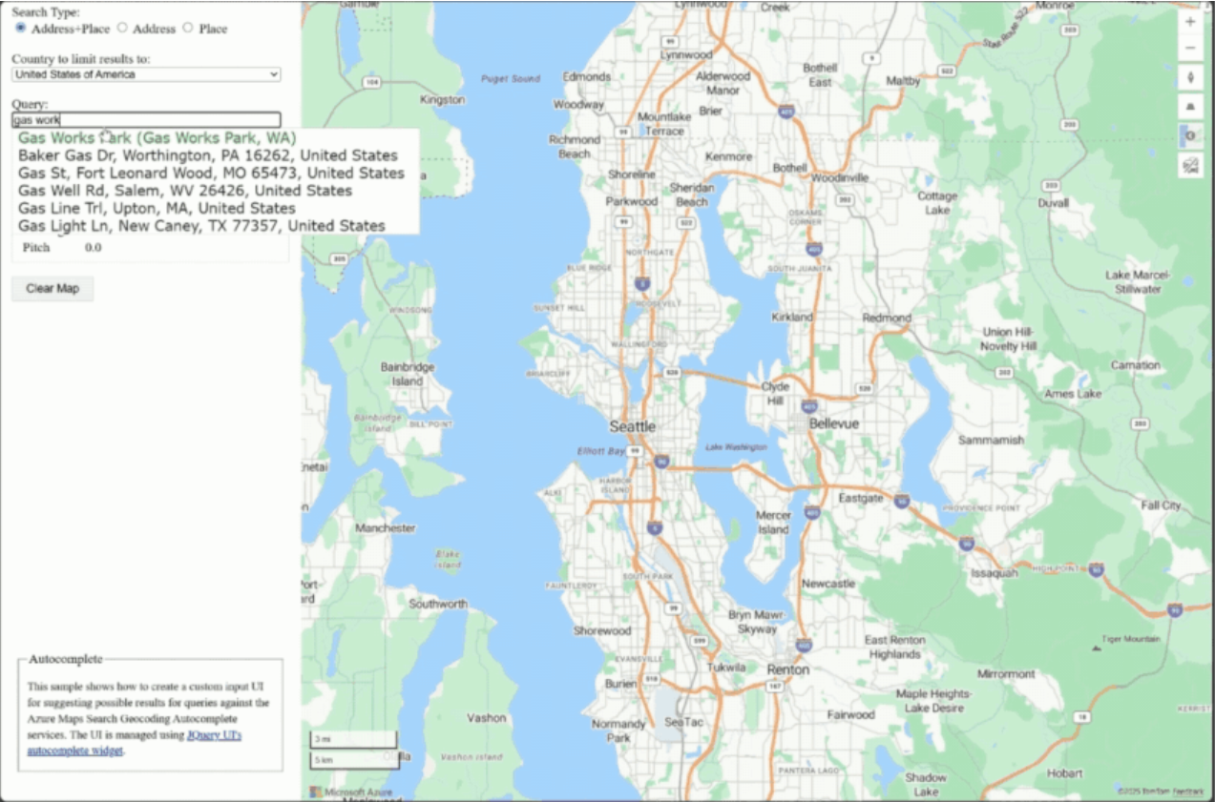
Miscellaneous Updates
Announcing the General Availability of the Azure Maps Geocode Autocomplete API
MS announced the general availability (GA) of the Azure Maps Geocode Autocomplete API, a production‑ready REST service that delivers fast, intelligent, and structured location suggestions.
Today’s applications increasingly rely on smart, real‑time location suggestions, whether for store locators, delivery routing, rideshare dispatch, address entry, or dynamic search UIs. The Azure Maps Geocode Autocomplete API brings:
Instant, relevant, typed‑ahead suggestions
Granular result type filtering for Place or Address categories or even subtypes of Place category
Structured, developer‑friendly outputs
Support for multilingual experiences and localized ranking
Proximity‑aware and popularity‑aware results

Slide 21
Information

Slide 22
Information
Azure Times GitHub Repo

Slide 23
Questions

