Slide 1
Azure Times #168
June 30, 2025

Slide 2
Networking

Slide 3
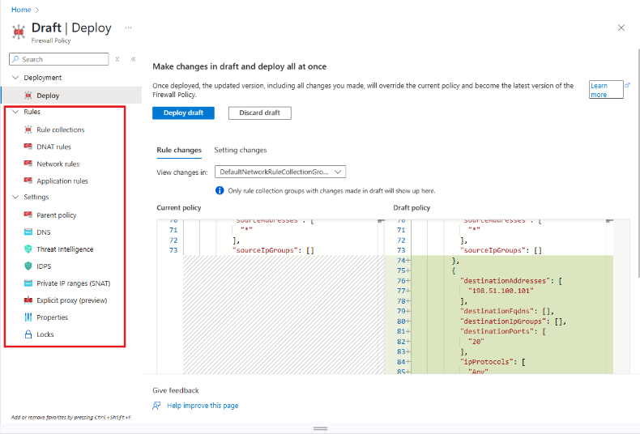
Networking Updates
Public Preview: Draft & Deploy on Azure Firewall
The new Draft & Deploy feature for Azure Firewall Policy introduces a streamlined, two-phase approach to managing firewall policies, significantly reducing deployment time and disruption. Traditionally, any policy update would trigger a full deployment of both the policy and the attached firewall, taking 2–4 minutes per change.
With Azure Firewall Policy Draft + Deployment, you can streamline this process using a two-phase approach:
Draft: Make multiple changes collaboratively, saved in a temporary draft policy cloned from your current applied policy. These changes don't affect the live policy.
Deployment: Apply all changes at once by deploying the draft, replacing the current applied policy with the updated version.
A draft is created as a clone of the currently applied policy. Any changes made to the applied policy after the creation of the draft isn't reflected in the draft unless manually updated.
Deploying a draft replaces the entire applied policy. Changes made to the applied policy after the draft is created aren't preserved unless they're also added to the draft.
Creating a new Rule Collection Group (RCG) isn't supported directly within a policy draft.
Only one draft can exist for a policy at any given time.

Slide 4
Networking Updates
Generally Available: Azure Virtual Network Manager IP address management
The following are some key features of IPAM in Azure Virtual Network Manager:
Create pools for IP address planning.
Autoassign nonoverlapped CIDRs to Azure resources.
Create reserved IPs for specific needs.
Prevent Azure address space from overlapping on-premises and cloud environments.
Monitor IP/CIDR usages and allocations in a pool.
Support for IPv4 and IPv6 address pools.
There are two types of pools in IPAM:
Root pool: The first pool created in instance is the root pool. This represents entire IP address range.
Child pool: A child pool is a subset of the root pool or another child pool. You can create multiple child pools within a root pool or another child pool. You can have up to seven layers of pools.

Slide 5
Security & Identity

Slide 6
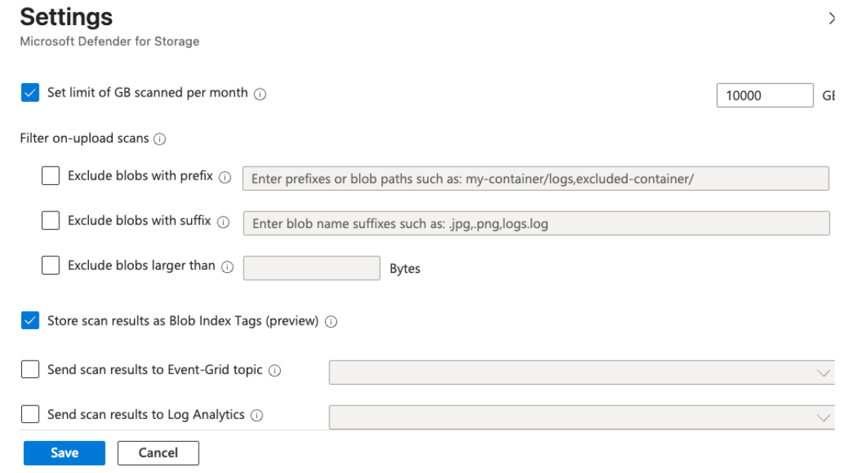
Security & Identity Updates
New feature in Defender for Storage: Optional Index Tags
Microsoft Defender for Storage to protect blobs from malware and scan results are automatically written to blob index tags. These tags are helpful for querying scan status efficiently and seeing results in near-real time in the blob itself, but for high-frequency scans, those extra writes can add up in cost.
Starting June 25th, Defender for Storage introduces optional index tags. This means it is possible to disable writing scan results as index tags, while keeping malware scanning fully active and effective.

Slide 7
Management & Governance

Slide 8
Management & Governance Updates
Public Preview: Monitor ingestion issues with Azure Monitor Workspace
Azure Managed Prometheus sends metrics into Azure Monitor Workspace. Customers can now view and monitor issues with ingestion of Prometheus metrics as part of the platform metrics for the Azure Monitor Workspace. Ingestion errors are issues that occurred during data ingestion and might suggest data loss.

Slide 9
Management & Governance Updates
Generally Available: Azure Advisor VM Right-Sizing Update – Expanded SKU support and series coverage
Azure Advisor has improved its VM right-sizing recommendations by extending coverage for newer VM series. This broader SKU coverage across the D, E, and F VM families enables a more comprehensive evaluation of CPU performance, providing your teams with recommendations to optimize workloads efficiently.
Now, organizations can identify overprovisioned VMs and switch to right-sized configurations that better align with actual usage. This helps reduce costs, minimize resource waste, and lower carbon emissions - all without impacting performance.

Slide 10
Compute

Slide 11
Compute Updates
Generally Available: Azure FXv2-series Virtual Machines
Microsoft has announced the General Availability of Azure FXv2-series Virtual Machines (VMs), which are powered by the 5th Generation Intel® Xeon® Platinum 8573C processor. These VMs offer significant improvements in CPU performance, memory capacity, and storage capabilities, making them ideal for compute-intensive workloads such as databases and data analytics.
FXv2-series VMs provide up to 50% better CPU performance compared to the previous generation, with sizes supporting up to 96 vCPUs and 1,832 GiB of memory. They also feature NVMe support for faster remote storage performance up to 400K IOPS and 11.25 GBps throughput.

Slide 12
Storage & Data

Slide 13
Storage & Data Updates
Generally Available: Transition existing platform-managed keys (PMK) to customer-managed keys (CMK) for Azure NetApp Files volumes without data migration.
It is now possible to transition existing volumes from platform-managed keys (PMK) to customer-managed keys (CMK) seamlessly. This provides customers flexibility of encryption key lifecycle (renewals, rotations) and additional security for regulated industry requirements (Finance, Healthcare, Federal).

Slide 14
Integration

Slide 15
Integration Updates
Introducing Confluent Kafka Connector (Public Preview)
MS announced the Confluent Kafka Connector in Logic Apps (Standard) which allows to both send and receive messages between Logic Apps and Confluent Kafka.
Confluent Kafka is a distributed streaming platform for building real-time data pipelines and streaming applications. It is used across many industries including financial services, Omnichannel retail, autonomous cars, fraud detection services, microservices and IoT deployments.
Supported regions:
West Central US
East Asia
West US 2
North Europe
North Central US
East US
South Africa West
Canada East

Slide 16
DevOps & IaC & Automation

Slide 17
DevOps & IaC & Automation
Public Preview: Create Dev Boxes on Behalf of Your Developers
MS announced create Dev Boxes on behalf of developers.
During onboarding of a new hire, running a hackathon, or setting up for a customer demo, this feature makes it easy for admins to set developers workplace.
To enable this feature, your admin must assign a custom role at the subscription level with the following permissions:
Create On-Behalf Permission
Name: Microsoft.DevCenter/projects/users/devboxes/CreateOnBehalf
Display Name (UI): Other : Projects_Users_DevBoxes_CreateOnBehalf
Dev Box Approval Permission
Name: Microsoft.DevCenter/projects/users/devboxes/Approve
Display Name (UI): Other : Projects_Users_DevBoxes_Approve

Slide 18
Miscellaneous

Slide 19
Miscellaneous Updates
AzureAD PowerShell retirement
The AzureAD and AzureAD-Preview PowerShell modules will be retired (and stop working) starting in mid-October 2025.
You can expect one or more temporary outage tests of 8-24hrs in duration in the month of September 2025.
Azure AD Graph retirement
Applications that were configured for extended access that still depend on Azure AD Graph APIs will not be able to continue using these APIs starting in early September 2025.
You should expect one to two temporary outage tests of 8-24hrs in duration between late July and early September 2025.

Slide 20
Information

Slide 21
Information
Azure Times GitHub Repo

Slide 22
Questions

