Slide 1
Azure Times #169
June 7, 2025

Slide 2
Networking

Slide 3
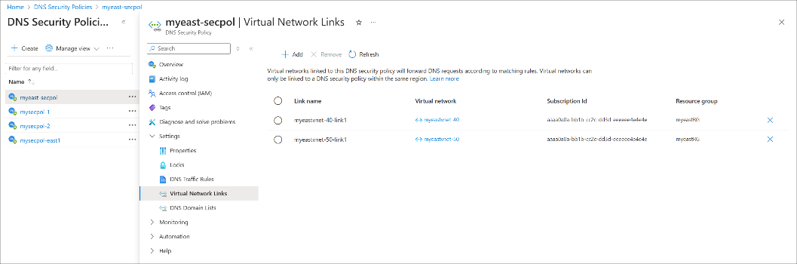
Networking Updates
Generally Available: FQDN Filtering in DNAT rules in Azure Firewall
Azure Firewall supports the use of Fully Qualified Domain Names (FQDNs) in DNAT (Destination Network Address Translation) rules, allowing inbound traffic to be routed to backend resources using domain names instead of static IP addresses.
This feature is especially useful for scenarios where backend IP addresses are dynamic or centrally managed via DNS.
Key Highlights:
DNS-based backend targeting: Route inbound traffic to backend servers using FQDNs.
Dynamic IP support: Ideal for applications where backend IPs change frequently.
Monitoring: Monitor DNAT activity using AZFWNatRule logs.
Generally Available: Azure DNS security policy
DNS security policy offers the ability to filter and log DNS queries at the virtual network (VNet) level. Policy applies to both public and private DNS traffic within a VNet. DNS logs can be sent to a storage account, log analytics workspace, or event hubs. You can choose to allow, alert, or block DNS queries.
The policy:VNet relationship is 1:N. When a VNet is associated with a security policy (via virtual network links), that VNet can't be associated with another security policy without first removing the existing virtual network link. A single DNS security policy can be associated with multiple VNets in the same region.

Slide 4
Security & Identity

Slide 5
Security & Identity Updates
Generally Available: Two-Way Forest Trusts for Microsoft Entra Domain Services
This capability allows organizations to create forest trusts between Microsoft Entra Domain Services and on-premises Active Directory Domain Services (AD DS) environments in either or both directions.
Previously Microsoft Entra Domain Services only supported forest trusts in one direction, out-bound from a managed domain to any customer on-premises domains or forests. This allows users in the on-premises domain to access resources in the managed domain, but not vice versa.
One-way out-bound: This allows users in the on-premises domain to access resources in the managed domain, but not vice versa.
One-way in-bound: This option allows users in the managed domain to access resources in the on-premises domain.
Two-way: This is a bi-directional trust that allows users in both the managed domain and the on-premises domain to access resources in either domain.
This capability offers more control and flexibility over management of hybrid identity environment with Entra Domain Services.
An Enterprise or Premium SKU license is required.

Slide 6
Management & Governance

Slide 7
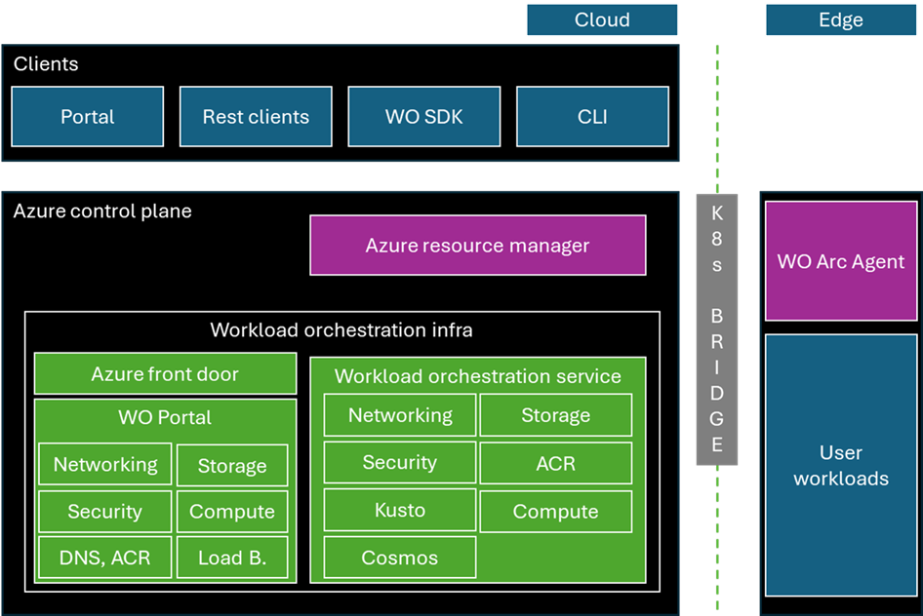
Management & Governance Updates
Announcing general availability of workload orchestration: simplifying edge deployments at scale
Workload orchestration for Azure Arc is a comprehensive, cloud-native, cross-platform service engine that simplifies the deployment, management, and update of application workloads across edge environments.
Migration of Azure VM backups from Standard to Enhanced policy is now generally available
Azure Backup now supports migration to the enhanced policy for Azure VM backups using standard policy. The migration of VM backups to enhanced policy enables to schedule multiple backups per day (up to every 4 hours), retain snapshots for longer duration, and use multi-disk crash consistency for VM backups.
Before start the migration, ensure that there are no ongoing backup jobs for the VM that you plan to migrate.
Migration is supported for Managed VMs only and isn’t supported for Classic or unmanaged VMs.
Once the migration is complete, you can’t change the backup policy back to standard policy.
When migrate a VM Backup Item from Standard to Enhanced policy, the process triggers a backup job that might take several hours for large VMs. This precautionary backup uses managed disk snapshots — starting with a full disk copy for instant restore, which increases backup time. Later snapshots are incremental, storing only changes since the last snapshot. If you're using unmanaged disks, make sure the storage account hosting the snapshot or VHD files allows public network access or similar settings; otherwise, the system falls back to a standard recovery point restore, which slows down recovery.
The change from standard policy to enhanced policy can result in extra costs.

Slide 8
Management & Governance Updates
Generally Available: Query editor in Azure Monitor Metrics
MS announced the General Availability of Query Editor in Azure Metric Explorer through Azure Monitor Workspace (AMW).
With this update, it is possible to directly query Prometheus metrics using PromQL within their Azure Monitor workspace. This empowers users to efficiently explore and analyze their metric data by writing PromQL queries directly in Metric Explorer, gaining valuable insights to optimize their resources and enhance performance.

Slide 9
Management & Governance Updates
Public preview: Azure Migrate supports end-to-end migration of Gen2 VMs—(VM with UEFI boot type)—to Trusted Launch virtual machines (TVMs).
This is available for all migration scenarios (VMware, Hyper-V, and Physical). Users can now assess their Gen2 VMs for TVM readiness and perform direct migrations to TVMs using Azure Migrate. It includes full support for Secure boot, test migrations and scaled migrations, enabling a seamless and secure transition to Trusted Launch VMs.
Public preview: Azure Migrate supports sustainability efforts by offering Sustainability insights in its Business Case.
It empowers IT, finance, and sustainability teams estimate on-premise emissions, compare them with Azure emissions, track yearly reductions, and show both cost and environmental benefits in a single view. This enables customers to make smart migration choices that reduce carbon emissions and support their organization’s ESG goals.

Slide 10
Compute

Slide 11
Compute Updates
Announcing App Service Outbound IPv6 Support in Public Preview
Public preview of outbound IPv6 support for Windows multi-tenant apps is supported on all App Service plan SKUs, Functions Consumption, Functions Elastic Premium, and Logic Apps Standard running Windows. This is the next announcement in our series of IPv6 related feature work on App Service.
IPv6 outbound (dual-stack) allows to resolve endpoints to IPv6 addresses and call the IPv6 endpoint. There are no changes required in code to start using IPv6 compatible endpoints.
Linux sites are NOT supported at this time but will be available in the next few months
The first iteration of the implementation does not support virtual network traffic.

Slide 12
Compute Updates
Generally Available: Azure App Service on Azure Stack Hub 25R1
Azure App Service on Azure Stack Hub 25R1 is now available to download and update their Azure Stack Hub deployments.
Updates to .NET 8 and 9.
Updates to App Service on Azure Stack Hub Resource Provider.
Resolution to [issues customers encountered with 24R1](## Issues fixed in this release).
Retirement: VM Insights Map and Dependency Agent are being on June 30, 2028
With this retirement, all functionality associated with the VM Insights Map and the Dependency Agent will be completely retired.
After this date:
Will not be possible to access the Map tab in VM Insights in the Azure Portal;
Will not be possible to access the Connections Overview workbook which utilizes VM Insights Map data;
Will not be possible to install the Dependency Agent on new VMs from the Azure Portal.
Will not be possible to send new data to Azure Monitor Log Analytics using the Dependency Agent.
Will not be able to query the Service Map API
Existing data will remain in Log Analytics workspace as per configured retention policy.
It is recommended to considering a replacement solution from the Azure Marketplace

Slide 13
Storage & Data

Slide 14
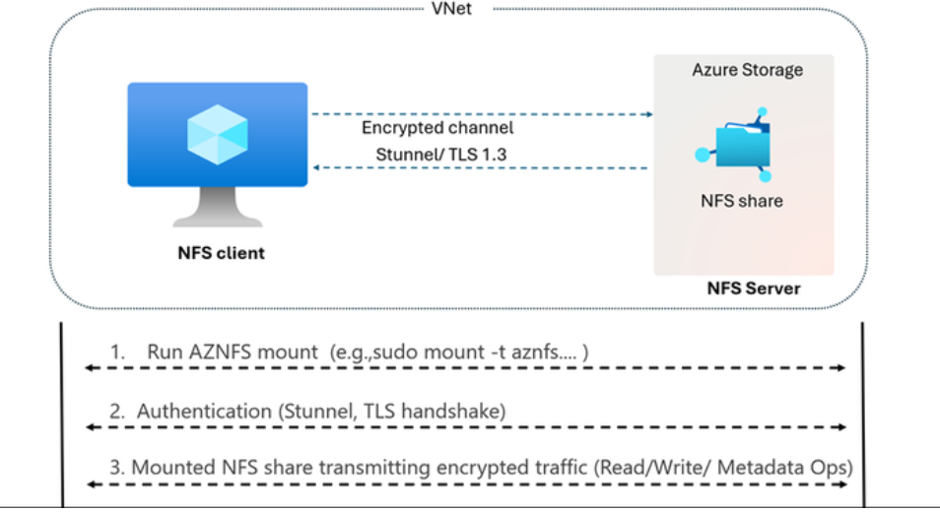
Storage & Data Updates
Generally Available: Encryption in Transit (EiT) for Azure Files NFS shares
Azure Files NFS shares now support Encryption in Transit (EiT) using TLS 1.3 to secure all NFS traffic, ensuring confidentiality, integrity, and authentication. This layer of added security helps enterprises meet end-to-end compliance needs while maintaining performance and simplicity.
Configuring EiT is simple using the open-source AZNFS mount helper, which automates TLS tunneling and volume mount operations for NFS shares. EiT is supported across all major Linux distros, Azure Linux VMs, on-premises Linux servers, and more.
AZNFS Mount Helper: A client utility package that abstracts the complexity of establishing secure tunnels for NFSv4.1 traffic.
Stunnel Process: Per-storage-account client process that listens for NFS client traffic on a local port and forwards it securely over TLS to the Azure Files NFS server.
AZNFS watchdog: The AZNFS package runs a background job that ensures stunnel processes are running, automatically restarts terminated tunnels, and cleans up unused processes after all associated NFS mounts are unmounted.

Slide 15
Databases

Slide 16
Databases Updates
Public Preview: Azure SQL updates for early-July 2025
In early-July 2025, the following updates and enhancements were made to Azure SQL:
Convert Azure SQL database to Hyperscale while keeping existing active geo-replication or failover group configurations.
Try the mssql-python driver with new platform support and powerful features for Microsoft SQL Server and the Azure SQL family
Rapid prototyping in Visual Studio Code with local SQL containers, GitHub Copilot agent mode, and connection groups.

Slide 17
Databases Updates
Generally Available: Latest PostgreSQL minor versions supported by Azure Database for PostgreSQL flexible server
PostgreSQL minor versions 17.5, 16.9, 15.13, 14.18, and 13.21 are now supported by Azure Database for PostgreSQL flexible server.
These minor version upgrades are automatically performed as part of the monthly planned maintenance in Azure Database for PostgreSQL flexible server. This upgrade automation ensures that your databases are always running the latest optimized versions without requiring manual intervention.
Generally Available: PostgreSQL 17 with in-place upgrade on Azure Database for PostgreSQL flexible server
It is now possible to use PostgreSQL 17 on Azure Database for PostgreSQL flexible server and perform seamless in-place upgrades from previous PostgreSQL versions—all without changing server endpoint, reconfiguring applications, or manually migrating data.
PostgreSQL 17 introduces several enhancements that improve database performance and developer experience. Faster vacuuming and query planning, expanded SQL/JSON support including JSON_TABLE, enhanced MERGE functionality, and more flexible partitioning.

Slide 18
Databases Updates
Announcing General Availability of Enhanced Server Audit for Azure SQL Database
This update delivers improved performance, availability, and reliability, aligning server auditing more closely with SQL Server and Azure SQL Managed Instance.
The new architecture introduces a single extended event session at the server level, capturing audit events across all databases. This design optimizes CPU and memory usage, reduces overhead, and ensures consistent audit behavior across Azure SQL platforms.
Server audit action groups are now available to achieve compliance and feature parity in Azure SQL Database.
Server-level audit action groups are now available in Azure SQL Database. This enhancement enables customers to meet security and compliance requirements more effectively by capturing broader activity at the server scope.

Slide 19
Databases Updates
Generally Available: Secondary users for Azure Cosmos DB for MongoDB (vCore)
MS announced that Azure Cosmos DB for MongoDB (vCore) clusters now support secondary users, enabling more flexible and granular access control for database. Previously, each cluster could have only one user with full privileges, limiting access control options.
These users can authenticate to the database using their username and password.
Additional users can be assigned read-write or read-only permissions, further enhancing the granularity of access control.

Slide 20
Information

Slide 21
Information
Azure Times GitHub Repo

Slide 22
Questions

