Slide 1
Azure Times #170
July 14, 2025

Slide 2
Networking

Slide 3
Networking Updates
Public Preview: Azure Virtual Network Manager high-scale private endpoints in connected groups
Azure Virtual Network Manager high-scale private endpoints in connected groups is now in public preview, delivering enhanced scalability for complex Azure network environments.
As organizations grow, the need to large numbers of private endpoints becomes critical. This new capability enables up 2,000 private endpoints within a connected group—empowering you to scale workloads more efficiently in Azure.

Slide 4
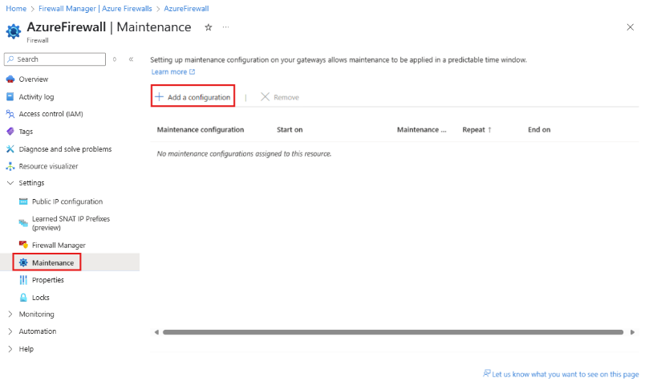
Networking Updates
Generally Available: Customer controlled maintenance for Azure Firewall
Azure Firewall allow users to set a maintenance window with a minimum duration of 5 hours, recurring daily, to best accommodate their requirements and minimize unexpected downtime. Firewalls with an associated maintenance configuration will not undergo upgrades outside the designated maintenance period.

Slide 5
Security & Identity

Slide 6
Security & Identity Updates
Generally Available: Granular Role-Based Access Control (RBAC) for Azure File Sync
Azure File Sync now offers two dedicated, built-in RBAC roles, designed to enhance security and operational efficiency for businesses managing file synchronization across on-premises and cloud environments.:
Azure File Sync Administrator - This role provides full access to manage all Azure File Sync (Storage Sync Service) resources, including the ability to assign roles in Azure RBAC
Azure File Sync Reader - This role provides read access to Azure File Sync service (Storage Sync Service)
Hotpatching now available for 64-bit Arm architecture
Hotpatching is now generally available for your Windows 11, version 24H2 Arm64 devices. More client devices can now experience the power of security updates that don't require a restart!

Slide 7
Management & Governance

Slide 8
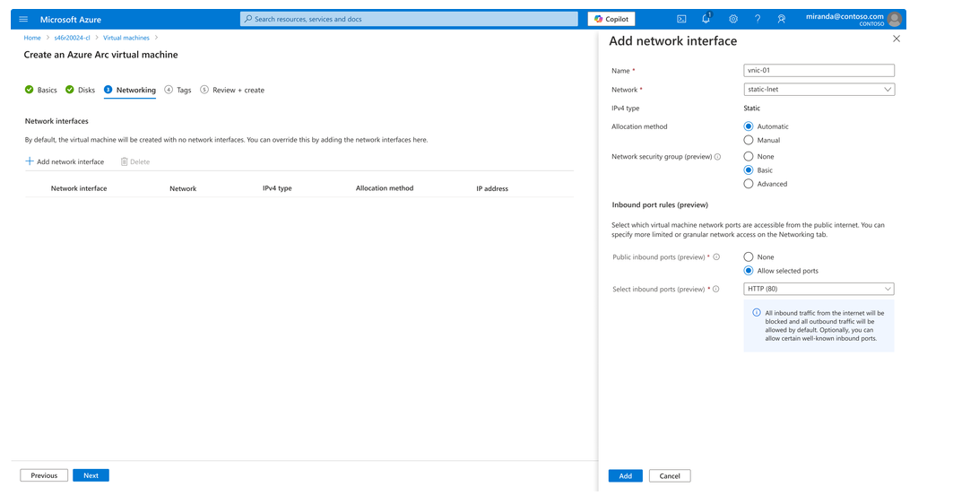
Management & Governance Updates
Announcing the preview of Software Defined Networking (SDN) enabled by Azure Arc on Azure Local
This release brings cloud-native networking capability of access control at the network layer using Network Security Groups (NSGs) on Azure Local.
Some of the key highlights in this release are:
Centralized network management: Manage Logical networks, network interfaces, and NSGs through the Azure control plane
Fine-grained traffic control: Safeguard edge workloads with policy-driven access controls by applying inbound and outbound allow/deny rules on NSGs
Seamless hybrid consistency
It is now possible:
Deploy logical networks
Attach VM Network Interfaces
Apply NSGs

Slide 9
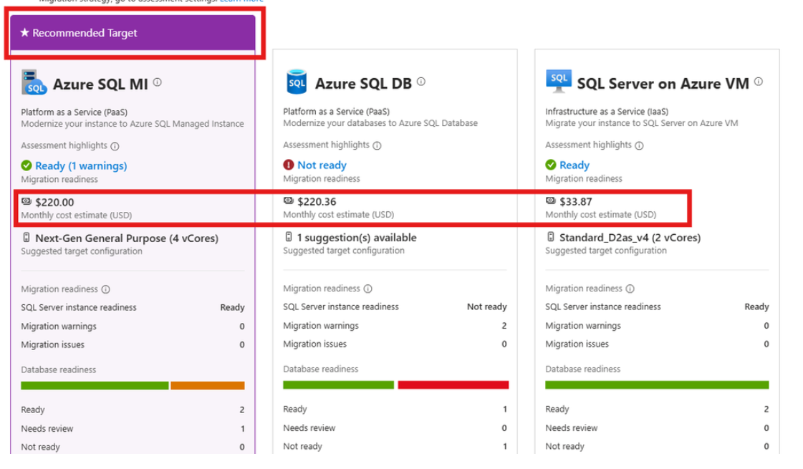
Management & Governance Updates
General Availability: Continuous Migration Assessment for SQL Server Enabled by Azure Arc
Enhanced Assessment Experience: Benefit from a refreshed landing page and detailed views for single Arc SQL Server instances.
Retail Pricing with Azure Savings Options: Now it is possible to seamlessly access retail pricing information for all Azure Savings Options, including SQL Azure Hybrid Benefit (AHB), Windows AHB, Reserved Instances, and Azure Savings Plans.
Comprehensive Cost Breakdown: See the projected cost split by Compute and Storage for each configuration, making it easier than ever to understand where your investments matter most.
Precomputed Savings: Save time and reduce manual errors. All prices for savings options are precomputed; simply adjust from Assessment settings and watch costs quickly update for the single instance view.
Migration Strategy Improvements: Migration strategy-based recommendations now appear in the portal alongside your chosen pricing settings, all within scope for a single instance—providing strategic guidance at your fingertips.

Slide 10
Compute

Slide 11
Compute Updates
Private Preview: Enable Trusted launch on existing Virtual machine Flex scale set
Announcing preview support to enable Trusted launch on existing Virtual machine Flex scale set by upgrading the scale set resource to Gen2-Trusted launch. This will help improve the foundational security of existing Azure Virtual machine Flex scale set resources.
Trusted Launch VMs provide foundational compute security to Azure Generation 2 VMs by enabling Secure Boot and vTPM capabilities. Trusted Launch capabilities protect OS against rootkits, boot kits and enables attestation by measuring the boot chain of VM.
Public Preview: Trusted launch default for new Gen2 VMs & Scale sets
Announcing public preview for key security enhancement in Azure: Trusted Launch as default (TLaD) for new deployments of Gen2 Virtual Machines (VMs), Virtual Machine Scale Sets (Scale set) and Azure Compute Gallery (ACG) resources.
Trusted Launch VMs provide foundational compute security to Azure Generation 2 VMs by enabling Secure Boot and vTPM capabilities. Trusted Launch capabilities protect OS against rootkits, boot kits and enables attestation by measuring the boot chain of VM.

Slide 12
Compute Updates
Generally Available: Enable Trusted launch on existing Virtual machine Uniform scale set
Announcing general availability of support to enable Trusted launch on existing Virtual machine Uniform scale sets by upgrading the scale set resource to Gen2-Trusted launch. This will help improve the foundational security of existing Azure Virtual machine Uniform scale set resources.
Trusted Launch VMs provide foundational compute security to Azure Generation 2 VMs by enabling Secure Boot and vTPM capabilities. Trusted Launch capabilities protect OS against rootkits, boot kits and enables attestation by measuring the boot chain of VM.
Improved Node.js Deployment Performance on Azure App Service
MS made significant improvements to how Node.js applications are deployed on Azure App Service — with deployment times now up to 8× faster in some cases.
Traditionally, the node_modules directory was extracted and synced in full during deployment. This process could be slow and resource-intensive, especially for apps with large dependency trees. To address this, MS optimized the way node_modules is handled.
During the deployment phase, instead of copying the entire node_modules folder to the site, MS now compress it into a node_modules.tar.gz archive.

Slide 13
Compute Updates
FSLogix Release 25.06 is now generally available!
Support, data roaming, and application registration for Microsoft Outlook for Windows (MSIX version).
Enabled special handling for the registration of the MSIX package family in both Profiles and ODFC.
Supports redirections of the application data for ODFC containers.
Allows coexistence between classic and Outlook for Windows under a single configuration setting.

Slide 14
Storage & Data

Slide 15
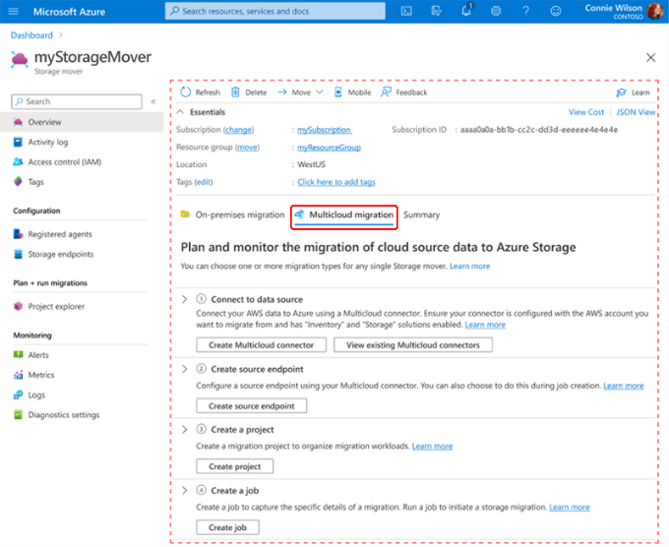
Storage & Data Updates
Public Preview: Azure Storage Mover adds free, direct AWS S3-to-Azure Blob migration
Azure Storage Mover - now supports data transfers from Amazon Web Services (AWS) S3 to Azure Blob Storage. The new Cloud-to-Cloud migration capability enables simplified, petabyte-scale data movement securely between clouds.
The feature utilizes Azure Arc multicloud connectors for AWS (Amazon Web Services) to simplify authentication and resource management capabilities to resources outside of the Azure cloud.
The following limitations apply:
Each migration job supports the transfer of 10 million objects.
A maximum of 10 concurrent jobs is supported per subscription.
Azure Storage Mover doesn't support automatic rehydration of archived objects. Data stored in AWS Glacier or Deep Archive must be restored before migration.
Private Networking is currently not supported.

Slide 16
Databases

Slide 17
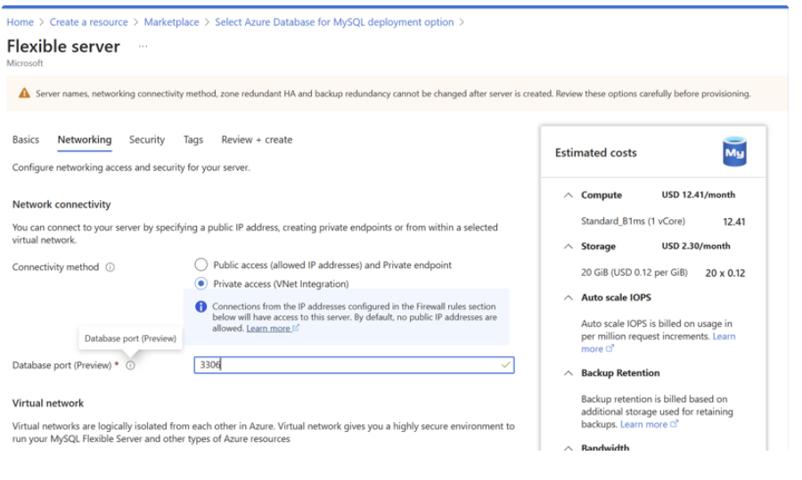
Databases Updates
Public Preview: Custom Port Support in Azure Database for MySQL – Flexible Server
By default, MySQL servers listen on port 3306. While this works well for most setups, some organizations need custom port configurations.
With this update, it is possible to choose a custom port number when creating VNet-injected MySQL Flexible Server—giving flexibility without compromising on the fully managed experience Azure offers.
Flexible Port Selection: Choose any port between 25001 and 26000 during server creation.
Seamless Restore and HA: Use custom ports with supported operations such as restore, read replica creation, and high availability.
One Port per Server: Each server supports a single custom port configuration.
Supported in Public Preview:
VNet-injected servers
New server creation with a custom port
Restores across different ports
Read replica creation
High Availability (HA) on custom ports
Current Limitations:
Updating the port after server creation
Geo-restore and geo-replication
Public access and Private Link (coming soon)

Slide 18
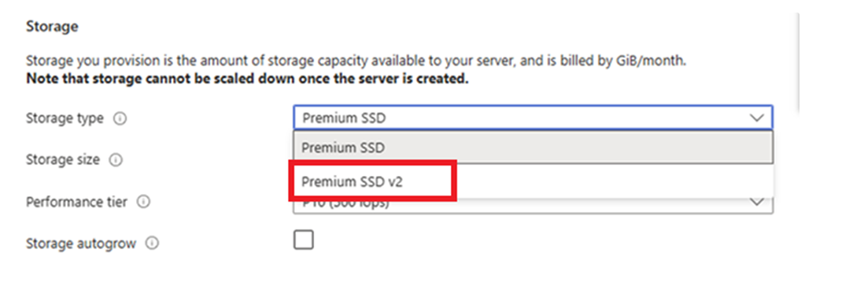
Databases Updates
Premium SSD v2 Brings Enhanced HA to Azure Database for PostgreSQL flexible server
With Premium SSD v2, high availability now comes with enhanced resiliency and under 10 seconds failovers, whether deployed in the same zone or across zones. This enables customers to build resilient, high-performance PostgreSQL applications with minimal overhead. It's especially ideal for workloads demanding higher IOPS and ultra-low latency
Key Features:
Premium SSD v2 provides flexible disk sizing from 32 GiB to 64 TiB, with 1-GiB granularity.
Failovers under 10 seconds.
Sub-millisecond latency, with high IOPS and throughput.
Up to 80,000 IOPS and 1,200 MBps throughput.
Performance scaling independent of disk size: For example, you can achieve 80,000 IOPS with just a 160 GiB disk.
Baseline performance: Free throughput of 125 MB/s and 3,000 IOPS for disks up to 399 GiB, and 500 MB/s and 12,000 IOPS for disks 400 GiB and above, at no additional cost.
Read replicas, geographically redundant backups, data encryption with customer managed keys, Major Version Upgrade, Long Term Retention or storage autogrow features aren't supported for Premium SSD v2.
Premium SSD v2 High availability can only be configured for servers created on or after July 1st. Currently, SSD v2 High availability is supported in Canada Central, Central US, and East Asia regions. Support for other regions will be coming soon.
You can configure high availability with SSDv2 using PG version 16. Support for all other versions will be coming soon.

Slide 19
DevOps & IaC & Automation

Slide 20
DevOps & IaC & Automation
Generally Available: Azure Automation supports PowerShell 7.4 & Python 3.10 runbooks and Runtime environment
Azure Automation is pleased to announce a series of releases:
General Availability of in-support PowerShell 7.4 and Python 3.10 runbooks
Runtime Environment GA, enabling customers to seamlessly upgrade their outdated scripts to supported runtime versions.
Support for Azure CLI commands in PowerShell 7.4 runbooks GA
Benefits:
Stay current – Access to new language versions for improved security and performance.
Faster Runbook upgrade – Easy portability of runbooks across different versions to keep pace with PowerShell and Python releases.
Granular control – Complete control to configure the script execution environment, without worrying about conflicting module versions.
Efficient Code organization – Eliminate the need to create multiple Automation accounts to segregate different versions of modules or conflicting modules.
Microsoft Graph PowerShell SDK V2.29 Now Available
On July 9, 2025, Microsoft released V2.29 of the Microsoft Graph PowerShell SDK to the PowerShell Gallery.
The release notes are available but don’t really throw much light into what’s been updated and the set of issues registered in GitHub for the SDK hasn’t gone down, so it’s hard to know exactly what changes Microsoft has made in V2.29.

Slide 21
Miscellaneous

Slide 22
Miscellaneous Updates
New Certification on GitHub administration
Take advantage of the discounted beta exam offer. The first 300 people who take Exam GH-100 (beta) on or before July 20, 2025, can get 80% off market price.
To receive the discount, when you register for the exam and are prompted for payment, use code GH100Hoyt. This is not a private access code. The seats are offered on a first-come, first-served basis. As noted, you must take the exam on or before July 20, 2025. Please note that this beta exam is not available in Turkey, Pakistan, India, or China.

Slide 23
Information

Slide 24
Information
Azure Times GitHub Repo

Slide 25
Questions

