Slide 1
Azure Times #171
July 21, 2025

Slide 2
Networking

Slide 3
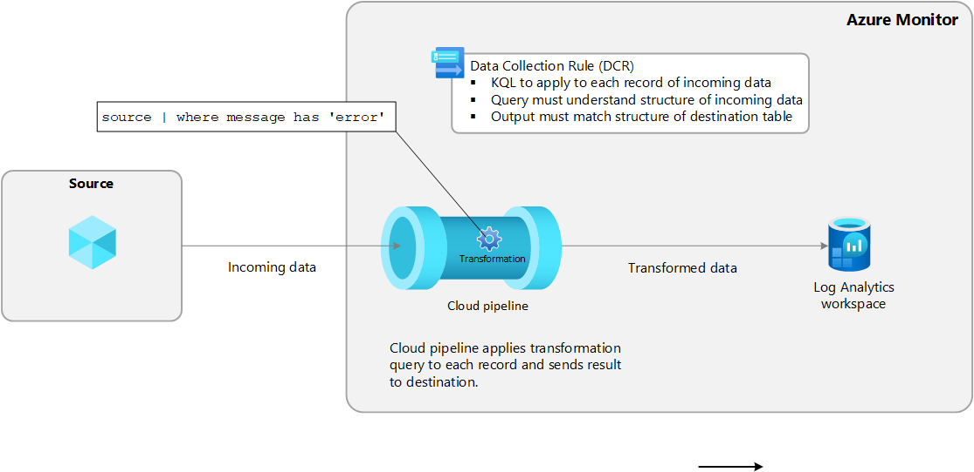
Networking Updates
Generally Available: Azure Firewall now supports ingestion-time transformation in Log Analytics for flexible, cost-efficient logging
For customers using Log Analytics to analyse firewall logs, the cost of log ingestion and storage itself can be significant. This feature lets filter and transform logs before ingestion, helping reduce costs while retaining critical data.
Security monitoring: Log only suspicious traffic for better threat detection.
Cost savings: Avoid ingesting and storing unnecessary logs.
Compliance: Use DCRs to route logs for audit/reporting.
Incident response: Faster access to relevant logs.
Custom alerts: Build dashboards and alerts in Azure Monitor.
Generally Available: Hosted-On-Behald-Of (HOBO) Public IP model for ExpressRoute Gateways
All newly deployed ExpressRoute Virtual Network Gateways will use the Hosted-On-Behalf-Of (HOBO) Public IP model. This change simplifies gateway configuration by removing the requirement to explicitly assign a Public IP address.
The HOBO model streamlines deployment and improves consistency across gateway types. This feature eliminates the need for customers to manually manage Public IPs for new gateways, helping reduce operation effort and overhead.
Improved security: The public IP is managed internally by Microsoft and isn't exposed to you, reducing risks associated with open management ports.
Reduced complexity: You aren't required to provision or manage a public IP resource.
Streamlined deployment: The Azure PowerShell and CLI no longer prompt for a public IP during gateway creation.
When you create an ExpressRoute gateway, Microsoft automatically provisions and manages the public IP address in a secure, backend subscription. This IP is encapsulated within the gateway resource, enabling Microsoft to enforce policies such as data rate limits and enhance auditability.

Slide 4
Networking Updates
Retirement: Azure Front Door (classic) and Azure CDN from Microsoft Classic SKU ending CNAME based domain validation and new domain/profile creations by August 15, 2025
Starting August 15, 2025, Azure Front Door (classic) and Azure CDN from Microsoft Classic SKUs will no longer support new domain onboarding or profile creation.
Additionally, DigiCert is deprecating CNAME-based Domain Control Validation (DCV) on the same date, aligning with the industry-wide transition to Multi-Perspective Issuance Corroboration (MPIC).
As a result, switching from Bring Your Own Certificate (BYOC) to managed certificates on existing domains will no longer be supported for these classic SKUs. Existing managed certificates will auto-renew before August 15, 2025, with a 12-month validity, ensuring no service disruption until July 1, 2026.
Required action
If you want to use managed certificates or create new domains/profiles, migrate to one of Azure Front Door Standard or Premium SKUs before August 15, 2025.
If you are already using Azure managed certificate on existing domains move to Bring Your Own Certificate (BYOC) before August 15, 2025, or migrate to one of Azure Front Door Standard or Premium SKUs before July 1, 2026. Please refer to Configure HTTPS for your custom domain for details.

Slide 5
Security & Identity

Slide 6
Security & Identity Updates
Generally Available: Microsoft Azure Cloud HSM
Azure Cloud HSM is a FIPS 140-3 Level 3, highly available, single-tenant Hardware Security Module (HSM) service built to meet the most stringent security and compliance requirements. It provides full administrative control over their HSMs, enabling them to manage cryptographic keys and perform sensitive cryptographic operations within their own dedicated Cloud HSM cluster.
It supports PKCS#11, OpenSSL, and JCE, enabling integration with common cryptographic libraries. It's well-suited for running shrink-wrapped software like Apache/Nginx SSL Offload, SQL Server/Oracle TDE, and ADCS on Azure VMs. It supports certificate storage with private keys in HSM via PKCS#11 and supports document and code signing.
The Conditional Access Optimization Agent and Security Copilot in Microsoft Entra are now generally available
Conditional Access Optimization Agent in Microsoft Entra — This agent scans tenant daily for policy gaps as new users and applications come online. It offers precise, one-click remediations so you can keep policies up to date without the overhead.
Security Copilot in Microsoft Entra — Allow to interact with Copilot in Entra to investigate threats, manage the identity lifecycle of employees and guests, and take action quickly across users, apps, and access. All of this works through natural language, without writing custom queries or scripts.

Slide 7
Management & Governance

Slide 8
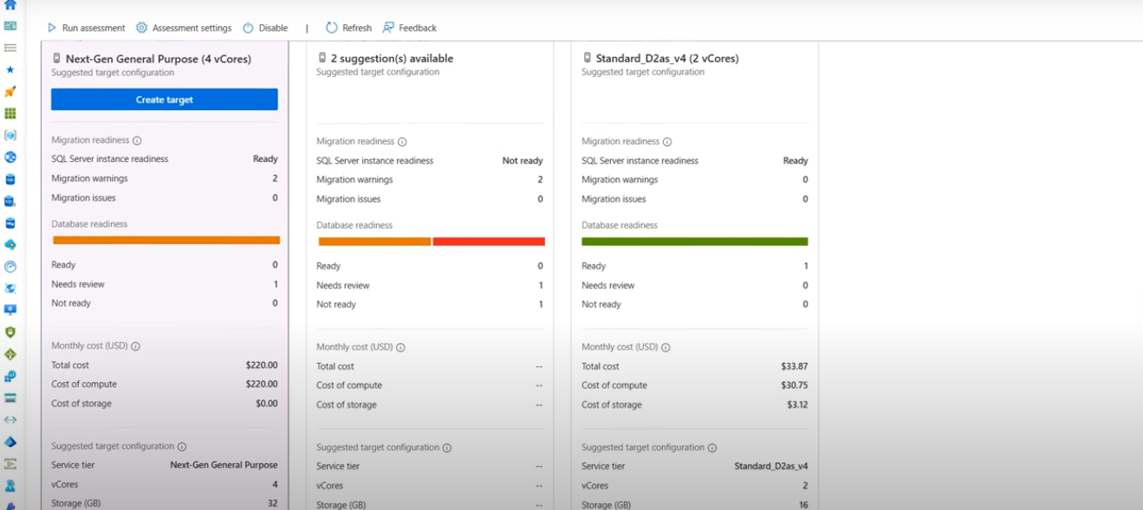
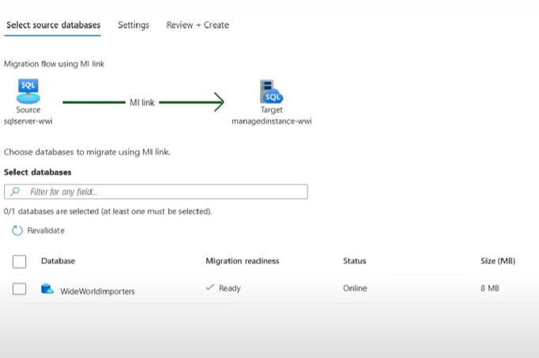
Management & Governance Updates
New database migration experience for SQL Server enabled by Azure Arc – Public Preview
This new migration experience integrates existing Azure Database Migration Service capabilities into Azure Arc by enabling the entire end to end migration journey with the following capabilities:
Continuous database migration assessments with Azure SQL target recommendations and cost estimates.
Seamless provisioning of Azure SQL Managed Instance as destination target, also with an option of free instance evaluation.
Option to choose between two built-in migration methods: real-time database replication using Distributed Availability Groups (powered by the MI link feature), or log shipping via backup and restore (powered by the Log Replay Service feature).
Unified interface that eliminates the need to use multiple tools or to jump between various places in Azure portal.
Microsoft Copilot is integrated to assist you at select points during the migration journey.

Slide 9
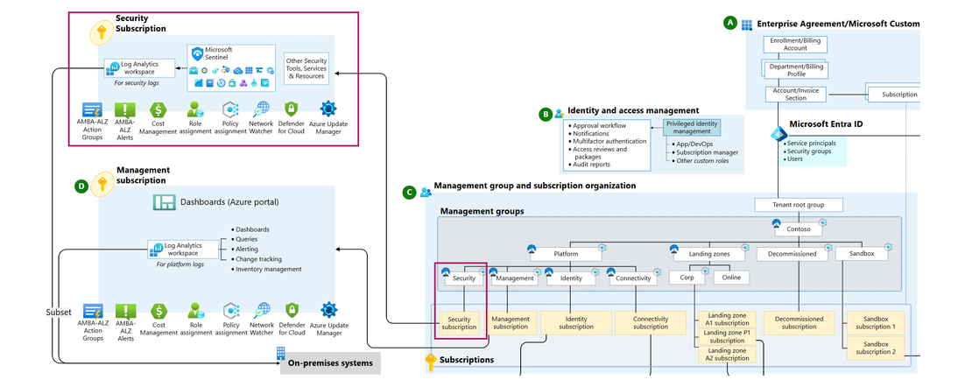
Management & Governance Updates
ALZ Accelerator Changes
Prior to these updates ALZ advised the following:
The central Log Analytics Workspace (LAW) in the Management Subscription should
Be used to capture all logs, including security/SIEM logs
The Microsoft Sentinel solution (called Security) should be installed upon this LAW also
Now:
A new dedicated Security Management Group beneath the Platform Management Group
A new dedicated Empty Security Subscription placed in the new Security Management Group
Generally Available: GRS and CRR support for Azure VMs using Premium SSD v2 in Azure Backup availability in Norway and Japan
Geo Redundant Storage (GRS) and Cross-Region Restore (CRR) is now supported for VMs using Premium SSD v2 in Norway West, Norway East, Japan West, Japan East.

Slide 10
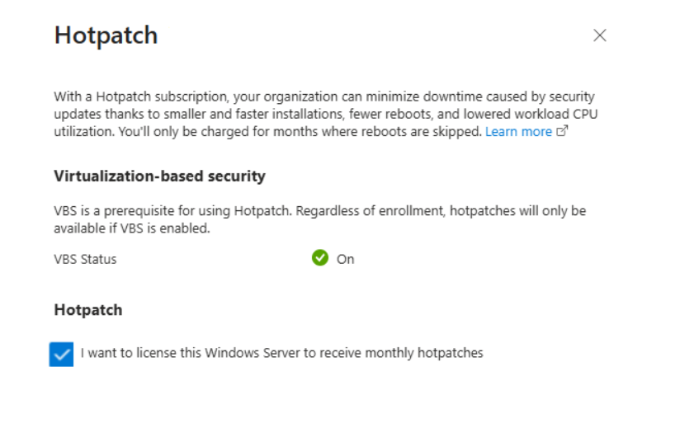
Management & Governance Updates
Generally Available: Azure Backup standard policies support for Trusted Launch virtual Machines
Trusted Launch support with standard backup policies enables seamless backup configuration for secure VMs, aligning with Trusted Launch becoming the default across VM creation interfaces.
GA: Hotpatching for Azure Arc–Connected Servers
Hotpatching enables to install OS security updates on Windows Server without requiring a reboot. This technology, previously exclusive to Windows Server Datacenter: Azure Edition, is now available for on-premises and hybrid environments through Azure Arc. Hotpatching has been in public preview at no cost, but as of July 16, 2025, a monthly subscription fee of $1.50 USD per CPU core will apply.

Slide 11
Compute

Slide 12
Compute Updates
Public Preview: Orchestration versioning for Durable Functions and durable task SDKs
The orchestration versioning feature allows to set the version of orchestrations so that you can write conditional logic to control when a certain orchestration version is run. Furthermore, the feature allows to version workers, so that orchestrations of a certain version can only be run on certain workers. This is useful when it is required to make big or breaking changes to orchestrations and want to have both new and existing inflight orchestrations run concurrently.
The orchestration versioning feature is now available for .NET isolated Durable Function apps using any of the supported storage providers, including the latest durable task scheduler.
In addition to Durable Functions, the durable task SDK for .NET also supports the orchestration versioning feature. This is a lightweight client SDK for users that don’t want to use Durable Functions to author orchestrations and are looking to run their apps outside of Azure Functions.
Public Preview: Azure Functions Kafka trigger support in Consumption plan
This extension enables to detect and respond to real time messages streaming into Kafka Topics or write to a Kafka Topic through the output binding.
NOTE::
Kafka bindings are only available for Functions on the Elastic Premium Plan and Dedicated (App Service) plan. They are only supported on version 3.x and later version of the Functions runtime.

Slide 13
Compute Updates
Public Preview: CLI command for migration from Availability Sets and Basic load balancer on AKS
Availability Sets and the Basic load balancer are being deprecated on September 30 2025. AKS now supports, in public preview, a simple Azure CLI command that will automatically migrate AKS cluster from Availability Sets to the new Virtual Machines node pool and upgrade load balancer SKU from Basic to Standard in one operation.
Public Preview: Max blocked nodes allowed support in AKS
The max blocked nodes allowed feature for AKS lets specify how many nodes that fail to drain (blocked nodes) can be tolerated during upgrades or similar operations. This feature only works if the undrainable node behavior property is set; otherwise, the command will return an error.

Slide 14
Storage & Data Updates
Generally Available: Virtual Machines node pools support in AKS
Virtual Machines node pools support in AKS is now generally available. With Virtual Machines node pools, Azure Kubernetes Services directly manages the provisioning and bootstrapping of every single node.
When deploying a workload onto Azure Kubernetes Services (AKS), each node pool typically can only contain one virtual machine (VM) type or SKU. Virtual Machines node pools allow the capability to add multiple VM SKUs of a similar family to a single node pool.
Virtual Machines node pools allow to specify a family of SKUs for a node pool without the need to maintain one node pool per SKU type, reducing the node pool footprint.
Cluster autoscaler is currently not supported.
InifiniBand isn't available.
This feature isn't available in Azure portal. Azure CLI or REST APIs must be used to perform CRUD operations or manage the pool.
Node pool snapshot isn't supported.
All VM sizes selected in a node pool need to be from a similar virtual machine family. For example, you can't mix an N-Series virtual machine type with a D-Series virtual machine type in the same node pool.
Virtual Machines node pools allow up to five different virtual machine sizes per node pool.
Generally Available: Node auto-provisioning support in AKS
Managing dynamic workloads in Kubernetes can often lead to overprovisioning, idle resources, and additional operational overhead from maintaining pre-configured node pools.
To address this, Node Auto-Provisioning (NAP) support in AKS is now generally available. NAP automatically provisions single-instance nodes (VMs) in response to unscheduled pods, eliminating the need for pre-configured node pools.
This enables fine-grained, on-demand scaling that aligns compute resources precisely with workload needs, resulting in improved efficiency, simplified cluster management, and better cost control for dynamic workloads.
Node autoprovisioning (NAP) uses pending pod resource requirements to decide the optimal virtual machine configuration to run those workloads in the most efficient and cost-effective manner.
NAP is based on the open source Karpenter project, and the AKS provider is also open source. NAP automatically deploys and configures and manages Karpenter on your AKS clusters.

Slide 15
Compute Updates
Generally Available: Cluster Extension Manager move to AKS control plane
Extension Manager, the core component responsible for managing the lifecycle of AKS cluster extensions, has been moved from customer worker nodes to the AKS control plane.
This transition enhances security, simplifies networking, and reduces operational overhead - delivering a more robust and streamlined experience for managing extensions like Azure Backup, Azure Container Storage, Flux (GitOps) as well as third-party solutions such as Cast AI and Cilium.
Generally Available: Durable Functions PowerShell SDK as a standalone module
The Durable Functions PowerShell SDK is now available as a standalone module in the PowerShell Gallery: AzureFunctions.PowerShell.Durable.SDK. This SDK is now generally available and is the recommended approach for authoring Durable Functions apps with PowerShell. The SDK includes support for sub-orchestrations, as well as many highly requested improvements such as better exception and null-value handling, and serialization fixes.
The previous Durable Functions PowerShell SDK was built into Azure Functions PowerShell language worker. This approach came with the benefit that Durable Functions apps could be authored out-of-the box for Azure Functions PowerShell users. However, it also came with various shortcomings, the biggest being that new features, bug fixes, and other changes were dependent on the PowerShell worker’s release cadence. This made it harder to quickly release improvements and changes requested by Durable Functions PowerShell users, thus motivating the building of the new standalone SDK.

Slide 16
Compute Updates
Retirement: Azure HDInsight – Enterprise Security Package
On July 31, 2026, Support for Enterprise Security Package on Azure HDInsight will end, clusters running ESP on HDInsight will start facing service disruptions, as they would be deleted and associated data will be lost.
Required Action
To avoid potential service disruptions and data loss, migrate to alternative offerings such as Microsoft Fabric.

Slide 17
Storage & Data

Slide 18
Storage & Data Updates
Public Preview: Cosmos DB in Microsoft Fabric
Take advantage of the innovations in Fabric to unify operational data and analytics in OneLake using real-time intelligence, Copilot-powered Microsoft Power BI, and SQL queries—without having to stitch together separate services.
Public Preview: AZNFS (3.0) for BlobNFS with FUSE for superior performance
For customers requiring NFS 3.0 protocol support or POSIX compliance, Azure Blob Storage natively supports NFSv3 (aka BlobNFS). BlobNFS is accessed via the Linux NFS client with AZNFS mount helper package, which streamlines mounting and reliably connecting to Blob Storage’s NFS endpoints.
MS announced an update to AZNFS (3.0) for BlobNFS, which now uses the same libfuse3 library that powers BlobFuse bringing significant improvements in performance and scale. The updated AZNFS for BlobNFS delivers significantly higher throughput, larger file support, better metadata performance, and removes user group limits, enhancing performance for demanding workloads.
AZNFS now supports up to 256 TCP connections (up from16 in native NFS client)
The updated AZNFS client outperforms native NFS client for read and write scenarios (3x or 5x)
Removing the 16-group limitation.
Improved metadata query performance
Support for large file sizes (up to 5TB)

Slide 19
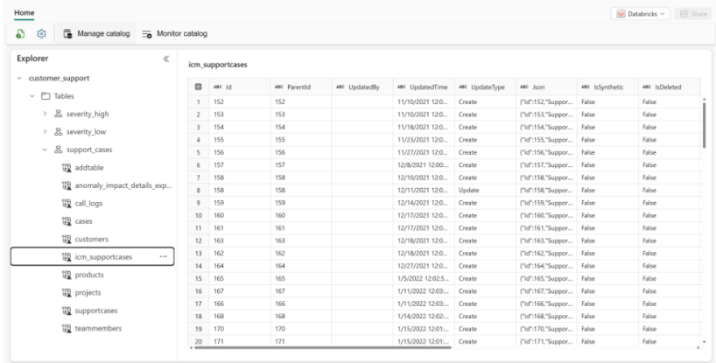
Storage & Data Updates
Generally Available: Mirroring Azure Databricks Unity Catalog to Microsoft OneLake in Fabric
It is secure, high-performance integration that provides seamless access to Azure Databricks tables from Fabric.
Now, with expanded integration with Azure Databricks Unity Catalog, you can enjoy a unified, governed experience across both platforms, without data duplication.
Generally Available: SSD storage account support for Ephemeral OS disks
With this GA release, customers can now choose Standard SSD (StandardSSD_LRS) or Premium SSD (Premium_LRS) as the base disk type for Ephemeral OS Disks; previously limited to Standard HDD. This unlocks:
Higher SLA: VMs using Premium SSDs benefit from a 99.9% SLA, compared to 95% with Standard HDD.
Improved Read Performance: By choosing Premium SSD as the base disk, customers can enhance the disk read performance of their OS disks. While most writes occur on the local temp disk, some reads are performed from managed disks. Premium SSD disks provide 8-10 times higher IOPS than Standard HDD.

Slide 20
Databases

Slide 21
Databases Updates
Generally Available: Azure Database for PostgreSQL flexible server: Indonesia Central
Azure Database for PostgreSQL flexible server in the Indonesia Central region.

Slide 22
Integration

Slide 23
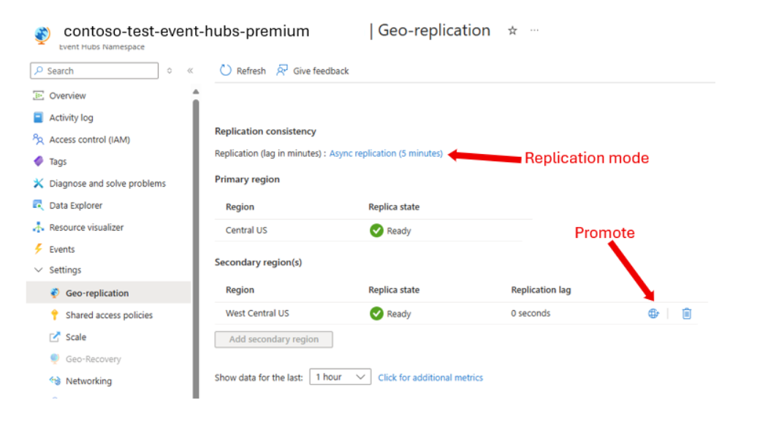
Integration Updates
Generally Available: Geo-Replication for Azure Event Hubs Premium and Dedicated
The Event Hubs Geo-Replication feature is one of the options to insulate Azure Event Hubs client applications against outages and disasters, providing replication of both metadata (entities, configuration, properties) and data (message data and message property / state changes).
The Geo-Replication feature ensures that the metadata and data of a namespace are continuously replicated from a primary region to one or more secondary regions. Moreover, it allows promoting any secondary region to primary, at any time.
Promoting a secondary repoints the endpoint for the namespace to the selected secondary region and switches the roles between the primary and secondary region.

Slide 24
ML & AI & IOT

Slide 25
ML & AI & IOT Updates
Retirement: Azure AI Speaker Recognition
Beginning on September 30, 2025, Azure AI Speaker Recognition will be retired, and applications will no longer be able to access its APIs.

Slide 26
Information

Slide 27
Information
Azure Times GitHub Repo

Slide 28
Questions

