Slide 1
Azure Times #172
July 28, 2025

Slide 2
Networking

Slide 3
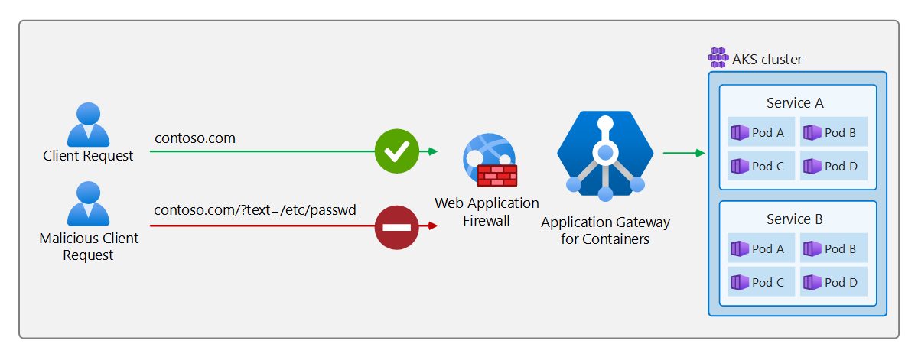
Networking Updates
Public Preview: Web Application Firewall (WAF) running on Application Gateway for Containers
Application Gateway for Containers, Azure’s application (layer 7) load balancing and dynamic traffic management solution for workloads running in a Kubernetes cluster, now supports Web Application Firewall (WAF) in public preview. Application Gateway for Containers is the next evolution of Application Gateway + Application Gateway Ingress Controller. With the addition of Azure WAF support, Application Gateway for Containers workloads can now protect workloads from web-based attacks like SQL injections, cross-site scripting, protocol anomalies, and more.

Slide 4
Networking Updates
Generally Available: Azure CNI static block allocation for pod subnet
Many AKS users need a flat network architecture, pods with direct inbound connectivity, and Azure-native solution integrations, but traditional flat networks couldn't scale beyond 65K pods. Until the launch of static block, customers either choose overlay networks to achieve massive scale or sacrifice the benefits of flat networking.
Azure CNI Pod Subnet - Static Block Allocation enables VNET routed IP addresses that can scale to over 1M pods, providing the simplicity and low latency of a flat network. Each node receives pre-allocated CIDR blocks, and all pods on that node obtain IP addresses from these ranges. This approach delivers massive scale, previously only available with overlay networks (up to 1M pods) while maintaining all the benefits of a flat network architecture. It also works seamlessly alongside existing dynamic IP allocation for pod subnet – simply deploy it on new node pools with dedicated subnets.
AKS users can scale up AKS network solutions with minimal effort while maintaining enterprise-grade reliability and security.
Limitations
Minimum Kubernetes Version required is 1.28
Maximum subnet size supported is x.x.x.x/12 ~ 1 million IPs
Only a single mode of operation can be used per subnet.
Only supported in new clusters or when adding node pools with a different subnet to existing clusters.
Across all the CIDR blocks assigned to a node in the node pool, one IP will be selected as the primary IP of the node.

Slide 5
Networking Updates
Generally Available: ExpressRoute - Auto-assigned Public IP for ExpressRoute Gateways
All newly deployed ExpressRoute Virtual Network Gateways will use auto-assigned Public IPs. This change simplifies gateway configuration by removing the requirement to explicitly assign a Public IP address.
This model streamlines deployment and improves consistency across gateway types. This feature eliminates the need for customers to manually manage Public IPs for new gateways, helping reduce operation effort and overhead.
Existing gateways are not impacted by this change.

Slide 6
Security & Identity

Slide 7
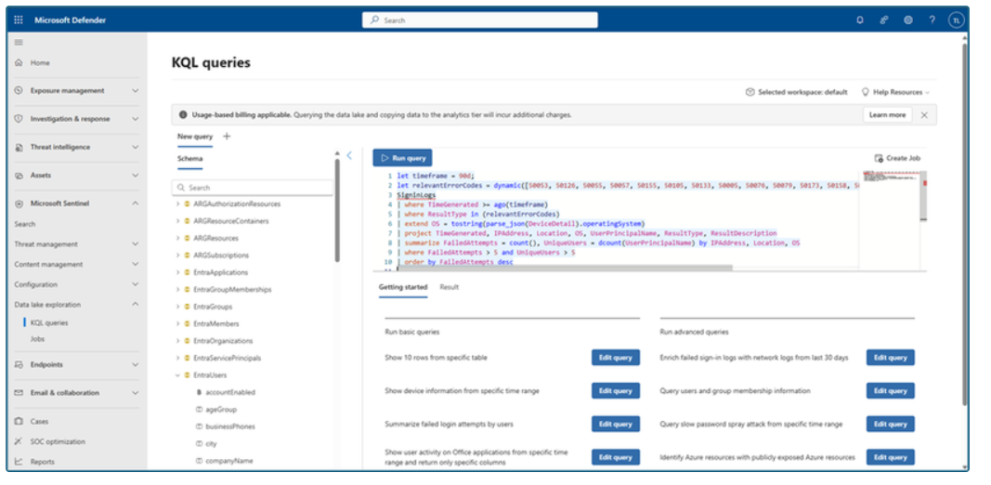
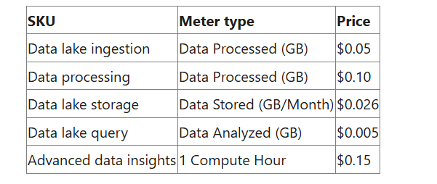
Security & Identity Updates
Microsoft Sentinel data lake
MS announced a significant expansion of Microsoft Sentinel’s capabilities through the introduction of Sentinel data lake
Microsoft Sentinel data lake enables a fully managed, cloud-native, data lake that is purposefully designed for security, right inside Sentinel. Built on a modern lake architecture and powered by Azure, Sentinel data lake simplifies security data management, eliminates security data silos, and enables cost-effective long-term security data retention with the ability to run multiple forms of analytics on a single copy of that data.
Security teams can now store and manage all security data. This takes the market-leading capabilities of Sentinel SIEM and supercharges it even further. Customers can leverage the data lake for retroactive TI matching and hunting over a longer time horizon, track low and slow attacks, conduct forensics analysis, build anomaly insights, and meet reporting & compliance needs. By unifying security data, Sentinel data lake provides the AI ready data foundation for AI solutions. Let’s look at some of Sentinel data lake’s core features.

Slide 8
Security & Identity Updates
Linkable token identifiers now GA
MS announced the general availability of linkable token identifiers, which let trace a user’s session across workloads from a specific authentication event. This feature improves incident response and anomaly detection, helping mitigate threats like remote phishing and malware attacks. Linkable token identifiers are now available for:
Microsoft Entra sign-in logs
Microsoft Exchange Online audit logs
Microsoft Graph activity logs
Microsoft Teams audit logs
Microsoft SharePoint Online audit logs

Slide 9
Management & Governance

Slide 10
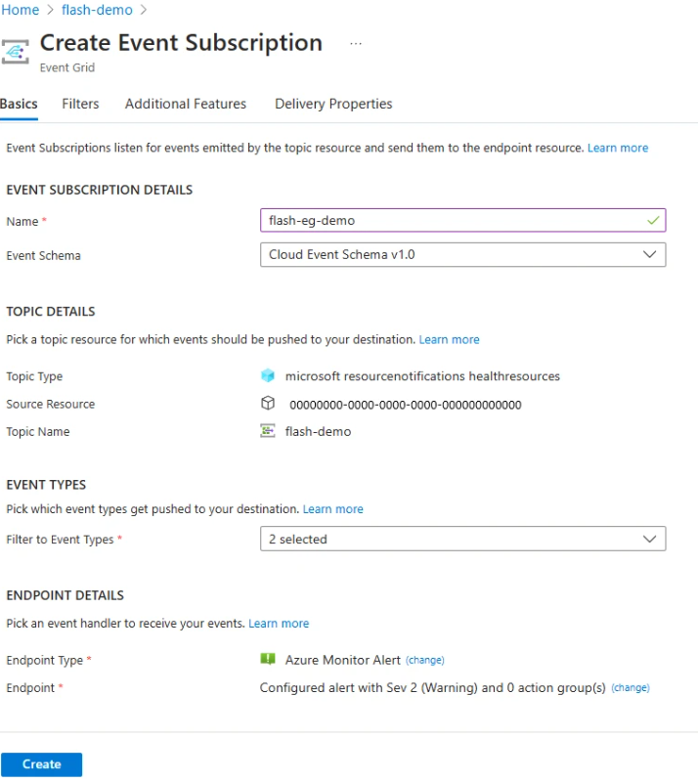
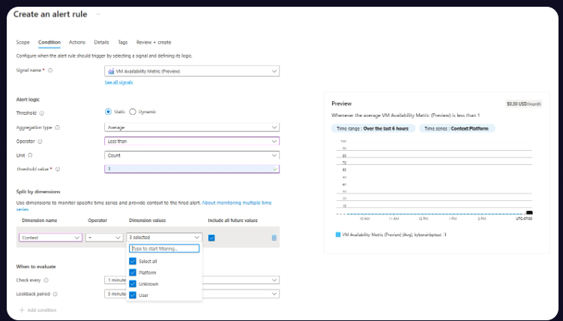
Management & Governance Updates
Public preview: User vs platform dimension introduced for VM availability metric
Context dimension to identify whether VM availability was influenced by Azure or user-orchestrated activity. This dimension indicates, during any disruption or when the metric drops to zero, whether the cause was platform-triggered or user-driven. It can assume values of Platform, Customer, or Unknown.
Public preview: Enable sending health resources events to Azure Monitor alerts in Event Grid
Azure Monitor alerts is a new event handler, allows to receive low-latency notifications—such as VM availability changes and detailed annotations—via SMS, email, push notifications, and more. This combines Event Grid’s near real-time delivery with Azure Monitor’s direct alerting capabilities.

Slide 11
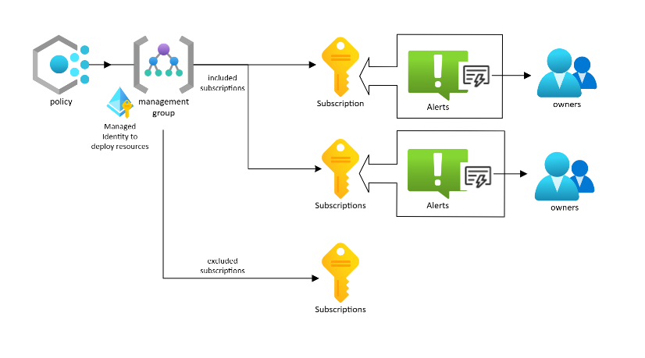
Management & Governance Updates
Azure Service Health Built-In Policy (Preview)
Azure Service Health Built-In Policy (Preview), a new built-in Azure Policy designed to simplify and scale the deployment of Service Health alerts across Azure environment. This policy enables customers to automatically deploy Service Health alerts across subscriptions, ensuring consistent visibility into platform-level issues that may impact workloads. Existing subscriptions can be remediated in bulk and new Azure subscriptions, created once the Policy has been assigned, will automatically be configured for receiving Service Health alerts.

Slide 12
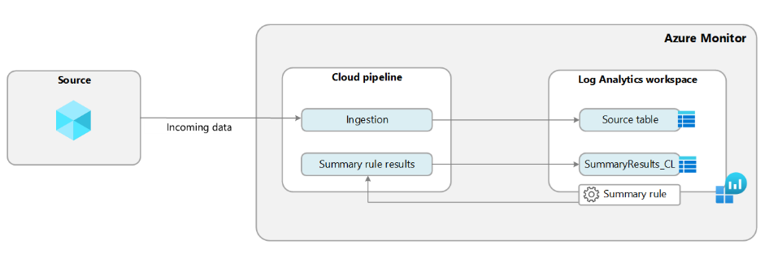
Management & Governance Updates
Generally Available: Log Analytics Summary rules
Summary rules let summarize high-ingestion-rate streams across Analytics, Basic, or Auxiliary plans, providing robust analysis, dashboarding, and long-term reporting experiences on summarized Analytics tables.
Summary rules perform batch processing directly in your Log Analytics workspace. The summary rule aggregates chunks of data, defined by bin size, based on a KQL query, and re-ingests the summarized results into a custom table
The maximum number of active rules in a workspace is 100.
THe API version labeled preview. A stable version, SDKs, and cmdlets are expected in September 2025.
Summary rules are currently only available in the public cloud.
The summary rule processes incoming data and can't be configured on a historical time range.
When bin execution retries are exhausted, the bin is skipped and can't be re-executed.
Creating a summary rule with query across another tenant under Lighthouse isn't supported.
Adding workspace transformation to Summary rules destination table isn't supported.

Slide 13
Management & Governance Updates
Generally Available: Search Job Enhancements in Log Analytics
A Search Job is an asynchronous query that runs on any data in Log Analytics workspace, including data from the long-term retention period, making the results available for further queries in a new Analytics table within workspace.
Intuitive and streamlined UI experience for easier setup.
Cost estimation preview before running a Search Job.
Enhanced concurrency, allowing more jobs to run in parallel and removing additional limits.
Increased result limits, supporting up to 100 million results - coming soon.
Expanded KQL support and other enhancements are coming soon.
Public Preview: Modernizing Azure Resource Manager Throttling for Sovereign Clouds
Following our 2024 announcement to modernize Azure Resource Manager throttling, MS announced that Azure Resource Manager will be bringing parity between public and sovereign clouds by the end of 2026. This update will ensure that the same throttling limits and architecture apply across all Azure environments, enhancing consistency and reliability for our customers.
Throttling limits have increased by roughly 30 times for writes, 2.4 times for deletes, and 7.5 times for reads.

Slide 14
Management & Governance Updates
EOL of Azure Linux 2.0 on Azure Kubernetes Service enabled by Azure Arc
Azure Linux 2.0 (formerly CBL-Mariner) will reach its official End of Life (EOL) on July 31, 2025. After this date, it will no longer receive updates, security patches, or support from the Azure Linux team.
Starting with the Azure Local 2507 release, Azure Kubernetes Service enabled by Azure Arc will ship Azure Linux 3.0 images for all supported Kubernetes versions.

Slide 15
Compute

Slide 16
Compute Updates
Important Changes to App Service Managed Certificates
DigiCert, the Certificate Authority (CA) for Azure App Service Managed Certificates (ASMC), is required to migrate to a new validation platform to meet multi-perspective issuance corroboration (MPIC) requirements.
Impacted Cases:
Site is not publicly accessible:
Public accessibility to app is required.
Other site configurations or setup methods not explicitly listed here that restrict public access, such as firewalls, authentication gateways, or any custom access policies, can also impact eligibility for managed certificate issuance or renewal.
Action: Ensure your app is accessible from the public internet. However, if you need to limit access to your app, then you must acquire your own SSL certificate and add it to your site.
Site uses Azure Traffic Manager "nested" or "external" endpoints:
Only “Azure Endpoints” on Traffic Manager will be supported for certificate creation and renewal.
“Nested endpoints” and “External endpoints” will not be supported.
Action: Transition to using "Azure Endpoints". However, if you cannot, then you must obtain a different SSL certificate for your domain and add it to your site.
Site relies on *.trafficmanager.net domain:
Certificates for *.trafficmanager.net domains will not be supported for creation or renewal.
Action: Add a custom domain to app and point the custom domain to your *.trafficmanager.net domain. After that, secure the custom domain with a new SSL certificate.

Slide 17
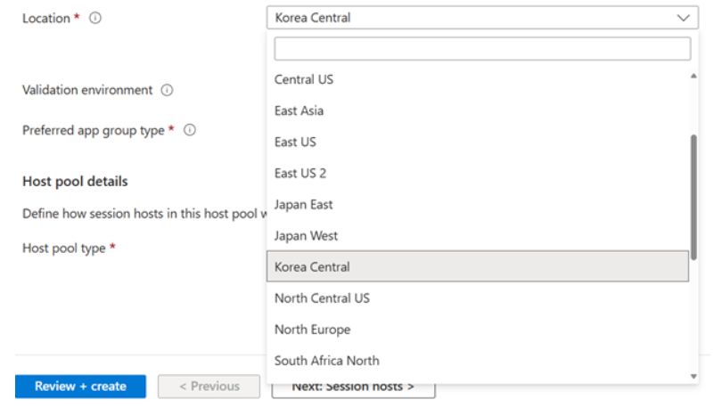
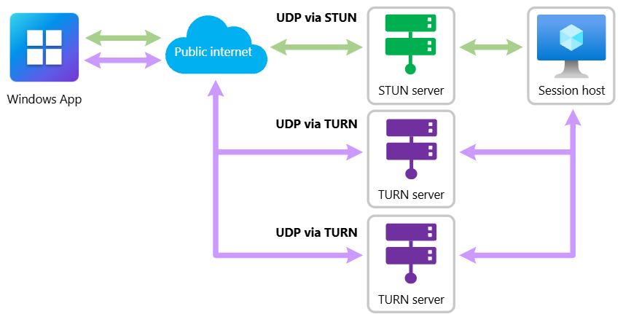
Compute Updates
Azure Virtual Desktop metadata database now available in Korea Central
MS announced that the Azure Virtual Desktop metadata database is now available in the Korea Central region. This release is part of ongoing global expansion, following our rollout earlier this year in Southeast Asia. By extending regional availability, we continue to enhance Azure Virtual Desktop’s performance, support data residency, and meet compliance requirements across more markets.
The metadata database is a critical service component that stores configuration and operational data such as host pool settings, user assignments, and session host details.
RDP Multipath is now generally available for Azure Virtual Desktop and Windows 365
RDP Multipath continuously evaluates multiple UDP network paths and dynamically switches to the most reliable one. This ensures a more stable and consistent experience, especially in environments with fluctuating network conditions. Because redundant connections are maintained throughout the session, the system can instantly switch to a backup path if the primary one fails—without interrupting the user's experiences.
Key Benefits:
Seamless integration
Dynamic path management
Enhanced reliability
Lower user latency
Connection Insights

Slide 18
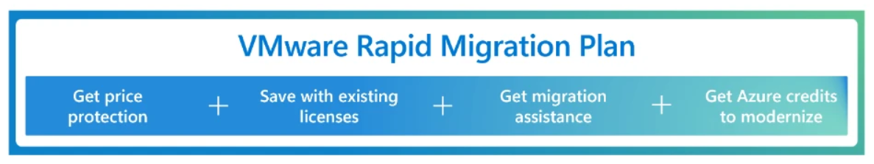
Compute Updates
Azure VMware Solution now available in Spain Central
Azure VMware Solution is now available in Spain Central. Now in 35 Azure regions, Azure VMware Solution empowers to seamlessly extend or migrate existing VMware workloads to Azure without the cost, effort or risk of re-architecting applications or retooling operations.

Slide 19
Storage & Data

Slide 20
Storage & Data Updates
Generally Available: Azure Managed Lustre now supports VNet Encryption for in-transit data protection
Azure Managed Lustre now supports Virtual Network (VNet) Encryption, enabling encryption of data in transit between Azure Managed Lustre and client virtual machines
VNet Encryption uses Datagram Transport Layer Security (DTLS) 1.2 with AES-GCM-256 encryption and offloads encryption to inline FPGAs on the VM host to maintain high throughput and low latency.
It can be enabled on the virtual network hosting Azure Managed Lustre or a peered network with encryption enabled. Supported VM series include D, E, F, and L. Existing AMLFS clusters require a maintenance event and subsequent reboot to activate encryption.
Customers can validate encrypted traffic using Azure Network Watcher, Azure Monitor, and diagnostic tools.

Slide 21
Integration

Slide 22
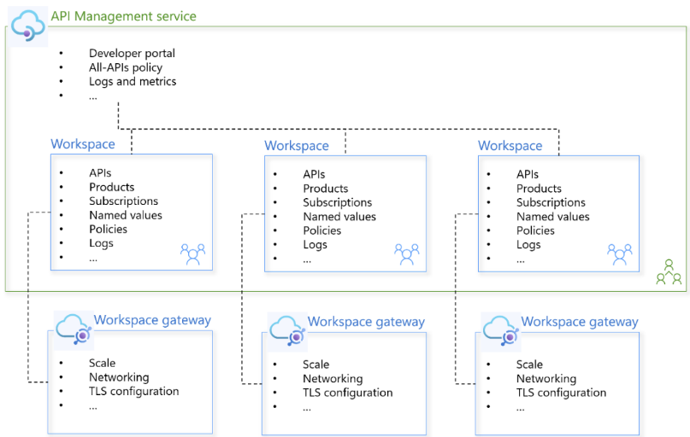
Integration Updates
Workspaces Are Now Generally Available In Azure API Management Premium v2
MS announced the general availability of workspaces and workspace gateways in the Premium v2 tier of Azure API Management! Premium v2 tier remains in preview at the time of this announcement.
Workspaces enable management and governance of APIs at scale. Whether you're supporting hundreds of APIs across teams or enabling new lines of business to independently manage their APIs, workspaces make it easier to adopt a federated API management model with central governance, observability, and security.

Slide 23
ML & AI & IOT

Slide 24
ML & AI & IOT Updates
GitHub Spark is now in public preview and included with Copilot Pro+ plans
Key features
Natural language to app: Describe idea and watch Spark build it, with frontend and backend capabilities included, all powered by Claude Sonnet 4.
No setup required: Data, LLM inference, hosting, deployments, and GitHub auth all included out-of-the-box.
Add AI to apps: Add intelligent features powered by LLMs from OpenAI, Meta, DeepSeek, xAI and more – no API key management needed.
One-click deployments: Publish your app with a single click.
Build way: Use natural language, visual editing controls, or code with GitHub Copilot code completions at your fingertips to iterate on your ideas.
Create a repository: Get a repository with GitHub Actions and Dependabot incorporated in just a click. Everything stays synchronized so you aren’t trapped in a sandbox.
Expand with Copilot agents: Open a codespace directly from Spark to iterate with Copilot agent mode or assign an issue to Copilot coding agent.

Slide 25
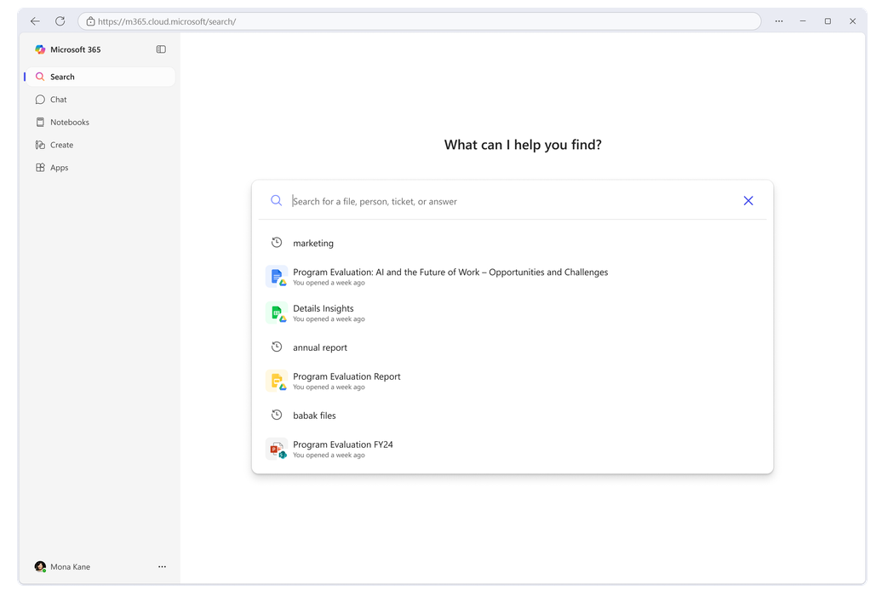
ML & AI & IOT Updates
Announcing Microsoft 365 Copilot Search General Availability: A new era of search with Copilot
MS announced general availability of Microsoft 365 Copilot Search.
Introducing Microsoft 365 Copilot Search, available as a dedicated module within the Microsoft 365 Copilot app, accessible across desktop, web, and mobile platforms. If you have an eligible Microsoft 365 Copilot license, you’ll see a Search tab right alongside Chat and other Copilot experiences—no setup required.
Introducing API Management Support in the Azure SRE Agent
SRE Agent now extends capabilities to Azure API Management (APIM) , delivering deep operational visibility, guided troubleshooting, and intelligent remediation for customers running critical APIs at scale.
The SRE Agent helps APIM users stay ahead of these challenges by providing both diagnostics and remediation tailored for API Management environments.
Proactively Monitor API Management App Health
Visualize Backend Connections and Health
Drill into Backend App Issues

Slide 26
Miscellaneous

Slide 27
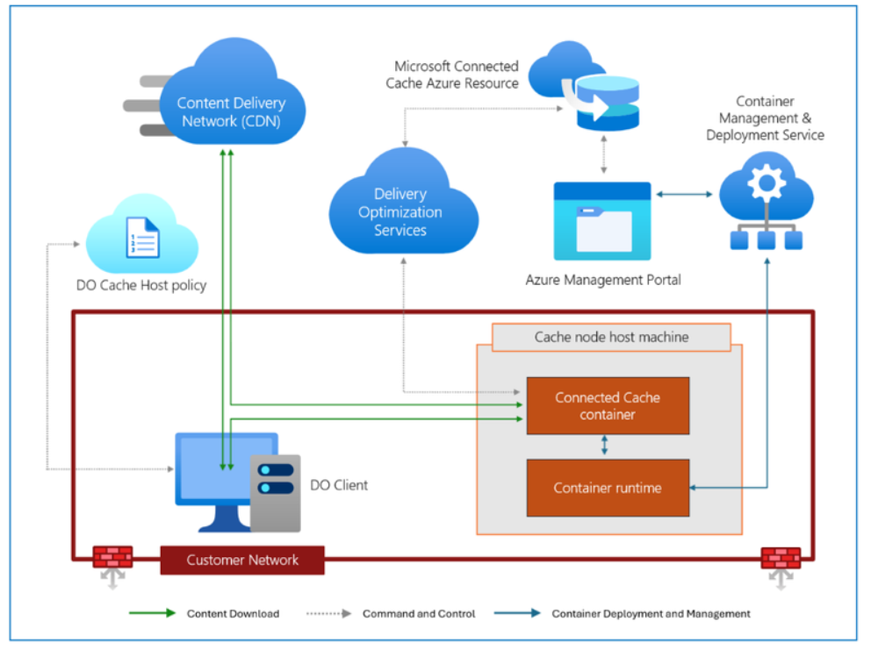
Miscellaneous Updates
Microsoft Connected Cache is now generally available
Connected Cache helps organizations realize significant bandwidth savings when performing Windows 11 upgrades, Microsoft Intune provisioning, Intune application installations, Windows Autopilot software updates, and other monthly update deployments.
Microsoft Connected Cache for Enterprise and Education is available to all organizations with Windows Enterprise (E3, E5, and F3) or Windows Education (A3 and A5) entitlements, or a more comprehensive Microsoft 365 subscription. Eligible organizations can deploy Connected Cache nodes directly to host machines running Windows Server, Windows Desktop, and Linux [Ubuntu and Red Hat Enterprise Linux (RHEL)].

Slide 28
Information

Slide 29
Information
Azure Times GitHub Repo

Slide 30
Questions

