Slide 1
Azure Times #173
August 4, 2025

Slide 2
Networking

Slide 3
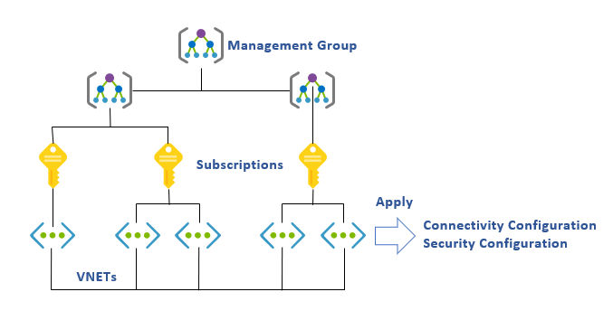
Networking Updates
Generally Available: Customer-controlled maintenance
Now it is possible to configure maintenance windows to schedule gateway maintenance for Point-to-Site VPN Gateway (P2S VPN) in Virtual WAN Service.
With P2S VPN in Virtual WAN service now being generally available, customers can now configure maintenance windows for all gateway resources in ExpressRoute, VPN and Virtual WAN services: (1) Virtual Network Gateway in ExpressRoute service (2) Virtual Network Gateway in VPN Gateway service (3) Site-to-Site VPN Gateway in Virtual WAN service (4) Point-to-Site VPN Gateway in Virtual WAN service (5) ExpressRoute Gateway in Virtual WAN service.
Generally Available: Azure Virtual Network Manager in Azure US Government Cloud
Azure Virtual Network Manager is now generally available in Azure US Government Cloud, providing unified control for connectivity, security, and routing across subscriptions, regions, and tenants. By automating configurations, it guarantees consistent policy and visibility as your network environment expands.

Slide 4
Security & Identity

Slide 5
Security & Identity Updates
Public Preview: New tagging features in Azure confidential ledger
Tags in Azure confidential ledger serve as secondary keys that enhance data organization and retrieval within collections. By allowing users to assign up to five tags per transaction, these tags provide an additional layer of categorization, making it easier to manage and locate specific data entries. Tags are limited to 64-character strings and can be used to group transactions in a way that suits the specific needs of the client. This feature ensures efficient data retrieval without any performance degradation, thereby improving the overall data management experience.
Users can leverage tags to categorize and group transactions based on various criteria, such as project names, departments, or data types. This flexibility allows for more tailored data organization, which can be particularly useful in complex environments where data needs to be accessed and analyzed quickly.
# multiple tags can be specified using commas.
append_result = ledger_client.create_ledger_entry(entry=sample_entry, collection_id="icecream-flavors", tags="chocolate,vanilla")
Managed Identity support for Azure Key Vault in SQL Server running on Linux
MS announced support of Managed Identity to authenticate to Azure Key Vault from SQL Server running on Azure VM (Linux) available from SQL Server 2022 CU18 onwards.
Using managed identity to access Azure Key Vault in SQL Server running on an Azure Linux VM boosts security, streamlines key management, and supports compliance.

Slide 6
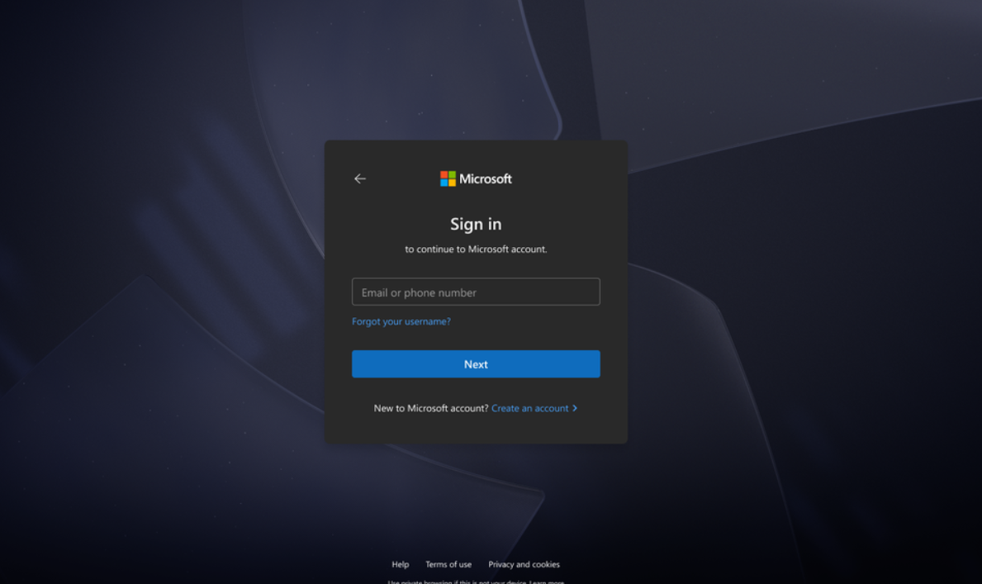
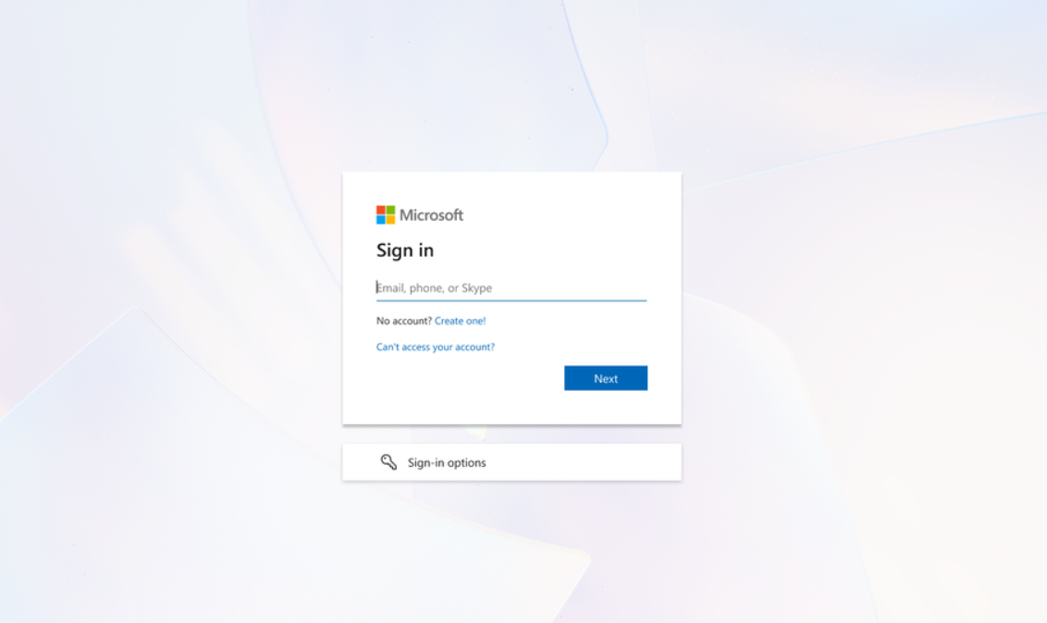
Security & Identity Updates
A fresh look for the Microsoft authentication background
A new background image for sign-in screens will appear starting August 2025 for Microsoft personal accounts, and September 29, 2025, for Microsoft Entra work or school accounts. Aligning with broader efforts to modernize end-user UX via Microsoft’s Fluent design language, this update aims to provide a cleaner, distraction-free experience and ensure consistent visuals across all authentication flows.

Slide 7
Security & Identity Updates
Retirement: Azure Dedicated HSM
Microsoft is announcing the planned retirement of Azure Dedicated HSM, which will be succeeded by the Azure Cloud HSM service.
Microsoft will provide full support for all existing Azure Dedicated HSM customers until July 31, 2028. During this support window, customers are encouraged to begin planning and executing their transition to Azure Cloud HSM or Azure Managed HSM, depending on their workload and compliance requirements.
Azure Cloud HSM is designed to meet or exceed existing customer scenarios for Dedicated HSM customers. It delivers FIPS 140-3 Level 3, hardware-backed key protection with improved integration, operational efficiency, and scalability to meet the evolving needs of security-first organizations.
Required action
Effective immediately, Microsoft will no longer accept new customer onboardings to Azure Dedicated HSM.
All new customers must onboard Azure Cloud HSM, Azure Managed HSM, or Azure Key Vault depending on their use case.
Make a plan to transition plan for Azure Cloud HSM by July 31, 2026
Azure Dedicated HSM will be retired on July 31, 2028, please transition to Azure Cloud HSM by that date.

Slide 8
Management & Governance

Slide 9
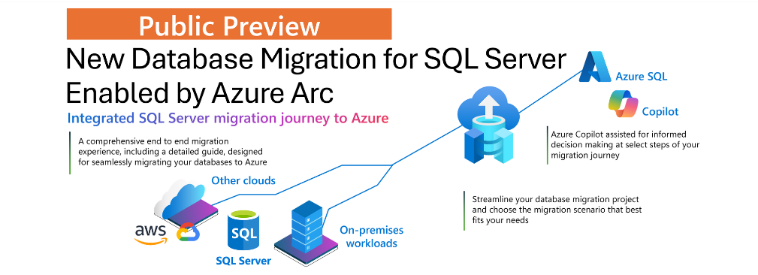
Management & Governance Updates
Public Preview: New SQL Server database migration in Azure Arc
It is now possible to streamline the entire SQL Server migration journey—from assessment to provisioning to cutover—within a single Azure portal experience.
Continuous migration assessments with cost visibility, simplified target provisioning, and support for near real-time database replication. You can also validate migration readiness through R/O database replicas and client connection summaries, ensuring a smooth migration with minimal downtime. Microsoft Copilot is seamlessly integrated to support informed decision-making at select points of your migration journey.

Slide 10
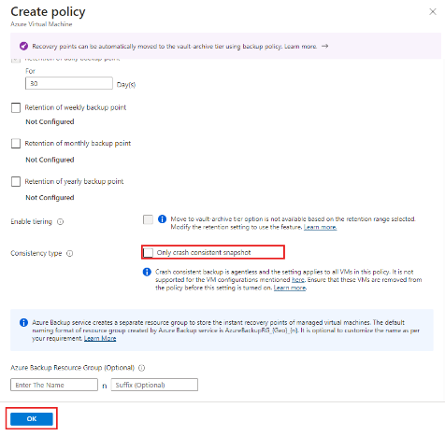
Management & Governance Updates
Generally Available: Agentless multi-disk crash consistent backup for Azure VMs
Azure Backup support for agentless multi-disk crash consistent backups for Azure Virtual Machines is now Generally Available.
Agentless multi-disk crash consistent backups for Azure VM allows to take VM backups without installing additional software like the VM agent or snapshot extension in your VM. If workload is performance sensitive and can recover from crash consistent backups, this feature can help reduce the quiesce time during backup. You can also use this feature if your operating system is not supported for application or file-system consistent backup.
You can enable crash consistent backups by setting the Consistency Type in Backup policy for your Azure VM
Generally Available: Azure File Sync Arc Extension
Azure File Sync Arc Extension is now generally available, enabling seamless deployment and management of Azure File Sync on Arc-enabled Windows Servers. This extension brings hybrid file sync capabilities to a broader range of on-premises and multi-cloud environments. With it, it is possible to install the latest Azure File Sync agent directly from the Azure Portal, PowerShell, or CLI.
The extension supports Windows Server 2012 R2 and later and is available in all Azure File Sync regions at no additional cost.
Azure Arc-enabled server (Windows only)
Arc-enabled server must have the Microsoft Root Certificate (Microsoft Root Certificate Authority 2011) installed.

Slide 11
Compute

Slide 12
Compute Updates
Announcing General Availability of Azure E128 & E192 Sizes in the Esv6 and Edsv6-series VM Families
MS announced the addition of two new sizes, E128 and E192, in the Azure Esv6 and Edsv6-series Virtual Machine families, powered by the 5th Generation Intel® Xeon® Platinum 8573C (Emerald Rapids) processor. These sizes are generally available with diskful and diskless options in select Azure regions.
These new VM sizes offer up to 192 vCPUs and 1832 GiB of RAM, making them ideal for enterprise-scale applications such as in-memory analytics, large relational databases, and in-memory cache workloads. With Intel® Total Memory Encryption (Intel TME) and NVMe-enabled local and remote storage, these VMs deliver both performance and security at scale.
Memory-Optimized Performance: Up to 1832 GiB of RAM for memory intensive workloads.
Azure Boost: Up to 400K IOPS and 12 GB/s remote storage throughput with 200 Gbps network bandwidth.
Security First: Intel TME ensures data protection in system memory.
NVMe Interface: 3X improvement in local storage IOPS for low-latency access.

Slide 13
Storage & Data

Slide 14
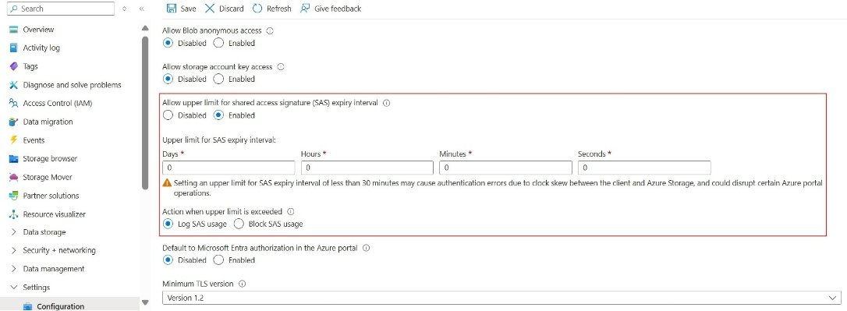
Storage & Data Updates
Generally Available: Live Resize for Premium SSD v2 and Ultra NVMe Disks
Announcing the General Availability of Live Resize for Premium SSD v2 (Pv2) and Ultra NVMe Disks. This feature allows to dynamically expand the storage capacity of disks without any disruption to applications.
Is supported only for data disks.
Isn't supported for shared disks.
4 TiB limits still require deallocation
Generally Available: Log or block shared access signature (SAS) tokens for Azure Storage based on expiration policy
Azure Storage’s SAS expiration policy (validity interval) allows to set an upper limit for the period for validity of SAS tokens. Up until now, administrators could set how long a SAS should be valid through the SAS expiration policy, however, it was possible to extend this time period through the SAS signed expiry date.
Auditing with ‘Log’ action helps detect trends and investigate access without disrupting workflows, while ‘Block’ action lets enforce zero-tolerance for out-of-policy SAS tokens.
You can choose to get started with ‘Log’ action to monitor your diagnostic logs and ensure your current access patterns are not disrupted. We strongly recommend using Block action to ensure that if a SAS token expiry interval has surpassed the validity of the expiration period set on the storage account, then access to storage must be blocked.

Slide 15
Databases

Slide 16
Databases Updates
Public Preview: Azure Database for PostgreSQL cascading read replica
It is now possible to use cascading read replicas in Azure Database for PostgreSQL flexible server. With this new capability, it is possible to create additional read replicas from an existing one.
A read replica can act as the source for new replicas, helping scale read workloads more efficiently across regions.
Cascading read replicas can help distribute read workloads, reducing the load on the primary server. Deploying read replicas in different regions (cross-region read replicas) can help distribute read traffic closer to users in various geographies.
The first-level read replica asynchronously replicates data from the primary server. A second-level read replica can then be created using the first-level replica as its source, forming a two-tier replication hierarchy. This architecture increases scalability, supporting up to 30 read replica servers with the primary server allowing up to 5 read replicas, and each of those replicas supporting 5 additional replicas.
This feature is currently supported in the following Azure regions: West US, Spain Central, Australia East, South Central US, UK West, Poland Central, Italy North, West US 2, East US.

Slide 17
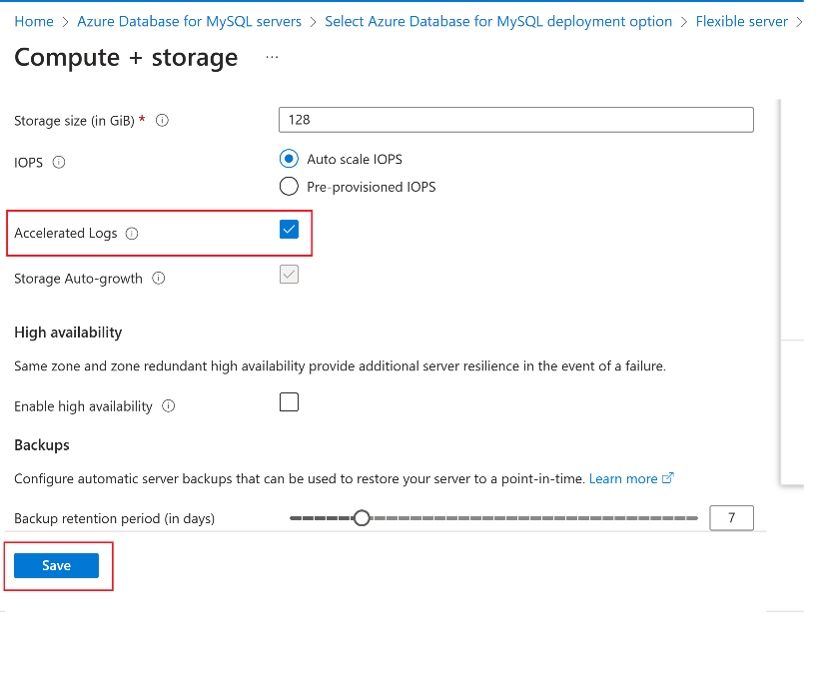
Databases Updates
Generally Available: Azure Database for PostgreSQL Entra authentication for Power BI Desktop
It is now possible to use Microsoft Entra ID authentication to connect to Azure Database for PostgreSQL from Power BI Desktop. This update simplifies access management, enhances security, and helps support organization’s broader Entra-based authentication strategy.
Generally Available: Accelerated logs now available for General Purpose tier in Azure Database for MySQL - Flexible Server
Now available for the General Purpose tier, accelerated logs in Azure Database for MySQL - Flexible Server give the performance benefits previously available only in the Business Critical tier.
Accelerated logs boost performance for a broader range of workloads, enabling benefits such as reduced transaction latency and increased throughput.

Slide 18
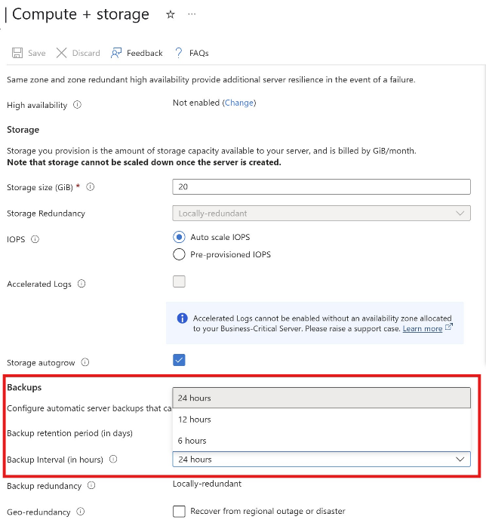
Databases Updates
Generally Available: Configure backup interval for Azure Database for MySQL automated backups
Azure Database for MySQL now enables to configure the backup interval for the automatic backups taken by the system to improve restore speed. This new feature optimizes the process by introducing more frequent snapshots, thereby reducing the number of binlogs that need to be replayed for point-in-time restore and minimizing overall restore time.
Generally Available: Azure SQL updates for late-July 2025
In late-July, the following updates and enhancements were made to Azure SQL:
The UNISTR function provides support for Unicode string literals by letting you specify the Unicode encoding value of characters in the string, making it especially useful for working with international or special characters.
The || operator is now supported for string concatenation, offering a more readable and standard-compliant alternative to existing methods like + and CONCAT(). The || operator concatenates two or more characters or binary strings, columns, or a combination of strings and column names into one expression.

Slide 19
Databases Updates
Oracle Database@Azure: New Services, More Regions & Enhanced Security for Faster Innovation
Base Database Service is now available in Public Preview - Oracle Database Enterprise Edition and Standard Edition 2 (19c and 23ai), Base Database Service offers built-in automation, consistent tooling, BYOL licensing, with pay-as-you-go pricing to independently scale compute and storage. It’s a simple, flexible way to run Oracle workloads natively in Azure—without overprovisioning or operational overhead.
Enhanced networking capabilities for enterprise workloads - Enterprise networking capabilities like Network Security Groups (NSG), Private Link, Global Peering, and ExpressRoute FastPath are now generally available for Oracle Database@Azure
Bring Your Own Keys: Now Store Oracle TDE Keys in Azure Key Vault with Oracle Database@Azure
Bringing Oracle Database@Azure to 6 new regions - Oracle Database@Azure, now available in South Central US, Sweden Central, North Europe, West US2, West US3, and Japan West!
Exadata Exascale: Single Node Cluster Support Now Available - This new deployment option is tailored for customers who need the performance and automation of Exadata, but with a smaller footprint. Whether it’s for dedicated workloads, development environments, or operational simplicity, the single-node configuration provides a flexible and resource-efficient alternative to multi-node clusters—without compromising on core capabilities.

Slide 20
ML & AI & IOT

Slide 21
ML & AI & IOT Updates
Announcing a flexible, predictable billing model for Azure SRE Agent
Billing for Azure SRE Agent will start on September 1, 2025. Azure SRE Agent is a pre-built AI agent for root cause analysis, uptime improvement, and operational cost reduction, announced in preview at Microsoft Build 2025.
Azure SRE Agent is a powerful tool that uses machine learning and advanced monitoring capabilities to proactively manage cloud resources, detect anomalies, and execute remediation tasks. The agent’s unique dual-action architecture allows it to remain always-on, learning from application behavior, and ready to spring into action the moment intervention is required. Whether you’re running small-scale workloads or managing complex, mission-critical applications, Azure SRE Agent brings automation, reliability, and peace of mind to your operations.
The Azure SRE Agent billing model includes two components: always-on flow for continuous monitoring and active flow for incident mitigation and other tasks where the AI is actively engaged. Total cost is a combination of the fixed baseline cost and incremental usage-based costs.
Each agent is billed at 4 Azure Agent Units per hour as the baseline cost for always-on flow.
Each task the agent executes is billed at an additional 0.25 Azure Agent Units per second as usage-based cost for active flow.

Slide 22
DevOps & IaC & Automation

Slide 23
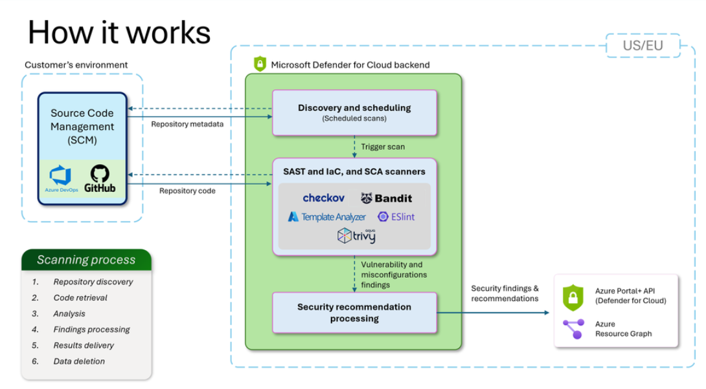
DevOps & IaC & Automation
Agentless code scanning for GitHub and Azure DevOps (preview)
Agentless code scanning runs entirely outside your pipelines. Once a connector has been created, Defender for Cloud automatically discovers repositories, pulls the latest code, scans for security issues, and publishes findings as security recommendations - every day.
Built-in scanners run in MS environment:
Code Scanning – looks for insecure patterns, bad crypto, and unsafe functions (e.g., `pickle.loads`, `eval()`) using Bandit and ESLint.
Infrastructure as Code (IaC) – detects misconfigurations in Terraform, Bicep, ARM templates, CloudFormation, Kubernetes manifests, Dockerfiles, and more using Checkov and Template Analyzer.

Slide 24
DevOps & IaC & Automation
Azure Automation: General Availability of PowerShell 7.4, Python 3.10 runbooks, Runtime Environment
General Availability of PowerShell 7.4 and Python 3.10 runtime versions.
Runtime Environment (GA), offering seamless modernization of outdated scripts to supported runtime versions.
Support for Azure CLI commands in PowerShell runbooks (GA).
Announcing GA of Bicep templates support for Microsoft Entra ID resources
Bicep templates bring declarative infrastructure as code (IaC) capabilities to Microsoft Graph resources. This new capability will initially be available for core Microsoft Entra ID resources.

Slide 25
Information

Slide 26
Information
Azure Times GitHub Repo

Slide 27
Questions

