Slide 1

Azure Times #221
August 31, 2026

Slide 2

Networking

Slide 3
Networking Updates (Preview)
Public Preview: IPv6 dual-stack support for Azure Bastion
Azure Bastion support for IPv4 and IPv6 dual-stack configurations is now available in public preview. Customers can configure a newly created Bastion deployment with both IPv4 and IPv6 public IP addresses.
IPv6 is supported for connections between the user and Azure Bastion. Connections from Azure Bastion to target virtual machines continue to use IPv4. Existing IPv4-only Bastion deployments cannot currently be converted to dual stack.

Slide 4
Networking Updates (General Available)
Generally Available: Connect to AKS clusters using Azure Bastion
Azure Bastion integration with Azure Kubernetes Service is now generally available. Customers can establish a secure tunnel from their local machine through Azure Bastion to an AKS cluster API server.
The integration enables customers to use standard Kubernetes tools while avoiding public exposure of private cluster endpoints. It reduces the need to deploy and maintain separate jump boxes, VPN servers, or additional access agents.
Generally Available: Azure Bastion shareable link expiration
Azure Bastion shareable link expiration is now generally available. When creating a shareable link, administrators can specify the date and time when the link should expire.
After the configured expiration time, the link can no longer be used to connect to the target resource. This helps organizations limit persistent access and better manage temporary connections provided through Azure Bastion.

Slide 5
Networking Updates (General Available)
Generally Available: Custom block response code and body for Application Gateway WAF
Announcing the General Availability of custom block response code and body for WAF integrated with Application Gateway
Azure WAF integrated with Application Gateway now supports customizable response status codes and bodies for blocked requests, enabling greater flexibility and control.
By default, when the WAF blocks a request due to a matched rule, it returns a 403 status code with a "The request is blocked" message. As with WAF with Azure Front Door, now customers can also define a custom response status code and message with Application Gateway when WAF blocks a request. This customization is a policy-level setting, ensuring that all blocked requests receive the same custom response status and message.

Slide 6

Compute

Slide 7
Compute Updates (Preview)
Announcing: Aspire 13.5 has shipped
Aspire 13.5 refreshes the dashboard and aspire.dev, expands the Interaction Service, adds cross-scope Azure references and persistent Kubernetes volumes, and brings live terminals into the apphost.

Slide 8
Compute Updates (General Available)
Generally Available: Azure 248 and 372 vCPU sizes for D/E v7 series VMs
Microsoft has announced the general availability of new 248 vCPU and 372 vCPU Dlsv7, Dsv7, and Esv7 virtual machines, powered by Intel® Xeon® 6 processors. These next-generation general-purpose and memory-optimized VMs deliver up to 20% higher compute performance than the previous Intel v6 generation while significantly increasing compute, memory, networking, and storage capacity for demanding enterprise workloads.
The new VM sizes scale up to 372 vCPUs and 2.8 TiB of RAM, making them well suited for large in-memory databases, SAP, HPC, agentic AI workloads, and large language model (LLM) inference requiring extensive memory and reduced cross-node communication. Powered by Azure Boost, they also provide up to 400 Gbps networking, 800,000 remote storage IOPS, and 9.6 million local NVMe IOPS, delivering industry-leading performance for compute-intensive applications.
Available in multiple Azure regions, including East US, East US 2, Central US, South Central US, West US 2, West US 3, Sweden Central, and Germany West Central, these VM sizes strengthen Azure's high-performance compute portfolio by enabling customers to consolidate larger workloads, improve application performance, and support next-generation AI and enterprise computing scenarios.
Generally Available: Azure VM Image Builder in sovereign and air-gapped clouds
Azure VM Image Builder is now generally available in Azure Government, Azure Government Secret, Azure Government Top Secret, and Azure China North 3. Organizations can now use the same fully managed image-building service across global Azure and sovereign cloud environments, enabling consistent creation and management of standardized VM images while meeting strict security, compliance, and data sovereignty requirements.
The service automates the creation, customization, hardening, and validation of golden images without requiring customers to deploy or maintain dedicated image build infrastructure. Organizations can reuse the same image templates and automation pipelines across multiple Azure cloud environments and distribute completed images through Azure Compute Gallery for regional replication and standardized deployments.
This expansion is particularly valuable for government agencies, regulated industries, and organizations with sovereign cloud requirements, enabling them to implement consistent operating system baselines, security hardening, and compliance controls while reducing operational overhead and maintaining local regulatory compliance.

Slide 9
Compute Updates (General Available)
Retirement: Support for Node 22 LTS ends on April 30, 2027
On April 30 2027, support for Node 22 LTS will end. Your apps that are hosted on App Service will continue to run, but security updates will no longer be available, and we’ll no longer provide customer service for Node 22 LTS.
Generally Available: Workload identity support for Azure Files CSI driver (SMB) in Azure
The Azure Files CSI driver in Azure Kubernetes Service (AKS) now supports Microsoft Entra Workload Identity for pod-level authentication to Azure Files SMB shares. Instead of relying on storage account keys or node-level managed identities, individual Kubernetes pods can now authenticate directly using their own workload identity, enabling least-privilege access to Azure Files.
This enhancement allows organizations to grant each application access only to the file shares and data it requires, significantly improving security and reducing the risk associated with shared node-level credentials. The capability is particularly valuable for regulated industries and organizations implementing Zero Trust and compliance-driven security models.
Available in all Azure regions that support AKS and Azure Files, workload identity support strengthens Kubernetes security by providing fine-grained access control, simplifying credential management, and eliminating the need to distribute storage account keys to workloads.

Slide 10

Databases

Slide 11
Databases Updates (General Available)
Announcing: Extended Support for Azure Database for PostgreSQL Flexible Server
Extended Support for Azure Database for PostgreSQL Flexible Server helps you maintain secure, supported workloads while transitioning to newer PostgreSQL versions. With access to critical security updates, critical bug fixes, and technical support for eligible versions after community support ends, you can upgrade on your timeline with greater flexibility and confidence.
Generally Available: eBPF host routing in Advanced Container Networking Services for AKS
eBPF Host Routing in Advanced Container Networking Services for Azure Kubernetes Service (AKS) is now generally available.
eBPF Host Routing improves Kubernetes networking performance by moving packet forwarding and routing decisions directly into the Linux kernel using eBPF. This removes the overhead of iptables-based processing and reduces dependence on the host networking stack, resulting in lower latency, fewer network hops, and higher throughput for application traffic. For large-scale AKS deployments, eBPF Host Routing helps deliver more efficient network performance, improved scalability, and a better experience for latency-sensitive and high-traffic workloads.
This release also introduces an enhanced enablement experience that respects existing network connections during rollout. When eBPF Host Routing is enabled on an existing cluster, AKS performs a controlled node rotation to transition nodes to the new networking mode, helping maintain connection continuity and minimize disruption to running applications.

Slide 12
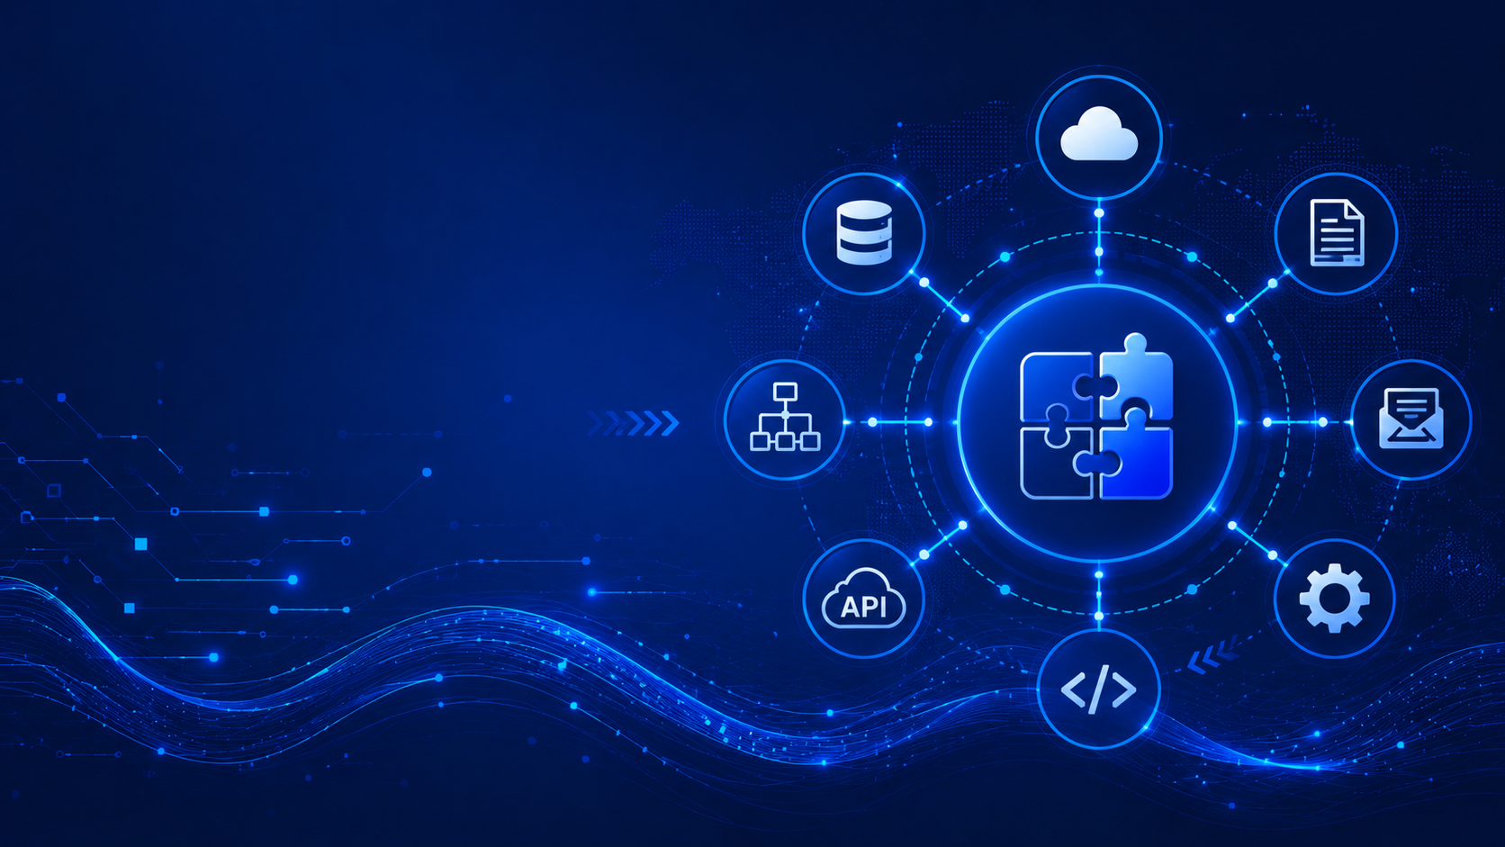
Integration

Slide 13
Integration Updates (General Available)
Zonal redundancy in API management Standard v2
Zone Redundancy is now available for Azure API Management (APIM) Standard v2, enabling API gateways to remain available during the failure of an individual Availability Zone. By distributing gateway instances across multiple zones within an Azure region, organizations can improve service resilience and reduce the risk of application downtime caused by datacenter-level failures.
The capability provides high availability without requiring complex infrastructure design, allowing mission-critical APIs to continue serving requests even when a single Availability Zone becomes unavailable. It integrates seamlessly with the Standard v2 tier, complementing existing features such as autoscaling, virtual network integration, and enterprise-grade API management.
For organizations exposing business-critical APIs, zone redundancy strengthens the resilience of API platforms while simplifying disaster recovery planning. This enhancement makes Azure API Management Standard v2 a stronger choice for production workloads requiring higher availability, fault tolerance, and enterprise-grade reliability.

Slide 14

ML & AI & IOT

Slide 15
ML & AI & IOT Updates (Preview)
Public Preview: Introducing Live Reports for Azure SRE Agent
Live Reports are now available in public preview for Azure SRE Agent, enabling operations teams to create dynamic, continuously updated operational reports directly from SRE Agent conversations. Instead of manually building dashboards or collecting data from multiple monitoring tools, teams can generate reports that automatically refresh on a daily, weekly, or monthly schedule using the latest data from connected Azure environments.
Live Reports provide a centralized view of service health, incidents, operational trends, recurring investigations, and reliability metrics, making it easier to track system performance and share operational insights across teams. The reports remain continuously up to date, helping operations and Site Reliability Engineering (SRE) teams make faster, data-driven decisions without manual reporting effort.
For organizations adopting AI-assisted operations, Live Reports simplify operational visibility by combining conversational AI with automated reporting, reducing administrative overhead while improving collaboration and decision-making across IT operations and engineering teams.

Slide 16
ML & AI & IOT Updates (Preview)
Generally Available: Azure SRE Agent 30-Day Trial
Microsoft now offers a 30-day trial for Azure SRE Agent, allowing new customers to evaluate AI-assisted operations without baseline always-on charges. During the trial, organizations can create SRE Agents, connect them to operational tools and data sources, and pay only for the Azure Agent Units (AAUs) consumed when agents perform work.
The trial enables operations teams to explore scenarios such as root cause analysis, automated incident investigation, post-deployment health checks, configuration drift detection, certificate monitoring, cost optimization, and compliance validation. Azure SRE Agent can also integrate with platforms including Azure Monitor, Datadog, Dynatrace, PagerDuty, GitHub, ServiceNow, Jira, and Azure DevOps to automate investigations and operational workflows.
This trial lowers the barrier to adopting AI-driven Site Reliability Engineering by allowing organizations to validate Azure SRE Agent's capabilities in production-like environments before committing to long-term usage. It provides an opportunity to assess how AI can accelerate incident response, improve operational efficiency, and automate routine reliability tasks.
Azure SRE Agent VNet integration is now generally available
Azure SRE Agent now supports Virtual Network (VNet) integration in general availability, enabling organizations to securely connect SRE Agents to private Azure resources and services without exposing traffic to the public internet. This allows AI-powered operational workflows to access internal applications, monitoring systems, and infrastructure that reside within private networks.
With VNet integration, Azure SRE Agent can investigate incidents, perform diagnostics, and automate operational tasks against resources protected by private endpoints, Network Security Groups (NSGs), Azure Firewall, and other network isolation controls. This makes it suitable for enterprise environments with strict security, compliance, and data residency requirements.
For organizations adopting AI-driven operations, VNet integration removes a key barrier to production deployment by enabling Azure SRE Agent to operate securely within existing enterprise network architectures. It strengthens security while allowing IT operations and SRE teams to leverage AI automation across both public and private Azure environments.

Slide 17
ML & AI & IOT Updates (General Available)
Cohere Parse v5 is now available in Microsoft Foundry
Cohere Parse v5 is now available in Microsoft Foundry, providing an advanced AI model for extracting structured information from documents, PDFs, forms, invoices, contracts, and other unstructured content. The model is designed to accurately understand document layouts, tables, images, and complex formatting, enabling organizations to automate document processing without building custom parsing solutions.
Through Microsoft Foundry, developers can integrate Parse v5 into AI workflows alongside other language and vision models while benefiting from enterprise security, governance, model management, and observability. The service supports retrieval pipelines, knowledge extraction, and intelligent document processing for applications such as financial services, legal, healthcare, and enterprise content management.
For organizations building AI-powered document automation solutions, Cohere Parse v5 simplifies the extraction of structured data from complex documents, improving accuracy, reducing manual processing, and accelerating the development of intelligent business workflows.
Grok 4.6 comes to Microsoft Foundry Models: Built for long-horizon reasoning and complex workflows
Grok 4.6 is now available in Microsoft Foundry, expanding the platform's portfolio of enterprise AI models with a model optimized for long-horizon reasoning, coding, and complex problem solving. Designed to handle extended context and multi-step reasoning tasks, Grok 4.6 is well suited for AI agents, software development, research, and enterprise decision-support scenarios.
Through Microsoft Foundry, organizations can deploy Grok 4.6 using the same enterprise capabilities available for other foundation models, including model governance, evaluation, observability, security, and content safety. Developers can integrate the model into AI applications and agent workflows while managing it alongside models from Microsoft, OpenAI, Anthropic, Cohere, and other providers through a unified platform.
The addition of Grok 4.6 further strengthens Microsoft Foundry's multi-model ecosystem, giving customers greater flexibility to choose the most suitable model for advanced reasoning and coding workloads. This reinforces Microsoft's strategy of providing a single enterprise platform for building, governing, and operating AI solutions across multiple leading model providers.

Slide 18

Information

Slide 19
Information
Azure Times GitHub Repo

Slide 20

Questions

