Slide 1
Azure Times #203
April 27, 2026

Slide 2
Security & Identity

Slide 3
Security & Identity Updates
Now generally available: License usage insights in Microsoft Entra
License Usage Insights in Microsoft Entra is now generally available, providing visibility into license allocation and actual usage across the organization. Administrators can identify unused or underutilized licenses, helping optimize costs. The feature offers built-in reporting and analytics to support better decision-making. It enables organizations to align licensing with real usage patterns and improve governance.
General Availability: Single Sign-On (SSO) from Native Apps to Embedded Web Views in Microsoft Entra External ID Native Authentication
Native Authentication with Single Sign-On (SSO) is now generally available in Microsoft Entra, enabling applications to provide a seamless, embedded sign-in experience. It allows users to authenticate directly within the app while still benefiting from centralized identity management and SSO capabilities. This improves user experience by reducing redirects and simplifying login flows. At the same time, it maintains strong security with Entra ID policies and controls. Developers can build modern apps with integrated authentication and consistent identity across services.

Slide 4
Security & Identity Updates
Secure, Keyless Application Access with Managed Identities - Now GA in Azure Files SMB
Azure Files now supports managed identities (GA) for secure, keyless access to file shares. This allows applications to authenticate using Microsoft Entra ID identities instead of storage account keys. It eliminates the need to manage and rotate secrets, improving security and reducing operational overhead. Access can be controlled using Azure RBAC and identity-based permissions. This enables a more secure, Zero Trust–aligned approach to accessing Azure Files.

Slide 5
Management & Governance

Slide 6
Management & Governance Updates
Public Preview: Azure Arc adds SQL Server on Azure Virtual Machines as a migration target
Azure Arc migration now supports SQL Server on Azure Virtual Machines as a migration target. You can migrate Arc-enabled SQL Server instances not only to Azure SQL Managed Instance but also to SQL Server running on Azure infrastructure—using the same unified workflow.
Public Preview: Azure Monitor supports native OTLP ingestion using the Azure Monitor Agent
Azure Monitor now supports native ingestion of OpenTelemetry Protocol (OTLP) signals, enabling direct telemetry collection from instrumented applications. The Azure Monitor Agent (AMA) can receive OTLP data and export it to Azure Monitor across VMs, scale sets, and Azure Arc-enabled environments. Applications can be instrumented using OpenTelemetry SDKs without vendor lock-in. OTLP data can be analyzed in Application Insights, visualized with Grafana and Prometheus queries, and queried in Log Analytics using OpenTelemetry semantics. This provides unified observability across metrics, logs, and traces.

Slide 7
Management & Governance Updates
Public Preview: Azure Backup for Elastic SAN
Azure Backup now supports Elastic SAN, offering a fully managed solution for backing up and restoring Elastic SAN volumes. This integration helps protect data against accidental deletions, ransomware attacks, and application updates by exporting Elastic SAN volumes to independent Managed Disk Incremental Snapshots. These snapshots are stored in locally redundant storage and are independent of the Elastic SAN volume lifecycle.
The solution supports up to 450 restore points with 24 hours backup frequency. It is currently available in select Azure regions and supports volumes up to 4 TiB. Long-term vaulted backups and hourly backups are not supported in this preview.
This public preview does not incur Azure Backup Protected Instance fees. However, standard charges apply for Managed Disk Incremental Snapshots.
Announcing Windows Admin Center: Virtualization Mode Public Preview 2!
Windows Admin Center now introduces Virtualization Mode (public preview), enabling centralized management of virtualization workloads directly from the Windows Admin Center interface. It provides a unified experience for managing virtual machines and host resources without requiring separate tools. The feature improves operational efficiency by simplifying deployment, monitoring, and administration of virtualized environments. It is designed to support modern infrastructure scenarios, including hybrid and on-premises deployments. This update enhances visibility and control over virtualization resources.

Slide 8
Management & Governance Updates
Generally Available: Capacity Autoscaling
Capacity Autoscaling support is now generally available on Elastic SAN. Customers can avoid the constraints of overprovisioning and manual capacity management by setting a policy to automatically expand SAN Capacity based on usage. Autoscaling provides the ability to specify scaling increments for cost control and predictability. This capability is especially helpful for customers navigating rapid growth scenarios and unplanned usage spikes.
Generally Available: Azure Monitor for Azure Arc-enabled Kubernetes with OpenShift and Azure Red Hat OpenShift
Azure Monitor support for Azure Arc-enabled Kubernetes (OpenShift) and Azure Red Hat OpenShift is now generally available. This provides end-to-end monitoring across infrastructure and applications using Container Insights and Managed Prometheus. Organizations can gain unified visibility into hybrid and multicloud Kubernetes environments. It enables consistent monitoring, troubleshooting, and performance analysis across clusters. The integration simplifies observability while supporting enterprise-scale operations.

Slide 9
Management & Governance Updates
Generally Available: Azure Monitor pipeline
Azure Monitor pipeline is now generally available, providing a centralized control point for telemetry ingestion and processing. It enables automatic mapping of logs into Azure-native schemas like Syslog and CommonSecurityLog. The pipeline supports local buffering with backfill, preventing data loss during connectivity issues. It allows pre-ingestion filtering, aggregation, and transformation, helping reduce costs. The architecture is scalable for high-throughput environments, handling large volumes of events. It also enhances security with centralized TLS/mTLS and automated certificate management.

Slide 10
Management & Governance Updates
Retirement: Transition to Entra ID (formerly known as Azure AD) to query data from Azure Monitor application insights by September 30, 2026
API keys for querying Application Insights will be retired on September 30, 2026. Organizations must transition to Microsoft Entra ID authentication to maintain access. Entra ID provides enhanced security features such as Multi-Factor Authentication and centralized identity management. It also supports hybrid integration with on-premises environments. Migration should be planned early to avoid disruption.

Slide 11
Compute

Slide 12
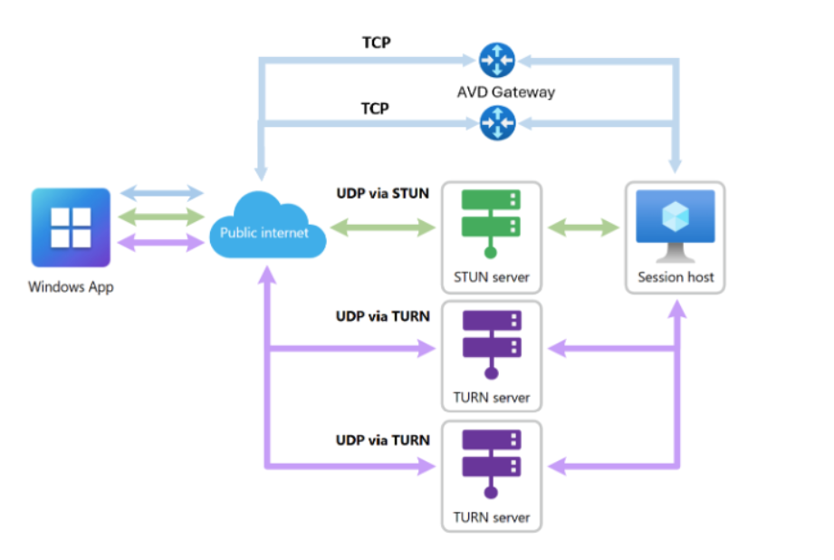
Compute Updates
Announcing public preview of redundant TCP support for RDP Multipath for Azure Virtual Desktop
Azure Virtual Desktop introduces redundant TCP transport paths for RDP Multipath (public preview) to improve connection resiliency. It allows multiple UDP and TCP network paths between client and session host, dynamically selecting the most reliable path. If a connection degrades or fails, sessions automatically switch to another available path without user disruption. This is especially beneficial for TCP-only or UDP-restricted environments, where multiple standby TCP paths improve stability. It reduces session drops and improves continuity during network instability or outages.

Slide 13
Compute Updates
Generally Available: WireGuard In‑Transit Encryption for Azure Kubernetes Service (AKS)
WireGuard in‑transit encryption is now generally available for Azure Kubernetes Service (AKS) clusters using Azure CNI powered by Cilium and Advanced Container Networking Services (ACNS).
This capability enables transparent, node‑level encryption for inter‑node pod traffic using WireGuard’s modern cryptography, helping protect data in transit as it traverses the underlying network infrastructure without requiring application changes.

Slide 14
Compute Updates
Retirement: Support for .NET 8 (LTS) ends on November 10, 2026—upgrade your apps to .NET 10 (LTS)
Support for .NET 8 (LTS) will end on November 10, 2026. Applications on Azure App Service will continue to run, but no security updates or support will be provided. This increases the risk of vulnerabilities over time. Organizations must upgrade to .NET 10 (LTS) before the deadline. Planning and testing the upgrade early is recommended to avoid disruptions.

Slide 15
Storage & Data

Slide 16
Storage & Data Updates
Generally Available: Azure NetApp Files advanced ransomware protection
Azure NetApp Files advanced ransomware protection (ANF ARP) is now in GA (General Availability). ANF ARP is designed to help organizations proactively detect, respond to, and recover from ransomware threats on cloud volumes. ANF ARP monitors Azure NetApp Files volumes for suspicious activity using file extension profiling, entropy, and IOPS patterns. When a threat is detected, the system creates a point-in-time snapshot, enabling rapid evaluation and recovery. Notifications are sent via Azure Activity log and attack reports are retained for 30 days. There is no specific additional charge for ANF ARP but see Considerations section when sizing your deployment to accommodate ANF ARP.
Azure NetApp Files advanced ransomware protection is available in all Azure NetApp Files regions.
Generally Available: CRC Protection
Azure Elastic SAN now supports CRC-32C checksum verification for connections to volumes, enhancing data integrity. When enabled, it validates header and data digests to detect transmission errors. Administrators can enforce this at the volume group level, ensuring all volumes inherit the policy. If enforcement is enabled, connections without CRC protection are rejected, strengthening reliability. When disabled, checksum verification depends on client configuration without blocking access.

Slide 17
Databases

Slide 18
Databases Updates
Public Preview: Logical replication slot sync Status metric for Azure PostgreSQL Flexible Server
You can now monitor logical replication slots in Azure Database for PostgreSQL – Flexible Server using the logical_replication_slot_sync_status metric (preview). It shows whether each slot is synchronized, catching up, or in an unknown state, improving visibility into replication health. This is particularly useful for CDC and logical decoding tools like Debezium or Kafka. It enables per-slot monitoring and alerting to detect issues early. It helps ensure replication consistency during maintenance, migrations, and operational events.
Public Preview: Migrating from virtual network-integrated to Private Endpoint–capable network configuration
You can now migrate Azure Database for PostgreSQL from VNet-integrated deployment to Private Endpoint-based networking. This provides a more flexible and scalable connectivity model while maintaining private access over the Azure backbone. The migration can be initiated via Azure CLI, API, or SDK without recreating the server or moving data. It reduces reliance on delegated subnets and aligns with modern network architectures. The process involves planned downtime and requires post-migration configuration such as Private Endpoints or firewall rules. Currently, it supports servers without high availability or read replicas.

Slide 19
Databases Updates
Generally Available: Enhanced Mirroring Azure Database for PostgreSQL in Microsoft Fabric
Microsoft Fabric mirroring for Azure Database for PostgreSQL now supports native data types like JSON and JSONB, enabling richer schemas without workarounds. Setup is simplified as the replication user no longer needs table ownership, allowing mirroring on existing databases without security changes. New error messaging and PostgreSQL UDFs provide better visibility into mirroring status and issues. The feature also supports high availability (HA) configurations on earlier PostgreSQL versions, improving flexibility. These enhancements make mirroring more transparent and easier to operate at scale.
Generally Available: Dynamic data masking with Azure Cosmos DB
Dynamic Data Masking (DDM) in Azure Cosmos DB is a server-side, policy-based security feature that protects sensitive data. It dynamically masks data for non-privileged users, ensuring sensitive information is hidden in real time. The original data remains unchanged in the database. It helps reduce exposure of PII and PHI while maintaining application functionality. It supports security, compliance, and regulatory requirements by controlling data visibility.

Slide 20
Databases Updates
Generally Available: Cascading read replicas in Azure Database for PostgreSQL
Cascading read replicas in Azure Database for PostgreSQL are now generally available, enabling multi-level replication from existing replicas. You can create up to 30 replicas across two levels, with each source supporting up to five replicas. This allows flexible, tree-like replication topologies for global applications. It helps place replicas closer to users, improving read latency and performance. It also enables better load distribution and reduced pressure on the primary server.

Slide 21
ML & AI & IOT

Slide 22
ML & AI & IOT Updates
Introducing OpenAI's GPT-image-2 in Microsoft Foundry
OpenAI’s GPT-Image-2 is now available in Microsoft Foundry, bringing advanced image generation capabilities to enterprise AI workflows. The model enables creation of high-quality, context-aware images from text prompts, supporting use cases such as content generation, design, and automation. It integrates with Foundry’s standard APIs and governance framework, allowing teams to use it within existing secure, compliant environments. Developers can incorporate image generation into applications, copilots, and agent-based solutions with minimal changes. This release expands multimodal AI capabilities, combining text and visual generation in a unified platform.
Introducing Toolboxes in Foundry
Microsoft Foundry introduces Toolboxes, a new capability that simplifies how developers integrate and manage tools within AI applications. Toolboxes provide a centralized way to define, organize, and reuse tools such as APIs, functions, and connectors across agents and workflows. This improves consistency and reduces duplication when building agent-based and AI-driven solutions. Developers can more easily compose complex workflows by combining multiple tools in a structured way. Toolboxes integrate with Foundry’s existing orchestration and governance model, ensuring secure and scalable usage.

Slide 23
ML & AI & IOT Updates
Generally Available: Foundry Toolkit for Visual Studio Code (formerly AI Toolkit for VS Code)
Foundry Toolkit for VS Code is now generally available and provides VS Code tooling for Microsoft Agent Framework, including agent creation from templates or via GitHub Copilot, local test/debug with visualization and traces, and direct deployment to Foundry Agent Service from VS Code.
Public Preview: Hosted Agents in Foundry Agent Service
Hosted agents run in an isolated execution sandbox that provides a dedicated, secure runtime per agent session. Sessions start with a clean environment with no shared state between sessions, no cross-session data leakage, and strong compute boundaries between tenants.

Slide 24
Information

Slide 25
Information
Azure Times GitHub Repo
AzureTimes.org

Slide 26
Questions

